Slide 1
Arch 1250
Site Planning and Sustainability
Professor Info : Unknown

Slide 2
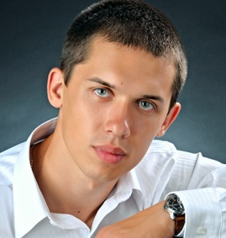
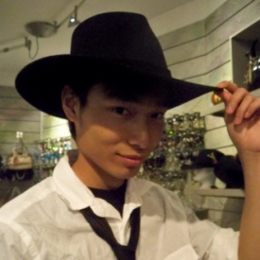


Dane Isaac
Team Members
Andriy Boychuk
Edmund Huang
Heidi Cherubin

Slide 3
Microclimate
Slide 4
Field Trip Map
Slide 5~7
Jay street, Sands street and Pearls street
Slide 8~13
Brooklyn bridge park - Main street & Plymouth Street
Brooklyn bridge park - Pier 1
Slide 14
Cadman Plaza Park

Slide 4
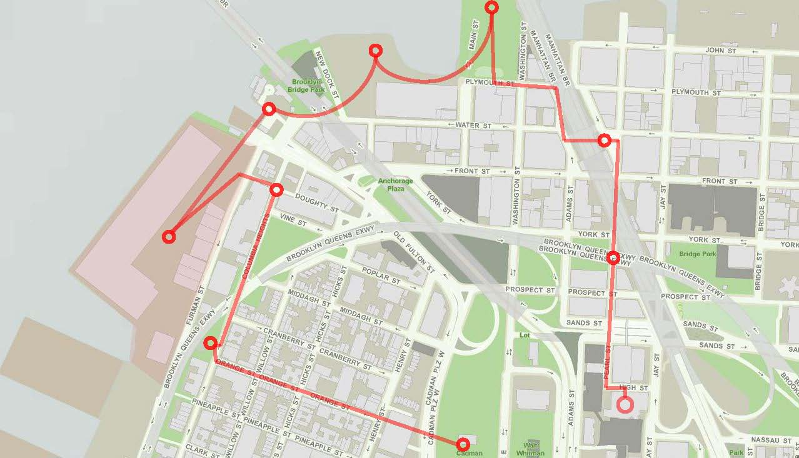
Field Trip Map

Slide 5
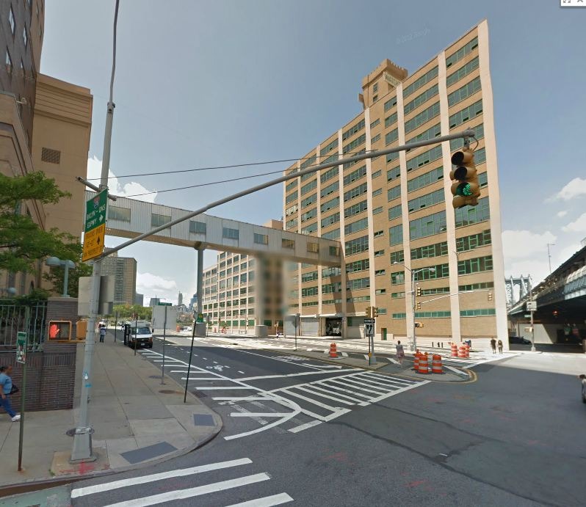
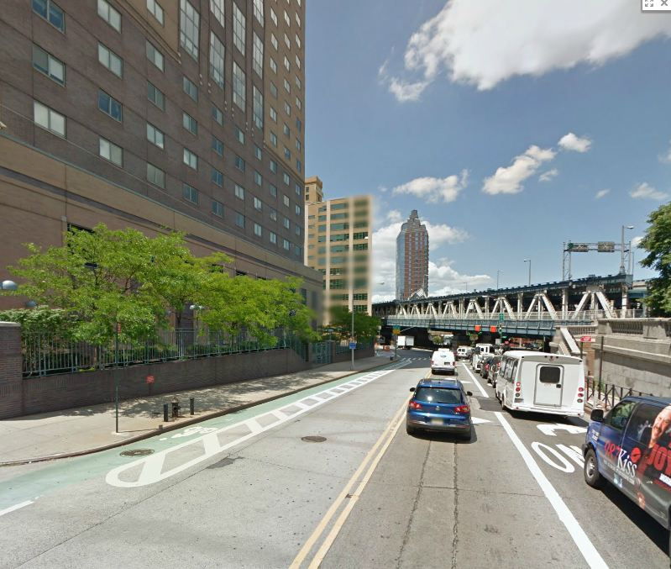
Jay street, Sands street and Pearls street
Problem:
- Strong wind between high buildings
- High buildings creates shadows
- Limited vegetation (1-3 trees per street)
- Moist air under BQE bridge on Pearl street
- The metal fence on pearl street under Manhattan bridge reflects sun and heat up objects around
- Concrete and asphalt paving generates heat
- Under the Manhattan bridge has a lot of noise from cars and trains passing every 35 seconds.

Slide 6
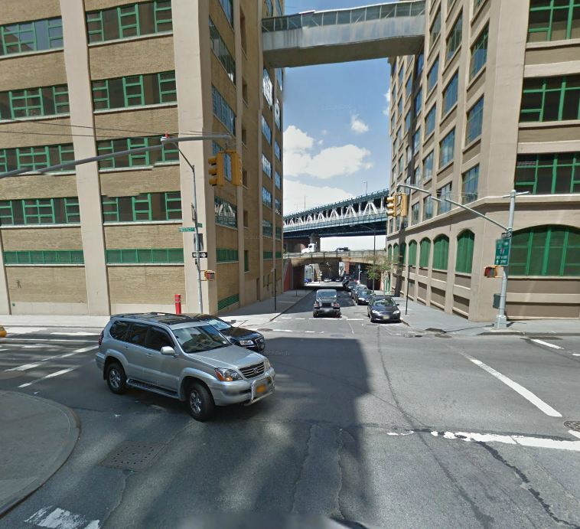
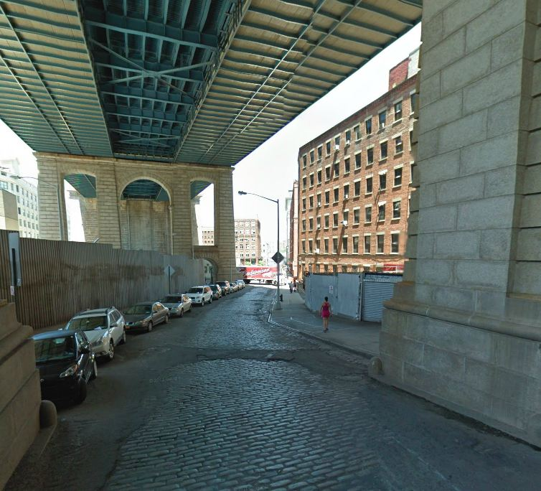
Possible Solutions
To plant additional angiosperm type trees on each street. It will add shade during summer and decrease wind during cold seasons.
- To add flower and/or grass beds to sidewalks.
- To reduce reflecting surfaces such as the metal fence and replace it with non reflective one.
- Add a distraction to the noise, maybe music or any other noise.
- Needs more signs showing where the way to Brooklyn bridge park.

Slide 7
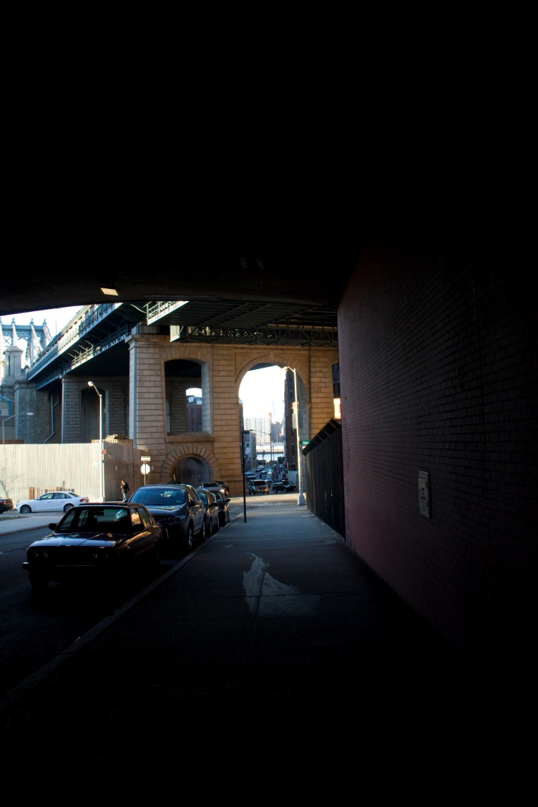
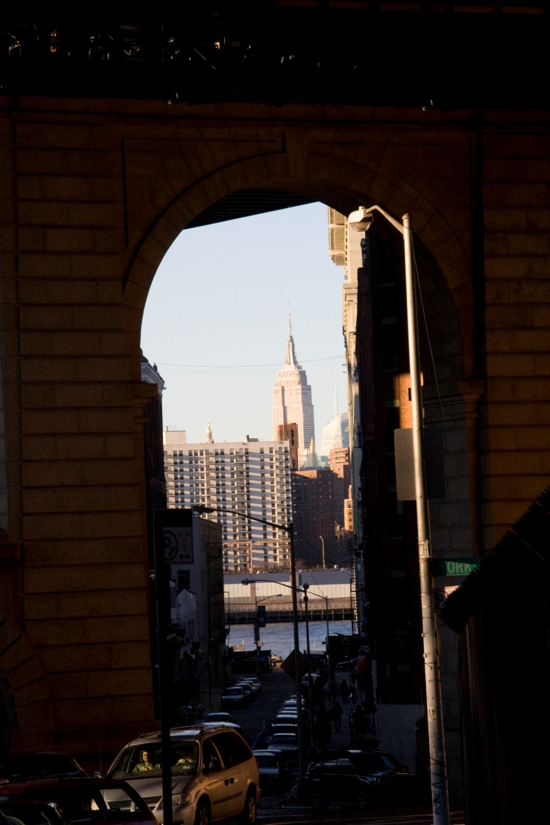
There is a pretty nice view of the empire state building.

Slide 8
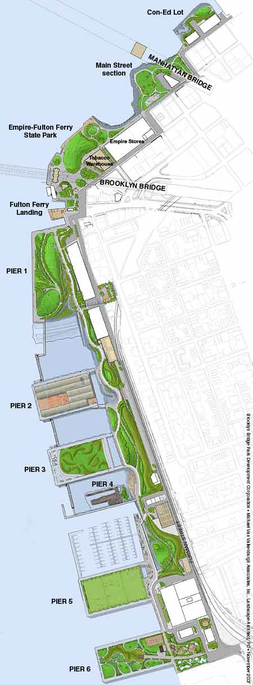
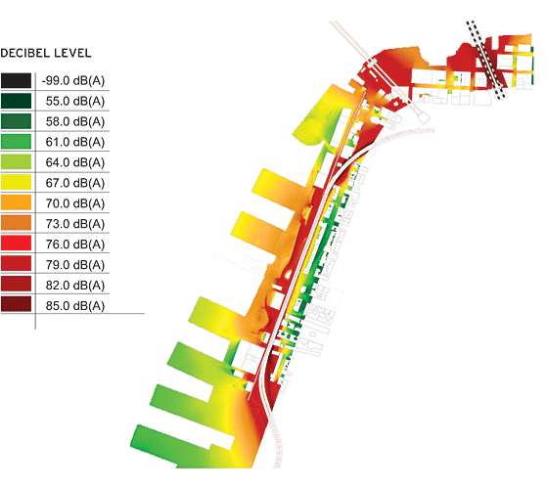
Brooklyn bridge park

Slide 9
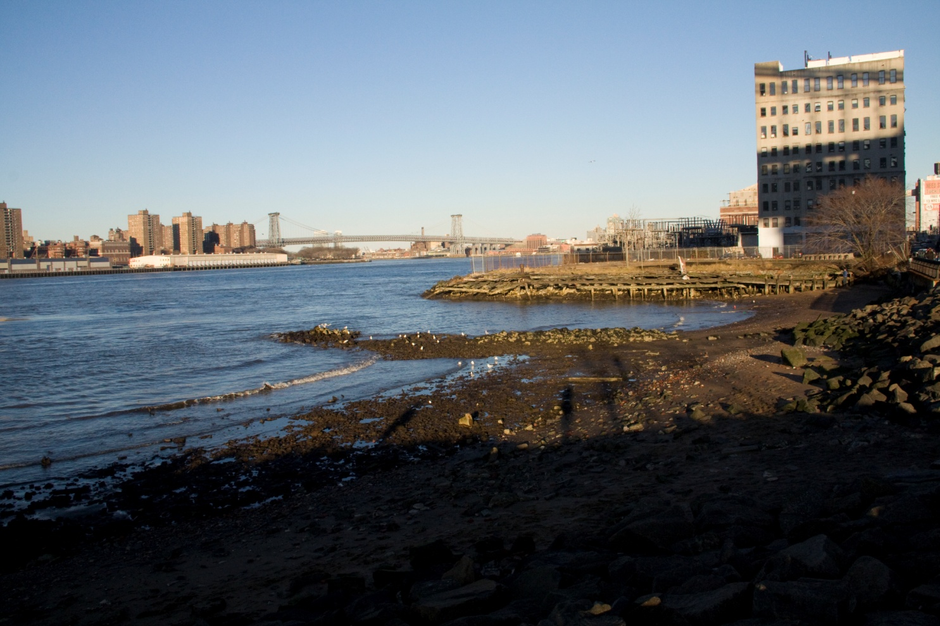
Brooklyn bridge park - Main street & Plymouth Street
Analysis
- Treatment of river banks in the park (rocks, sand, gravel and concrete)

Slide 10
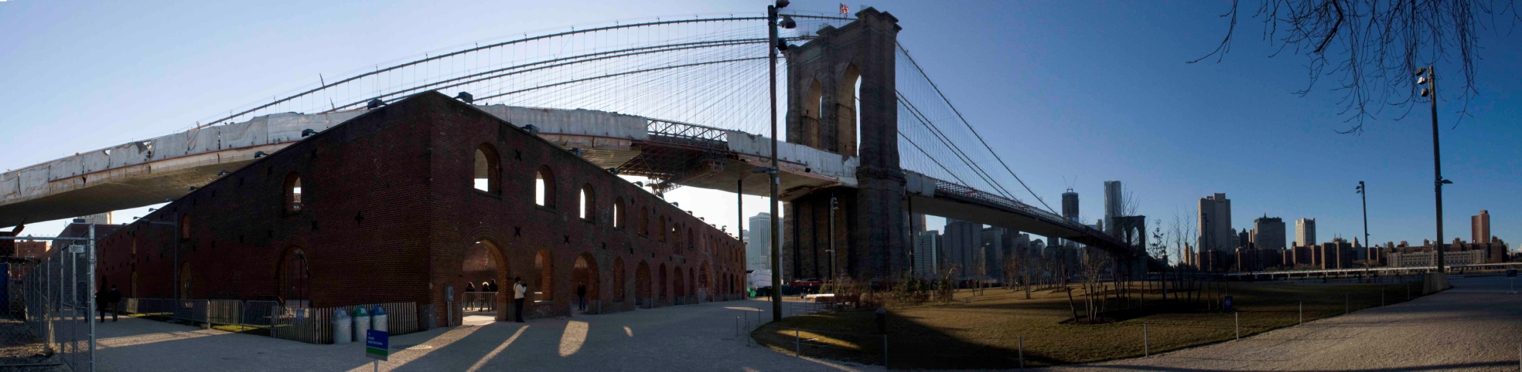
Problem
- High wind from west side near Carrousel
- Big open areas without trees (shades)
- Bad small from garbage recycle organization on Plymouth street

Slide 11
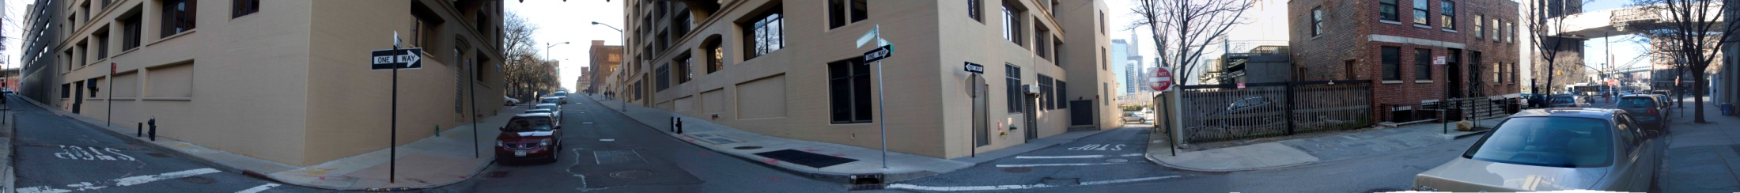
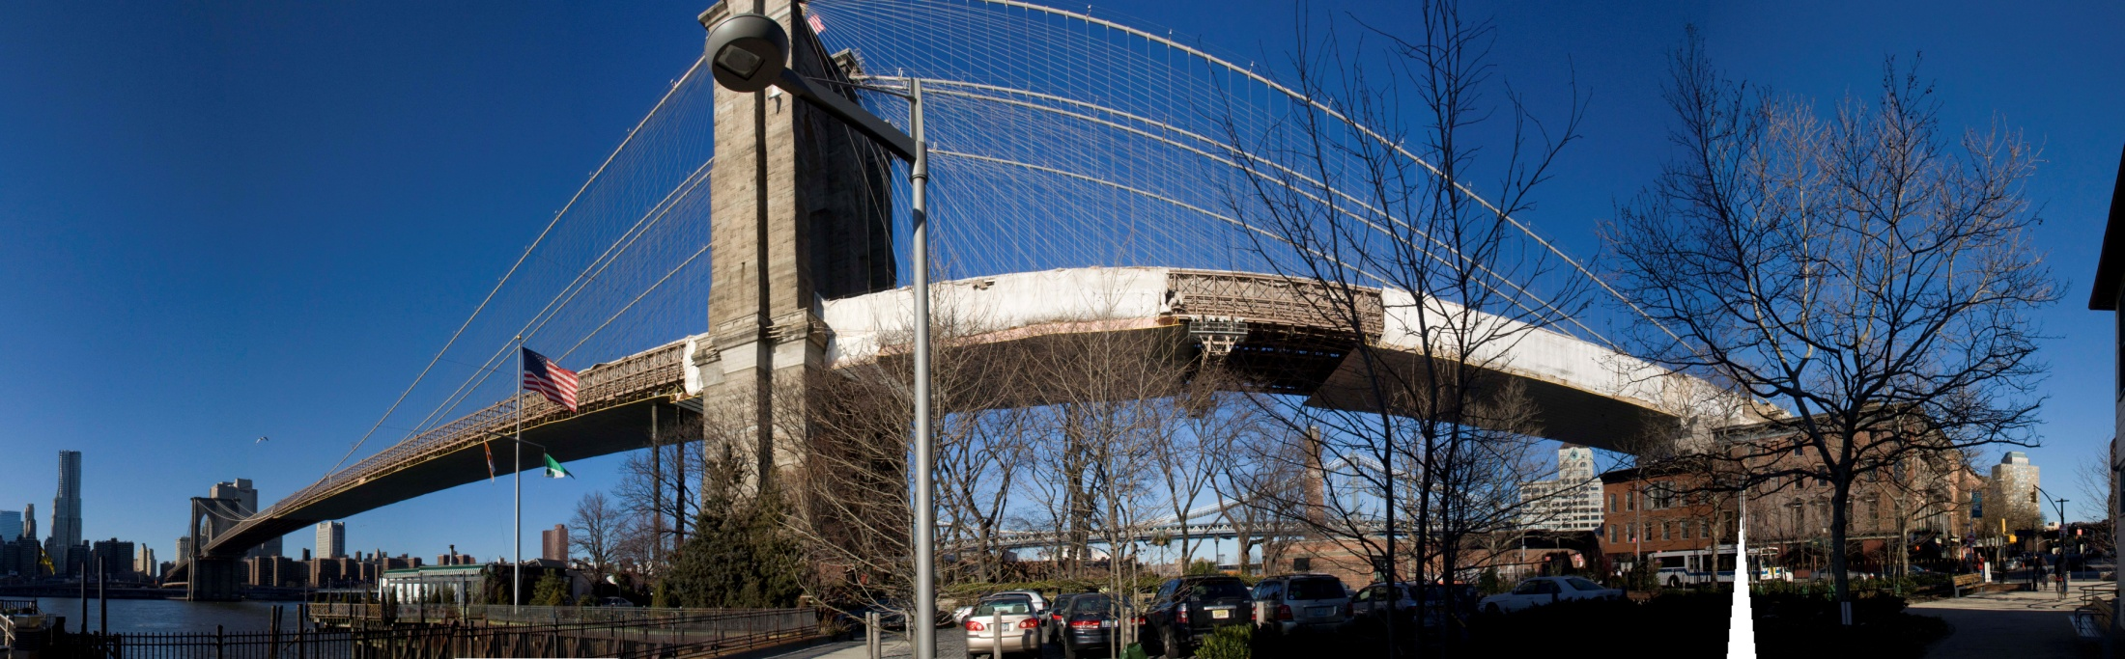
High wind speed from west side

Slide 12
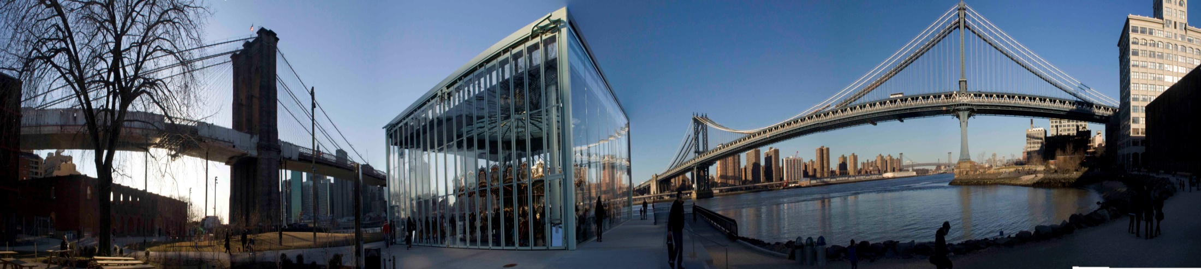
Possible solutions
- to add low gymnosperms type trees at westside of carrousel
- to add angiosperm type trees to open areas

Slide 13
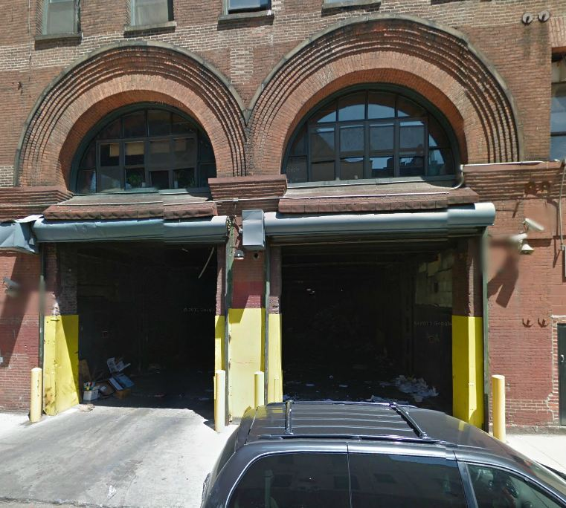
Is there any possible way to reduce the smell, of the garbage recycling plant?
- we can move the plant to different location
- we can plant more trees at entrance of the plant
- Another possible solution is to relocate the entrance to the plant

Slide 14
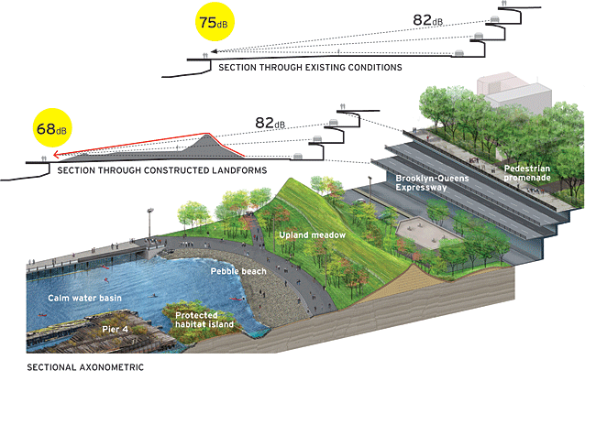

Slide 15
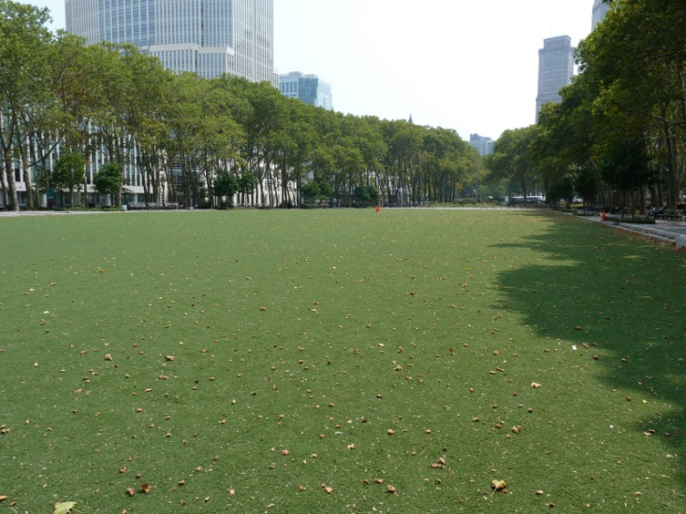
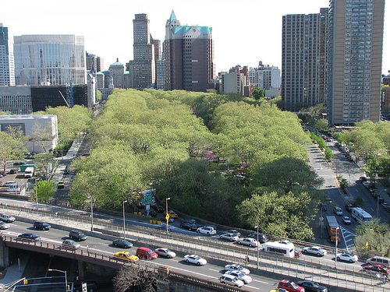
Cadman Plaza Park
Analysis
- A lot of trees.
- Big grass bed areas
Problem
- Not easy to find your way around.
- Park is a little isolated, needs to be repaired.
Solution
- Could use more signs to help tourist move around easier.

