Slide 1
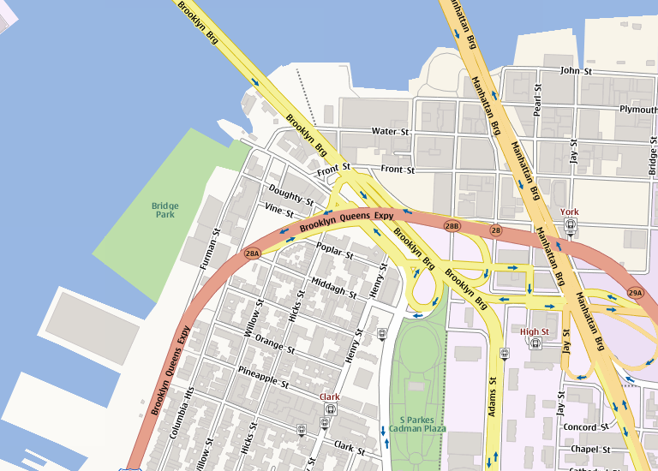
Map 1
Site Observations
Key
Photo Area
Place reference photos here, label each photo with a letter and place that letter at the correct location on the map.
Remember to create two maps:
One map documenting your observations from your field trip
A second map documenting proposed solutions (remove all field trip observations from the second map)

Slide 2
Map 2
Proposed Interventions
Key
Photo Area
Place reference photos here, label each photo with a letter and place that letter at the correct location on the map.
Remember to create two maps:
One map documenting your observations from your field trip
A second map documenting proposed solutions (remove all field trip observations from the second map)

