Slide 1
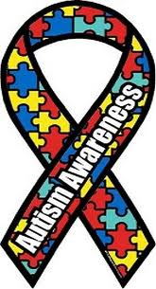
Developmental disabilities
Autism throughout the Lifespan

Slide 2
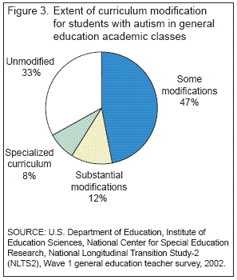
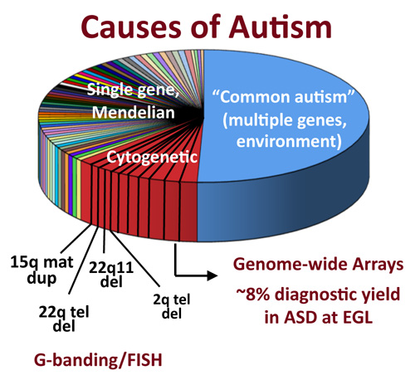
Autism and the life-span

Slide 3
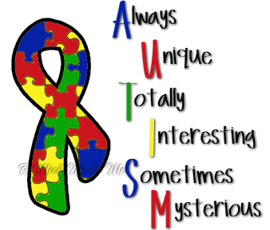

Slide 4
Zero through 2 years old
Autism is usually diagnosed at 18 months old because this is when the child’s Gross, Motor skills, and physical attributes develop.
Children with Autism display repetitive behavior when engaging in social activities.

Slide 5
Zero through 2 years old
Scientists are not sure what cause ASD, but it is likely that both genetics and the environment play a role.
Speech impairment and language deficits are the major symptoms of children with Autism; it also affects their sensory organs, adaptation skills, cognitive, and socialization skills.

Slide 6
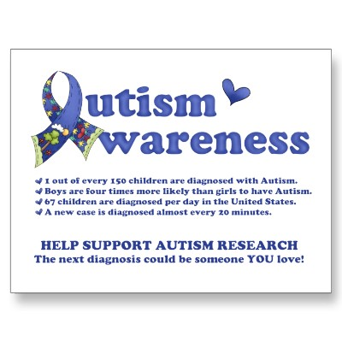
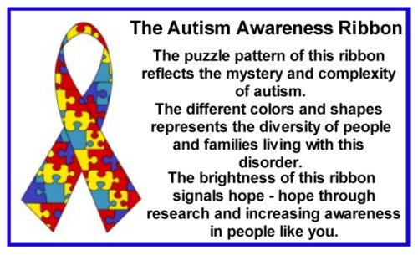
Autism awareness

Slide 7
School-age
Pecs is an experiment which was done on school-age children who are autistic.
Pecs study is to measure children IQ’S and behavior.
Pecs impact children appears to have an increase d tendency of speech in children who can communicate at a baseline .

Slide 8
School-Age
Pecs is to teach causes and functional talking to child4ren with autism in a social context.
Pecs is widely used in the home and school setting. Pecs was included in the school curriculum in the classroom of special need children with a staff under regulation of Pecs supervision consultants

Slide 9
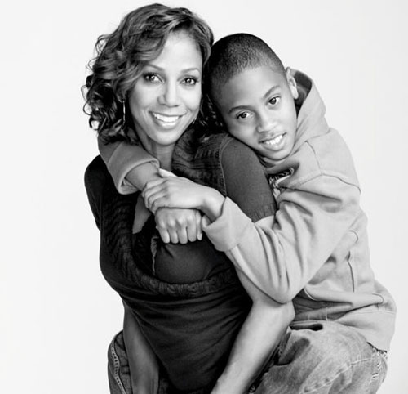
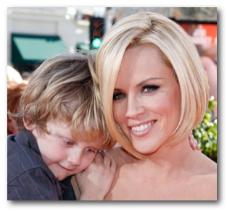
Famous people and their autistic children

Slide 10
Teenagers and Autism
In a teenager, connecting through these tough years can already be difficult, but for a teenager with Autism the connection can almost be non-existent.
The teenage years are formative and can have some of the biggest life changes which also can be the scariest.

Slide 11
Knowing the upcoming milestones puberty, socialization, sexual curiosity, social pressures of drugs and alcohol, and bullying will help a teenager with Autism cope better.
There is help for these transitions, such as, support groups.
Teenagers

Slide 12
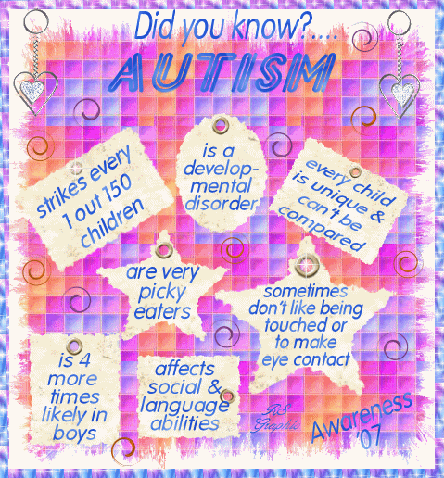
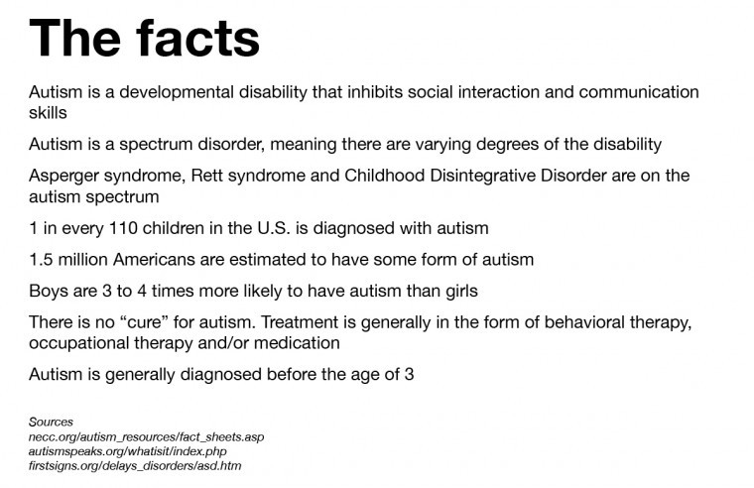
Autism facts

Slide 13
Autism and Adults
May require housing.
May require employment training.
Social communication.
Difficulty understanding gestures, body language and facial expressions.
Unaware of what is socially appropriate and have difficulty choosing topics to talk about.

Slide 14
Problems understanding double meanings flexible thoughts problems making plans for the future, and having difficulties organizing your life an obsession with rigid routines and severe distress if routine is disrupted
Adults

Slide 15
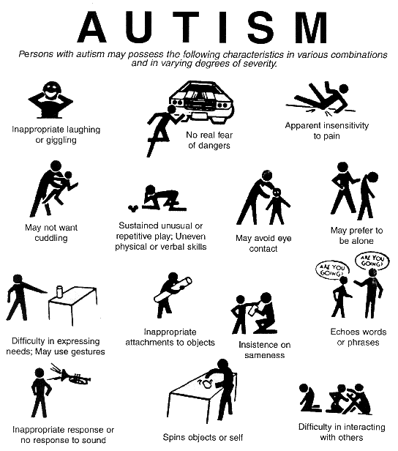
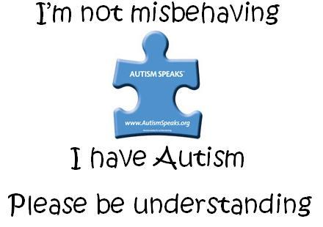
Symptoms of autism

Slide 16
Autism and mental illness
1 out of 4 young adults will experience a depressive episode by age 24
About 255 of incarcerated adults and youths in the juvenile justice system lie with a serious mental illness
Mental illness strike individuals in the prime of their lives, often during adolescence and young adulthood
Mental health disorders account for four of the top ten causes of disability in the US.

Slide 17
MENTAL ILLNESS FACTS
SUICIDE IS THE 3RD LEADING CAUSE OF DEATH FOR THOSE AGED 15-24, THE 2ND LEADING CAUSE OF DEATH OF COLLEGE STUDENTS
26% OF HOMELESS LIVE SEVERE MENTAL ILLNESS OVER 4 TIMES THE RATE OF THE GENERAL POPULATION

Slide 18
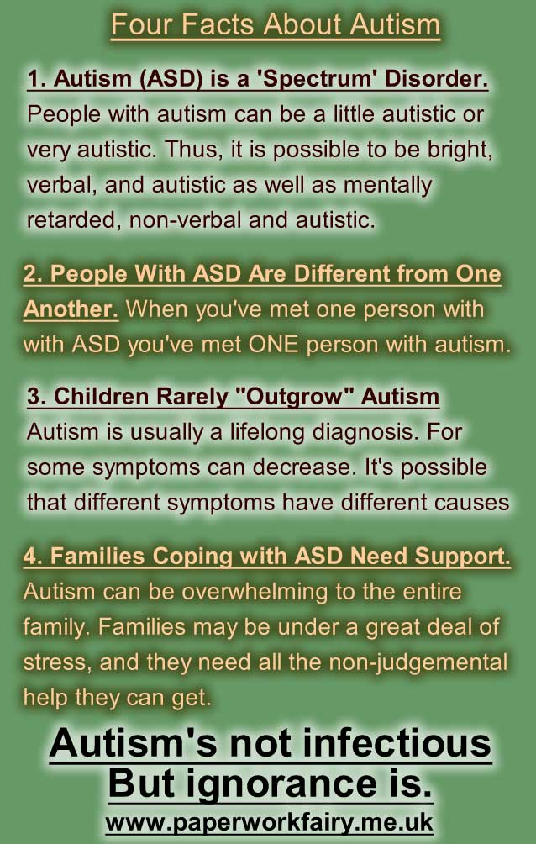

Slide 19
Facts about Autism

Slide 20
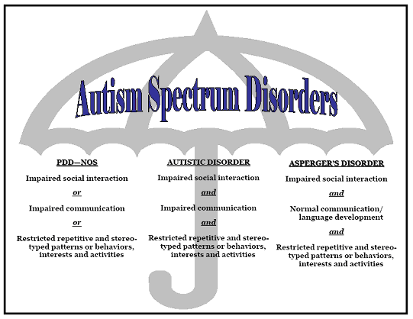
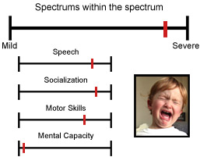
Different spectrums of autism

Slide 21
DEVELOPMENTAL DISABILITIES – Autism throughout the lifespan
Sophia Copeland
Marlene Baptiste
Alesia Blackney
Tanisha Hunter
Amelia Perez

