Slide 1
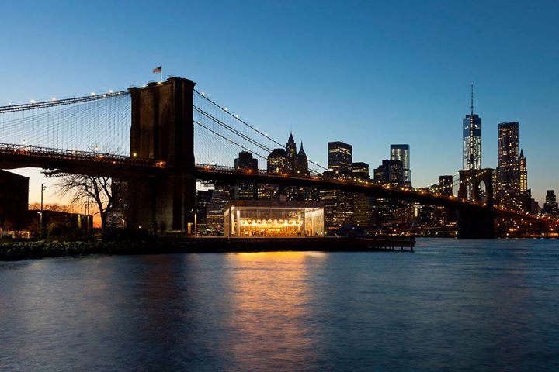
WELCOME TO THE
BROOKLYN WATER FRONT

Slide 2

Restaurants
Notes:
Nick’s Lobster House
Dolphin Restaurant Bar
The Waterfront Crab House

Slide 3


Arts
Notes:
BROOKLYN WATER FRONT ARTISTS COALITION(BWAC) 499 VANT BRUNT STREET
The largest Non-Profit

Slide 4

ANNUAL BEER FESTIVAL
Notes:
80 breweries from the US and around the world
Last week of March – First week of April
Admission $65
Kent Avenue in Williams Burg
Catch the G and L train

Slide 5
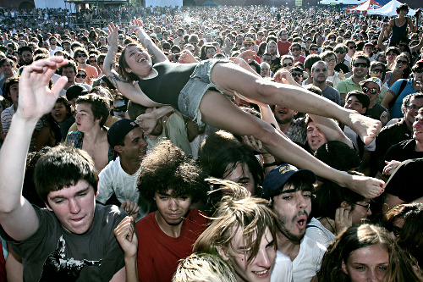
CONCERTS

Slide 6


Slide 7
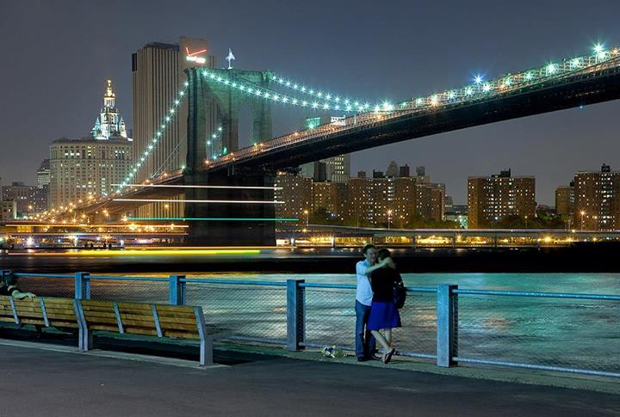

Slide 8


Slide 9


