Slide 1
Brooklyn bridge waterfront
Concierge assignment

Slide 2
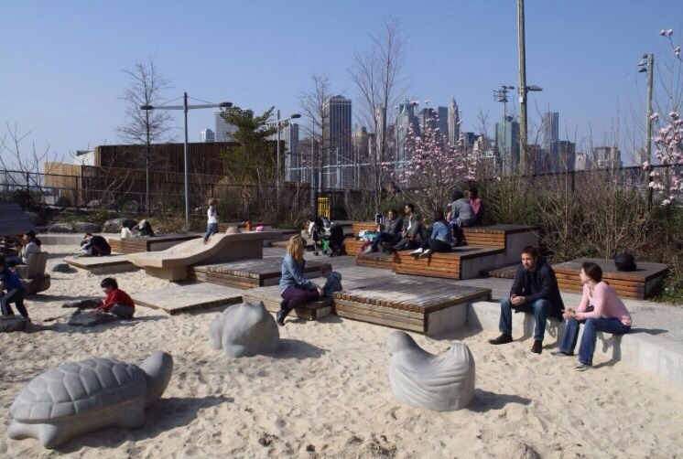

Slide 3
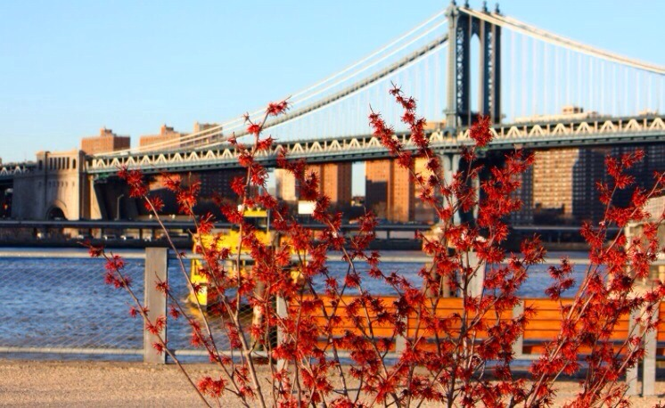
Autumn Section Header Layout
Subtitle

Slide 4
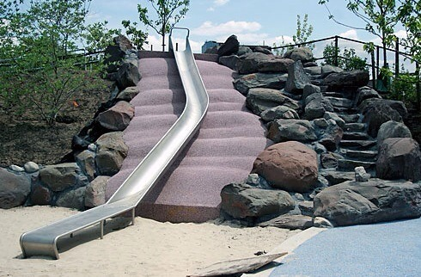

Slide 5
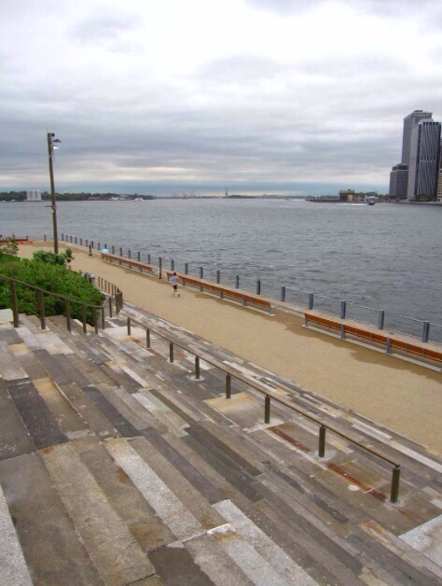
Winter Section Header Layout
Subtitle

Slide 6
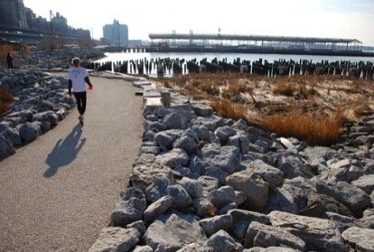

Slide 7
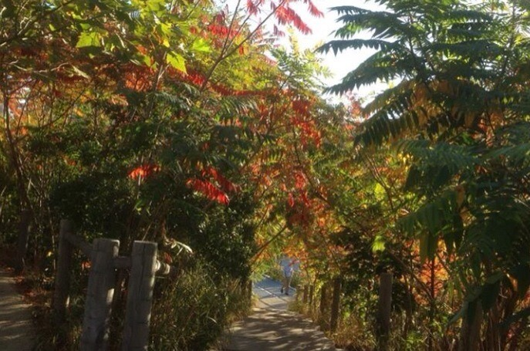
Winter Section Header Layout
Subtitle

Slide 8
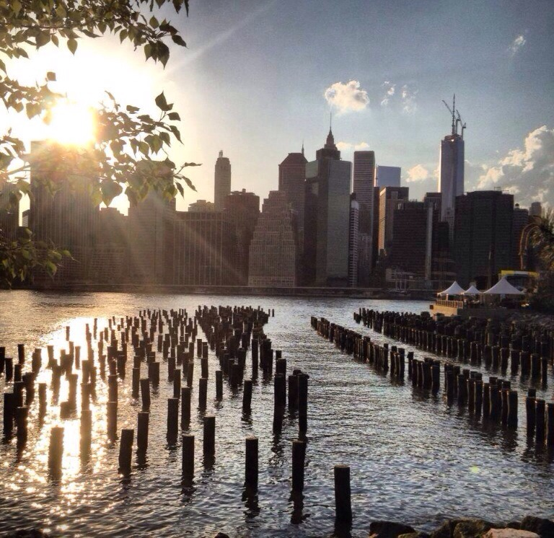
Awesome!!

Slide 9
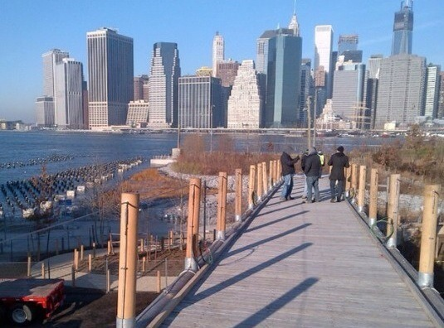

Slide 10
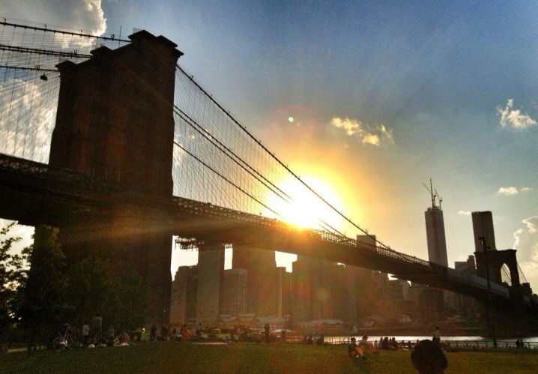
Romantic!!

Slide 11
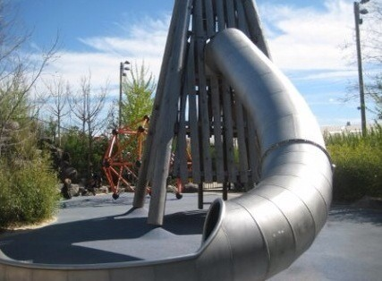
Playground for kids

Slide 12
The End

