Slide 1
Brooklyn Bridge Park
Lester Zeng
HMGT 1101

Slide 2
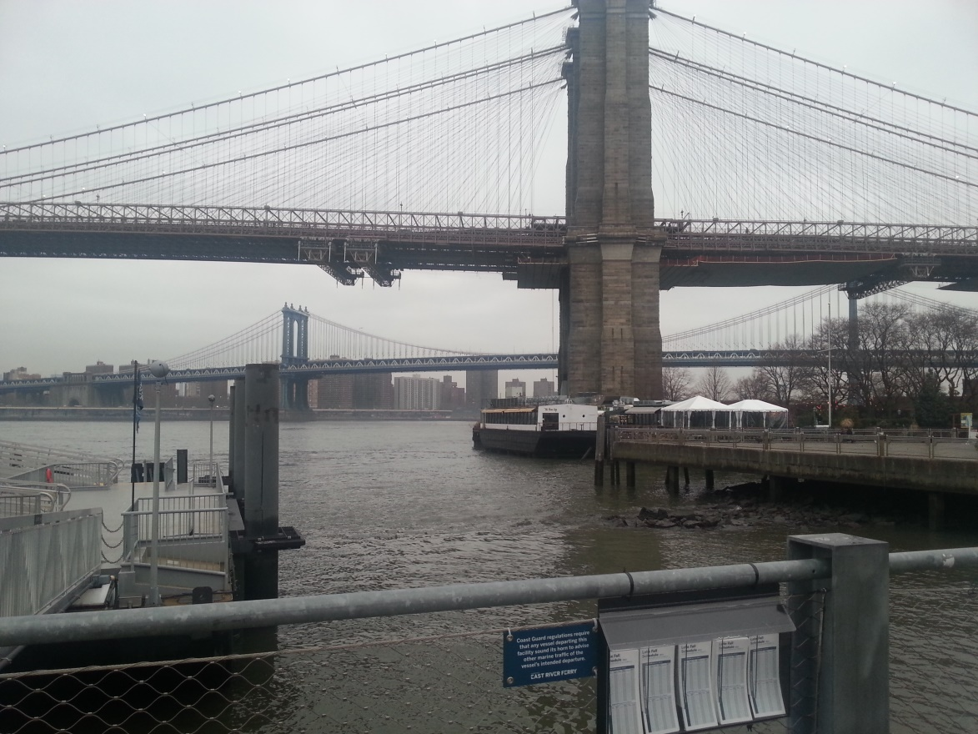
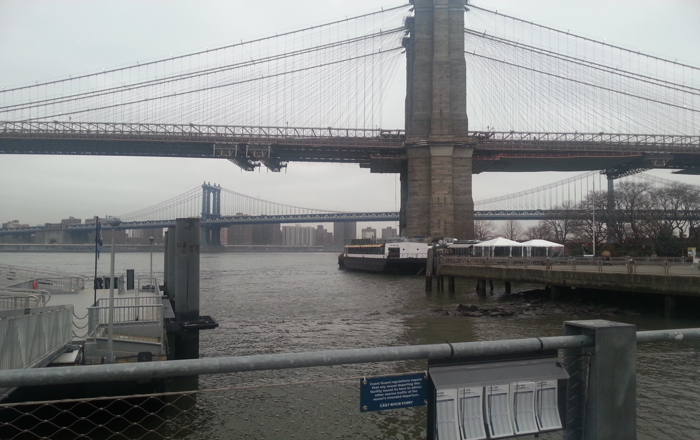
Bridge View

Slide 3
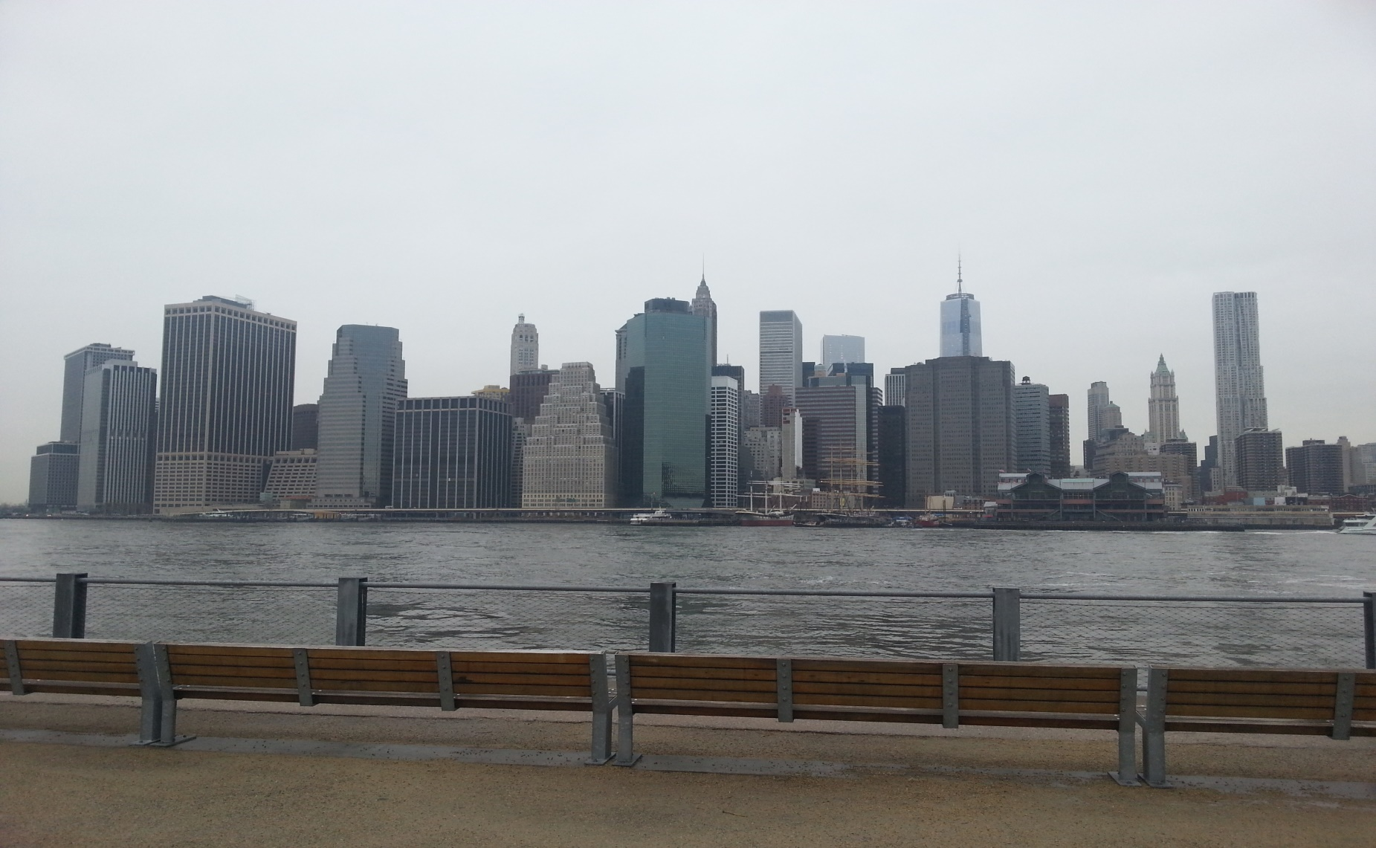
View of the city from the park

Slide 4
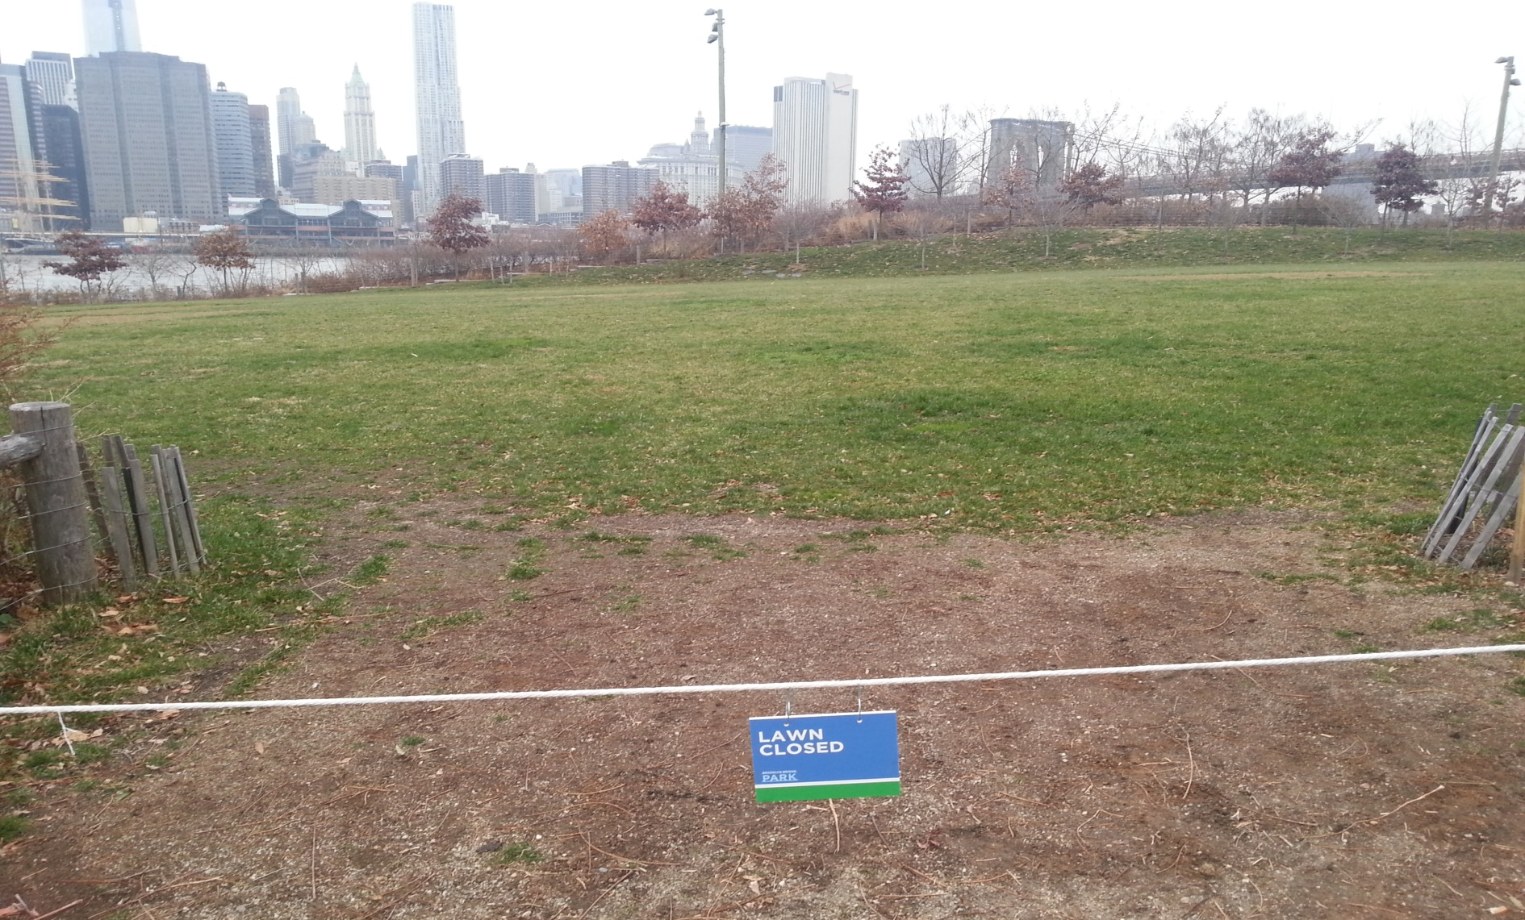
Pier 1 Lawn

Slide 5
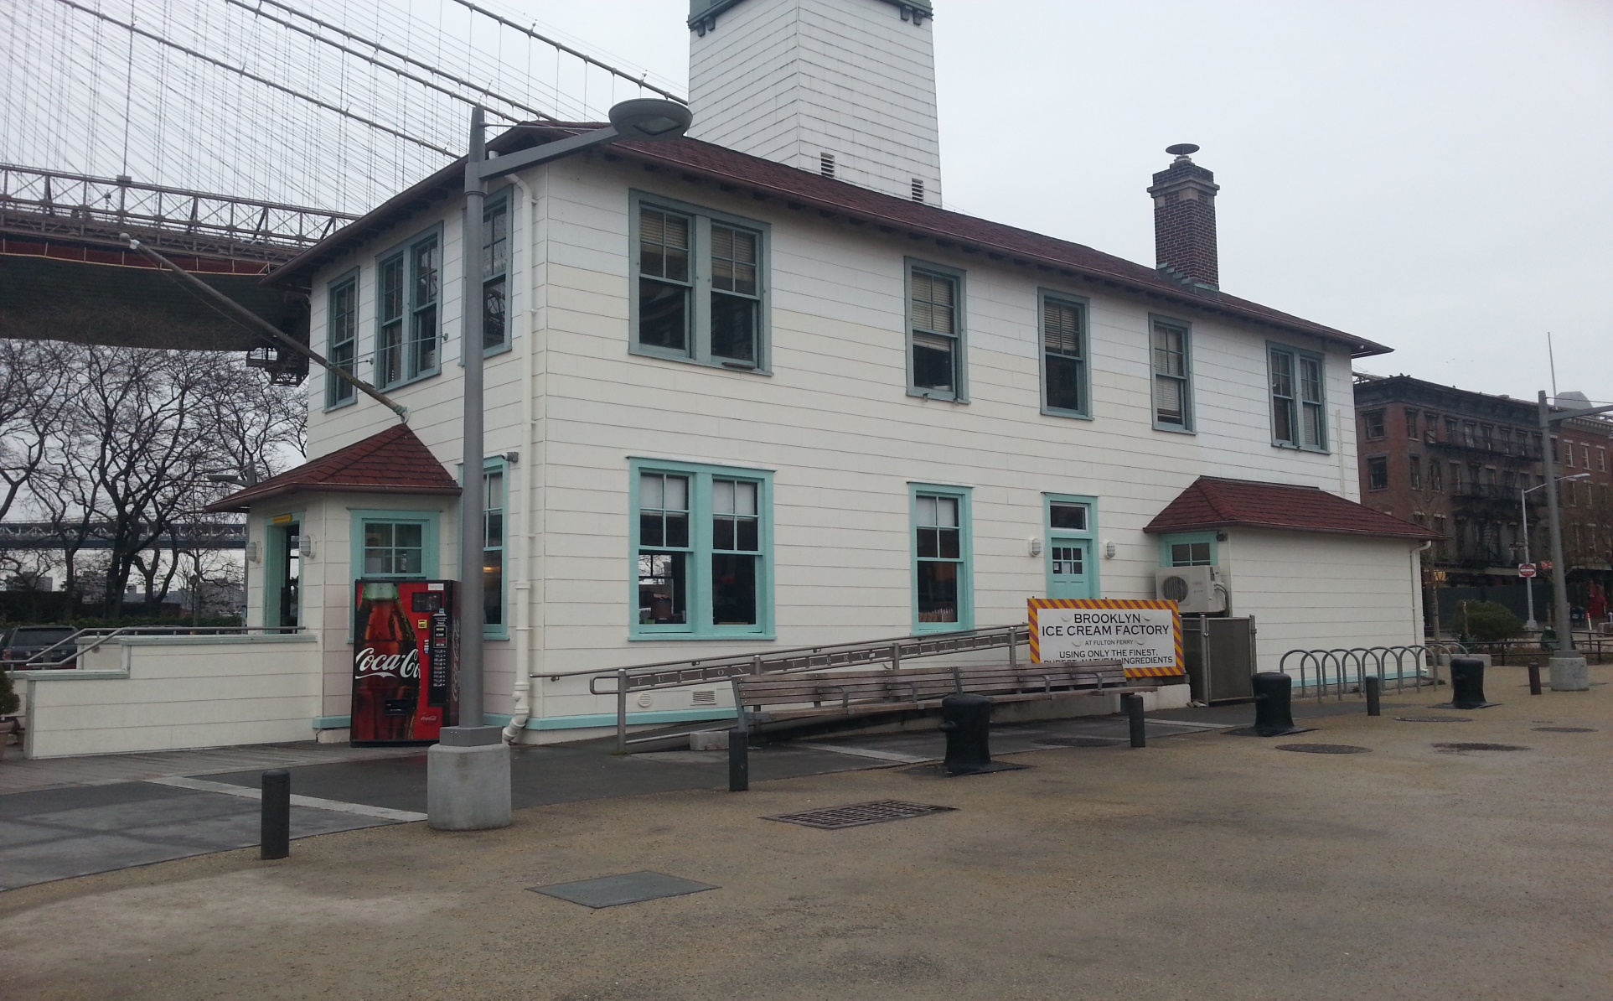
Brooklyn Ice Cream Factory

Slide 6
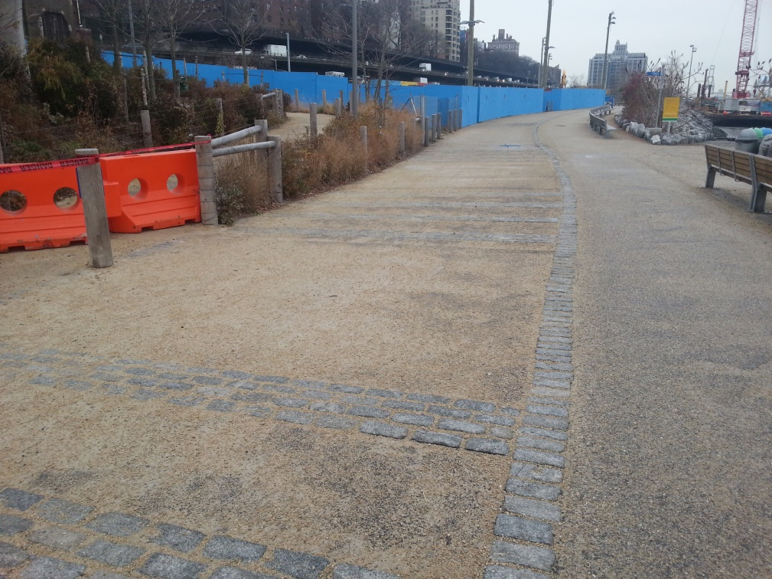
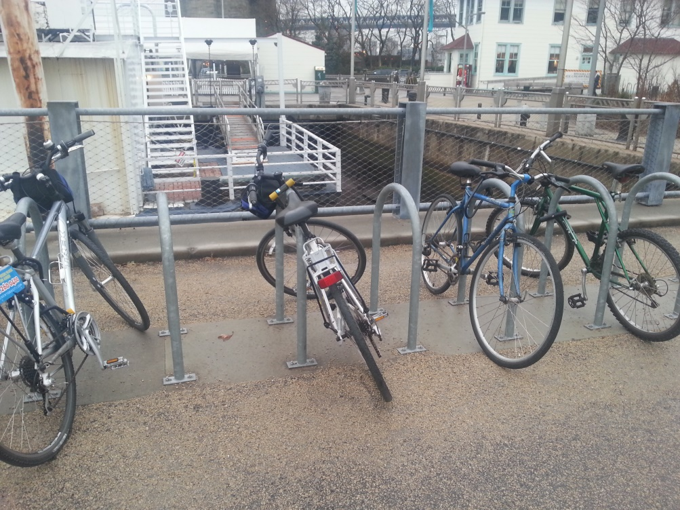
Biking and Jogging

Slide 7
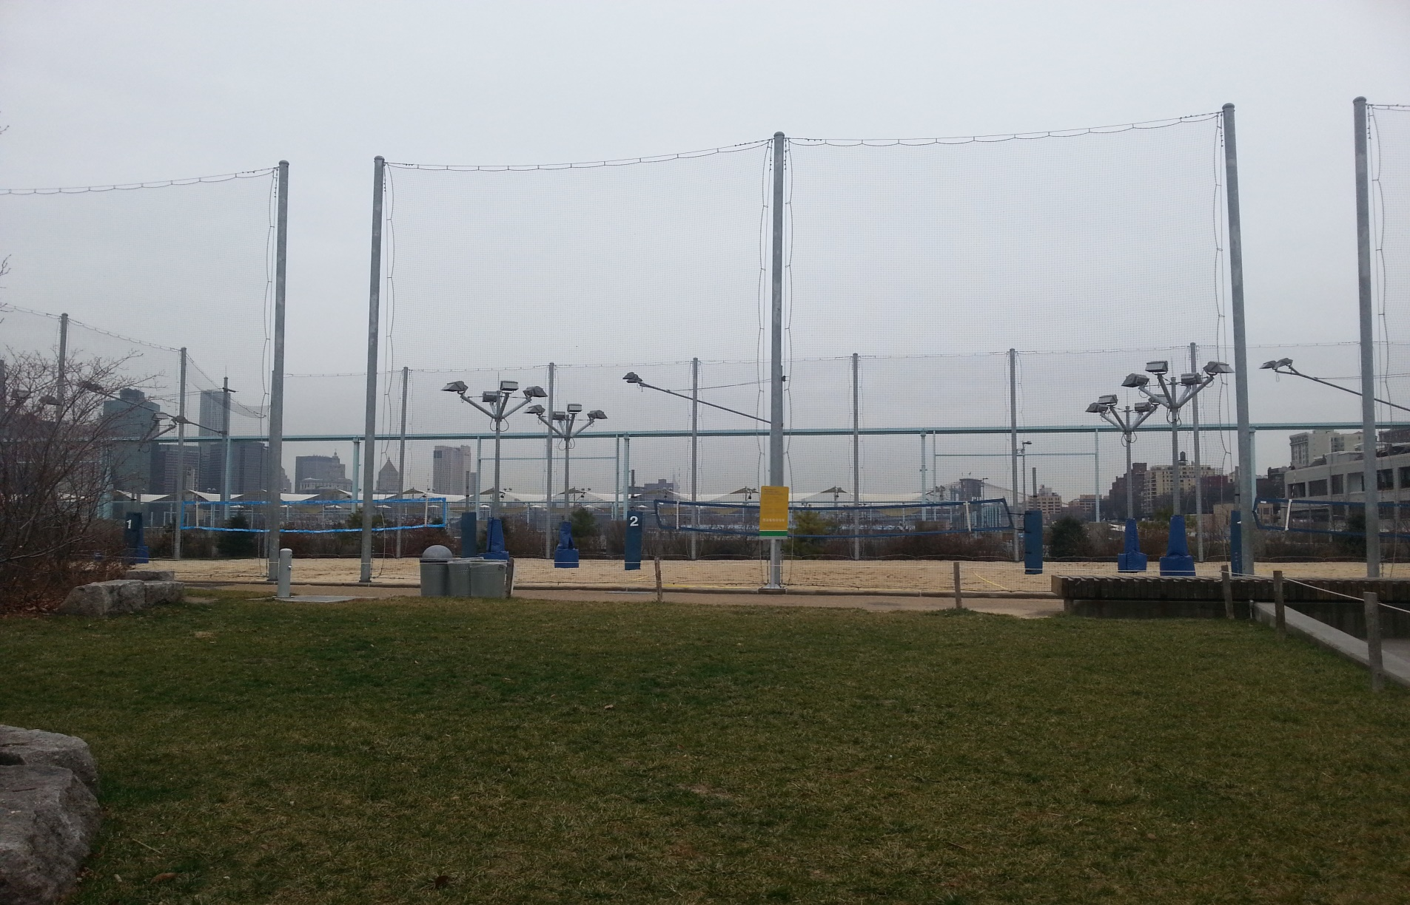
Pier 6 Volleyball Courts

Slide 8
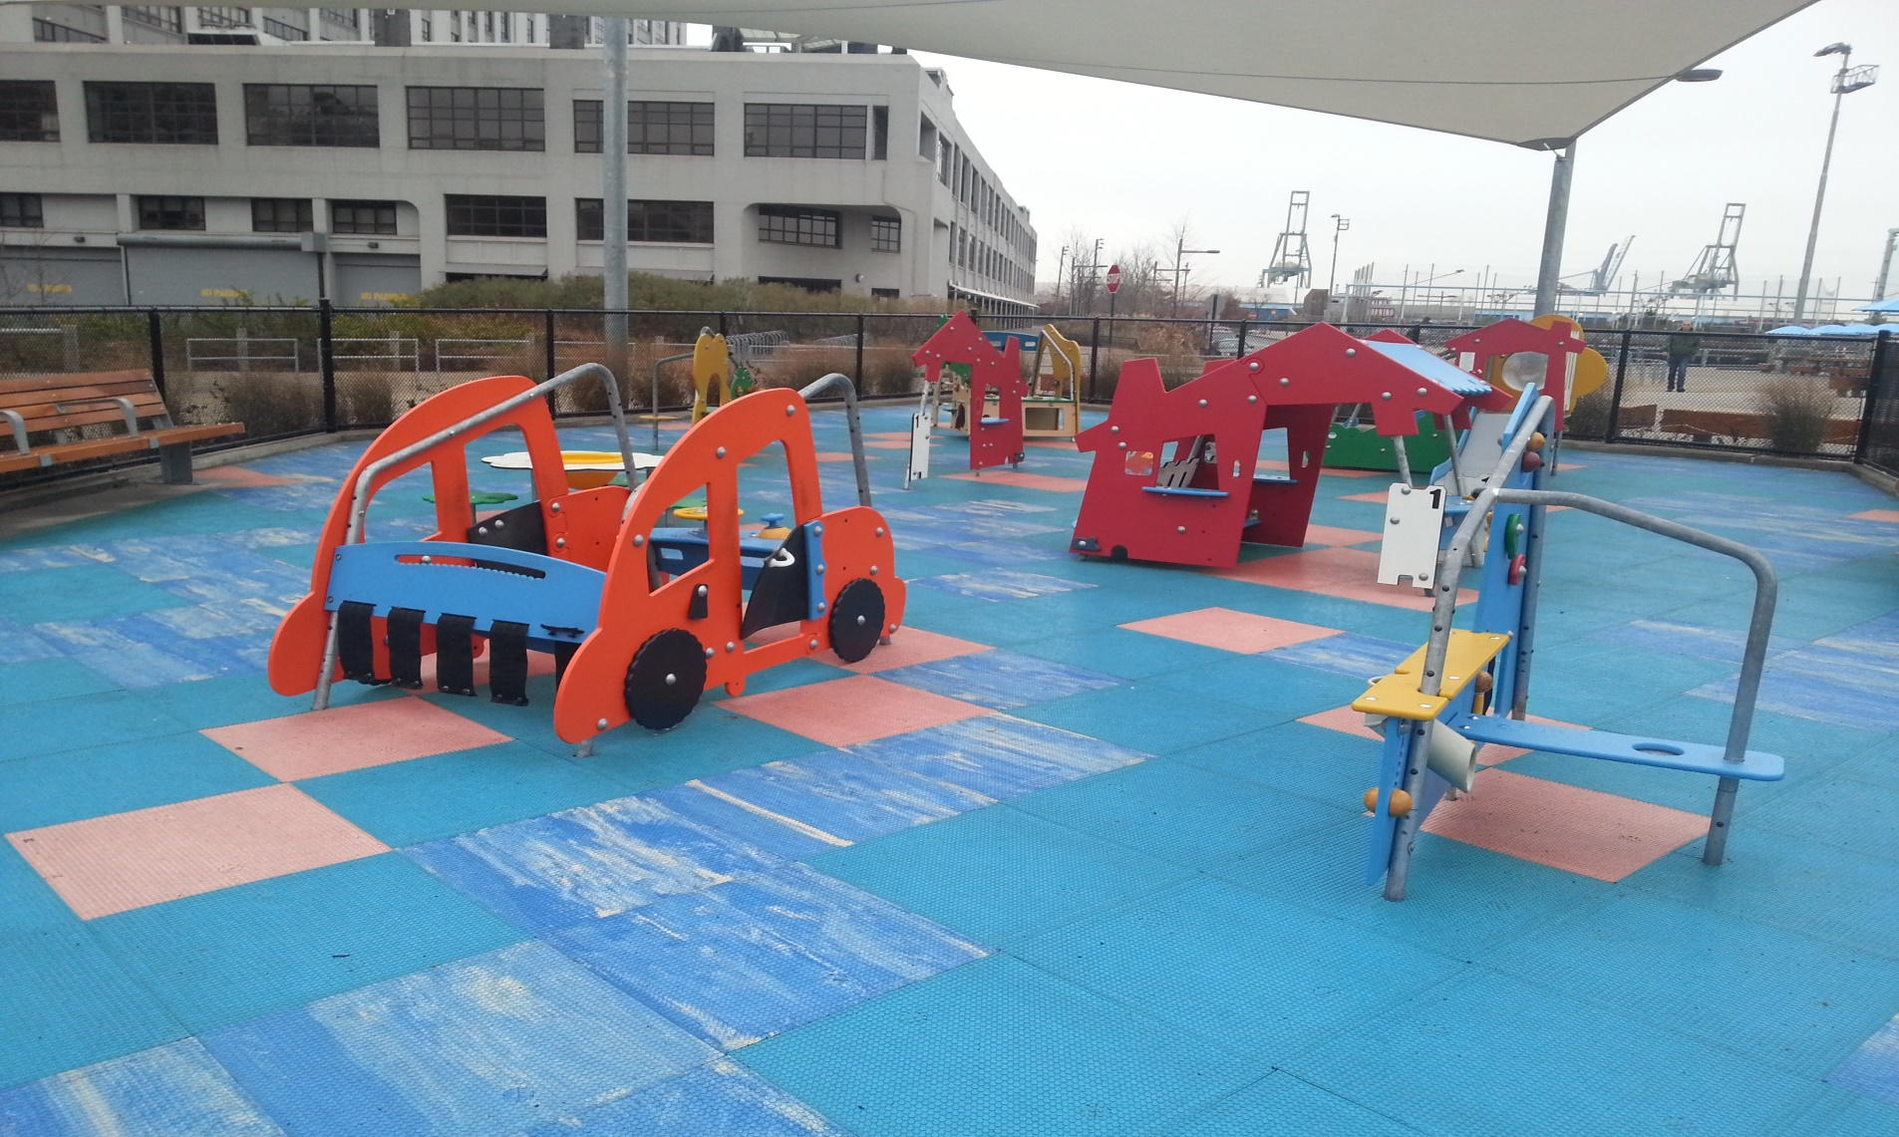
Playground For Kids

Slide 9
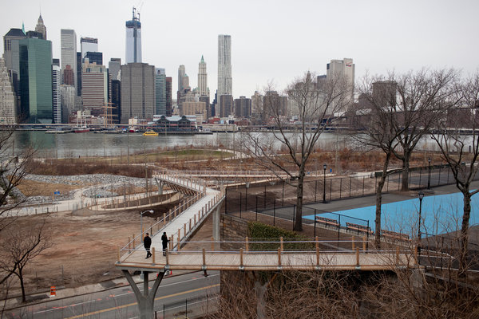
Squibb Bridge

