Slide 1
ARCH 1250
APPLIED ENVIRONMENTAL STUDIES
CLASS FOUR
MICROCLIMATE
John Seitz, RA, LEED AP
Adjunct Assistant Professor

Slide 2
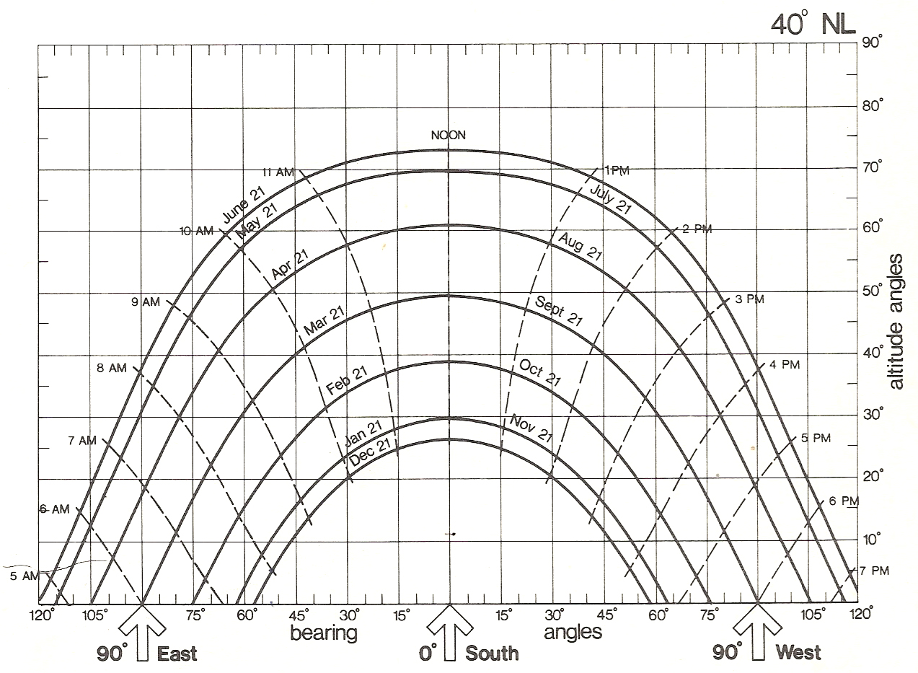

Slide 3
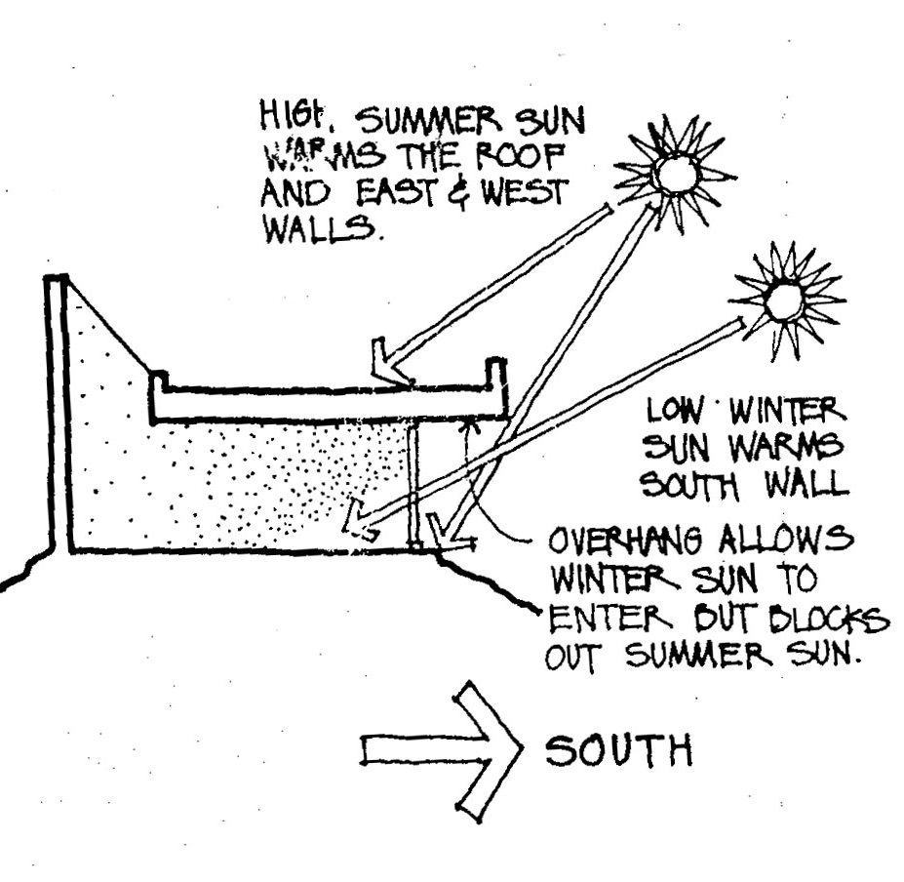
Sun angle and buildings
Seasonal changes in sun angles allow us to shape buildings to maximize opportunities for all year daylight capture and cold season passive heating, while shading to protect against the hot summer sun.

Slide 4
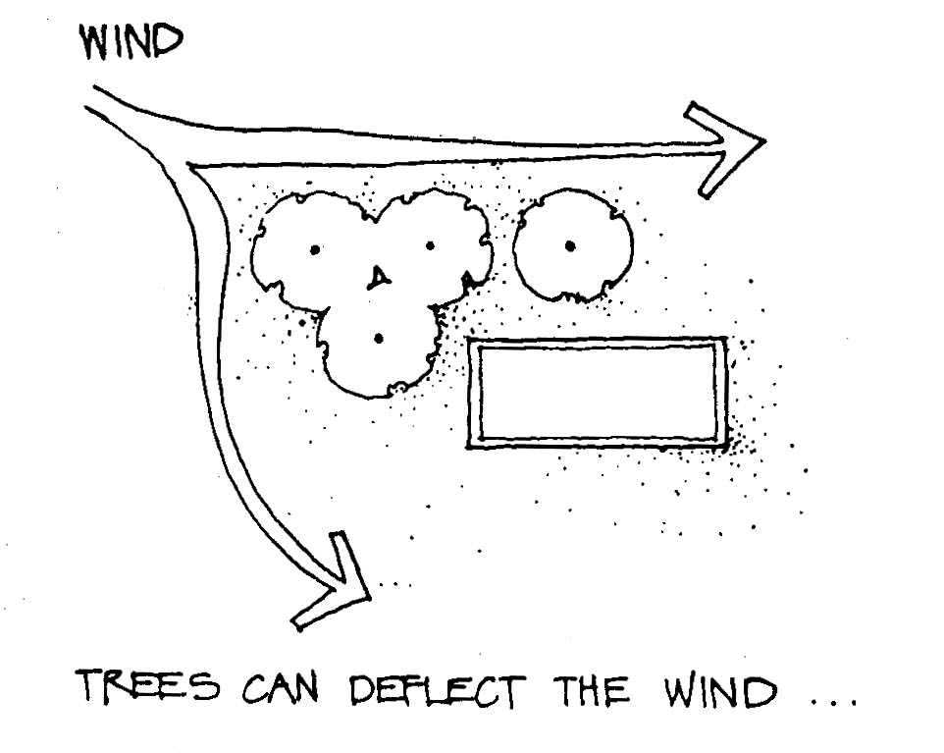
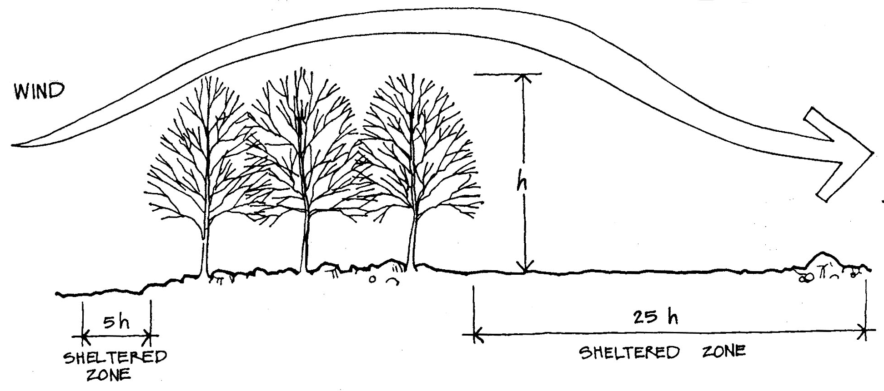
Wind and site planning
Trees and site plantings may be used to deflect winds, sheltering both outdoor spaces and buildings.

Slide 5
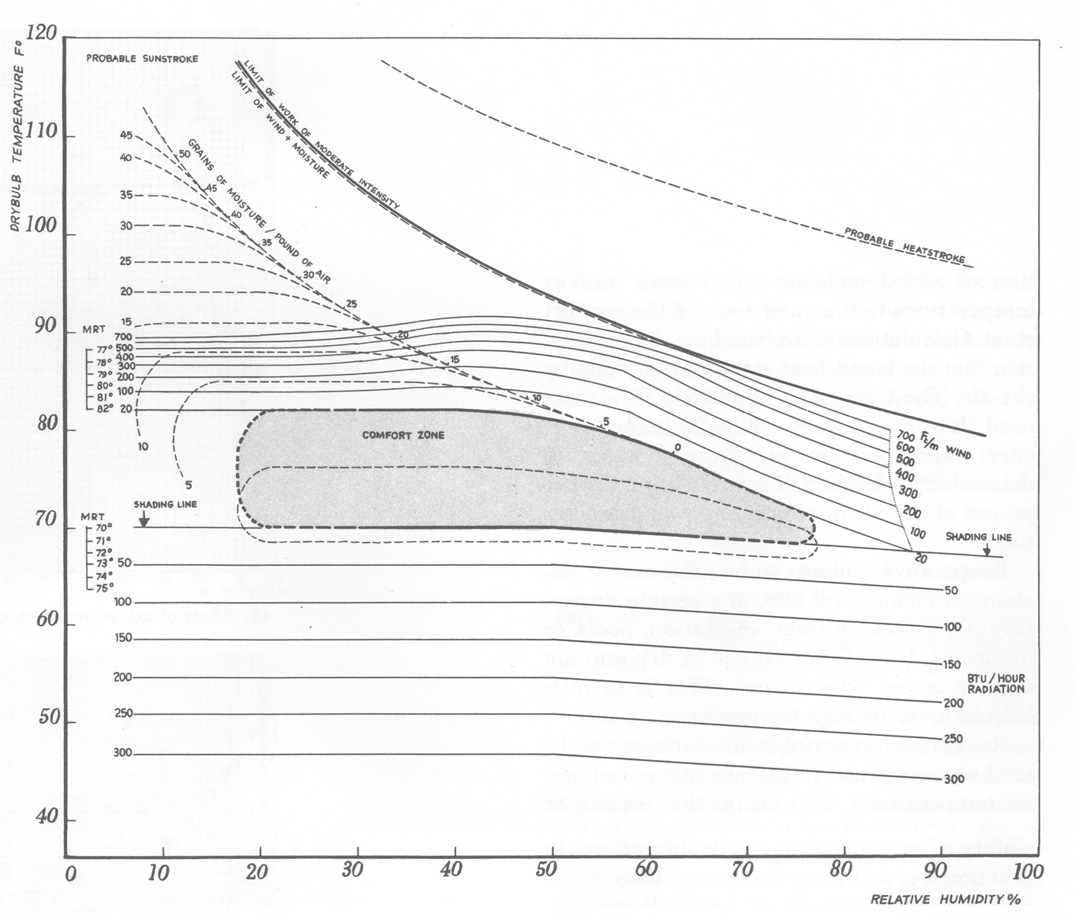
Bioclimatic Chart
BioClimatic Chart, from Victor Olgyay’s, Design With Climate, 1963

Slide 6
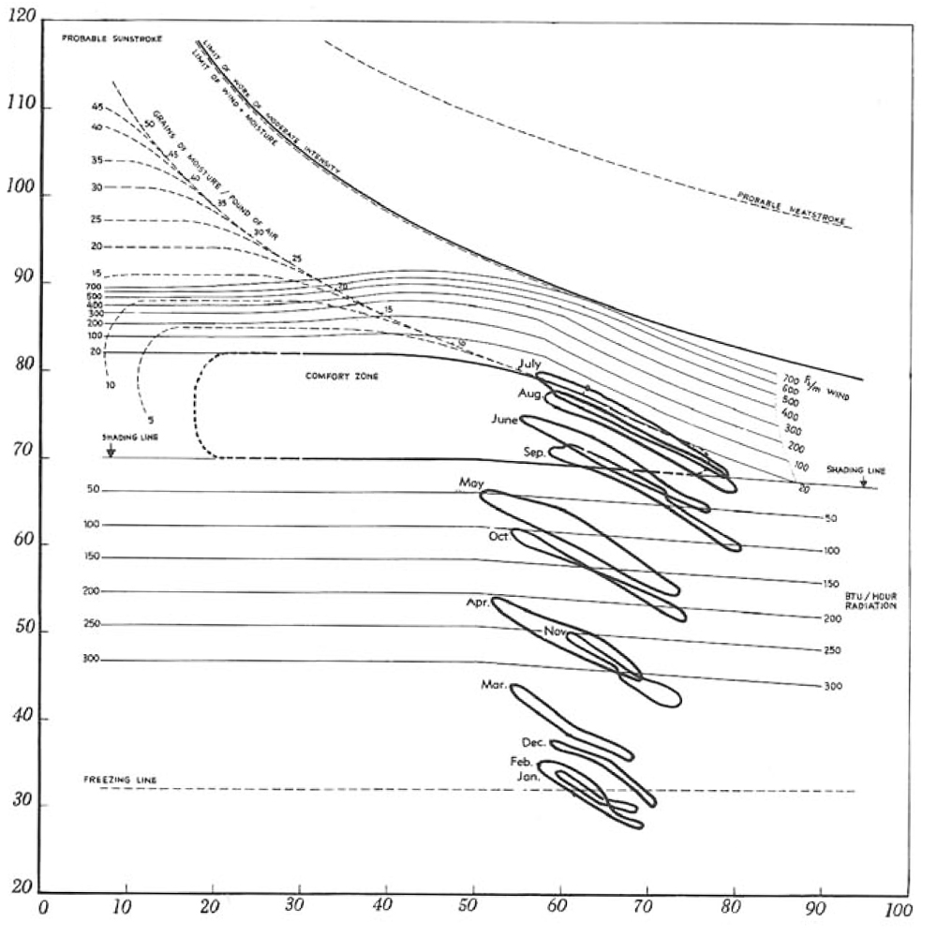
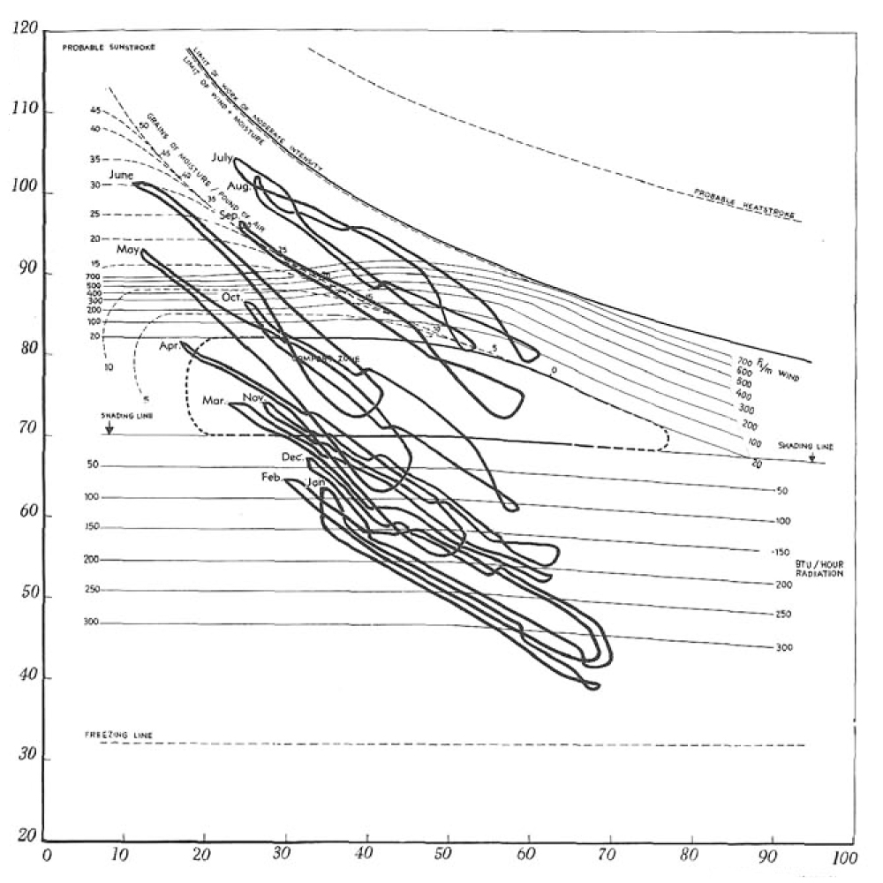
New York, NY
Phoenix, AZ

Slide 7
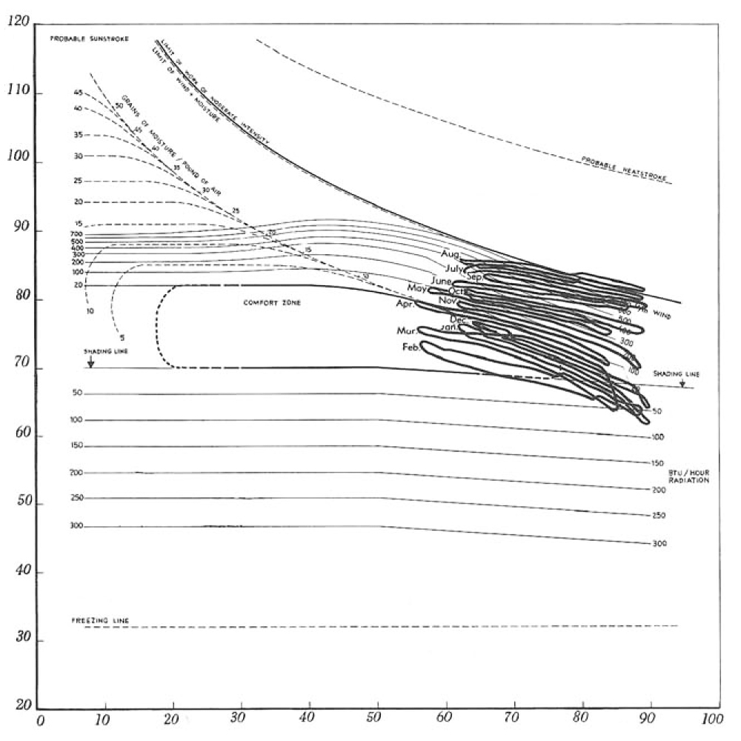
Miami, FL

Slide 8
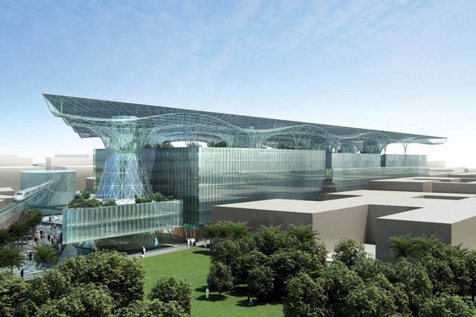
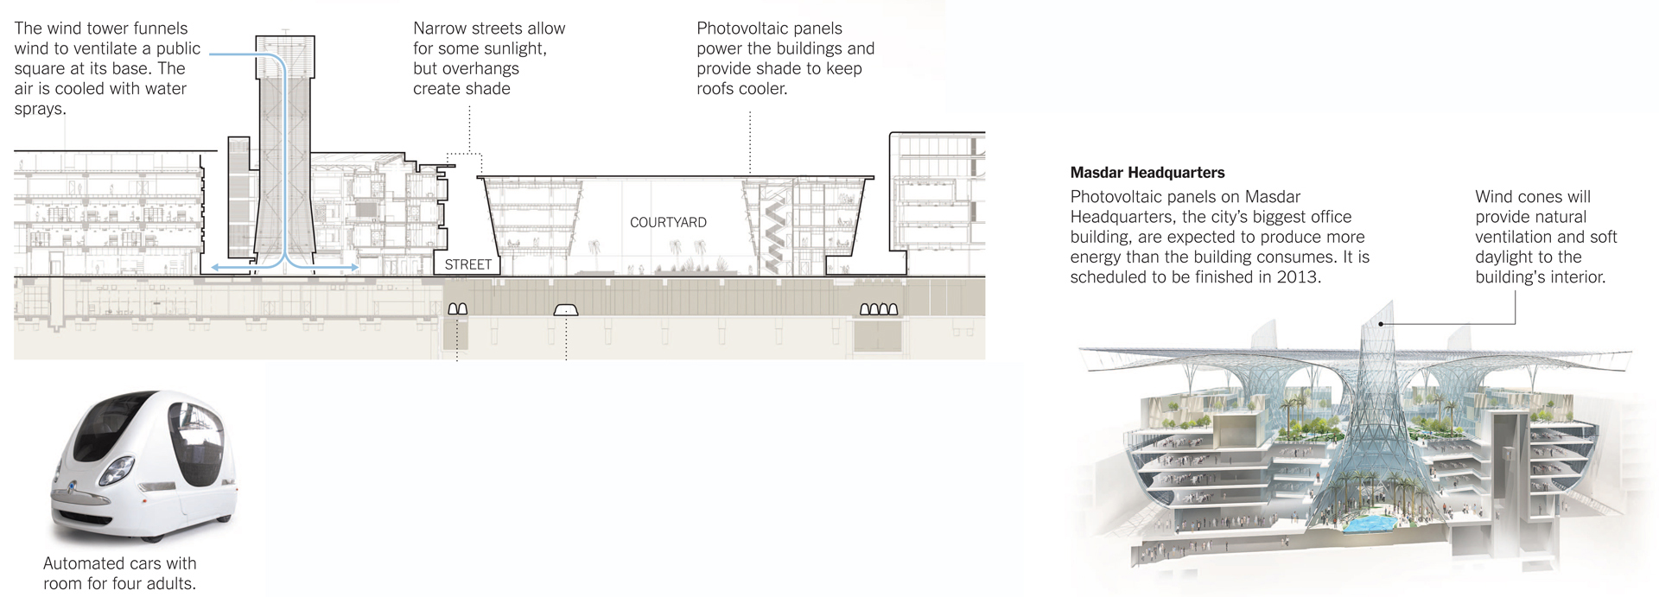

Masdar City
Foster and Partners, Architects
ENERGY FUNDAMENTALS
REDUCING DEMAND
SUPPLY
STORAGE
MANAGEMENT
EMBODIED ENERGY
NEXT CLASS

Slide 9


