Slide 1
MASONARY WALL SYSTEM (BRICK VENEER)
GROUP 2: MARLON BEST, TREVOR DAVIS, JOHN RUBIO

Slide 2
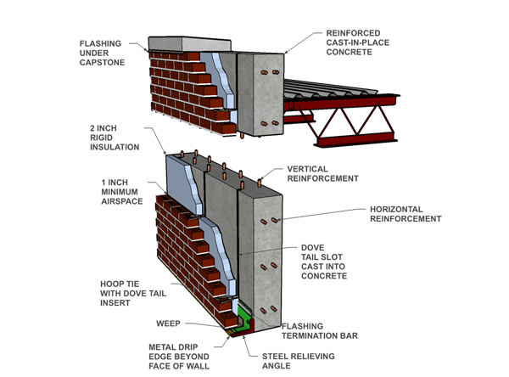
MASONARY WALL SYSTEM
WALLS THAT ARE MADE UP OF A SINGLE NON-STRUCTURAL OUTTER LAYER OF BRICK BACKED BY AN AIR SPACE. THE INNER COMPONENTS OF THE WALL ARE MADE UP OR WOOD, METAL OR BRICK.
IN MOST CASES, WALLS BUILT THIS WAY ARE GENERALLY BETTER THAN SOLID MASONARY WALLS THUS, HAVING A CAVITY WALL IN WHICH BOTH THE INTERIOR AND EXTERIOR ARE STRUCTURAL.

Slide 3
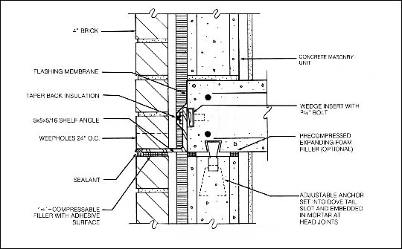
SUPPORT AND MATERIALS
INORDER TO ENSURE MOVING WONT OCCUR FROM STRONG WINDS AND EARTHQUAKES, THE BRICK VENEER HAS TO BE TIED TO THE BUILDING. INORDER FOR THIS TO HAPPEN, THE PROCESS CANNOT INTERFER WITH DRINAGE. USUALLY BRICK TIES ARE USED AND MAY COME IN THE FORM OF CONGIGATED METAL NAILS, HORIZONTAL WIRE EXTENSIONS TO COMPLETELY REINFORCE THE SYSTEM. FOR MULTI STORY BUILDINGS SHELF ANGLES ARE USED FOR HORIZONTAL EXPANSION.
MASONARY VENEER CAN BE MADE UP OF CONCRETE, MANUFACTURED CLAY, ARTIFICAL OR NATURAL STONE.

Slide 4
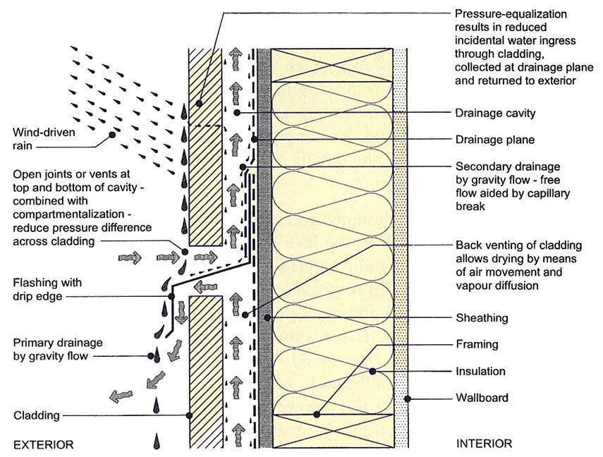
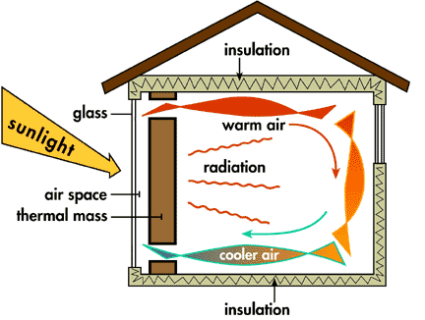
RAIN SCREENS AND THERMAL PERFORMANCE
TO ENSURE SAFETY FROM WIND DRIVEN RAIN, RAIN SCREENS ARE USED ON MASONARY VENEER TO STOP RAIN FROM ENTERING THE TOP OR BOTTOM OF THE BUILDING.
MASONARY USUALLY HAS A HIGH THERMAL MASS WHICH MEANS THAT ITS SLOWLY TO HEAT UP. DARK MASONARY ABSORBES THE HEAT WHILE LIGHTER MASONARY REFLECTS IT. DEPENDING ON WETHER OR NOT THE COLOR IS CONSTRUCTED ON THE INSIDE OR OUTSIDE, WILL AID IN THERMAL MASS FOR THE EXTERIOR OF THE BUILDING. ECONOMIC ADVANTAGES INCLUDE LESS ENERGY USAGE AND MORE HEAT CAN BE RELEASED DURING THE SUMMER.

