Slide 1
Wines of Germany
Prof. Karen Goodlad
HMGT 2402
Fall 2011

Slide 2
Climate
One of the coolest wine producing regions in the world
High latitudes
  long daylight hours in summer
Selective vineyard sites:
  Near rivers, reflect sun, moderate temperatures
  Steep riverbanks offer elevated growing areas to capture more sun light
Notes:
Long growing season, sometimes until Novemeber for dry wines = high acidity

Slide 3
Wine Styles
Dry Still, Sweet Still and Sparkling (Sekt)
75% of German wines are white
  Riesling
  Müller-Thurgau
  Silvaner
  Grauburgunder (Pinot Gris)
  Weissburgunder (Pinot Blanc)
Red wine
  predominately Spätburgunder (Pinot Noir)
Notes:
Sweet wines are made due to botrytis helped by cool misty conditions at the end of the growing season
Sekt = Charmat Method
Fresh lively wines with low alc.
Riesling: Noble grape, 22% of total acreage, wonderfully fresh when young but very expressive when aged
Muller-Thurgau: 20% of acreage, cross between riesling and gutedel developed in 1893 designed to shorten the growing season, floral character, fresh fruit make is and every day drinking wine,
Pinot Noir: 8%, called Spatburgunder, high yields, light wine
Silvaner: 7% of production, late budding and early ripening,
Stainless steel fermentation, some very large oak casks
Technology allows wine makers to stop fermentation to achieve desired level of sugar

Slide 4
Wine Laws
Laws are governed solely by sugar contend at harvest
  NOT vineyard site
  NOT historical preferences
  NOT classifications
  NOT sugar levels after fermentation
Labels identify origin, style and taste characteristics
Notes:
Laws changed significantly in 1971 and have been altered only slightly since.
Grape sugar is measured and recorded then categorized

Slide 5
Wine Laws: Categories
Pradikatswein, gU (PDO)
Landwein, gga (PGI Category)
Wein (PGI Category)
Geschutzte Ursprungs-bezeichnung, gU
(PDO)
Notes:
Unlike other regions in Europe most of the wine in German is of high quality. This is partly due to the understanding that the leading alc. Beverage produced and consumed in Germany is beer.
Deautscher Tafelwein: only general region name on label Rhein and Mosel, Bayern
Nechar, OberrheinLaws are not strict, vitification and vinification has a lot of freedoms, Likr Frances vin d’pay ~4% of production
Geschutzle Geographische Angabe(gga
Landwein: higher yields of sugar, 20 designated wine regions.
QbA: largest amount of German wine grown in specified regions called Anbaugebiete (13)
QmP: any vineyard (Anbaugebiete) with the right growing conditions can qualify, grapes from the same vineyard will be hand picked at various times
Lists region where grapes were grown and grape variety.

Slide 6
Wine Laws: Qualitätswein
Approved Grape Varieties
Reflect natural flavor characteristics of grape and region
Grown in one of 13 Anbaugebiete

Slide 7
Wine Laws:
Prädiskatswein or QmP Categories
Kabinett: fine light wines, high acidity
Spatlese: “late picked”, fuller flavors than kabinett, higher sugar levels
Auslese: “selected” harvested in clusters with signs of botrytis
Beerenauslese: “berries out picked” wines are rich and luscious, $$$
Trockenbeerenauslese: selected raisins, very rare $$$$$
Eiswein: “icewine” rare, pressed frozen to concentrate grape characteristics $$$$
For more information about German wine categories visit: http://www.winepage.de/
Notes:
Kabinett: ripe, not over ripe
Spatlese: fuller bodied
Auslese: very sweet
Beerenauslese: wine has finesse and elegance
Eiswein: pressed frozen, ice floats and is skimmed off top

Slide 8
Sweetness After Fermentation
Trocken Dry
Halbtrocken Half-Dry

Slide 9
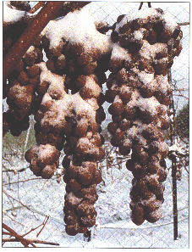
Eiswein

Slide 10
Wine Laws: Labels
Anbaugebiet: Wine Region
Bereich: District
Grosslage:
  collective vineyard sites
Einzellage
Weingut: winery
Notes:
Labels can be a poor marketing tool for German wines
Anbaugebiet: Wine Region, required on all labels
Bereich: District
Grosslage: “collective site” bulk blended wine
Einzellage: Single Vineyard, smallest geographical area allowed by law

Slide 11
Wine Laws: Quality Control Process
A.P.No.
Stipulate grape varieties in an area
Define growing regions
Define minimum sugar levels for all grapes at harvest
Pass a taste panel
  Reduce category if the wine does not pass or winemaker can blend it into other wines

Slide 12
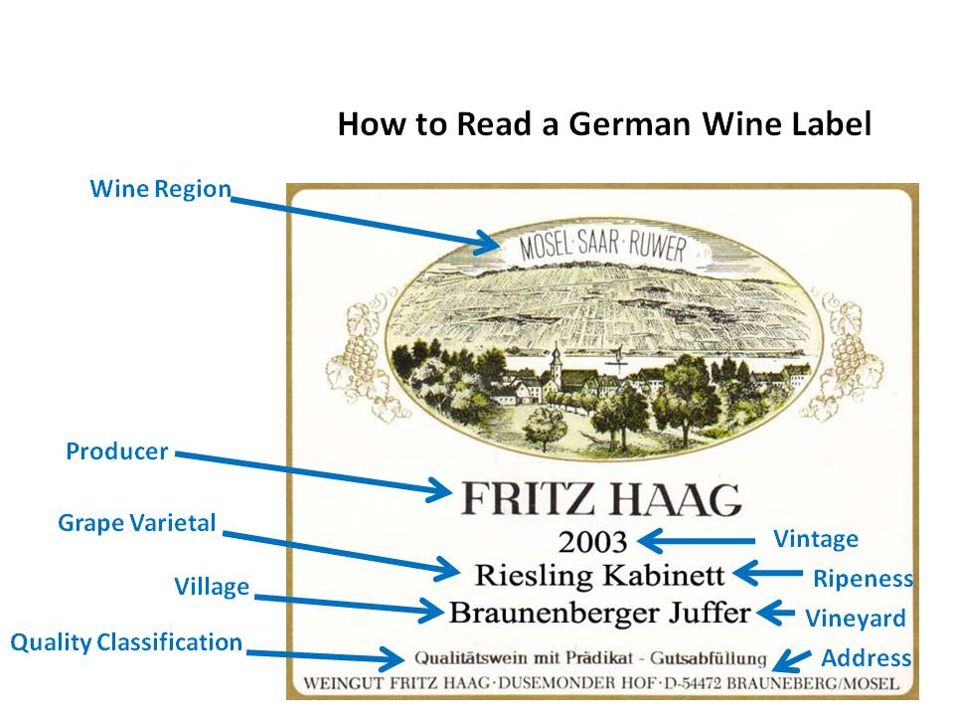
German Wine Labels

Slide 13
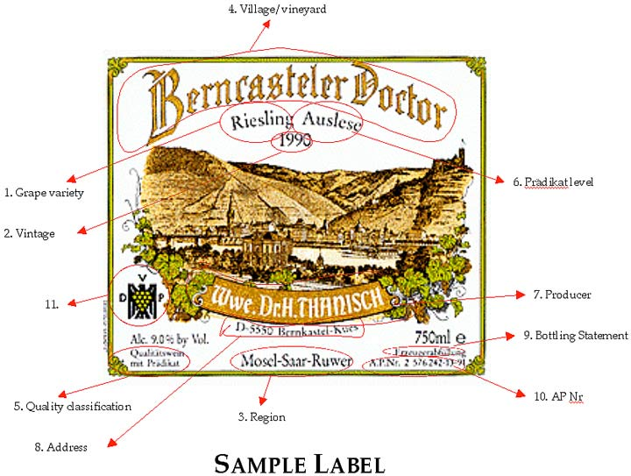
German Wine Labels

Slide 14
Mosel
Six Bereiche
Elegant Wines
  92% White Wine
  56% Riesling
Mosel River flows from south to north to meet Rhine River
  Slate Soil
  Steep Slopes
  Nothing else will grow
  Riesling 55%
  Muller-Thurgau
Notes:
Consistently produces the highest quality of all German wines.
Elegant fruit delicate, minerality

Slide 15
Rheingau
World Class White Wines
  Fuller in body than Mosel
  Slopes create lovely acidity
  Flat areas more full bodied
Johannisberg, Famous and only Bereich
80% Riesling
Rhine River runs through it

Slide 16
Pfalz
2nd largest region
62% white wine
  20% Riesling and Müller-Thurgau and others make up the reminder
“sturdy wines”, higher in alcohol than other German Wines
Soil: sandstone, gravel and granite
  Forest protects it from cold and rain

Slide 17
Rheinhessen
Largest Region and largest producer of wine
Mostly fertile, flat plains, some clay, with the Rhine River flowing through
  Muller-Thurgau, 21.5%
  Silvaner 12%
  Riesling10%
Popular Villages: Nierstein & Nackenheim
  Eastern facing slopes

Slide 18
Terms To Know
Bereich
Einzellage
Eiswein
Grosslage
Halbtrocken
Trocken
Landwein
Auslese
Beerenauslese
Trockenbeerenauslese
Kabinett
Spatlese
Tafelwein
QbA
QmP

