Slide 1
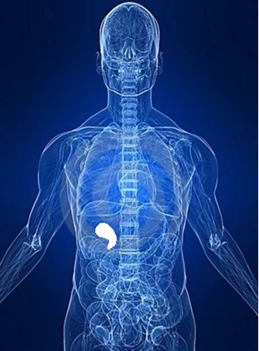

Inter-hospital
Case Study
Group 1
Shapiro Aleus-Ledain
Erika Gonzalez
Charles Neri
Giuseppe Spata
Michael Bottaro
Kathran Mayotte
Porfirio Reinoso
Runie Thibaud
Acute
Cholecystitis

Slide 2
Patient History
September 19, 2013, a CT scan of the abdomen/pelvis and a sonogram of the abdomen were taken of a 82 year old male ambulatory patient (who will be referred to as patient X). According to Igor Fishkin MD results showed that the gallbladder appeared to be distended with thickening of the wall, indicating a possible case of acute cholecystitis.

Slide 3
What is Acute Cholecystitis?
Sudden inflammation of the gallbladder
Once inflamed bile is unable to travel out of gallbladder, causing an accumulation of bile and increased pressure.
The combination of concentrated bile and pressure building up can irritate the wall of the gallbladder causing it to swell.
Severe inflammation of the gallbladder will interrupt normal blood flow, and if not treated can cause cell death.

Slide 4
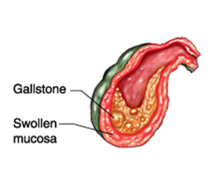
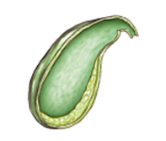
Normal Gall Bladder
Inflammed Gall Bladder

Slide 5
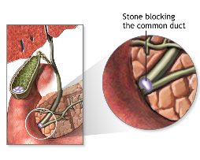
Acute Cholecystitis Causes
Over 90% of acute cholecystitis cases are caused by obstruction of the cystic duct by gallstones in the gall bladder
Numerous other pathologies may also be causes such as an infection, trauma and tumors of the gallbladder.

Slide 6
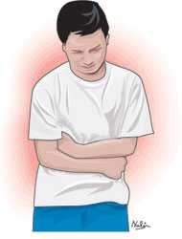
Signs and Symptoms
Pain in the right upper quadrant
An increase in pain when taking
in a deep breath
Fever

Slide 7
Diagnosing Acute Cholecystitis
Routine physical exam, to see if there's any tenderness in the right upper quadrant
Blood test
The size and shape of the gallbladder is best demonstrated using CT or ultrasound, which will also show any abnormal fluid levels

Slide 8
CT Exam of Patient X
Patient was placed in supine position on the CT table
Consciously sedated with 50 mcg of fentanyl, a lightly sedating narcotic, intravenously by the interventional radiology nurse.
The patient was also administered 1 mg of Versed which is a drug derivative of midazolam which induces a drowsy and calm feeling throughout the exam. Vital signs were closely monitored throughout the procedure and the CT of the abdomen was obtained.

Slide 9
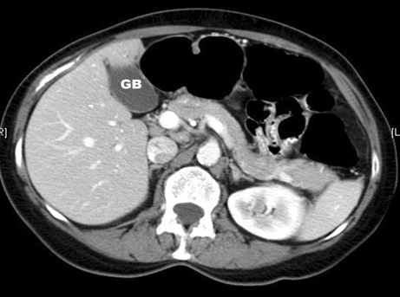

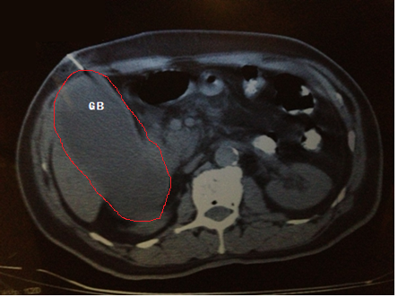
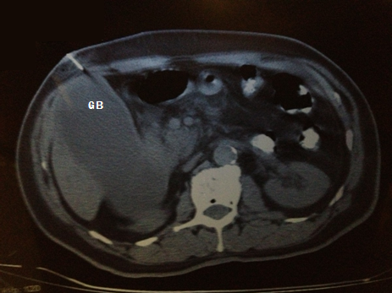
CT Scans
Normal size gallbladder
Patient X, Gallbladder diagnosed with Cholecystitis

Slide 10
Following the CT exam of Patient X it was decided by the attending physicians that it was time for a CT guided percutaneous cholecystostomy

Slide 11
CT Guided Percutaneous Cholecystostomy
A procedure done utilizing an imaging modality for guided placement of a drainage catheter into the gallbladder lumen to retrieve a sample of fluid for testing, in this case CT was used, though ultrasound or fluoroscopy could have also been utilized.

Slide 12
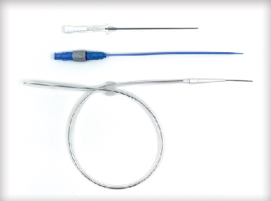
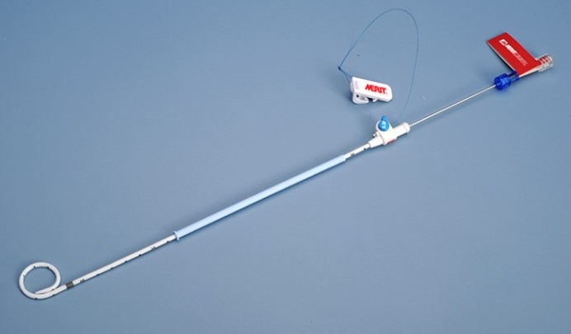
CT Guided Percutaneous Cholecystostomy of Patient X
According to the report of Doctor Fishkin
A safe spot for needle insertion was chosen and marked on the skin.
The right upper quadrant of the abdomen was prepped and draped in the usual sterile fashion.
Micro puncture set in a French Size 5 and an All purpose draining catheter in a Size 8 were used
Micropuncture Kit
Drainage Catheter

Slide 13
The gallbladder was punctured with an 18 gauge needle under CT guidance.
Aspiration of bile/pus from the drain confirms satisfactory position
Approximately 300 cc's of a cloudy greenish fluid were aspirated out of patient X’s catheter and sent for examination

Slide 14
Post-Percutaneous Cholecystostomy
Patient requires bed rest , typically 2-4 hours with regular monitoring of vital signs, and medication for pain if necessary
Catheter must be cared for by being flushed and aspirated regularly with saline approximately every 6 to 8 hours.
Once patient is determined to be stable a cholecystogram can be performed to confirm satisfactory catheter position and state of the gallbladder.

Slide 15
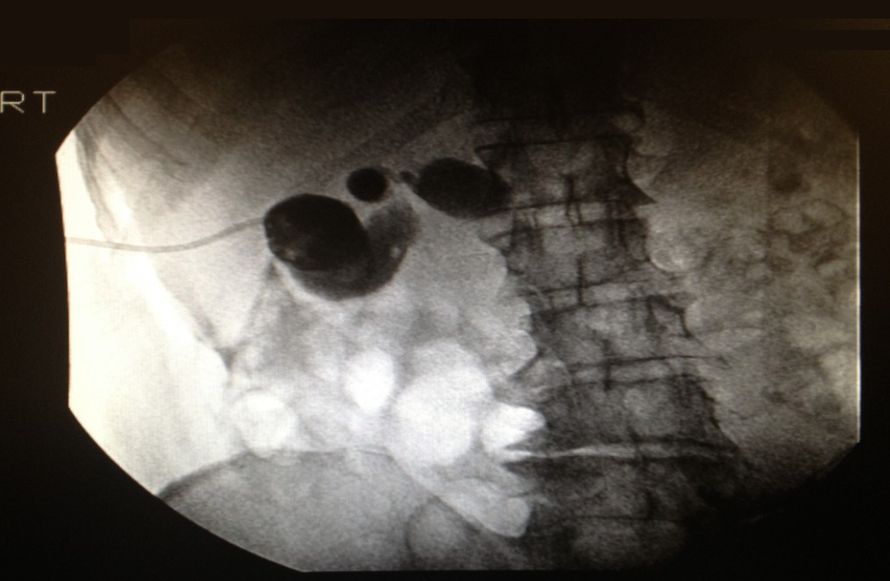
Cholecystogram
A fluroscopic procedure , where contrast is injected into the catheter and radiograph's are taken
Cholecystogram images of patient X

Slide 16
If lab results from the Percutaneous Cholecystostomy diagnose the patient with Cholecystitis, the patient will need to undergo a Cholecystectomy.

Slide 17
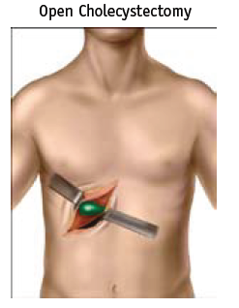
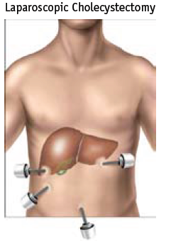
Cholecystectomy
A cholecystectomy is the surgical removal of the gallbladder
Laparoscopic cholecystectomy uses a small camera to assist in the procedure, resulting in less pain and a typical recovery time of 1-2 weeks.

Slide 18
Laparoscopic Cholecystectomy
The camera is inserted through one of four incisions in the abdomen.
The doctor will use air or carbon dioxide to inflate the patient’s stomach in order to have a clear view of the surgical instruments and the gallbladder and have a clean removal through one of the incisions.

Slide 19
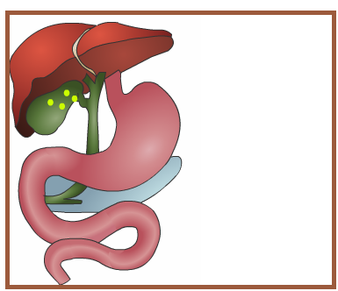
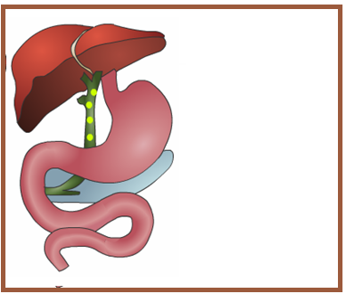
Post-Laparoscopic Cholecystectomy
Liver will produce bile and transport it to the small intestine via the common bile duct rather then it being stored in the gallbladder, patient is able to resume a normal life.
Normal functioning gallbladder with bile traveling from liver to gallbladder to small intestine
Gallbladder has been removed, bile now travels from liver to small intestine via the common bile duct

