Slide 1
Counterfeiting of Products
It’s effect and Prevention
MECH 3620 – Advanced Manufacturing Processes Fall 2013
Rolando Molina

Slide 2
Background of Counterfeiting
What is Counterfeiting?
Counterfeiting is the practice of manufacturing goods that often are of inferior quality, and selling them under a brand name without the brand owner’s authorization.
It is illegal.
It causes companies to lose a lot of revenue if their products are being counterfeited.
Approximately $200billion dollars in losses each year.
Most counterfeit goods are made in china.

Slide 3
How can we stop or reduce counterfeiting?
Be aware of what companies you conduct business with. Keep an eye out for leaks.
Register your trademarks in your home country and China. Or where ever you will be selling your product. Without registering your products you have no rights.
Register your products with China Customs. This increases the chances of counterfeiting products being identified before leaving the country.
You can train China Customs to be able to find your counterfeit products.
Monitor the internet to see if your product is being counterfeited.
Create a counterfeiting department within your company.

Slide 4
What is RFID Labeling? And how can it help?
RFID stands for Radio Frequency Identification
It is a digital finger print for products.
Flexible label containing a passive chip that contains critical information
The chips can be encoded with specific product and reference information for verification of authenticity of part or product.
The information on the chip is locked to allow no alteration of the information stored inside.
Can cost about 10-30 cents to create label for each part or product.

Slide 5
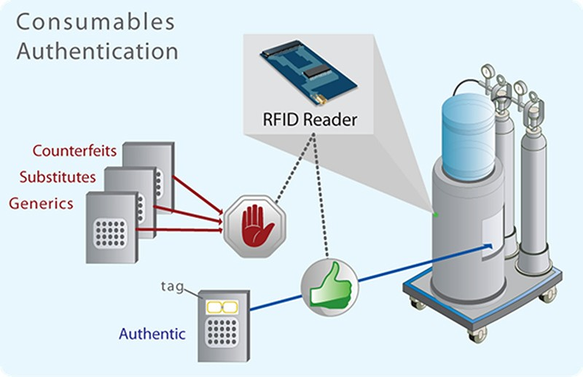
What is RFID Labeling? And how can it help?

Slide 6
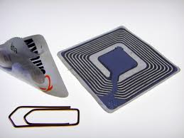

What is RFID Labeling? And how can it help?

Slide 7
Conclusion
There are many ways to prevent and reduce the manufacturing of products.
Educating yourself and your company about what prevention options are available.
Make sure your products are registered in your home country and any other country it will be sold in. It makes it more difficult for others to counterfeit your product.
Monitor the internet to see if there is anyone selling counterfeits of your product.
Choose a prevention process that makes it hard for others to replicate your product. You decide what will work best for you and your product.

Slide 8
References
www.chinalawblog.com
www.Inta.org/trademarksbasic.com
http://www.intermec.com/public-files/application-briefs/en/ab-Anti-Counterfeit-RFID-Labeling.pdf
http://en.wikipedia.org/wiki/Radio-frequency_identification

