Slide 1
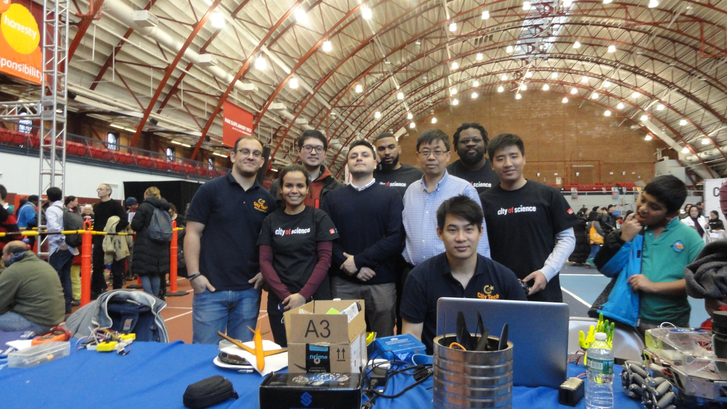
City Tech Maker Team
in the 2017 City of Science Fair

Slide 2
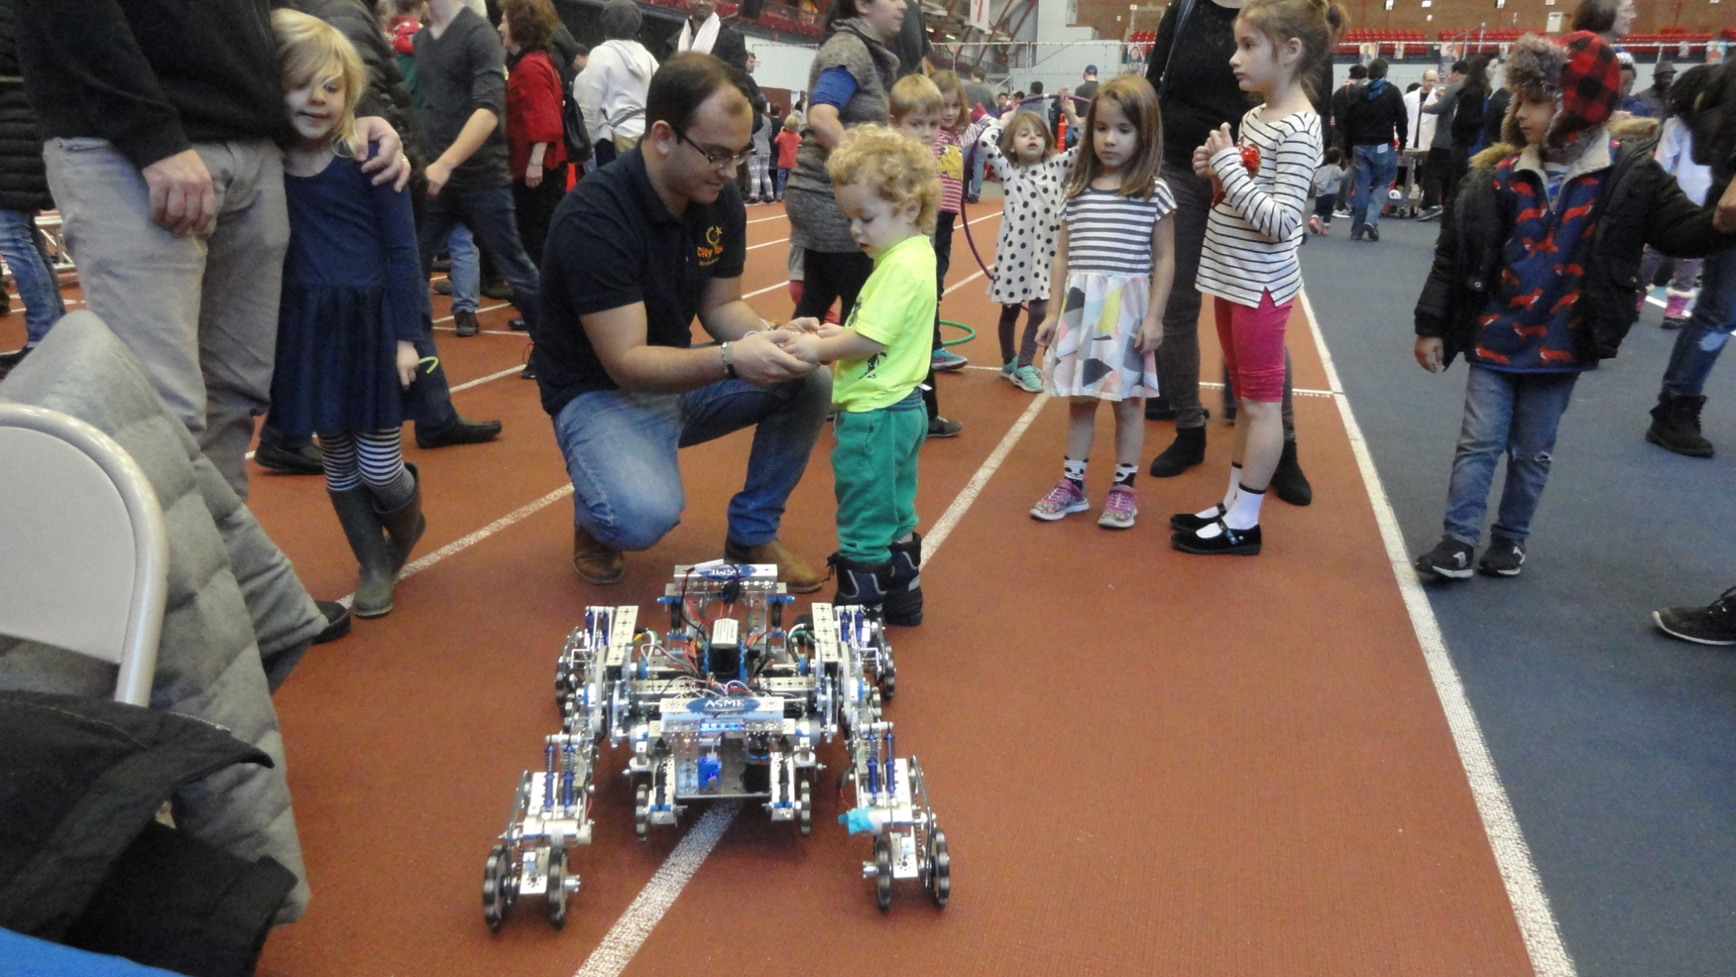
FlexBot Again Attracted Many Young Attendees to Play in the 2017 City of Science Fair

Slide 3
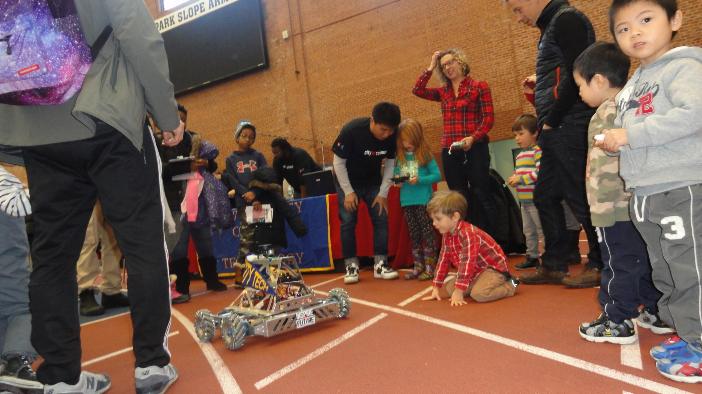
NaviBot in the 2017 City of Science Fair

Slide 4
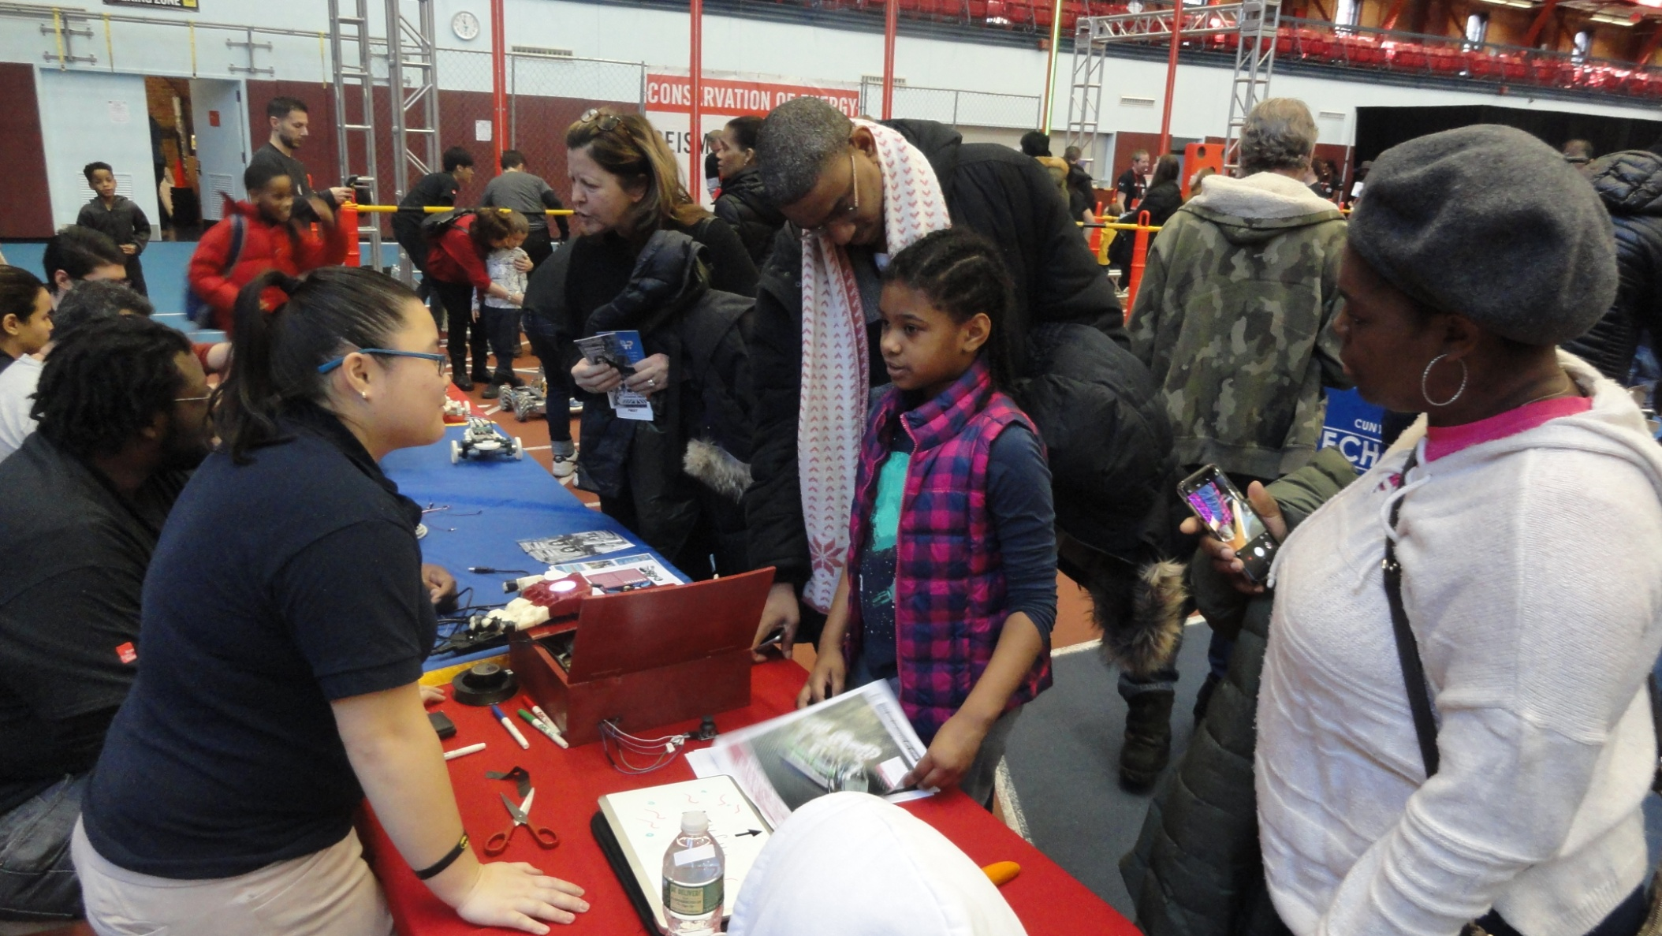
Prosthetic Hand Project Attracted Many Attendees Young and Old in the 2017 City of Science Fair

Slide 5
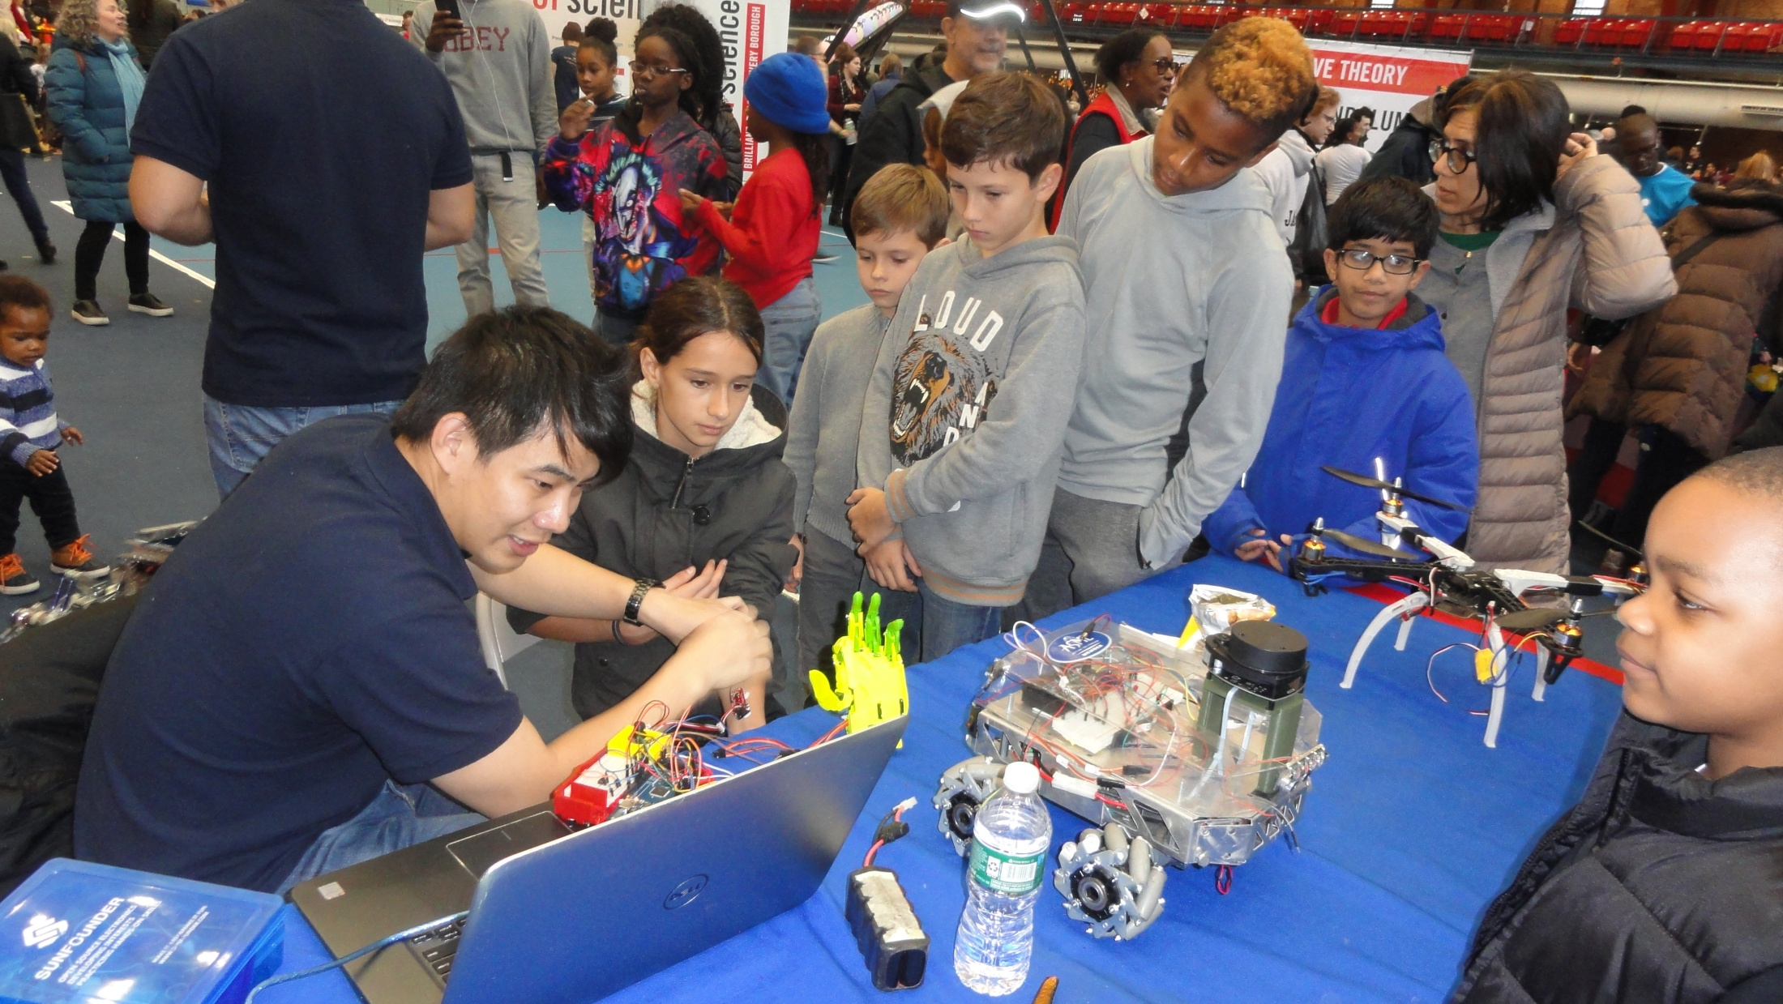
City Tech Maker’s Booth Attracted Many Attendees Young and Old in the 2017 City of Science Fair

Slide 6
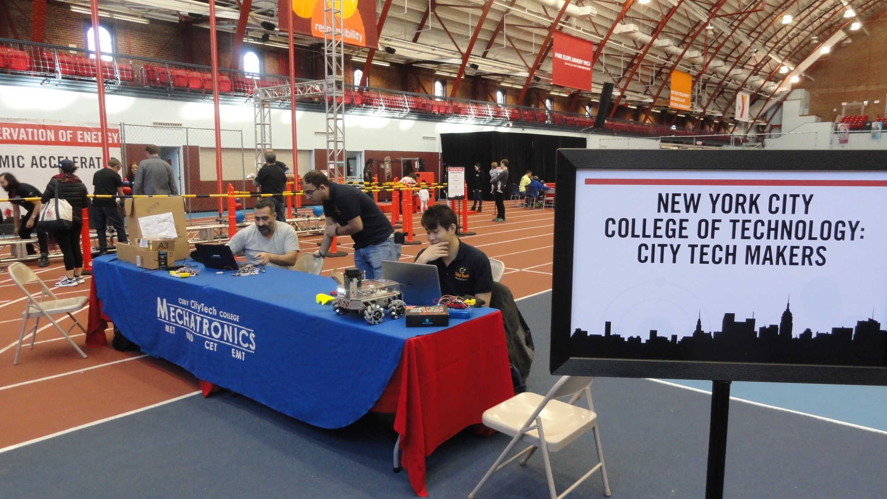
City Tech Maker’s Booth in the 2017 City of Science Fair

