Slide 1



Community Health Nursing: Flu Vaccination Fair
Welcome to
By: Sabrina Azeez, Michelle Bazil, Christina Ming, Alison Miller, Tina Mahler, Sonia Preston-Campbell, Juliet Coombs-Puranda, Tashiba Thomas & Shayna John.

Slide 2
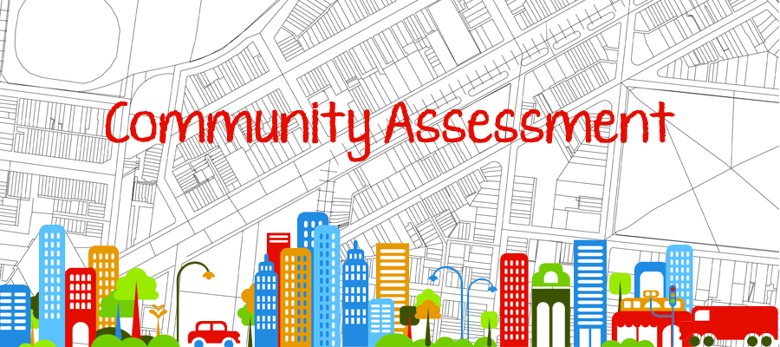

Community Assessment
Bellevue Hospital Center has been in operation since 1736, it serves patients regardless of immigration status or ability to pay. It consists of 750 beds, six ICU’s, world-class Emergency and Trauma center. BHC today is a major provider of healthcare including long-term and acute care in New York City.
Annually, the hospital treats approximately 27,000 inpatients, 500,000 outpatients, and 89, 000 emergency service visits in over 90 adult and pediatric ambulatory care clinics.

Slide 3


Slide 4

Public Schools:
P.S. 116 - Mary Lindley Murray
Norman Thomas High School
School Enrollment:
Nursery/Preschool - 383 children
Kindergarten – 112 children
Elementary /Middle School – 1, 101 students
High School- 476 teens
College/Universities: 5,848 students
1,048 residents who has below 9th grade level of education, high school drop-outs account for 1,678 residents, who obtained between 9th and 12th grade education.

Slide 5

-
Child Day Care-There are six of them in the zip code 10016.
Universities- There are five universities in this zip code location.
Courts-There is only one court. The Amy Begel Court is located at 114 E. 32nd St.
Movie Theatres- There are four movie theatres.
Employment Agencies-There are one hundred fifty-seven (157).
Pet Services- There are ten pet services.
Veterinary-There are five veterinaries.
Security Services- There are three security services.
Food Banks-There is only one food bank located at 120 E. 32nd St.
Dentists- There are one hundred eighty-four (184) dentists in this zip code area.
Health Clinics-There are five health clinics.
Free Clinics-There are five free clinics.
Family Services-There are eighty-seven family services.
Social Services-There are two social services, NYC food stamps office is at 225 E. 34St., and NYC Medicaid is at 466 1st Ave.
Hospitals-There are thirteen hospitals in this zip code area.

Slide 6


Slide 7
Commute:
The residents in this neighborhood utilize private transportation, carpools, bus, train, walking, bikes, skateboards, and rollerblades to get to work and other places of business.
Housing:
Apartment buildings with multiple units is the major type of home structure in this neighborhood
Other Statistics:
The total population in the 10016 zip code area is 51,217 residents.
Males account for 47% and females account for 53%.
18 years and older is 47,825
21 years and older is 46,417.
Residents who are 65 years and older total 5,460.

Slide 8

Bellevue hospital center deals with eight priority issues of the community. These eight issues are mental illness, diabetes, hypertension, substance abuse, health literacy, cancer, obesity and HIV/AIDS/STDs.
1. Patterns of morbidity and mortality
- NYC receives about 20,438 hospitalizations of patients a year with a diabetic diagnosis. That is 355 persons per every 100,000.
- People living in low income communities higher morbidity rates. (Kim, Berger and Matte, 2006)
- Diabetes is listed as the underlying cause of 1,819 New York City deaths. Diabetes have a mortality rate of 24 per 100,000 population. This makes diabetes the 4th leading cause of death among New Yorkers.
Blacks have a higher diabetic mortality rate than any other race.
(Kim, Berger and Matte, 2006)
- 60% of adults in New York State are either overweight or obese. African Americans (66%) have a higher morbidity rate than Caucasians (61%).
Between 2003 and 2007 obesity morbidity rate increased from 20% to 22%.
Obesity has a mortality rate of 16.6% in NYC. (New York Times,2004)
- Cancer morbidity rate in Manhattan: 560.9/100,000 (male) and 438.5/100,000 (female) (n.a., 2012)
Cancer mortality rate in Manhattan: 191.0/100,000 (male) and 132.6/100,000 (female) (n.a., 2012)
- Hypertension morbidity rate increased an 11.3% since 2009.

Slide 9
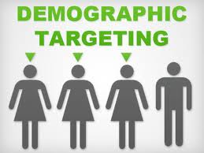
2. Demographics
- Bellevue Hospital Center serves patients from many different race and ethnic backgrounds. Within its primary service area it provides service to 40% Caucasian, 38.1% Hispanics, 21% Blacks, 15% Asians and 22.55 of people from other races. (Pressman and Bohlen, 2013)
- It is projected that by 2018 the Caucasian and Asian population will increase steadily, while the African American and Hispanic population, which had been declining will continue its downward trend. (Pressman and Bohlen, 2013)
- According to the Bellevue 2013 community health needs assessment and implementation strategy (Pressman and Bohlen, 2013), the Bellevue community has eight priority needs that need to be addressed to better the health of the community. These eight needs are: mental illness, diabetes, hypertension, substance abuse, health literacy, cancer, obesity and HIV/AIDS/STDs

Slide 10
3. Environmental concerns
- Social/ economic concerns: about 15% of the Bellevue service community population is living twice below the poverty line (N.a, 2013). This can affect community health.
Living in poverty can contribute to poor health. It can increase resident’s chances of obesity, hypertension, and substance abuse and can also contribute to a lower level of health literacy understanding.
- Studies have shown that “the highest rates of obesity occur among population groups with the highest poverty rates” (Drewnowski and Specter, 2004). This is often because they are not privileged to buy the healthy foods that they need because healthy foods cost more.
- Obese patients have a higher risk for cardiovascular disease, diabetes, and cancer. (N.a., 2013)
- Obese patients also have an increased likelihood of depression and social/economic problems. (N.a., 2013)
- Unhealthy eating and obesity can then lead to diabetes and hypertension.
- According to the 2013 Bellevue community health needs assessment and implementation strategy, 1,524 patient have a diagnosis of diabetes. This number represents 6% of the adult population in Bellevue who actively engage with a primary care provider. According to the assessment (2013) four out of every five patients visited the ED within the year and 2.5 of every five patients had an inpatient admission. (Pressman and Bohlen, 2013)
- The assessment shows that as of 2012, 41% of patients in the Bellevue care community have a diagnosis of hypertension. Uncontrolled hypertension can lead to heart disease and stroke. (Pressman and Bohlen, 2013)
According to the environmental Public Health and Sustainability Tracking Portal (2013), 54.1% of adults 65 years and older were hospitalized for heart attacks.

Slide 11

5. Aesthetics
- The community surrounding Bellevue hospital is beautified by a wide array of restaurants and cafes. Restaurants offering all types of cuisine such as Greek, Indian, Mexican, African and Asians.
- There are a few parks around the area also. The two closest parks are the Bellevue South Park and the Vincent F. Albano Jr. Playground.
- There’> s also the Asser Levy Recreation Center and the Asser Levy outdoor pool. Anyone in the community is welcome to sign up for a membership at the center and the pool.
Member in the community can visit the recreation center and participate in individual or group work. Exercise can help reduce obesity, which can in turn help lower the risk for hypertension and diabetes.
4. Public services
- The Health Professions Library which is located at 425 E25th. It is the closest library to the hospital. Members of the community can go there to help increase their health literacy level.
- Community centers are within access to the public, to help aid in health promotional behaviors. The two closest community centers in the Bellevue area are The Three Jewels Outreach Center and the 14th street Y.

Slide 12


6. Health-related facility
- There are many health care facilities in and around Bellevue Hospital. Within Bellevue Hospital they offer outpatient clinic service for many disease treatments. A few of these clinics are: the substance abuse clinics, mental health clinic, diabetic clinic, oncology clinic, medical weight management clinic and the HIV/Virology clinic.
- There are many other health facilities that are located around the Bellevue Hospital Center community.
•There’s the NYU Clinical Cancer Center that is located 160 E 34th St New York, NY 10016
•Diabetic Eye Center located at 30 Park Ave, New York, NY
•The New York University Medical Center located at 400 East 34th street New York, NY
•The Aaron Diamond Aids Research Center located at 455 1st Ave New York, NY
- There are also many pharmacies in the area that residents can go to fill their prescriptions and to also find out more about their medications. A few of the pharmacies around the area are: Rite Aid, CVS, Duane Reade and a few other small neighborhood brands such as Prohealth Pharmacy and Halpern Pharmacy.

Slide 13
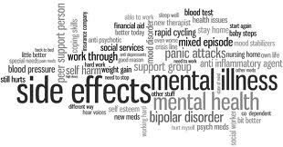
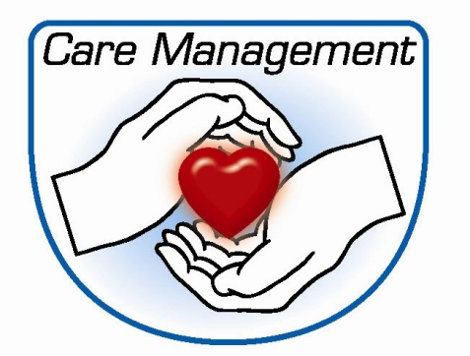
Care Management Techniques
As a case manager managing care of patients in the community with hypertension, diabetes, health literacy and obesity would realize that there would be greater outcomes when community centers are utilize to promote disease prevention and management teaching. Also an incorporation of exercise programs and nutritional counselling within the community.
For substance abuse, mentally ill, cancer and HIV/AIDS/STD patients offering more support programs outside the hospital setting would be helpful.
Mental Illness: identifying patients is key to treatment. Integrate primary care and mental health services and improve access to outpatient services.
Screen parents/caregivers to provide supportive services, if needed.
Integrate more behavioral health practitioners within the primary care setting in order to provide a one-step model of care for those in need.
There is currently 25,805 patients in the Bellevue Hospital Center (BHC) primary care population. Out of those patients 608 per 1000 had emergency visits and 242 had admissions. By implementing these strategies BHC hope to decrease these numbers by 5 percent.
(Pressman and Bohlen, 2013)

Slide 14
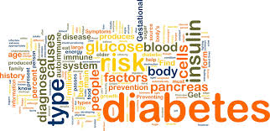

Care Management Techniques
Diabetes: Bellevue hospital participates in the diabetes chronic disease collaborative. All patients with a diagnosis of diabetes are entered into the chronic disease registry to facilitate measuring compliance with care and outcome.
Each patient have an individual care plan to fit their specific needs.
“ At risk” patients are set up with care coordination and/or care management. At risk patients are patients who have poor compliance, have more than one ED visit within one year period and/or one or more admissions during that same period and as those who have more than one socioeconomic factor such as homelessness.
There are 1,524 patients with a diagnosis of diabetes registered in the diabetes chronic disease registry. This number represents 6% of BHC adult patient population. By implementing these strategies it is expected that there should be a 10% improvement in ED visits and admission because of diabetic complications.
(Pressman and Bohlen, 2013)
Hypertensions: Bellevue Hospital Center (BHC) is connecting patients to primary care providers to help promote the continuity of care/disease management.
Extend access to HTN management services such as regular blood pressure checks, counseling on diet and exercise and medication management.
Work with dietitians to develop culturally appropriate diets for patients. Group classes will be offered targeting topics such as healthy cooking and stress management.
In the BHC there are currently 41% of patients in the adult primary care that have a diagnosis of HTN. By implementing these strategies, there is an expectation that 64% of these patients will have control of their blood pressure.
(Pressman and Bohlen, 2013)

Slide 15


Care Management Techniques
Substance abuse: Bellevue Hospital Center (BHC) participates in New York State’s Health Home program (HH). This programs enrolls “high Utilizers” of emergency and inpatient services. Substance abuse patients are one of the groups that are considered “high utilizers”.
Patients in this program will receive care management, care coordination, primary care, substance and mental health services.
Each patient receives a care plan that is actively managed by their care team.
(Pressman and Bohlen, 2013)
Health literacy: Bellevue Hospital Center (BHC) uses the HealthPix graphical display, developed by Dr. Shonna Yin from the Department of Pediatrics, to teach parents how to administer medications to their children. The goal is to use the HealthPix model to explain other literatures such as diet, exercise and medication management for adults. Using this model can be very instrumental when conducting discharge teaching.
As of 2013 BHC has begun using iPads in the clinic setting to conduct surveys on the effectiveness of patient teaching understanding. Results show that 88% of participants replied “always”. The goal is to raise that number to 95%.
(Pressman and Bohlen, 2013)

Slide 16
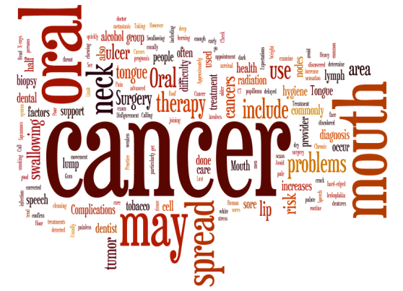

Care Management Techniques
Obesity: BHC is tackling the obesity epidemic by utilizing primary care and specialty care services. They are including intensive medical treatment, evidence-based diet programs and psychological counseling to identify psychosocial risk factors.
The BHC Nutrition and Fitness Program (BENUFIT) is being utilized to provide comprehensive evaluation and treatment for patients through weight management programs.
(Pressman and Bohlen, 2013)
Cancer: BHC is having primary care providers screen patients for lifestyle habits that are known to put patients at an increased risk for developing cancer.
BHC is hoping to increase and expand cancer screening and treatment services into the community setting.
(Pressman and Bohlen, 2013)

Slide 17
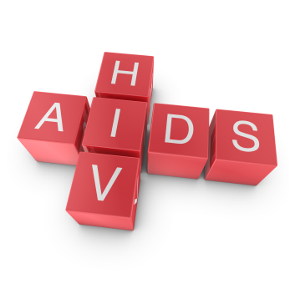

Care Management Techniques
HIV/AIDS/STDs: BHC is working to be a “one-step shopping” service for persons with HIV/AIDS.
Enrolling patients into BHC’s harm Reduction Recovery Readiness and Relapse Prevention Program (HRR). Data show that 40-50% of the patients enrolled in the program had received individual counseling. The goal is to increase it to 80%.
(Pressman and Bohlen, 2013)

Slide 18
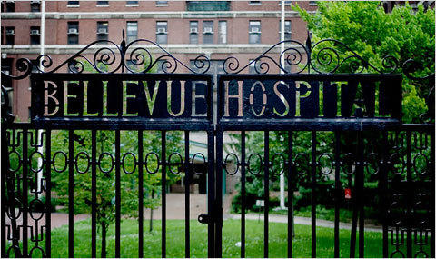

INFLUENCES ON RESOURCES ALLOCATION
Bellevue Hospital Center is one of the highlights in HHC where resources is transferred into palliative care services.
The Palliative Care consultation at BHC has the largest interdisciplinary team with many therapies, including psychological, physical, and occupational which are involved in case conferences. Child life specialists are maintained on the Bellevue team, as they care for the necessities of the children whose parents are experiencing life-threatening illnesses. BHC is now producing a palliative care clinic for outpatients, concentrating on the control of pain for home care, nursing facilities or those not in hospice.

Slide 19

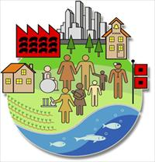
Diagnostic Community Statements
For the overall assessment of community, we decided to adopt the data available at Bellevue Hospital Center’s website (2013 Community Health Needs Assessment and Implementation Strategy). Approximately 50% of BHC’s outpatients (excluding visitors to the emergency room) reside in 27 different neighborhoods, in other words, 27 different “communities.” Clients originate from various neighborhoods in Manhattan, Brooklyn and Queens. Only 3.21% of the outpatient visitors (excluding visitors to the emergency room) live within the zip code zone 10016, the Kips Bay neighborhood in Manhattan in which Bellevue is located.
).
The communities that BHC serves are impoverished. “Over 22% of all families and over 31% of families with children live below Federal poverty guidelines.” BHC accepts patients regardless of their ability to pay, and patients who are otherwise not able to access health care through private physicians or voluntary hospitals depend on BHC as a crucial point of access. A large proportion of BHC’s patients are “self-pay” (uninsured) and Medicaid recipients. “This adds to the complexity of providing health care and in managing population health” .
The communities that BHC serves are largely White and Hispanic. The Asian population is increasing

Slide 20
Diagnostic Statements with Rationale and Identified Problems
For the diagnostic statements with rationale and identified problems, we decided to adopt the data available at Bellevue Hospital Center’s website (2013 Community Health Needs Assessment and Implementation Strategy). BHC provided a total of 1,172,700 clinic visits to patients in the year July 2011 to June 2012 to clientele drawn from incredibly diverse neighborhoods throughout the City.
BHC gathered information from two types of sources. The primary type of source was focus groups. The secondary type of source was data gathered from a variety of primary and secondary sources, including the websites of the U.S. Census, New York City Health and Hospitals Corporation, New York City Department of Health and Mental Hygiene Community Health Surveys, city boroughs’ statements of Community District Needs, and New York State Department of Health
Three focus groups were conducted in March, 2013, each with a different set of participants. One focus group consisted of patients, a second of community stakeholders, and a third of healthcare providers at BHC. The patient focus group consisted of clients who each came from a different zip code. As mentioned earlier, zip codes are utilized to organize information about the communities in which patients reside. The community stakeholder focus group included local residents and representatives of community-based organizations. The healthcare providers focus group consisted of healthcare providers representing a wide variety of disciplines at BHC

Slide 21


Diagnostic Statements with Rationale and Identified Problems
The purpose of the assessment that was developed was to identify “existing and emerging healthcare needs of the local community” so that services could be developed “to further the goals of the State and Federal health care agendas.” The three different focus groups identified different needs. Then from the priorities listed by each group, commonalities were identified. Eight priorities were finally decided upon. In deciding upon these priorities, community assets in the primary service area (hospitals and clinics that provide services) were identified to determine the facilities available to deal with these priorities (p. 10 – 12).
The identified priorities are (1) mental illness, (2) diabetes, (3) hypertension, (4) substance abuse, (5) health literacy, (6) cancer, (7) obesity, (8) HIV/AIDS/STDS.

Slide 22
Planning and Implementation
Goals/Objectives:
To educate ourselves and our fellow students of New York City College of Technology about all the aspect of influenza (flu) including key facts and myths about seasonal flu, flu virus, symptoms and severity, spread of flu, prevention of flu and population at greater risk.
To educate students to get vaccinated
3. We wanted to promote simple methods on how to prevent the spread of the flu. Such as good hand washing techniques, using a tissue when sneezing or coughing and throw the tissue away after you use it.
4. To provide free flu shot for students who do not have health insurance

Slide 23
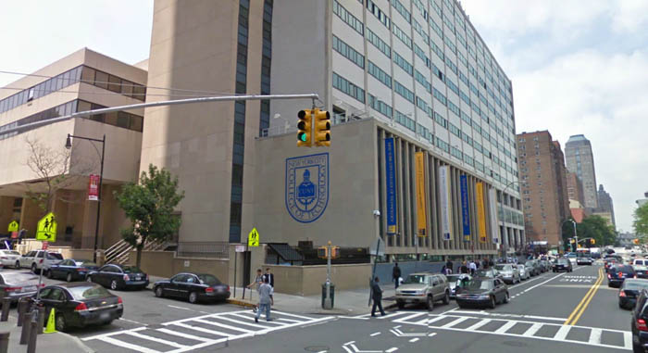
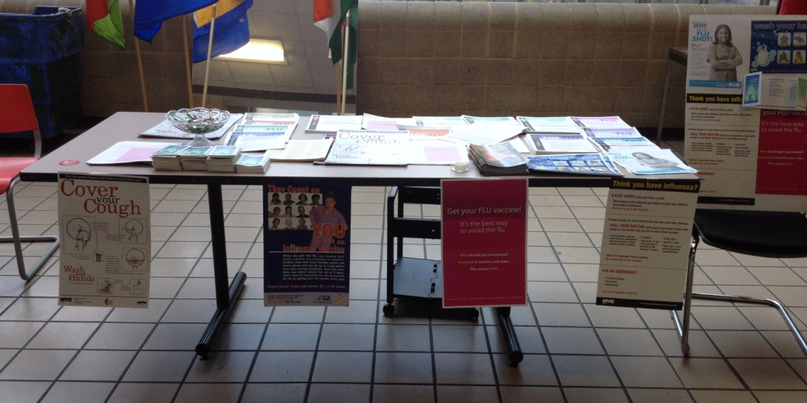
Planning and Implementation
Date of project, site of project, address where project took place:
-November 12 & 19 2013
Ground & First floor of Atrium Building at NYCCT.

Slide 24
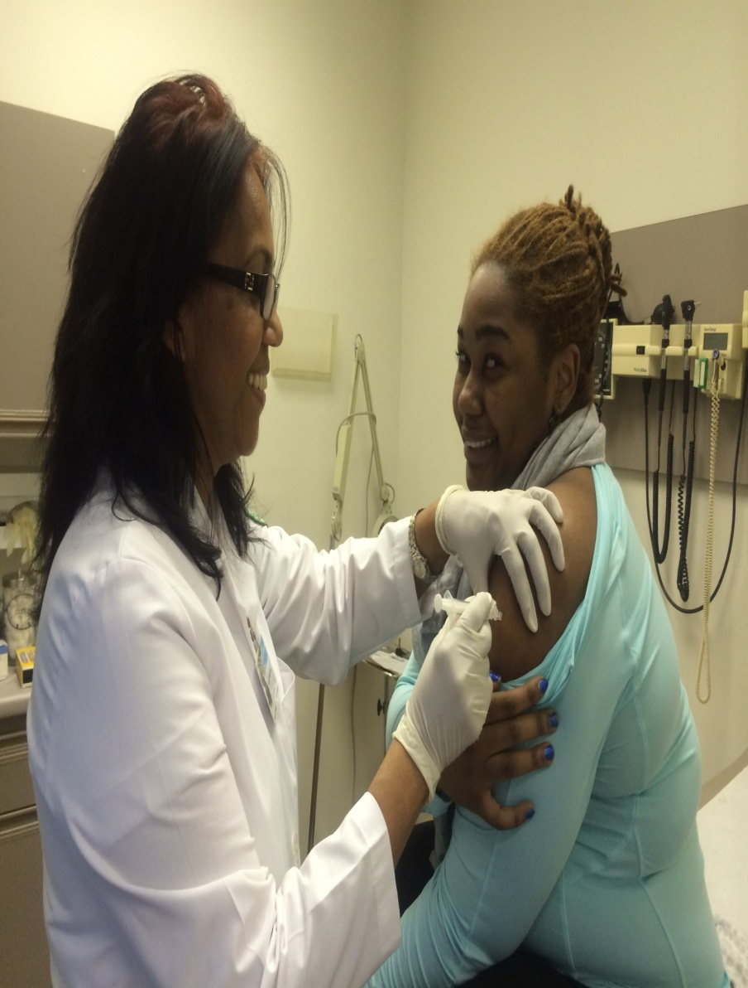
Planning and Implementation
Number of community participants/clients attending:
Health Fair –All nine group members participated in health fair
Number of students who were attended and educated about flu literature – about 50 students
Total number of students vaccinated – 35 students

Slide 25


Planning and Implementation
New York City Department of Health – Provided with all requested poster and brochures about flu
Department of Student Wellness Center of NYCCT – Posting flyers, Flu vaccine, Consent for vaccination from students, and assistance from school nurse providing supplies for administering flu vaccine
Department of Nursing – Nursing faculty assists group members to be able to administer flu vaccine in the student wellness center
Community organizations that provided assistance with project:

Slide 26
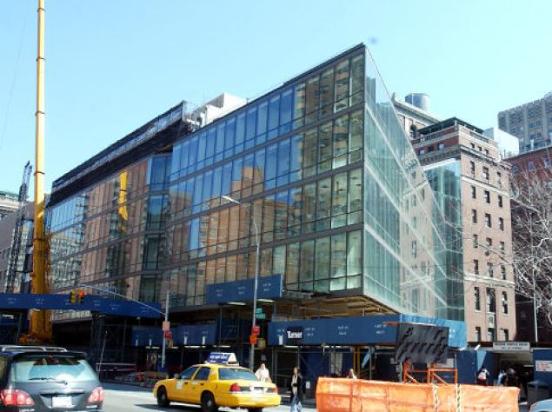
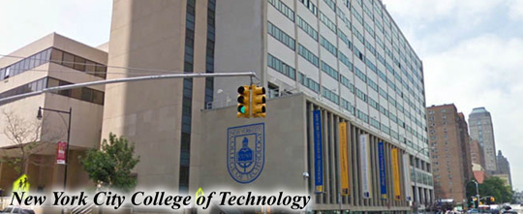
Implementation of Project
We decided to do literature about flu vaccine and to administer flu vaccine at our clinical site Bellevue Hospital. We identified our team leader and team members, then, we outlined our project. Finally, each member was assigned a role and responsibility with interest of each member and area of member’s expertise. Following role distribution, we discussed using blackboard as a way of communication between members about progression of our assigned task and responsibilities. Unfortunately, we did not get permission to implement our project at Bellevue Hospital because of the process to go through as a student nurse to be able to give flu shot at the hospital due to computer documentation.
Second plan was conducted with assistance of our two nursing faculty (our lecture and clinical professor) and implemented to carry out on campus. We kept some ideas of our original plan and added some new ideas to our new plan.

Slide 27
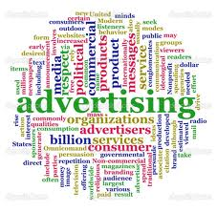
Publicity Attained for Event and Means of Advertisement
Announcements was made in class to our classmates to join our health fair on campus and each member also invited friends from other classes to stop by at our table on campus for our health promotion.
Days before the activity the student wellness center assisting in posting flyers about providing free flu vaccine on campus.
Our team members were also actively gone around the area that most students gather like cafeteria to educate students to get vaccinated.

Slide 28
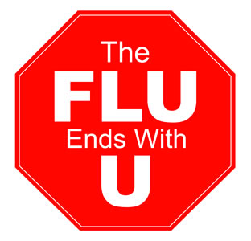

Activities Presented
On the day of the health fair, we choose to set up table on the hall way of the ground floor / first floor that we thought a lot of students pass by and close to elevator that most students would use. We split two groups for two days of the health fair at school. The first group with group members of four on first week, two did the literature on the ground floor of the school and two were given the flu shot at the student wellness center
On second week, five students participated in the health fair. Three students participated in literature and two students involved in vaccinating students. Team members who involved in literature section made sure our fellow students got facts and myths about flu and more students to get vaccinated. Team members who involved in giving vaccine also answered all concerned questions about flu from students who got vaccinated and explained what they would feel after vaccination.

Slide 29

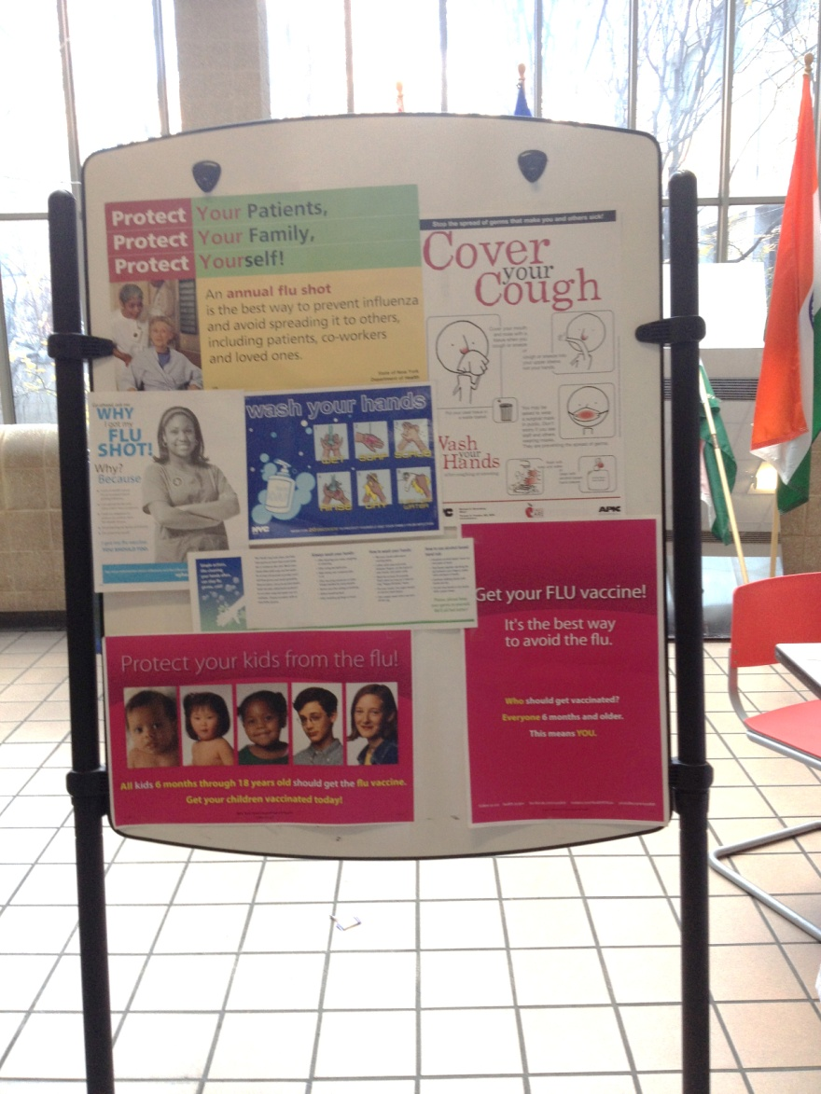
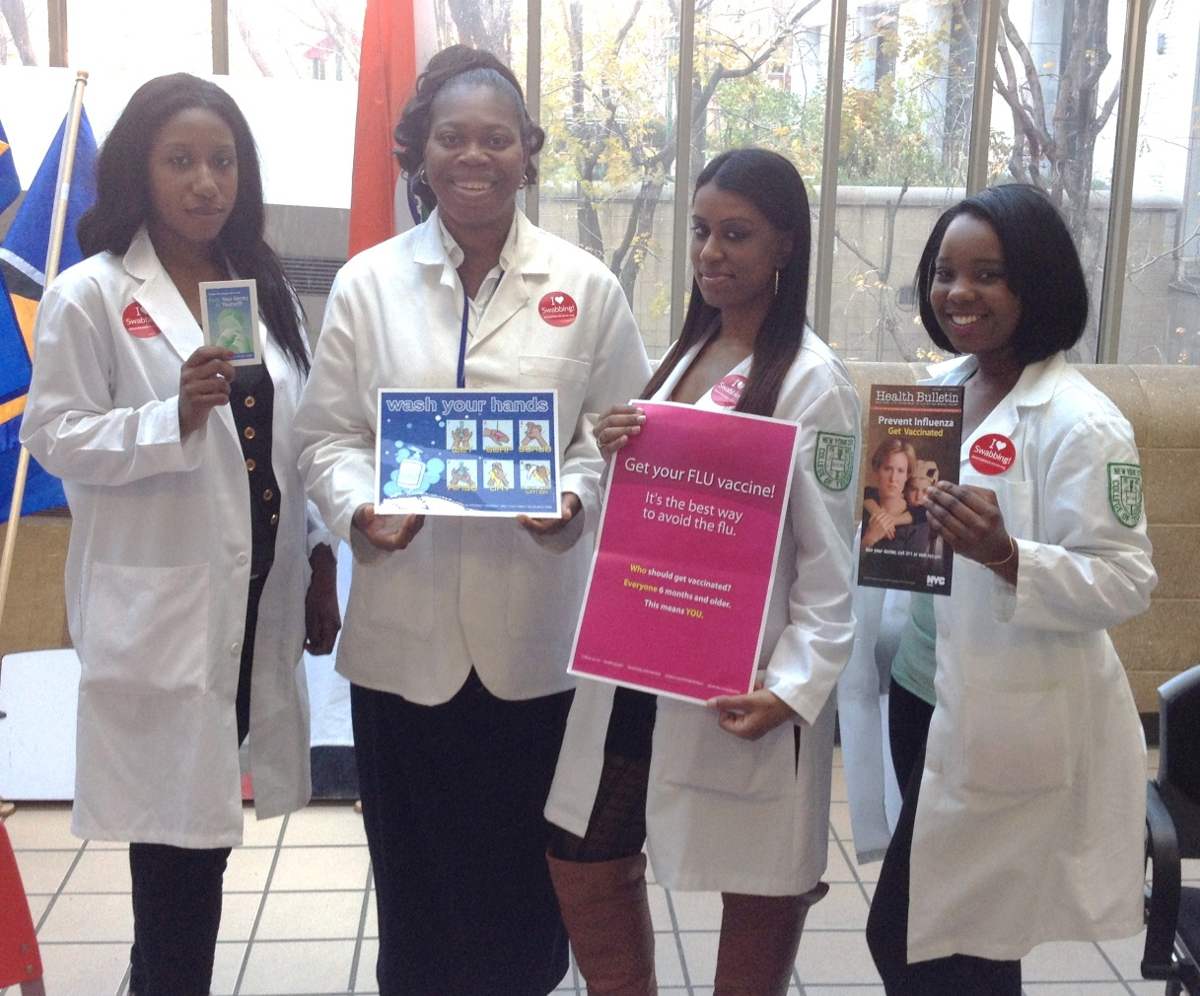
Flu Vaccination Fair

Slide 30
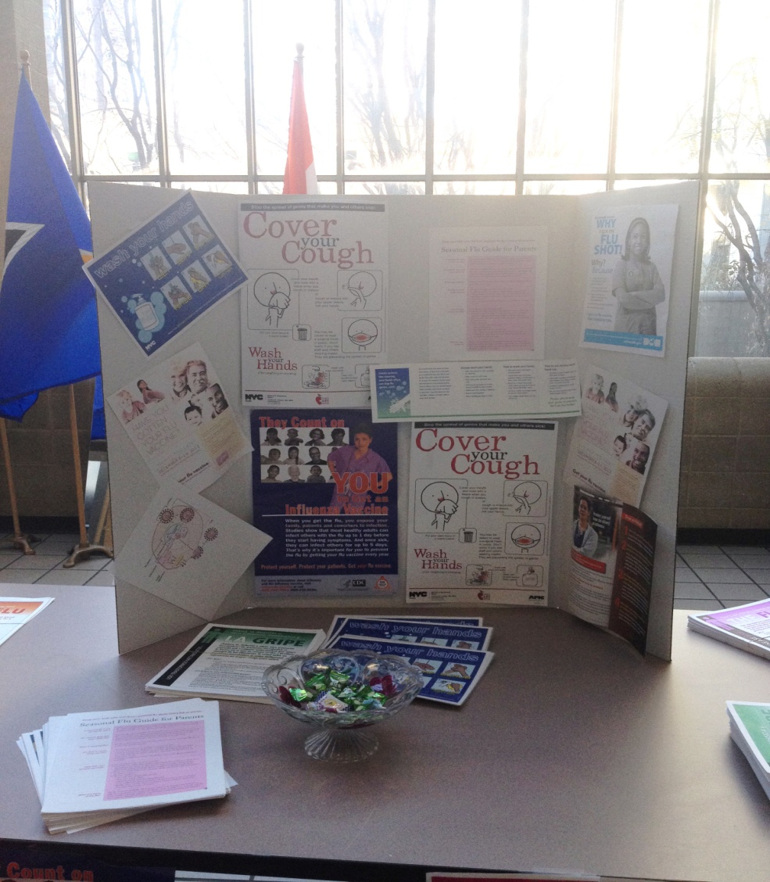
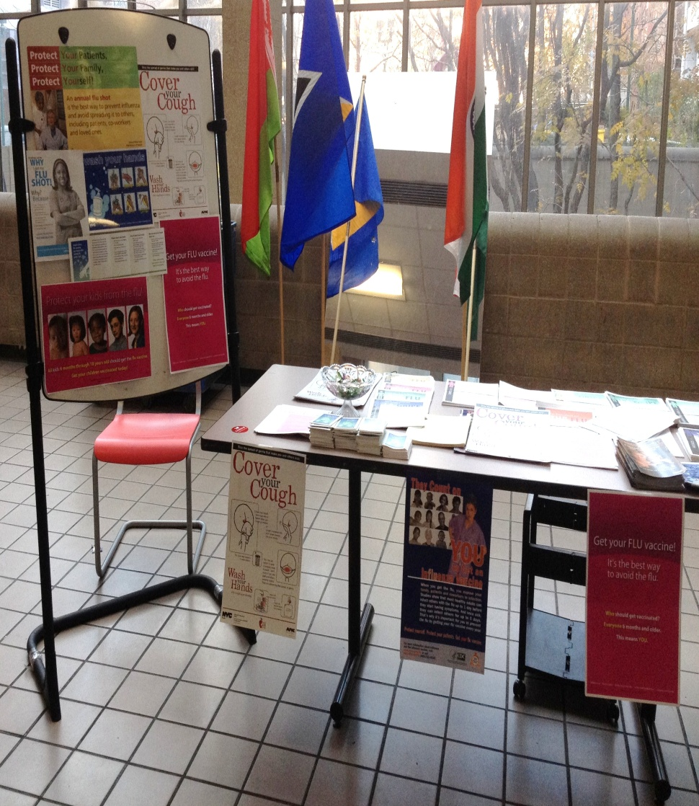

Slide 31


Cost of Project
Binder – donated by Alison Miller
Divider – donated by Tina Miller
Cost of copy and photo paper – donated by Sabrina Azeez
Stationary and give away sweets- donated by Christina Ming
Other accessory cost – donated by other team members

Slide 32

Ev
The goals of our project were to encourage as much members of the community as possible to get the flu vaccine. We wanted to ensure community members were well informed on what the influenza virus is as well as the signs and symptoms..
2. We also wanted to dispute any myths about the flu vaccine such as getting vaccinated will lead to you getting sick or experiencing side effects.
3. Overall we wanted to educate the community members the flu vaccine is safe and recommended for everyone over 6 months of age. It is highly recommended for individuals with chronic diseases such as diabetes, respiratory diseases, kidney disease and liver disease as catching the flu will exacerbate these conditions

Slide 33
Collaborative Process
Collaborative Process
Collaborative Process
Collaborative Process
Our collaborative process for achieving our goals includes a comprehensive assessment of the community. The priorities we identified for the community were diabetes, HTN, mental illness, cancer, obesity, substance abuse, health literacy and HIV/AIDS/STDS.
From the data we gather from our research we decided to conduct a flu fair educating the community on the importance of getting vaccinated. Our methods to accomplish our goals were by providing the community with flyers, brochures and pamphlets on the benefits of getting vaccinated and methods on preventing the spread of the flu.
We provided these flyers, brochures and pamphlets in multiple languages to accommodate the multiple diverse cultures residing within the community. Prior to our flu fair date we posted flyers and posters around the area.
We contacted well known companies for products we could share out to the community. Johnson and Johnson for hand lotion, Kimberly Clark Professional for tissue packs and pure hand sanitizes.

Slide 34

Goals accomplished:
The community members were effectively educated on the benefits of receiving the vaccine. We provided the community with resources on how to prevent the spread of the virus and recognizing the symptoms of the flu.
We successfully vaccinated 26 students at NYCCT

Slide 35


Benefits of Project to Community
Benefits of Project to Community
Benefits of Project to Community:
The benefits of our project to the community were providing the community with resources and information about a preventable otherwise lethal virus. In worse cases influenza leads to pneumonia which can be fatal. The flu vaccine protects against three strains of viruses that cause influenza. We provided individuals without any medical insurance the opportunity to get vaccinated.

Slide 36

References
Drewnowski, A and Specter, SE. (2004). Poverty and obesity. The role of energy density and energy costs. American Society for Clinical Nutrition. Retrieved from http://ajcn.nutrition.org/content/79/1/6.full
Greene, C. (2011) Summary Of Vital Statistics 2010 The City Of New York. New York City Department of Health and Mental Hygiene. Retrieved from http://www.nyc.gov/html/doh/downloads/pdf/vs/vs-population-and-mortality-report.pdf
Kim M, Berger D, Matte T. (2006). Diabetes in New York City: Public Health Burden and Disparities. New York: New York City Department of Health and Mental Hygiene. Retrieved from http://www.nyc.gov/html/doh/downloads/pdf/epi/diabetes_chart_book.pdf
N.a. (2013). Bariatric Surgery and Weight Management. The City of New York, Bellevue Hospital. Retrieved from http://www.nyc.gov/html/hhc/bellevue/html/services/weight-management.shtml
N.a. (2004). Death Rate From Obesity Gains Fast On Smoking. New York Times. Retrieved from http://www.nytimes.com/2004/03/10/us/death-rate-from-obesity-gains-fast-on-smoking.html
N.a. ( 2012) New York State Department of Health, New York State Cancer Registry Cancer Incidence and Mortality by County and by Gender, 2006-2010 New York(Manhattan). NY Health. Retrieved from, http://www.health.ny.gov/statistics/cancer/registry/pdf/volume1.pdf
N.a. (2013). Environmental Public Health Tracking. NYC Health. Retrieved from http://a816-dohbesp.nyc.gov/IndicatorPublic/QuickView.aspx
The Flu. (2010). Retrieved from Yew York States Department of Health Poster, November, 2010. Irwin, B.J., Rrnoldsussen, J.A., Burckhardt, J.A., Dobish, B., Finesilver, C., Mahoney, E., Redemske, M. (2010). The RN Course Book: Kaplan Nursing (13th ed.).
Influenza (2009). Retrieved from flyer and http://www.nyhealth.gov on November 12, 2013

