Slide 1
Crown Heights Brooklyn, NY
Aleyda Austin

Slide 2
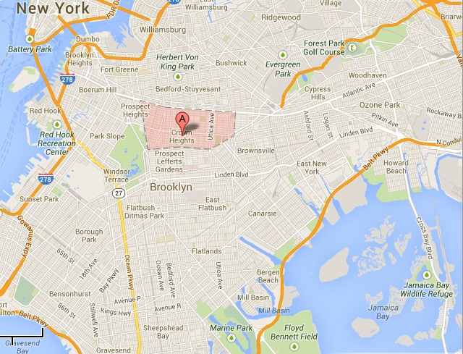

Slide 3
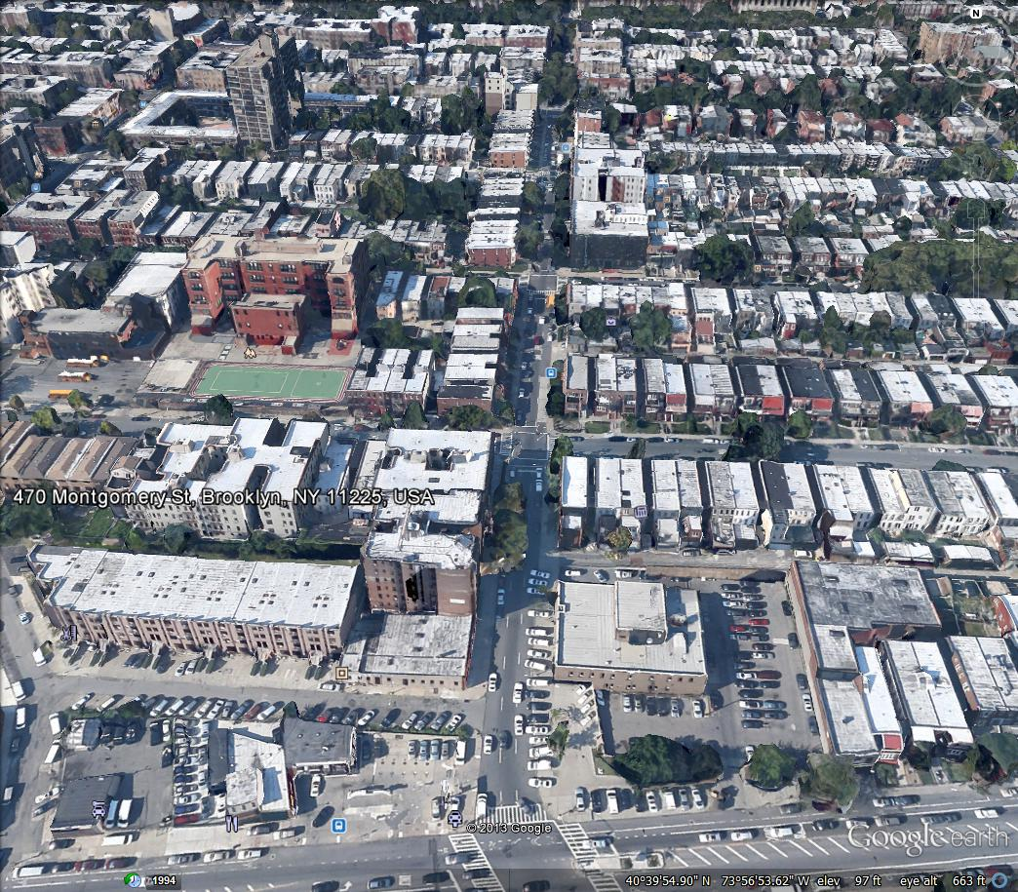

Slide 4
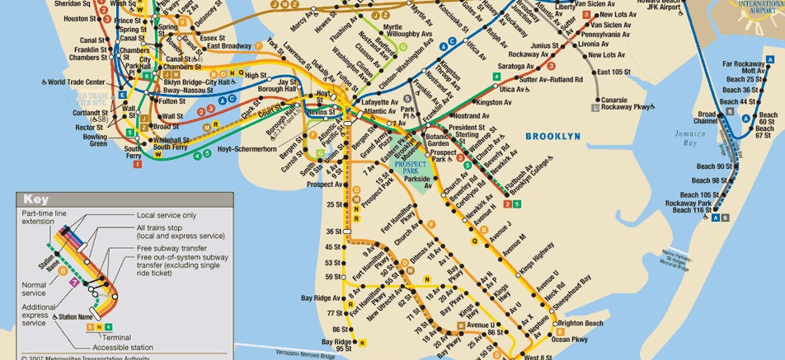

Slide 5
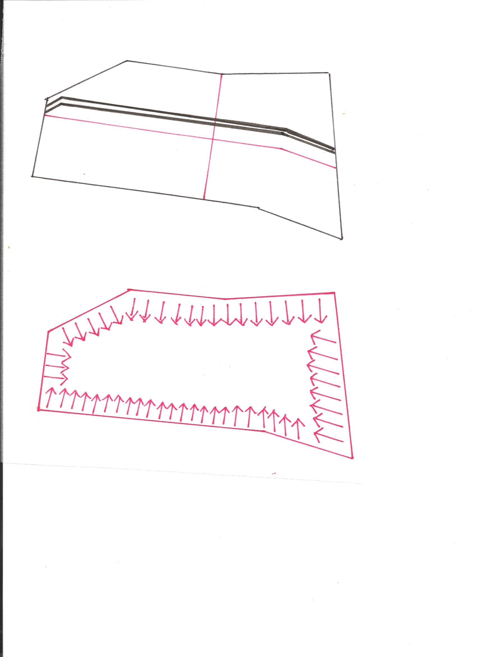
BOUNDARIES

Slide 6
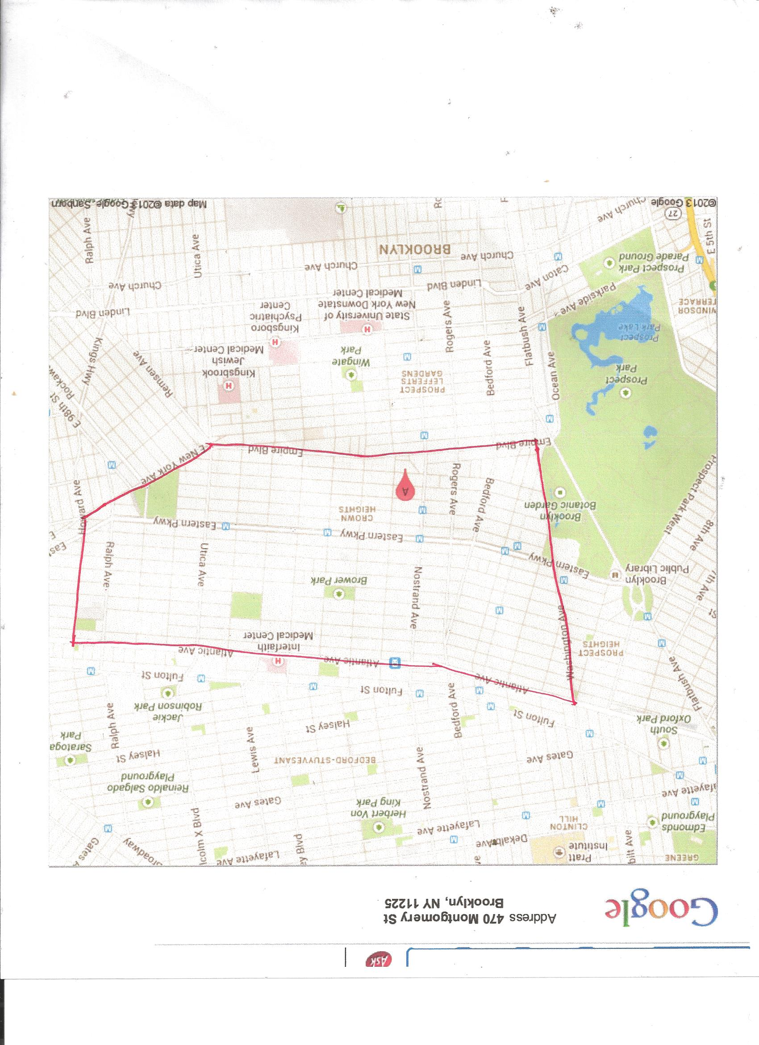
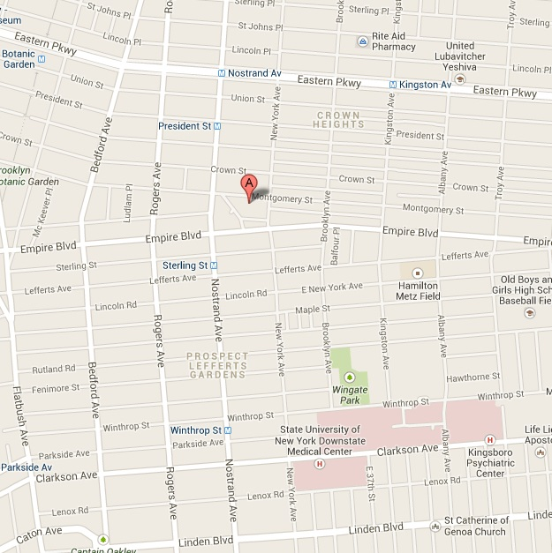

Slide 7
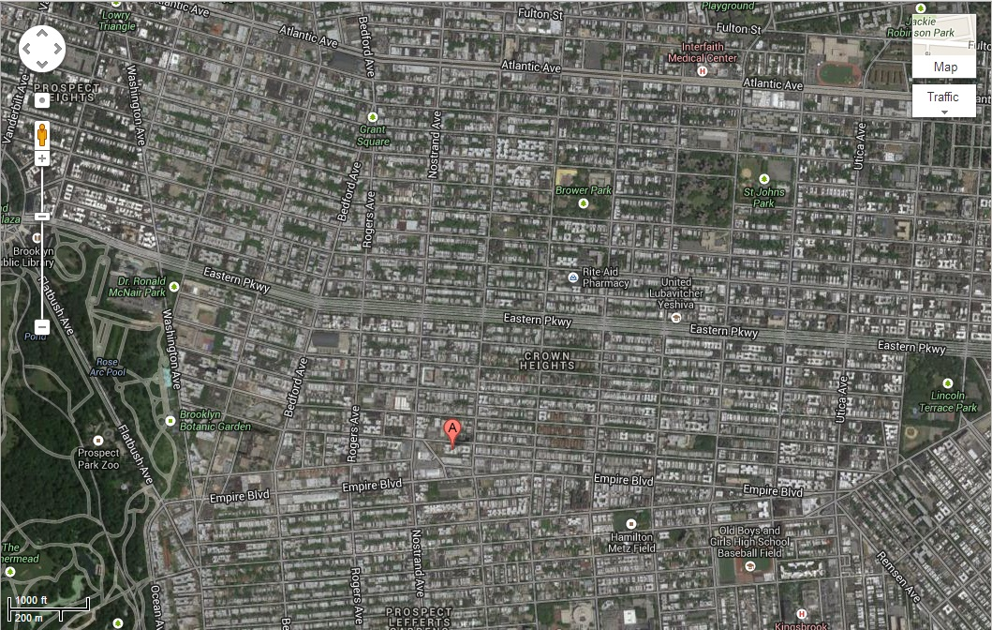
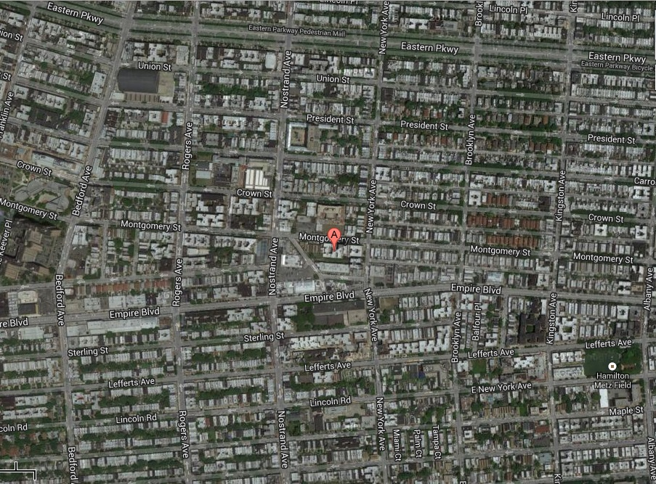

Slide 8
CENTER

Slide 9
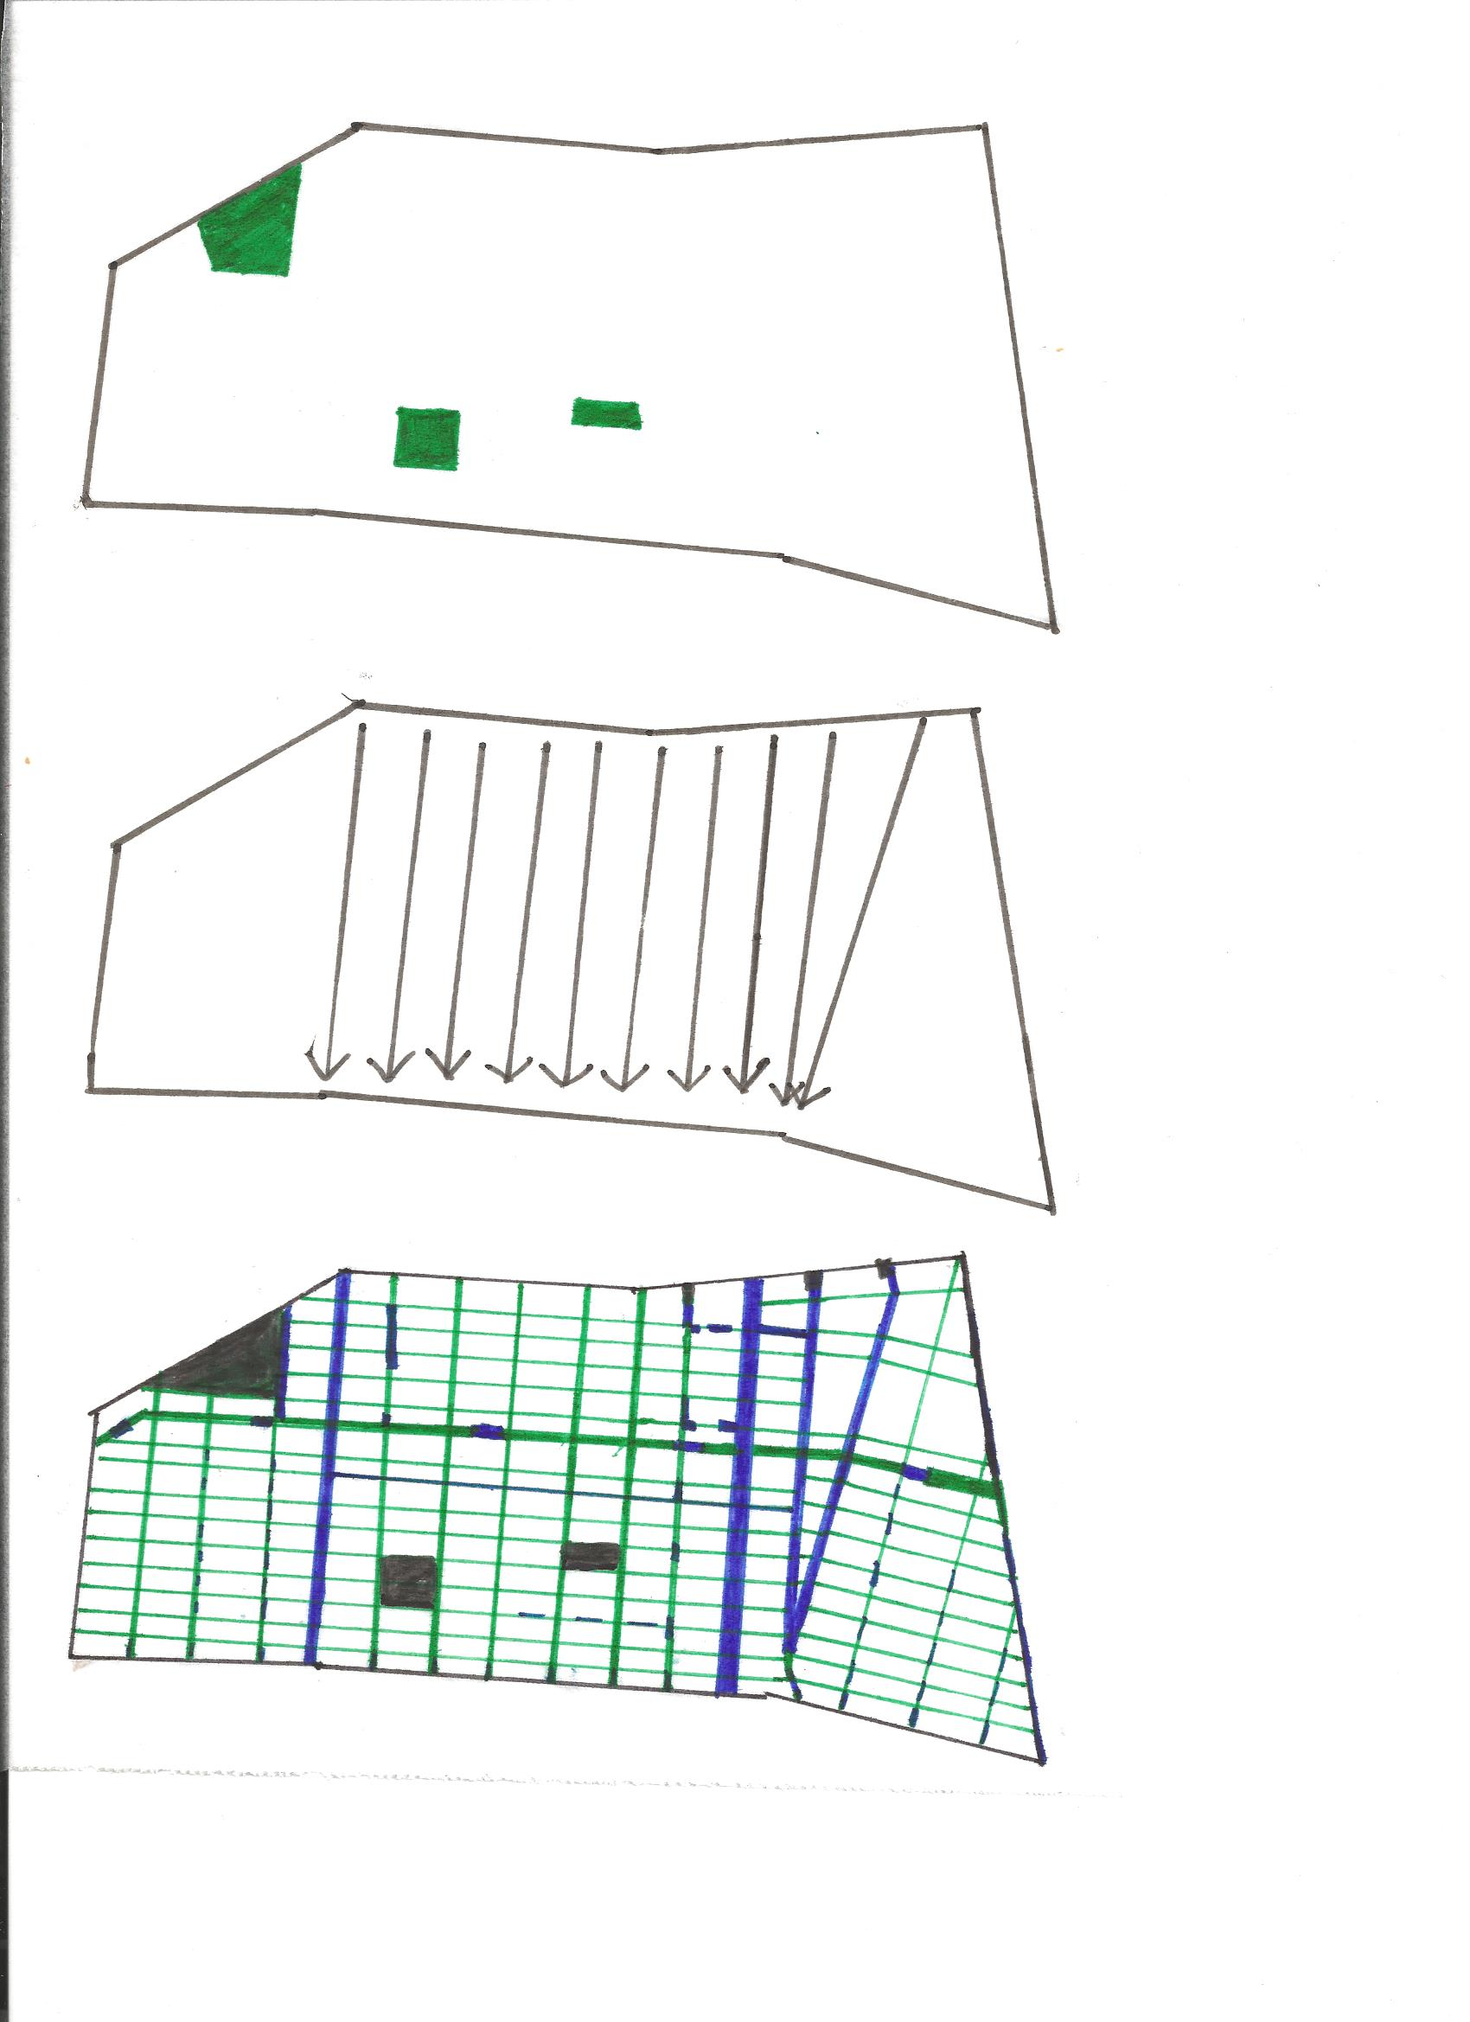
HOUSING TYPES

Slide 10
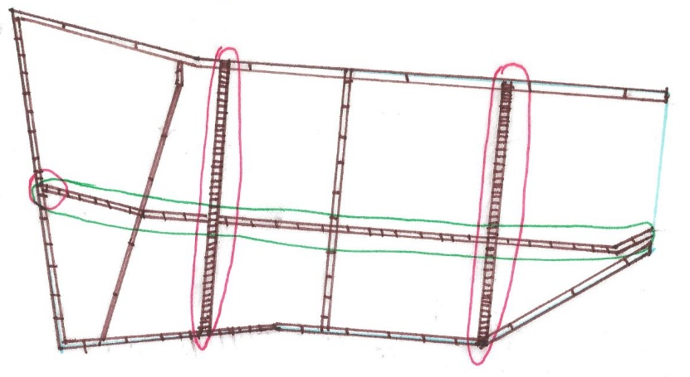
KEY ROADS

Slide 11
TOPOGRAPHY

Slide 12
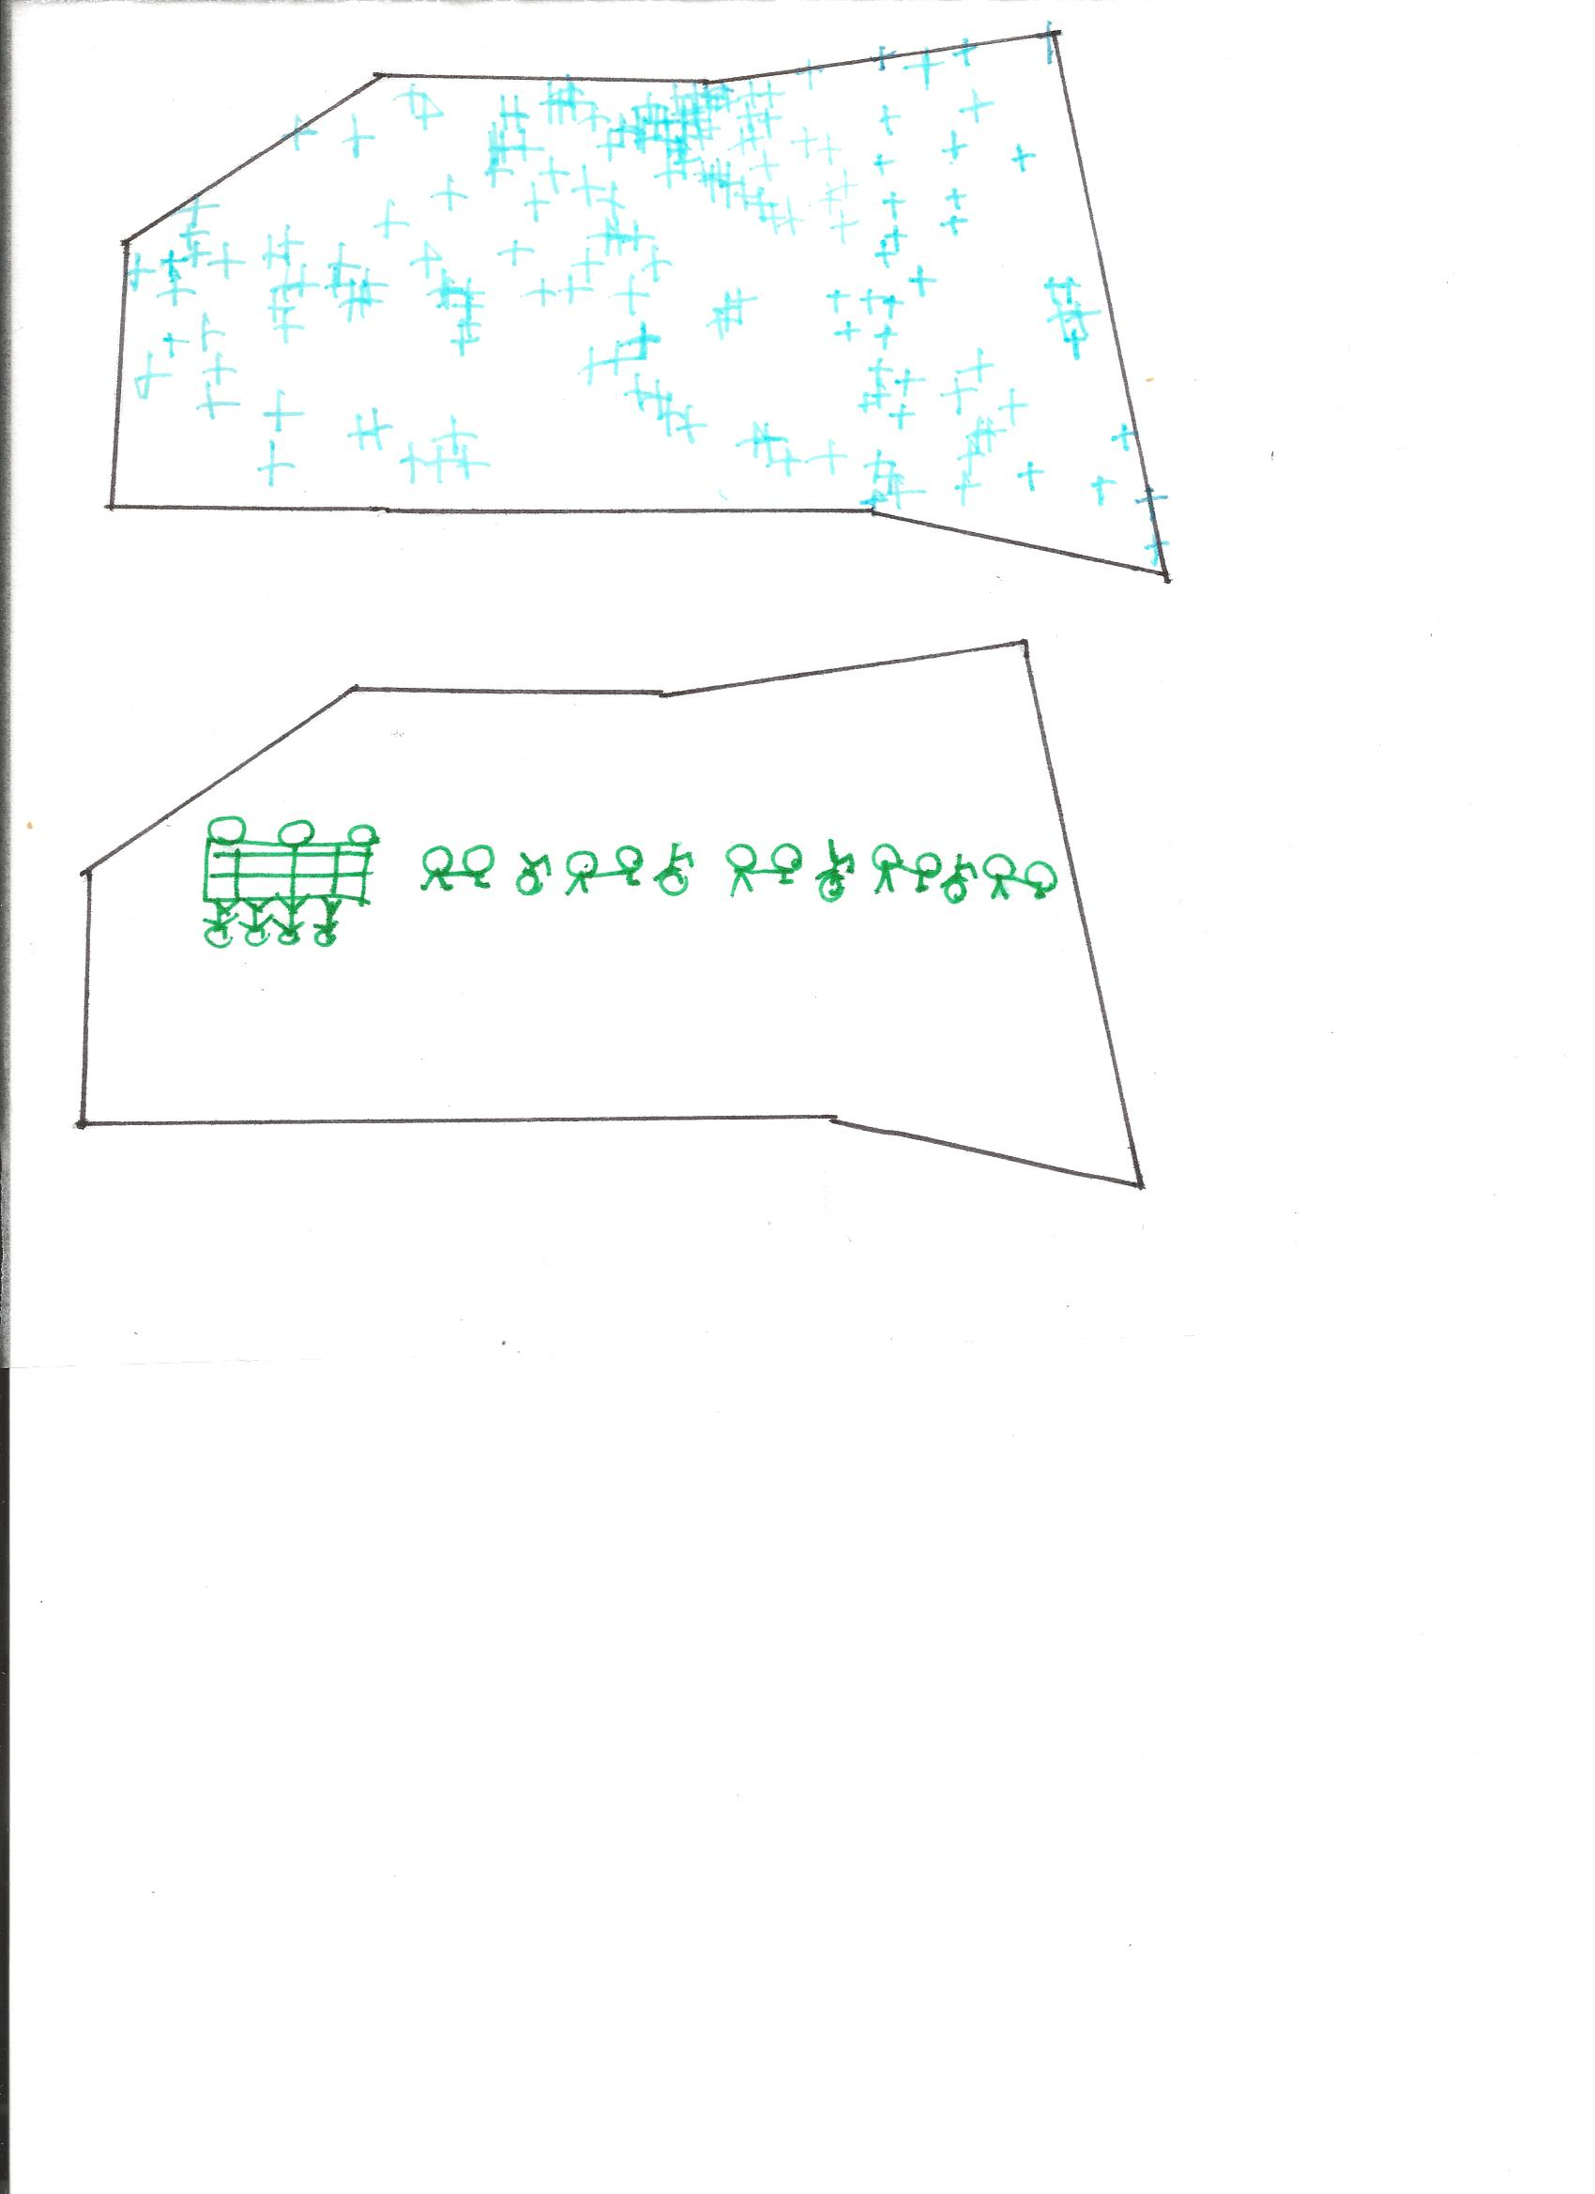
RELIGION

Slide 13
GREEN/PARKS

Slide 14
RELATIONS/CONNECTIONS

Slide 15
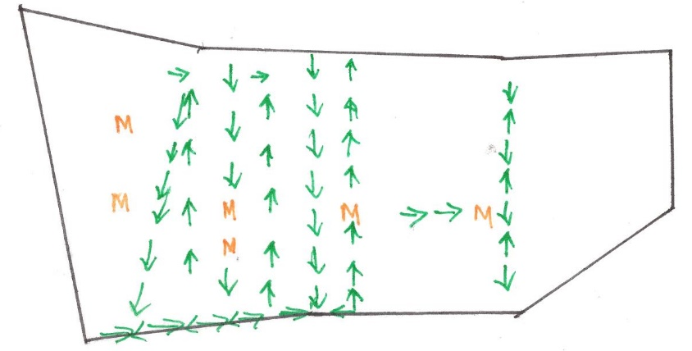
TRANSPORTATION

