Slide 1
Welcome to
Staten Island
I don’t think we’re in Brooklyn anymore..

Slide 2
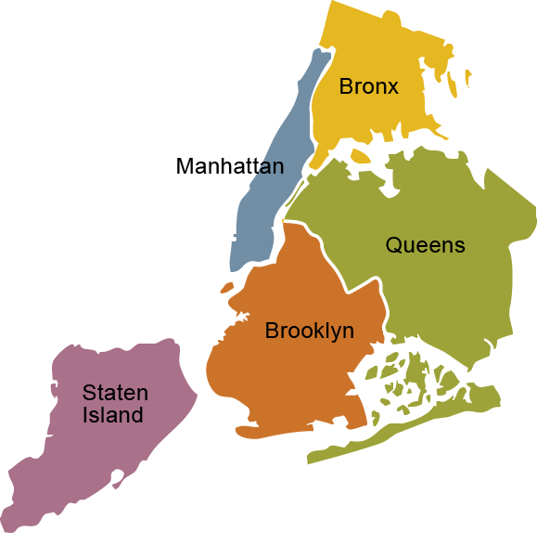

Slide 3
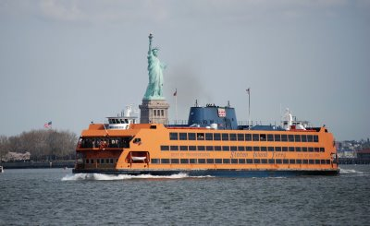
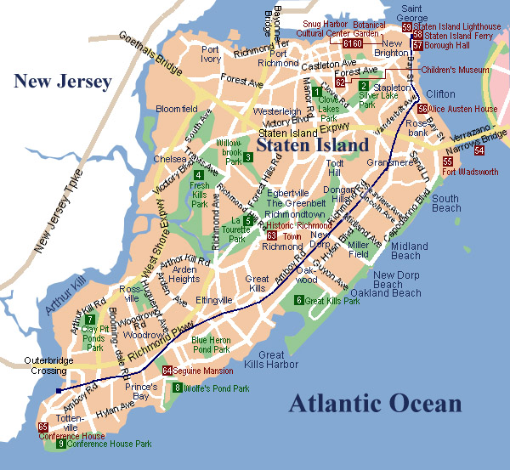
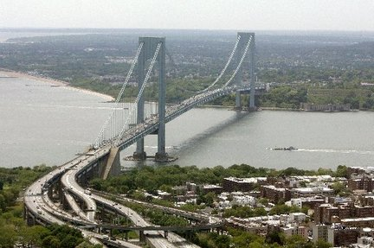
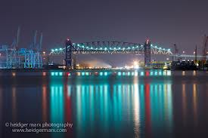

Slide 4
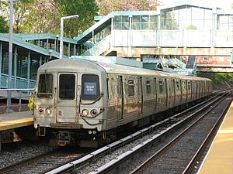
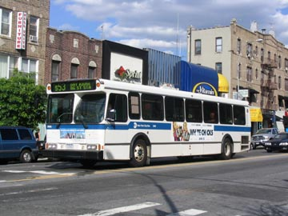

Slide 5
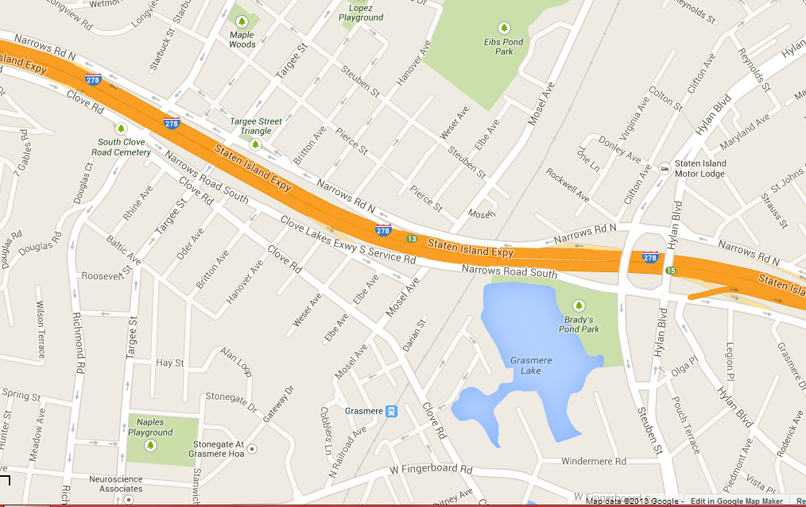

Slide 6
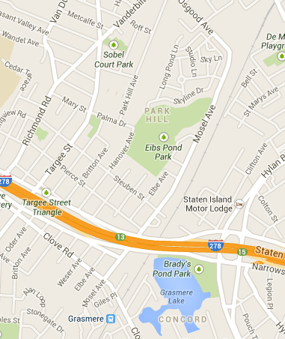
+5
+10
+20-30

Slide 7
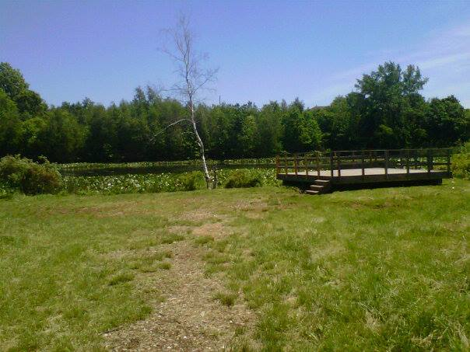

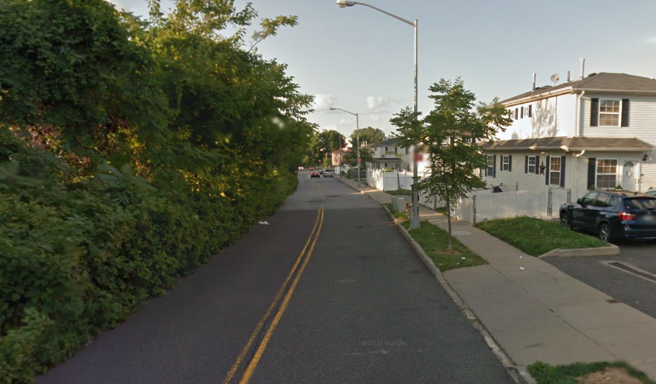
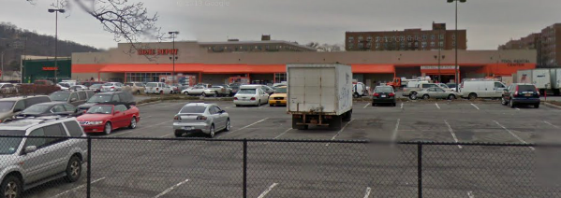
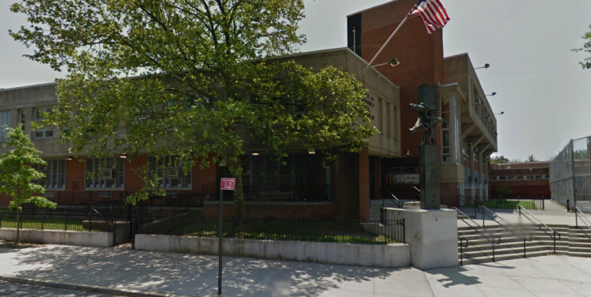
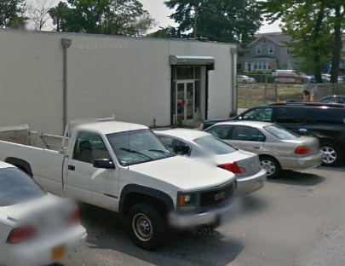
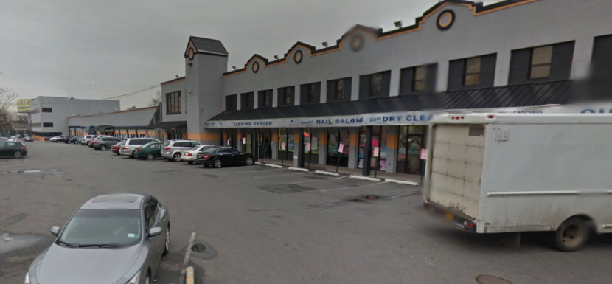
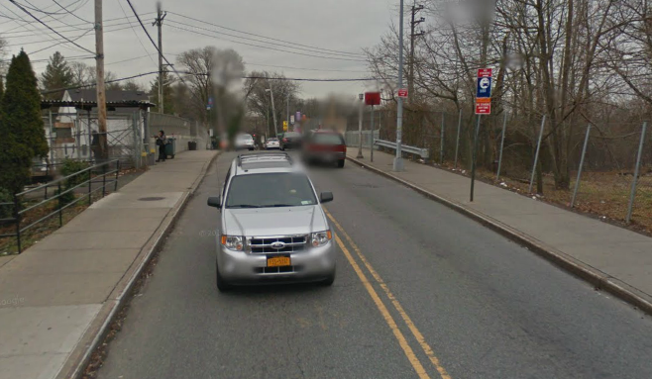
What can I do after walking 5 minutes ..
10 minutes ..
20+ minutes ..

Slide 8
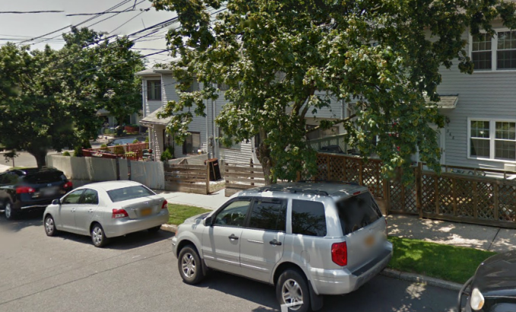
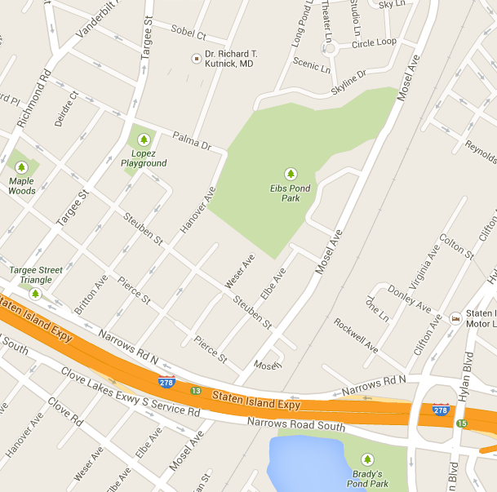
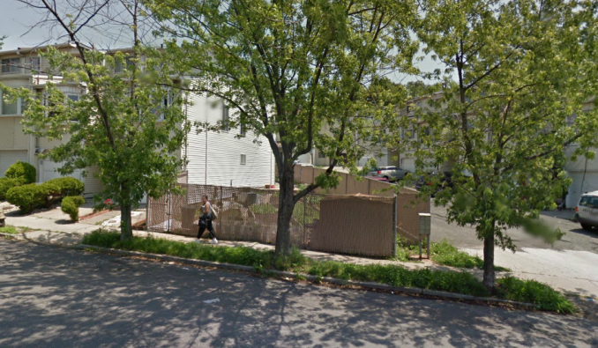
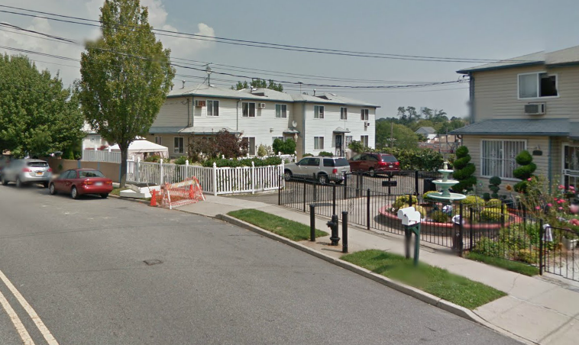
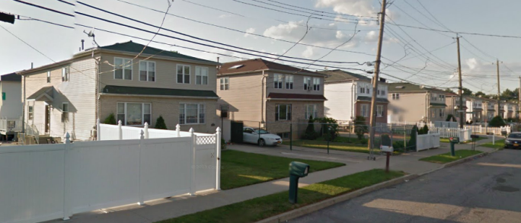
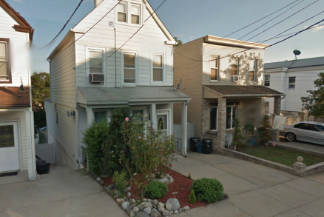
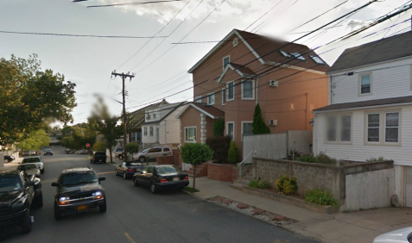
Average age: 30-50
Major Ethnicity: Italian American
Fact: 60% of these home owners grow vegetation in their yards
Average age: 3o+
Major Ethnicity: N/A
Average age: 30 +
Major Ethnicity: Latin American
Fact: 20% of the homeowners in this development own a taxi cab
Average age: 40+
Major Ethnicity: Asian American
Fact: 40% of these home owners live with or beside a family member

Slide 9
Fin.

Slide 10
Photo credits
Slide 1
abbietastic.blogspot.com
Slide 3
sipoor.pbworks.com
panys.org
Slide 4
sipoor.pbworks.com
www.bridgeandtunnelclub.com

