Slide 1

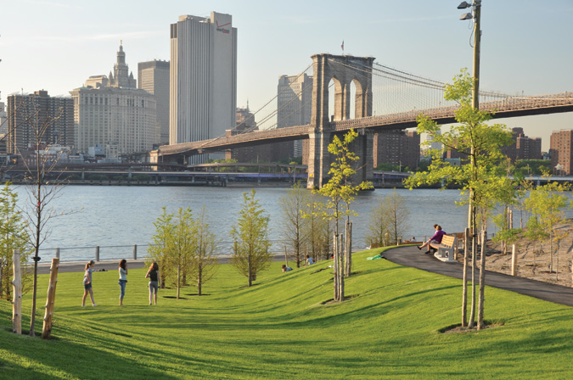
Fort Greene

Slide 2


1
  Community Services
Schools in the Fort Greene community are Benjamin Banneker Academy, Brooklyn Community Arts and Media High School, and P.S. 020 Clinton Hill.
There is a Brooklyn Community Board 2 located on 350 Jay St where public meetings and hearings are held, information about the local Brooklyn government, and the elected officials are located in Brooklyn.
Community groups are PAL Head Start Program, Brooklyn Women’s Anti-Rape Exchange, and Services for the Underserved Home Care Service. Places to hang or meet are the Clinton Hill Library and the Brooklyn Academy of Music. Yearly community events that occur in Fort Greene are The Brooklyn Flea and the Halloween Walk.

Slide 3
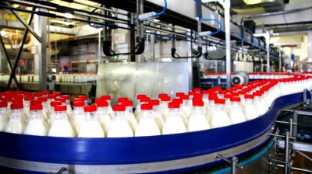
2
  Environment
In the Fort Greene environment the air quality is 92.44% which is classified as good air quality. The Fort Greene area is in the the Northeast region of the Middle Atlantic located in the Metropolitan area in the Kings County of Brooklyn, New York. The factories located in the Fort Greene is the Milk Factory which primarily operates in the Diary Product and The Chocolate Factory.
Notes:
Although during slavery it was prohibited for this culture to practice their traditions, African-Americans managed to keep their beliefs, customs and practices alive.
traditions were transmitted from generations to generations through story telling rather than through written information

Slide 4


3
  Health Services
The health services located in Fort Greene are the Angel Guardian Home (Community Health Info and Referral Center), Brooklyn AIDS Task Force, Brooklyn Plaza Medical Center, Classon Medical and Dental, HeartShare Human Services, Jewish Board of Family and Children Services, and Counseling and Services to AIDS affected clients Willoughby Settlement House.

Slide 5
4
  Health Disparities
Some health disparities this community is faced with are:
General health
Maternal and child health
Infectious diseases
(including pneumonia, influenza, HIV/AIDS)
Chronic diseases (including heart disease, diabetes,
lung diseases)
Notes:
f one is not in harmony with God it is believed that illness will come as means of punishment

Slide 6
4
  Health Disparities
Major cause of death:
Heart disease
Cancer
Pneumonia and influenza
AIDS
Chronic lung disease
Diabetes
Stroke
Accidents and injuries
Drug-related
Liver disease
Notes:
f one is not in harmony with God it is believed that illness will come as means of punishment

Slide 7
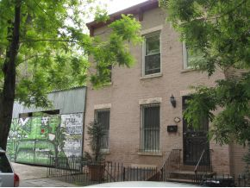
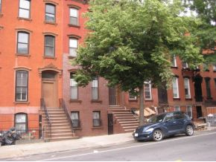
5
  Housing
Housing in this neighborhood are mostly 20 or more units, and was built in 1939 or earlier. The majority of residents here are renting and paying about $1500 or more every month.
Notes:
f one is not in harmony with God it is believed that illness will come as means of punishment

Slide 8
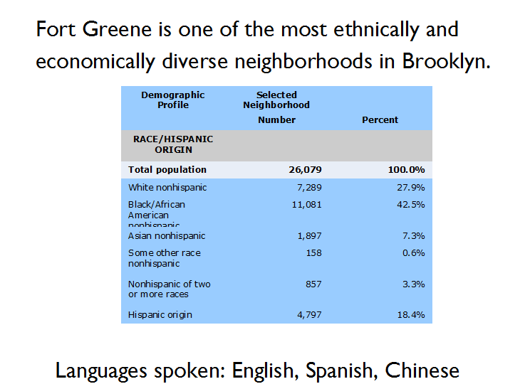
6
  People
Notes:
f one is not in harmony with God it is believed that illness will come as means of punishment

Slide 9

6
  People (Sex and age)
Notes:
f one is not in harmony with God it is believed that illness will come as means of punishment

Slide 10

6
  People (Socioeconomics)
Notes:
f one is not in harmony with God it is believed that illness will come as means of punishment

Slide 11
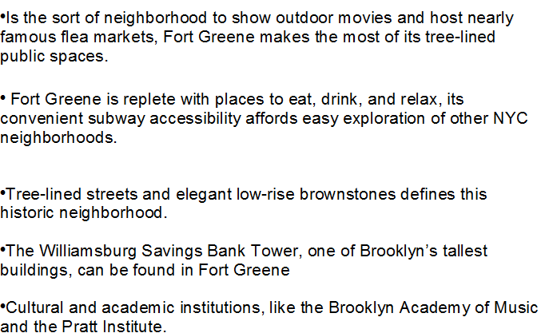
7
  Shopping/ Common Areas

Slide 12
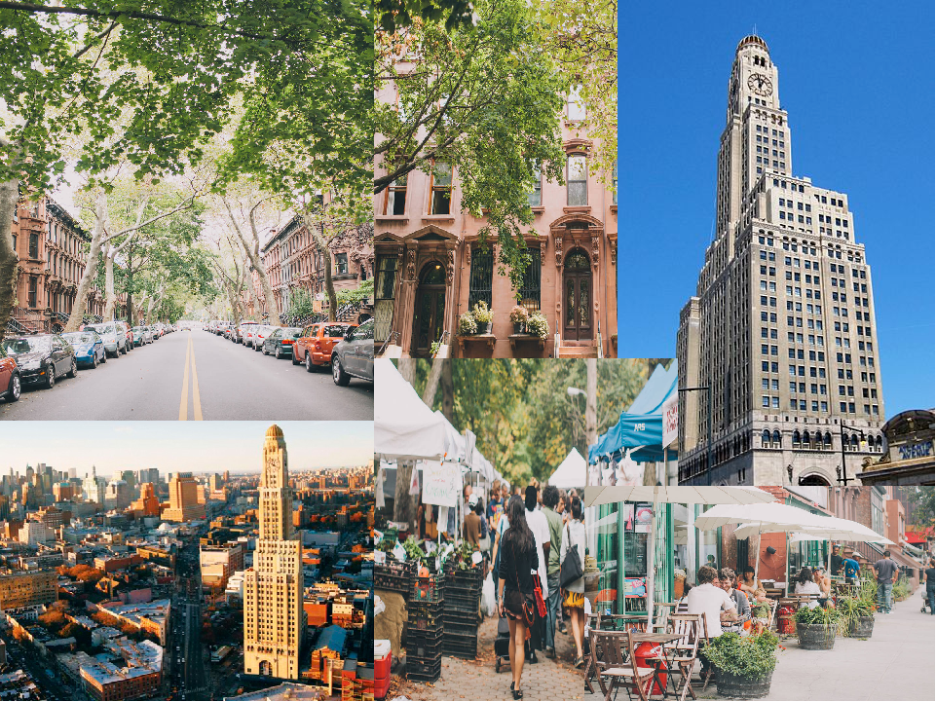
7
  Shopping/ Common Areas
Notes:
especially among females

Slide 13
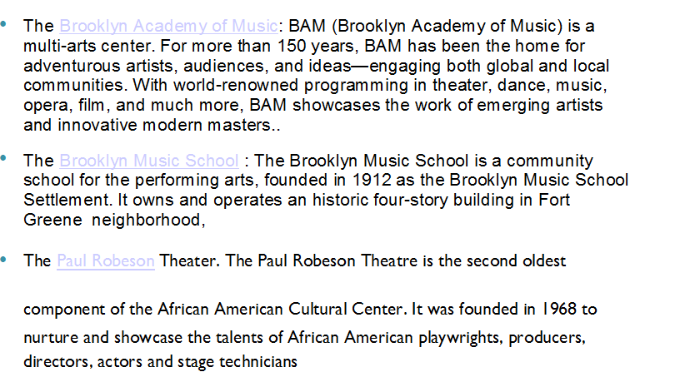
7
  Shopping/ Common Areas

Slide 14
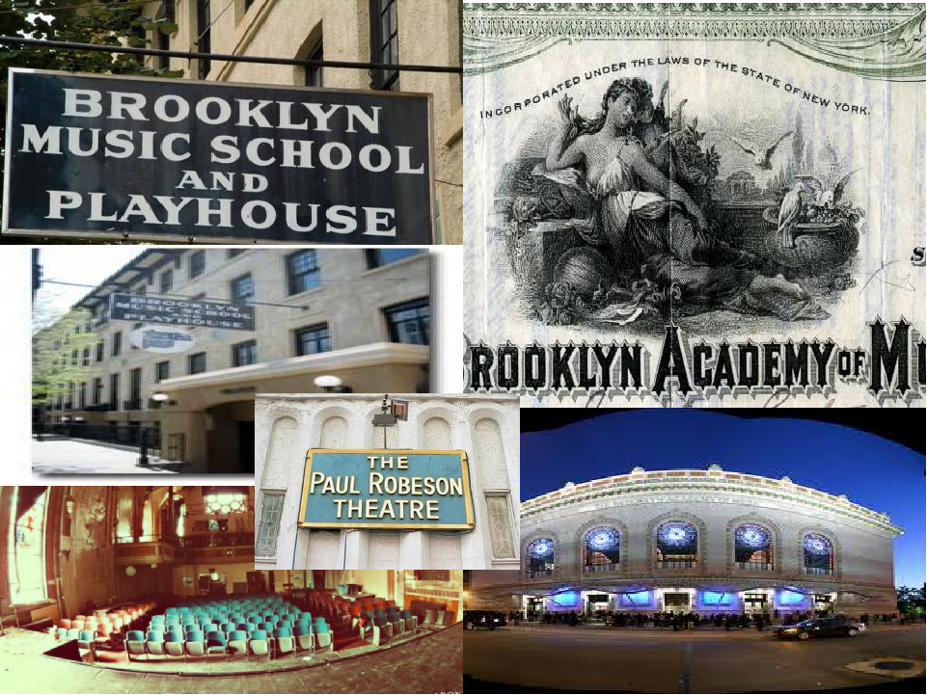
7
  Shopping/ Common Areas

Slide 15
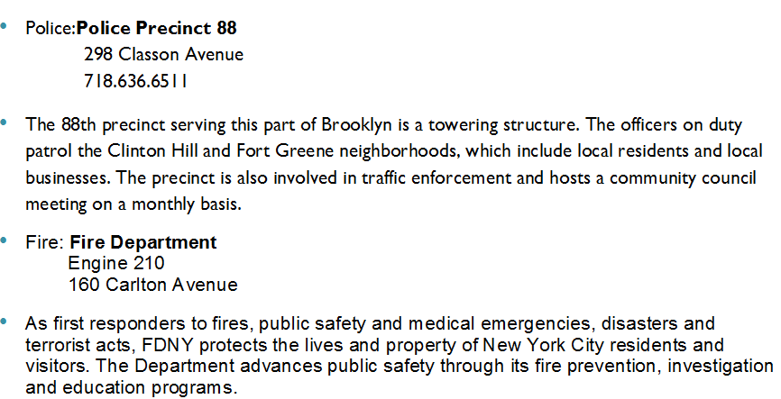
8
  Safety Service

Slide 16
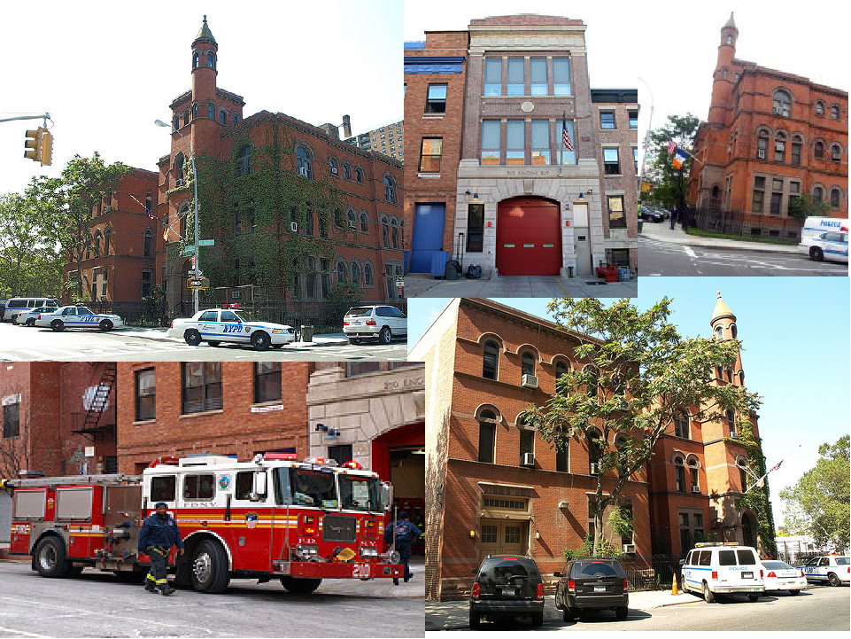
8
  Safety

Slide 17
9
  Transportation
For those living in the western reaches of Fort Greene toward Flatbush Avenue, there are multiple subway options into Manhattan: the B, D, M, N, Q, R, 2, 3, 4 and 5 lines stop full- or part-time at the Atlantic Avenue-Pacific Street and/or DeKalb Avenue stations.
Farther east in the neighborhood, riders on the C line wait 9 to 10 minutes for each train.

Slide 18

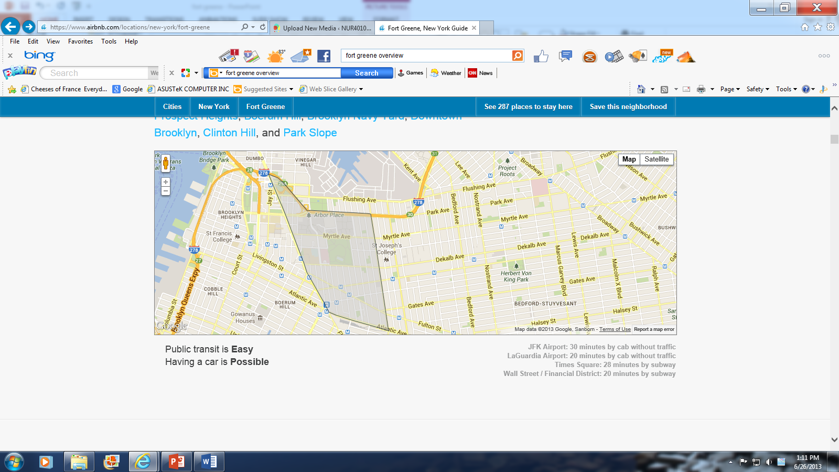
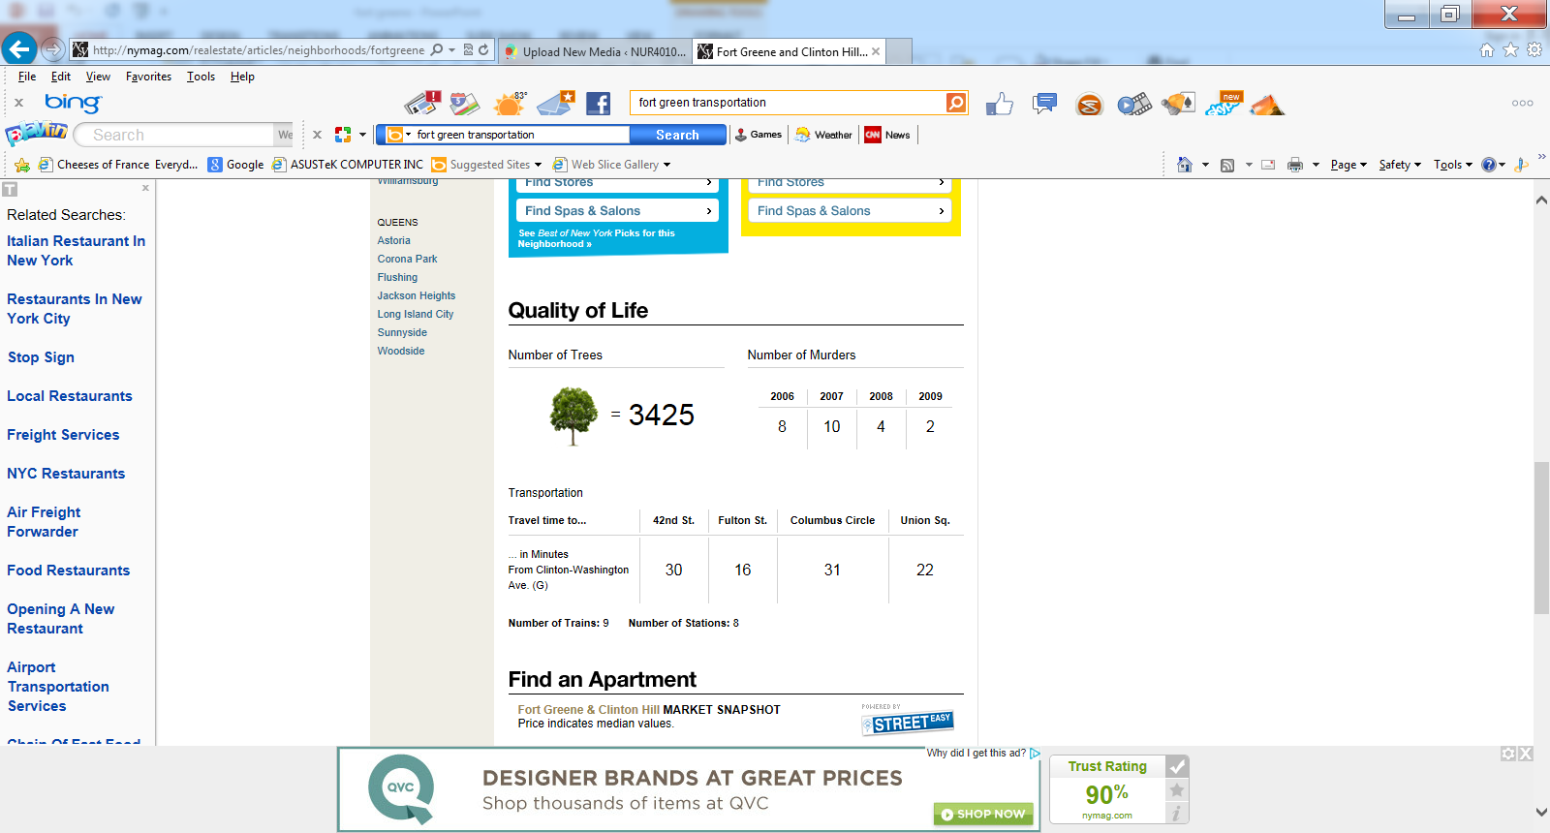
9
  Transportation

Slide 19
10
Overall status of the community
Fort Greene is ever changing historic neighborhood, which over the years has become one of the best neighborhoods to live in New York City.
The historic community of this neighborhood of African American poets, artists, musicians and actors still dominates this historic site. However, over the years what was once considered mostly African American neighborhood has become a true melting pot of cultures and races.
With influx of variety of population Fort Greene has become the place to live with its brownstones and great location.
This neighborhood is home to many restaurants, bars, shopping areas, great schools, good healthcare services, and great sport as well as theater entertainment.

Slide 20
10
Overall status of the community
Fort Greene is conveniently located for those wanting access to Manhattan, its only 20-30 minutes away with abundantly available subway service, specifically Atlantic Terminal, which provides access to NYC Transit and Long Island Rail Road.
Access to healthcare is also just minutes away with Brooklyn Hospital servicing this community.
Education is readily available with Long Island University campus conveniently positioned on the west side of Fort Greene.
The neighborhood has also become one of the safest in Brooklyn, a far cry from what it use to be with its famous Myrtle Ave that was once called the “Murder Ave.”
As this neighborhood grows the standard of living and modernization is improving drastically while still maintaining its historic roots, this is what makes Fort Greene great.

Slide 21
11
Areas of Strengths and Weaknesses
Strengths
Great location.
This neighborhood is multicultural and multiracial where cohesiveness and pride are like nowhere else.
Access to healthcare, education, public transportation, entertainment, shopping centers and restaurants all within a close proximity and a walking distance.
The neighborhood has become of the safest in NYC over the past 10 years. Many famous residents like politicians, actors, musicians and writers reside here.

Slide 22
11
  Areas of Strength and Weaknesses
Weaknesses.
With its changing environment and great location, the prices of housing has sky rocketed over the last 10 years.
Many of the homes, that were once affordable to middle class resident are now only affordable by those of upper class due to the rising prices on real state. This forces the lower and middle class residents to look elsewhere for housing.
Many historic small businesses are forced to close due to rising rent prices. This takes away from the historic value of what Fort Greene was built on.

Slide 23
12
  Nursing Interventions
Two ways in which the role of the CHN may help to maximize the health of the community are:
Make sure people have access to proper health care and insurance coverage
Provide cancer screening and other preventive services to the people of the community.

Slide 24
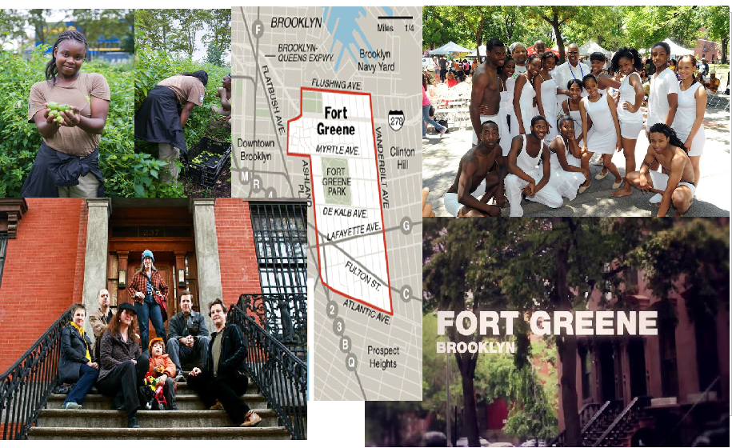
Fort Greene

