Slide 1
City Tech 101
Fall 2024
Professor Perreira
Professor Email: gperreira@citytech.cuny.edu
City Tech 101 by Karen Goodlad and Sarah Paruolo is licensed under a Creative Commons Attribution-NonCommercial-ShareAlike 4.0 International License.

Slide 2
Wrapping Up and Looking Ahead
Session 10
11/5/24
Professor Perreira
City Tech 101 by Karen Goodlad and Sarah Paruolo is licensed under a Creative Commons Attribution-NonCommercial-ShareAlike 4.0 International License.

Slide 3
Faculty Note:
The activities on the following slides are optional. You may use them as activities for all or part of this session if your liaison-led activity does not extend into Session Ten.
If you use the following activities, you may want to review the slides from Session Six on setting goals at the start of class, since the following activities build on those concepts.
Please see the CT101 faculty handbook for more suggestions for activities for this session!

Slide 4
Today’s Topics
Creating an Action Plan
Hello, Future Me

Slide 5
Action Plan for the Semester

Slide 6
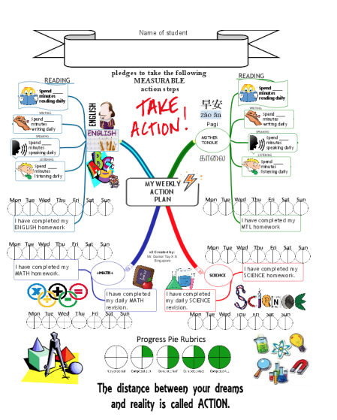
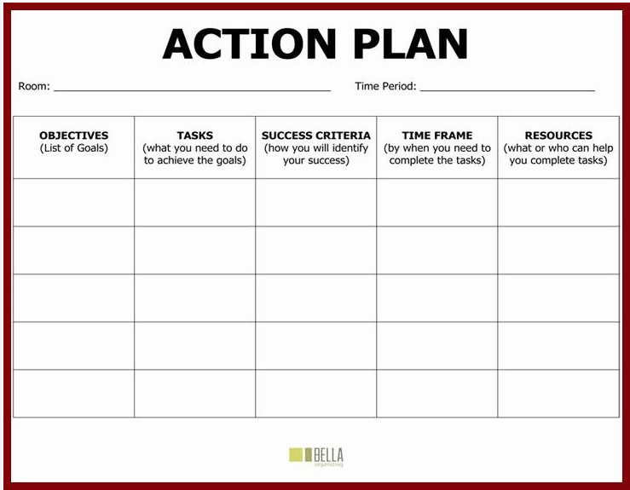
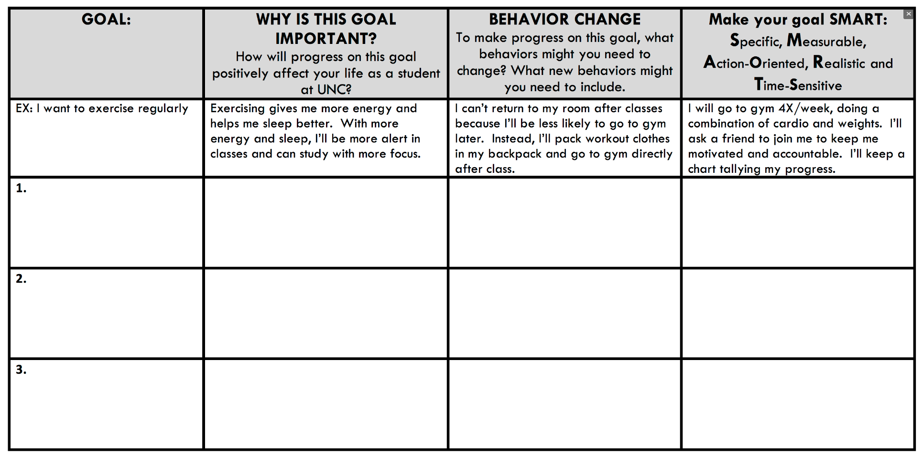
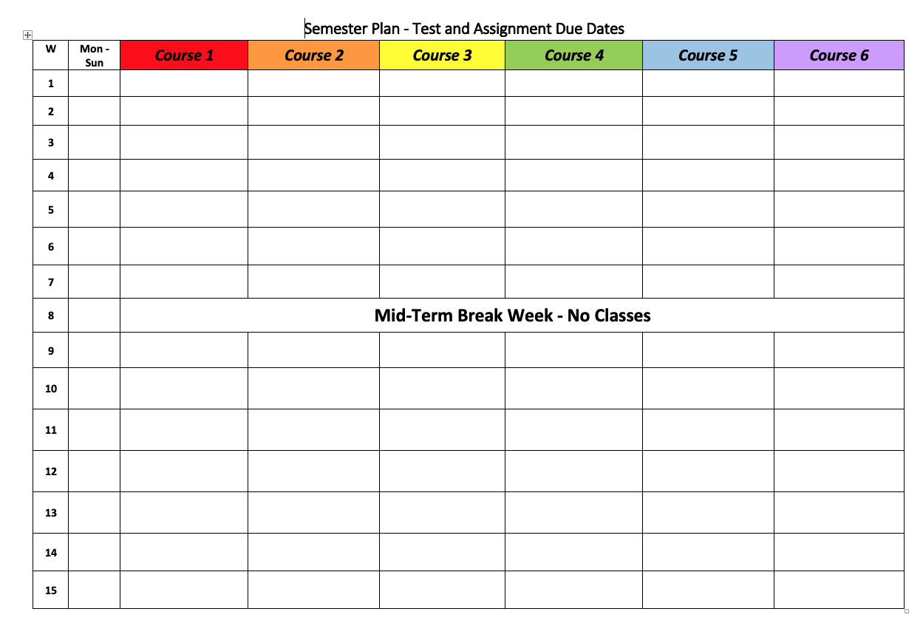
Creating an Action Plan
What does an Action Plan look like?
There is no one correct way to make an Action Plan
They can look like calendars, lists, charts, maps…the possibilities are endless!
Pick what makes the most sense to you

Slide 7
Creating an Action Plan
What should you include?
SMART Goals
Practical Scheduling
Means to achieve your goals
Concepts you have learned in CT101

Slide 8
Creating an Action Plan
What do you need to prepare before the first day of the semester?
What do you want to accomplish by the end of week one? Week two? Week eight? Week fourteen?
How will you manage your energy and time to accomplish these goals?
How will you motivate yourself?
How will you assess your progress during the semester?
How will you evaluate your Action Plan throughout the semester?
What will you do when parts of your plan are not working as you hoped?
How will you get support when you need it?
What will get you over the finish line?

Slide 9
Hello, Future Me
OPTIONAL ACTIVITY 2: insert slides 48-49 after slide 39

Slide 10
Activity: Hello, Future Me
Write yourself a note planning for your success next semester.
What is your success plan for next semester?
Consider how you will use the strategies explored during the CT101 workshop.
Which strategies and concepts will be most effective for you during your second semester as a college student?
What do you want to get out of your next semester at City Tech?
When you are finished, address the envelope to yourself and return to the professor. Your letter will be mailed to you at the beginning of the next semester.
Notes:
If you do this activity, please get letterhead and City Tech envelopes from Iman in the FYP office. Make sure to give students a tutorial on how to address an envelope! Most students do not know how to do this.

Slide 11
No reflection for this week!
Don’t forget to complete the post-workshop survey!
Notes:
If you do this activity, please get letterhead and City Tech envelopes from Iman in the FYP office. Make sure to give students a tutorial on how to address an envelope! Most students do not know how to do this.

Slide 12
Recap
Creating an Action Plan
Hello, Future Me

Slide 13
Wrapping Up and Looking Ahead
Session 10
11/5/24
Professor Perreira
City Tech 101 by Karen Goodlad and Sarah Paruolo is licensed under a Creative Commons Attribution-NonCommercial-ShareAlike 4.0 International License.

