Slide 1
City Tech 101
Fall 2024
Professor Perreira
Professor Email: gperreira@citytech.cuny.edu
City Tech 101 by Karen Goodlad and Sarah Paruolo is licensed under a Creative Commons Attribution-NonCommercial-ShareAlike 4.0 International License.

Slide 2
#aMAJORdecision
Session 8
10/22/24
Professor Perreira
City Tech 101 by Karen Goodlad and Sarah Paruolo is licensed under a Creative Commons Attribution-NonCommercial-ShareAlike 4.0 International License.

Slide 3
Today’s Topics
Registration: Commitments and Responsibilities
University Structure
Your Major Matters
Academic Advisement vs. Registration
Academic Advising Preparation
DegreeWorks Degree Audit
My Academic Career Planner
Academic Advisors
Vocabulary Review

Slide 4
Registration:
Commitments and Responsibilities

Slide 5
Registration is…
A financial commitment to the college
If you do no drop your classes BEFORE the start of the semester, you are required to pay some or all of the tuition, even if you drop the classes later or stop attending.
A Financial Aid commitment
Most financial aid is conditional upon you completing your courses successfully. If you fail all or almost all of your courses, your financial aid can be revoked, and you may have to pay a bill for all future classes.
An opportunity to plan your studies wisely!
Choose your courses well so you have a smooth path to getting your degree!
Notes:
This section is short but important. Many students do not understand the financial commitment they are making by registering, and many students end up in debt because they are faced with a bill at the end of the semester that they are not expecting. Help lay out the basics here, and encourage students to follow the links on the next page for more information.

Slide 6
For more information on college finances:
An introductory guide in The Companion to the First Year at City Tech
The Bursar’s Office
The Financial Aid Office
The Student Success Center (for support and guidance)
Notes:
This section is short but important. Many students do not understand the financial commitment they are making by registering, and many students end up in debt because they are faced with a bill at the end of the semester that they are not expecting. Help lay out the basics here, and encourage students to follow the links on the next page for more information.

Slide 7
University Structure

Slide 8
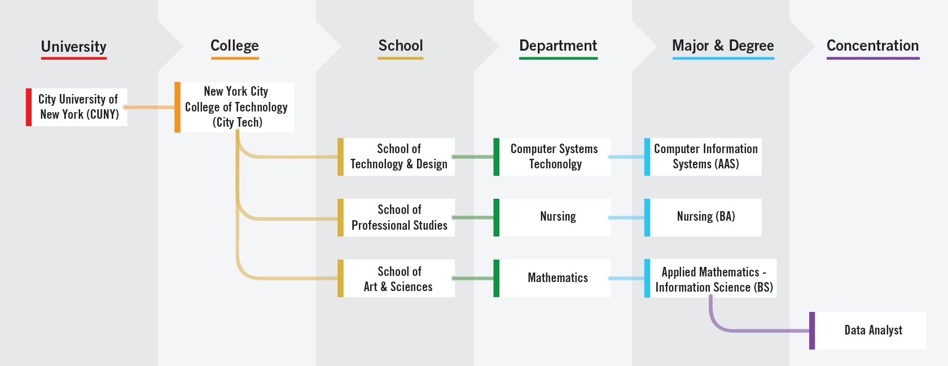
Notes:
4 minutes
Explain the foundation of the organizaiton and where each student fits into the organization. Ask there they fit into the organizaion.
It is exciting to announce that the college now offers New for fall 2021, Minors!
I asked this question using polls so that we can use the information in discussion during the session
1.How confident are you that you chose the right major? (Single Choice)*
I am Not Confident
I am Somewhat Confident
Neutral
I am Confident
I am Very Confident

Slide 9
Your Major Matters

Slide 10
Your Major Matters...
What is your major and why did you choose it?
Notes:
Create a JamBoard or other collaborative tool, and ask people to answer this question.As with any Google tool, make sure the people with the link have editing access (not just viewing access). Encourage creativity and variety in expression. If you’re meeting in person, you can also have students write answers on the board or on slips of paper, etc.

Slide 11
Academic advisement and registration, is there really
a difference?
Notes:
This slide brings in important vocabulary. Initially it is the difference between advisement and registration. Next it will be examples of questions that are related to both registration (the act of enrollment, something students do on their own, PM will guide them through the process), academic advisement is the act of discussing ones path to graduation, which includes advice on which classes to register for, but is more. Students work with an Academic Advisor who is a full time faculty member in their department. Academic Advisors should be able to
Discuss prerequisites
Which clubs are available and how to join
Guide a student who is struggling or who is excelling
Offer career advice
Discuss programs available to students.
Advisors will NOT talk about financial aid issues
Some students have additional advisors if they are in SEEK or ASAP programs.

Slide 12
Academic advisement and registration, is there really
a difference?
Which classes should I register for?
How do I enroll in classes?
Which activities will support my academic and career goals?
How can I maximize the value of tuition?
Besides class, what else does City Tech offer me?
How can I connect my education with my future?
Notes:
Peer Mentors helped develop this list of questions.
To engage students, ask if they think these questions are more academic advisement or registration

Slide 13
Find Information About
Your Department and Major
Sample Course of Study on your Department Site
Course Descriptions are found in the College Catalog
Talk to an Academic (Faculty) Advisor
Explore the Academic Advising Webpage
Become better prepared by using The Companion
Notes:
Sample Course of Study on your Department Site
Each department offers a sample course of study. This is exactly what it says, a sample. Students should use the sample as a guide but should consider their own specific plan towards graduation
For instance, some students will be enrolled in MAT1272CO but their sample states the first course as MAT1375. An example: https://www.citytech.cuny.edu/computer-engineering/computer-engineering-btech.aspx
Course Descriptions are found with in the department the course if offered

Slide 14
Academic Advising Preparation

Slide 16
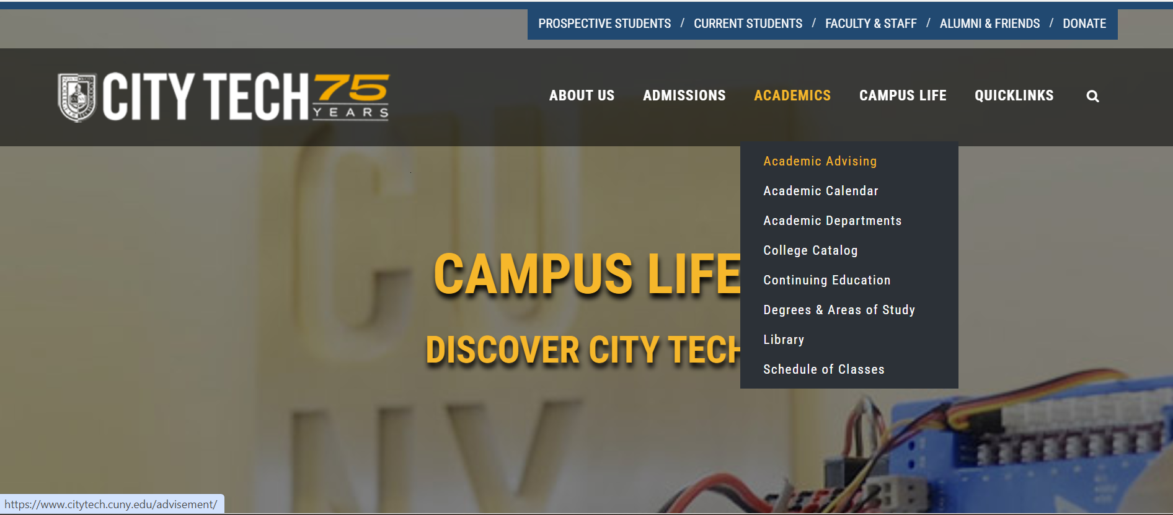

Slide 17
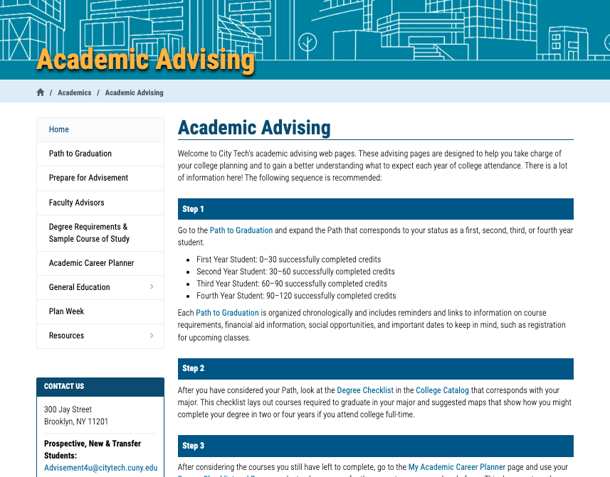
http://www.citytech.cuny.edu/advisement/

Slide 18
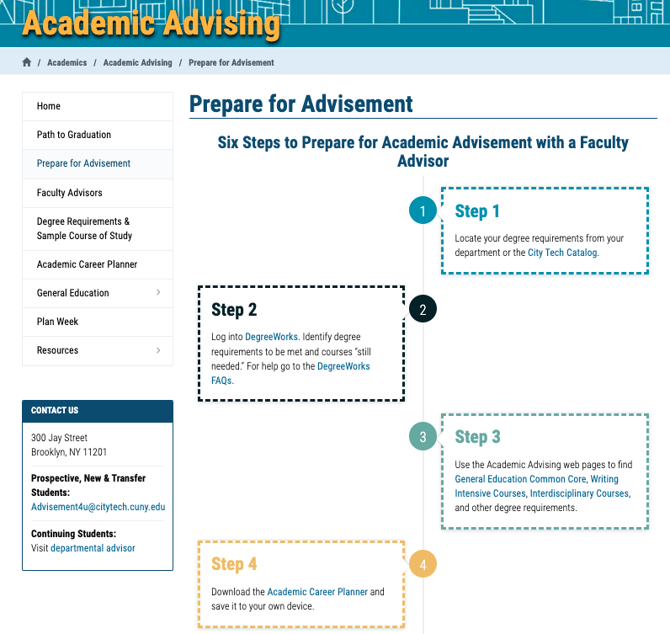
http://www.citytech.cuny.edu/advisement/six-steps.aspx

Slide 19
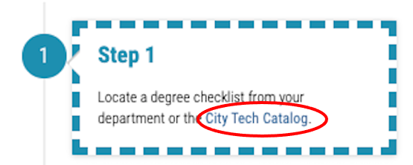

Slide 20
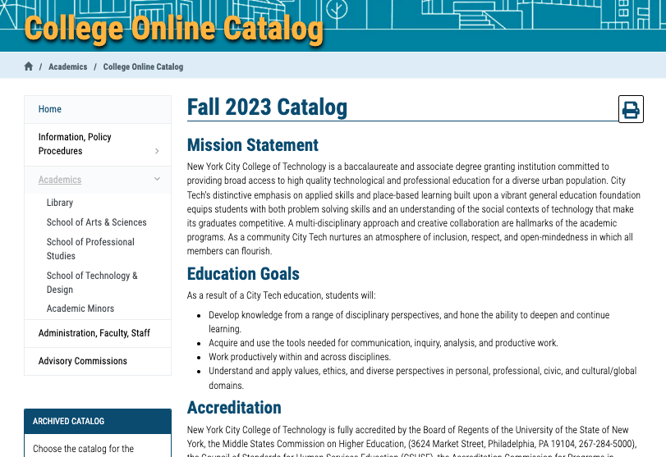

Slide 21
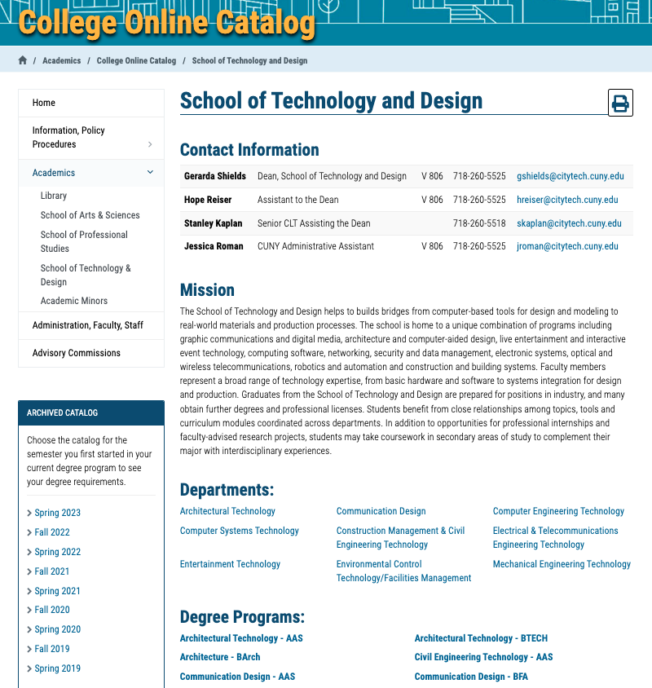

Slide 22
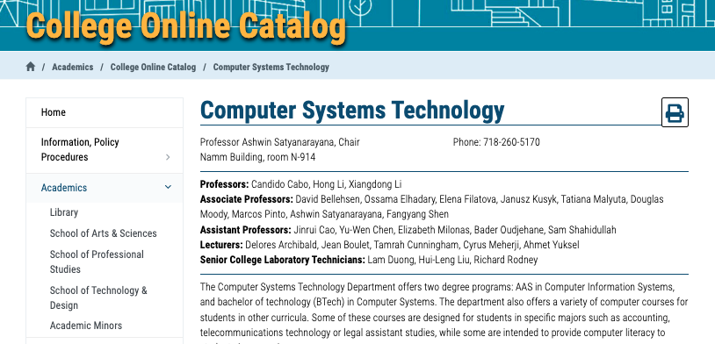
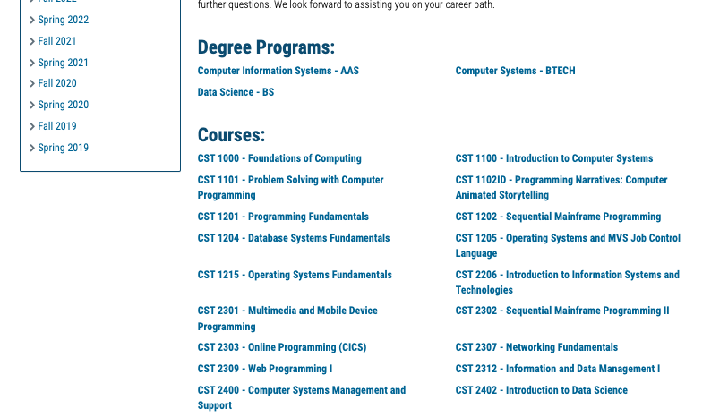

Slide 23
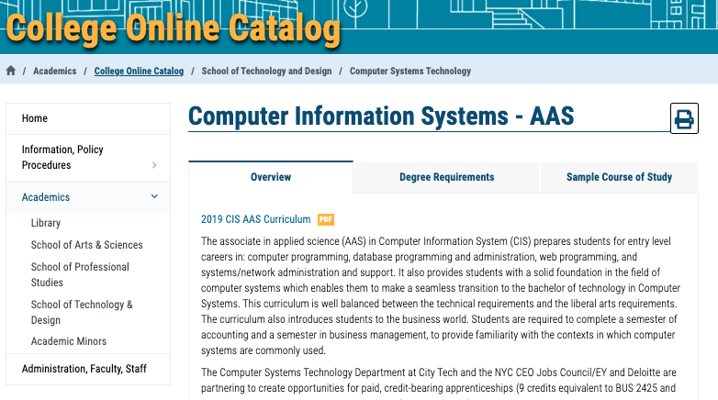

Slide 24
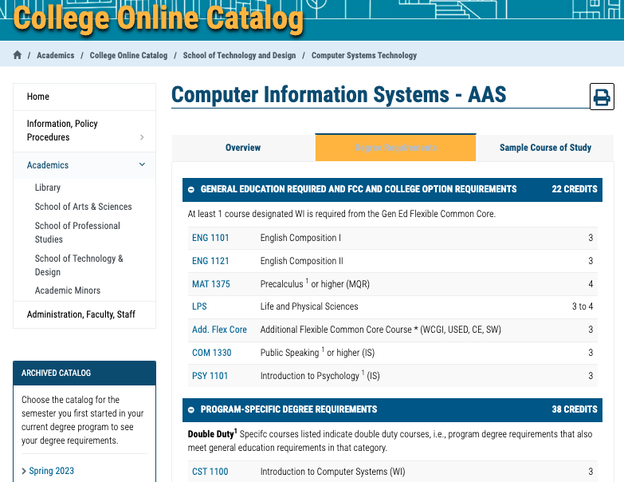

Slide 25
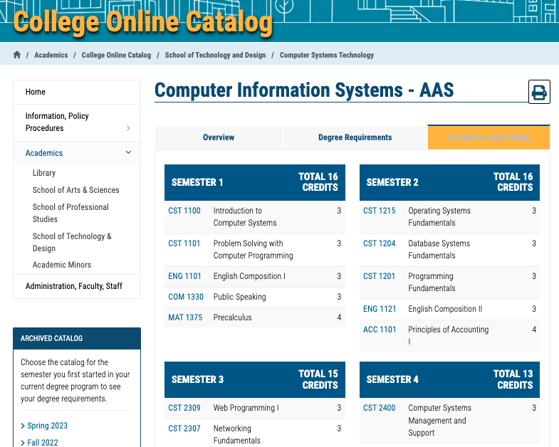

Slide 26
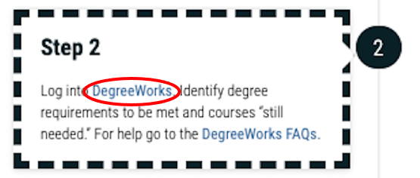

Slide 27
DegreeWorks
Degree Audit

Slide 28
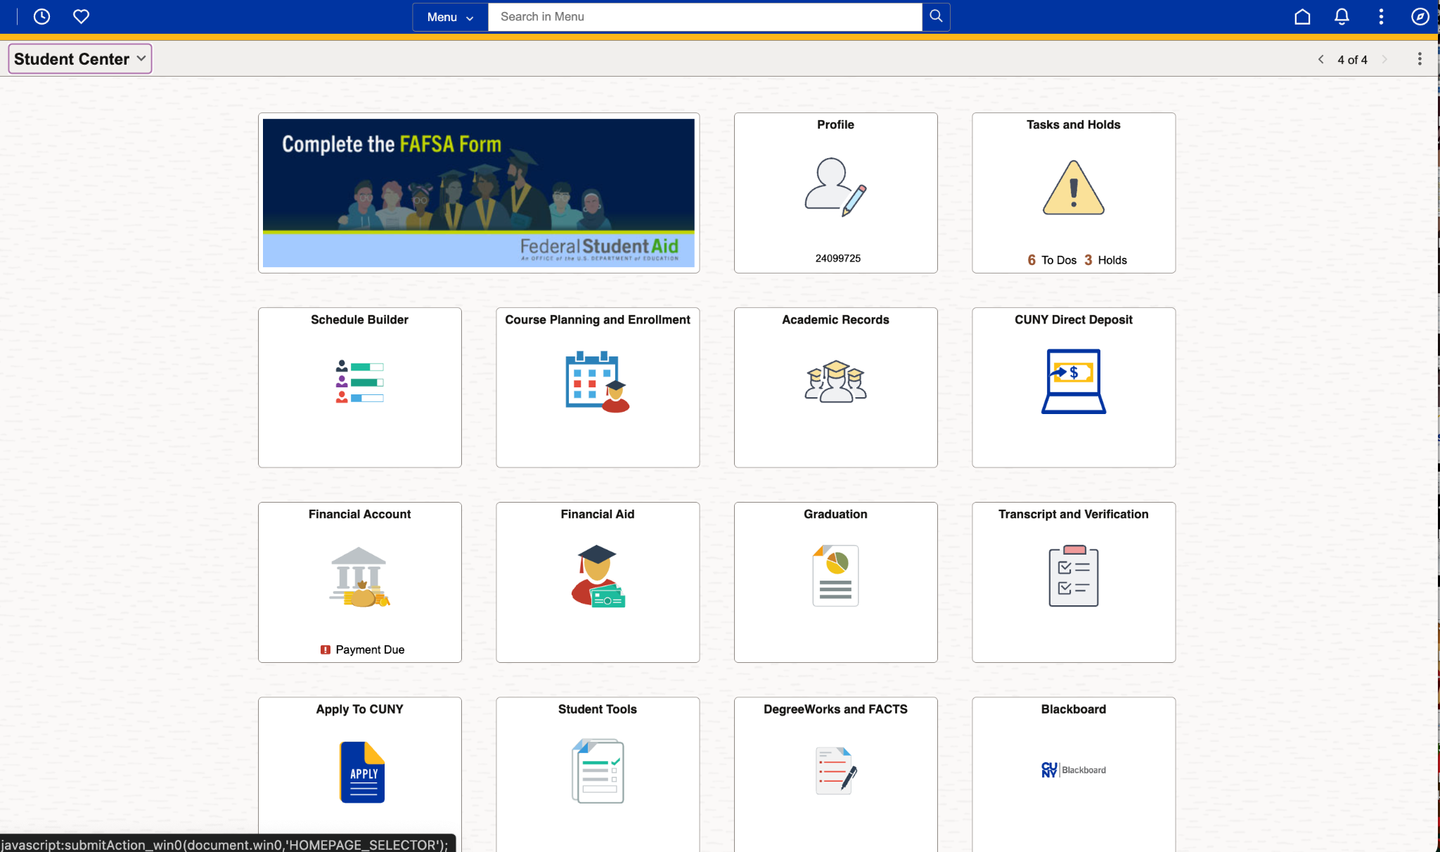

Slide 29
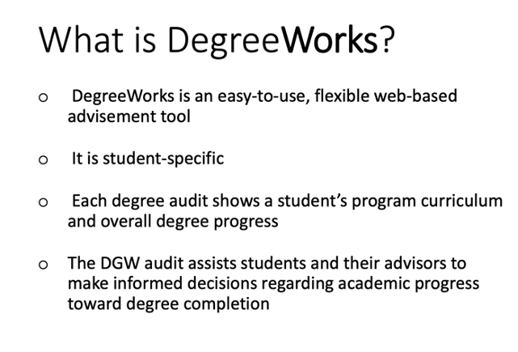
https://www.citytech.cuny.edu/registrar/docs/Student_Guides/How_to_Read_your_DegreeWorks_Presentation.pdf

Slide 30
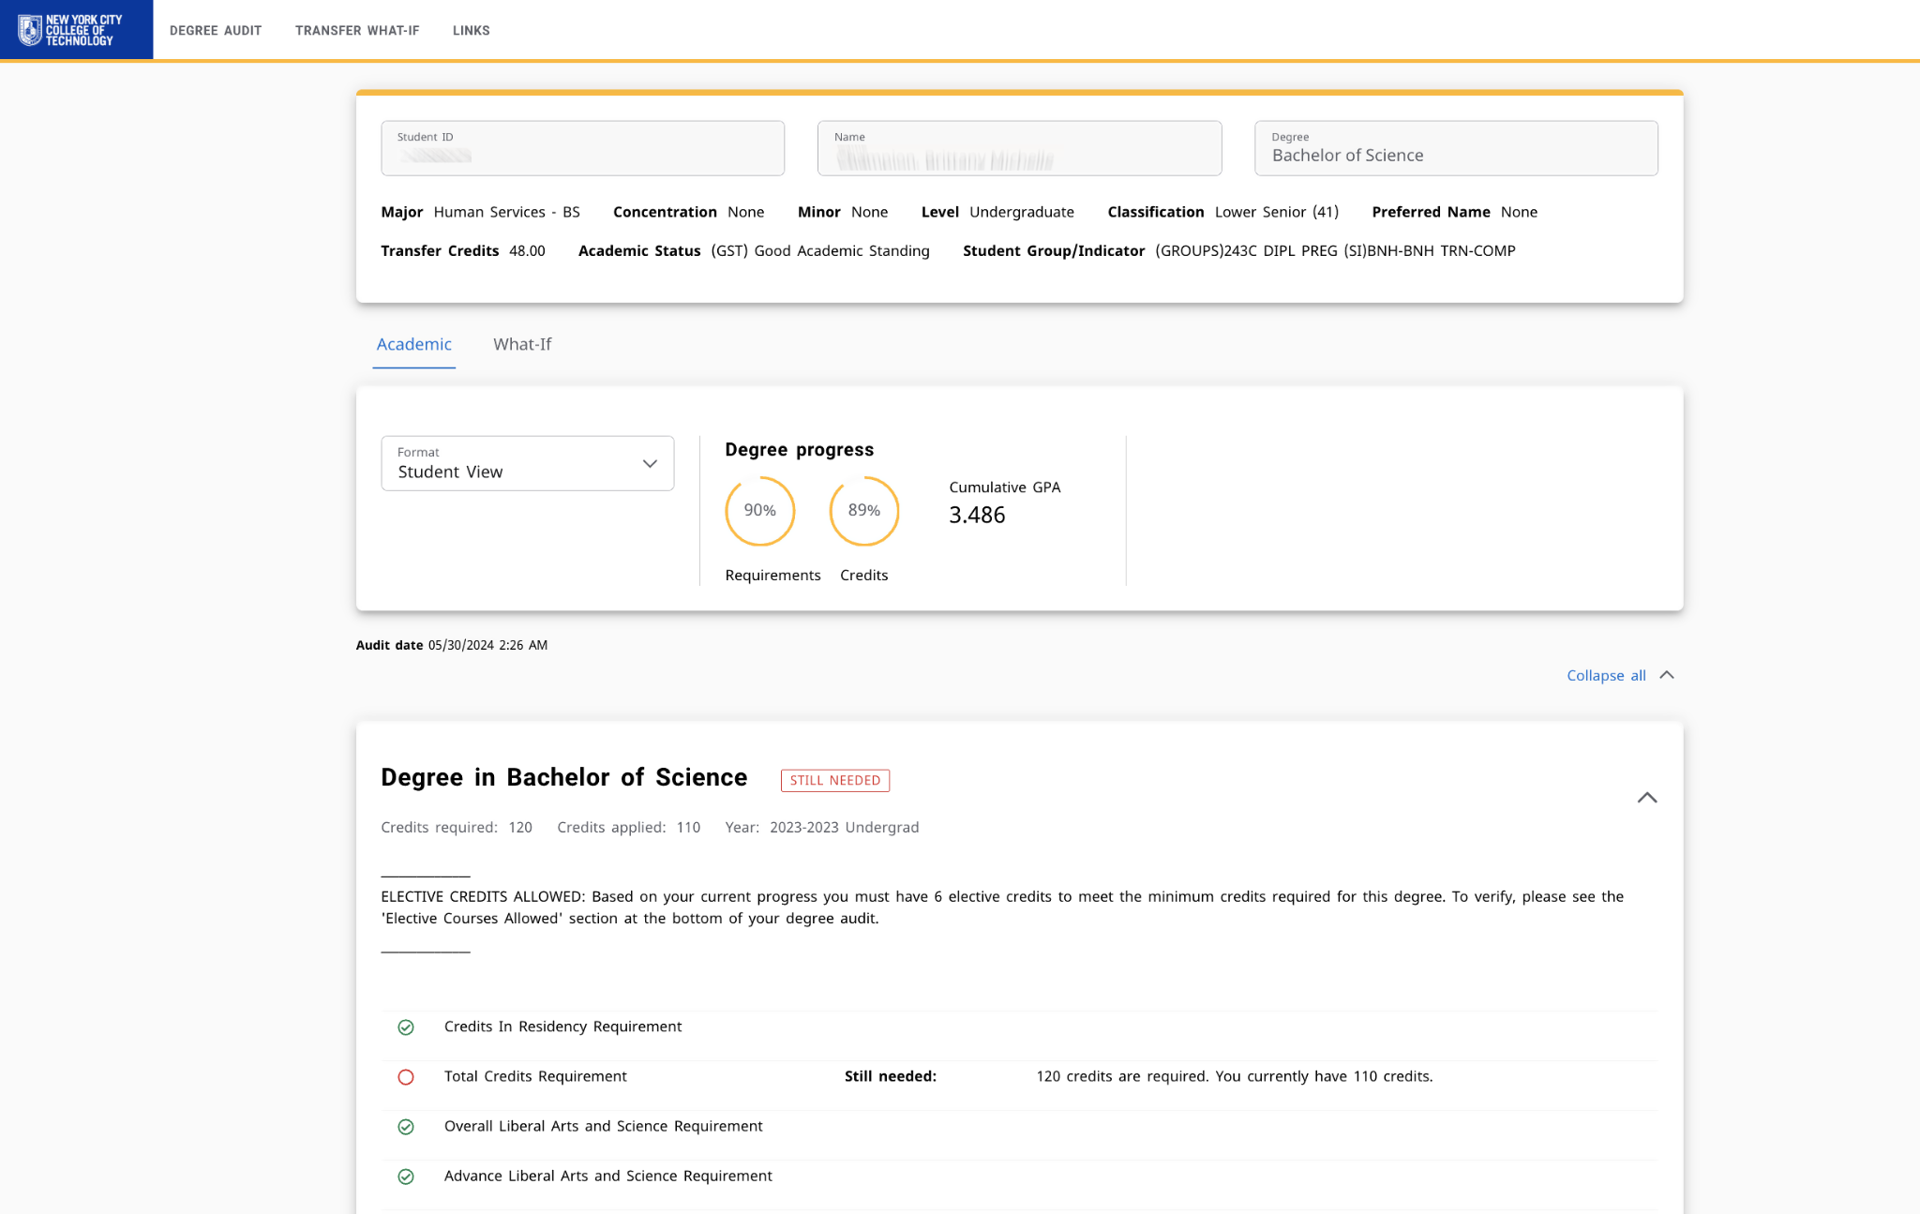

Slide 31
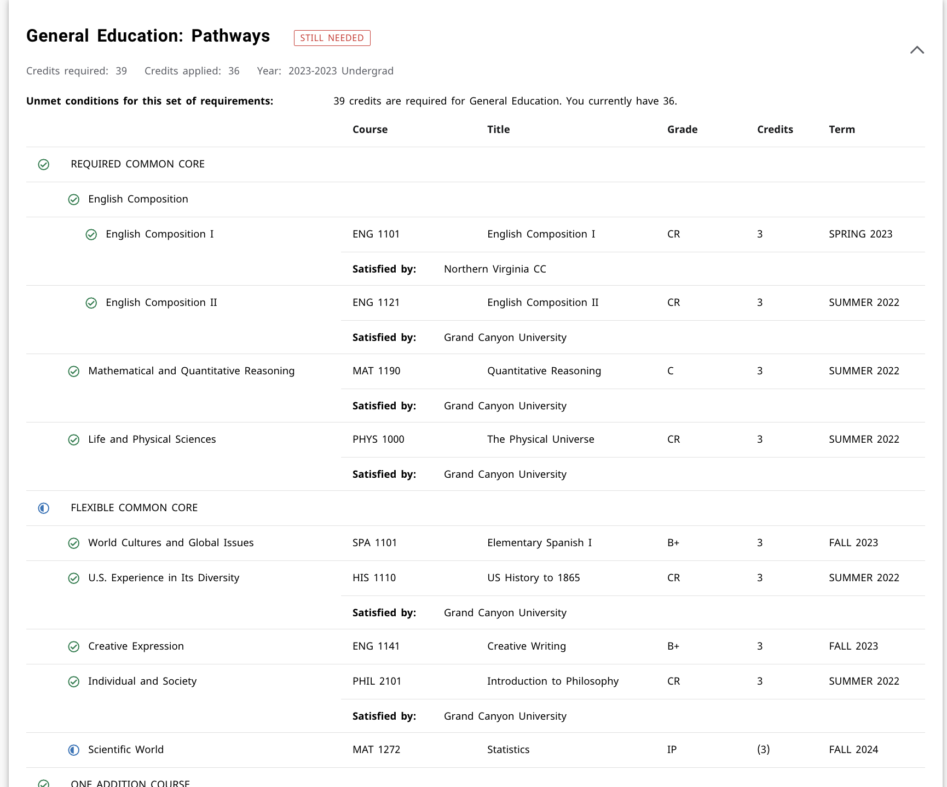

Slide 32
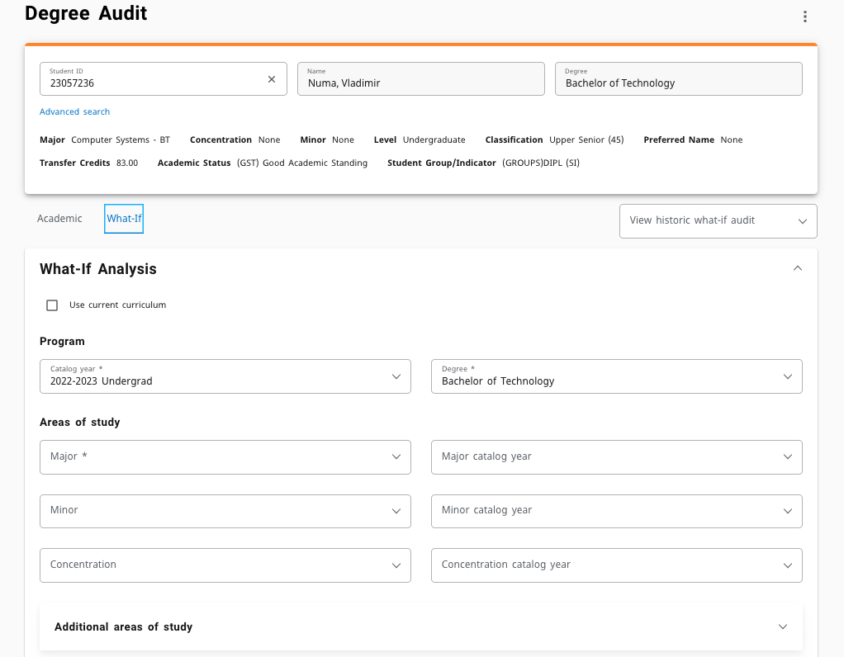

Slide 33
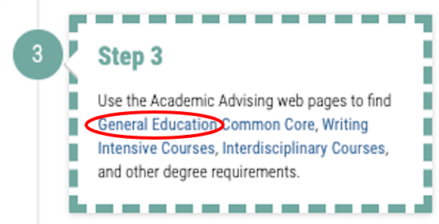

Slide 34
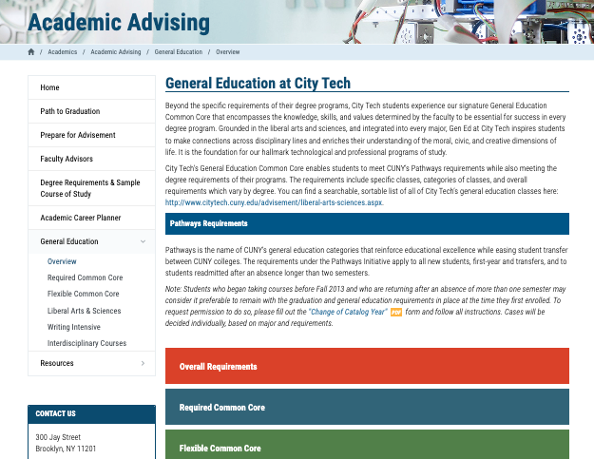
General Education
Writing Intensive
Interdisciplinary
College Requirements
http://www.citytech.cuny.edu/advisement/gen-ed.aspx

Slide 35
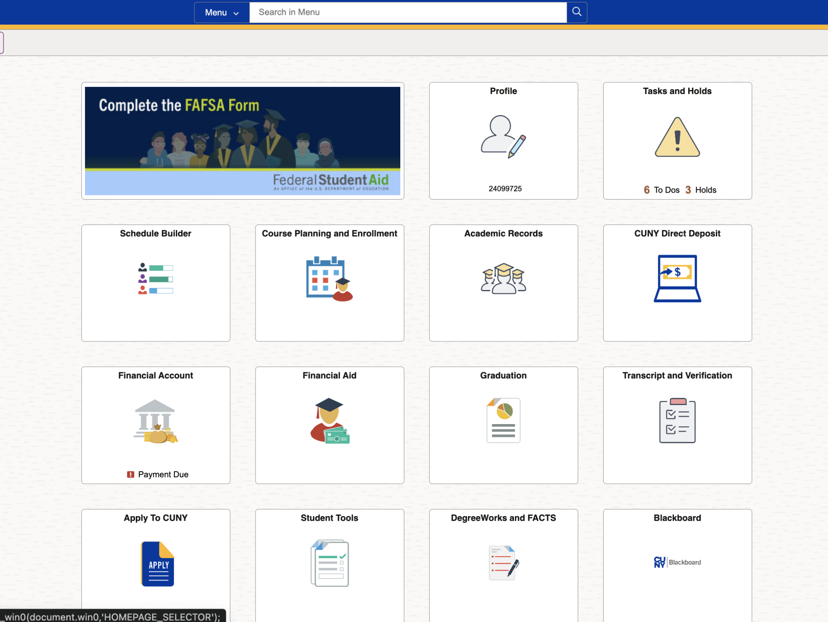
Schedule
Builder
https://www.citytech.cuny.edu/registrar/docs/Student_Guides/How_to_Use_Schedule_Builder_Presentation.pdf

Slide 36
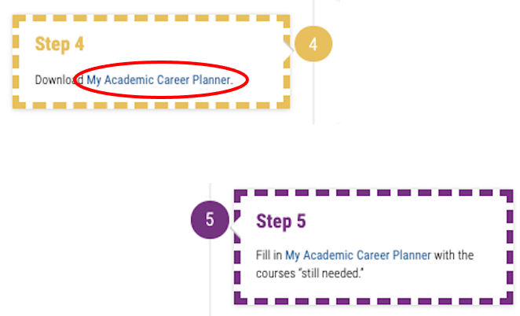

Slide 37
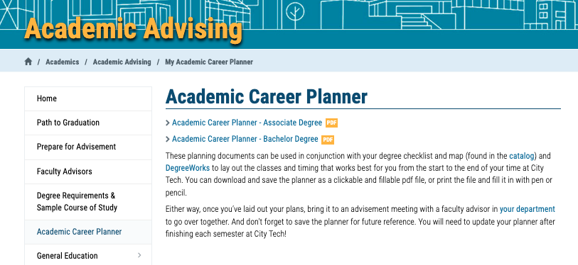
http://www.citytech.cuny.edu/advisement/planner.aspx

Slide 38
My Academic Career Planner

Slide 39
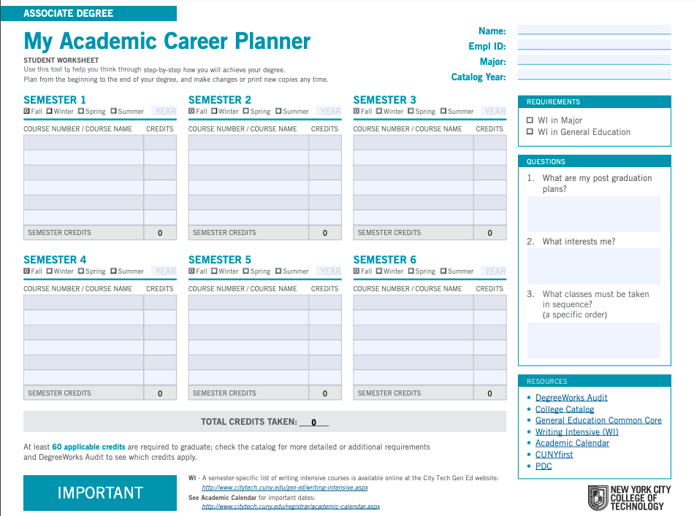
My Academic Career Planner
Download the PDF
(do not complete it on the web, you will lose all your work)
What else will you need?

Slide 40
My Academic Career Planner Review
First fill out your current course enrollment.
Complete the next three semesters of the My Academic Career Planner using the sample course of study as a guide.
Consider which Gen Ed courses you will consider to fulfill the required categories.

Slide 41
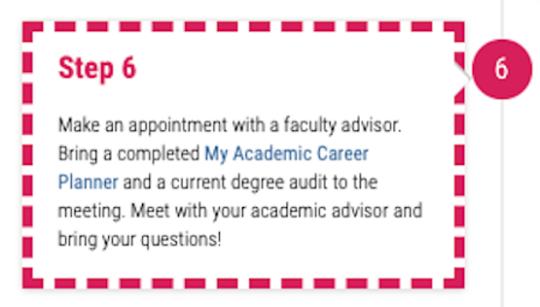

Slide 42
Academic Advisors

Slide 43
Who is your
Academic Advisor?
https://www.citytech.cuny.edu/advisement/virtual-advisors.aspx
Notes:
4 minutes
Share this link with students: https://www.citytech.cuny.edu/advisement/virtual-advisors.aspx
They will need to know the department/degree
It leads to the Academic Advising page and all departments will have something posted. Note, there is no consistency in the listing of the department’s information.

Slide 44
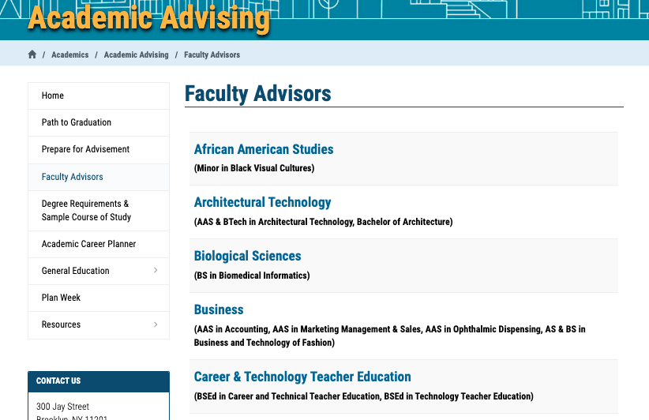

Slide 45
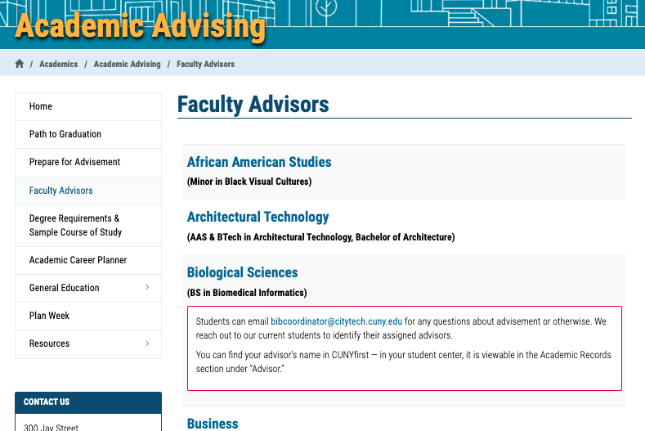

Slide 46
You found your Academic Advisor
Name
Emplid
Email
Phone number
Reason for advising appointment
What do you do now?
Notes:
I asked the PMs to talk about this slide
Remind students to use the city tech email address.

Slide 47
If you are in:
ASAP/ACE
SEEK
CUNY Edge
Crear Futuros
You have an advisor assigned to you through those programs!

Slide 48
Vocabulary Review
Notes:
If you have time at the end of your session, you can discuss these registration-related terms.

Slide 49
Vocabulary
Prerequisite
Corequisite
General Education Common Core
Pathways
Requirement
Elective
Sequential
Writing Intensive
Interdisciplinary
Certification/Licensing
Clinical
Lab
STAR Center
Advisor
CUNYFirst
DegreeWorks
Schedule Builder

Slide 50
Post Workshop Reflection #8
In Session Eight we learned about how to plan out our course schedules, seek out advisement, and register. Who is your academic advisor? How will you find this information if you don’t already know it?
What is something that you learned in Session Eight that you think is especially helpful or interesting?
What is one practice you learned about that you will use when going through your own advisement and registration process?

Slide 51
Recap
Registration: Commitments and Responsibilities
University Structure
Your Major Matters
Academic Advisement vs. Registration
Academic Advising Preparation
DegreeWorks Degree Audit
My Academic Career Planner
Academic Advisors
Vocabulary Review

Slide 52
#aMAJORdecision
Session 8
10/22/24
Professor Perreira
City Tech 101 by Karen Goodlad and Sarah Paruolo is licensed under a Creative Commons Attribution-NonCommercial-ShareAlike 4.0 International License.

