Slide 1
City Tech 101
Welcome!
Fall 2024
Professor G.Perreira
Email: gperreira@citytech.cuny.edu
City Tech 101 by Karen Goodlad and Sarah Paruolo is licensed under a Creative Commons Attribution-NonCommercial-ShareAlike 4.0 International License.

Slide 2
Academic Basics:
#WelcomeToCityTech
Session 1
09/03/24
Professor Perreira
City Tech 101 by Karen Goodlad and Sarah Paruolo is licensed under a Creative Commons Attribution-NonCommercial-ShareAlike 4.0 International License.

Slide 3
Today’s Topics
Introductions
CT101 Syllabus + Schedule Review
Learning Tools
Instructional Modalities
Campus Tour/”If the Walls…”

Slide 4
Introductions

Slide 5
Connect with your Professor
Prof. Perreira
Email: gperreira@citytech.cuny.edu
Notes:
Personalize this slide with your name and City Tech email address

Slide 6
What is a Peer Mentor?
Notes:
Please give your peer mentors time to introduce themselves–their names, years, majors, any other relevant info.

Slide 7
What is a Peer Mentor?
Peer Mentors are role models who are eager to share their experiences and knowledge to help incoming City Tech students adjust to college life.
Attend CT101 with you every week
Answer questions via email + office hours
Notes:
Please give your peer mentors time to introduce themselves–their names, years, majors, any other relevant info.

Slide 8
Connect with your
Peer Mentor
Name: Aurora Hidago
Email: aurora.hidalgo@mail.citytech.cuny.edu
Notes:
Personalize this slide with your peer mentor names and CT email addresses.

Slide 9
Ice Breaker Activity
Notes:
Feel free to use any of the icebreaker activities from the CT101 faculty handbook, or use one of your own choosing.

Slide 10
What will we do during the ten sessions?
This workshop focuses on helping new students transition to college life, and specifically to City Tech. The workshop will enhance the new student experience with information, activities, and various opportunities to connect with faculty, staff, and current City Tech students. In addition to learning how to access a variety of college services and resources, students will develop personalized plans for their college career.

Slide 11
Syllabus + Schedule Review (10-Session)
Session 1 > Academic Basics: #WelcomeToCityTech
Tuesday/09/3/24/12:00 pm to 1:50 pm
Session 2 > The Syllabus and the Classroom
Tuesday/09/10/24/12:00 pm to 1:50 pm
Session 3 > #RiseAndGrind
Tuesday/09/17/24/12:00 pm to 1:50 pm
Session 4 > You Paid For It, Use It: Resources + Services
Tuesday/09/24/24/12:00 pm to 1:50 pm
Session 5 > Get Your Head in the Game: Mindset + Self-Care
Tuesday/10/1/24/12:00 pm to 1:50 pm
Session 6 > #YellowJacketLife: The Buzz on Getting Involved
Tuesday/10/8/24/ 12:00 pm to 1:50 pm
Session 7 > Coming to Terms with College Vocabulary
Tuesday/10/22/24/12:00 pm to 1:50 pm
Session 8 > #aMAJORdecision
Tuesday/10/29/24/12:00 pm to 1:50 pm
Session 9> Discover your Direction
Tuesday/11/05/24/12:00 pm to 1:50 pm
Session 10 > Wildcard / Wrap-up
Tuesday/11/12/24/12:00 pm to 1:50 pm

Slide 12
Have you completed the pre-workshop survey?
To get credit for successful completion of this workshop, you must complete it by today!
Notes:
Give students a few minutes to find and complete the survey if they haven’t done it

Slide 13
Learning Tools

Slide 14
Electronic Platforms Used at City Tech
Administrative Apps
CUNYFirst
Schedule Builder
DegreeWorks
General College Activities
Campus Wifi
City Tech Email (Outlook)
Microsoft Office
OneDrive (Microsoft)
DropBox
In the Classroom
Brightspace
OpenLab
Zoom
Which of these are you familiar with?

Slide 15
How to Access Campus Computers
Navigate to: https://forgot.citytech.cuny.edu
Enter username. Username: Firstname.Lastname
Enter default password.
(For New Users Only) First name initial UPPERCASE, last name initial lowercase, your Date of Birth (MMDDYYYY), followed by the last four digits of your CUNYfirst EMPL ID. Default Password: JdMMDDYYYY9367
(Current Users): password you set up for your Active Directory account
Select four Security Questions and Provide Answers, click Save Answers. • The answers are not case sensitive. • Answers must be more than four characters.
Answer both Helpdesk Security Questions, click Save Answers.
Enter and confirm your new password, click Change Password.

Slide 16
How to Access Campus Wifi on a
Personal Device
Connect your device to CityTech-WiFi network.
Open a browser, enter: http://ecsa.citytech.cuny.edu
Click on “Faculty, Staff and Students.”
Enter username: Firstname.Lastname
Enter password: City Tech Active Directory (AD) password.
Click Continue and wait for the progress bar to complete your network connection.

Slide 17
How to Access Campus Wifi on a
Personal Device (alternate option/continued)
Download the free “geteduroam” app onto your device
Search for the institution “City University of New York,” then click “next.”
Login using your CUNYFirst credentials

Slide 18
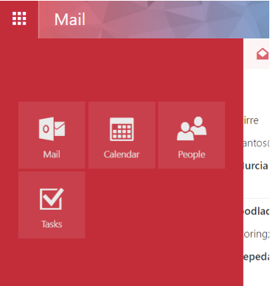
City Tech Email (Outlook)
Email
Calendar
Teams
Tasks

Slide 19
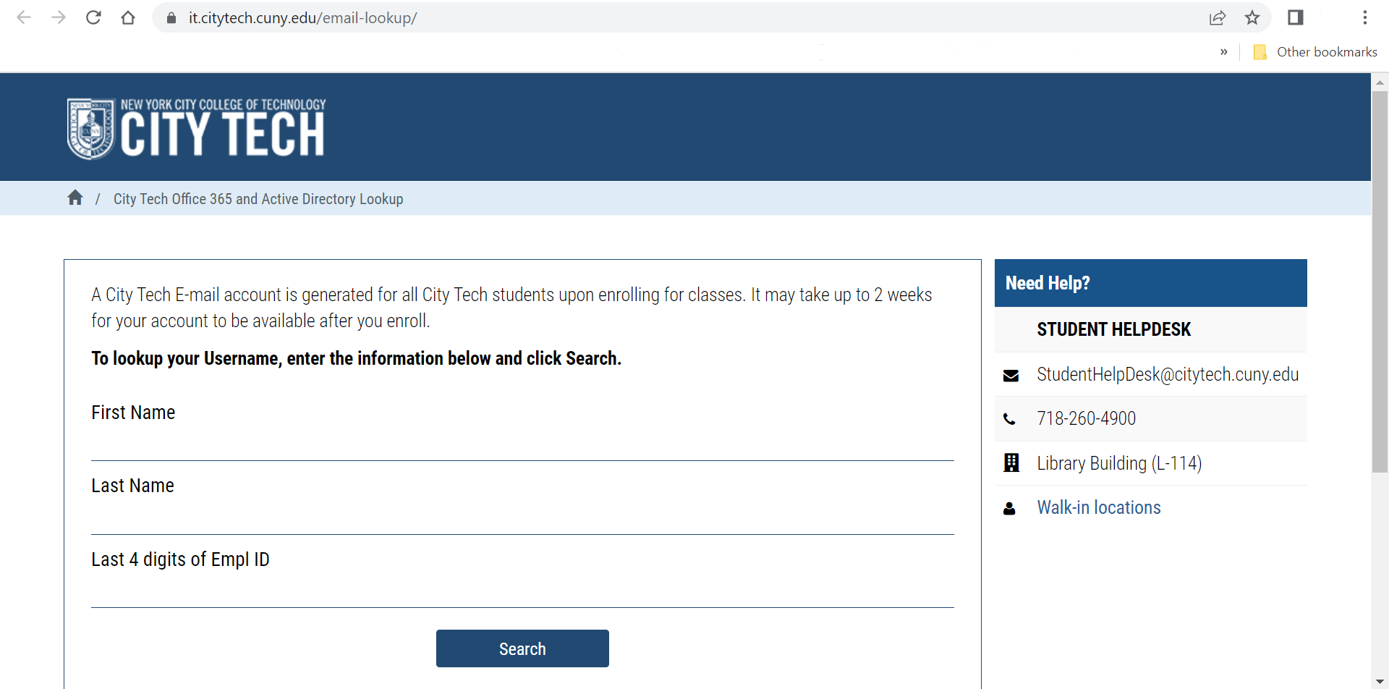
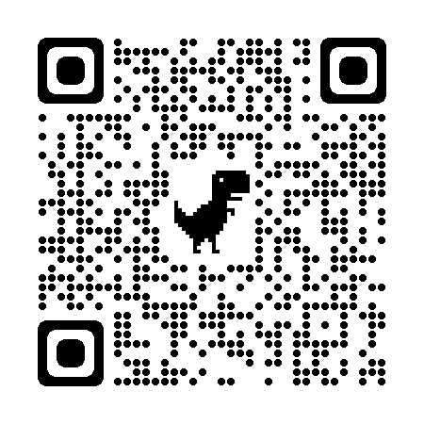
City Tech Email (Outlook)
Have you activated your email?
Notes:
http://cis.citytech.cuny.edu/Student/it_student_findemail.aspx

Slide 20
Activating Your City Tech Email (Outlook)
Visit Email Address Look Up to find your email. (https://cis.citytech.cuny.edu/Student/it_student_findemail.aspx)
Go to the Microsoft Office 365 email login at https://myapps.microsoft.com/
Log in using the following:
YourPassword: First initial of first name UPPERCASE + first initial of last name lowercase + MMDDYYYY + last 4 of your EMPL ID.
For example: If your name is John Doe and your date of birth is 01/06/1986 and the last four digits of your EMPL ID are 1234, your password is: Jd010619861234
You will be asked a number of security questions. If prompted to create a new password, do so, but make sure to write it down!
You will also need to complete your e-mail security verification, which will enable you to reset your password if you forget it. To do this:
Open a new tab in your browser and type https://myapps.microsoft.com in the address line.
Click Verify Now.
Set up authentication for cellphone and email and verify them. Set up security questions and answers. Click Finish.
Click the Outlook icon to access your email.
Notes:
Please give students time to activate their email accounts if they have not already done so. The peer mentors can help any students who need support. Please make sure students know that their CUNYFirst login is NOT the same as their email address!

Slide 21
Log in. What is the most recent message you have received?
Have you received emails from any of your professors?
What can you do in Outlook besides email?

Slide 22
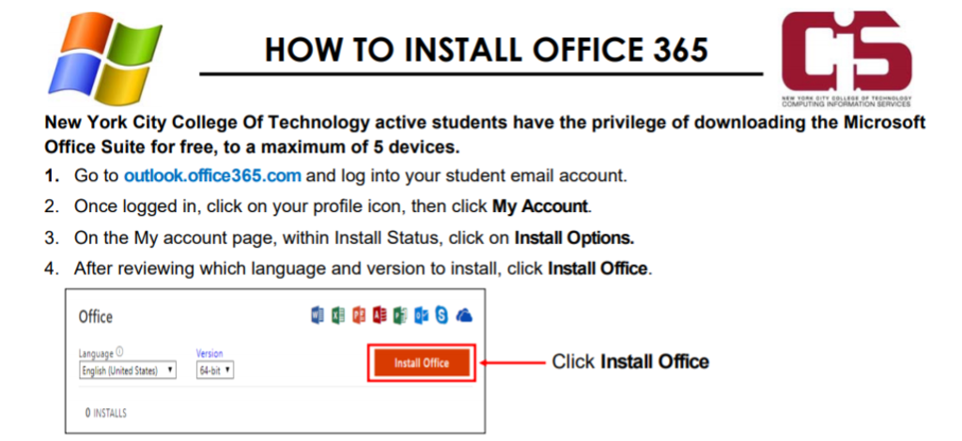
Students have access to Microsoft Word, Excel, Powerpoint, and
One Drive (cloud storage)!
Notes:
You should mention this option, but you do not need to give students time to do this in class, unless you find time at the end or in another session.

Slide 23
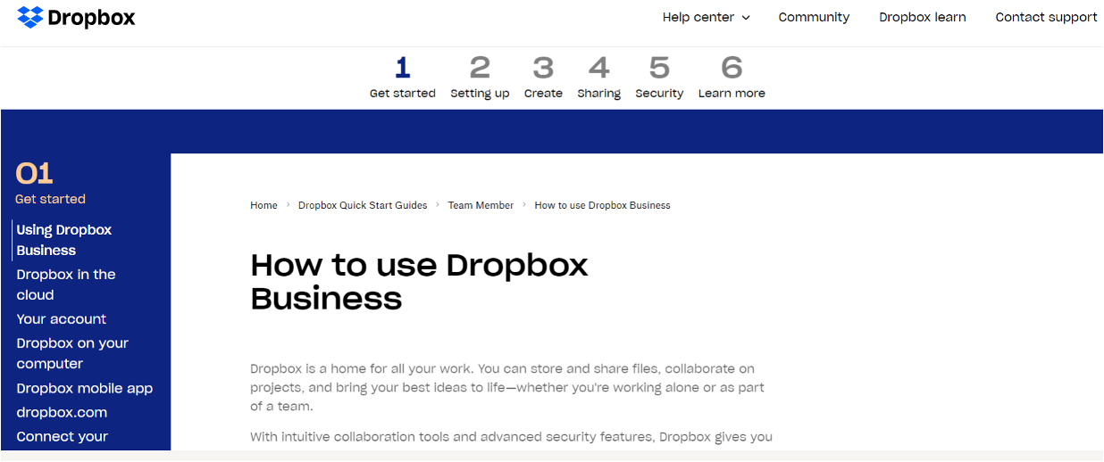
Some professors use DropBox for course materials and collecting student work.
Notes:
https://help.dropbox.com/guide/team/how-to-use-dropbox#how-to-use-dropbox-business

Slide 24

Brightspace is a Learning Management System– this is where many of your courses live online. Professors will use Brightspace to post syllabi, schedules, assignments, homework, quizzes, grades, etc.

Slide 25
Log in to Brightspace…
What features do you notice?
Are any of your classes available yet?
Have any professors posted a welcome message or other info?

Slide 26
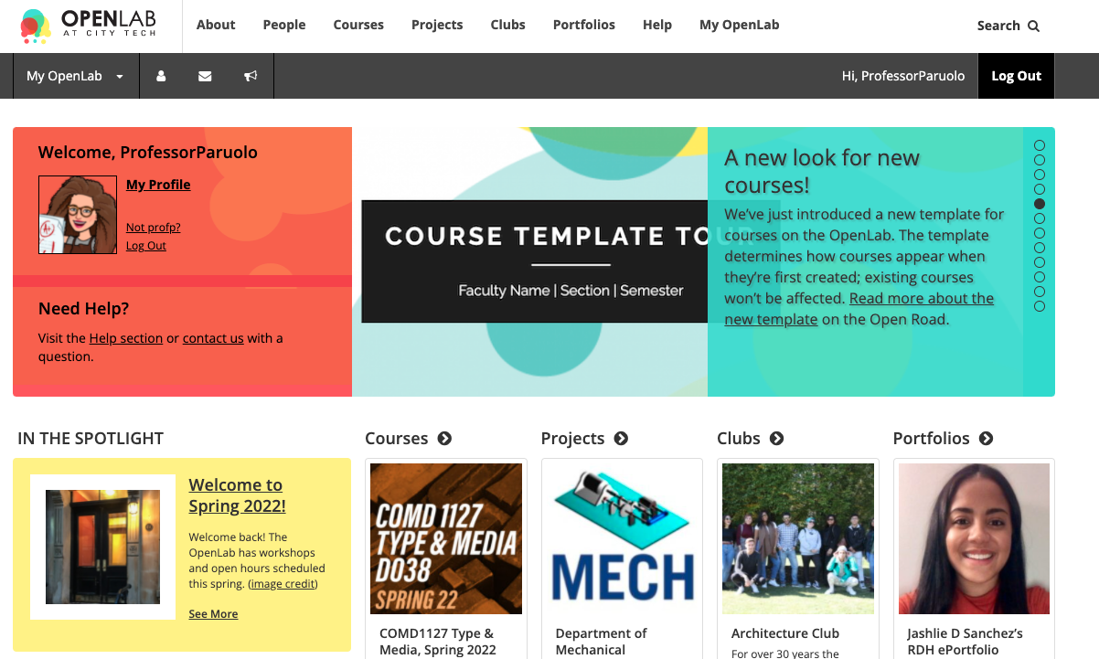
OpenLab (OL) is similar to Brighspace– this is a place where your courses live online. Some professors may use it in a similar way as Brightspace. OL also has projects, clubs, and portfolios, which you will not find on Brightspace.
Notes:
https://openlab.citytech.cuny.edu/

Slide 27
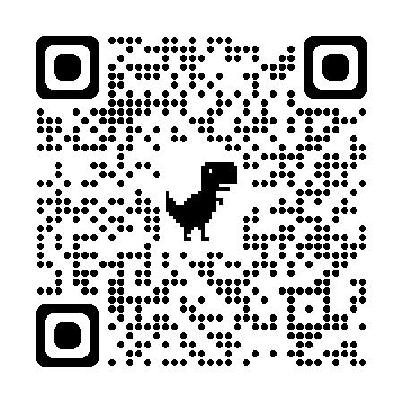
We will be using OpenLab as the classroom management tool for our CT101 Workshop.
Please take a moment now to go to openlab.citytech.cuny.edu to set up your account and join this course!
[insert openlab course name to facilitate lookup]
Notes:
Add your OpenLab course name to the slide so students can more easily search for the site. If you have time, students can create their accounts and join your course during class. If not, give students time after class to get help with technology.

Slide 28

Students may use Zoom to attend online or hybrid classes, meet with professors, attend school events, and more.
Notes:
Again, no need to give students time to do this in class. Just make sure they know that the link to the instructions is embedded in these slides. https://it.citytech.cuny.edu//docs/Login_CUNY_Zoom.pdf

Slide 29
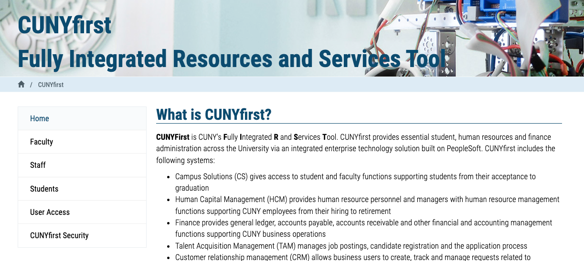
Students use CUNYfirst for management of almost all personal records.
Notes:
Many students have already accessed CUNYFirst when they come to CT101. If any students have not, you can ask the peer mentors to make sure they can do so. https://home.cunyfirst.cuny.edu/oam/Portal_Login1.html

Slide 30
Log in. What is the most recent message you have received?
Have you received emails from any of your professors?
What can you do in Outlook besides email?

Slide 31
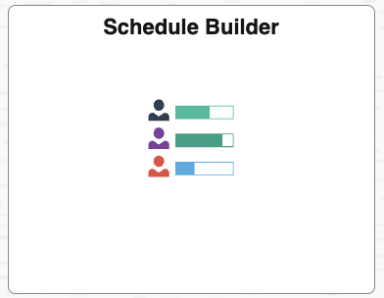
Schedule Builder is a tool you can find within CUNYFirst. You can use it to help register for classes.
Notes:
Again, you do not need to give students time to look at Schedule Builder–they will have time to navigate it during the session on advisement and registration. Just mention that it is a part of CUNYFirst, and let them know they will look at it soon.

Slide 32
Schedule Builder is a planning tool that can contain draft versions of your schedule.
Do NOT use Schedule Builder to look up your schedule for the upcoming semester! Instead, use the “Course Planning and Enrollment” tile in CUNY First.
Notes:
Please MAKE SURE STUDENTS DO NOT USE SCHEDULEBUILDER TO CHECK THEIR FALL SCHEDULES. Schedulebuilder can contain tentative schedule options that are not part of their official schedule. They should use the “Academic Records” tile to find their schedule.”

Slide 33
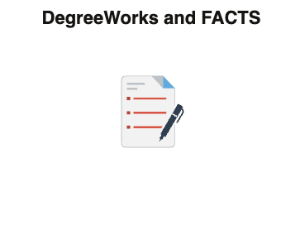
DegreeWorks can also be found within CUNYFirst. Use it to track academic progress and degree requirements.
Notes:
Treat DegreeWorks the same as Schedule Builder–a quick mention is enough. Students will get to know ScheduleBuilder and DegreeWorks in Session 8.

Slide 34
Instructional Modalities
Notes:
Using the following slides, help students to decode the information on their schedules. Make sure they are clear on the differences between in-person, hybrid, and synchronous/asynchronous classes.

Slide 35
Instructional Modalities at City Tech
In person
Online
  Synchronous
  Asynchronous
Hybrid

Slide 36
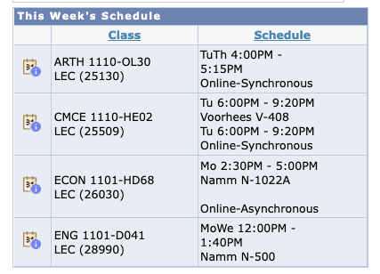
Modalities
Which class is fully in person?
Which class is Online, Synchronous?
Which class is Online, Asynchronous?
Which class is Hybrid?

Slide 37
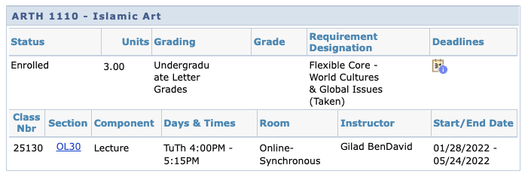
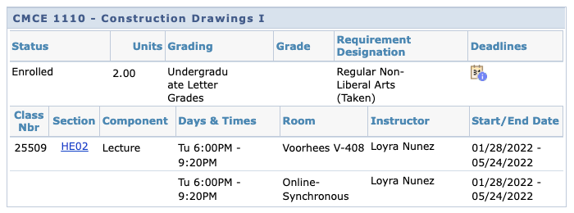

Slide 38
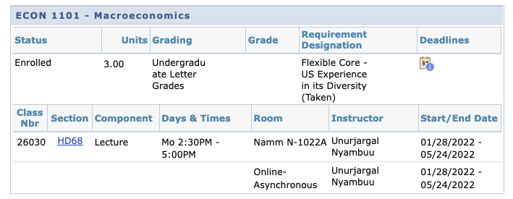
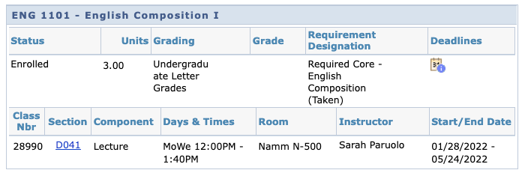

Slide 39
Schedule Issues?
Stay at the end of the session today for help with your schedule.

Slide 40
Let’s take a tour!
or
If the Walls Could Talk
Notes:
With the remaining class time, you can take your students on a tour of the campus or ask them to complete the “If the Walls Could Talk” activity. Full instructions and links to all relevant materials can be found in the faculty handbook. Whatever activity you choose, please take every measure to make the activity accessible to all students. Take the elevator or use ramps instead of stairs (even when just going up or down one flight or a few steps), and move slowly.

Slide 41
Course Information
Next Meeting: 09/10/24
Workshop Location: Namm 417
Open Lab site: ADD LINK
Prof. email: gperreira@citytech.cuny.edu
Peer Mentor 1 Email: aurora.hidalgo@mail.citytech.cuny.edu

Slide 42
Recap
Introductions
CT101 Syllabus + Schedule Review
Learning Tools
Instructional Modalities
Campus Tour/”If the Walls…”

Slide 43
Before Session 2…
Download and review 1101 syllabi (plural of syllabus) posted on OpenLab.
Complete Reflection on OpenLab by replying to Reflection #1 Post.
  Remember, you must have an account and be logged in to OpenLab to reply to a post.
  How to Respond to a Reflection
Read the Reflection post.
Click on Comment.
Write your comment in the box.
Click Post.
Reflection #1
What do you want your classmates to know about you? Consider
sharing your goals as a college student, why you chose City Tech,
what you hope to learn in your first semester at City Tech or
anything important to you.
Read other classmate’s posts and help welcome each other by
writing a response.
Notes:
ADD LINK

Slide 44
Academic Basics:
#WelcomeToCityTech
Session 1
09/03/24
Professor Perreira
City Tech 101 by Karen Goodlad and Sarah Paruolo is licensed under a Creative Commons Attribution-NonCommercial-ShareAlike 4.0 International License.

