Slide 1
City Tech 101
Fall 2024
Professor Perreira
Professor Email: gperreira@citytech.cuny.edu
City Tech 101 by Karen Goodlad and Sarah Paruolo is licensed under a Creative Commons Attribution-NonCommercial-ShareAlike 4.0 International License.

Slide 2
Get Your Head
in the Game:
Mindset + Self-Care
Session 5
10/1/24
Professor Perreira
City Tech 101 by Karen Goodlad and Sarah Paruolo is licensed under a Creative Commons Attribution-NonCommercial-ShareAlike 4.0 International License.

Slide 3
Today’s Topics
Where College Happens, Pt. 4
What is a Growth Mindset?
Fixed Mindset Habits
Growth Mindset Habits
Skills-Based Learning
Self-Care

Slide 4
Where does
college happen?
Notes:
We want students to understand that college isn’t just going to class and leaving. Getting a full college experience means that learning and growth happen in many different spaces and in different ways. Variations on these slides will appear in each presentation from Session 2 to Session 6.

Slide 5

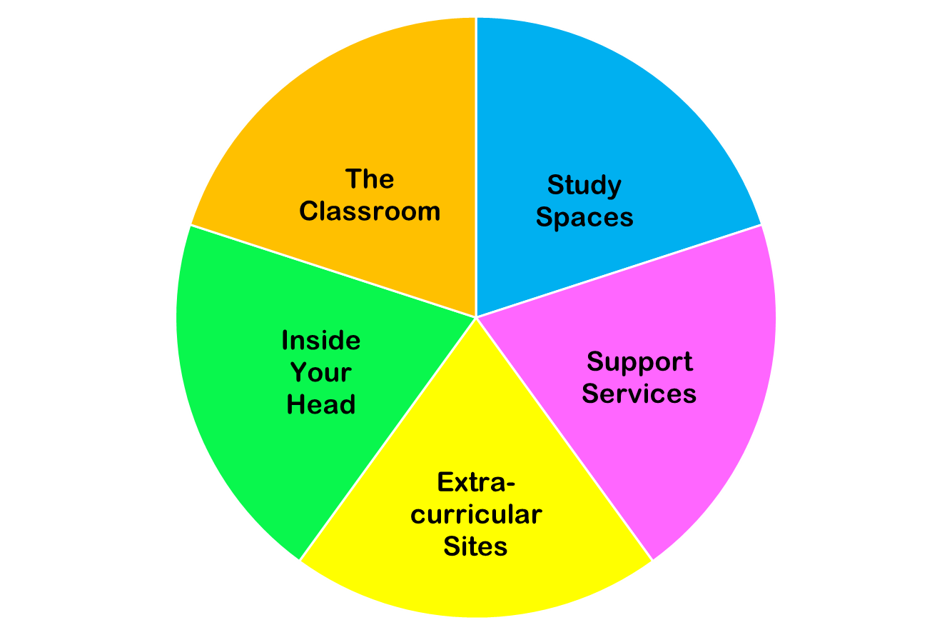
College happens in lots of places
These
are all necessary parts of college!
Notes:
You do NOT need to discuss each piece of this pie in detail. Just discuss the “pie wedge” for the current session and let students know that we will go over each of these pieces in subsequent sessions.

Slide 6
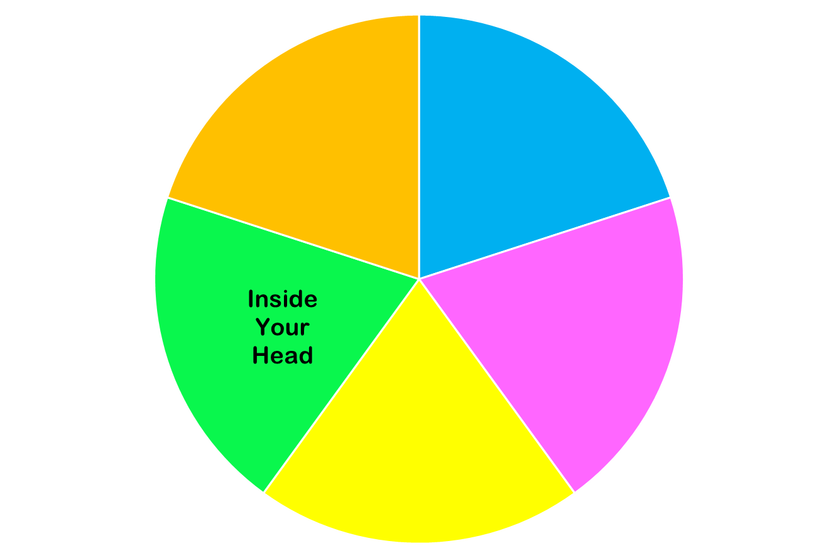
Today we are focused on…

Slide 7
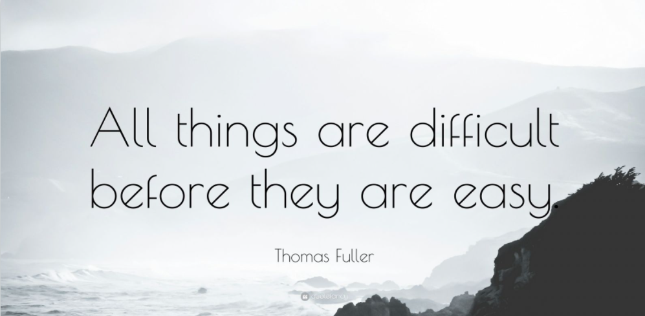
Notes:
I remember a number of people stated they wanted to meet new people at CT, well that is hard and everyone starts as a stranger until they are your best friend

Slide 8
Growth Mindset

Slide 9
Have you ever said any of these things?
“I’m just not good at math.”
“Writing papers just isn’t my thing.”
“Some people have a talent for languages.”
“People are who they are; they can’t really change.”
Notes:
Take a few minutes to talk about these sentences with students, and think of variations on these sentiments that they may have said or believed. You may take an informal poll of how many think some people are just “math people” or “English people” and some aren’t.

Slide 10
[Optional] Let’s take and score a mindset quiz:
https://drive.google.com/file/d/15FEi_-98M8gstY84RXg_929fZ0agFtDQ/view?usp=drive_link

Slide 11
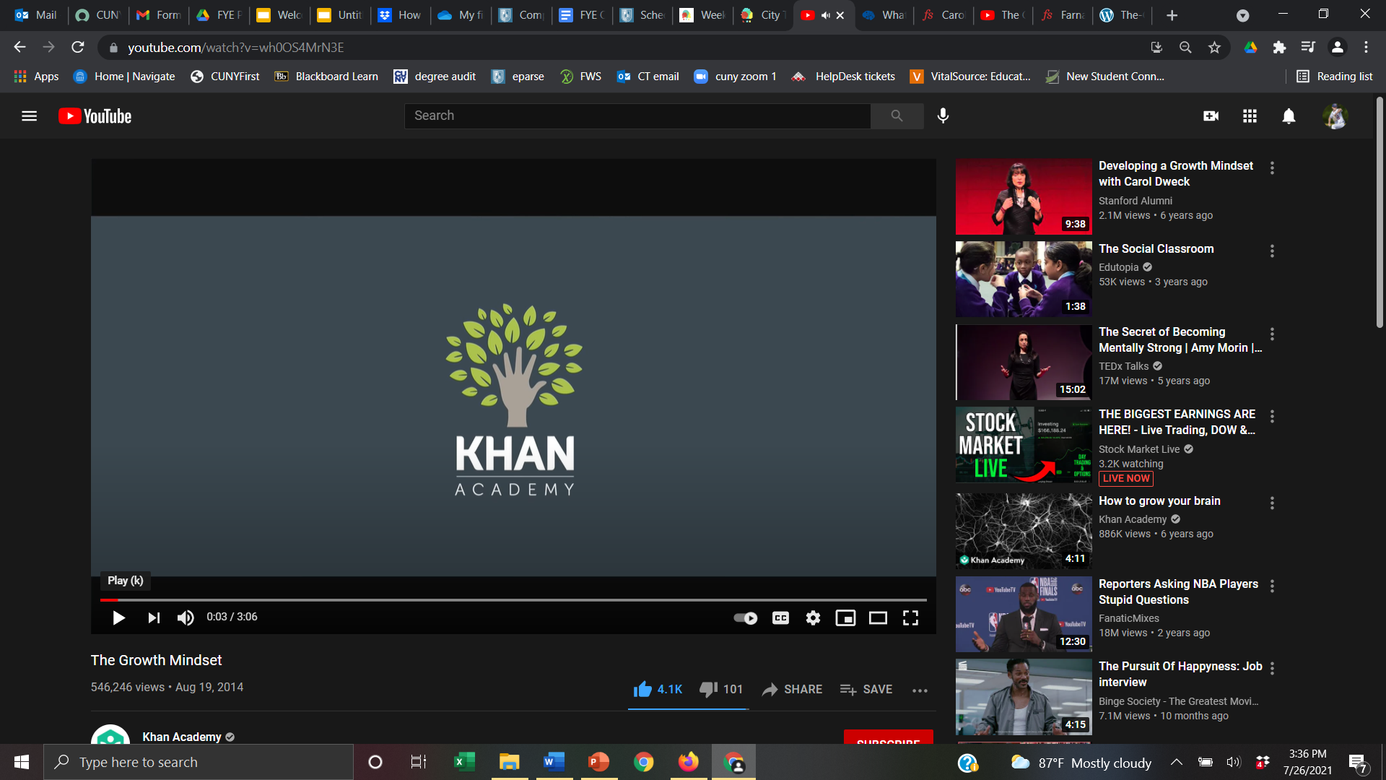

Here are some explanations of mindset:
Video option 1
Video option 2
This Photo by Unknown Author is licensed under CC BY-SA
Article on Mindset
Do you want to know more about creating a growth mindset? Here are more resources:
Mindset, Talks at Google
Assess your Mindset (alternate quiz—requires registration)
A Summary of Growth and Fixed Mindset

Slide 12
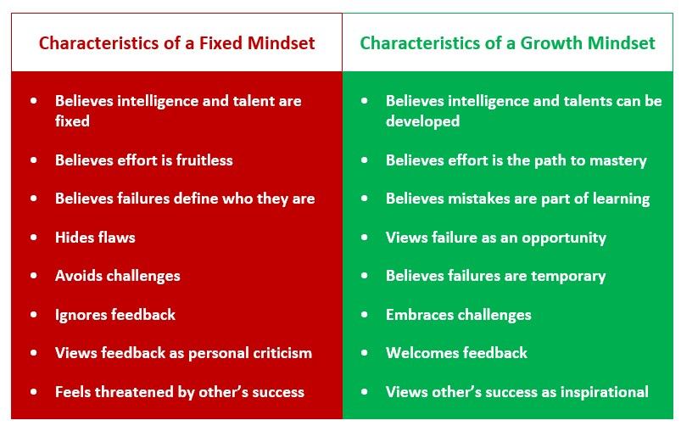
Attribution: https://thepeakperformancecenter.com/development-series/mental-conditioning/mindsets/fixed-mindset-vs-growth-mindset/

Slide 13
Habits of Fixed Mindset
College Students

Slide 14
What kinds of habits and practices do Fixed Mindset students have?

Slide 15
Fixed Mindset Behaviors:
Resistance
Procrastination
Notes:
10:40-10:45
Activate the poll

Slide 16
Resistance:
Pushing back
Refusing to engage or care about learning
Seeing anything challenging or hard to understand as “dumb” or “pointless.”
You do your work, but in a “mechanical”way–you follow directions and get the work done as quickly as possible, without caring about what you learn. Things that require intense effort or thought irritate you.
Notes:
10:40-10:45
Activate the poll

Slide 17
Procrastination
Voluntarily delaying a task or act unnecessarily and seemingly “irrationally,” even though this delay brings negative consequences
Often accompanied by negative feelings and possibly emotional dysregulation
Notes:
10:40-10:45
Activate the poll

Slide 18
What are some causes of procrastination?

Slide 19
Which of these causes of procrastination are related to having a fixed mindset?
Anxiety/anxious feelings
Ego-identity protection
Fatigue/Burnout
Lack of motivation
Low self-esteem
Pessimism
“Self-sabotage”
Time management/executive functioning issues
Notes:
10:40-10:45
Activate the poll

Slide 20
Which of these causes of procrastination are related to having a fixed mindset?
Anxiety/Anxious feelings
Ego-identity protection
Fatigue/Burnout
Lack of motivation*
Low self-esteem
Pessimism
“Self-sabotage”
Time management/executive functioning issues
Notes:
10:40-10:45
Activate the poll

Slide 21
For some tips to help you manage procrastination, visit the Procrastination Station Site.
For procrastination habits that persist or are overwhelming, visit the Counseling Center.
Notes:
https://procrastination.squarespace.com/

Slide 22
Habits of Growth Mindset
College Students

Slide 23
What kinds of habits and practices do Growth Mindset students have?

Slide 24
Growth Mindset Behaviors:
Focus on building skills
Work with patience and engagement
Ask for what you need
Care for yourself
Notes:
10:40-10:45
Activate the poll

Slide 25
Building Skills (with Patience)

Slide 26
Skill-Building Activity: Understanding the Learning Beneath the Assignment
Identify a group scribe and a speaker.
Read the assignment prompt on the next slide. This is a typical assignment that a first year student might see.
As you read, try to identify the tasks that the assignment is asking you to accomplish. What does the assignment want you to do?
Next, look at the list of skills that is provided.
What SKILLS will you need to accomplish the tasks in the assignment?
When we come back together as a full group, we will compare our results.
Notes:
10 minutes

Slide 27
SAMPLE PROMPT
UNIT 1: EDUCATION NARRATIVE
Now that we have read and thought about several different education narrative essays, it is time for you to create an education narrative of your own. In the education narratives we read, the writers discuss educational journeys and use their experiences as a way to draw conclusions about themselves, about education, or about the world in general. You will do the same! You may write about a single event in your educational life that transformed you or changed your way of thinking, or you may write about a series of events that all tie together to make a single point. In writing about your education, you want your reader to understand your interpretation of the events you describe and agree with your overall point (thesis).
Use the readings you have done as models to help you with this task. You may choose to use elements of several different pieces, or you may choose to use one of the pieces as a “mentor text” to help you structure your own work.
Your essay should do or have the following things:
Describe your own personal education experiences (a kind of “personal essay”) and be written in the first person (I/me pronouns)
Describe a single event/experience OR a series of different connected events/experiences
Be thoughtful—analyze your situation and its effect on you
Use specific details and precise language to convey the events and your feelings to the reader
Information should be divided into distinct, organized paragraphs
Should have a point of view and make an overall point about the events you describe and why they are significant
Should be approximately three pages or ~1000 words long

Slide 28
Questions for Discussion:
What did the assignment ask you to do?
What skills do you think you need to complete the assignment?
What was most challenging about reading the prompt and the list of skills?
Of the skills we discussed, which ones do you think you already have mastery of? Which ones have you partly mastered? Which ones do you still have to learn?
If you try to do the assignment without having mastery of all of those skills, what do you think will happen?
Why might a teacher give an assignment knowing that students might not yet have mastery of the skills needed to complete it?
How long to you think it might take to get full mastery of all of those skills? What can you do to have patience with yourself while you learn them?
How can having a Growth Mindset help you as you build skills?

Slide 29
Small Group Discussion: Growth Mindset Habits of Successful College Students
Review the “Track your Learning Process” checklist.
Share which of the practices you did not know successful college students used.
Which of the practices seem most consistent with Growth Mindset behavior? How can having a Growth Mindset help you do some of these tasks?
Which tasks would you like to incorporate into your own study routine?
When you return to the larger group, the speaker from your small group will summarize your discussion
Notes:
10 minutes

Slide 30
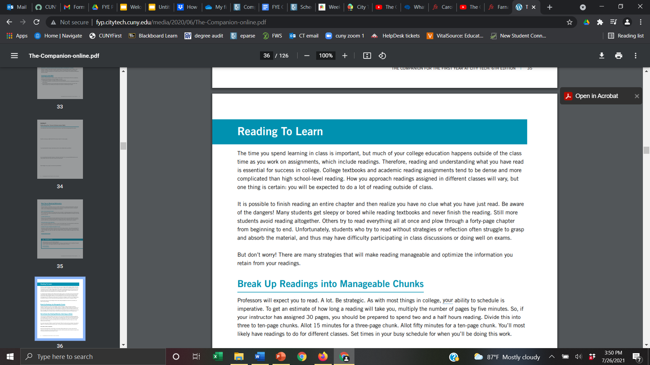
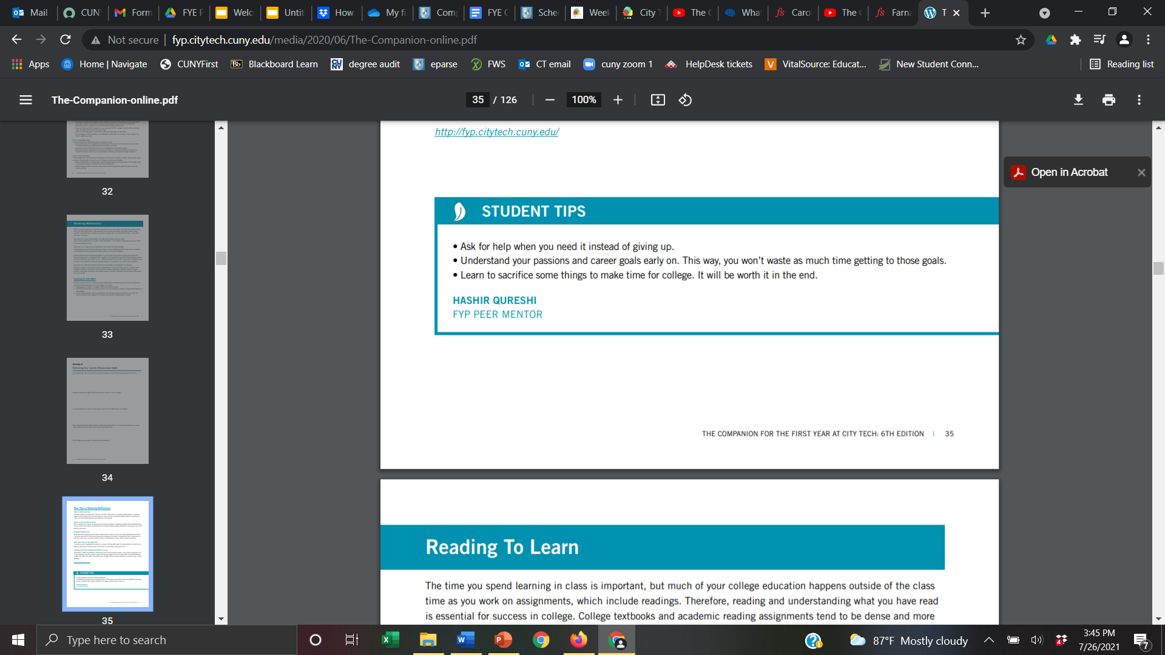
Page 36 of the former Companion for the First Year at City Tech
Notes:
10:48

Slide 31
Think back to our discussion of school resources from Session Four.
Which resources and services can help you be a Growth Mindset learner?

Slide 32
How do I take care of myself?

Slide 33
Two Ways to Recharge
Self-Soothing
INDULGE + RELAX
Feels good right now.
Self-Care
RESPONSIBLE + RATIONAL
Your future self will thank you.
Both types are important and necessary!!
Notes:
People tend to focus on the first type, but the second type is also VERY important

Slide 34
Self-Care Brainstorm
How do you take care of yourself?
Notes:
OPTIONAL
Sharing images and words of what self-care means to/looks like for them

Slide 35
Time with friends
Eating healthy foods
Time with family
Physical activity
Pursuing hobbies
or passions
Managing physical/
mental health
Observing religious/ cultural celebrations
Personal hygiene
Engaging in meaningful spiritual practices
Playing games/Reading
/Watching shows
SLEEP!
Alone/”zoning out” time
Notes:
OPTIONAL
Sharing images and words of what self-care means to/looks like for them

Slide 36
These are things we can skimp on in the short term.
They are necessary on a long-term basis to keep us healthy, happy, and able to learn!

Slide 37
Recap
Where College Happens, Pt. 4
What is a Growth Mindset?
Fixed Mindset Habits
Growth Mindset Habits
Skills-Based Learning
Self-Care

Slide 38
Before Session 6…
Complete Reflection on OpenLab by replying to Reflection #5 Post.
Reflection #5
Consider the discussions we had today about mindset. Share a concept you believe is important and explain what the concept means to you as a college student.
Read and comment on another student’s post.

Slide 39
Get Your Head
in the Game:
Mindset + Self-Care
Session 5
10/1/24
Professor Perrera
City Tech 101 by Karen Goodlad and Sarah Paruolo is licensed under a Creative Commons Attribution-NonCommercial-ShareAlike 4.0 International License.

