Slide 1
City Tech 101
Fall 2024
Professor Perreira
Professor Email: gperreira@citytech.cuny.edu
City Tech 101 by Karen Goodlad and Sarah Paruolo is licensed under a Creative Commons Attribution-NonCommercial-ShareAlike 4.0 International License.

Slide 2
#RiseAndGrind
Session 3
09/17/24
Professor Perreira
City Tech 101 by Karen Goodlad and Sarah Paruolo is licensed under a Creative Commons Attribution-NonCommercial-ShareAlike 4.0 International License.

Slide 3
Today’s Topics
Where College Happens, Pt. 2
Learning Plan Questions
Creating Workspaces
Your New Schedule
Time Management
Learning Styles Discussion
What is your study/learning plan?

Slide 4
Where does
college happen?
Notes:
We want students to understand that college isn’t just going to class and leaving. Getting a full college experience means that learning and growth happen in many different spaces and in different ways. Variations on these slides will appear in each presentation from Session 2 to Session 6.

Slide 5

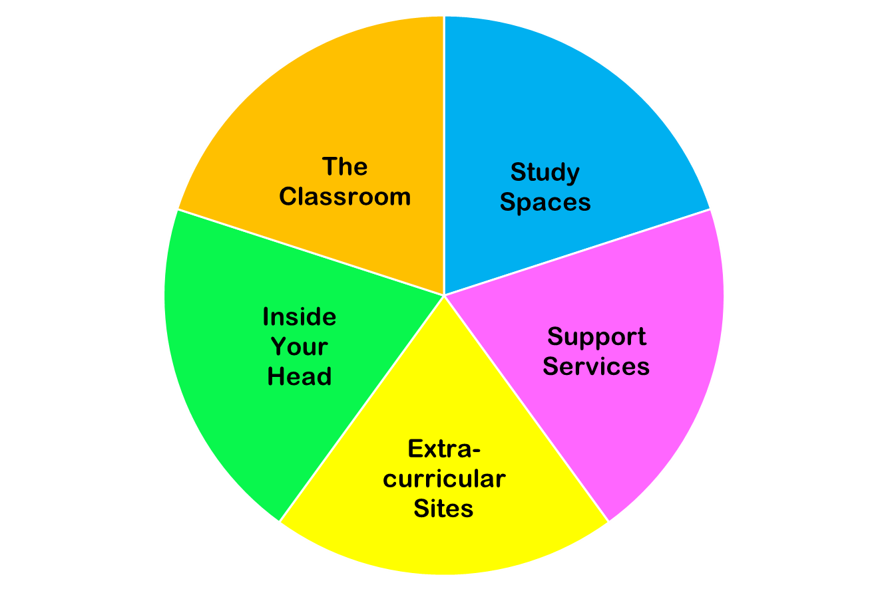
College happens in lots of places
These
are all necessary parts of college!
Notes:
You do NOT need to discuss each piece of this pie in detail. Just discuss the “pie wedge” for the current session and let students know that we will go over each of these pieces in subsequent sessions.

Slide 6
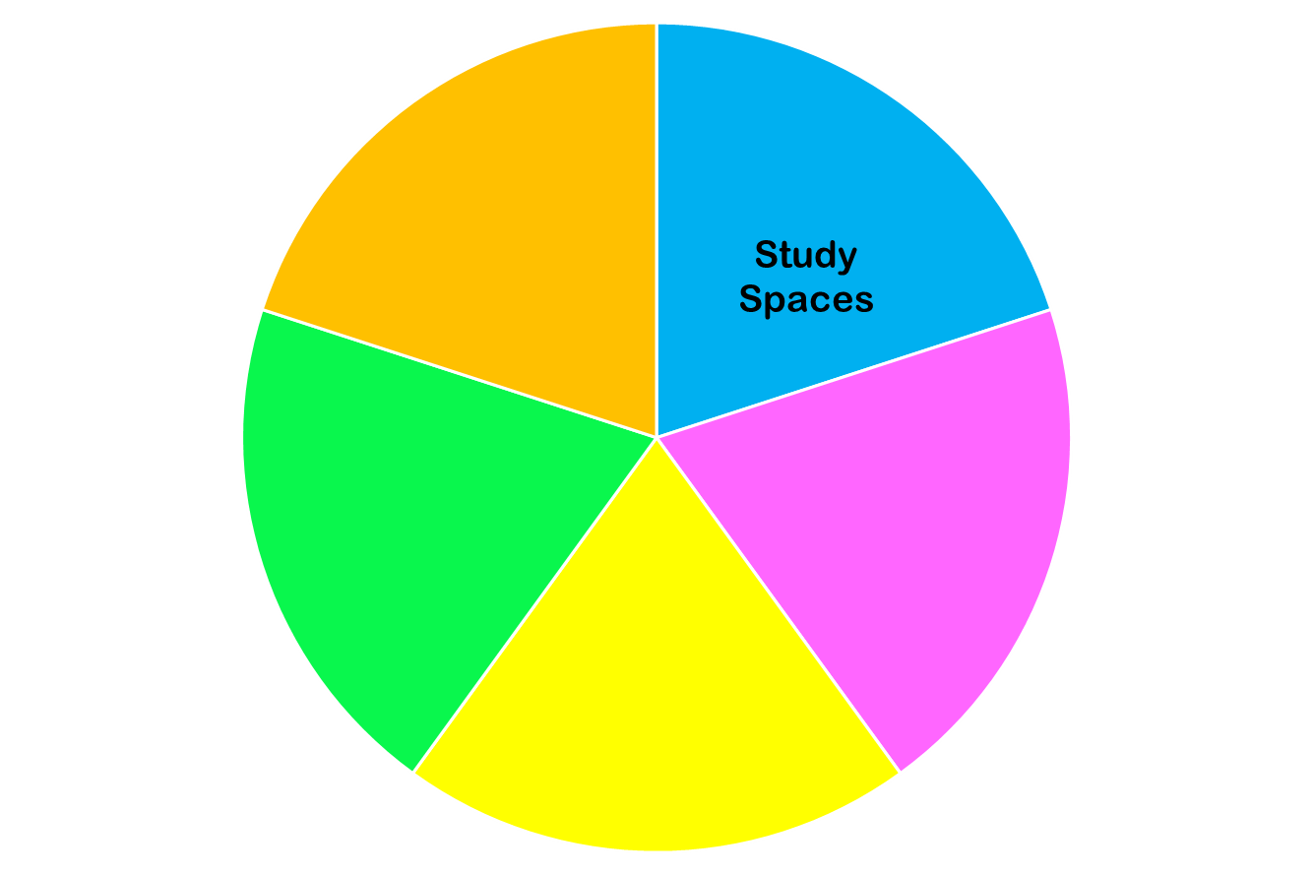
Today we are focused on…

Slide 7
Increased Personal Responsibility
Taking Control of Your Own Learning
=
Notes:
Q: What does it mean to take control of your own learning?
Q: Why is this important?
Q: How does this present as being different from how you learned in high school?

Slide 8
Learning Plan Questions
PDF of Questionnaire
Notes:
Introduce the idea that people learn in different ways, know how you learn makes a huge difference in how easy you find school/studying.
Give them 10 minutes to take the quiz.

Slide 9
Learning Spaces:
Where do I learn?
Notes:
Q: Where do you do your homework and study? Why? Do you think that is the best place to do it? Why/Why not?

Slide 10
Working Remotely
In your home
In your own space
In your personal classroom
In a suitable place in your neighborhood (library, coffee shop, park, or a different CUNY campus)
Notes:
Pros and cons
Online/Remote Learning-- difficulties and advantages
Armed with the knowledge of past 2.5 years
Even if in person, will all your work be done at school? Do you need a space at home to work?

Slide 11
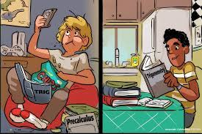
Which student is an engaged learner?

Slide 12
Create Your Own Workspace at Home
Limit distractions and unwanted noise
Set up computer/tablet on a desk or table, not your lap
Sit in a chair, rather than a couch or bed
Have a notebook and pens/pencils nearby
Make sure there is plenty of light
Hang a calendar or weekly schedule
Post a To Do list
Post pictures, images, and/or motivational quotes
Add a plant for increased oxygen
Notes:
Importance of making space
Creating the right atmosphere and routine
Train your brain to know that this is a space for work

Slide 13
On City Tech Campus
In the classroom
In the lab
In the library
In the computer lab
In other spaces
Have you found a place on campus to study that works for you?
A place to hang out?
Notes:
Pros and cons:
Quiet v. Noise
Distractions
Comfort-- but not too much
Specific spaces
What kind of access will you have this/next semester?

Slide 14
Find Your Own Workspace on Campus
Which spaces have the optimal amount of quiet or noise for you?
Alone or with friends/classmates?
Find a place where you can work in a comfortable position
Carry your supplies with you
Where are the places you can get help on campus when you need it?
Notes:
Importance of making space
Creating the right atmosphere and routine
Train your brain to know that this is a space for work

Slide 15
What other places are workspaces?

Slide 16
What other places are workspaces?
Coffee shop or restaurant
Park or other outdoor area
Public Library
Library at a different CUNY campus

Slide 17
Think back to the answers you gave on your “Learning Profile” Questions.
What spaces will help you study most productively? Where can you find those spaces?

Slide 18
What spaces will help you study most productively? Where can you find those spaces?
Take a few minutes to draw or diagram a study space you plan to use. What will be the best layout for this space? What will this space include?
OPTIONAL ACTIVITY: Study Space Diagram Worksheet
Notes:
You can direct students to the activity sheet (in their course packet) and give them a few minutes to draw or sketch an ideal study space for themselves.

Slide 19
When do I learn?

Slide 20
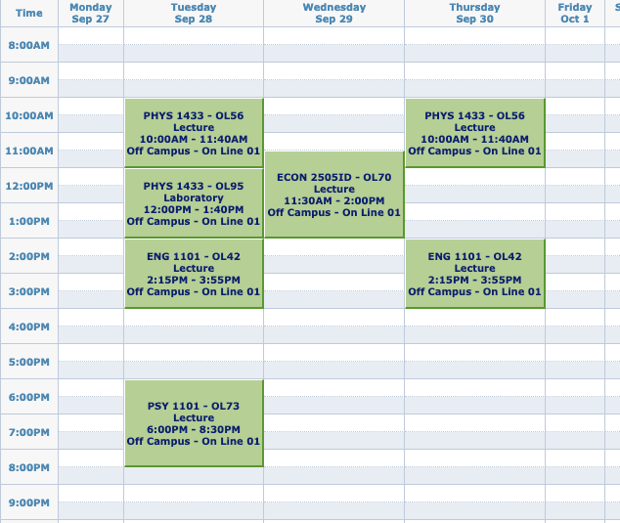
A Typical FY College Schedule
What does this schedule look like compared to your HS schedule?
What assumptions might you make based on those differences?
IMAGE

Slide 21
Do you really have all that free time now??
One of the hardest parts of college is BALANCING everything—your courses,your assignments, and the rest of your life.

Slide 22
Question
How many hours will you spend
in class and doing work for class in one semester?
Notes:
Have them guess

Slide 23
Answer:
Over 600 hours!
That’s a lot of hours!
Let’s break it down week by week.

Slide 24
The Breakdown
15 credits = roughly 15 hours in class each week
for each hour in class, budget 2 hours for homework and studying
15 credits = roughly 30 hours of work outside of class each week
so when taking 15 credits, you should expect to spend about 45 hours each week just on school
15 credits each semester
many classes are 3 credits
often, 15 credits means
5 courses (but not always)
1 credit = approximately 1 hour in class each week

Slide 25
Math Time!
How many hours a week do you spend doing…
https://drive.google.com/file/d/1yEQJnM4ocvgn0PiPHEdC2_XeEN0AAuNA/view?usp=drive_link
(But don’t worry, you can use your calculator for this.)
Notes:
Not all hours are created equal. Open Google Doc or Zoom Whiteboard to DEMO math.

Slide 26
Think back again to the answers you gave on your “Learning Profile” Questions.
What times of the day are the best time for you to study? What can you do to make sure you’re available during those times?

Slide 27
How do I learn?

Slide 28
How do you learn something new?
How do you practice a new skill?
What are the best practices and habits to help you learn?
How can you take charge of your own learning?
Take time to discuss these questions as a class or in small groups.
Notes:
Open students up to the idea that they don’t actually know HOW they learn things. Invite students to consider what methods best help them memorize and retain information and what kinds of habits or goals help motivate them to learn.
I usually say something like… “At this point in your lives most of you have been professional students for at least 12 years. We expect professionals in most fields to be experts at their craft. Examples like a carpenter, a plumber, a pilot, etc. Are you an expert at learning? How could you not be? Is it possible you learned how to learn but have no idea that you did?”
This leads into why we need to understand how our brains work, and how we actually learn-- especially since it is now in their hands.

Slide 29
What is my Learning Plan?

Slide 30
Based on all you have learned today, take time to write down three or more practices or habits you will incorporate into your study routine.
Why did you choose them? Why do you think they will help you?

Slide 31
BE OPEN
TO
LEARNING HOW TO LEARN
The definition of futility is doing them same thing over and over, but expecting different results.
Successful learners adjust their practices to improve their outcomes.
Notes:
Prompt students to understand that do get new results, they have to be willing to try new things.
I like to share this example: When introducing new food to a child, you have to make them try it 20 times before accepting that they really don’t like the food. Not to torture them, but because our bodies are trained to be suspicious of new things. Translate this to learning.
Trying to integrate new study methods and routines will not be simple. You are going to have to push yourself for a while before it feels natural/right/comfortable.

Slide 32
Recap
Where College Happens, Pt. 2
Learning Plan Questions
Creating Workspaces
Your New Schedule
Time Management
Learning Styles Discussion
What is your study/learning plan?

Slide 33
Before Session 4…
Complete Reflection on OpenLab by replying to Reflection #3 Post.
Read the following quote by Dr. Pamela Brown, Provost and Vice President for Academic Affairs:
“Learning is a source of hope for a better future. It requires hard work and sacrifice which can be even more difficult in challenging times. Your time in college is also your opportunity to connect with others, lift your spirit, enrich your life, and develop the skills and knowledge to make a difference in your community.”
Choose a question below and write a reflection in the comment box below this post.
What life experiences have prepared me for college?
When I have been faced with a difficult situation, what strategies did I use to find a solution?
How will I create positive academic habits for myself?
Read and comment on another student’s post. These are your classmates; encourage them to work towards their goals!

Slide 34
#RiseAndGrind
Session 3
09/17/24
Professor Perreira
City Tech 101 by Karen Goodlad and Sarah Paruolo is licensed under a Creative Commons Attribution-NonCommercial-ShareAlike 4.0 International License.

