Slide 1
City Tech 101
Fall 2024
Professor Perreira
Professor Email: gperreira@citytech.cuny.edu
City Tech 101 by Karen Goodlad and Sarah Paruolo is licensed under a Creative Commons Attribution-NonCommercial-ShareAlike 4.0 International License.

Slide 2
The Syllabus
and the Classroom
Session 2
09/10/24
Professor Perreira
City Tech 101 by Karen Goodlad and Sarah Paruolo is licensed under a Creative Commons Attribution-NonCommercial-ShareAlike 4.0 International License.

Slide 3
Today’s Topics
Where College Happens, pt 1
Organizing your Materials
Learning Etiquette + Engagement
Contents of a Syllabus
Group Work 101/Syllabus Scavenger Hunt
Duties + Responsibilities of a Student
Duties + Responsibilities of a Professor

Slide 4
Where does
college happen?
Notes:
We want students to understand that college isn’t just going to class and leaving. Getting a full college experience means that learning and growth happen in many different spaces and in different ways. Variations on these slides will appear in each presentation from Session 2 to Session 6.

Slide 5

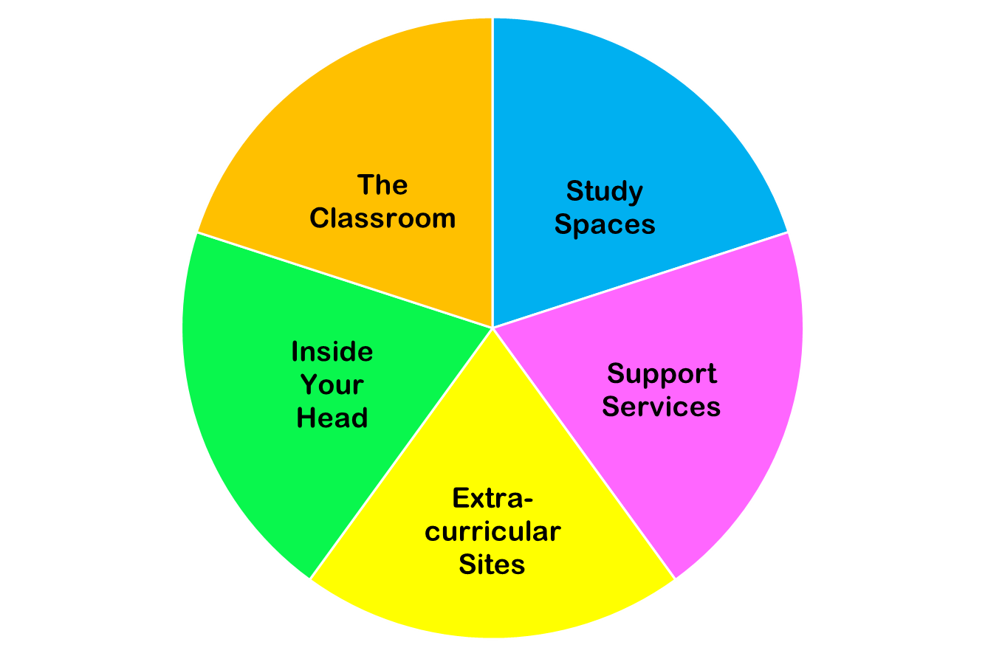
College happens in lots of places
These
are all necessary parts of college!
Notes:
You do NOT need to discuss each piece of this pie in detail. Just discuss the “pie wedge” for the current session and let students know that we will go over each of these pieces in subsequent sessions.

Slide 6
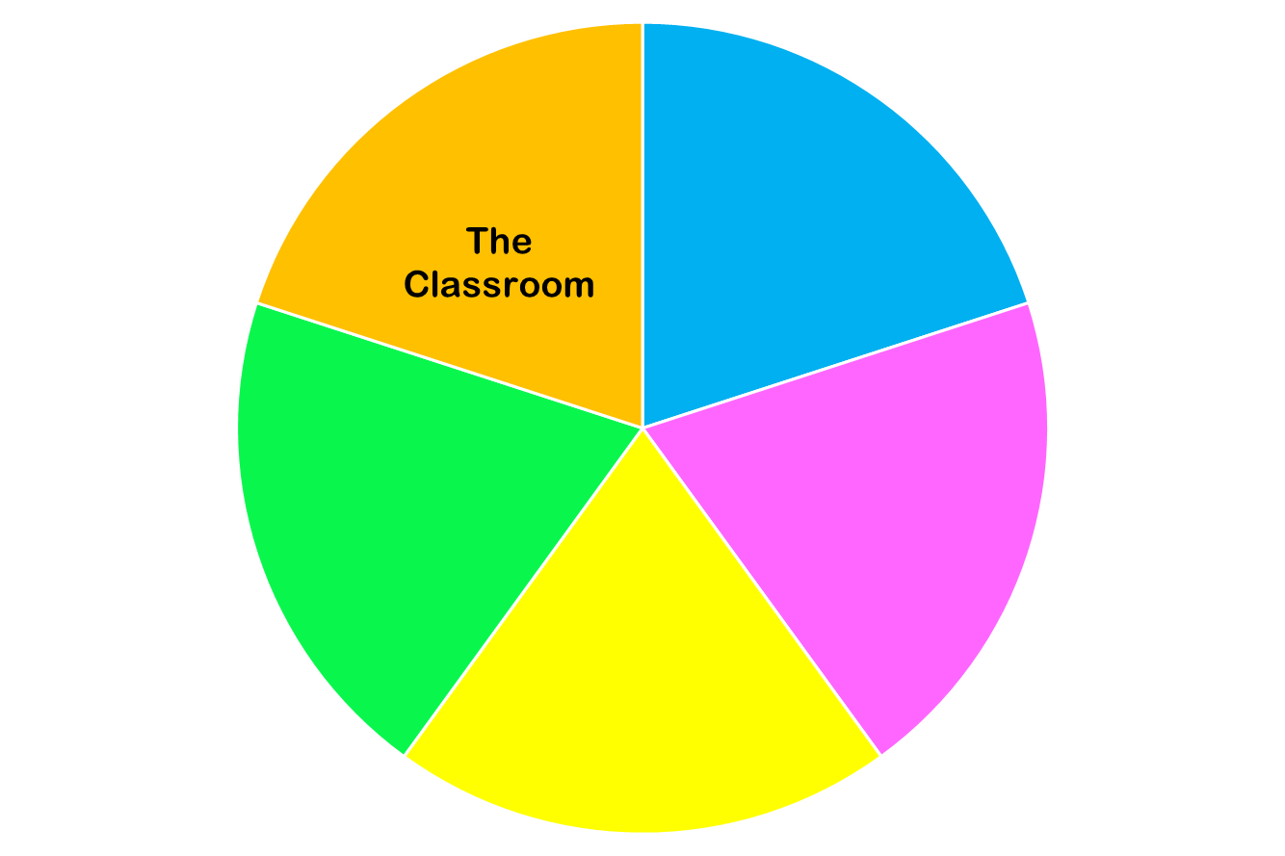
Today we are focused on…

Slide 7
Organize your Materials
Notes:
Give students an overview of the electronic resources and physical materials they will need for their classes.

Slide 8
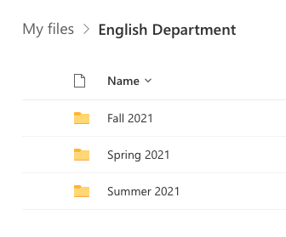
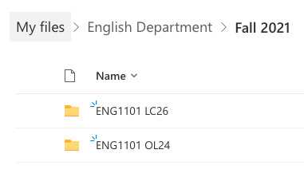
Organize electronically...
Make folders in your OneDrive or Dropbox
Organize by semester
Organize by course
First file is your syllabus + schedule
Save ALL your work for the course
Use consistent and clear file names
LastName_Assignment_Class_Semester
e.g. Paruolo_Reflection4_CT101_SU21

Slide 9
And organize IRL!
IMPORTANT THINGS TO HAVE:
Loose-leaf, college-ruled paper (or a perforated notebook)
Writing implements
Any specialized equipment you need for class (calculator, tools, etc.)
A file folder or binder for every class
  Keep all handouts (including syllabus!)
  Save any hard copies of graded assignments
A place to take notes for every class
  Binder or notebook with sections
  OR a separate notebook for each class
  OR paper you store in your dedicated class folder

Slide 10
Learning Etiquette + Engagement
Notes:
This section should just be a preview. You can use it to set ground rules for behavior in your class. If you don’t have time, you can skip this section and move it to Session Two as part of an in-depth discussion of appropriate classroom behavior.

Slide 11
Classroom Learning:
The Necessities of Etiquette
Arrive on time
Leave the classroom only for emergencies
Pay attention
Be prepared to participate
Take notes (have a pen and paper at all times)
Headphones off/out!
Phones on silent and put away
Communicate with your teacher if you need to break these rules regularly.
Notes:
Please make it clear to students that these are basic, non-negotiable rules of classroom etiquette, not optional behaviors. Breaking these rules breaks the social contract of classroom behavior.

Slide 12
Classroom Learning:
The “Good-to-Haves” of Engagement
Asking and answering questions
Addressing your professors
Active learning doesn’t always mean speaking up
Choose your seat wisely
Notes:
Emphasize to students that these behaviors, while not required, will go a long way to fostering goodwill and a supportive relationship with the professor.

Slide 13
Online Learning: Etiquette + Engagement
Everything from Classroom Learning plus…
Camera on? Yes, please!
Camera off? Check if your professor requires it!
Mute your microphone, not your voice!
Chat to stay connected throughout class.
Breakout Rooms–be active and participate
Notes:
This is a good opportunity to highlight to students that online learning requires levels of motivation, discipline, and ability to focus beyond those required for classroom learning. Please also make are aware of the updated camera policy for online classes. Profs. Can require that cameras be on

Slide 14
Contents of a Syllabus

Slide 15
Why is a syllabus so important?

Slide 16
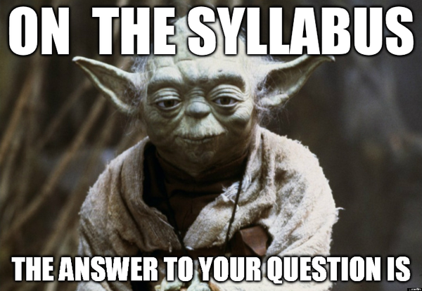

Slide 17
The syllabus is an informal contract between a student and a professor.
Lays out requirements and expectations for the student
Lays out commitments and standards for the teacher
Notes:
Remind students that this works both ways–they are responsible for upholding the standards laid out in the syllabus, and so are instructors.

Slide 18
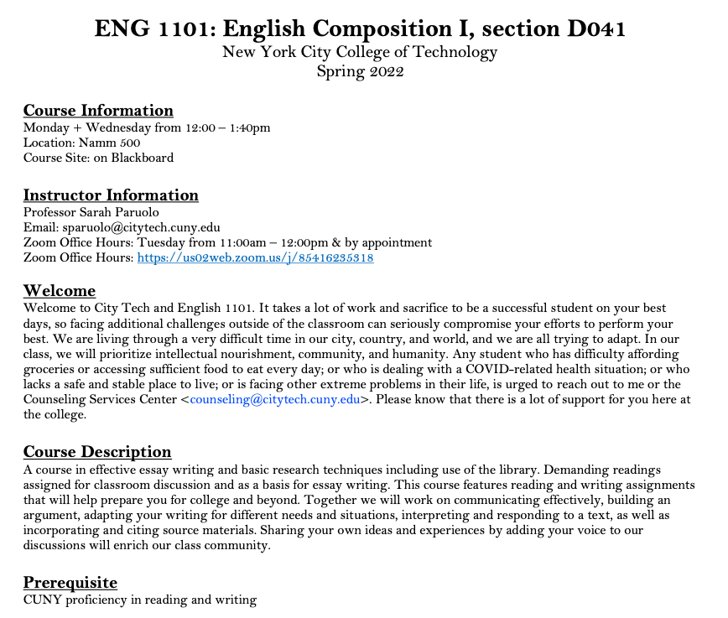
Department Abbreviation
Course Number
Course Name
Course Meeting Information
Course Site Information
Instructor Contact Information
Office Hours Information
Course Description
Pre/Co- Requisites
Notes:
These images of a syllabus on slides 14-18 are there as a sample if you cannot, for some reason, give students access to electronic or hard copies of sample syllabi. Please do NOT go through the information on the slides in great detail. If you need to use these slides, you can highlight a few parts and also give students a chance to study selected images and talk about the details or features that they notice.

Slide 19
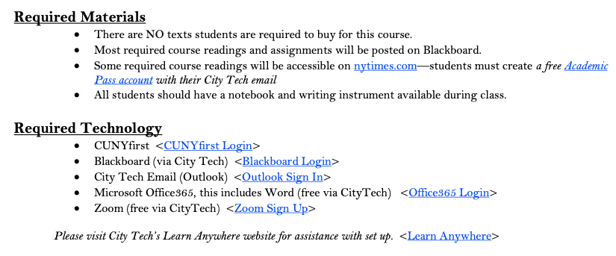
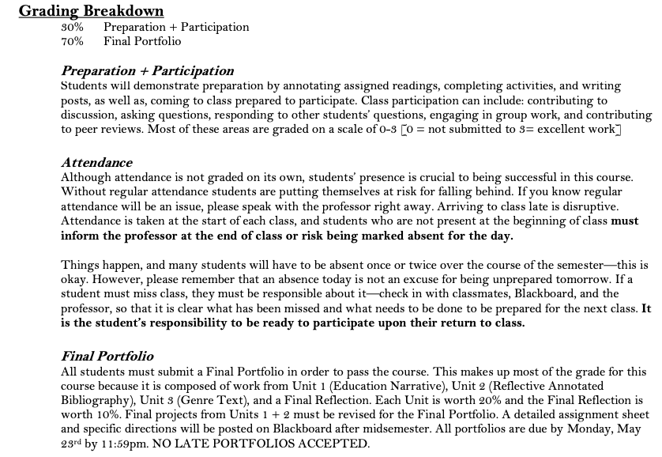
Required Texts
Required Materials
Required Technology
Grading Breakdown
Course Assignment Descriptions

Slide 20
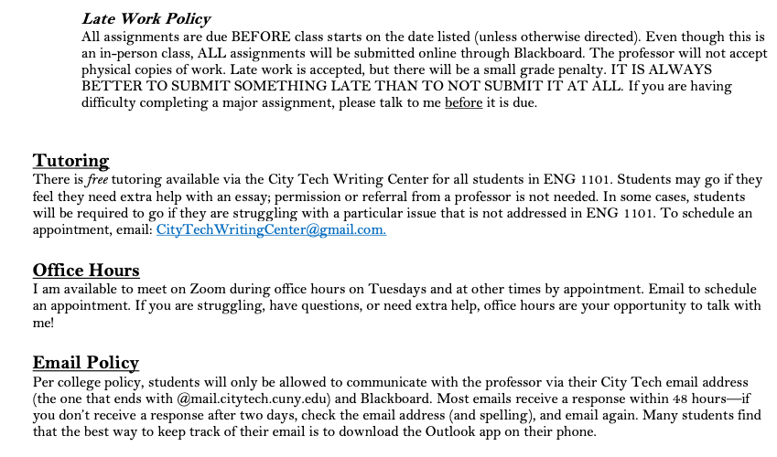
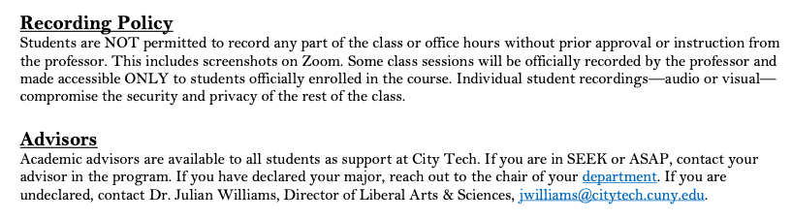
Course Policies

Slide 21
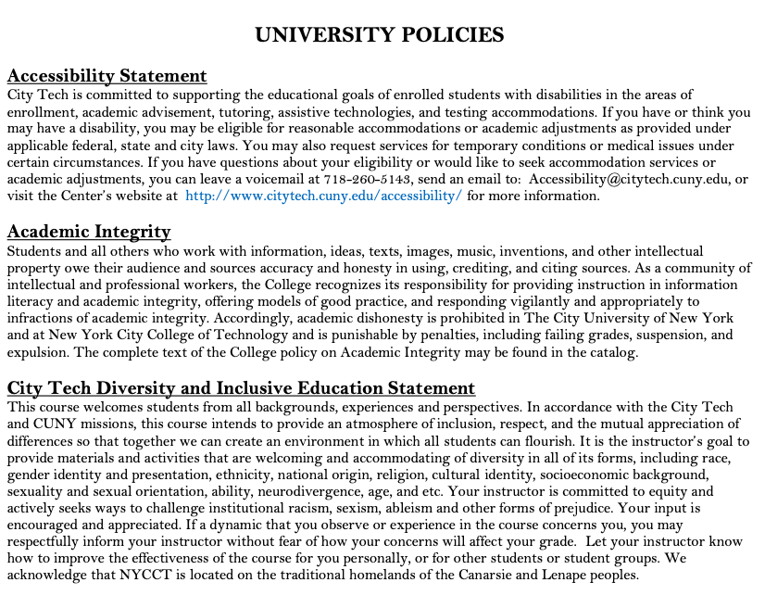
Accessibility Statement
Academic Integrity Statement
Diversity and Inclusive Education Statement

Slide 22
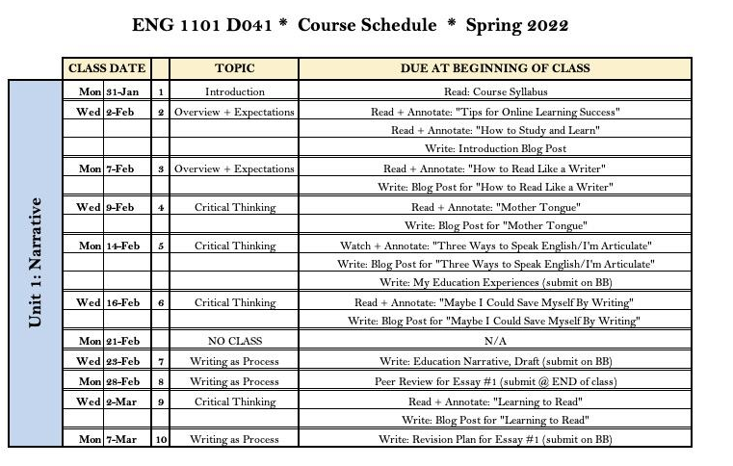

Slide 23
Sample Syllabi
Biology 1101 Syllabus
Hospitality 1101 Syllabus
Human Services 1102 Syllabus
Math 1190 Syllabus
Notes:
You can use these syllabi or provide others of your choosing. If you choose to use others, please make sure they conform to the standard set by CIty Tech and include all required text. Make sure students have access to the syllabi by printing hard copies or by making links/files available to them before class.

Slide 24
Syllabus Exploration
and
Group Work 101

Slide 25
Group Work 101
Here are some basic requirements for working in a group in class. Make sure you are ready to work with others!
You are facing everyone else in your group, and your back is to no one in your group.
You are sitting close enough to every other person in your group that they can hear or understand you and you can hear or understand them if they speak at a normal volume.
You have introduced myself to your group.
You know the names of everyone else in your group.
You are prepared to look at others when they speak and/or to show interest and engagement in other ways.
Your group has made sure that you all understand the directions and are ready to work.
You have designated a secretary or note-taker, if necessary. (If no one volunteers, draw numbers, count off, use “rock, paper, scissors,” etc. to pick someone.)
Notes:
If you decide to do the activity on the next slide (or in the following segment) as a group project, take this opportunity to introduce the basic etiquette of group work. You may also choose to use the worksheet linked here as a guide for students to help them complete the activity while practicing how to work in a group.

Slide 26
Syllabus Scavenger Hunt
Or use this alternate version
Look through the sample syllabi and through syllabi you may have gotten for your own classes. What do you see? Try to answer the following questions:
If you want to email your professor, where on the syllabus are you likely to find their email address?
Where should you look to find a breakdown of how your final grade will be calculated?
If you want to know what you will be discussing in class on a certain day, where are you likely to find that information?
Where will you be likely to find the time and location of your professor’s office hours?
What is the class policy on late/missing work? Where did you find it in the syllabus?
Notes:
Break students into groups and ask them to look through some sample syllabi, or if short on time ask them to do this individually. You can make this into a game or contest if you like.

Slide 27
Duties + Responsibilities
of a Student

Slide 28
Question: What are a student’s responsibilities when taking a class? Brainstorm your answers and collect them as a group.
Directions:
5-7 minutes to discuss questions in breakout rooms
Assign scribe to take notes while you all discuss (or use GoogleDoc to share with group)
Assign reporter to share your answers
We will come back as group to discuss-- be prepared!
Small Group Discussion
A Student’s Classroom Responsibilities

Slide 29
A Student’s Job Includes...
Contributing to an Inclusive Classroom + Campus Environment
Completing All Major Assignments + Exams
Submitting Work On Time
Learning Course Content, as Taught by Professor
Studying Course Content
Asking Questions and seeking help (in class, via email, + during office hours)
Reading All Announcements and Directions Thoroughly
Being Prepared for All Classes
Reading + Understanding the Syllabus + Course Schedule
Being Responsible for ALL Information in the Syllabus
Asking Questions about Course Requirements, Assignments, Policies, + Grading Criteria
Attending Class Regularly + On Time
Informing Professor of Absences in a Timely Manner
Completing All Work in Accordance with City Tech’s Academic Integrity Policy
Using any Online Class Sites Fully

Slide 30
Duties + Responsibilities
of a Professor

Slide 31
A Professor’s Job Includes...
Creating and Distributing a Syllabus + Course Schedule (1st week of semester)
Notifying Students of Any Changes to the Course Schedule in a Timely Manner
Providing Clear Grading Scheme + Criteria
Grading Student Work Fairly
Informing Students of Midsemester Grades (8th week of semester)
Providing Clear Expectations for Students
Addressing All Learning Objectives for Course
Teaching Students Course Content in a Clear Manner
Holding Weekly Office Hours for Students
Answering Student Emails in a Timely Manner
Answering Student Questions
Assigning Final Grades
Treating All Students with Respect + Fairness

Slide 32
What can you do if your professor doesn’t fulfill their responsibilities?

Slide 33
Start with the professor!
Then speak to the department chair (head)
The academic dean is the last step
The student affairs office can give you advice

Slide 34
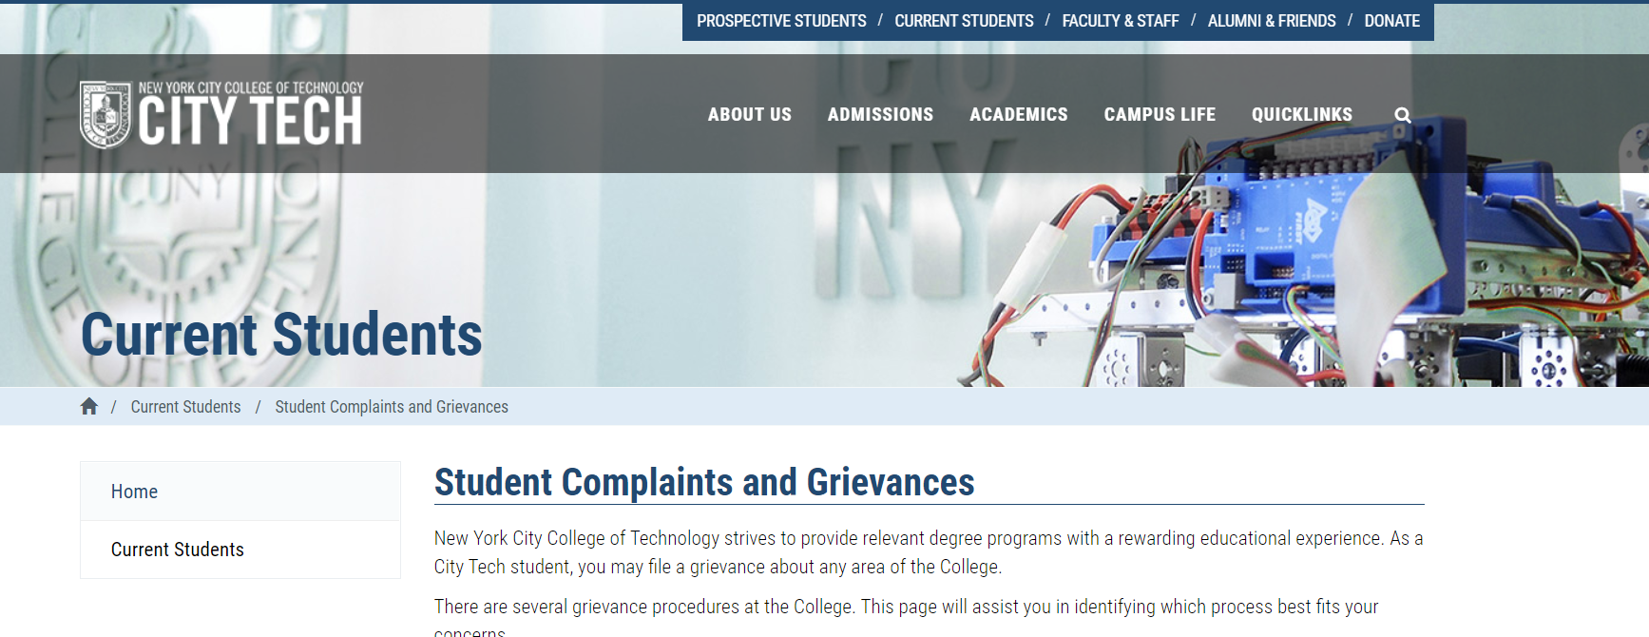
What are some reasons students may complain or file a grievance?

Slide 35
Tips for Effective Communication
Set up your City Tech email
Download the Outlook App for your phone
Organize your files and supplies
Check your City Tech email EVERY DAY
Check Blackboard and/or OpenLab EVERY DAY
Write clear emails and ask good questions
Utilize professor office hours

Slide 36
Recap
Where College Happens, pt 1
Organizing your Materials
Learning Etiquette + Engagement
Contents of a Syllabus
Group Work 101/Syllabus Scavenger Hunt
Duties + Responsibilities of a Student
Duties + Responsibilities of a Professor

Slide 37
Before Session 3…
Complete Reflection on OpenLab by replying to Reflection #2 Post.
  Remember, you must have an account and be logged in to OpenLab to reply to a post.
  How to Respond to a Reflection
Read the Reflection post.
Click on Comment.
Write your comment in the box.
Click Post.
Reflection #2
Review the introductory course syllabi you looked at in class. What does this information tell you about what you should expect this semester? What information interests or surprises you?

Slide 38
The Syllabus
and the Classroom
Session 2
9/10/24
Professor Perreira
City Tech 101 by Karen Goodlad and Sarah Paruolo is licensed under a Creative Commons Attribution-NonCommercial-ShareAlike 4.0 International License.

