Slide 1

Chapter 2
Psychological Research
OpenStax Psychology 2E
OpenStax ancillary resource is © Rice University under a CC-BY-4.0 DEED license and may be used with proper attributes. Unless otherwise noted all material and text contained in these ancillary materials is from Spielman, R. M., Jenkins, W. J., & Lovett, M. D. (2020). Psychology 2E. OpenStax and is licensed under CC BY 4.0 DEED.

Slide 2
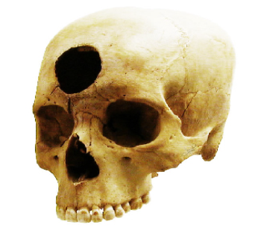
Why is Research Important?
At one time in history, people believed the earth was flat and that mental illnesses were caused by possession. People can be very wrong in their ideas about the world when they do not rely on evidence to support their claims.
  Research is a mandatory process in validating claims.
Scientific research is empirical; it is grounded in
objective, tangible evidence that can be observed time and time again, regardless of who is observing.
Without research, we would only have intuition and groundless assumptions. Through research we are able to prove certain ideas through study and testing.
Psychology is a science, therefore, research is
required to not only further investigate something but
provide verification and support of the findings.
Figure 2.2 Some of our ancestors, across the world and over the centuries, believed that trephination—the practice of making a hole in the skull, as shown here—allowed evil spirits to leave the body, thus, curing mental illness and other disorders.
All text and images from Psychology 2e OpenStax Revised Version Copyright © 2020 by Openstax is licensed under a Creative Commons Attribution 4.0 International License, except where otherwise noted. Edited by Marie Parnes

Slide 3
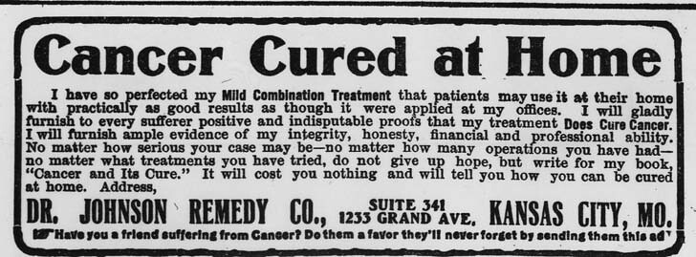
Use of Research Information
Advertising campaigns often claim to be based on “scientific evidence” when in reality it is based off belief.
Thinking critically about claims:
What is the expertise of the person making the claim?
What might they gain if the claim is valid?
Does the claim seem justified given the evidence?
What do other researchers think of the claim?
Advertisement for patent medicine claiming to cure cancer, early 20th century.
This image is from the 'Health in America' 2011 calendar produced by the La Guardia and Wagner Archives/CUNY. For more images from the Archives' several collections, go to www.laguardiawagnerarchive.lagcc.cuny.edu CC0 Public Domain. Retrieved from Flickr.
Link to Learning Video: Watch this video about early childhood program effectiveness to learn how scientists evaluate effectiveness and how best to invest money into programs that are most effective
All text and images from Psychology 2e OpenStax Revised Version Copyright © 2020 by Openstax is licensed under a Creative Commons Attribution 4.0 International License, except where otherwise noted. Edited by Marie Parnes

Slide 4
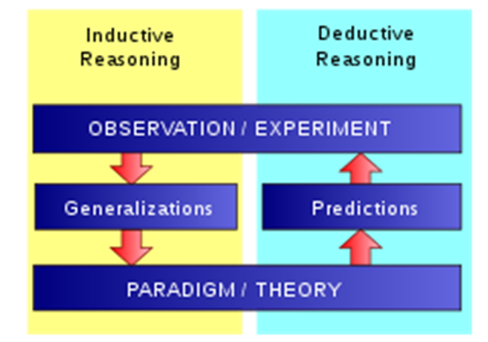
The Process of Scientific Research: Inductive vs Deductive Reasoning
Deductive reasoning - results are predicted based on a general premise.
For example: All dogs have ears. Poodles are dogs. Therefore, poodles have ears.
Inductive reasoning - conclusions are drawn from specific observations.
For example: My dog Zelda has white fur. Zelda is lazy. White furry dogs are lazy.
Scientists form ideas (theories/hypotheses) through inductive reasoning.
Hypotheses are then tested through empirical observations and scientists form conclusions through deductive reasoning.
These conclusions lead to new theories and hypotheses (or more broad generalizations).
Psychological research relies on both inductive and deductive reasoning.
All text and images from Psychology 2e OpenStax Revised Version Copyright © 2020 by Openstax is licensed under a Creative Commons Attribution 4.0 International License, except where otherwise noted. Edited by Marie Parnes

Slide 5
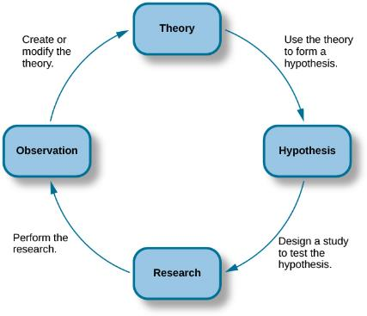
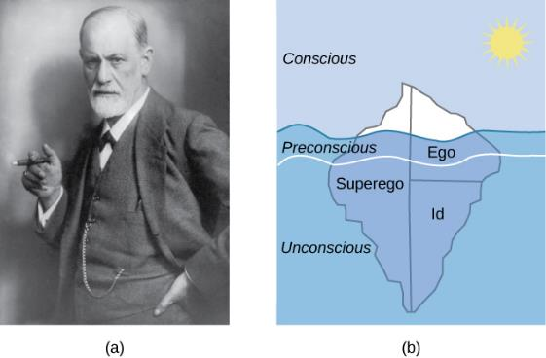
The Scientific Method
Scientists use inductive reasoning to form theories which then generate hypotheses.
Theory – well-developed set of ideas that propose an explanation for observed phenomena.
Hypothesis – tentative and testable statement (prediction) about the relationship between two or more variables.
Predicts how the world will behave if the theory is correct.
Usually an “if-then” statement.
Is falsifiable (capable of being shown to be incorrect).
Text: OpenStax Psychology 2E is licensed under CC BY 4.0 International.
Many of the specifics of (a) Freud's theories, such as (b) his division of the mind into id, ego, and superego, have fallen out of favor in recent decades because they are not falsifiable. In broader strokes, his views set the stage for much of psychological thinking today, such as the unconscious nature of the majority of psychological processes.
The scientific method of research includes proposing hypotheses, conducting research, and creating or modifying theories based on results.
All text and images from Psychology 2e OpenStax Revised Version Copyright © 2020 by Openstax is licensed under a Creative Commons Attribution 4.0 International License, except where otherwise noted. Edited by Marie Parnes

Slide 6
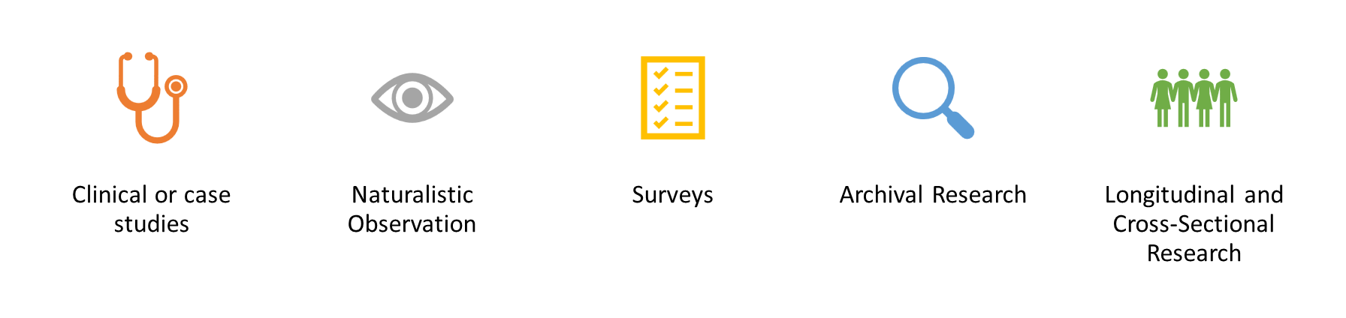
Approaches to Research: An Overview
All text and images from Psychology 2e OpenStax Revised Version Copyright © 2020 by Openstax is licensed under a Creative Commons Attribution 4.0 International License, except where otherwise noted. Edited by Marie Parnes

Slide 7
Clinical or Case Studies
Clinical or case studies focus on one individual. The studied individual is typically in an extreme or unique psychological circumstance that differentiates them for the general public.
Allows for a lot of insight into a
case.
Difficult to generalize results to the
larger population.
The Case of Genie
Genie was studied by psychologists after she was found at age 13, having suffered severe abuse and social isolation. Psychologists were interested in the effect social isolation had on her development.
YouTube video on Genie Wiley
All text and images from Psychology 2e OpenStax Revised Version Copyright © 2020 by Openstax is licensed under a Creative Commons Attribution 4.0 International License, except where otherwise noted. Edited by Marie Parnes

Slide 8
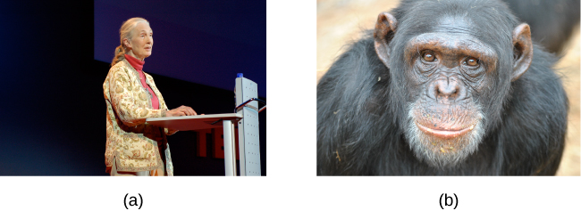
Naturalistic Observation
Naturalistic behavior is generally hidden under scrutiny or observation.
Seeing a police car behind you would probably affect your driving behavior.
To study the most accurate and genuine behaviors, naturalistic observation has proven most effective.
Through naturalistic observations, any feeling of performance or anxiety of the studied individuals is eliminated.
Observer bias - when observations may be skewed to align with observer expectations.
Establishment of clear criteria to observe should help eliminate observer bias.
(a) Jane Goodall made a career of conducting naturalistic observations of (b) chimpanzee behavior. (credit “Jane Goodall”: modification of work by Erik Hersman; “chimpanzee”: modification of work by “Afrika Force”/Flickr.com)
YouTube video on Jane Goodall - Jane Goodall: A Retrospective
from the Institut Jane Goodall France
All text and images from Psychology 2e OpenStax Revised Version Copyright © 2020 by Openstax is licensed under a Creative Commons Attribution 4.0 International License, except where otherwise noted. Edited by Marie Parnes

Slide 9
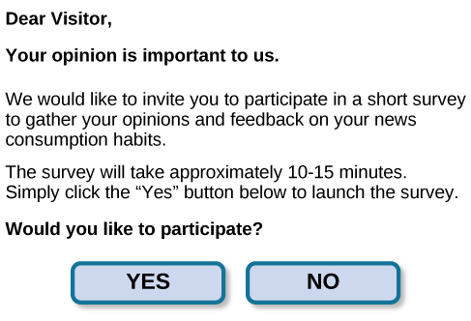
Surveys
A list of questions that can be delivered in many ways:
Paper-and-pencil
  Electronically
  Verbally
Surveys can be used to gather a large amount of data from a sample (subset of individuals) from a larger population.
Surveys can be administered in a number of ways, including electronically administered research.
Surveys can be administered in a number of ways, including electronically administered research, like the survey shown here. (credit: Robert Nyman)
All text and images from Psychology 2e OpenStax Revised Version Copyright © 2020 by Openstax is licensed under a Creative Commons Attribution 4.0 International License, except where otherwise noted. Edited by Marie Parnes

Slide 10
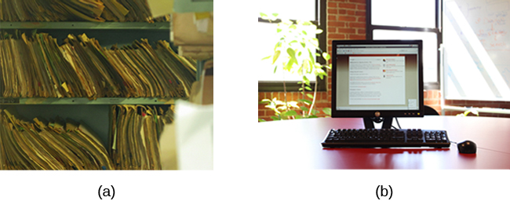
Archival Research
Archival research - uses past records or data sets to answer various research questions, or to search for interesting patterns or relationships.
A researcher doing archival research examines records, whether archived as a (a) hardcopy or (b) electronically. (credit “paper files”: modification of work by “Newtown graffiti”/Flickr; “computer”: modification of work by INPIVIC Family/Flickr)
All text and images from Psychology 2e OpenStax Revised Version Copyright © 2020 by Openstax is licensed under a Creative Commons Attribution 4.0 International License, except where otherwise noted. Edited by Marie Parnes

Slide 11
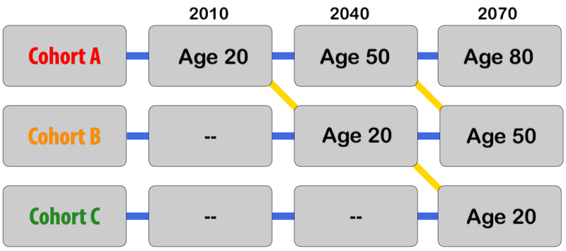
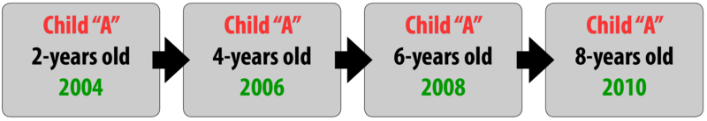
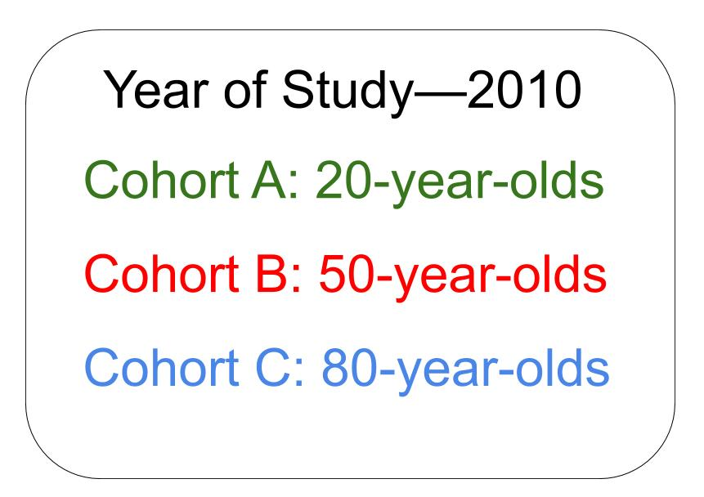
Longitudinal, Cross-Sectional, and Sequential Research
Longitudinal Research – The same group of individuals (a cohort) is surveyed or measured repeatedly over an extended period of time.
Researchers often expect
some participants to drop out and typically recruit a large number of participants. Attrition is the reduction in the number of research participants due to drop out.
Longitudinal research is
costly and time consuming
Cross-Sectional Research – Compares multiple groups of a population at a single time (such as different age groups).
Attrition is greatly
minimized.
Less costly than
longitudinal research.
Differences between groups may reflect social and cultural factors unique to each group (cohort effects), rather than development.
Sequential Research – Combines aspects of longitudinal and cross- sectional research in which a researcher repeatedly compares multiple age groups at the same point over an intermediate period of time
This design helps to
discover possible cohort
effects.
YouTube video on Longitudinal and Cross Sequential Studies by Charles Shallhorn
All text and images from Psychology 2e OpenStax Revised Version Copyright © 2020 by Openstax is licensed under a Creative Commons Attribution 4.0 International License, except where otherwise noted. Edited by Marie Parnes
Images retrieved from Research Methods in Developmental Psychology by Angela Lukowski and Helen Milojevich under Creative Commons Attribution-NonCommercial-ShareAlike 4.0 International License. In R. Biswas-Diener & E. Diener (Eds), Noba textbook series: Psychology. Champaign, IL: DEF publishers.

Slide 12
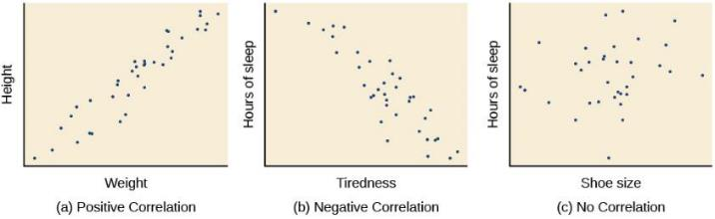
Correlational Research
Correlation – Relationship between two or more variables; when two variables are correlated, one variable changes as the other does.
  Correlation Coefficient - number from -1 to +1, indicates the strength (number) and direction (sign) of the relationship between variables, and usually represented by r.
  Correlations have predictive value.
Positive Correlation – Two variables change in the same direction, both becoming either larger or smaller.
Negative Correlation - two variables change in different directions, with one becoming larger as the other becomes smaller; a negative correlation is not the same thing as no correlation.
The closer the number is to zero, the weaker the relationship, and the less predictable the relationships between the variables becomes.
Scatterplots are a graphical view of the strength and direction of correlations. The stronger the correlation, the closer the data points are to a straight line.
All text and images from Psychology 2e OpenStax Revised Version Copyright © 2020 by Openstax is licensed under a Creative Commons Attribution 4.0 International License, except where otherwise noted. Edited by Marie Parnes

Slide 13
Correlation Does Not Indicate Causation
A major limitation in correlational research is the inability to establish causality (i.e., cause and effect).
Cause-and-effect relationship - changes in one variable cause the changes in the other variable; can be determined only through an experimental research design
With correlational research, one must consider confounding variables.
Confounding variable - unanticipated outside factor that affects both variables of interest, often giving the false impression that changes in one variable causes changes in the other variable.
Example of a Confounding Variable:
As ice-cream sales increase, so does the overall rate in crime.
A relationship exists between ice-cream and crime but is it correlation or does one cause the other?
In this example, temperature is a confounding variable. As the temperature increases, ice-cream sales increase and people are more likely to be outside increasing crime rates.
All text and images from Psychology 2e OpenStax Revised Version Copyright © 2020 by Openstax is licensed under a Creative Commons Attribution 4.0 International License, except where otherwise noted. Edited by Marie Parnes

Slide 14

Illusory Correlations
As well as mistaking correlation for causation, people can also make false correlations.
Illusory Correlations - Seeing relationships
between two things when in reality no such
relationship exists. It is a false correlation.
Confirmation bias is one explanation for illusionary correlations
Confirmation bias - tendency to ignore
evidence that disproves ideas or beliefs.
Is Our Behavior Affected By the Moon?
One well-known illusory correlation is the supposed effect that the moon’s phases have on human behavior; specifically, that people act strangely when the moon is full.
Many people believe that a full moon makes people behave oddly. (credit: Cory Zanke)
All text and images from Psychology 2e OpenStax Revised Version Copyright © 2020 by Openstax is licensed under a Creative Commons Attribution 4.0 International License, except where otherwise noted. Edited by Marie Parnes

Slide 15

Causality: Conducting Experiments & Using the Data
The only way to establish that there is a cause-and-effect relationship between two variables is to conduct a scientific experiment.
A scientific experiment has precise requirements for design and implementation.
An experimental hypothesis can be formulated through:
Observation
After review of previous research
How might the use of technology in the classroom impact learning? (credit: modification of work by Nikolay Georgiev/Pixabay)
All text and images from Psychology 2e OpenStax Revised Version Copyright © 2020 by Openstax is licensed under a Creative Commons Attribution 4.0 International License, except where otherwise noted. Edited by Marie Parnes

Slide 16
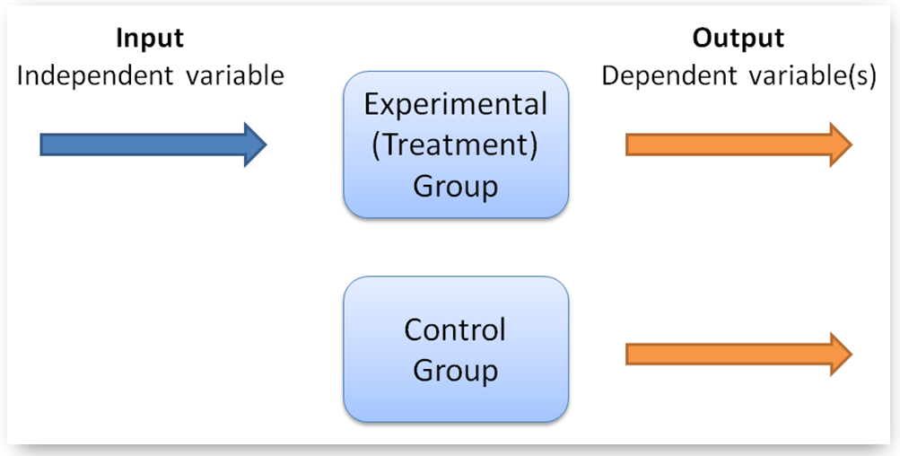
Designing an Experiment
Experimental and Control Groups
Experimental group - The participants that experience the manipulated variable (group designed to answer the research question).
Control group - Participants that do not experience the manipulated variable.
Serve as a basis for comparison and controls for chance factors that might influence the results of the study
Experimental manipulation is the only difference between the experimental and control groups, so any differences between the two are due to experimental manipulation rather than chance.
Defining Variables and How They Will be Measured
  Operational definition - description of what actions and operations will be used to measure the dependent variables and manipulate the independent variables.
  YouTube video on operational definitions by Josh Knapp
Image retrieved from Pytolearn and is licensed under https://creativecommons.org/licenses/by-nc-nd/4.0/
All text and images from Psychology 2e OpenStax Revised Version Copyright © 2020 by Openstax is licensed under a Creative Commons Attribution 4.0 International License, except where otherwise noted. Edited by Marie Parnes

Slide 17
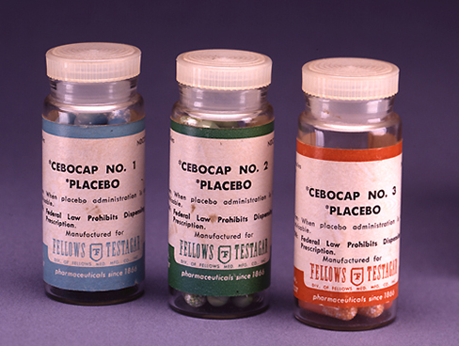
Designing an Experiment: Avoiding Bias and the Placebo Effect
Avoiding Bias
Experimenter bias - researcher
expectations skew the results of the study.
Participant bias – participant
expectations skew the results of the study.
Single-blind study - experiment in which the researcher knows which participants are in the experimental group and which are in the control group but participants do not. (Controls for participant expectations).
Double-blind Study - experiment in which both the researchers and the participants are blind to group assignments. (Controls for both participant and experimenter expectations).
Placebo effect - people’s expectations or beliefs influencing or determining their experience in a given situation.
When people are given a pill to improve their mood their mood may increase just because they believe it will.
To know if a medication is really having an effect or whether it us a placebo effect, the experimental group receive the medication and the control group receive a placebo treatment (a sugar pill). This is a double-blind study.
Any differences between the groups will be due to the medication.
Providing the control group with a placebo treatment protects against bias caused by expectancy. (credit: Elaine and Arthur Shapiro)
All text and images from Psychology 2e OpenStax Revised Version Copyright © 2020 by Openstax is licensed under a Creative Commons Attribution 4.0 International License, except where otherwise noted. Edited by Marie Parnes

Slide 18
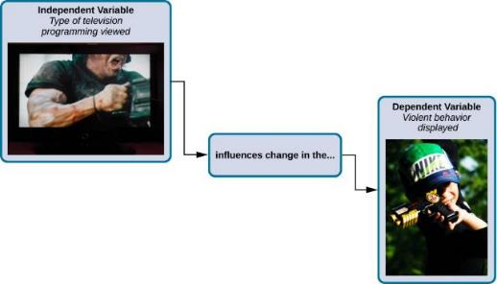
Variables
Independent Variable – Variable that is influenced/controlled by the experimenter. Ideally this should be the only important difference between the experimental and control group.
Dependent Variable – Variable that the researcher measures to see how much effect the independent variable had.
Youtube video on Independent vs Dependent Variable from Nucleus Medical Media
In an experiment, manipulations of the independent variable are expected to result in changes in the dependent variable. (credit “automatic weapon”: modification of work by Daniel Oines; credit “toy gun”: modification of work by Emran Kassim)
All text and images from Psychology 2e OpenStax Revised Version Copyright © 2020 by Openstax is licensed under a Creative Commons Attribution 4.0 International License, except where otherwise noted. Edited by Marie Parnes

Slide 19
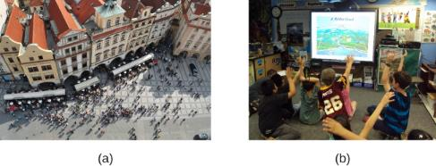
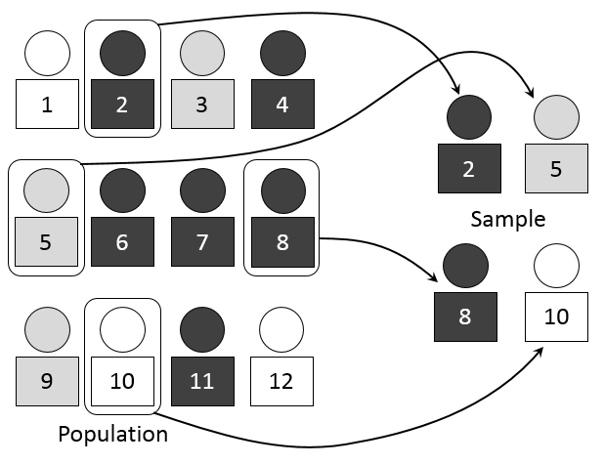
Selecting Participants
Participants – Subjects of psychological research.
Populations are too large for a researcher to
include everyone so samples are used.
Sample - subset of individuals selected from the
larger population.
Population – overall group of individuals that the researcher is interested in (e.g. College students).
Researchers may work with (a) a large population or (b) a sample group that is a subset of the larger population. (credit “crowd”: modification of work by James Cridland; credit “students”: modification of work by Laurie Sullivan)
Random Sample - subset of a larger population in which every member of the population has an equal chance of being selected.
  This form of sampling is preferred because it is more likely that the selected participants will be representative of the larger population (sex, ethnicity, social economic status etc).
Simple Random Sampling
All text and images from Psychology 2e OpenStax Revised Version Copyright © 2020 by Openstax is licensed under a Creative Commons Attribution 4.0 International License, except where otherwise noted. Edited by Marie Parnes
Simple Random Sampling by Dan Kernler was retrieved from Wikimedia Commons is licensed under Creative Commons Attribution-Share Alike 4.0 International

Slide 20
Assigning Participants To Groups: Experimental or Control
Random Assignment – Method of experimental group assignment in which all participants have an equal chance of being assigned to either group.
Can be achieved using statistical software or by simply flipping a coin.
Prevents systematic differences between groups such as gender or age.
Without random assignment, an experiment cannot find a true cause-and-effect relationship. Any relationship could be due to preexisting differences between the groups.
Random assignment helps to avoid preexisting systematic differences so that any significant differences between groups can be said to be the result of the manipulation.
Random Sampling and Random Assignment are not the sample thing.
Once you have selected your randomly selected sample from the population, then the next step is to use random assignment to assignment participants to the experimental and control groups.
This YouTube video explains the difference between the two:
Random Sample vs Random Assignment by Charles Schallhorn
All text and images from Psychology 2e OpenStax Revised Version Copyright © 2020 by Openstax is licensed under a Creative Commons Attribution 4.0 International License, except where otherwise noted. Edited by Marie Parnes

Slide 21
Issues to Consider
Manipulating Variables
As stated, random assignment is required to state causation. Once randomly assigned, each group is then manipulated in some way. However, some experimental designs are more complicated.
Example: The effect of sex (male/female) on spatial memory.
Sex (independent variable) cannot be manipulated.
Males and females cannot be randomly assigned.
This kind of an experiment is therefore called quasi-experimental.
A cause-and-effect relationship cannot be determined from this type of experiment.
Ethics
Some questions cannot be answered using an experimental design because they would be unethical.
Example: The effect of experiencing abuse as a child on levels of self-esteem.
You cannot randomly assign participants to receive abuse.
This would need to be studied using other approaches such as case studies or surveys.
All text and images from Psychology 2e OpenStax Revised Version Copyright © 2020 by Openstax is licensed under a Creative Commons Attribution 4.0 International License, except where otherwise noted. Edited by Marie Parnes

Slide 22

Interpreting Experimental Findings
Once data has been collected, a statistical analysis is conducted.
Statistical analysis - determines how likely any difference between experimental groups is due to chance.
Psychologists usually discuss results as significant or non-significant.
If the odds that the differences occurred by chance are 5% or less, then the results are significant.
A true experiment, including random assignment, manipulation of the independent variable and control of extraneous variables reduce the odds of results occurring by chance.
Researchers employ the scientific method that involves a great deal of statistical thinking: generate a hypothesis --> design a study to test that hypothesis --> conduct the study --> analyze the data --> report the results. [Image: widdowquinn, https://goo.gl/9l8Dht, CC BY-NC-SA 2.0, https://goo.gl/Toc0ZF]
All text and images from Psychology 2e OpenStax Revised Version Copyright © 2020 by Openstax is licensed under a Creative Commons Attribution 4.0 International License, except where otherwise noted. Edited by Marie Parnes
Image retrieved from Statistical Thinking by Beth Chance and Allan Rossman is licensed under a Creative Commons Attribution-NonCommercial-ShareAlike 4.0 International License.

Slide 23

Reporting Findings
Research is usually reported in scientific journals.
Usually aimed at an audience of professionals/scholars.
Articles published are peer-reviewed journal articles.
Peer-reviewed journal article – article read by several other scientists (usually anonymously) with expertise in the subject matter, who provide feedback regarding the quality of the manuscript before it is accepted for publication.
Helps to weed out poorly conceived or executed studies.
Improves articles with suggested revisions.
Determines whether the research is described clearly enough to be replicated by other researchers.
Replication
Determines reliability of original research design.
Can include additional measures that expand on the original findings.
Provide more evidence to support the original finding or to cast doubt on those findings.
Researchers strive to publish the results of their research in psychology journals.
All text and images from Psychology 2e OpenStax Revised Version Copyright © 2020 by Openstax is licensed under a Creative Commons Attribution 4.0 International License, except where otherwise noted. Edited by Marie Parnes
Image retrieved from Wikimedia Commons is from American Psychological Association and is in the public domain.

Slide 24
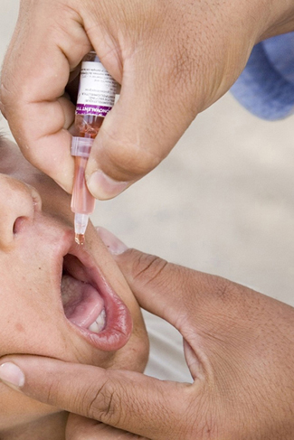
Bad science & Retraction: The Vaccine-Autism Myth
Many peer-reviewed publications published research making claims that routine childhood vaccines cause some children to develop autism.
Since these reports, large-scale research was carried out suggesting that vaccinations are not responsible for causing autism.
Many of the original studies have since been retracted.
It was found that the leading research in the original study had a financial interest in establishing a link between childhood vaccines and autism.
Unfortunately the initial claims were publicized and many people still think vaccinations cause autism.
Some people still think vaccinations cause autism. (credit: modification of work by UNICEF Sverige)
All text and images from Psychology 2e OpenStax Revised Version Copyright © 2020 by Openstax is licensed under a Creative Commons Attribution 4.0 International License, except where otherwise noted. Edited by Marie Parnes

Slide 25
Reliability and Validity
Reliability - consistency and reproducibility of a given result.
Would the same test give the same results every time?
When a study involves observations by multiple people, it is important that they all make observations and record them in the same way.
Inter-rater reliability - measure of agreement among observers on how they record and classify a particular event.
A reliable, consistent measurement does not always meant that it is measuring something correctly.
Validity - accuracy of a given result in measuring what it is designed to measure.
Does a test measure what it is meant to measure?
A valid measure is always reliable but a reliable measure is not always valid.
YouTube video on the different types of reliability
from Research Methods and Statistics
YouTube video on the different types of validity
from Research Methods and Statistics
All text and images from Psychology 2e OpenStax Revised Version Copyright © 2020 by Openstax is licensed under a Creative Commons Attribution 4.0 International License, except where otherwise noted. Edited by Marie Parnes

Slide 26

Ethics: Research Involving Human Participants
Research involving human participants must adhere to strict guidelines.
Institutional Review Board (IRB) – Committee of administrators, scientists, and community members that reviews proposals for research involving human participants.
Exist at any research institution that receives federal support for research involving human participants.
Generally, IRB must approve research proposal before it can proceed.
An institution’s IRB meets regularly to review experimental proposals that involve human participants. (credit: modification of work by Lowndes Area Knowledge Exchange (LAKE)/Flickr)
Informed consent - process of informing a research participant about what to expect during an experiment and then obtaining the person’s consent to participate. Includes:
Potential risks involved
Implications of the research
Notification that participation is voluntary
Notification that any data collected will be kept confidential
All text and images from Psychology 2e OpenStax Revised Version Copyright © 2020 by Openstax is licensed under a Creative Commons Attribution 4.0 International License, except where otherwise noted. Edited by Marie Parnes

Slide 27
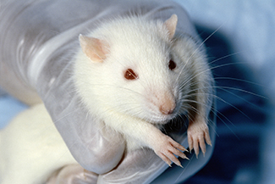
Ethics: Research Involving Animal Subjects
90% of psychological research involving animal subjects uses rodents or birds.
Animals make good substitutes because many of their basic processes are sufficiently similar to those in humans.
Animals are used when the research would be unethical in human participants.
Researchers must still aim to minimize pain or distress.
Rats often serve as the subjects of animal research.
Institutional Animal Care and Use Committee (IACUC) - committee of administrators, scientists, veterinarians, and community members that reviews proposals for research involving non-human animals.
All text and images from Psychology 2e OpenStax Revised Version Copyright © 2020 by Openstax is licensed under a Creative Commons Attribution 4.0 International License, except where otherwise noted. Edited by Marie Parnes

