Slide 1

Chapter 15
Psychological Disorders
OpenStax Psychology 2E
OpenStax ancillary resource is © Rice University under a CC-BY-4.0 DEED license and may be used with proper attributes. Unless otherwise noted all material and text contained in these ancillary materials is from Spielman, R. M., Jenkins, W. J., & Lovett, M. D. (2020). Psychology 2E. OpenStax and is licensed under CC BY 4.0 DEED.

Slide 2
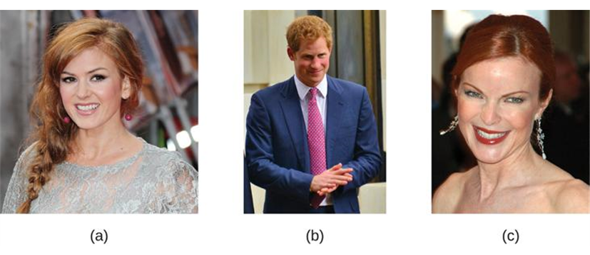
Definition of a Psychological Disorder
Psychopathology – the study of psychological disorders, including their symptoms, etiology (causes), and treatment.
Psychological disorder – a condition characterized by abnormal thoughts, feelings, and behaviors.
  Behaviors, thoughts, and inner experiences that are atypical, dysfunctional, or dangerous are signs of psychological disorders.
  However, there is no single definition of psychological abnormality or normality.
    For example, just because something is atypical, does not mean it is disordered. Red hair is considered unusual, but not abnormal.
Figure 15.2 (a) Isla Fischer, (b) Prince Harry, and (c) Marcia Cross are three natural redheads.
All text from Psychology 2e OpenStax Revised Version Copyright © 2020 by Openstax is licensed under a Creative Commons Attribution 4.0 International License, except where otherwise noted. Edited by Maria Pagano

Slide 3
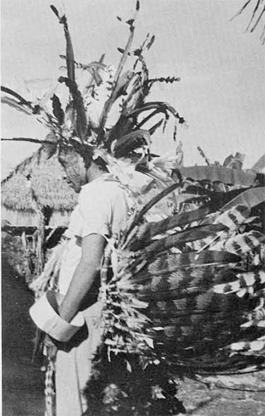
Definition of a Psychological Disorder: Continued
Cultural Expectations
  Violating cultural expectations is not enough by itself to identify a psychological disorder.
  Social norms vary between cultures - what is considered appropriate in one culture may be viewed differently in another.
    Hallucinations is a violation of cultural expectations in Western Societies. People who report hallucinations are likely to be labeled with a psychological disorder.
    However, in some other cultures, certain types of hallucinations are highly valued.
Harmful Dysfunction
  Wakefield (1992): Proposed a more influential concept in which he defines psychological disorders as a harmful dysfunction.
    Dysfunction occurs when an internal mechanism (e.g., cognition, perception, learning) breaks down and cannot perform its normal function.
  For a dysfunction to be classed as a disorder, it must also be harmful – leads to negative consequences for the individual or for others, as judged by the standards of the individual’s culture.
The Cashinahua peoples of the Upper Amazon use hallucinogenic brews as a spiritual guide that provide guidance.
Image from Kensinger, Kenneth M.. "The Cashinahua of Southeastern Peru." Expedition Magazine 7, no. 4 (July, 1965): -. Accessed June 25, 2024. https://www.penn.museum/sites/expedition/the-cashinahua-of-southeastern-peru/
All text from Psychology 2e OpenStax Revised Version Copyright © 2020 by Openstax is licensed under a Creative Commons Attribution 4.0 International License, except where otherwise noted. Edited by Maria Pagano

Slide 4
Definition of a Psychological Disorder: Continued
American Psychological Association (APA) Definition
A psychological disorder is a condition that consists of the following:
  Significant disturbances in thoughts, feelings, and behaviors.
    Behaviors that most would consider atypical and negative.
  The disturbances reflect some kind of biological, psychological, or developmental dysfunction.
  The disturbances lead to significant distress or disability in one’s life.
    E.g. difficulty performing appropriate and expected roles.
  The disturbances do not reflect expected or culturally approved responses to certain events.
Despite the many existing definitions, there is no universal agreement on where the boundary between disordered and not disordered is.
All text from Psychology 2e OpenStax Revised Version Copyright © 2020 by Openstax is licensed under a Creative Commons Attribution 4.0 International License, except where otherwise noted. Edited by Maria Pagano

Slide 5
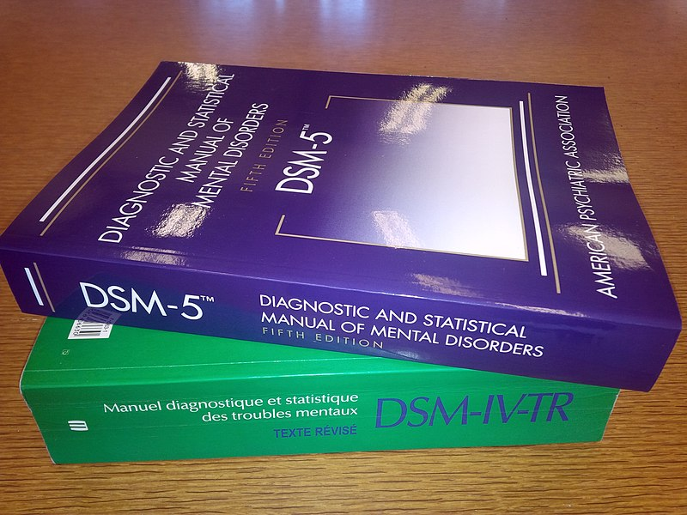
The Diagnostic and Statistical Manual of Mental Disorders DSM
Diagnosis – appropriately identifying and labeling a set of defined symptoms
  Requires classification systems that organize psychological disorders systematically.
Diagnostic and Statistical Manual of Mental Disorders:
  Published by the American Psychiatric Association.
  First published in 1952 and has since undergone numerous revisions.
    The first two editions listed homosexuality as a disorder but was removed in 1973.
  DSM-5 is the classification system used by most mental health professionals.
  Categorizes and describes each disorder.
    Diagnostic features – overview of the disorder.
    Diagnostic criteria – specific symptoms required for diagnosis.
    Prevalence – percent of population thought to be afflicted.
    Risk factors.
  Provides information about comorbidity (the co-occurrence of two disorders).
Above image from Wikimedia Commons by
F.RdeC. Licensed under CC BY SA 3.0 UNPORTED DEED,
Video: DSM-5: An Overview from APA's New President shows 2013-2014 APA President Jeffrey A. Lieberman discussing the improvements found in the DSM V (3:04).
All text from Psychology 2e OpenStax Revised Version Copyright © 2020 by Openstax is licensed under a Creative Commons Attribution 4.0 International License, except where otherwise noted. Edited by Maria Pagano

Slide 6
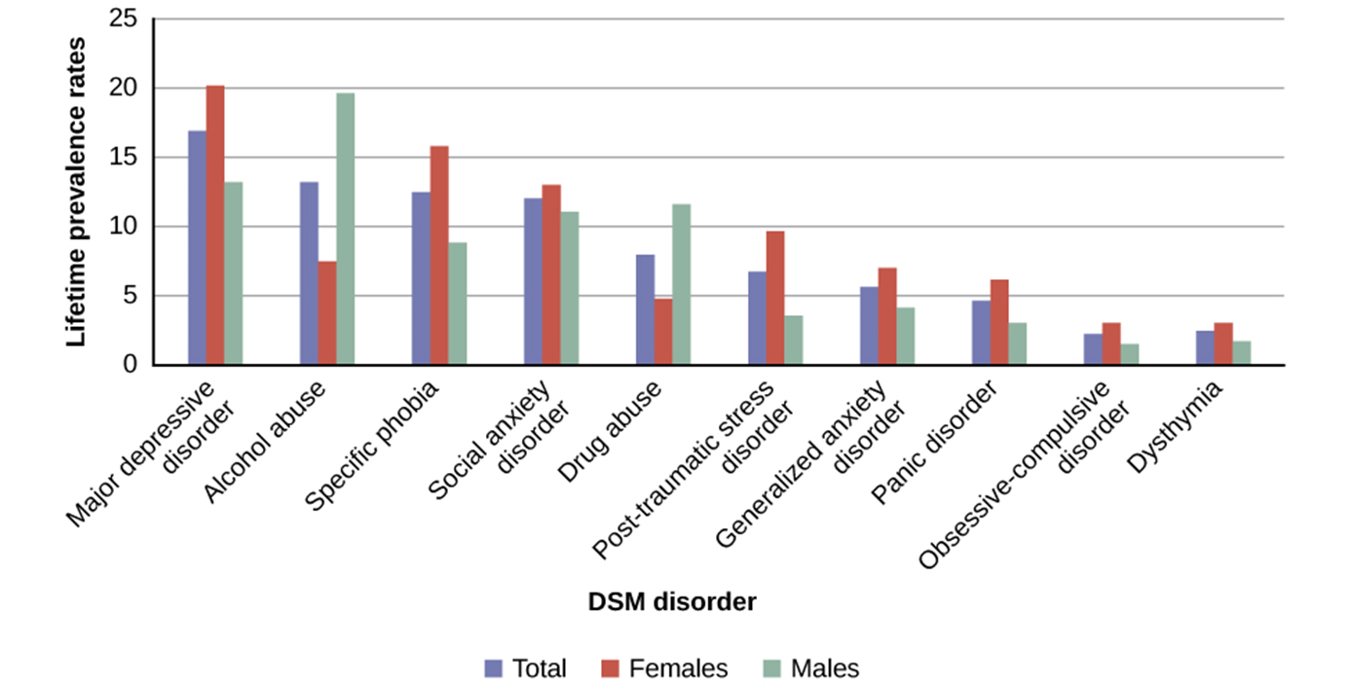
Prevalence Rates (DSM-IV)
Figure 15.4 The graph above shows the breakdown of psychological disorders, comparing the percentage prevalence among adult males and adult females in the United States. Because the data is from 2007, the categories shown here are from the DSM-IV, which has been supplanted by the DSM-5. Most categories remain the same; however, alcohol abuse now falls under a broader Alcohol Use Disorder category.
All text from Psychology 2e OpenStax Revised Version Copyright © 2020 by Openstax is licensed under a Creative Commons Attribution 4.0 International License, except where otherwise noted. Edited by Maria Pagano

Slide 7
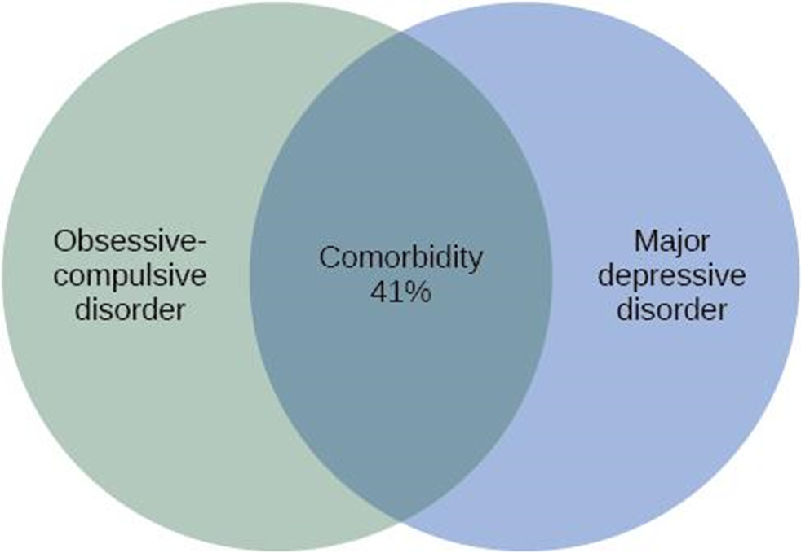
Comorbidity (DSM)
Figure 15.5 Obsessive-compulsive disorder and major depressive disorder frequently occur in the same person.
Image and text from Psychology 2e OpenStax Revised Version Copyright © 2020 by Openstax is licensed under a Creative Commons Attribution 4.0 International License, except where otherwise noted. Edited by Maria Pagano

Slide 8
The International Classification of Diseases (ICD)
Published by the World Health Organization (WHO).
Classification and criteria for specific disorders are similar to the DSM but some differences exist.
  Used to examine general health of populations and monitor prevalence of diseases/health problems internationally.
  Worldwide, the ICD is more frequently used for clinical diagnosis, whereas the DSM is more valued for research.
  DSM includes more explicit disorder criteria as well as extensive explanatory text.
  DSM is the classification system used among U.S. mental health professionals.
Video: WHO: Revision of ICD-11- Questions and Answers presents Dr. Robert Jakob, team leader for Classifications Terminologies and Standards at the World Health Organization discussing the revision of the ICD-11 (6:09).
Image and text from Psychology 2e OpenStax Revised Version Copyright © 2020 by Openstax is licensed under a Creative Commons Attribution 4.0 International License, except where otherwise noted. Edited by Maria Pagano

Slide 9
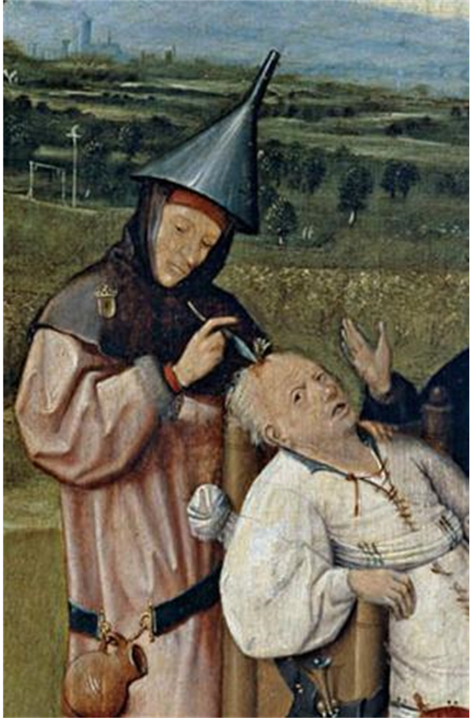
Perspectives on Psychological Disorders: Supernatural Perspectives
For centuries, psychological disorders were viewed from a supernatural perspective.
  Supernatural perspective – psychological disorders attributed to a force beyond scientific understanding.
    Practitioners of black magic (sorcery).
    Possessed by spirits.
    Witchcraft.
  Treatments included torture, beatings, and exorcism.
Figure 15.6 In The Extraction of the Stone of Madness, a 15th century painting by Hieronymus Bosch, a practitioner is using a tool to extract an object (the supposed “stone of madness”) from the head of an afflicted person.
Image and text from Psychology 2e OpenStax Revised Version Copyright © 2020 by Openstax is licensed under a Creative Commons Attribution 4.0 International License, except where otherwise noted. Edited by Maria Pagano

Slide 10
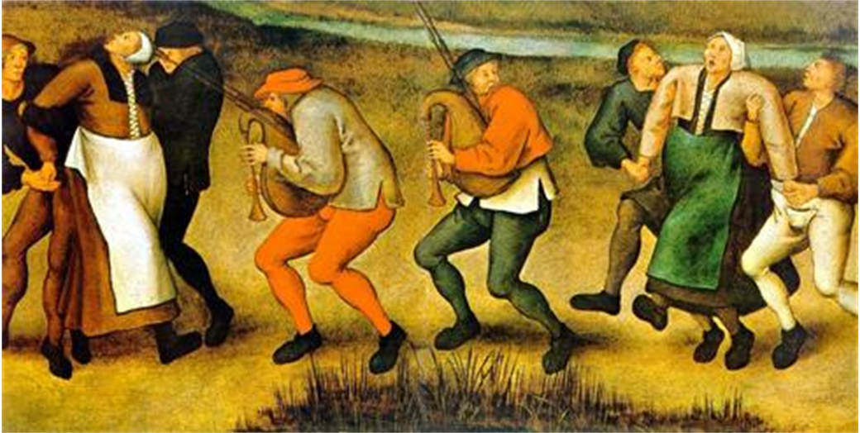
Dancing Mania
Epidemic in Western Europe (11th-17th centuries) in which groups of people would suddenly begin to dance with wild abandon.
Some would dance for days or weeks, screaming of terrible visions.
Figure 15.7 Although the cause of dancing mania, depicted in this painting, was unclear, the behavior was attributed to supernatural forces.
Video: Dancing Mania: Short Documentaries discusses several examples of dancing mania that occurred throughout Europe (3:00).
Image and text from Psychology 2e OpenStax Revised Version Copyright © 2020 by Openstax is licensed under a Creative Commons Attribution 4.0 International License, except where otherwise noted. Edited by Maria Pagano

Slide 11
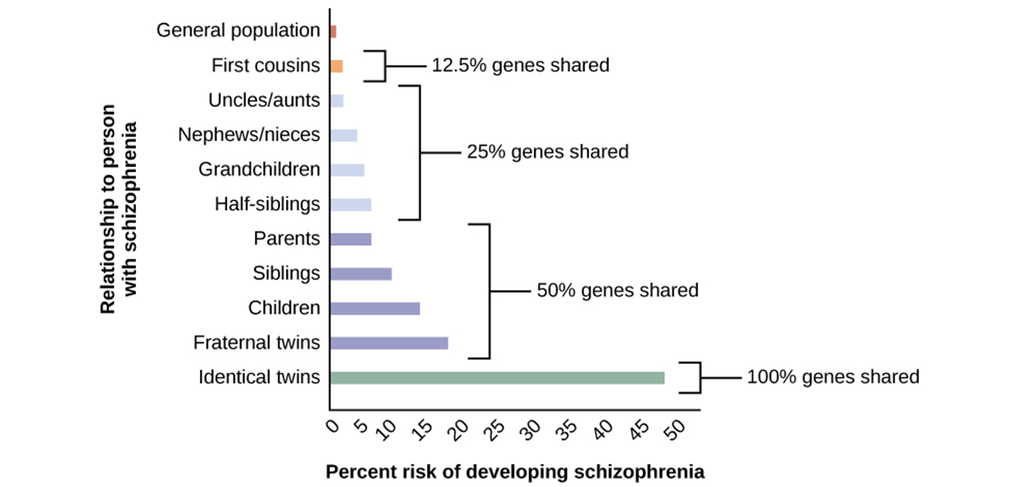
Perspectives on Psychological Disorders: Biological Perspective
View psychological disorders as linked to biological phenomena:
  Genetic factors, chemical imbalances, and brain abnormalities.
Supported by evidence that most psychological disorders have a genetic component.
Figure 15.8 A person’s risk of developing schizophrenia increases if a relative has schizophrenia. The closer the genetic relationship, the higher the risk.
Image and text from Psychology 2e OpenStax Revised Version Copyright © 2020 by Openstax is licensed under a Creative Commons Attribution 4.0 International License, except where otherwise noted. Edited by Maria Pagano

Slide 12
Perspectives on Psychological Disorders: Psychosocial and Diathesis-Stress Model
Psychosocial Perspective emphasizes the importance of learning, stress, faulty and self-defeating thinking patters, and environmental factors.
  Views the cause of psychological disorders as a combination of biological and psychosocial factors.
Diathesis-Stress Model integrates biological and psychosocial factors to predict the likelihood of a disorder.
  Diathesis + Stress → Development of a disorder
    People with an underlying predisposition for a disorder (diathesis) are more likely than others to develop a disorder when faced with adverse environmental or psychological events.
    A diathesis can be a biological or psychological vulnerability.
Video: The Diathesis Stress Model (Intro Psych Tutorial) explains the diathesis-stress model of mental illness (5:04).
Image and text from Psychology 2e OpenStax Revised Version Copyright © 2020 by Openstax is licensed under a Creative Commons Attribution 4.0 International License, except where otherwise noted. Edited by Maria Pagano

Slide 13
Anxiety Disorders
Fear vs Anxiety
  Fear – an instantaneous reaction to an imminent threat.
  Anxiety – apprehension, avoidance, and cautiousness regarding a potential threat, danger, or other negative content.
    Motivates us to take action, avoid certain things.
    Level and duration of anxiety usually matches the magnitude of the potential threat. However, some people experience anxiety that is excessive, persistent and out of proportion with the actual threat.
Anxiety Disorders
  Characterized by excessive and persistent fear and anxiety, and by related disturbances in behavior.
    Prevalence:
      Effects approximately 25%-30% of the U.S. population during their lifetime.
      More common in women than men.
      Most frequently occurring class of mental disorders.
Video: Anxiety Disorders-Diagnosis shows 4 individuals discussing their symptoms of different anxiety disorders (3:21).
Image and Text from Psychology 2e OpenStax Revised Version Copyright © 2020 by Openstax is licensed under a Creative Commons Attribution 4.0 International License, except where otherwise noted. Edited by Maria Pagano

Slide 14
Anxiety Disorders: Specific Phobia
Involves excessive, distressing, and persistent fear or anxiety about a specific object or situation.
  People may realize their fear and anxiety is irrational but may still go to great lengths to avoid the stimulus.
Prevalence - affects 12.5% of the U.S. population at some point in their lifetime.
Common specific phobias include:
  Acrophobia – heights.
  Aerophobia – flying.
  Arachnophobia – spiders.
  Claustrophobia – enclosed spaces.
Agoraphobia:
  Listed as a separate anxiety disorder.
    Characterized by intense fear, anxiety, and avoidance of situations in which it might be difficult to escape or receive help if one experiences a panic attack.
    These situations include public transportation, crowds, being outside the home alone.
Text and image from Psychology 2e OpenStax Revised Version Copyright © 2020 by Openstax is licensed under a Creative Commons Attribution 4.0 International License, except where otherwise noted. Edited by Maria Pagano

Slide 15
Acquisition of Phobias Through Learning
Rachman (1977): 3 Major Learning Pathways
  Classical Conditioning.
    Child is bitten by dog (US) → dogs become associated with biting (CS) → child experiences fear around dogs (CR).
    Conditioned fears develop more readily to fear-relevant stimuli (images of snakes and spiders) than to fear-irrelevant stimuli (images of flowers).
  Vicarious Learning.
    Child observes cousin react with fear around spiders → child later expresses the same fears even though spiders have never presented any danger to him.
    Verbal transmission of information.
    A child is continuously told that snakes are dangerous → child starts to fear snakes.
Why are certain types of phobias more common than others?
  One theory argues that because our ancestors associated certain stimuli with danger (e.g., snakes, spiders, and heights), we are evolutionarily predisposed to associate those stimuli with fear.
Video: What is a Specific Phobia Disorder and How is it Treated? Stacey Dobrinsky, Ph. D discusses different types of specific phobia disorder and ways in which to treat the disorder (1:54).
Text from Psychology 2e OpenStax Revised Version Copyright © 2020 by Openstax is licensed under a Creative Commons Attribution 4.0 International License, except where otherwise noted. Edited by Maria Pagano
Image from Wikimedia Commons authored by Blausen.com staff (2014). Medical Gallery of Blausen Medical 2014. Licensed under CC BY 3.0 DEED.

Slide 16
Anxiety Disorders: Social Anxiety Disorder
Characterized by extreme and persistent fear or anxiety and avoidance of social situations in which the person could potentially be evaluated negatively by others, leading to serious impairments in life.
  Associated with lower educational attainment, lower earning, poor work performance, unemployment.
  Safety behaviors – mental or behavioral acts that reduce anxiety in social situations by reducing the chance of negative social outcomes.
    E.g., avoiding eye contact or rehearsing sentences before speaking.
Prevalence - experienced by about 12% of Americans during their lifetime.
Comorbidity - high rate of comorbidity with alcohol use disorder.
Individuals may self-medicate to reduce anxiety in social situations.
Risk Factors
  Fears of social situations possibly develop through conditioning.
    92% of a sample of adults with social anxiety disorder reported a history of severe teasing in childhood.
  Behavioral inhibition – a consistent tendency to show fear and restraint when presented with unfamiliar people or situations.
Video: Too Scared: Social Anxiety Disorder In this WebMD video, Becky Bruno and her psychiatrist, Dr. John Lochridge discuss social anxiety disorder (2:19).
Text and image from Psychology 2e OpenStax Revised Version Copyright © 2020 by Openstax is licensed under a Creative Commons Attribution 4.0 International License, except where otherwise noted. Edited by Maria Pagano

Slide 17
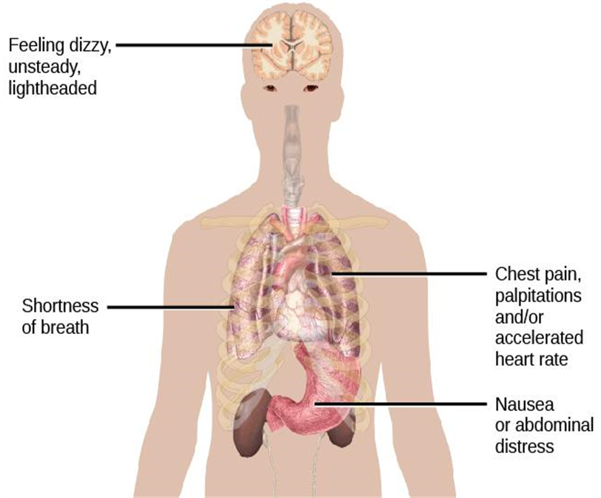
Anxiety Disorders: Panic Disorder
Panic disorder is a recurrent and unexpected panic attacks, along with at least one month of persistent concern about additional panic attacks, worry over the consequences of the attacks, or self-defeating changes in behavior related to the attacks.
  Comorbidity - anxiety disorders or major depressive disorder.
Panic attack – a period of extreme fear or discomfort that develops abruptly and reaches a peak within 10 minutes.
  Can be expected (in response to an external trigger) or unexpected.
  Panic attacks alone are not a disorder.
  Some of the physical manifestations of a panic attack are shown. People may also experience sweating, trembling, feelings of faintness, or a fear of losing control, among other symptoms.
Figure 15.9 Some of the physical manifestations of a panic attack are shown. People may also experience sweating, trembling, feelings of faintness, or a fear of losing control, among other symptoms.
Text and image from Psychology 2e OpenStax Revised Version Copyright © 2020 by Openstax is licensed under a Creative Commons Attribution 4.0 International License, except where otherwise noted. Edited by Maria Pagano

Slide 18
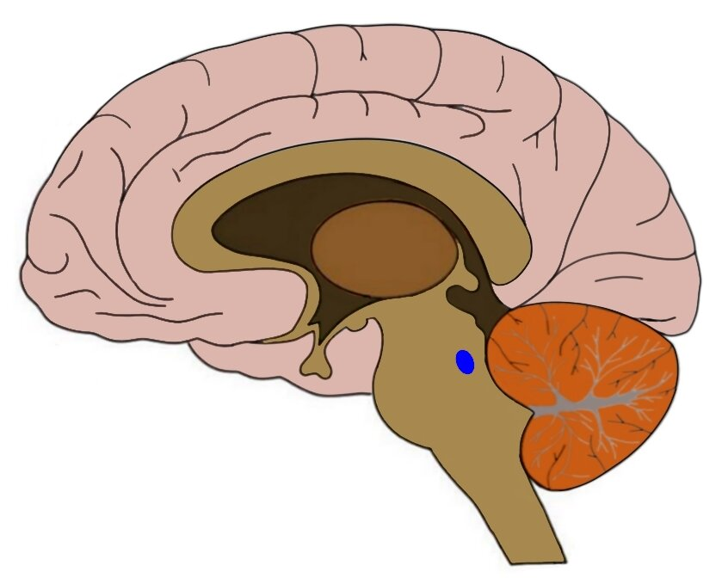
Panic Disorder: Causes
Genetics
  43% heritability.
Neurobiological Theories
  Locus coeruleus in the brainstem is possibly involved.
    Major source of norepinephrine (neurotransmitter that triggers flight-or-flight response).
    Activation is associated with anxiety and fear and produces panic-like symptoms in nonhuman primates.
Conditioning Theories
  Panic attacks are classical conditioning responses to subtle bodily sensations resembling those normally occurring when one is anxious or frightened.
Cognitive Theories
  Individuals with panic disorder are prone to interpret ordinary bodily sensations catastrophically, setting the state for panic attacks.
    In some patients, reducing catastrophic cognitions about sensations has proven to be as effective as medication in reducing panic attacks.
*
The locus coeruleus (a nucleus found in the pons area of the brainstem) is represented above by the red asterisk.
Video: What Causes Panic Attacks, and How Can You Prevent Them? - Cindy J. Aaronson discusses in this TED-Ed talk digs into the science of what triggers panic attacks and how to recognize them. This video also discusses the available treatments for panic disorder (5:22).
Text from Psychology 2e OpenStax Revised Version Copyright © 2020 by Openstax is licensed under a Creative Commons Attribution 4.0 International License, except where otherwise noted. Edited by Maria Pagano

Slide 19
Generalized Anxiety Disorder
Generalized anxiety disorder is a relatively continuous state of excessive, uncontrollable, and pointless worry and apprehension.
Diagnosis Criteria
  The diffuse worrying and apprehension is not part of another disorder.
  Symptoms occur more days than not for at least 6 months.
  Symptoms are accompanied by any three of the following symptoms:
    Restlessness, difficulty concentrating, being easily fatigued, muscle tension, irritability, and sleep difficulties.
Prevalence
  Affects about 5.7% of U.S. population during their lifetime.
  Females are 2 times as likely as males to experience the disorder.
Comorbidity
  Comorbid with mood disorders and other anxiety disorders.
Text from Psychology 2e OpenStax Revised Version Copyright © 2020 by Openstax is licensed under a Creative Commons Attribution 4.0 International License, except where otherwise noted. Edited by Maria Pagano

Slide 20

Generalized Anxiety Disorder: Causes
Cognitive Theories
  Worry represents a mental strategy to avoid more powerful negative emotions perhaps stemming from earlier unpleasant or traumatic experiences.
    Worrying acts a distraction from remembering painful childhood experiences.
    Longitudinal study found childhood maltreatment was strongly related to development of the disorder during adulthood.
Figure 15.10 Worry is a defining feature of generalized anxiety disorder (credit: Freddie Peña)
Video: Generalized Anxiety Disorder (GAD) - Causes, Symptoms & Treatment (5:32).
Text from Psychology 2e OpenStax Revised Version Copyright © 2020 by Openstax is licensed under a Creative Commons Attribution 4.0 International License, except where otherwise noted. Edited by Maria Pagano

Slide 21
Obsessive Compulsive (OCD) and Related Disorders
Obsessive compulsive disorder involves thoughts and urges that are intrusive and unwanted (obsessions) and/or the need to engage in repetitive behaviors or mental acts (compulsions).
  Obsessions – persistent, unintentional, and unwanted thoughts and urges that are highly intrusive, unpleasant, and distressing.
    Common obsessions:
    Concerns about germs and contamination
    Doubts
    Order and symmetry
    Aggressive or lustful urges
  Compulsions – repetitive and ritualistic acts, typically carried out primarily as a means to minimize the distress that obsessions trigger or to reduce the likelihood of a feared event.
    Not performed out of pleasure.
    The person usually knows these obsessions and compulsions are irrational but suppressing them is extremely difficult.
Prevalence
  Experienced by approximately 2.3% of the U.S. population in their lifetime.
Text from Psychology 2e OpenStax Revised Version Copyright © 2020 by Openstax is licensed under a Creative Commons Attribution 4.0 International License, except where otherwise noted. Edited by Maria Pagano

Slide 22
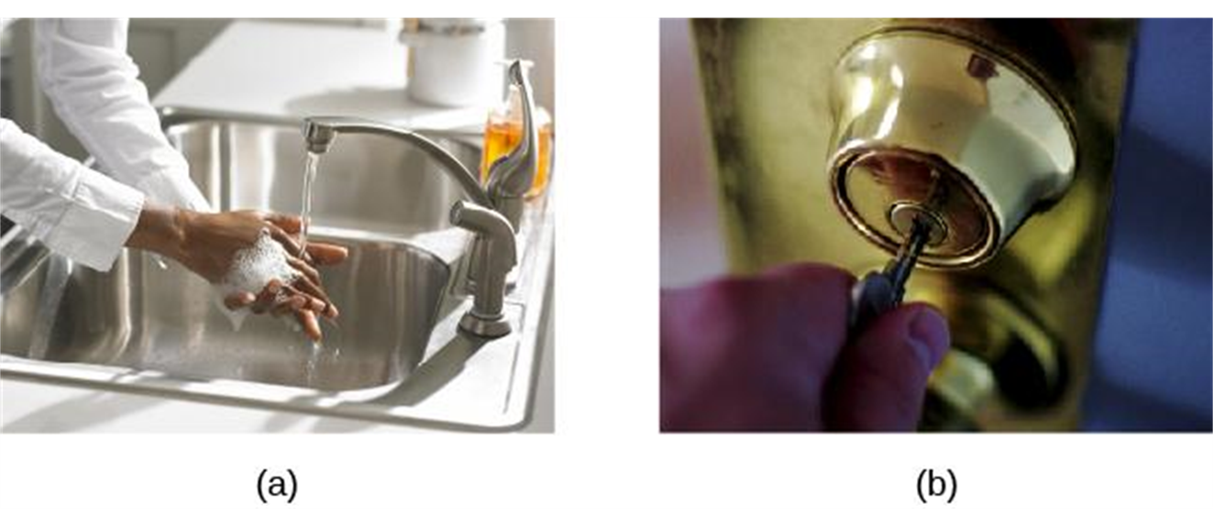
Obsessive-Compulsive Disorder (OCD)
(a) Repetitive hand washing and (b) checking (e.g., that a door is locked) are common compulsions among those with obsessive-compulsive disorder. Other common compulsions include cleaning, ordering, and counting.
Video: Obsessive Compulsive Disorder (OCD) - Causes, Symptoms & Pathology (5:18).
Text from Psychology 2e OpenStax Revised Version Copyright © 2020 by Openstax is licensed under a Creative Commons Attribution 4.0 International License, except where otherwise noted. Edited by Maria Pagano

Slide 23
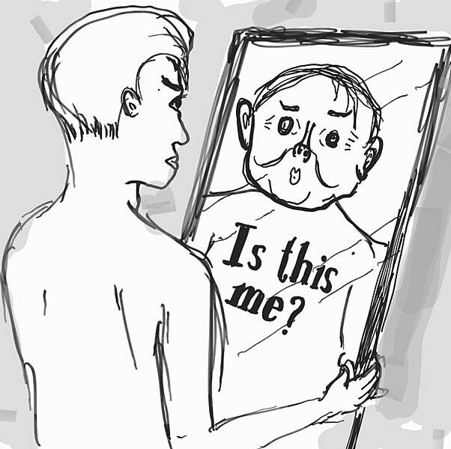
Obsessive Compulsive Disorder: Body Dysmorphic Disorder
Body dysmorphic disorder involves a preoccupation with a perceived flaw in the individual's physical appearance that is either nonexistent or barely noticeable to other people.
  Causes person to think they are unattractive or deformed.
  Typically involve skin, face, or hair, but can focus on any bodily area.
  Causes person to engage in repetitive and ritualistic behavioral and mental acts.
    Constantly looking in the mirror.
    Trying to hide the offending body part.
    Comparison with others.
    Cosmetic surgery.
Prevalence
  Affects approximately 2.4% of adults in the U.S.
  Slightly higher rates in women than in men.
Image from Wikimedia Commons by Chainwit.
Licensed under CC BY SA 3.0 UNPORTED DEED,
Video: Seeing Myself as Ugly: What Body Dysmorphia Feels Like looks at several individuals and their attempts to cope with body dysmorphia (2.46).
Text and image from Psychology 2e OpenStax Revised Version Copyright © 2020 by Openstax is licensed under a Creative Commons Attribution 4.0 International License, except where otherwise noted. Edited by Maria Pagano

Slide 24

Obsessive Compulsive Disorder: Hoarding Disorder
Hoarding disorder involves great difficulty in discarding possessions, regardless of how valueless/useless they are, usually resulting in an accumulation of items that clutter living or work areas.
  Why are they unable to let go of items?
    They think items might be useful at a later time.
    Sentimental attachment to items.
Excessive clutter prevents the individual using necessary living spaces such as the kitchen or bed.
Diagnosed as long as the hoarding is not a symptom of another disorder.
Figure 15.12 Those who suffer from hoarding disorder have great difficulty in discarding possessions, usually resulting in an accumulation of items that clutter living or work areas.
Video: Classic Profile of Hoarding Disorder. Randy Frost, Ph. D. discusses hoarding disorder and what may cause individuals to hoard (5:50).
Video: Causes of Hoarding Disorder. In this video, Randy Frost, Ph. D. discusses in detail, the causes of hoarding disorder (5:55).
Video: Ways to Help a Family Member Who Hoards. In this video, Randy Frost, Ph. D. discusses how to provide help to someone with hoarding disorder (4:28).
Image and text and from Psychology 2e OpenStax Revised Version Copyright © 2020 by Openstax is licensed under a Creative Commons Attribution 4.0 International License, except where otherwise noted. Edited by Maria Pagano

Slide 25

Obsessive Compulsive Disorder: Causes
Genetics
  5 times more frequent in first-degree relatives of people with OCD.
  Identical twins - 57% concordance rate.
  Fraternal twins - 22% concordance rate.
  Genes involved regulate the function of serotonin, dopamine, and glutamate.
Conditioning Theories
  Symptoms of OCD are learned responses resulting from both classical and operant conditioning.
    Neutral stimulus + unconditioned stimulus → anxiety or distress.
    Once association has been acquired, encounters with the NS trigger anxiety and obsessive thoughts.
    Anxiety and obsessive thoughts continue until a strategy is identified to relieve it.
    Relief may be ritualistic behavior or mental activity that reduces anxiety.
    Compulsive acts become negatively reinforcing.
Figure 15.14 PTSD was first recognized in soldiers who had engaged in combat. Research has shown that strong social support decreases the risk of PTSD. This person stands at the Vietnam Traveling Memorial Wall.
Text from Psychology 2e OpenStax Revised Version Copyright © 2020 by Openstax is licensed under a Creative Commons Attribution 4.0 International License, except where otherwise noted. Edited by Maria Pagano

Slide 26
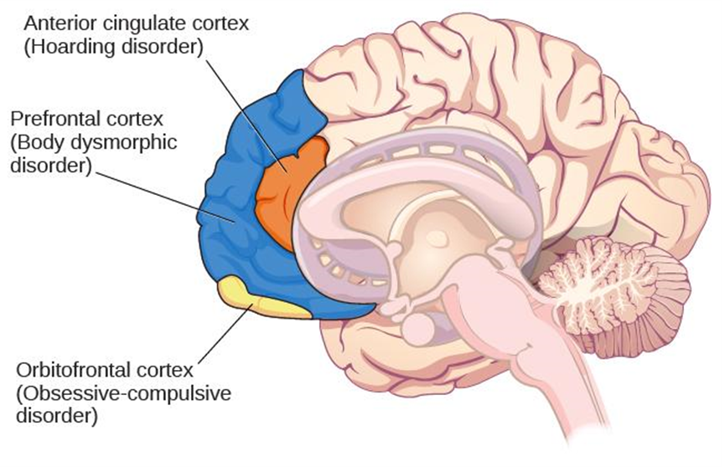
OCD: Causes
Brain Anatomy
  OCD Circuit:
    Several interconnected regions that influence perceived emotional value of stimuli and selection of behavioral and cognitive responses.
    Abnormalities in these areas may produce symptoms of OCD.
Orbitofrontal cortex – involved in learning and decision making.
  Becomes hyperactive in people with OCD when provoked with tasks such as looking at photos of a toilet or a pictures hanging crookedly on a wall.
Figure 15.13 Different regions of the brain may be associated with different psychological disorders.
Text from Psychology 2e OpenStax Revised Version Copyright © 2020 by Openstax is licensed under a Creative Commons Attribution 4.0 International License, except where otherwise noted. Edited by Maria Pagano

Slide 27
Definition of PTSD
Diagnosis Criteria
  Individual was exposed to, witnessed, or experienced the details of a traumatic experience (“actual or threatened death, serious injury, or sexual violence”) (APA, 2013).
    PTSD was first recognized in soldiers who had engaged in combat.
  Symptoms occur for at least one month.
Symptoms
  Intrusive and distressing memories of the event.
  Flashbacks – states during which individual relives the event and behaves as if it were occurring at that moment.
  Avoidance of stimuli connected to the event.
  Persistently negative emotional states.
  Feelings of detachment from others.
  Irritability.
  Proneness toward outbursts.
  Exaggerated startle response.
Prevalence - Experienced by approximately 7% of the U.S. population in their lifetime.
Video: What is PTSD? Discusses how certain traumas may induce PTSD in individuals (4:41).
Text and image from Psychology 2e OpenStax Revised Version Copyright © 2020 by Openstax is licensed under a Creative Commons Attribution 4.0 International License, except where otherwise noted. Edited by Maria Pagano

Slide 28
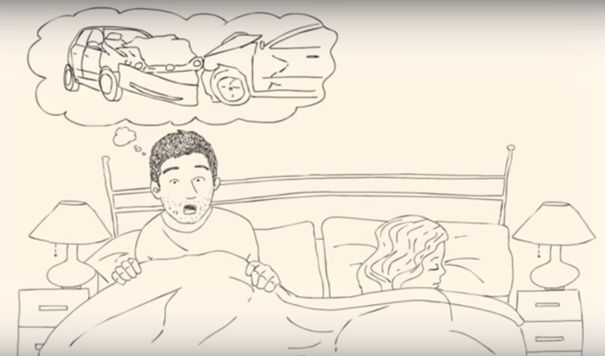
Risk Factors for PTSD
Risk Factors
  Trauma experience.
  Those involving harm by others carry greater risk than those that do not.
  Lack of immediate social support.
    Social Support (comfort, advice, and assistance from relatives, friends, and neighbors) can reduce the risk of developing PTSD.
  Subsequent life stress.
  Female gender.
  Low socioeconomic status.
  Low intelligence.
  Personal history of mental disorders.
  History of childhood adversity.
  Family history of mental disorders.
  Personality characteristics – neuroticism and somatization (tendency to experience physical symptoms when one encounters stress).
  Possession of one or two short versions of a gene that regulates serotonin.
Image from Wikimedia Commons by CFA (Country Fire Authority). The screenshot was originally uploaded on YouTube under a CC license. YouTube allows users to mark their videos with a Creative Commons license.
Licensed under CC BY SA 3.0 UNPORTED DEED,
Video: Warning Signs of PTSD produced by the Cleveland Clinic, discusses some of the common warning signs of PTSD (2:48).
Text and image from Psychology 2e OpenStax Revised Version Copyright © 2020 by Openstax is licensed under a Creative Commons Attribution 4.0 International License, except where otherwise noted.

Slide 29
Learning and the Development of PTSD
Conditioning Theories
  Traumatic event (UCS) → Extreme fear and anxiety (UCR).
  Cognitive, emotional, physiological, and environmental cues associated with the traumatic event become conditioned stimuli.
  Traumatic reminders (CS) → Extreme fear and anxiety (CR).
Cognitive Theories
  Two key processes in development and maintenance of PTSD:
    Disturbances in memory for the event.
      Poorly encoded memories of trauma can become fragmented, disorganized, and lacking in detail.
      Individuals cannot remember event in a way that gives meaning and context.
      May become haunted by these fragments involuntarily triggered by stimuli associated with the event.
    Negative appraisals of the trauma and its aftermath (e.g., ”I deserve to be raped because I am stupid”).
  May lead to dysfunctional behavioral patterns that maintain symptoms and prevent changes in the problematic appraisals.
Image and text from Psychology 2e OpenStax Revised Version Copyright © 2020 by Openstax is licensed under a Creative Commons Attribution 4.0 International License, except where otherwise noted.

Slide 30
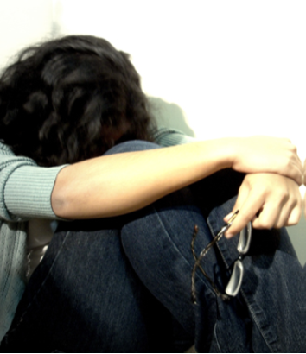
Mood and Related Disorders
Mood disorders are characterized by massive disruptions in mood and emotions that can cause a distorted outlook on life and impair ability to function.
  Depressive Disorders
    Depression (intense and persistent sadness) is the main feature.
  Bipolar and Related Disorders
    Mania (extreme elation and agitation) is the main feature.
      Manic episode – “a distinct period of abnormally and persistently elevated, expansive, or irritable mood and abnormally and persistently increased activity or energy lasting at least one week.” (APA, 2013).
Figure 15.15 Mood disorders are characterized by massive disruptions in mood. Symptoms can range from the extreme sadness and hopelessness of depression to the extreme elation and irritability of mania.
Text from Psychology 2e OpenStax Revised Version Copyright © 2020 by Openstax is licensed under a Creative Commons Attribution 4.0 International License, except where otherwise noted. Image by Maria Pagano

Slide 31
Major Depressive Disorder
Diagnosis Criteria
  “Depressed mood most of the day, nearly every day” (APA, 2013).
  Loss of interest and pleasure in usual activities.
  At least 5 symptoms for at least a two-week period.
  Symptoms cause significant distress or impair normal functioning and are not caused by substances or a medical condition.
Major depressive disorder is episodic (symptoms are usually present at their full magnitude for a certain period of time and then gradually diminish).
Symptoms
  Weight loss or weight gain/increased or decreased appetite.
  Difficulty falling asleep or too much sleep.
  Psychomotor agitation or psychomotor retardation.
  Fatigue/loss of energy.
  Feelings of worthlessness or guilt.
  Difficulty concentrating, indecisiveness.
  Suicidal ideation – thoughts of death, thinking about/planning suicide, suicide attempt.
Video: Major Depressive Disorder produced by Psych Hub discusses the signs, symptoms, and treatments of major depressive disorder (3:45).
Image and text from Psychology 2e OpenStax Revised Version Copyright © 2020 by Openstax is licensed under a Creative Commons Attribution 4.0 International License, except where otherwise noted. Edited by Maria Pagano

Slide 32
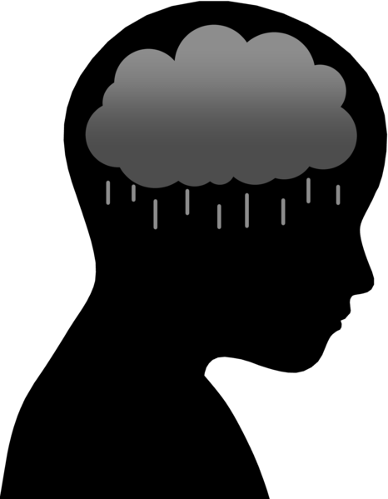
Major Depressive Disorder
Prevalence
  Affects around 6.6% of the U.S. population each year and 16.9% of the U.S. population in their lifetime.
  More common among women than men.
Comorbidity
  Comorbid with anxiety disorders and substance abuse disorders.
Risk Factors
  Unemployment.
  Low income.
  Living in urban areas.
  Being separated, divorced, or widowed.
Video: 3 Ways to Cope with Depression produced by the Cleveland Clinic discusses strategies to help deal with depression (3:45).
Reading Link: 988 Fact Sheet website provides a downloadable factsheet that explains 988, what you need to know about 988 and compares 988 to 911.
Image from Wikimedia Commons by MissLunaRose12
Licensed under CC BY SA 4.0,
Image (olfactory bulb, olfactory recptors, and nasal cavity) and Text from Psychology 2e OpenStax Revised Version Copyright © 2020 by Openstax is licensed under a Creative Commons Attribution 4.0 International License, except where otherwise noted. Edited by Maria Pagano

Slide 33
Subtypes of Depression
Seasonal pattern – applies to situations in which a person experiences the symptoms of major depressive disorder only during a particular time of year.
Peripartum onset (postpartum depression) – major depression during pregnancy or in the four weeks following the birth.
Persistent depressive disorder (dysthymia) – depressed moods most of the day nearly every day for at least two years, as well as at least two of the other symptoms of major depression.
  Chronically sad but do not meet all the criteria for major depression.
Video: Recognizing the Signs & Symptoms of Seasonal Depression Dr. Steven Levine discusses the treatments for seasonal depression (4:42).
Video: Postpartum Depression Explained: Symtoms, Risk Factors, and Treatment Dr. Leena Mittal, Chief, Division of Women’s Mental Health, Brigham & Woman’s Hospital, discusses the differences between baby blues and clinical perinatal depression, and which treatments can help (3:17).
Video: Persistent Deptressive Disorder (PDD), Causes, Signs, and Symtoms, Diagnosis and Treatment produced by Medical Centric (4:36).
Image and text from Psychology 2e OpenStax Revised Version Copyright © 2020 by Openstax is licensed under a Creative Commons Attribution 4.0 International License, except where otherwise noted. Edited by Maria Pagano

Slide 34
Bipolar Disorder
Involves mood states that fluctuate between depression and mania.
  Symptoms of Mania
    Excessively talkative.
    Excessively irritable.
    Exhibit flight of ideas – talk loudly and rapidly, abruptly switching from one topic to another.
    Easily distracted.
    Exhibit grandiosity – inflated but unjustified self-esteem and self-confidence.
    Show little need for sleep.
    Take on several tasks at once.
    Engage in reckless behaviors.
  Prevalence
    Onset is typically before the age of 25.
    Affects 1 out of 100 people in the U.S. in their lifetime.
    36% of these individuals attempt suicide.
  Comorbidity - anxiety disorder and substance abuse disorder.
Video: Bipolar Disorder Explained: Symptoms, Different Types, and More- Mass General Brigham Dr. Andrew Nierenberg, Dauten Family Center for Bipolar Treatment Innovation, Massachusetts General Hospital discusses bipolar disorder (3:13).
Image and text from Psychology 2e OpenStax Revised Version Copyright © 2020 by Openstax is licensed under a Creative Commons Attribution 4.0 International License, except where otherwise noted. Edited by Maria Pagano

Slide 35
Biological Basis of Mood Disorders
Genetics
Major Depressive Disorder:
  Relatives have double the risk of developing the disorder.
  Identical twins – 50% concordance rate.
  Fraternal twins – 38% concordance rate .
Bipolar Disorder:
  Relatives have over 9 times the risk.
  Identical twins – 67% concordance rate.
  Fraternal twins – 16% concordance rate.
Hormones
  Elevated levels of cortisol (stress hormone) are found in depression.
  Cause or consequence of depression?
  A risk factor for future depression.
  Cortisol activates the amygdala and deactivates the prefrontal cortex (disturbances connected to depression).
Image and text from Psychology 2e OpenStax Revised Version Copyright © 2020 by Openstax is licensed under a Creative Commons Attribution 4.0 International License, except where otherwise noted. Edited by Maria Pagano

Slide 36
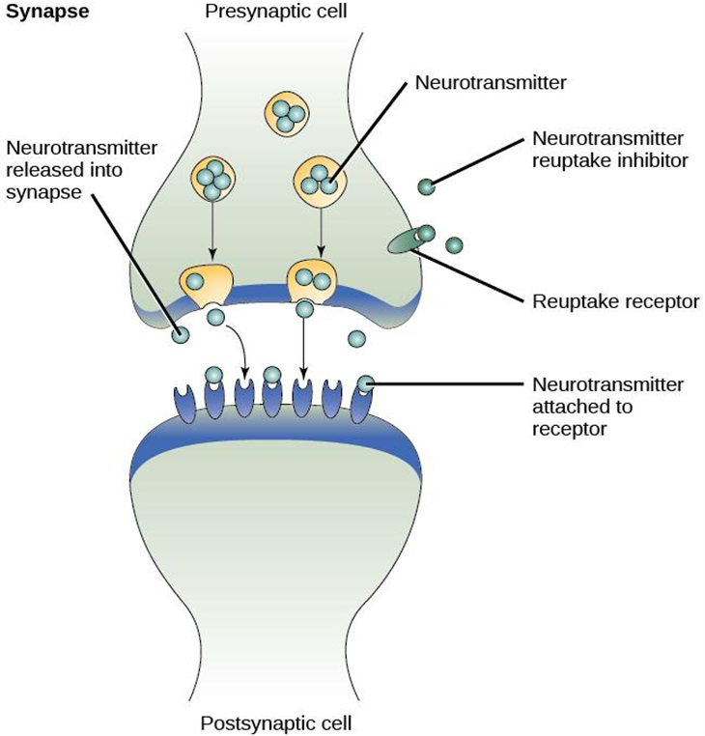
Biological Basis of Mood Disorders: Continued
Neurotransmitters
  Mood disorders often involve imbalances in neurotransmitters.
    Particularly serotonin and norepinephrine.
      These neurotransmitters are involved in bodily functions that are disrupted in mood disorders.
  Many medications designed to treat mood disorders work by altering neurotransmitter activity in the neural synapse.
    Medications for depression – usually increase serotonin and norepinephrine activity.
    Medication for bipolar – Lithium, which blocks norepinephrine activity at the synapse.
Figure 15.16 Many medications designed to treat mood disorders work by altering neurotransmitter activity in the neural synapse.
Image and text from Psychology 2e OpenStax Revised Version Copyright © 2020 by Openstax is licensed under a Creative Commons Attribution 4.0 International License, except where otherwise noted. Edited by Maria Pagano

Slide 37

Biological Basis of Mood Disorder: Continued
Brain Anatomy
  Depression:
    Amygdala – important in assessing the emotional significance of stimuli and experiencing emotions.
      Depressed individuals react to negative emotional stimuli, such as sad faces, with greater amygdala activation than do non-depressed individuals.
      More prone to react emotionally to negative stimuli.
    Prefrontal cortex – important in regulating and controlling emotions.
      Decreased activation in depressed individuals which may inhibit its ability to override negative emotions.
      Greater difficulty controlling emotional reactions.
Figure 15.17 Depressed individuals react to negative emotional stimuli, such as sad faces, with greater amygdala activation than do non-depressed individuals.
Image and text from Psychology 2e OpenStax Revised Version Copyright © 2020 by Openstax is licensed under a Creative Commons Attribution 4.0 International License, except where otherwise noted. Edited by Maria Pagano

Slide 38
Diathesis-Stress Model & Major Depressive Disorders
Stressful life events often precede the onset of depressive episodes.
  However, not everyone who experiences stressful life events develop depression, suggesting predispositions or vulnerability factors could be involved.
Genetic vulnerability:
  Alteration in the 5-HTTLPR gene which regulates serotonin.
    1 or 2 short alleles + stressful life events → increasingly likely to experience a depressive episode.
  A study on gene-environment interaction in people experiencing chronic depression in adulthood suggests a much higher incidence in individuals with a short version of the gene in combination with childhood maltreatment (Brown & Harris, 2013).
Image and text from Psychology 2e OpenStax Revised Version Copyright © 2020 by Openstax is licensed under a Creative Commons Attribution 4.0 International License, except where otherwise noted. Edited by Maria Pagano

Slide 39
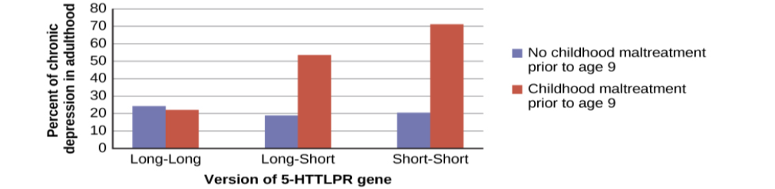
Diathesis-Stress Model & Major Depressive Disorders: Continued
Figure 15.18 A study on gene-environment interaction in people experiencing chronic depression in adulthood suggests a much higher incidence in individuals with a short version of the gene in combination with childhood maltreatment.
Image and text from Psychology 2e OpenStax Revised Version Copyright © 2020 by Openstax is licensed under a Creative Commons Attribution 4.0 International License, except where otherwise noted. Edited by Maria Pagano

Slide 40
Cognitive Theories of Depression
Cognitive theories suggest that depression is triggered by negative thoughts, interpretations, self-evaluations, and expectations.
  Diathesis-Stress model: cognitive vulnerability + stressful life events → depression.
Aaron Beck (1960s)
  Theorized that depression-prone people possess mental predispositions to think about most things in a negative way (depressive schemas).
    Depressive schemas – contain themes of loss, failure, rejection, worthlessness, and inadequacy.
      May develop in childhood in response to adverse experiences.
      Dormant until activated by stressful or negative life events.
      Prompt dysfunctional and pessimistic thoughts about the self, world, and the future.
      Maintained by cognitive biases which lead us to focus on negative aspects of experiences, interpret things negatively, and block positive memories.
  Led to the development of cognitive therapies for depression.
Video: Origins of Dr. Aaron Beck's Theory of Depression shows Dr. Aaron Beck discussing the origins of his theory of depression along with research he conducted to support his theory (4:18).
Image and text from Psychology 2e OpenStax Revised Version Copyright © 2020 by Openstax is licensed under a Creative Commons Attribution 4.0 International License, except where otherwise noted. Edited by Maria Pagano

Slide 41
Cognitive Theories of Depression: Continued
Hopelessness Theory
  Specific negative thinking style → sense of hopelessness → depression.
    Negative thinking – refers to a tendency to perceive negative life events as having stable (”It’s never going to change”) and global (“It’s going to affect my whole life”) causes.
      Creates view that the life event will have negative implications for the person’s future and self-worth, increasing likelihood of hopelessness.
    Hopelessness - expectation that unpleasant outcomes will occur, or desired outcomes will not occur, and there is nothing one can do to prevent such outcomes (seen as the primary cause of depression).
Rumination
  Distressed mood → Rumination → increased risk and duration of mood.
    Rumination – repetitive and passive focus on the fact that one is depressed and dwelling on depressed symptoms, rather than distracting oneself from the symptoms or attempting to address them in an active, problem-solving manner.
      Described to explain higher rates of depression in women, who are more likely to ruminate, than in men.
Video: The Hopelessness Theory of Depression discusses possible causes which can lead to hopelessness and subsequent depression (3:32).
Video: 3 Questions to Help Clients Interupt the Depression-Rumination Loop Dr. Christine Padesky shares 3 specific questions that can help clients eas patterns of obsessive negative thoughts (4:54).
Text from Psychology 2e OpenStax Revised Version Copyright © 2020 by Openstax is licensed under a Creative Commons Attribution 4.0 International License, except where otherwise noted. Edited by Maria Pagano

Slide 42
Suicide
Statistics
  90% of those who complete suicides have a diagnosis of at least one mental disorder (most frequently mood disorders).
  10th leading cause of death for all ages in 2010 (an average of 105 each day).
  4 times higher among males (79% of all suicides) than females.
  Males most commonly use firearms; females most commonly use poison.
Risk Factors
  Substance abuse problems (10 times greater in individuals with alcohol dependence).
  Previous suicide attempts.
  Access to lethal means in which to act (e.g., firearm in the home).
  Precursors – withdrawal from social relationships, feeling like a burden, engaging in reckless and risk-taking behaviors.
  Sense of entrapment (feeling unable to escape feelings or external circumstances).
  Cyberbullying.
  Suicide of a family member.
  Serotonin dysfunction.
Image and text from Psychology 2e OpenStax Revised Version Copyright © 2020 by Openstax is licensed under a Creative Commons Attribution 4.0 International License, except where otherwise noted. Edited by Maria Pagano

Slide 43
Schizophrenia: Symptoms
Hallucinations – perceptual experience that occurs in the absence of external stimulation. (Auditory hallucinations are most common).
Delusions – beliefs that are contrary to reality.
  Paranoid delusions – belief that other people or agencies are plotting to harm them.
  Grandiose delusions – belief that one holds special power, unique knowledge, or is extremely important.
  Somatic delusions – belief that something highly abnormal is happening to one’s body.
  Thought withdrawal/insertion – the belief that external forces are putting thoughts into or taking thoughts out of one’s mind
Disorganized thinking – disjointed and incoherent thought processes.
Disorganized or abnormal motor behavior – unusual behaviors/movements.
  Catatonic behaviors – decreased reactivity to the environment
Negative Symptoms - decreases and absences in certain behaviors, emotions, drives.
  Avolition – lack of motivation to engage in self-initiated and meaningful activity.
  Alogia – reduced speech output.
  Asociality – social withdrawal.
  Anhedonia – inability to experience pleasure.
Link to Learning Video: Watch this video of schizophrenia case studies and try to identify which classic symptoms of schizophrenia are shown. (8:11).
Image and text from Psychology 2e OpenStax Revised Version Copyright © 2020 by Openstax is licensed under a Creative Commons Attribution 4.0 International License, except where otherwise noted. Edited by Maria Pagano

Slide 44
Schizophrenia: Causes
Prevalence – Affects 1% of the population.
Genetics
  Risk is 6 times greater if one parent has schizophrenia (even if adopted).
Neurotransmitters
  Dopamine hypothesis – an overabundance of dopamine or too many dopamine receptors are responsible for the onset and maintenance of schizophrenia.
    Drugs that increase dopamine levels can produce schizophrenia-like symptoms.
    Medications that block dopamine activity reduce the symptoms.
  High levels of dopamine in the limbic system → hallucinations and delusions.
  Low levels of dopamine in the prefrontal cortex → negative symptoms.
Brain Anatomy
  Enlarged ventricles.
  Reduced gray matter in the frontal lobes.
  Many show less frontal lobe activity when performing cognitive tasks.
Image and text from Psychology 2e OpenStax Revised Version Copyright © 2020 by Openstax is licensed under a Creative Commons Attribution 4.0 International License, except where otherwise noted. Edited by Maria Pagano

Slide 45
Schizophrenia: Causes: Continued
Events During Pregnancy
  Obstetric complications during birth.
  Mother’s exposure to influenza during the first trimester.
  Mother’s emotional stress.
Marijuana
  An investigation of 45,000 Swedish military personnel who were followed up after 15 years found that those individuals who had reported using marijuana at least once by the time they were drafted into the military were more than 2 times as likely to develop schizophrenia during the ensuing 15 years than were those who reported never using marijuana; those who had indicated using marijuana 50 or more times were 6 times as likely to develop schizophrenia (Andréasson, Allbeck, Engström, & Rydberg, 1987).
  Another study reviewed 35 longitudinal studies and found a substantially increased risk of schizophrenia and other psychotic disorders in people who had used marijuana, with the greatest risk in the most frequent users (Moore et al., 2007).
Video: Schizophrenia: Causes, Symptoms, Risk Factors and More- Mass General Brigham Dr. Abigail Donovan, Director, Clinical Services Psychosis Clinical & Research Program at Massachusetts General Hospital explains the spectrum of schizophrenia (4:31).
Image and text from Psychology 2e OpenStax Revised Version Copyright © 2020 by Openstax is licensed under a Creative Commons Attribution 4.0 International License, except where otherwise noted. Edited by Maria Pagano

Slide 46
Dissociative Disorders
Dissociative disorders are characterized by an individual becoming split off, or dissociated, from their core sense of self - Memory and identity become disturbed.
Dissociative Amnesia - Inability to recall important personal information.
  Usually follows a stressful or traumatic experience.
  Dissociative fugue – individual suddenly wanders away from home, experiences confusion about their identity, and in some cases may adopt a new identity.
Depersonalization/Derealization Disorder - Characterized by recurring episodes of depersonalization, derealization, or both.
  Depersonalization – feelings of “unreality or detachment from, or unfamiliarity with, one’s whole self or from aspects of the self” (APA 2013).
    Symptoms: Out of-body experiences, thinking you are not real, feeling as if you are not in control of what you say and do, difficult to attach emotions to memories, and feeling numb,
  Derealization – a sense of ”unreality or detachment from, or unfamiliarity with, the world, be it individuals, inanimate objects, or all surroundings” (APA, 2013).
    Symptoms: Feeling you are separated from the world, difficult to recognize where you are, feeling a distortion in your sense of time, and finding your surroundings fake or unclear,
Video: Dissociative Amnesia: Causes, Symptoms, Diagnosis and Treatment looks at several aspects of dissociative amnesia (3:26).
Video: Living With Dissociation - Joe's Story discusses one individual’s experience of living with depersonalization/derealization disorder (3:06).
Image and text from Psychology 2e OpenStax Revised Version Copyright © 2020 by Openstax is licensed under a Creative Commons Attribution 4.0 International License, except where otherwise noted. Edited by Maria Pagano

Slide 47
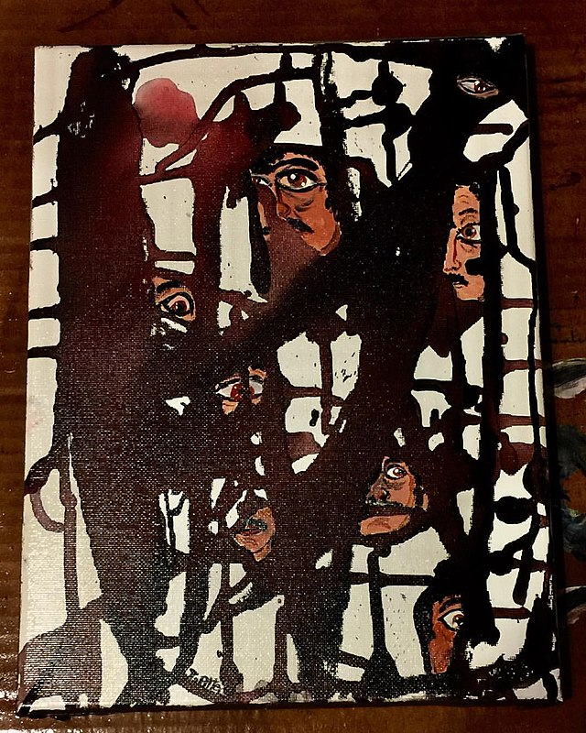
Dissociative Disorders: Continued
Dissociative Identity Disorder (formerly multiple personality disorder) - Individual exhibits two or more separate personalities or identities.
  Involves memory gaps for the time during which another identity is in charge.
  Individuals tend to report a history of childhood trauma - Adoption of multiple personalities may serve as a psychologically important coping mechanism for threat and danger.
Image from Wikimedia Commons by Tony Alter
Licensed under CC BY 2.0 DEED,
Video: Me, Myself, and I: Dissociative Identity Disorder Hank Green discusses dissociative identity disorder. Produced by SciShow Psych (5:19).
Image and text from Psychology 2e OpenStax Revised Version Copyright © 2020 by Openstax is licensed under a Creative Commons Attribution 4.0 International License, except where otherwise noted. Edited by Maria Pagano

Slide 48
Disorders in Childhood:ADHD
Neurodevelopmental disorders – involve developmental problems in personal, social, academic, and intellectual functioning.
ADHD - constant pattern of inattention and/or hyperactive and impulsive behavior that interferes with normal functioning.
  Symptoms:
    Inattention:
      Difficulty sustaining attention.
      Failure to follow instructions.
      Disorganization.
      Lack of attention to detail.
      Easily distracted and forgetful
    Hyperactivity:
      Excessive movement.
      Interrupting and intruding on others.
      Blurting out responses before questions have been completed.
      Difficulty waiting ones turn.
Image and text from Psychology 2e OpenStax Revised Version Copyright © 2020 by Openstax is licensed under a Creative Commons Attribution 4.0 International License, except where otherwise noted. Edited by Maria Pagano

Slide 49
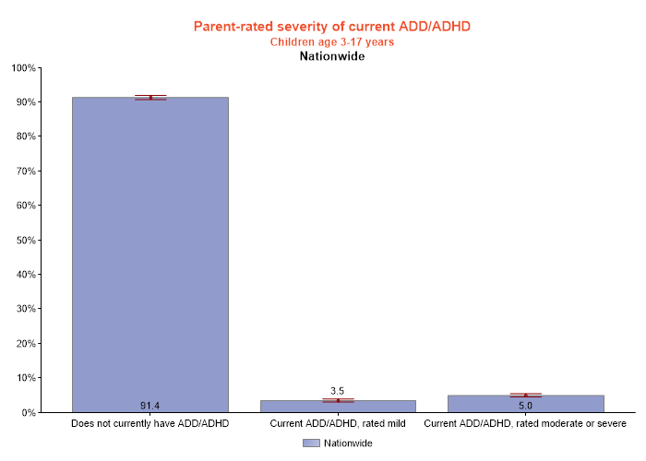
Disorders in Childhood:ADHD: Continued
Prevalence
  Occurs in about 5% of children.
  Boys are 3 times more likely to have ADHD than girls.
Life Problems
  Low educational attainment, low socioeconomic status, unemployment, low wages, substance abuse problems, and relationship problems.
n= 25, 612
Citation: Child and Adolescent Health Measurement Initiative. 2019 National Survey of Children’s Health (NSCH) data query. Data Resource Center for Child and Adolescent Health supported by the U.S. Department of Health and Human Services, Health Resources and Services Administration (HRSA), Maternal and Child Health Bureau (MCHB). Retrieved [07/02/24] from [www.childhealthdata.org].
Video: What is ADHD? Looks at ADHD, Attention Deficit Disorder, and Hyperactivity Disorder (4.28).
Image and text from Psychology 2e OpenStax Revised Version Copyright © 2020 by Openstax is licensed under a Creative Commons Attribution 4.0 International License, except where otherwise noted. Edited by Maria Pagano

Slide 50
ADHD: Causes
Genetics
  Inattention – 71% heritable.
  Hyperactivity – 73% heritable.
Neurotransmitters
  Dopamine:
    Genes involved are thought to include at least two that are important in the regulation of dopamine.
    Individuals with ADHD show less dopamine activity in key brain regions (especially those associated with motivation and reward.
    Medications have stimulant qualities and elevate dopamine activity.
Brain Anatomy
  Studies show smaller frontal lobe volume and less activation when performing mental tasks.
  Frontal lobe inhibits behavior – may explain hyperactive, uncontrolled behavior of ADHD.
Video: Causes of ADHD (Attention Deficity Hyperactivity Disorder) Megan Slater, Director of Nursing Services at New Haven Residential Treatment Center, talks about the causes of ADHD (2:42).
Image and text from Psychology 2e OpenStax Revised Version Copyright © 2020 by Openstax is licensed under a Creative Commons Attribution 4.0 International License, except where otherwise noted. Edited by Maria Pagano

Slide 51
Disorders in Childhood: Autism Spectrum Disorder
Symptoms
  Deficits in social interaction (e.g., do not make eye contact, turn head away when spoken to, prefer playing alone).
  Deficits in communication (e.g., one-word responses, difficulty maintaining conversation, echoed speech, and problems using and understanding nonverbal cues).
  Repetitive patterns of behavior or interests.
Prevalence
  Affects approximately 1 in 88 children in the U.S.
  5 times more common in boys.
Causes
  Genetics:
    Identical twins – 60%-90% concordance rates.
    Fraternal twins – 5%-10% concordance rates.
    Genes involved are those important in the formation of synaptic circuits that facilitate communication between different areas of the brain.
  Environment:
    Factors that contribute to new mutations (e.g. pollutants).
Link to Learning Video: Watch this video about early signs of autism to learn more. (6:37).
Video: What is Autism Spectrum Disorder and What Does it Look Like? by D. Doherty - OPENPediatrics discusses autism spectrum disorder and presents a patient with autism (2:53).
Image and text from Psychology 2e OpenStax Revised Version Copyright © 2020 by Openstax is licensed under a Creative Commons Attribution 4.0 International License, except where otherwise noted. Edited by Maria Pagano

Slide 52
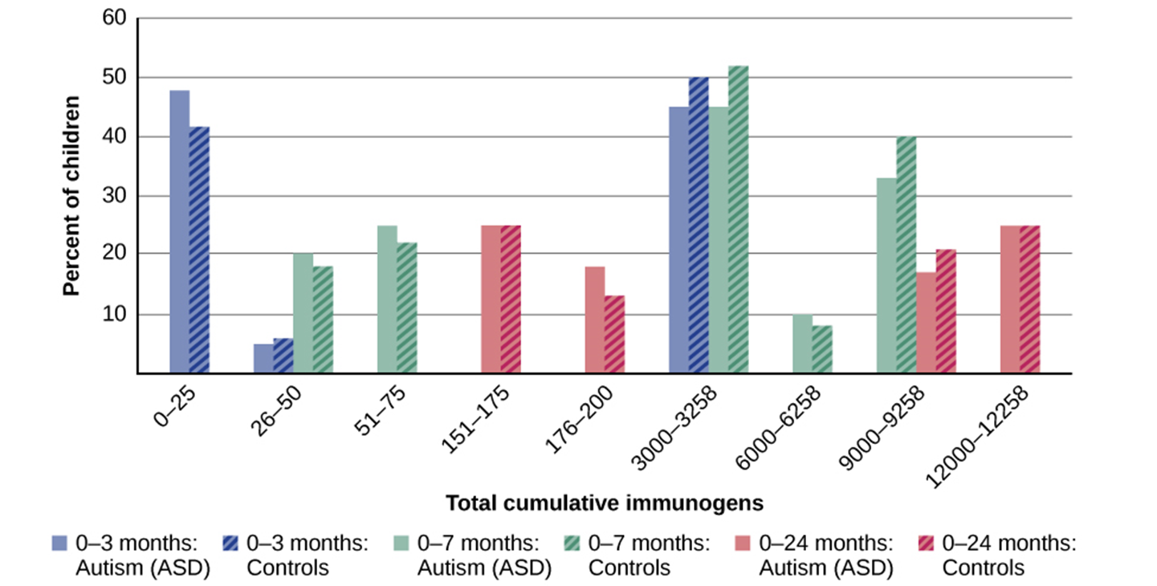
Child Vaccinations and Autism Spectrum Disorder
Figure 15.19 In terms of their exposure to immunogens in vaccines, overall, there is not a significant difference between children with autism spectrum disorder and their age-matched controls without the disorder.
Image and text from Psychology 2e OpenStax Revised Version Copyright © 2020 by Openstax is licensed under a Creative Commons Attribution 4.0 International License, except where otherwise noted. Edited by Maria Pagano

Slide 53
Personality Disorders
Begins in adolescence or early adulthood and is characterized by a pervasive and inflexible personality style that differs markedly from the expectations of the individual's culture and causes distress or impairment.
Prevalence
  Slightly over 9% of the U.S. population suffers from a personality disorder.
  Avoidant and schizoid personality disorders are most frequent.
  Antisocial and borderline personality disorder are most problematic.
The DSM-5 recognizes 10 personality disorders, organized into 3 different clusters
Cluster A
Paranoid personality disorder
Schizoid personality disorder
Schizotypal personality disorder
Cluster B
Antisocial personality disorder
Histrionic personality disorder
Narcissistic personality disorder
Borderline personality disorder
Cluster C
Avoidant personality disorder
Dependent personality disorder
Obsessive-compulsive personality disorder
Video: Personality Disorders-Psychiatric Mental Health for Nursing Students briefly covers each of the three clusters of personality disorders and at the end of the video provides a test-yourself portion (5:38).
Image and text from Psychology 2e OpenStax Revised Version Copyright © 2020 by Openstax is licensed under a Creative Commons Attribution 4.0 International License, except where otherwise noted. Edited by Maria Pagano

Slide 54
Borderline Personality Disorder
Characterized by instability in interpersonal relationships, self-image, and mood, as well as marked impulsivity.
Symptoms
  Cannot tolerate the thought of being alone – will make frantic efforts to avoid abandonment or separation.
  Relationships are intense and unstable.
  Unstable view of self – might suddenly display a shift in personal attitudes, interests, career plans, and choice of friends.
  May be highly impulsive and may engage in reckless and self-destructive behaviors.
  May sometimes show intense and inappropriate anger.
  Can be moody, sarcastic, bitter and verbally abusive.
Prevalence – afflicts 1.4% of the U.S. population.
Comorbidity – anxiety, mood, and substance use disorders.
Causes
  Core personality traits such as impulsivity and emotional instability show a high degree of heritability.
  Many individuals report childhood abuse.
Video: What is BPD? Dr. Lois Choi-Kain of the Mass General Brigham McClean Hospital addresses questions about BPD (2:43).
Image and text from Psychology 2e OpenStax Revised Version Copyright © 2020 by Openstax is licensed under a Creative Commons Attribution 4.0 International License, except where otherwise noted. Edited by Maria Pagano

Slide 55
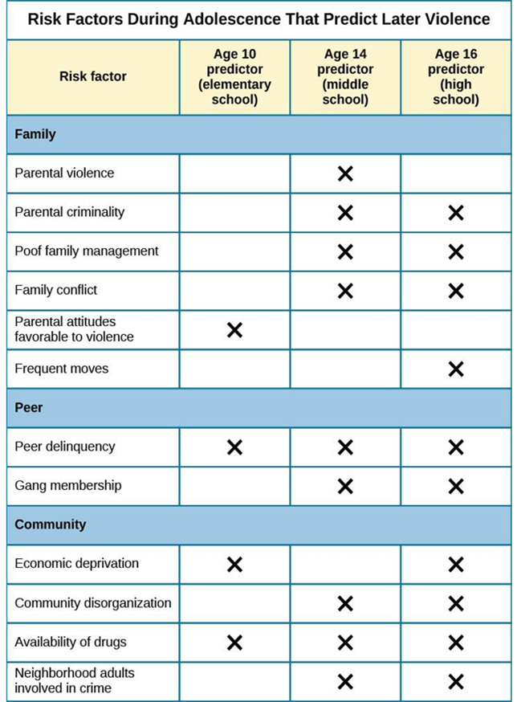
Antisocial Personality Disorder
Characterized by complete lack of regard for other people’s rights or feelings.
Symptoms
  Repeatedly performing illegal acts.
  Lying to or conning others.
  Impulsivity and recklessness.
  Irritability and aggressiveness.
  Failure to act in responsible ways.
  Lack of remorse.
  Overinflated sense of self.
  Superficial charm.
  Lack ability to empathize.
Diagnosis requires individual to be at least 18 years old.
Prevalence
  Observed in 3.6% of the population.
  More common in males.
Figure 15.20 Longitudinal studies have helped to identify risk factors for predicting violent behavior.
Image and text from Psychology 2e OpenStax Revised Version Copyright © 2020 by Openstax is licensed under a Creative Commons Attribution 4.0 International License, except where otherwise noted. Edited by Maria Pagano

Slide 56
Antisocial Personality Disorder: Causes
Genetics
  Personality and temperament dimensions related to this disorder (fearlessness, impulsive antisociality, and callousness) have a genetic influence.
  Adoption studies suggest antisocial behavior is determined by the interaction of genetic factors and adverse environmental circumstances.
Emotional Deficits
  Individuals with antisocial personality disorder fail to show fear in response to environment cues that signal punishment, pain, or noxious stimulation.
    Show less skin conductance which may indicate emotional deficits.
Brain Anatomy
  Research has revealed:
    Less activation in brain regions involved in the experience of empathy and feeling concerned for others.
    Greater activation in a brain area involved in self-awareness, cognitive function and interpersonal experience.
Video: Why Being Introverted Doesn't Make You Antisocial- Antisocial Personality Disorder Hank Green of SciShow Psych discusses antisocial personality disorder and why it should not be confused with introversion (5:45).
Image and text from Psychology 2e OpenStax Revised Version Copyright © 2020 by Openstax is licensed under a Creative Commons Attribution 4.0 International License, except where otherwise noted. Edited by Maria Pagano

