Slide 1

Chapter 13
Industrial-Organizational Psychology
OpenStax Psychology 2E
OpenStax ancillary resource is © Rice University under a CC-BY-4.0 DEED license and may be used with proper attributes. Unless otherwise noted all material and text contained in these ancillary materials is from Spielman, R. M., Jenkins, W. J., & Lovett, M. D. (2020). Psychology 2E. OpenStax and is licensed under CC BY 4.0 DEED.

Slide 2

What is Industrial-Organizational Psychology?
Industrial-Organizational (I/O) Psychology is a branch of psychology that studies how human behavior and psychology effect work and how they are affected by work.
Industrial-Organizational psychologists work in:
  Academia
  Government
  Consulting firms
  Business
Figure 13.1 What does an office look like? For people who telecommute, their workspace may be adapted to fit their lifestyle.
Image and Text: OpenStax ancillary resource © Rice University under a CC-BY 4.0 International license. Image from Wikimedia Commons by Ben Taylor is licensed under CC BY 2.0 DEED

Slide 3
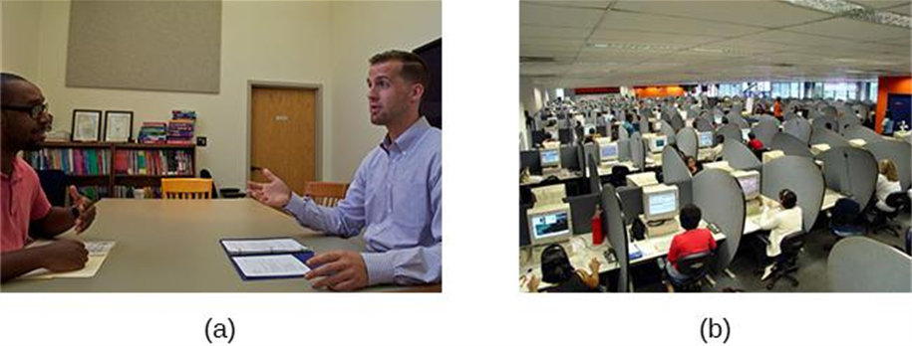
Areas of Industrial-Organizational Psychology
Industrial Psychology
  Studies job characteristics, applicant characteristics, and how to match them; also studies employee training and performance appraisal.
    Focuses on hiring and maintaining employees.
    Considers issues of legality regarding discrimination in hiring.
Organizational Psychology
  Studies interactions between people working in organizations and effects of those interactions on productivity.
    Interested in worker satisfaction, motivation, commitment, management and leadership styles, social norms and role expectations.
    Considers harassment and workplace violence.
Figure 13.2 (a) Industrial psychology focuses on hiring and maintaining employees. (b) Organizational psychology is interested in employee relationships and organizational culture.
Image and text from Psychology 2e OpenStax Revised Version Copyright © 2020 by Openstax is licensed under a Creative Commons Attribution 4.0 International License, except where otherwise noted. Edited by Maria Pagano

Slide 4
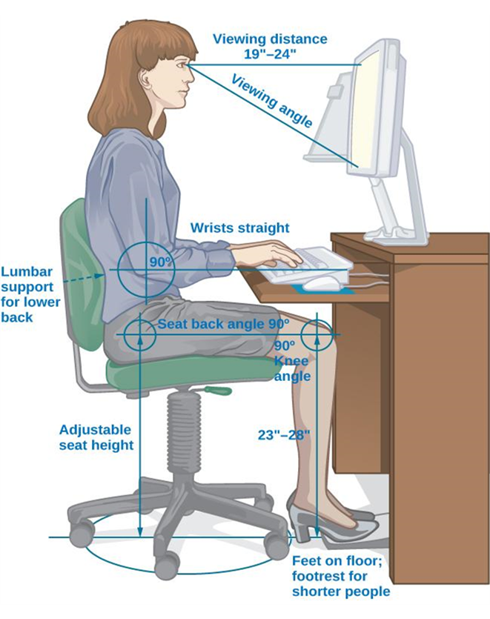
Areas of Industrial-Organizational Psychology
Human Factors Psychology
  Studies how workers interact with the tools of work and how to design those tools to optimize workers’ productivity, safety, and health.
    Known as Ergonomics in Europe.
    Tools of work can include interaction with a machine, workstation, information displays, and the local environment (e.g., lighting).
Link to Learning Reading: Find out what I-O psychologists do on the Society for Industrial and Organizational Psychology (SIOP) website—a professional organization for people working in the discipline. This site also offers several I-O psychologist profiles.
Video: Five Minute Career Preview: I-O Psychology introduces you several individuals who have degrees in I/O psychology and the type of work that they do (5:09).
Figure 13.3 Human factors psychology is the study of interactions between humans, tools, and work systems. (a) At a traditional desk, certain positioning is ideal for ergonomics and health. (b) Recent developments in workspaces include desks where people might sit on a ball, stand, or even cycle while working.
All text from Psychology 2e OpenStax Revised Version Copyright © 2020 by Openstax is licensed under a Creative Commons Attribution 4.0 International License, except where otherwise noted. Edited by Maria Pagano

Slide 5
Fields of Industrial Organizational Psychology (Table 13.1)
Field of I-O Psychology | Description | Types of Jobs
Industrial Psychology | Specializes and focuses on the retention of employees and hiring practices to ensure the least number of firings and the greatest number of hirings relative to the organization’s size. | Personnel Analyst Instructional Designer Professor Research Analyst
Organizational Psychology | Works with the relationships that employees develop with their organizations and conversely that their organization develops with them. In addition, studies the relationships that develop between co-workers and how that is influenced by organizational norms. | HR Research Specialist Professor Project Consultant Personnel Psychologist Test Developer Training Developer Leadership Developer Talent Developer
Human Factors and Engineering | Researches advances and changes in technology in an effort to improve the way technology is used by consumers, whether with consumer products, technologies, transportation, work environments, or communications. Seeks to be better able to predict the ways in which people can and will utilize technology and products in an effort to provide improved safety and reliability. | Professor Ergonomist Safety Scientist Project Consultant Inspector Research Scientist Marketer Product Development
Humanitarian Work Psychology | Works to improve the conditions of individuals who have faced serious disaster or who are part of an underserved population. Focuses on labor relations, enhancing public health services, effects on populations due to climate change, recession, and diseases. | Professor Instructional Designer Research Scientist Counselor Consultant Program Manager Senior Response Officer
Occupational Health Psychology | Concerned with the overall well-being of both employees and organizations. | Occupational Therapist Research Scientist Consultant Human Resources (HR) Specialist Professor

Slide 6
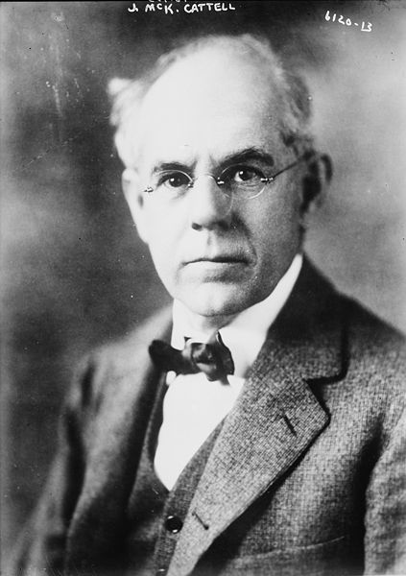
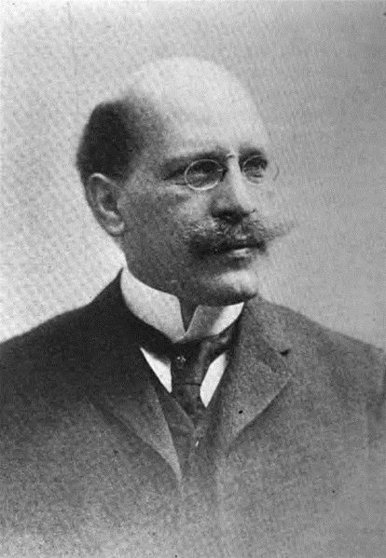
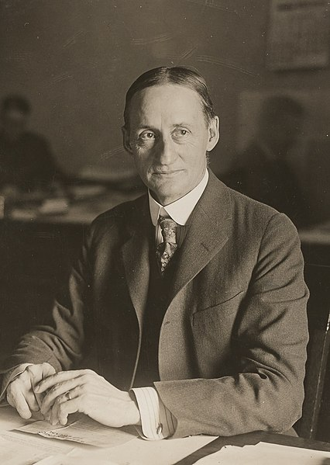
Historical Development: Early 20th Century
James Cattell, Hugo Munsterberg, Walter Dill Scott
  Students of Wilhelm Wundt.
  Conducted research focusing on what is now called industrial psychology.
    Cattell - founded the Psychological Corporation, a psychological consulting company.
    Munsterberg – published Psychology and Industrial Efficiency (1913), which covered employee selection, employee training, and effective advertising.
    Scott – one of the first psychologists to apply psychology to advertising, management, and personnel selection. Published the first books to describe the use of psychology in the business world.
James Cattell (1860-1944)
(Hugo Munsterberg (1863-1916)
Walter Dill Scott (1920-1939)
Image from Wikimedia Commons source from Library of Congress. Licensed under Public Domain.
Image from Wikimedia Commons source from HathiTrust. Licensed under Public Domain.
Image from Wikimedia Commons source from National Archives and Records Administration. Licensed under Public Domain.
Text from Psychology 2e OpenStax Revised Version Copyright © 2020 by Openstax is licensed under a Creative Commons Attribution 4.0 International License, except where otherwise noted. Edited by Maria Pagano

Slide 7
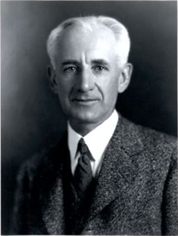
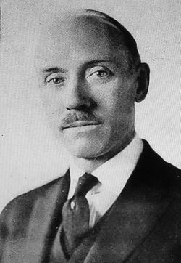
Historical Development: Early 20th Century
Robert Yerkes
  Organized a group that developed methods for screening and selecting enlisted men during World War I.
  Developed the Army Alpha test to measure mental abilities.
Walter Dill Scott along with Walter Bingham organized a group with the goal to develop selection methods for officers.
Robert Yerkes (1860-1944)
Walter V. Bingham (1880-1952)
Image from Wikimedia Commons source from Psyche Games. Licensed under CC BY SA 4.0.
Image from Wikimedia Commons source unknown. Licensed under Public Domain.
All text from Psychology 2e OpenStax Revised Version Copyright © 2020 by Openstax is licensed under a Creative Commons Attribution 4.0 International License, except where otherwise noted. Edited by Maria Pagano

Slide 8
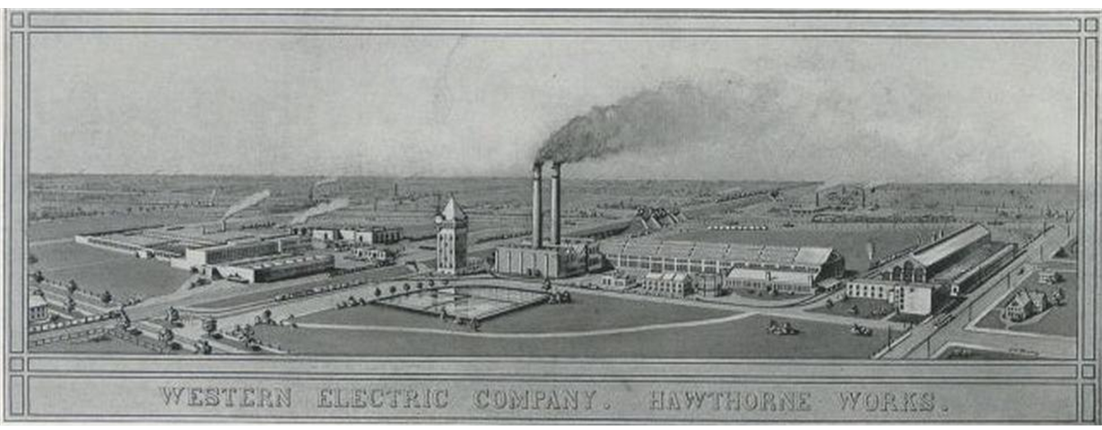
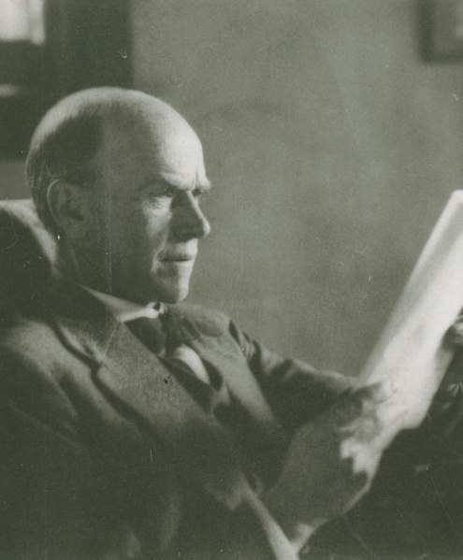
Historical Development: Early 20th Century
Elton Mayo conducted studies at Western Electric’s Hawthorne Work (1929-1932).
  Explored interpersonal relations, motivation, and organizational dynamics.
  Examined how human interaction factors enhanced or decreased productivity.
Origin of organizational psychology.
  Researchers reported that any changes they made to variables resulted in increased productivity.
Elton Mayo (1880-1949)
Figure 13.4 Hawthorne Works provided the setting for several early I-O studies
Image from Wikimedia Commons source unknown. Licensed under Public Domain.
All text from Psychology 2e OpenStax Revised Version Copyright © 2020 by Openstax is licensed under a Creative Commons Attribution 4.0 International License, except where otherwise noted. Edited by Maria Pagano

Slide 9
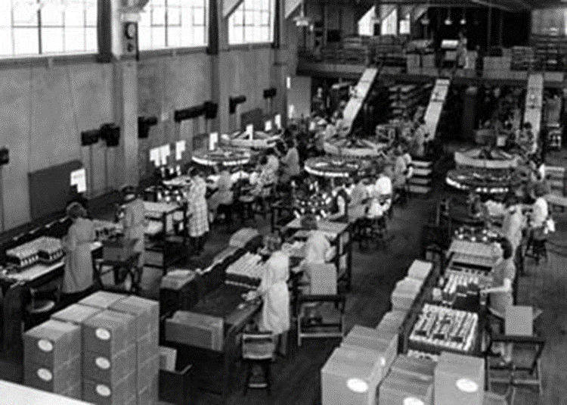
The Hawthorne Effect
Years after Mayo’s study, researchers analyzed the results and noticed that employees performed better when researchers or supervisors observed and interacted with them.
  Suggested that productivity increased because people’s performance changes when they are being observed.
Hawthorne Effect - The increase in performance of individuals who are noticed, watched, and paid attention to by researchers or supervisors.
Figure 13.5 Researchers discovered that employees performed better when researchers or supervisors observed and interacted with them, a dynamic termed the Hawthorne effect.
Link to Learning Video: Watch this video of first-hand accounts of the original Hawthorne studies to learn more (13:57).
Image and text from Psychology 2e OpenStax Revised Version Copyright © 2020 by Openstax is licensed under a Creative Commons Attribution 4.0 International License, except where otherwise noted. Edited by Maria Pagano

Slide 10
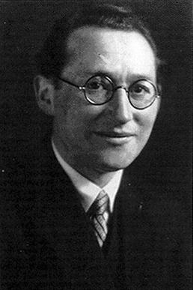
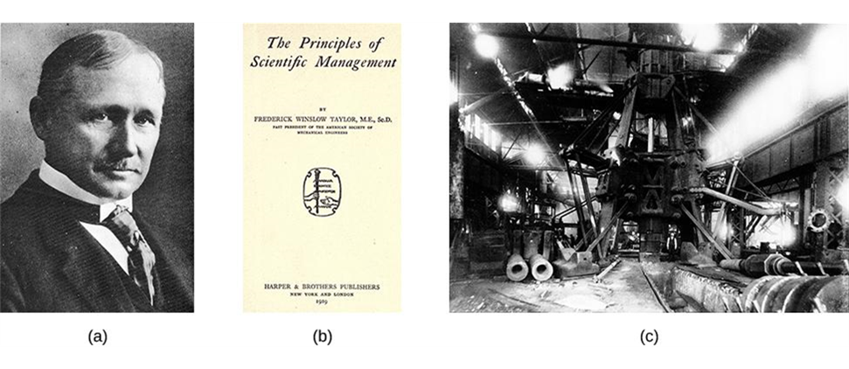
Historical Development: Early 20th Century
Kurt Lewin (1930s) researched the effects of leadership styles, team structure, and team dynamics.
  Studied group interactions, cooperation, competition, and communication.
  Coined the term group dynamics.
Frederick Taylor (1911) strived to engineer workplaces to increase productivity.
Wrote, The Principles of Scientific Management – examines management styles, personnel selection and training.
Kurt Lewin (1890-1947)
Britannica, T. Editors of Encyclopaedia (2024, March 21). Kurt Lewin. Encyclopedia Britannica. Use permitted by Encyclopedia Britannica for educational purposes.
Figure 13.6 (a) Frederick Taylor (1911) strived to engineer workplaces to increase productivity, based on the ideas he set forth in (b) his book, The Principles of Scientific Management. (c) Taylor designed this steam hammer at the Midvale Steel Company. (credit c: modification of work by “Kheel Center, Cornell University”/Flickr)
Image and text from Psychology 2e OpenStax Revised Version Copyright © 2020 by Openstax is licensed under a Creative Commons Attribution 4.0 International License, except where otherwise noted. Edited by Maria Pagano

Slide 11
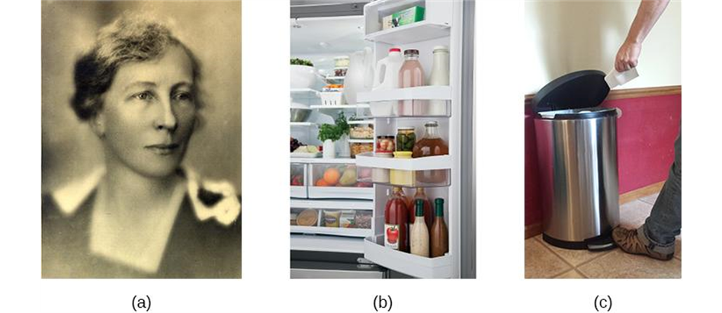
Historical Development: Early 20th Century
Lilian Gilbreth – The Mother of Modern Management
  Strove to find ways to increase productivity.
  Studied efficiency improvements that reduced the number of motions required to perform a task and were applicable in the workplace, home, and other areas.
  Credited with the idea of putting shelves on the inside of refrigerator doors and foot-pedal-operated garbage cans.
  Investigated employee fatigue and time management stress.
  Found many employees were motivated by money and job satisfaction.
Figure 13.7 (a) Lillian Gilbreth studied efficiency improvements that were applicable in the workplace, home, and other areas. She is credited with the idea of (b) putting shelves on the inside of refrigerator doors and (c) foot-pedal-operated garbage cans.
Image and text from Psychology 2e OpenStax Revised Version Copyright © 2020 by Openstax is licensed under a Creative Commons Attribution 4.0 International License, except where otherwise noted. Edited by Maria Pagano

Slide 12
Industrial Psychology: Selecting Employees
Job Advertising
  Job analysis – accurately describing the task/job.
    Task-oriented – lists in detail the tasks that will be performed for the job.
    Worker-oriented – describes characteristics required of the worker to successfully perform the job (e.g., knowledge, skills, abilities).
O*Net – database of previously compiled job analyses for different jobs and occupations.
Candidate Analysis and Testing - Can involve testing, interviews, and work samples, or exercises.
  Personality tests can be used to identify personality characteristics of the candidate and match those personality characteristics that would ensure good performance on the job.
  Other tests can include IQ tests, integrity tests, and physical tests, such as drug tests or physical fitness tests.
Image and text from Psychology 2e OpenStax Revised Version Copyright © 2020 by Openstax is licensed under a Creative Commons Attribution 4.0 International License, except where otherwise noted. Edited by Maria Pagano

Slide 13
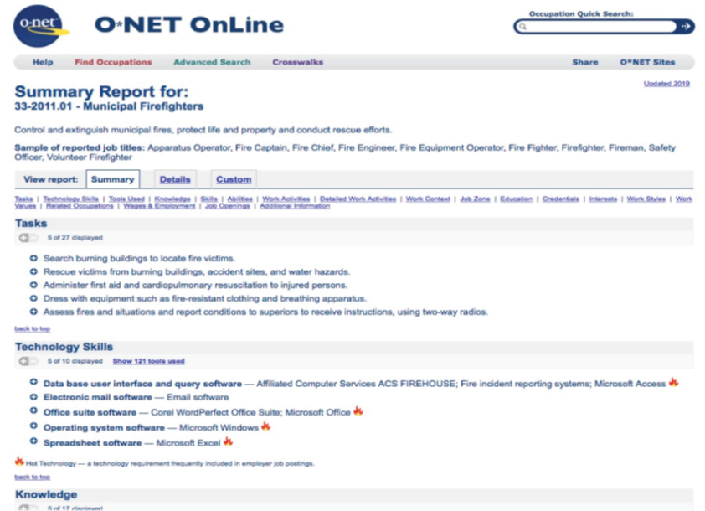
Industrial Psychology: Selecting Employees
Figure 13.8 The O*Net database from the United States Department of Labor provides information about a variety of occupations, including the knowledge, skills, and abilities desired for the position. In this example, the search shows information related to the job of being a municipal firefighter.
Link to Learning Reading: The O*Net database describes the skills, knowledge, and education required for occupations, as well as what personality types and work styles are best suited to the role. See what it has to say about being a food server in a restaurant or an elementary school teacher or an industrial-organizational psychologist to learn more about these career paths.

Slide 14
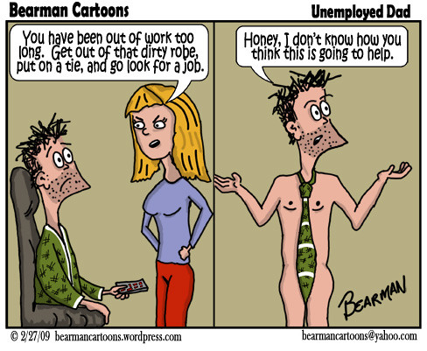
Industrial Psychology: Interviews
Interviews can be influenced by social factors and body language such as the degree of similarity of the applicant to the interviewer and nonverbal behaviors (e.g., hand gestures, head nodding, and smiling).
Research found that lack of eye contact and smiling lead to lower applicant ratings.
Unstructured interview:
  Different questions for different candidates.
  Questions are usually unspecified beforehand.
Structured interview:
  Same questions for every candidate.
  Questions are prepared in advance.
  Standardized rating system for each response.
  More effective at predicting subsequent job performance of the job candidate.
Image from flickr by Bearman2007. Licensed under CC BY NC ND 2.0 DEED.
Text from Psychology 2e OpenStax Revised Version Copyright © 2020 by Openstax is licensed under a Creative Commons Attribution 4.0 International License, except where otherwise noted. Edited by Maria Pagano

Slide 15
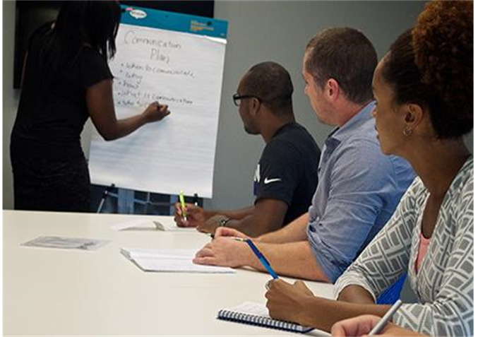
Industrial Psychology: Training
Training usually begins with an orientation period during which a new employee learns about company policies, practices, and culture.
  Educates the new employee about the organizational culture, the values, visions, hierarchies, norms and ways the company’s employees interact.
Mentoring:
  Experienced employee guides the work of a new employee.
  Mentors may be formally assigned or develop informally.
Research on mentoring:
  Mentoring positively affected protégés compensation, and number of promotions compared with non-mentored employees.
  Protégés were more satisfied with their careers and had greater job satisfaction.
Figure 13.9 Training usually begins with an orientation period during which a new employee learns about company policies, practices, and culture.
Image and text from Psychology 2e OpenStax Revised Version Copyright © 2020 by Openstax is licensed under a Creative Commons Attribution 4.0 International License, except where otherwise noted. Edited by Maria Pagano

Slide 16
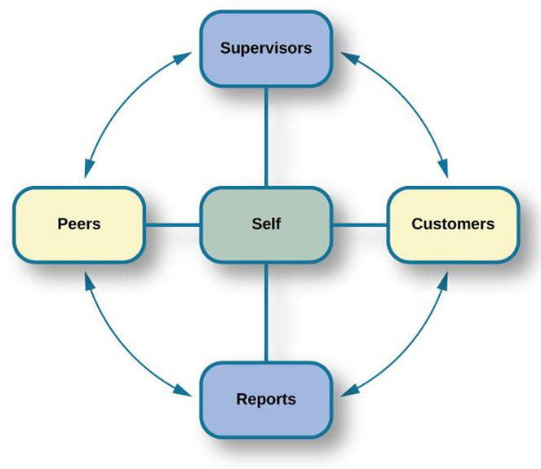
Industrial Psychology: Evaluating Employees
Industrial-organizational psychologists are often involved in designing performance-appraisal systems for organizations.
  Aim to make evaluations as fair and positive as possible and decrease subjectivity.
Performance appraisals – evaluation of an employee’s success or lack of success at performing the duties of the job.
  Often used to motivate employees to improve performance and expand areas of competence.
360-degree Feedback Appraisal:
  Supervisors, customers, direct reports, peers, and the employee himself rate an employee’s performance.
  Provides different perspectives of employee's job performance.
  Often fail to accomplish their purpose because they are used incorrectly.
Figure 13.10 In a 360-degree performance appraisal, supervisors, customers, direct reports, peers, and the employee himself rate an employee’s performance.
Image and Text from Psychology 2e OpenStax Revised Version Copyright © 2020 by Openstax is licensed under a Creative Commons Attribution 4.0 International License, except where otherwise noted. Edited by Maria Pagano

Slide 17
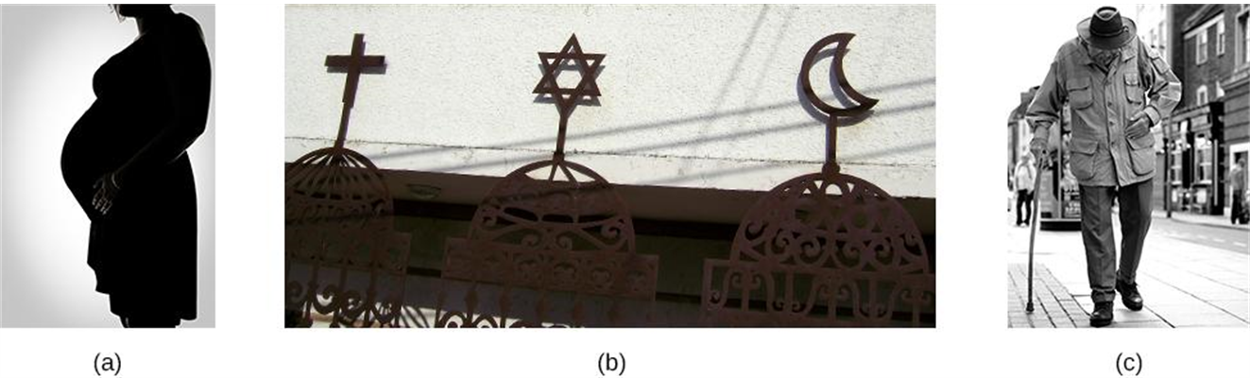
Industrial Psychology: Bias & Protection in Hiring
Selecting candidates based on group membership, when it does not directly affect potential job performance, is discriminatory.
Many laws exist to prevent hiring based on various group-membership criteria.
  Pregnancy, religion, and age are some of the criteria on which hiring decisions cannot legally be made.
Did you know it is illegal for a potential employer to ask your age in an interview?
Figure 13.11 (a) Pregnancy, (b) religion, and (c) age are some of the criteria on which hiring decisions cannot legally be made.
Text and image from Psychology 2e OpenStax Revised Version Copyright © 2020 by Openstax is licensed under a Creative Commons Attribution 4.0 International License, except where otherwise noted. Edited by Maria Pagano

Slide 18
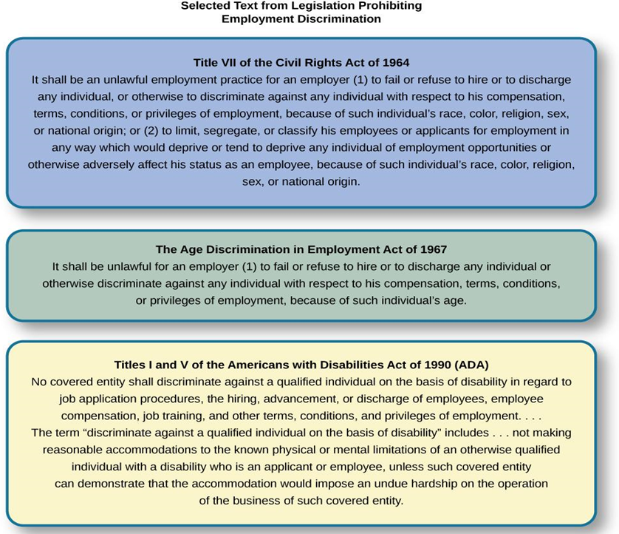
The U.S. Equal Employment Opportunity EEOC
The EEOC is responsible for enforcing federal laws that make it illegal to discriminate against a job applicant or an employee because of the person’s race, color, religion, sex (including pregnancy), national origin, age (40 or older), disability, or genetic information.
Link to Learning Video: In 2011, the U.S. Supreme Court decided a case in which women plaintiffs were attempting to group together in a class-action suit against Walmart for gender discrimination in promotion and pay. The case was important because it was the only practical way for individual women who felt they had been discriminated against to sustain a court battle for a redress of their claims. The Court ultimately decided against the plaintiffs, and the right to a class-action suit was denied. However, the case itself effectively publicized the issue of gender discrimination in employment. Watch this video about the case history and issues (5:19) and this PBS NewsHour video about the arguments (11:05)to learn more.
Figure 13.12 The laws shown here protect employees in the U.S. from discriminatory practices.
Text from Psychology 2e OpenStax Revised Version Copyright © 2020 by Openstax is licensed under a Creative Commons Attribution 4.0 International License, except where otherwise noted. Edited by Maria Pagano

Slide 19
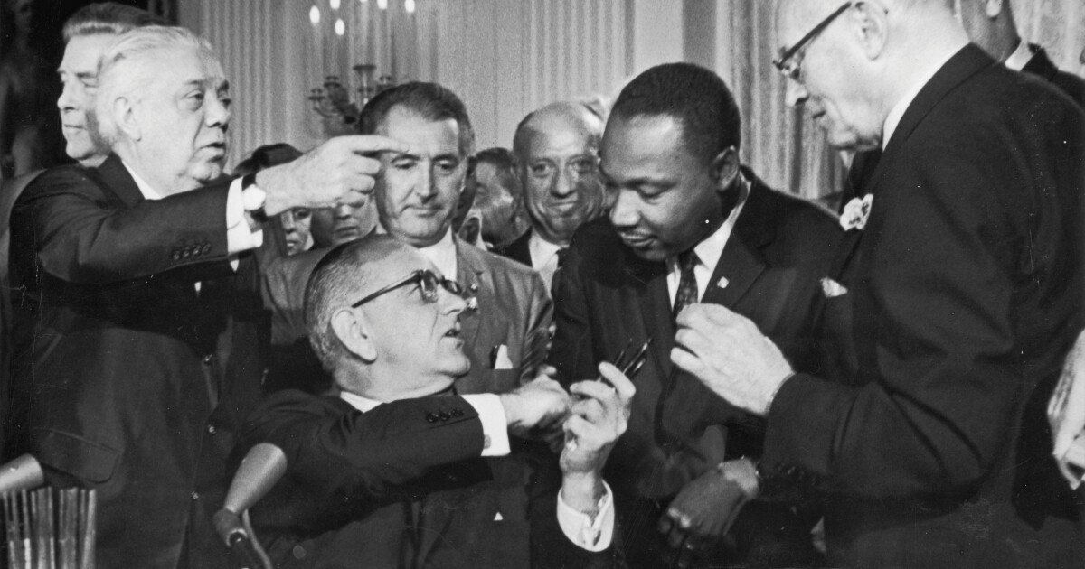
The U.S. Equal Employment Opportunity (EEOC)
Equal Pay Act – requires equal pay for men and women in the same workplace who are performing equal work.
Title VII of the Civil Rights Act (1964) – makes it illegal to treat individuals unfavorably because of their race or color of their skin.
Pregnancy Discrimination Act (1978) – prohibits job discrimination of a woman because she is pregnant as long as she can perform the work required.
Americans with Disabilities Act - Employers cannot discriminate against any individual based on a disability.
  Disability – a physical or mental impairment that limits one or more major life activities such as hearing, walking, and breathing.
  Has been expanded to include individuals with alcoholism, former drug use, obesity, or psychiatric disabilities.
Bona Fide Occupational Qualification (BFOQ) - Requirement of certain occupations for which denying an individual employment would otherwise violate the law, such as requirements concerning religion or sex.
  In some cases, religion, national origin, age, and sex are bona fide occupational qualifications.
President Lyndon B. Johnson and Dr. Martin Luther King, Jr. at the signing of the Civil Rights Act of 1964. Image licensed under Public Domain.
Text and image from Psychology 2e OpenStax Revised Version Copyright © 2020 by Openstax is licensed under a Creative Commons Attribution 4.0 International License, except where otherwise noted. Edited by Maria Pagano

Slide 20

Organizational Psychology: Job Satisfaction
Results from how we think about our work (cognition) and how we feel about our work (affect).
Influenced by the work itself, our personality, and our culture.
Measured using questionnaires that employees complete.
Can be measured at a global level (general satisfaction with work) or at the level of specific factors (which aspects of the job lead to satisfaction).
(Credit: Linkedin)
Text and image from Psychology 2e OpenStax Revised Version Copyright © 2020 by Openstax is licensed under a Creative Commons Attribution 4.0 International License, except where otherwise noted. Edited by Maria Pagano

Slide 21
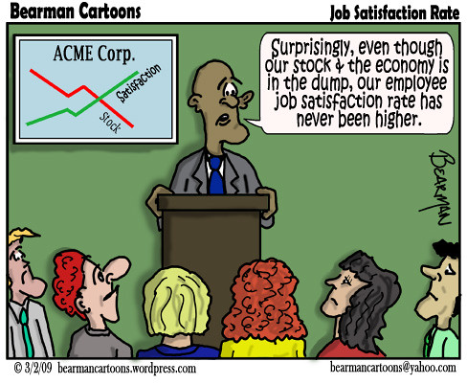
Organizational Psychology: Job Satisfaction
Factors Involved in Job Satisfaction (Table 13.2)
  Autonomy – Individual responsibility, control over decisions.
  Work Content – Variety, challenge, role clarity. (Most strongly predictive of overall job satisfaction).
  Communication – Feedback.
  Financial rewards – Salary and benefits. (Weak correlation with job satisfaction).
  Growth and development – Personal growth, training, education.
  Promotion – Career advancement opportunity.
  Coworkers – Professional relations or adequacy.
  Supervision and feedback – Support, recognition, fairness.
  Workload – Time pressure, tedium.
  Work demands – Extra work requirements, insecurity of position.
Image from flickr by Bearman2007. Licensed under CC BY NC ND 2.0 DEED.
Link to Learning Assessment: Take Paul Spector’s Job Satisfaction Self-Assessment. Note: You will need to scroll down slightly to get to the assessment.
Text from Psychology 2e OpenStax Revised Version Copyright © 2020 by Openstax is licensed under a Creative Commons Attribution 4.0 International License, except where otherwise noted. Edited by Maria Pagano

Slide 22
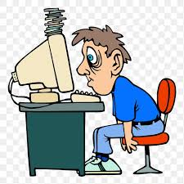
Organizational Psychology: Job Stress
Caused by specific stressors in an occupation and can lead to poor health, job performance, and family life.
  Stressors include:
    Having to fill multiple roles.
    Workplace role ambiguity.
    Lack of career progress.
    Lack of job security.
    Lack of control over work outcomes.
    Isolation.
    Work overload.
    Discrimination.
    Harassment
    Bullying.
Image from rawpixel. No author provided. Licensed under CC0 1.0 Universal.
Text from Psychology 2e OpenStax Revised Version Copyright © 2020 by Openstax is licensed under a Creative Commons Attribution 4.0 International License, except where otherwise noted. Edited by Maria Pagano

Slide 23
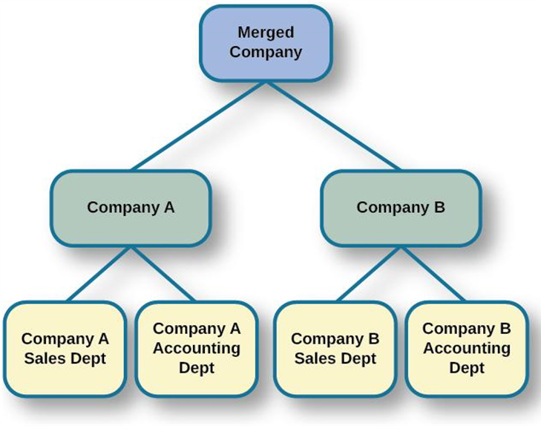
Organizational Psychology: Threats to Job Security
Downsizing – process in which an organization tries to achieve greater overall efficiency by reducing the number of employees.
  I-0 psychologists may be involved in how the news is delivered and how laid-off and retained employees are supported.
Corporate Mergers - the joining of two organizations.
Acquisition – one organization purchases another.
  Often leads to cuts due to duplication of core functions, like sales and accounting, at each company.
  Research focuses on understanding employee reactions and practical recommendations for managing organizational changes.
Figure 13.14 When companies are combined through a merger (or acquisition), there are often cuts due to duplication of core functions, like sales and accounting, at each company.
Text from Psychology 2e OpenStax Revised Version Copyright © 2020 by Openstax is licensed under a Creative Commons Attribution 4.0 International License, except where otherwise noted. Edited by Maria Pagano

Slide 24
Organizational Psychology: Work-Family Balance
Work-family balance – occurs when people juggle the demands of work life with the demands of family life.
Greenhaus & Beutell (1985):
  Three sources of work-family conflicts:
    Time devoted to work makes → difficult to fulfill requirements of family, or vice versa.
    Strain from participation in work → difficult to fulfill requirements of family, or vice versa.
    Specific behaviors required by work → difficult to fulfill requirements of family, or vice versa.
Ways to decrease work-family conflict:
  Support in the home – emotional and practical.
    Practical support found to be the most effective.
  Workplace support – understanding supervisors, flextime, leave with pay, and telecommuting.
  Telecommuting – employees’ ability to set their own hours allowing them to work from home at different parts of the day.
    Telecommuting was found to make the conflict worse.
Link to Learning Application: The Glassdoor website posts job satisfaction reviews for different careers and organizations. Use this site to research possible careers and/or organizations that interest you.
Text from Psychology 2e OpenStax Revised Version Copyright © 2020 by Openstax is licensed under a Creative Commons Attribution 4.0 International License, except where otherwise noted. Edited by Maria Pagano

Slide 25
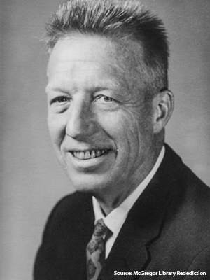
Organizational Psychology: Management & Organizational Structure
Douglas McGregor (1960), combined scientific management and human relations into the notion of leadership behavior.
  Scientific management – theory of management that analyzes and synthesized workflows with the main objective of improving economic efficiency, especially labor productivity.
Identified two different styles of managers.
  Theory X – manager assumes workers are inherently lazy and unproductive; managers must have control and use punishments.
  Theory Y – manager assumes workers are people who seek to work hard and productively; managers and workers can find creative solutions to problems; workers do not need to be controlled and punished.
Theory X and Theory Y Management Styles (Table 13.3)
Theory X | Theory Y
People dislike work and avoid it. | People enjoy work and find it natural.
People avoid responsibility. | People are more satisfied when given responsibility.
People want to be told what to do. | People want to take part in setting their own work goals.
Goals are achieved through rules and punishments. | Goals are achieved through enticements and rewards.
Douglas McGregor (1906-1964)
Image from Wikimedia Commons source from toolshero. Licensed under CC BY SA 4.0.
Text from Psychology 2e OpenStax Revised Version Copyright © 2020 by Openstax is licensed under a Creative Commons Attribution 4.0 International License, except where otherwise noted. Edited by Maria Pagano

Slide 26
Organizational Psychology: Management & Organizational Structures
Donald Clifton researched how an organization can best use an individual’s strengths.
  Argued that our strengths provide the greatest opportunity for growth.
    Strength-Based Management – approach that focuses on employees' strengths.
Bass (1985)
  Transactional leadership
    characteristic of leaders who focus on supervision and organizational goals achieved through a system of rewards and punishments
    maintenance of the organizational status quo.
  Transformational leadership
    charismatic role models,
    inspirational (optimistic about goal attainment),
    intellectually stimulating (encourage critical thinking and problem solving), and
    individually considerate and who seek to change the organization.
Text from Psychology 2e OpenStax Revised Version Copyright © 2020 by Openstax is licensed under a Creative Commons Attribution 4.0 International License, except where otherwise noted. Edited by Maria Pagano

Slide 27

Organizational Psychology: Goals, Teamwork & Work Teams
Team-Based Approach: Many companies structure their organization so that work can be delegated to work teams.
  Work team – group of people within an organization or company given a specific task to achieve together.
    Brings together diverse skills, experience, and expertise.
    Do not always deliver greater productivity.
Why do some teams work well while others do not?
  Social loafing.
  Poor communication.
  Poor decision-making skills due to conformity effects.
  Conflict with the group.
    Team halo effect - teams are given credit for their success but individuals within a team are blamed for team failures.
Image from stockvault by Mohamed Hassan. Licensed under CC0 1.0 Universal.
Text from Psychology 2e OpenStax Revised Version Copyright © 2020 by Openstax is licensed under a Creative Commons Attribution 4.0 International License, except where otherwise noted. Edited by Maria Pagano

Slide 28

Organizational Psychology: Goals, Teamwork & Work Teams: Continued
Teams and Gender Diversity
  Cons – Diversity can introduce communication and interpersonal-relationship problems.
  Pros – Diversity can increase the team’s skill set.
Hoogendoom, Oosterbeek, & van Praag (2013):
  Found that gender-balanced teams performed better than predominantly male teams.
  Did not identify which mechanism accounted for performance improvement.
Types of Teams
  Problem resolution teams – created for the purpose of solving a particular problem.
  Creative teams – used to develop innovative possibilities or solutions.
  Tactical teams – used to execute a well-defined plan or objective.
Research on the virtual team:
  Examines how groups of geographically disparate people brought together using digital communications technology function.
Creator: pixy.org. Licensed under CC BY NC ND 4.0 DEED. Found on Reader Question for Shan.
Text and image from Psychology 2e OpenStax Revised Version Copyright © 2020 by Openstax is licensed under a Creative Commons Attribution 4.0 International License, except where otherwise noted. Edited by Maria Pagano

Slide 29
Organizational Psychology: Organizational Culture
Organizational Culture – the values, visions, hierarchies, norms, and interactions among its employees.
  How an organization is run, how it operates, and how it makes decisions.
Ostroff, Kinicki & Tamkins (2003)
  Three layers in organizational culture:
    Observable artifacts – symbols of language (jargon, slang, humor), narratives (stories and legends), and practices (rituals) that represent the underlying cultural assumptions.
    Espoused values – concepts/beliefs that management or entire organization endorses.
    Basic assumptions – usually unobservable and unquestioned.
Diversity training – educates participants about cultural differences with the goal of improving teamwork.
  Aims to reduce prejudice.
Video: Organizational Culture discusses Edgar Shein’s three layers of organizational culture. The discussion of organizational cultures begins at timestamp 5:05 (10:54).
Text and image from Psychology 2e OpenStax Revised Version Copyright © 2020 by Openstax is licensed under a Creative Commons Attribution 4.0 International License, except where otherwise noted.

Slide 30
Organizational Psychology: Sexual Harassment
Most organizations have developed sexual harassment policies that define harassment and procedures to prevent and address it when it occurs.
  Sexual harassment – sexually-based behavior that is knowingly unwanted and has an adverse effect on a person’s employment status, interferes with a person’s job performance, or creates a hostile or intimidating work environment.
    Types of sexual harassment:
      Quid pro quo – you give something to get something.
        Organizational rewards are offered in exchange for sexual favors.
      The threat of withholding a reward if a sexual request is refused.
      Hostile environment sexual harassment – employee experiences conditions in the workplace considered hostile/intimidating (e.g., environment allowing offensive language or sexually explicit images).
Text from Psychology 2e OpenStax Revised Version Copyright © 2020 by Openstax is licensed under a Creative Commons Attribution 4.0 International License, except where otherwise noted. Image by Maria Pagano

Slide 31
Organizational Psychology: Violence in the Workplace
Workplace violence – violence or the threat of violence against workers; can occur inside or outside the workplace.
  Includes physical violence, harassment, intimidation, or other disruptive behavior.
  Ranges from threats and verbal abuse to physical assaults and homicide.
  Warning signs – intimidating behavior, threats, sabotaging equipment, or radical changes in a coworker’s behavior.
  Feelings of being treated unfairly, unjustly, or disrespectfully are significant triggers.
    Procedural justice – fairness of the processes by which outcomes are determined in conflicts with or among employees.
Greenberg & Barling (1999):
  History of aggression and amount of alcohol consumed → accurate predictors of violence against a coworker.
  Feelings of being unfairly treated or untrusted → predictors of aggression against a supervisor.
  Job security and alcohol consumption → predictors of aggression against a subordinate.
Every year, nearly 2 million workers are physically assaulted or threatened with assault.
Image and text from Psychology 2e OpenStax Revised Version Copyright © 2020 by Openstax is licensed under a Creative Commons Attribution 4.0 International License, except where otherwise noted. Edited by Maria Pagano

Slide 32
Areas of Study in Human Factors Psychology
Studies the integration (physical, cognitive or both) of the human-machine interface in the workplace.
  Concerned with researching and designing machines that fit human requirements.
  Involved in the development of regulations and principles of test design – often related to safety.
Areas of Study
  Attention – includes vigilance and monitoring, recognizing signals in noise, mental resources, and divided attention.
    How is attention maintained? What about tasks maintains attention? How to design systems to support attention?
  Cognitive engineering – includes human software interactions in complex automated systems, especially decision-making processes of workers as they are supported by the software system.
    How do workers use and obtain information provided by software?
  Task analysis – breaking down the elements of a task.
    How can a task be performed more efficiently? How can a task be performed more safely?
  Cognitive task analysis – breaking down the elements of a cognitive task.
    How are decisions made?
Video: Psychology Career Pathways: Human Factors presents two human factors psychologists answering some basic questions about working in the field of Human Factors (8:37).
Image and text from Psychology 2e OpenStax Revised Version Copyright © 2020 by Openstax is licensed under a Creative Commons Attribution 4.0 International License, except where otherwise noted. Edited by Maria Pagano

Slide 33
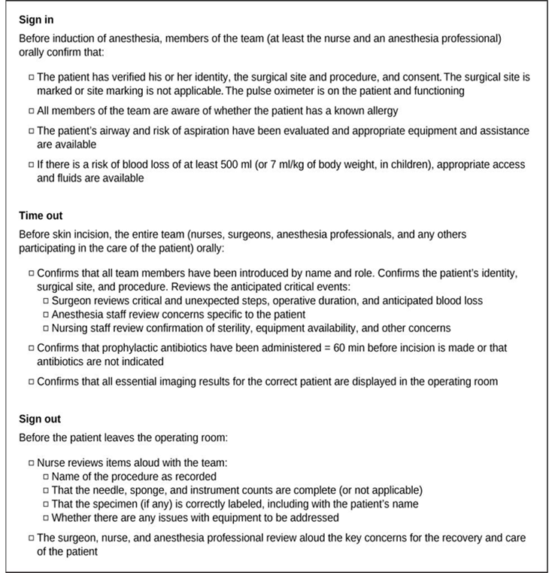
Human Factors Psychology: Workplace Safety
Checklists:
  Used to reduce accidents in the workplace.
  E.g. Pilots are required to go through a detailed checklist of the different parts of the aircraft before takeoff to ensure that all essential equipment is working correctly.
Time limits on operating equipment:
  Limits how long an operator, such as a pilot or truck driver, is allowed to operate the equipment.
Figure 13.15 Checklists, such as the WHO surgical checklist shown here, help reduce workplace accidents.
Image and text from Psychology 2e OpenStax Revised Version Copyright © 2020 by Openstax is licensed under a Creative Commons Attribution 4.0 International License, except where otherwise noted. Edited by Maria Pagano

