Slide 1

Chapter 11
Personality
OpenStax Psychology 2E
OpenStax ancillary resource is © Rice University under a CC-BY-4.0 DEED license and may be used with proper attributes. Unless otherwise noted all material and text contained in these ancillary materials is from Spielman, R. M., Jenkins, W. J., & Lovett, M. D. (2020). Psychology 2E. OpenStax and is licensed under CC BY 4.0 DEED.

Slide 2

Personality
Figure 11.1What makes two individuals have different personalities?
All text from Psychology 2e OpenStax Revised Version Copyright © 2020 by Openstax is licensed under a Creative Commons Attribution 4.0 International License, except where otherwise noted. Edited by Maria Pagano

Slide 3
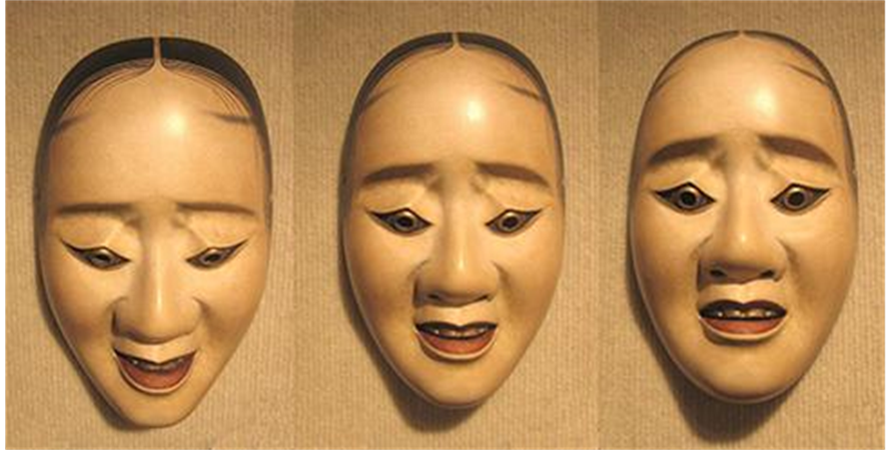
What is Personality?
Personality – the long-standing traits and patterns that propel individuals to consistently think, feel, and behave in specific ways.
  Comes from the Latin word persona (a mask worn by an actor).
  In ancient times, theatrical masks were used to represent/project a specific personality trait.
Figure 11.2 Happy, sad, impatient, shy, fearful, curious, helpful. What characteristics describe your personality?
All text from Psychology 2e OpenStax Revised Version Copyright © 2020 by Openstax is licensed under a Creative Commons Attribution 4.0 International License, except where otherwise noted. Edited by Maria Pagano

Slide 4
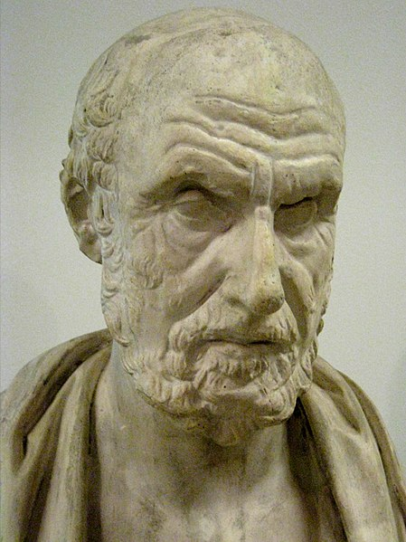
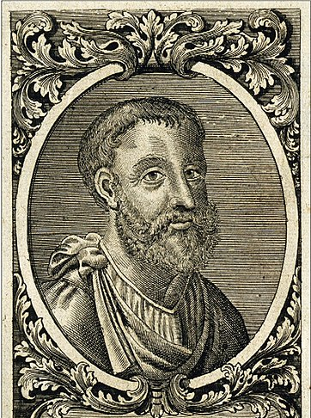
Historical Perspectives: Hippocrates and Galen
Hippocrates (370 BCE)
  Theorized that personality traits and human behaviors are based on four separate temperaments associated with four fluids (“humors”) of the body.
    Choleric – yellow bile from the liver.
    Melancholic – black bile from the kidneys.
    Sanguine – red blood from the heart.
    Phlegmatic – white phlegm from the lungs.
Galen (129AD-216AD)
  Believed both diseases and personality differences could be explained by imbalances in the humors and that each person exhibits one of the four temperaments.
  Prevalent view for over 1000 years and through the Middle Ages.
    Choleric – passionate, ambitious, and bold.
    Melancholic – reserved, anxious, and unhappy.
    Sanguine – joyful, eager, and optimistic.
    Phlegmatic – calm, reliable, and thoughtful.
Hippocrates
Image from Wikimedia Commons by Shakko (Own work). Licensed under Public CC BY SA 3.0 DEED.
Galen
Image from Wikimedia Commons from The Lancet. Licensed under Public Domain.
All text from Psychology 2e OpenStax Revised Version Copyright © 2020 by Openstax is licensed under a Creative Commons Attribution 4.0 International License, except where otherwise noted. Edited by Maria Pagano

Slide 5
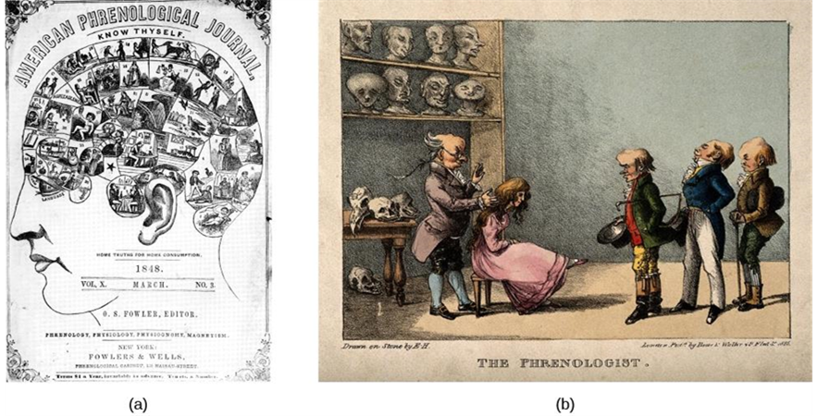
Historical Perspectives: Phrenology
Franz Gall (1780)
  Proposed that the distances between bumps on the skull reveal a person’s personality traits, character, and mental abilities.
  Phrenology was discredited for lack of empirical support.
Figure 11.3 The pseudoscience of measuring the areas of a person’s skull is known as phrenology. (a) Gall developed a chart that depicted which areas of the skull corresponded to particular personality traits or characteristics. (b) An 1825 lithograph depicts Gall examining the skull of a young woman.
All text from Psychology 2e OpenStax Revised Version Copyright © 2020 by Openstax is licensed under a Creative Commons Attribution 4.0 International License, except where otherwise noted. Edited by Maria Pagano

Slide 6
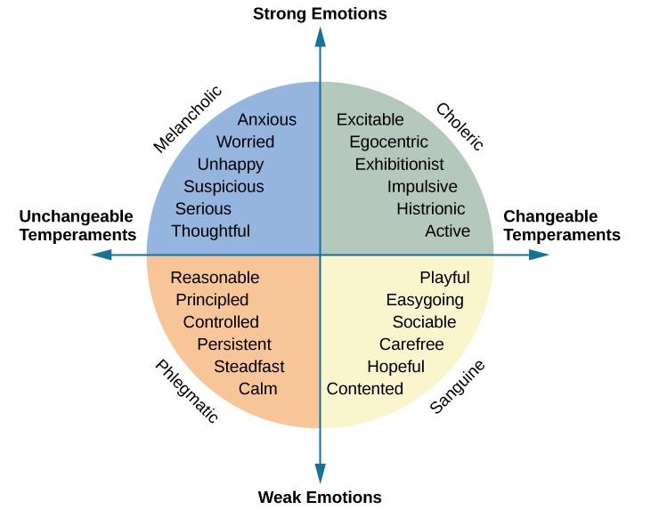
Historical Perspectives: Immanuel Kant and Wilhelm Wundt
Immanuel Kant (18th century)
  Agreed with Galen that individuals could be categorized into one of the four temperaments.
  Developed a list of traits to describe the personality of each of the four temperaments.
Wilhelm Wundt (19th century)
  Suggested that personality could be described using two major axes:
    Emotional/non-emotional – separated strong emotions (melancholic, choleric) from the weak emotions (phlegmatic, sanguine).
    Changeable/unchangeable – divided the changeable temperaments (choleric, sanguine) from the unchangeable ones (melancholic, phlegmatic).
Figure 11.4 Developed from Galen’s theory of the four temperaments, Kant proposed trait words to describe each temperament. Wundt later suggested the arrangement of the traits on two major axes.
All text from Psychology 2e OpenStax Revised Version Copyright © 2020 by Openstax is licensed under a Creative Commons Attribution 4.0 International License, except where otherwise noted. Edited by Maria Pagano

Slide 7
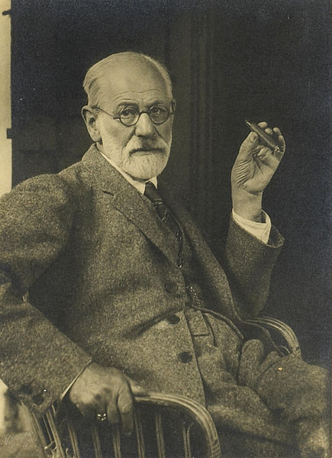
Historical Perspectives: Psychodynamic Perspectives (20th Century)
Sigmund Freud:
  First comprehensive theory of personality explaining both normal and abnormal behaviors.
    Proposed that unconscious drives influenced by sex, aggression and childhood sexuality influence personality.
Neo-Freudians (Psychologists who agreed with many of the fundamental ideas put forward by Freud):
  Agreed that childhood experiences matter.
  Less emphasis on sex.
  Focused on the social environment and effects of culture on personality.
Sigmund Freud (1856-1939)
Image from Wikimedia Commons from Bonhams. Licensed under Public Domain.
Image and text from Psychology 2e OpenStax Revised Version Copyright © 2020 by Openstax is licensed under a Creative Commons Attribution 4.0 International License, except where otherwise noted. Edited by Maria Pagano

Slide 8
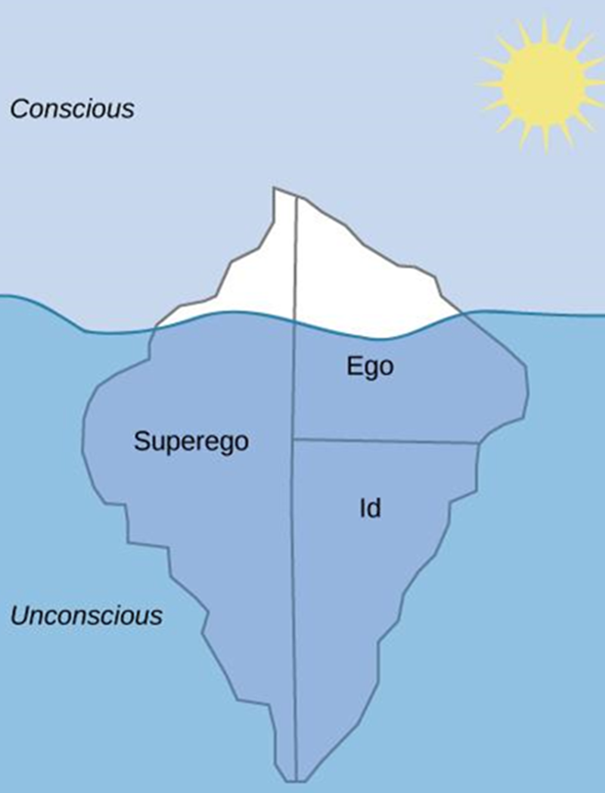
Levels of Consciousness
Unconscious – mental activity that we are unaware of and are unable to access.
According to Freud:
  We are only aware of a small amount (about one-tenth) of our mind’s activities and most of it remains hidden from us in our unconscious.
  Unacceptable urges and desires are kept in our unconscious through repression.
  The information in our unconscious affects our behavior, although we are unaware of it.
Freudian slip - Freud suggested that slips of the tongue (saying a word you did not intend to say) are sexual/aggressive urges accidently slipping out of our unconscious.
Figure 11.5 Freud believed that we are only aware of a small amount of our mind’s activities and that most of it remains hidden from us in our unconscious. The information in our unconscious affects our behavior, although we are unaware of it.
Video: The Conscious, Preconscious and Unconscioius Mind. Freud's Topographical Model discusses Freud’s topographical model of the mind and how it can be compared to an iceberg (4:01).
Image and text from Psychology 2e OpenStax Revised Version Copyright © 2020 by Openstax is licensed under a Creative Commons Attribution 4.0 International License, except where otherwise noted. Edited by Maria Pagano

Slide 9
Id, Ego & Superego
Freud posited that personality results from efforts to balance two competing forces.
  Biological aggressive and pleasure-seeking drives.
  Internal (socialized) control over these pleasure-seeking drives.
Freud described this process as an interaction between three systems.
  Id
    Contains primitive urges (for hunger, thirst, and sex).
    Impulsive, instinctual.
    Operates on the ”pleasure principle” – seeks immediate gratification.
  Ego (self)
    Attempts to balance the id with the superego.
    Rational
    Operates on the “reality principle” – helps the id satisfy desires in a realistic way.
    The part of the personality seen by others.
  Superego
    Develops through interactions with others, learning social rules for right and wrong.
    Moral compass that tells us how we should behave based on rules..
    Strives for perfection.
    Judges behavior - leads to feelings of pride or guilt.
Image and text from Psychology 2e OpenStax Revised Version Copyright © 2020 by Openstax is licensed under a Creative Commons Attribution 4.0 International License, except where otherwise noted. Edited by Maria Pagano

Slide 10
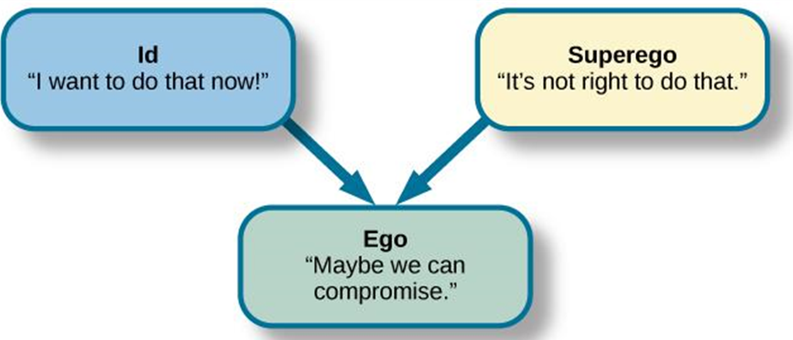
Id, Ego, & Superego: Continued
Effects on Personality
  A balanced id and superego → healthy personality.
  An imbalanced id and superego → neurosis (tendency to experience negative emotions), anxiety disorders, or unhealthy behaviors.
Figure 11.6 The job of the ego, or self, is to balance the aggressive/pleasure-seeking drives of the id with the moral control of the superego.
Video: Know About Sigmund Freud's Triple-Decker Model of the Human Psyche: The Id, Ego, and Superego discusses and provides examples of how the id, ego, and superego operate to form our personality (1:06).
Image and text from Psychology 2e OpenStax Revised Version Copyright © 2020 by Openstax is licensed under a Creative Commons Attribution 4.0 International License, except where otherwise noted. Edited by Maria Pagano

Slide 11
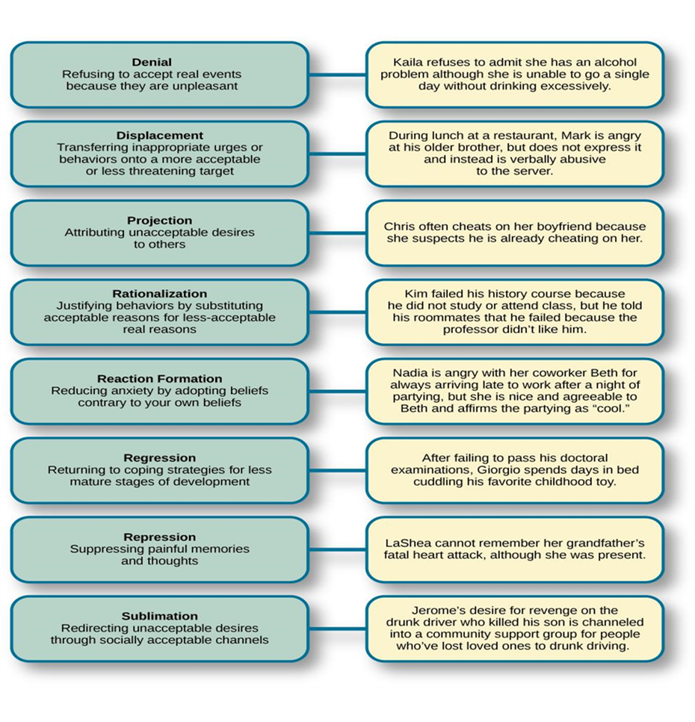
Defense Mechanisms
Defense mechanisms are unconscious protective behaviors that work to reduce anxiety.
  Used by the ego to restore balance between the id and superego.
  Freud believed them to be used by everyone, but that overuse could be problematic.
Link to Learning Video: Watch this video of Freud's defense mechanisms to review (2:30).
Figure 11.7 Defense mechanisms are unconscious protective behaviors that work to reduce anxiety.
Image and text from Psychology 2e OpenStax Revised Version Copyright © 2020 by Openstax is licensed under a Creative Commons Attribution 4.0 International License, except where otherwise noted. Edited by Maria Pagano

Slide 12
Stages of Psychosexual Development
Freud theorized that children pass through five psychosexual stages.
  In each stage, pleasure-seeking urges (id) are focused on a different erogenous zone (part of the body).
  Lack of proper nurturing and parenting during conflicts results in the person becoming stuck/fixated in that stage.
Oral Stage (Birth – 1 year)
  Erogenous zone – mouth.
  Pleasure – from eating and sucking.
  Major conflict – being weaned from bottle or breast.
  Adult fixation – smoking, overeating, nail biting.
Anal Stage (1-3 years)
  Erogenous zone – anus.
  Pleasure – from bowel and bladder movements.
  Major conflict – toilet training.
  Adult fixation – anal-retentive personality (stingy, stubborn, need for order and neatness), anal-expulsive personality (messy, careless, disorganized, prone to emotional outbursts).
Image and text from Psychology 2e OpenStax Revised Version Copyright © 2020 by Openstax is licensed under a Creative Commons Attribution 4.0 International License, except where otherwise noted. Edited by Maria Pagano

Slide 13
Stages of Psychosexual Development: Continued
Phallic Stage (3-6 years)
  Erogenous zone – genitals.
  Major conflict – child feels a desire for the opposite-sex parent, and jealousy and hatred toward the same-sex parent.
    Oedipus complex (boys) – desire for mother’s attention, urge to replace father. Afraid of being punished by father for these feelings (castration anxiety).
    Electra complex (girls) - desire for father’s attention, urge to replace mother. Angry at mother for not providing them with a penis (penis envy).
  Adult fixation – vanity, over-ambition.
Latency Stage (6-12 years)
  Erogenous zone – none.
  Sexual feelings are dormant as children focus on school, friendships, hobbies and engage with peers of the same-sex.
Genital Stage (12+)
  Erogenous zone – genitals.
  Sexual reawakening – urges are redirected from parents to more socially acceptable partners.
Video: Freud's 5 Stages of Psychosexual Development discusses and provides examples of Freud’s psychosexual stages of development (9:00).
Image and Text from Psychology 2e OpenStax Revised Version Copyright © 2020 by Openstax is licensed under a Creative Commons Attribution 4.0 International License, except where otherwise noted. Edited by Maria Pagano

Slide 14
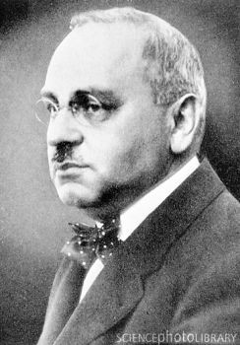
Neo-Freudians: Alfred Adler
Individual Psychology
  Focuses on our drive to compensate for feelings of inferiority.
    Inferiority complex – A person’s feelings that they lack worth and don’t measure up to the standards of others or of society.
  Social motives thought to be the force behind thoughts, emotions, and behaviors.
  Placed focus on social connections during childhood development.
  Believed happiness can be found in working together for the betterment of all.
  Viewed main goal of psychology to be “to recognize the equal rights and equality of others”.
  Saw conscious processes as more important.
  Theorized that birth order shapes our personality.
Adler identified three fundamental social tasks all individuals must experience.
  Occupational tasks – careers.
  Societal tasks – friendship.
  Love tasks – finding an intimate partner.
Alfred Adler (1870-1937)
Image from Wikimedia Commons from Science Photo Library. Licensed under CC BY SA 4.0 DEED.
Link to Learning Reading: One of Adler’s major contributions to personality psychology was the idea that our birth order shapes our personality. View this summary of birth order theory to learn more.
Video: Alfred Adler's Theory of Personality: Inferiority Complex, Personal Goals and Self-Fulfilment discusses and provides examples of Adler’s theory of personality development (3:34).
Text and image from Psychology 2e OpenStax Revised Version Copyright © 2020 by Openstax is licensed under a Creative Commons Attribution 4.0 International License, except where otherwise noted. Edited by Maria Pagano

Slide 15
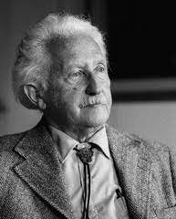
Neo-Freudians: Erik Erikson
As discussed in Chapter 7: Lifespan Development, Erikson proposed a Psychosocial theory of Development
  Personality develops throughout the lifespan.
  Emphasizes importance of social relationships at each stage.
  Development of a healthy personality and sense of competence depend on successfully completing each of the 8 stages.
Erik Erikson (1902-1994)
Image from Wikimedia Commons source from Erikson Institute. Licensed under CC BY SA 4.0 DEED.
Text from Psychology 2e OpenStax Revised Version Copyright © 2020 by Openstax is licensed under a Creative Commons Attribution 4.0 International License, except where otherwise noted. Edited by Maria Pagano

Slide 16
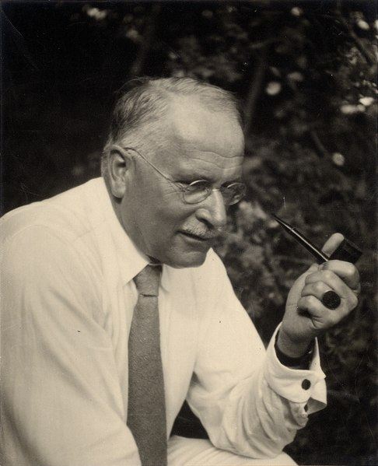
Neo-Freudians: Carl Jung
After breaking from Freud, Jung developed Analytical Psychology
  Analytical psychology focused on working to balance conscious and unconscious thought.
Jung acknowledged the concept of a personal unconscious but was also interested in exploring the collective unconscious.
  Collective unconscious – universal version of personal unconscious, holding mental patterns, or memory traces, which are common to all of us.
  Archetypes –patterns that exist in our collective unconscious across cultures/societies.
    Represented by universal themes in various cultures reflecting common experiences of people around the world.
    Integration of unconscious archetypal aspects of the self seen as part of self-realization process.
  Persona – A mask that we consciously adopt.
    Derived from conscious experiences and our collective unconscious.
    A compromise between our true self and the self that society expects us to be (hiding parts of the self that do not align with societies expectations).
Carl Jung (1875-1961)
Image from Wikimedia Commons source from ETH Zurich. Licensed under Public Domain.
Video: Introductin to Carl Jung - The Psyche, Archetypes and the Collective Unconscious discusses and provides examples of three Jungian concepts, the psyche, archetypes, and the collective unconscious (10:47).
Text and image from Psychology 2e OpenStax Revised Version Copyright © 2020 by Openstax is licensed under a Creative Commons Attribution 4.0 International License, except where otherwise noted. Edited by Maria Pagano

Slide 17
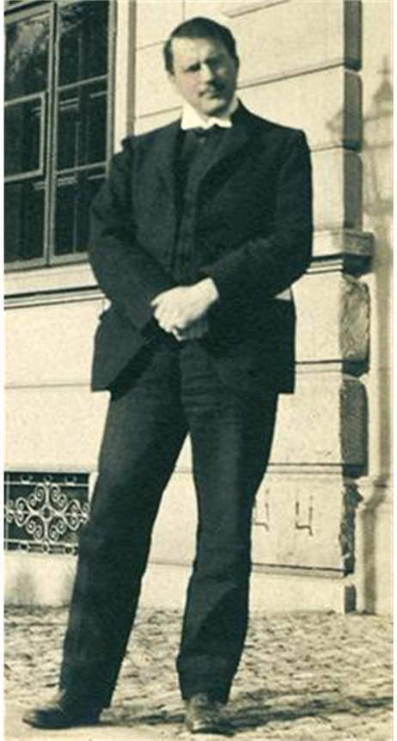
Neo-Freudians: Carl Jung: Continued
Jung’s most important contributions to the field of personality psychology was the idea of extroversion and introversion to explain different attitudes towards life.
Introverts | Extroverts
Energized by being alone | Energized by being with others
Avoids attention | Seeks attention
Speaks slowly & softly | Speaks quickly & loudly
Thinks before speaking | Thinks out loud
Stays on one topic | Jumps from topic to topic
Prefers written communication | Prefers verbal communication
Pays attention easily | Distractible
Cautious | Acts first, thinks later
Table 11.3
Video: Carl Jung's Theory on Introverts, Extraverts, and Ambiverts discusses all three of his personality types in this video which also provides examples (6:30).
Link to Learning Application: Jung’s view of extroverted and introverted types serves as a basis of the Myers-Briggs Type Indicator (MBTI). This questionnaire describes a person’s degree of introversion versus extroversion, thinking versus feeling, intuition versus sensation, and judging versus perceiving. Take this modified questionnaire based on the MBTI to learn more.
Figure 11.9 Carl Jung was interested in exploring the collective unconscious.
Text and image from Psychology 2e OpenStax Revised Version Copyright © 2020 by Openstax is licensed under a Creative Commons Attribution 4.0 International License, except where otherwise noted. Edited by Maria Pagano

Slide 18
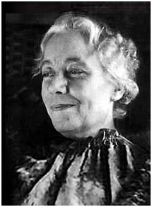
Neo-Freudians: Karen Horney
Agreed with Jung that individuals have the potential for self-realization and believed the goal of psychoanalysis should be moving toward a healthy self.
Disagreed with the idea of penis envy – suggested that any jealousy is culturally based.
  Differences in personality between men and women is culturally based.
  Men have womb envy because they cannot give birth.
Many of Horney’s theories focused on unconscious anxiety.
  Normal growth can be blocked by basic anxiety stemming from needs not being met.
3 styles of coping used by children to relieve anxiety:
  Moving toward people – affiliation and dependence.
    As adults – likely to have an intense need for love and acceptance.
  Moving against people – aggression and assertiveness.
    As adults – likely to lash out and exploit others.
  Moving away from people – detachment and isolation.
    As adults – likely to avoid love/friendship and avoid interaction with others.
Karen Horney (1885-1952)
Image from Wikimedia Commons. Licensed under CC BY SA 3.0 DEED.
Video: Karen Horney's Psychanalytic Social Theory: Key Concepts begins the discussion of the three coping styles at timestamp 8:05, which begins under “Neurotic Trends” (10:19).
Text from Psychology 2e OpenStax Revised Version Copyright © 2020 by Openstax is licensed under a Creative Commons Attribution 4.0 International License, except where otherwise noted. Edited by Maria Pagano

Slide 19
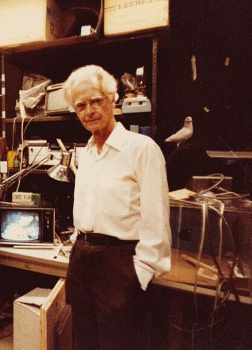
The Behavioral Perspective: B.F. Skinner
According to Skinner, learning approaches to personality focus on observable, measurable phenomena.
  We learn to behave in particular ways.
  Personality is shaped by reinforcements and consequences in the environment.
  Personality develops over our entire life.
  Personality can vary as we experience new situations.
B.F. Skinner (1904-1990)
Image from Wikimedia Commons by Biglicks12. Licensed under CC BY SA 4.0 DEED.
Text from Psychology 2e OpenStax Revised Version Copyright © 2020 by Openstax is licensed under a Creative Commons Attribution 4.0 International License, except where otherwise noted. Edited by Maria Pagano

Slide 20
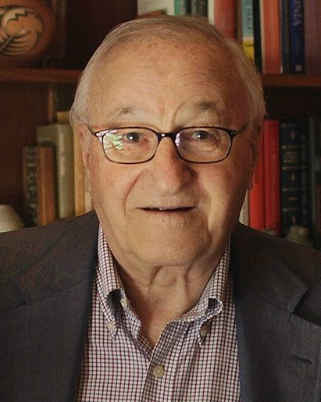
The Social Cognitive Perspective: Albert Bandura
Bandura greed that personality develops through learning but disagreed with the behaviorist approach because thinking and reasoning are important parts of learning.
Social-cognitive theory – emphasizes both learning and cognition as sources of individual difference in personality.
Factors in personality development:
  Reciprocal Determinism – cognitive processes (beliefs, expectations, and personality characteristics), behavior, and context (environment/situation) all interact.
  Observational learning – learning by observing someone else’s behavior and its consequences.
    Teaches us which behaviors are acceptable and rewarded in our culture.
    Teaches us which behaviors are socially unacceptable.
  Self-efficacy – level of confidence in our own abilities, developed through social experiences.
    Affects how we approach challenges.
Albert Bandura (1925-2021)
Image from Wikimedia Commons by Gentle. Licensed under CC BY SA 4.0 DEED.
Text from Psychology 2e OpenStax Revised Version Copyright © 2020 by Openstax is licensed under a Creative Commons Attribution 4.0 International License, except where otherwise noted. Edited by Maria Pagano

Slide 21
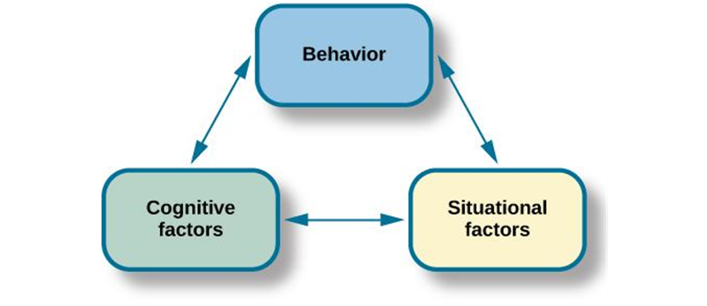
Reciprocal Determinism
Figure 11.10 Bandura proposed the idea of reciprocal determinism: Our behavior, cognitive processes, and situational context all influence each other.
Video: Khan Academy: Reciprocal Determinism looks at the complex and interconnected ways in which we are shaped by our surroundings and our own thoughts and actions (2:57).
Text from Psychology 2e OpenStax Revised Version Copyright © 2020 by Openstax is licensed under a Creative Commons Attribution 4.0 International License, except where otherwise noted. Edited by Maria Pagano

Slide 22
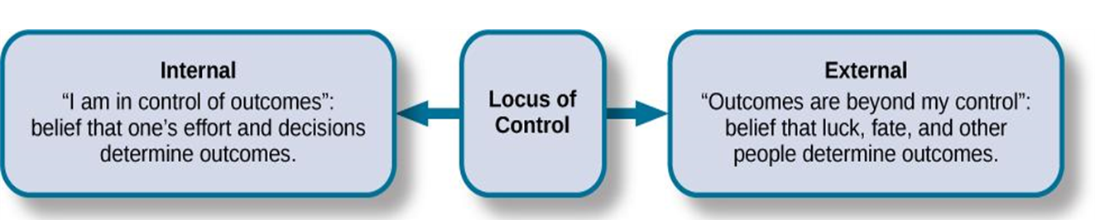
Julian Rotter and Locus of Control
Locus of control – beliefs about the power we have over our lives.
  Proposed as a cognitive factor that affects learning and personality development.
Internal locus of control – tend to believe that most of our outcomes are the direct result of our efforts.
  Perform better academically, achieve more in careers, more independent, healthier, less depressed.
External locus of control – tend to believe that our outcomes are outside of our control.
  Believe lives are controlled by other people, luck, or chance.
Figure 11.11 Locus of control occurs on a continuum from internal to external.
Link to Learning Application: Take the Locus of Control questionnaire to learn more. Scores range from 0 to 13. A low score on this questionnaire indicates an internal locus of control, and a high score indicates an external locus of control.
Video: The Locus of Control in Two-Minutes quickly explains both internal and external locus of control (2:01).
Text from Psychology 2e OpenStax Revised Version Copyright © 2020 by Openstax is licensed under a Creative Commons Attribution 4.0 International License, except where otherwise noted. Edited by Maria Pagano

Slide 23
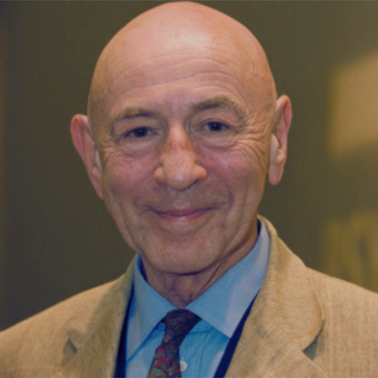
The Person-Situation Debate: Walter Mischel
Mischel found that:
  Behavior was inconsistent across different situations but more consistent within situations.
  Behavior is consistent in equivalent situations across time.
  This data did not support the theory that a person’s personality traits are consistent across situations - triggered the person-situation debate among psychologists.
The Stanford Marshmallow Study:
  Study on self-regulation (aka will power) – ability to delay gratification.
  Children were placed in a room with one marshmallow on the table - was told that they could either eat it now or wait until the researcher returned and could then have two marshmallows.
  Revealed that children differ in levels of self-control.
  Children that had more self-control (waited for two marshmallows) in preschool were more successful in high school.
  Children that had poorer self-control (took the one marshmallow) in preschool were more likely to have academic and behavioral problems.
Mischel’s approach to personality – People use cognitive processes to assess the situation in their own way and behave in accordance with that interpretation.
Walter Mischel (1930-2018)
Image from Wikimedia Commons by RishitaSharma2106. Licensed under CC BY SA 4.0 DEED.
Link to Learning Video: Watch Joachim de Posada's TEDTalk about the marshmallow test to learn more and to see the test given to children in Columbia (7:14).
Text and image from Psychology 2e OpenStax Revised Version Copyright © 2020 by Openstax is licensed under a Creative Commons Attribution 4.0 International License, except where otherwise noted. Edited by Maria Pagano

Slide 24
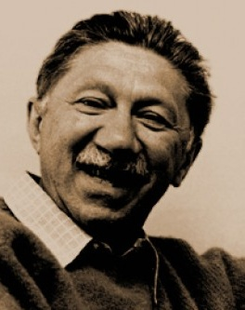
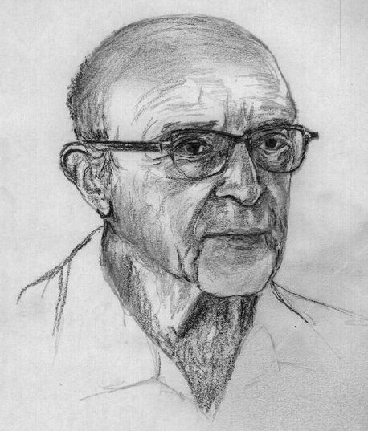
Humanistic Approaches: Abraham Maslow and Carl Rogers
The humanistic approach focuses on how healthy people develop.
  Abraham Maslow studied people he considered healthy, creative, and productive (Albert Einstein, Eleanor Roosevelt, Thomas Jefferson, Abraham Lincoln).
    Found that they shared similar characteristics – open, creative, loving, spontaneous, compassionate, concerned for others, accepting of themselves.
  Carl Rogers
  Linked personality to self-concept (thoughts and feelings about ourselves).
  Divided the self into the idea self and the real self.
    Ideal self – the person you would like to be.
    Real self – the person you actually are.
  Believed we needed to find congruence between the ideal and real self – thoughts about ideal self and real self are similar.
    High congruence → greater sense of self-worth and a health, productive life.
    Incongruence → maladjustment.
Abraham Maslow (1908-1970)
Image from Wikimedia Commons. Licensed under Fair Use for Non-Profit Educational Use.
Carl Rogers (1902-1987)
Image from Wikimedia Commons by Didius. Licensed under CC BY 2.5 DEED.
Text from Psychology 2e OpenStax Revised Version Copyright © 2020 by Openstax is licensed under a Creative Commons Attribution 4.0 International License, except where otherwise noted. Edited by Maria Pagano

Slide 25
Biological Approaches
The biological approach looks at differences in our personalities that can be explained by inherited predispositions and physiological processes.
Heritable Traits
  Minnesota Study of Twins Reared Apart:
    Found that identical twins, whether raised together or apart, have very similar personalities.
    Suggests the heritability of some personality traits.
    Traits with more than a 0.50 heritability ratio – leadership, obedience to authority, a sense of well-being, alienation, resistance to stress, and fearfulness.
Link to Learning Video: Watch this video about genetic makeup's influence on personality to learn more (5:28)
Text from Psychology 2e OpenStax Revised Version Copyright © 2020 by Openstax is licensed under a Creative Commons Attribution 4.0 International License, except where otherwise noted. Edited by Maria Pagano

Slide 26
Biological Approaches: Continued
Temperament* appears very early in life (suggesting a biological basis).
  Babies can be categorized into one of three temperaments – easy, difficult, or slow to warm up.
Environmental factors and maturation can affect expression of personality.
  Two dimensions of temperament important to adult personality:
    Reactivity – how we respond to new or challenging environmental stimuli.
    Self-regulation – ability to control responses.
Video: Navigating Your Child's Temperament discusses the different types of temperament styles (5:01). *Temperament was introduced in Chapter 9: Lifespan Development and this is the same video as presented in chapter 9.
Text and image from Psychology 2e OpenStax Revised Version Copyright © 2020 by Openstax is licensed under a Creative Commons Attribution 4.0 International License, except where otherwise noted. Edited by Maria Pagano

Slide 27
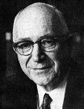
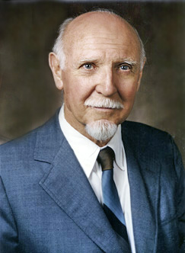
Trait Theorists: Gordon Allport & Raymond Cattell
Trait theorists believe that people have certain traits (characteristics or ways of behaving).
  For example, optimistic or pessimistic, sociable or shy.
Gordon Allport
  Found 4,500 words in the English language to describe people and organized them into three categories.
    Cardinal traits – dominates entire personality (rare).
    Central traits – make up our personality.
    Secondary traits – less obvious or consistent, present under certain circumstances (e.g., preferences, attitudes).
Raymond Cattell
  Narrowed Allport’s list to about 171 traits.
  Identified 16 dimensions of personality – instead of a present being present or absent, people are scored on a continuum.
Gordon Allport (1897-1967)
Image from Wikimedia Commons by Dr. C. George Boeree. Licensed under Free Art License.
Raymond Cattell (1905-1998)
Image from Wikimedia Commons. Permission given from Cattell family to Wikimedia. Licensed under CC BY SA 3.0 DEED.
Text and image from Psychology 2e OpenStax Revised Version Copyright © 2020 by Openstax is licensed under a Creative Commons Attribution 4.0 International License, except where otherwise noted.

Slide 28
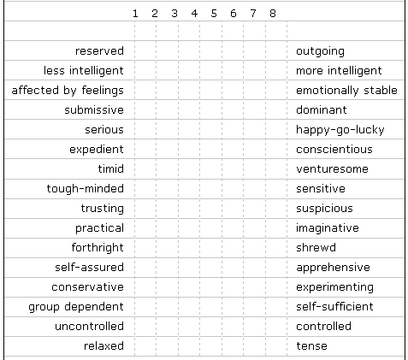
Cattell’s 16 PF (Personality Factor)
Personality Factors Measured by the 16PF Questionnaire
Factor | Low Score | High Score
Warmth | Reserved, detached | Outgoing, supportive
Intellect | Concrete thinker | Analytical
Emotional stability | Moody, irritable | Stable, calm
Aggressiveness | Docile, submissive | Controlling, dominant
Liveliness | Somber, prudent | Adventurous, spontaneous
Dutifulness | Unreliable | Conscientious
Social assertiveness | Shy, restrained | Uninhibited, bold
Sensitivity | Tough-minded | Sensitive, caring
Paranoia | Trusting | Suspicious
Abstractness | Conventional | Imaginative
Introversion | Open, straightforward | Private, shrewd
Anxiety | Confident | Apprehensive
Openmindedness | Closeminded, traditional | Curious, experimental
Independence | Outgoing, social | Self-sufficient
Perfectionism | Disorganized, casual | Organized, precise
Tension | Relaxed | Stressed
Cattell’s Sixteen Personality Factors (16PF)
Table 11.5
Link to Learning Assessment: Take this assessment based on Cattell's 16PF questionnaire to see which personality traits dominate your personality.
Image and text from Psychology 2e OpenStax Revised Version Copyright © 2020 by Openstax is licensed under a Creative Commons Attribution 4.0 International License, except where otherwise noted.

Slide 29
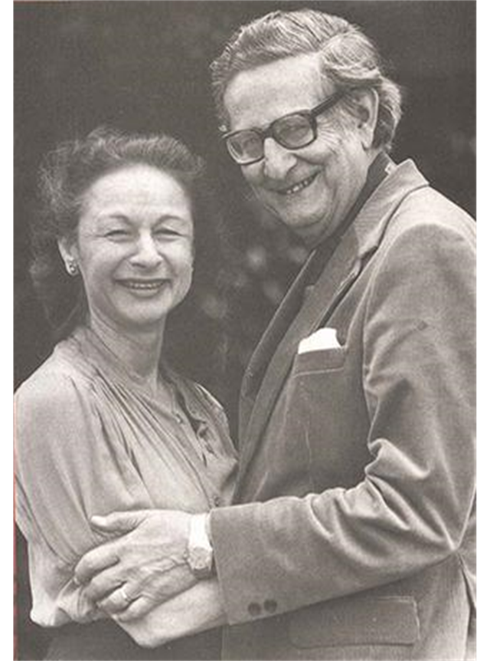
Trait Theorists: Hans & Sybil Eysenck
Hans and Sybil Eysenck focused on temperament and believed that our personality traits are influenced by our genetic inheritance.
Claimed 2 specific personality dimensions:
  Extroversion/Introversion.
    High in extroversion – sociable, outgoing.
    High in introversion – high need to be alone, engage in solitary behaviors.
  Neuroticism/Stability.
    High in neuroticism – anxious, overactive sympathetic nervous system.
    High in stability – more emotionally stable.
Figure 11.12Hans Eysenck (1916-1997) and Sybil Eysenck (1927-2020) believed that our personality traits are influenced by our genetic inheritance.
Text from Psychology 2e OpenStax Revised Version Copyright © 2020 by Openstax is licensed under a Creative Commons Attribution 4.0 International License, except where otherwise noted. Image by Maria Pagano

Slide 30
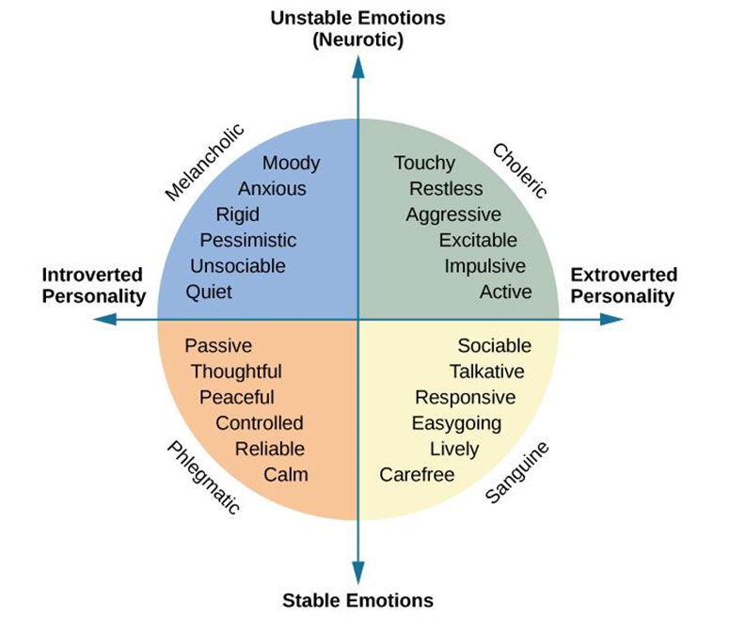
Trait Theorists: Hans and Sybil Eysenck: Continued
Figure 11.13 The Eysencks described two factors to account for variations in our personalities: extroversion/introversion and emotional stability/instability.
Video: Eysenck's Theory of Personality - Simplest Explanation Ever begins the discussion of personality dimensions at timestamp 2:05 (7:30).
Image and text from Psychology 2e OpenStax Revised Version Copyright © 2020 by Openstax is licensed under a Creative Commons Attribution 4.0 International License, except where otherwise noted. Edited by Maria Pagano

Slide 31
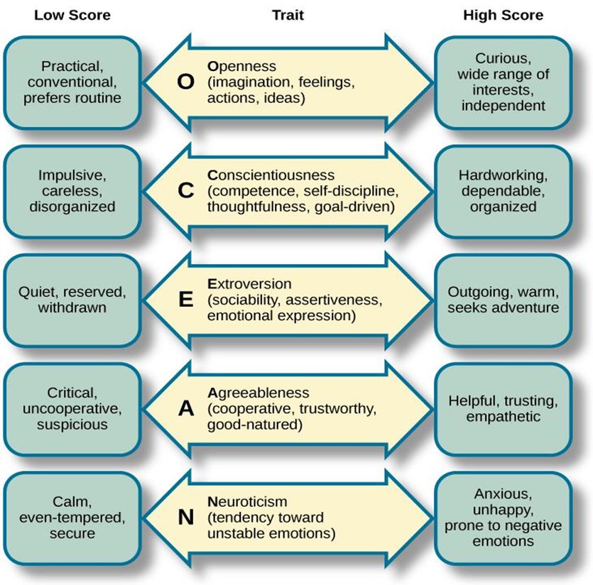
Trait Theorists: The Five Factor Model
Figure 11.14 In the Five Factor Model, each person has five factors, each scored on a continuum from high to low. In the center column, notice that the first letter of each factor spells the mnemonic OCEAN.
Link to Learning Assessment: Take the Big Five Personality test to find out about your personality and where you fall on the Big Five factors.
Image (olfactory bulb, olfactory recptors, and nasal cavity) and Text from Psychology 2e OpenStax Revised Version Copyright © 2020 by Openstax is licensed under a Creative Commons Attribution 4.0 International License, except where otherwise noted. Edited by Maria Pagano

Slide 32
Trait Theories: HEXACO Model
HEXACO Traits
Trait | Example Aspects of Trait
(H) Honesty-humility | Sincerity, modesty, faithfulness
(E) Emotionality | Sentimentality, anxiety, sensitivity
(X) Extraversion | Sociability, talkativeness, boldness
(A) Agreeableness | Patience, tolerance, gentleness
(C) Conscientiousness | Organization, thoroughness, precision
(O) Openness | Creativity, inquisitiveness, innovativeness
Table 11.6
Video: The Six HEXACO Personality Factors Explained- Origins and Sub-Facets explains the HEXACO model and how it differs from the Big Five Model (2:56).
Image and text from Psychology 2e OpenStax Revised Version Copyright © 2020 by Openstax is licensed under a Creative Commons Attribution 4.0 International License, except where otherwise noted. Edited by Maria Pagano

Slide 33
Cultural Understanding of Personality
Culture is one of the most important environmental factors that influences personality.
  Culture – beliefs, customs, art, and traditions of a particular society.
Are personality traits the same across cultures or are there variations?
  There are both universal and culture-specific aspects that account for variation in personalities.
    Examples:
    Asian cultures – more collectivist, tend to be less extroverted.
    Central and South American cultures – tend to score higher on openness to experience.
    Europeans – tend to score higher on neuroticism.
Image and text from Psychology 2e OpenStax Revised Version Copyright © 2020 by Openstax is licensed under a Creative Commons Attribution 4.0 International License, except where otherwise noted. Edited by Maria Pagano

Slide 34
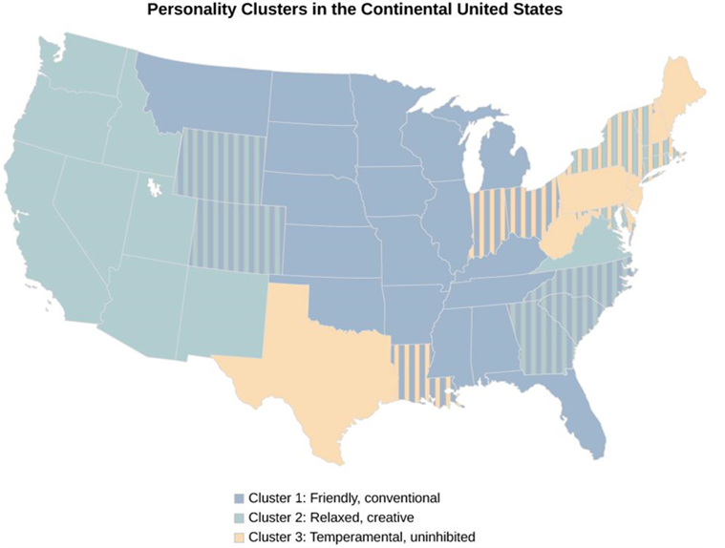
Regional Differences
Researchers found three distinct regional personality clusters in the United States. One explanation for this is selective migration - people choose to move to places that are compatible with their personalities and needs.
Figure 11.15 People tend to be friendly and conventional in the Upper Midwest and Deep South; relaxed, emotionally stable, and creative in the West; and stressed, irritable, and depressed in the Northeast.
Image and text from Psychology 2e OpenStax Revised Version Copyright © 2020 by Openstax is licensed under a Creative Commons Attribution 4.0 International License, except where otherwise noted. Edited by Maria Pagano

Slide 35
Individualist vs. Collectivist Cultures
Individualist cultures
  Value independence, competition, and personal achievement.
  Mainly Western nations such as the U.S. England, and Australia.
  People display more personally oriented personality traits.
Collectivist Cultures
  Value social harmony, respectfulness, and group needs over individual needs.
  Asia, Africa, and South America.
  People display more socially oriented personality traits.
Image and text from Psychology 2e OpenStax Revised Version Copyright © 2020 by Openstax is licensed under a Creative Commons Attribution 4.0 International License, except where otherwise noted. Edited by Maria Pagano

Slide 36
Personality Assessment: Self-Report Inventories
Personality testing is often used:
  To screen applicants for employment and job training.
  In criminal cases and custody battles.
  To assess psychological disorders.
Self-Report Inventories
  Objective test to assess personality.
  Often use multiple-choice items or numbered scales (Likert scales).
Minnesota Multiphasic Personality Inventory (MMPI):
  One of the most widely used personality inventories.
  Originally developed to assist in diagnosing psychological disorders.
  Newest version (MMPI-2-RF) has 338 questions.
  Scored on 10 scales – hypochondriasis, depression, hysteria, psychopathic deviance, masculinity vs femininity, paranoia, psychasthenia (obsessive/compulsive qualities), schizophrenia, hypomania, and social introversion.
Image and text from Psychology 2e OpenStax Revised Version Copyright © 2020 by Openstax is licensed under a Creative Commons Attribution 4.0 International License, except where otherwise noted. Edited by Maria Pagano

Slide 37
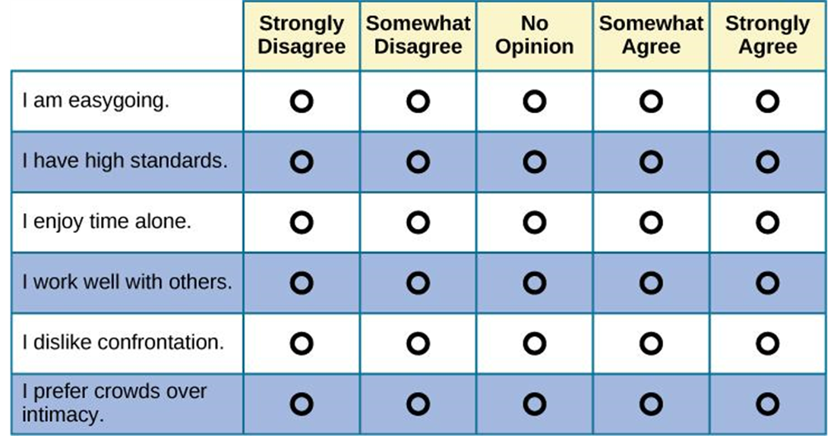
Likert Scales
Figure 11.16 If you’ve ever taken a survey, you are probably familiar with Likert-type scale questions. Most personality inventories employ these types of response scales.
Image and text from Psychology 2e OpenStax Revised Version Copyright © 2020 by Openstax is licensed under a Creative Commons Attribution 4.0 International License, except where otherwise noted. Edited by Maria Pagano

Slide 38
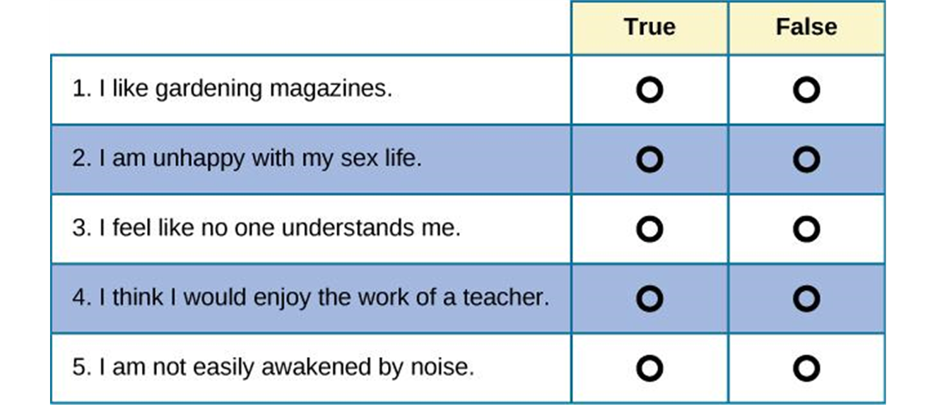
MMPI
Figure 11.17 These true/false questions resemble the kinds of questions you would find on the MMPI.
Video: The Minnesota Multiphasic Personality Inventory - MMPI (Intro Psych Tutorial #136) describes the MMPI, and the criterion key for finding patters of responses for groups of individuals who differ in some way (3:15).
Image and text from Psychology 2e OpenStax Revised Version Copyright © 2020 by Openstax is licensed under a Creative Commons Attribution 4.0 International License, except where otherwise noted. Edited by Maria Pagano

Slide 39
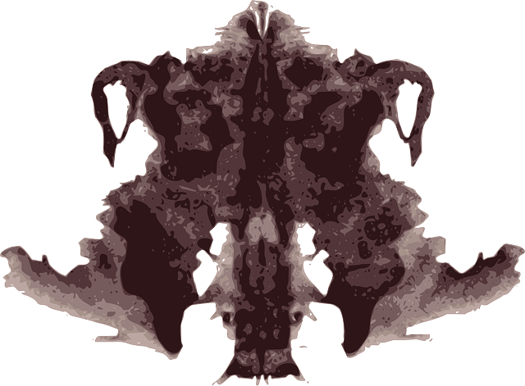
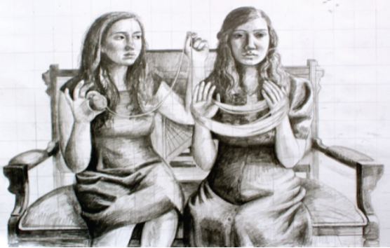
Projective Tests
Projective testing relies on projection (defense mechanism) to assess unconscious processes.
  Ambiguous cards are shown to individual who is asked to tell a story, interpret an image, or complete a sentence.
  Individual will project feelings, impulses, and desires onto the cards.
    Rorschach Inkblot Test – individual interprets a series of symmetrical inkblot cards, revealing unconscious feelings and struggles.
    Thematic Apperception Test (TAT) – individual tells a story about 8-12 ambiguous cards, giving insight into their social world, revealing hopes, fears, interests, and goals.
    Rotter Incomplete Sentence Blank (RISB) – Individual is asked to complete 40 incomplete sentences as quickly as possible to reveal desires, fears, and struggles.
Projective tests, such as the famous Rorschach inkblot test require a person to give spontaneous answers that “project” their unique personality onto an ambiguous stimulus. (Text and image from Personality Assessment by David Watson. Licensed under CC BY NC SA 4.0)
Figure 11.18 This image from the Thematic Apperception Tests (TAT) can be used in counseling settings.
Text from Psychology 2e OpenStax Revised Version Copyright © 2020 by Openstax is licensed under a Creative Commons Attribution 4.0 International License, except where otherwise noted. Edited by Maria Pagano

Slide 40
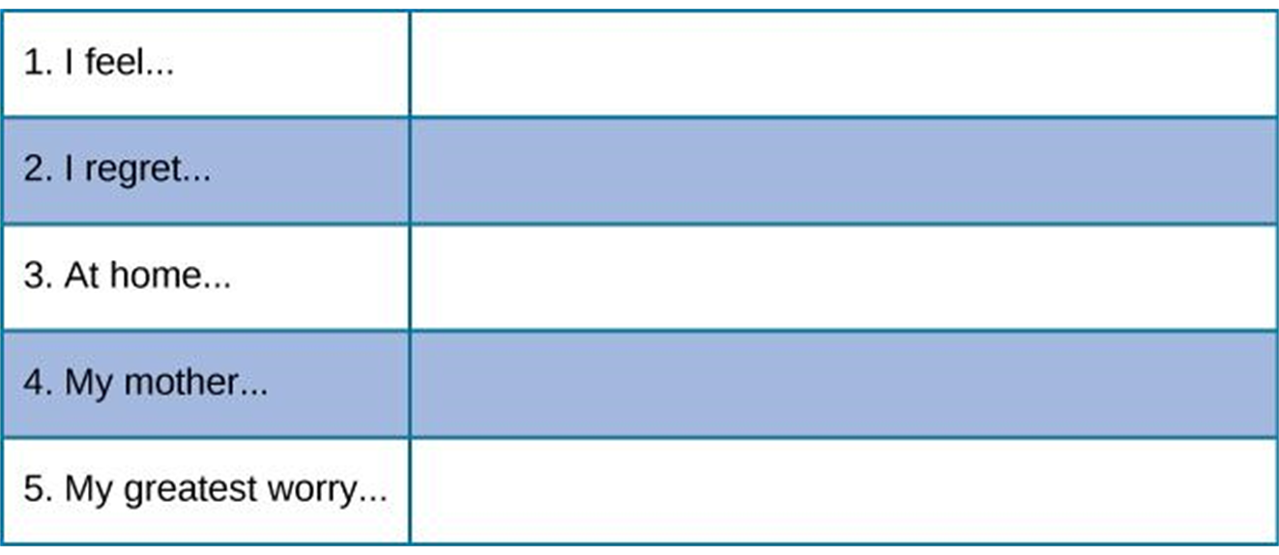
Rotter Incomplete Sentence Blank
Figure 11.19 These incomplete sentences resemble the types of questions on the RISB. How would you complete these sentences?
Image and text from Psychology 2e OpenStax Revised Version Copyright © 2020 by Openstax is licensed under a Creative Commons Attribution 4.0 International License, except where otherwise noted. Edited by Maria Pagano

