Slide 1

Chapter 9
Lifespan Development
OpenStax Psychology 2E
OpenStax ancillary resource is © Rice University under a CC-BY-4.0 DEED license and may be used with proper attributes. Unless otherwise noted all material and text contained in these ancillary materials is from Spielman, R. M., Jenkins, W. J., & Lovett, M. D. (2020). Psychology 2E. OpenStax and is licensed under CC BY 4.0 DEED.

Slide 2

Lifespan Development
Figure 9.1 Lifespan development studies how you change as well as how you remain the same over the course of your life.
Text: OpenStax ancillary resource © Rice University under a CC-BY 4.0 International license. Image from Wikimedia Commons by Ben Taylor is licensed under CC BY 2.0 DEED

Slide 3
What is Lifespan Development?
Developmental psychologists study lifelong development across three domains:
  Physical development – growth and changes in the body and brain, senses, motor skills, and health and wellness.
  Cognitive development – learning, attention, memory, language, thinking, reasoning and creativity.
  Psychosocial development – emotions, personality and social relationships.
What is “normal” development?”
  Normative psychologists have studied large numbers of children to determine norms (average ages) of when most children reach specific developmental milestones (e.g. crawling, walking, speaking in sentences, starting puberty).
  Biological milestones such as starting puberty are universal.
  Social milestones such as starting school vary across cultures.
Link to Learning Reading: The Centers for Disease Control and Prevention (CDC) describes the developmental milestones for children from 2 months through 5 years old.
Text: OpenStax Psychology 2E is licensed under CC BY 4.0 International. Edited by Maria Pagano

Slide 4
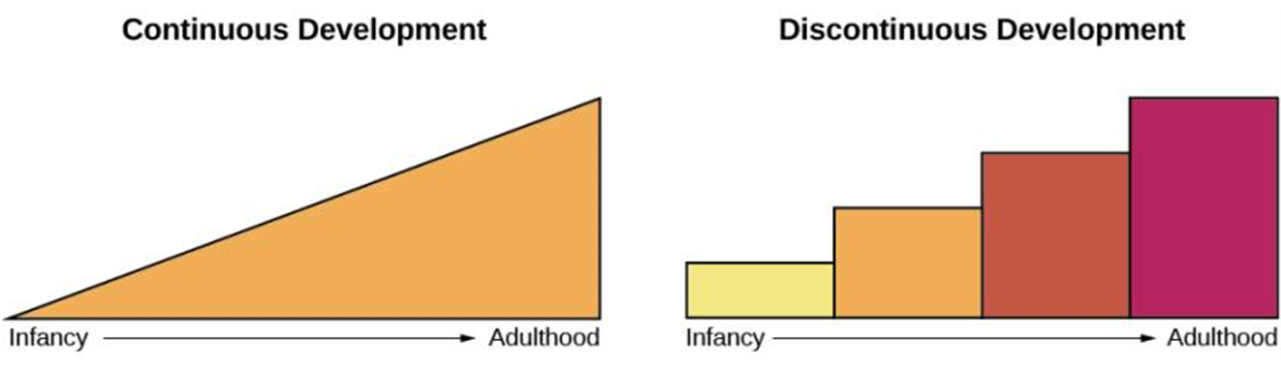
Continuous vs. Discontinuous Development
Developmental psychologists have different views on the process of lifespan development.
  Continuous development – views development as a cumulative process, gradually improving on existing skills.
    E.g. Adding inches to height each year.
  Discontinuous development – views development as occurring in unique stages (specific times or ages).
Figure 9.2 The concept of continuous development can be visualized as a smooth slope of progression, whereas discontinuous development sees growth in more discrete stages.
Video: Lifespan Development: Continuity & Discontinuity discusses whether human developmental changes are gradual and continuous or sudden and discontinuous (3:54).
Image and Text: OpenStax Psychology 2E is licensed under CC BY 4.0 International. Edited by Maria Pagano

Slide 5
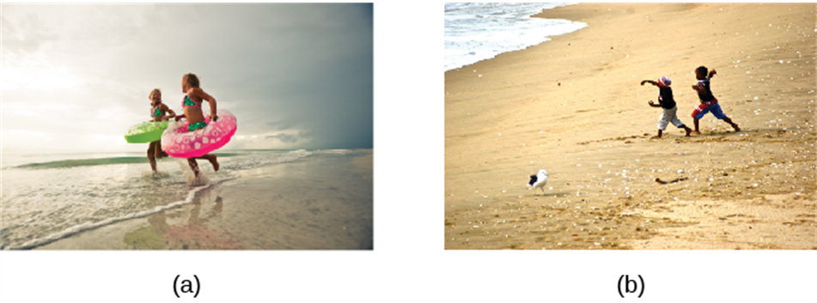
One Course of Development or Many?
Is development universal for all children or is it individual and depends on each child’s genetics and environment?
  Stage theories believe that the process of development is universal.
    Evidence for one course - Studies show that children from all around the world reach language milestones in a similar sequence.
  However, childcare practices vary by culture and by practice
    Evidence for many courses - Cultural differences in childcare practices – different practices can accelerate or inhibit achievement of developmental milestones.
Figure 9.3 All children across the world love to play. Whether in (a) Florida or (b) South Africa, children enjoy exploring sand, sunshine, and the sea.
Image and Text: OpenStax Psychology 2E is licensed under CC BY 4.0 International. Edited by Maria Pagano

Slide 6

Nature vs. Nurture
The nature vs nurture debate considers how our personalities and traits are the result of our genetics and biological factors, and how they are shaped by our environment.
  Nature – biology and genetics.
  Nurture – environment and culture.
The following questions can be answered by looking at the interaction between both nature and nurture, usually in twin and adoption studies.
  Why are siblings sometimes so different?
  Are adopted children more like their biological or adopted parents?
  Is intelligence inherited, is it shaped by our learning experiences or is it a combination of both?
Both nature and nurture are important in development, but psychologists debate the relative contributions of each.
Video: Nature vs Nurture (Psychology Debate Explained) looks at the debate between nature and nurture (2:35).
All text from Psychology 2e OpenStax Revised Version Copyright © 2020 by Openstax is licensed under a Creative Commons Attribution 4.0 International License, except where otherwise noted. Edited by Maria Pagano

Slide 7
Theories of Development
Psychosexual Theory (Sigmund Freud)
Psychosocial Theory (Eric Erikson)
Cognitive Theory (Jean Piaget)
Theory of Moral Development (Lawrence Kohlberg)
Image and text from Psychology 2e OpenStax Revised Version Copyright © 2020 by Openstax is licensed under a Creative Commons Attribution 4.0 International License, except where otherwise noted. Edited by Maria Pagano

Slide 8
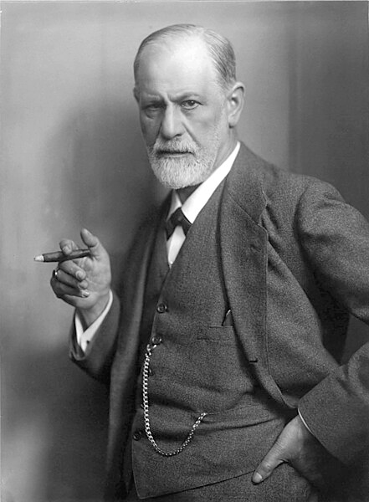
Psychosexual Theory (Freud)
Believed that childhood experiences shape our personalities and behavior as adults.
Viewed development as discontinuous.
Believed lack of proper nurturance and parenting during a stage could lead to a child becoming stuck/fixated in that stage.
Developed stages of psychosexual development, which claimed that children’s pleasure-seeking urges are focused on different erogenous zones at each of the 5 stages of development.
  Oral
  Anal
  Phallic
  Latency
  Genital
Video: Freud's 5 Stages of Psychosexual Development discusses each of Freud’s five stages of personality development (9:00).
Sigmund Freud (1856-1939) circa 1921. Image from Wikimedia Commons. Licensed under Public Domain.
Image and text from Psychology 2e OpenStax Revised Version Copyright © 2020 by Openstax is licensed under a Creative Commons Attribution 4.0 International License, except where otherwise noted. Edited by Maria Pagano

Slide 9
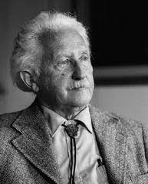
Psychosocial Theory (Erikson)
Emphasizes the social nature of development.
Argues that personality development takes place across the lifespan, not just in childhood.
Based on his belief that social interactions affect our sense of self (ego identity).
In each of Erikson’s 8 stages there is a psychosocial task that we must master in order to feel a sense of competence.
Eric Erikson (1902-1994). Image from Wikimedia Commons. Licensed under Public Domain.
Image and text from Psychology 2e OpenStax Revised Version Copyright © 2020 by Openstax is licensed under a Creative Commons Attribution 4.0 International License, except where otherwise noted. Edited by Maria Pagano

Slide 10
Erikson’s Psychosocial Stages of Development
 | STAGE | AGE | CHARACTERISTICS
1 | Trust vs. mistrust | 0-1 years | Trust (or mistrust) that basic needs, such as nourishment and affection, will be met.
2 | Autonomy vs shame/doubt | 1-3 years | Develop a sense of independence in many tasks.
3 | Initiative vs guilt | 3-6 years | Take initiative on some activities - may develop guilt when unsuccessful or boundaries overstepped.
4 | Industry vs inferiority | 7-11 years | Develop self-confidence in abilities when competent or sense of inferiority when not.
5 | Identity vs confusion | 12-18 years | Experiment with and develop identity and roles.
6 | Intimacy vs isolation | 19-29 years | Establish intimacy and relationships with others.
7 | Generativity vs stagnation | 30-64 years | Contribute to society and be part of a family.
8 | Integrity vs despair | 65+ | Assess and make sense of life and meaning of contributions.
Table 9.1
Video: 8 Stages of Development by Erik Erikson identifies and discusses each stage of Erikson's Psychosocial Theory (5:19).
Image and text from Psychology 2e OpenStax Revised Version Copyright © 2020 by Openstax is licensed under a Creative Commons Attribution 4.0 International License, except where otherwise noted. Edited by Maria Pagano

Slide 11
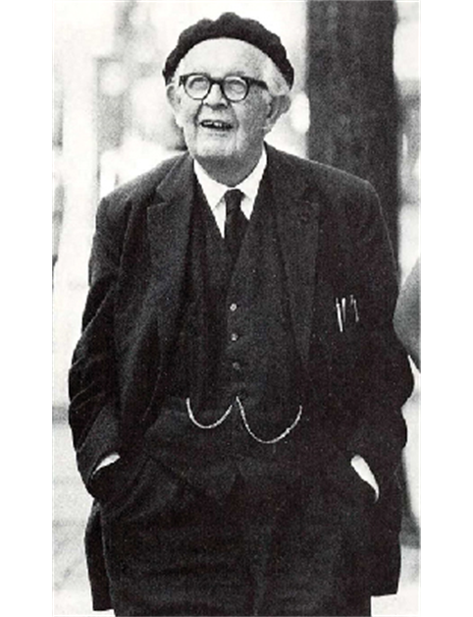
Cognitive Theory (Piaget)
Focused on children’s cognitive growth and theorized that cognitive abilities develop through specific stages.
Piaget believed children develop schemata (concepts used to categorize and interpret information) to help them understand the world.
When children learn new information, they adjust their schemata through assimilation and accommodation.
Assimilation – incorporates information into existing schemata.
Accommodation – Change schemata based on new information.
Figure 9.5 Jean Piaget spent over 50 years studying children and how their minds develop.
Image and text from Psychology 2e OpenStax Revised Version Copyright © 2020 by Openstax is licensed under a Creative Commons Attribution 4.0 International License, except where otherwise noted. Edited by Maria Pagano

Slide 12
Piaget’s Stages of Cognitive Development
Age (Yrs) | Stage | Description | Developmental issues
0-2 | Sensorimotor | World experienced through senses and actions. | Object permanence – understanding that even if something’s out of sight, it still exists Stranger anxiety
2-6 | Preoperational | Use words and images to represent things but lack logical reasoning. | Pretend play Egocentrism – unable to take the perspective of others. Language development
7-11 | Concrete operational | Understand concrete events and analogies logically; perform arithmetical operations. | Conversation Mathematical transformations
12+ | Formal operational | Formal operations. Utilize abstract reasoning. | Abstract logic Moral reasoning
Video: Piaget's Theory of Cognitive Development identifies and discusses each stage of Piaget’s Theory (6:55).
Table 9.2
Link to Learning Video: Take a few minutes and view this brief video demonstrating different children's abilities to understand object permanence to learn more. (1:03).
Link to Learning Video: Watch this video of a boy in the preoperational stage responding to Piaget's conservation tasks to learn more (3:49).
Link to Learning Video: Watch this short video of the Three Mountain Task in action from the University of Minnesota and the Science Museum of Minnesota (1:45).
Image and text from Psychology 2e OpenStax Revised Version Copyright © 2020 by Openstax is licensed under a Creative Commons Attribution 4.0 International License, except where otherwise noted. Edited by Maria Pagano

Slide 13
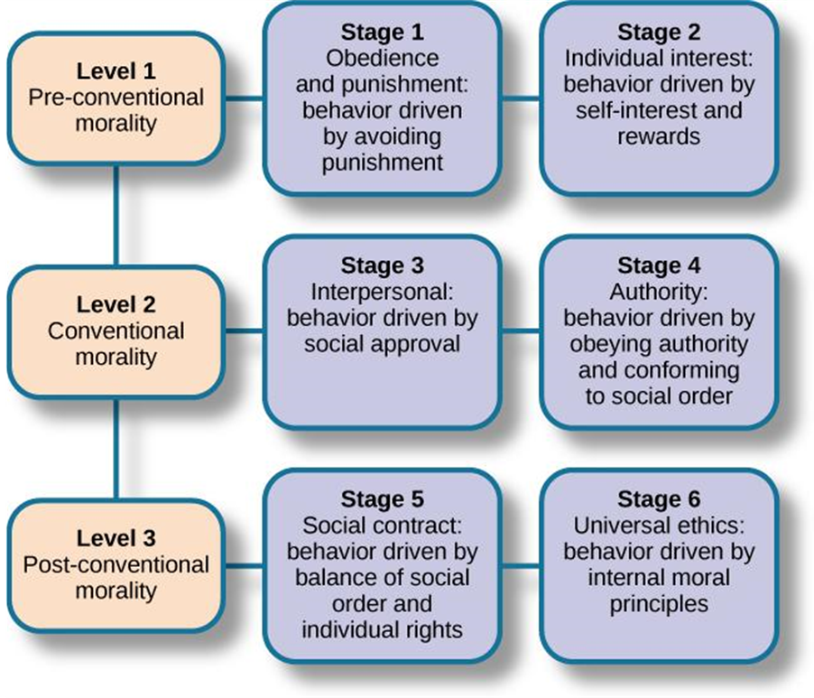
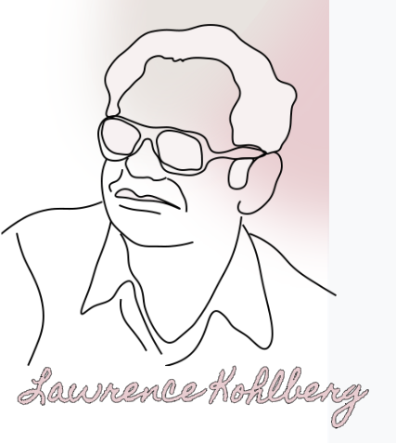
Theory of Moral Development (Kohlberg)
Kohlberg identified three levels of moral reasoning, each containing two stages:
  Pre-conventional
  Conventional
  Post-conventional
Each level is associated with increasingly complex stages of moral development.
Video: Kohlberg's 6 Stages of Moral Development identifies and discusses each stage of Kohlberg’s Theory (6:45).
Figure 9.6 Kohlberg identified three levels of moral reasoning: pre-conventional, conventional, and post-conventional: Each level is associated with increasingly complex stages of moral development.
Lawrence Kohlberg (1927-1987). Image from OER Commons. Licensed under CC BY NC SA 4.0 DEED.
Image and Text from Psychology 2e OpenStax Revised Version Copyright © 2020 by Openstax is licensed under a Creative Commons Attribution 4.0 International License, except where otherwise noted. Edited by Maria Pagano

Slide 14
Stages of Development
Prenatal
Infancy Through Childhood
Adolescence
Emerging Adulthood
Adulthood
Text and image from Psychology 2e OpenStax Revised Version Copyright © 2020 by Openstax is licensed under a Creative Commons Attribution 4.0 International License, except where otherwise noted. Edited by Maria Pagano

Slide 15
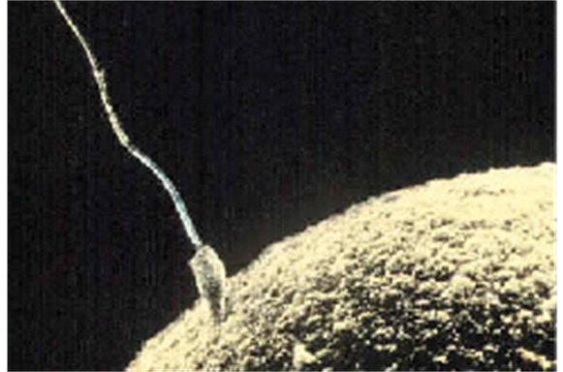
Prenatal Development: Germinal and Embryonic Stages
Germinal Stage (Weeks 1-2)
  Conception occurs when sperm fertilizes an egg and forms a zygote (one-cell structure).
  Mitosis – process of cell division.
  The zygote divides and cells become more specialized, forming organs and body parts.
Embryonic Stage (Weeks 3-8)
  After the zygote has 150 cells it travels down the fallopian tubes and implants itself in the lining of the uterus.
  The zygote is now an embryo (multi-cellular organism).
  Organs begin to function (heart begins to beat).
  Basic structures develop that will become the head, chest and abdomen.
Placenta – structure connected to the uterus that provides nourishment and oxygen from the mother to the embryo via the umbilical cord.
Figure 9.7 Sperm and ovum fuse at the point of conception.
Text from Psychology 2e OpenStax Revised Version Copyright © 2020 by Openstax is licensed under a Creative Commons Attribution 4.0 International License, except where otherwise noted. Edited by Maria Pagano

Slide 16
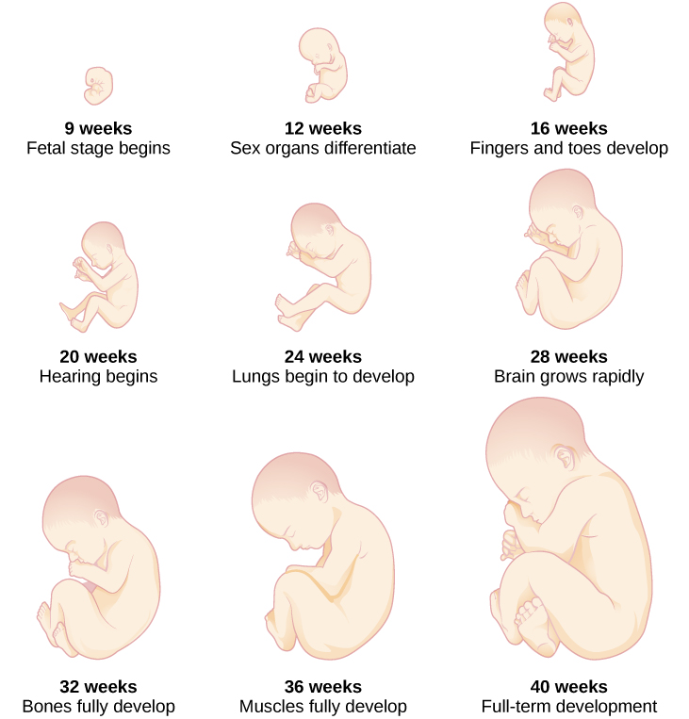
Prenatal Development: Fetal Stage
Fetal Stage (Weeks 9-40)
During the fetal stage, the baby's brain develops, and the body adds size and weight, until the fetus reaches full-term development.
Video: Tricky Topics: Prenatal Development discusses the three stages of prenatal development and the effects of teratogens (5:03).
Link to Learning Video: For an amazing look at prenatal development and the process of birth, view the video Life’s Greatest Miracle from Nova and PBS (1:45).
Figure 9.8 During the fetal stage, the baby's brain develops, and the body adds size and weight, until the fetus reaches full-term development.
Text and image from Psychology 2e OpenStax Revised Version Copyright © 2020 by Openstax is licensed under a Creative Commons Attribution 4.0 International License, except where otherwise noted. Edited by Maria Pagano

Slide 17
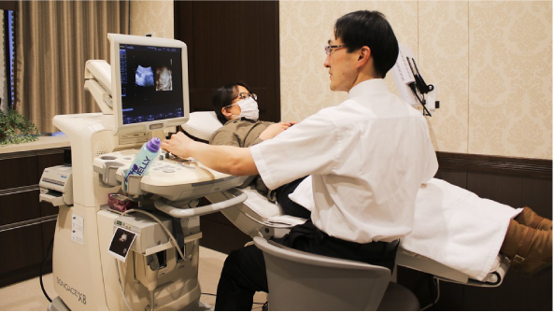
Prenatal Influences
Genetic and environmental factors can affect development during each prenatal stage.
It is important for the mother to receive prenatal care, (medical care during pregnancy), to monitor the health of the mother and fetus.
Teratogen – any environmental agent (biological, chemical, or physical) that causes damage to the developing embryo or fetus.
  Alcohol – can cause fetal-alcohol syndrome.
  Smoking – can result in premature birth, low-birth weight, stillbirths, sudden infant death syndrome.
  Drugs – heroine, cocaine, methamphetamine as well as prescription drugs.
  Radiation, viruses (e.g., HIV, Herpes, Rubella).
Figure 9.9 A pregnant woman receives an ultrasound as part of her prenatal care.
Text and image from Psychology 2e OpenStax Revised Version Copyright © 2020 by Openstax is licensed under a Creative Commons Attribution 4.0 International License, except where otherwise noted. Edited by Maria Pagano

Slide 18
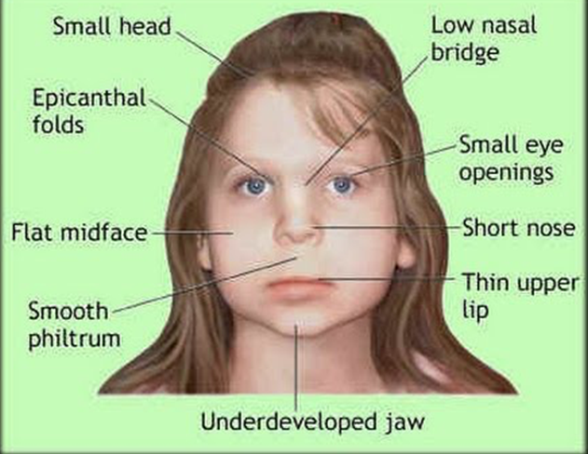
Prenatal Influences: Fetal-Alcohol Syndrome
Fetal Alcohol Spectrum Disorder is a collection of birth defects associated with heavy consumption of alcohol during pregnancy.
Research has found alcohol to be the leading preventable cause of intellectual disability (ID) in children in the U.S.
  Physical Manifestations FASD:
    Small head size.
    Abnormal facial features.
  Cognitive Manifestations of FASD:
    Poor judgement.
    Poor impulse control.
    Higher rates of ADHD.
    Learning issues.
    Lower IQ scores.
Video: Fetal Alcohol Syndrome Often Undiagnosed interviews a family who adopted a child with FASD and looks at how often FASD goes undiagnosed (2:50).
Text from Psychology 2e OpenStax Revised Version Copyright © 2020 by Openstax is licensed under a Creative Commons Attribution 4.0 International License, except where otherwise noted. Edited by Maria Pagano

Slide 19

Newborns
Newborn reflexes – inborn automatic responses to particular forms of stimulation (help the newborn survive).
  Rooting reflex – baby turns its head towards something that touches its cheek.
  Sucking reflex – suck on objects placed by the mouth.
  Grasping reflex – cling to objects placed in hands.
  Moro reflex – baby spreads arms and pulls them back in when they are startled/feel like they are falling.
Sensory abilities:
  Not yet fully developed at birth.
  Vision is the least developed sense.
  Prefer human voices, specifically their mothers over a stranger’s.
  Can distinguish between the smell of their mother and others.
Image Baby Sucking Fingers from Wikimedia Commons. Licensed under CC BY SA 4.0 DEED.
Link to Learning Video: Take a few minutes to view this brief video clip about newborn reflexes to learn more (2:14).
Text from Psychology 2e OpenStax Revised Version Copyright © 2020 by Openstax is licensed under a Creative Commons Attribution 4.0 International License, except where otherwise noted. Edited by Maria Pagano

Slide 20
Physical Development
Growth
  Occurs rapidly during infancy.
  Slows down at around ages 4-6.
  Girls have a growth spurt at age 8/9 – about 12.
Nervous System
  Blooming period - neural pathways form thousands of new connections during infancy and toddlerhood.
  Pruning period – neural connections are reduced during childhood and adolescence to allow the brain to function more efficiently.
  Size of the brain increases rapidly (especially the frontal lobe duirng ages 3-6).
  55% of adult size at age 2, 90% of adult size at age 6.
Motor Development
  Motor skills – ability to move our bodies and manipulate objects.
  Occurs in an orderly sequence – becomes more advanced.
  Fine motor skills – focus on the muscles in our fingers, toes, and eyes, and enable coordination of small actions (e.g., gripping a pencil).
  Gross motor skills – focus on large muscle groups that control arms and legs and involve larger movements (e.g., balancing, running).
Text from Psychology 2e OpenStax Revised Version Copyright © 2020 by Openstax is licensed under a Creative Commons Attribution 4.0 International License, except where otherwise noted. Edited by Maria Pagano

Slide 21
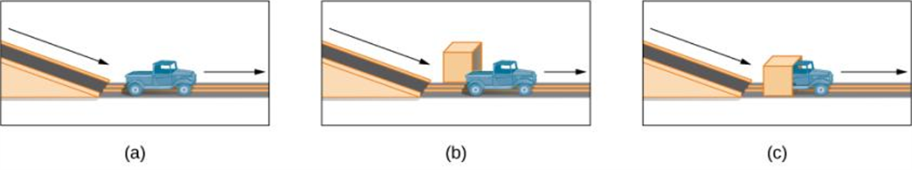
Cognitive Development
Piaget thought that children’s ability to understand objects developed slowly as a child matures and interacts with the environment. Today, developmental psychologists think Piaget was incorrect.
Baillargeon (1987):
  Very young children understand objects and how they work long before they have experience with those objects.
  In Baillargeon’s study, infants observed a truck (a) roll down an unobstructed track, (b) roll down an unobstructed track with an obstruction (box) beside it, and (c) roll down and pass through what appeared to be an obstruction.
  Infants spent more time looking at (c) suggesting that they knew solid objects cannot pass through each other.
Figure 9.11 In Baillargeon’s study, infants observed a truck (a) roll down an unobstructed track, (b) roll down an unobstructed track with an obstruction (box) beside it, and (c) roll down and pass through what appeared to be an obstruction.
Video: Baillargeon Object Permanence Study-Object Permanence shows Renne Baillargeon discussing the differences between her research and the work of Piaget and shows a child taking part in a study similar to the one described above (2:33).
Text from Psychology 2e OpenStax Revised Version Copyright © 2020 by Openstax is licensed under a Creative Commons Attribution 4.0 International License, except where otherwise noted. Edited by Maria Pagano

Slide 22
Cognitive Development: Continued
Cognitive Milestones
  6-9 months – can shake their head “no”.
  9-12 months – respond to verbal requests (e.g., wave bye-bye).
  8 months - understand object permanence.
  Toddlers – understand someone will come back when they leave the room, will look in appropriate places when asked to find objects.
  3-5 years – learn to count, name colors, know their name and age, can make small decisions, understand basic time concepts and sequencing, enjoy pretend play (can think symbolically), become more curious (always asking ”why?”), develop theory of mind.
  6-11 years – Thinking becomes more logical and organized, understand past, present, and future, can plan and work towards goals, understand cause-and-effect relationships, basic math skills.
  Attention span is limited until approximately age 11.
Link to Learning Video: False-belief tasks are useful in determining a child’s acquisition of theory-of-mind (TOM). Take a look at this video clip that shows a false belief task involving a box of crayons to learn more (3:34).
Text from Psychology 2e OpenStax Revised Version Copyright © 2020 by Openstax is licensed under a Creative Commons Attribution 4.0 International License, except where otherwise noted. Edited by Maria Pagano

Slide 23
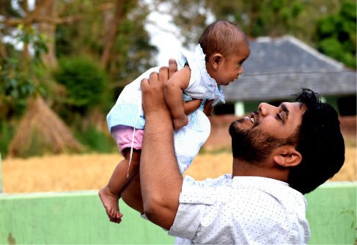
Psychosocial Development: Attachment
Psychosocial development occurs as children form relationships, interact with others, and understand and manage their feelings.
Attachment – a long-standing connection or bond with others.
  Forming health attachments is one of the main psychosocial milestones of infancy.
How do parent and infant attachment bonds form?
How does neglect affect these bonds?
What accounts for children’s attachment differences?
  The most influential studies conducted to answer these questions were by Harry Harlow, John Bowlby and Mary Ainsworth.
Figure 9.13 Mutually enjoyable interactions promote the parent-infant bond.
Text and image from Psychology 2e OpenStax Revised Version Copyright © 2020 by Openstax is licensed under a Creative Commons Attribution 4.0 International License, except where otherwise noted. Edited by Maria Pagano

Slide 24
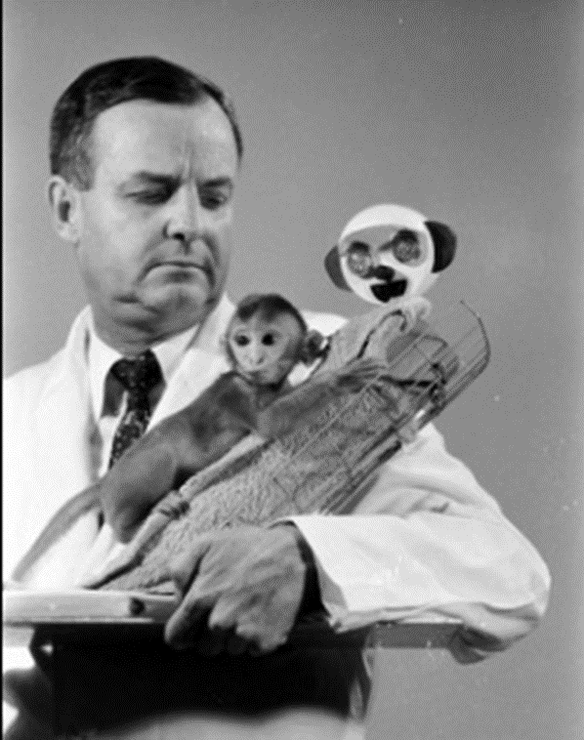
Psychosocial Development: Attachment: Harry Harlow
Separated newborn monkeys from their mothers and presented them with two surrogate mothers.
  One made out of wire mesh, could dispense milk.
  One made from cloth, did not dispense milk.
Monkeys spent more time clinging to the cloth monkey and only went to the wire monkey for food.
Results suggest that feelings of comfort and security are the critical components to maternal-infant bonding.
Link to Learning Video: Harlow’s studies of monkeys were performed before modern ethics guidelines were in place, and today his experiments are widely considered to be unethical and even cruel. Watch this video of actual footage of Harlow's monkey studies to learn more (6:07).
(Credit: Harlow’s Monkey experiments – Mr McNabb)
Text from Psychology 2e OpenStax Revised Version Copyright © 2020 by Openstax is licensed under a Creative Commons Attribution 4.0 International License, except where otherwise noted. Edited by Maria Pagano

Slide 25

Psychosocial Development: Attachment: John Bowlby
Defined attachment as the affectional bond/tie that an infant forms with the mother.
Bond must be made with primary care giver in order to have normal social and emotional development.
Saw attachment as an all-or-nothing process.
Secure base – parental presence that gives the child a sense of safety as he explores his surroundings.
Requirements for a healthy attachment:
  Caregiver must be responsive to the child’s physical, social, and emotional needs.
  The caregiver and child must engage in mutually enjoyable interactions.
The Bowlby-Ainsworth Award in attachment security research, which is given annually by the New York Attachment Consortium. Image from Wikimedia Commons. Licensed under CC BY SA 4.0 DEED.
Video: John Bowlby on Attachment and Psychotherapy shows John Bowlby lecturing on the role of the early parent-child relationship across the lifespan (2:41).
Text from Psychology 2e OpenStax Revised Version Copyright © 2020 by Openstax is licensed under a Creative Commons Attribution 4.0 International License, except where otherwise noted. Edited by Maria Pagano

Slide 26
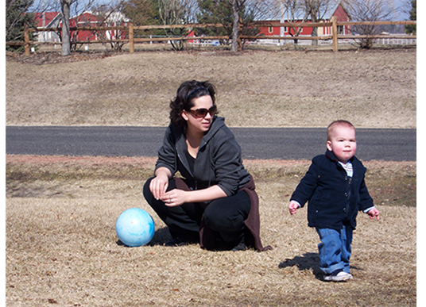
Psychosocial Development: Attachment: Mary Ainsworth
Ainsworth looked to answer the question, “Do children differ in the way they bond, and if so, why?”, by developing a procedure known as the Strange Situation.
  Mother (caregiver) and infant are placed in a room together, with toys.
  Stranger enters the room and mother leaves.
  After a few minutes, mother returns to the room to comfort the child.
Using the Strange Situation, Ainsworth identified 3 styles of attachment. A fourth was later identified.
  Secure
  Resistant
  Avoidant
  Disorganized
Figure 9.14 In secure attachment, the parent provides a secure base for the toddler, allowing him to securely explore his environment.
Text and image from Psychology 2e OpenStax Revised Version Copyright © 2020 by Openstax is licensed under a Creative Commons Attribution 4.0 International License, except where otherwise noted. Edited by Maria Pagano

Slide 27
Psychosocial Development: Attachment: Ainsworth’s Categories of Attachment
Secure – child uses the parent as a secure base from which to explore.
  Child was distressed when mother left, happy to see them when they returned.
  Common when caregivers are sensitive and responsive to needs.
Avoidant – unresponsive to parent, does not use the parent as a secure base, and does not care if parent leaves.
  Child was slow to show positive reaction when mother returned.
  Common when caregivers are insensitive and inattentive to needs.
Resistant – show clingy behavior, but then reject mothers attempts to interact with them.
  Child did not explore the toys, became extremely disturbed and angry when mother left, were difficult to comfort when mother returned.
  Common when caregiver is inconsistent with level of response.
Disorganized – show odd behavior around caregiver.
  Behaved oddly when mother left (froze/ran around erratically), tried to run away when mother returned.
  Common when child has been abused.
Link to Learning Video: Watch this video clip of the Strange Situation and try to identify which type of attachment baby Lisa exhibits (6:07).
Video: Strange Situation Experiment shows not only secure attachment, but also children who are categorized as resistant and avoidant (7:14).
Text and image from Psychology 2e OpenStax Revised Version Copyright © 2020 by Openstax is licensed under a Creative Commons Attribution 4.0 International License, except where otherwise noted.

Slide 28
Psychosocial Development: Self-Concept
Self-Concept (Self-Awareness)
  Development of a positive sense of self is the main psychosocial milestone of childhood.
  Children with a positive self-concept tend to be more confident, more independent, do better in school and are more willing to try new activities.
  By 18 months a baby can recognize themselves in the mirror.
  By 24-46 months they can recognize themselves in a photo.
Self-Concept & Social Behavior
  Children display increased social behavior after establishing a self-concept.
    Age 2-4:
      Enjoy playing with other children.
      Can label themselves as boy or girl - through play, children explore and come to understand gender roles
    Age 4:
      Can cooperate and share.
      Can initiate tasks and carry out plans.
    Age 6:
    Can identify themselves in terms of group membership.
Video: Rouge Test (Self-Recognition Test) or the Mirror Self-Recognition Test, looks at how young children’s reaction to themselves in mirror determines whether they have developed self-recognition (1:40).
Image and text from Psychology 2e OpenStax Revised Version Copyright © 2020 by Openstax is licensed under a Creative Commons Attribution 4.0 International License, except where otherwise noted.

Slide 29

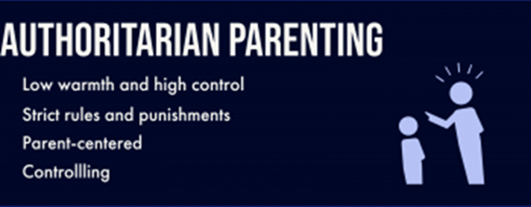
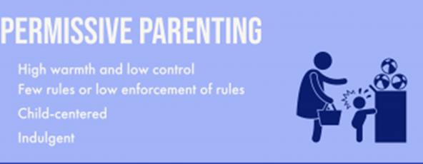
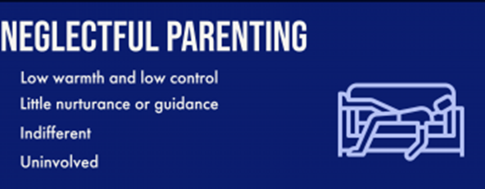
Psychosocial Development: Parenting Styles
The development of a healthy self-concept can depend on parenting styles. (Image from Caregiver Awareness: Identifying At-Risk Children by Haley Bennett; Emma Booth; Jordyn Carroll; Kori Carter; Chandler Coshatt; David Cote; Eldon DeLong; Isabel Durham; Bailie Featherston; Sean Graham; Aisling Hillman; Imani Hunt; Hanna Jiang; Morgan Johnson; Sydney Langley; Jordan Lewis; Lawson Logue; Clare Maloney; Avery Morse; Alicia Moylan; Marguerite Peterseim; Lily Rogers; Kathryn Root; ReganSpencer Spencer; and Jackson Yeh. Licensed under CC BY NC SA 4.0 DEED.)
Diana Baumrind’s Parenting Styles (1971)
Video: Parenting Styles and Outcomes looks at the different styles of parenting proposed by Baumrind (1:40).
Text from Psychology 2e OpenStax Revised Version Copyright © 2020 by Openstax is licensed under a Creative Commons Attribution 4.0 International License, except where otherwise noted. Image by Maria Pagano

Slide 30
Psychosocial Development: Temperament
Parenting style can depend on the temperament of a child.
  Temperament* – innate traits that influence how one thinks, behaves, and reacts with the environment.
    Easy temperament – positive emotions, adapt well to change, and capable of regulating emotions.
      More likely to elicit warm and responsive parenting.
    Difficult temperament – negative emotions, difficulty adapting to change and regulating emotions.
      More likely to evoke irritation and cause parents to withdraw.
Video: Navigating Your Child's Temperament discusses the different types of temperament styles (5:01).
*Thomas and Chess’s complete theory on temperament is discussed in more detail in Chapter 11:Personality
Image and text from Psychology 2e OpenStax Revised Version Copyright © 2020 by Openstax is licensed under a Creative Commons Attribution 4.0 International License, except where otherwise noted. Edited by Maria Pagano

Slide 31

Adolescence
Figure 9.15 Peers are a primary influence on our development in adolescence.
Image (olfactory bulb, olfactory recptors, and nasal cavity) and Text from Psychology 2e OpenStax Revised Version Copyright © 2020 by Openstax is licensed under a Creative Commons Attribution 4.0 International License, except where otherwise noted. Edited by Maria Pagano

Slide 32

Physical Development
Puberty
  Adrenarche – maturing of the adrenal glands.
  Gonadarche – maturing of the sex glands.
  Primary sexual characteristics develop.
    Uterus and ovaries in females.
    Testes in males.
  Secondary sexual characteristics develop.
    Breasts and hips in girls.
    Facial hair and deepened voice in boys.
  Menarche – beginning of menstrual periods (usually around 12-13 years old).
  Spermarche – first ejaculation (around 13-14 years old).
  Growth spurts in both sexes.
  Girls reach their adult height by 16.
  Boys reach their adult height by 17.
(Credit: Puberty – Evolving Sciences)
Image and text from Psychology 2e OpenStax Revised Version Copyright © 2020 by Openstax is licensed under a Creative Commons Attribution 4.0 International License, except where otherwise noted. Edited by Maria Pagano

Slide 33
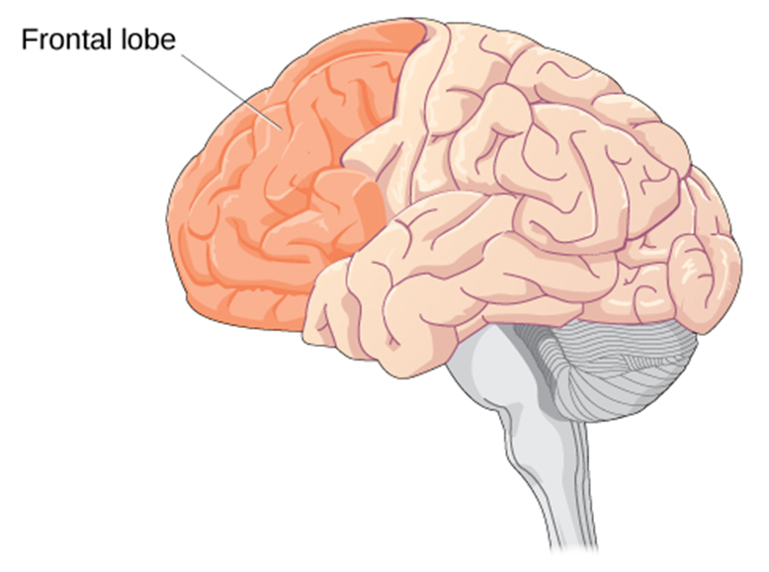
Physical Development
Brain growth continues into the early 20s.
  The development of the frontal lobe is important during this stage.
The frontal lobe is responsible for judgement, impulse control, and planning.
May explain why adolescents engage in increased risk-taking behaviors and emotional outbursts.
Link to Learning Video: According to neuroscientist Jay Giedd in the Frontline video “Inside the Teenage Brain” (2013), “It’s sort of unfair to expect [teens] to have adult levels of organizational skills or decision-making before their brains are finished being built.” Watch this segment on “The Wiring of the Adolescent Brain” to find out more about the developing brain during adolescence (5:09).
Figure 9.16 Brain growth continues into the early 20s. The development of the frontal lobe is important during this stage.
Image and text from Psychology 2e OpenStax Revised Version Copyright © 2020 by Openstax is licensed under a Creative Commons Attribution 4.0 International License, except where otherwise noted. Edited by Maria Pagano

Slide 34
Cognitive Development
Teenage thinking is characterized by the ability to reason logically and solve hypothetical problems such as how to design, plan, and build a structure.
  Some researchers believe this is due to an increase in mental capacity (development of new skills).
  Some researchers believe this is due to increases in processing speed and efficiency (improvements to existing skills).
Cognitive Empathy (theory of mind) – the ability to take the perspective of others and feel concern for others.
  Increases in adolescence.
  An important part of social problem solving and conflict avoidance.
Video: Disarming: Cognitive Empathy demonstrates how cognitive empathy can help move a conversation in a positive direction (3:11).
Image and text from Psychology 2e OpenStax Revised Version Copyright © 2020 by Openstax is licensed under a Creative Commons Attribution 4.0 International License, except where otherwise noted. Edited by Maria Pagano

Slide 35
Psychosocial Development
Adolescents refine their sense of self as they relate to others.
  Who am I?
  Who do I want to be?
  May adopt the values and roles that parents expect for them.
  May develop identities that are in opposition to their parents but align with a peer group.
  Peer relationships become a central focus in adolescents’ lives.
  According to Erikson, adolescents are in the identity vs role confusion stage. Teens may experiment while they figure out their identity.
Parent-Child Relationships
  Warm, healthy parent-child relationships have been associated with:
  Better grades.
  Fewer school behavior problems.
Image and text from Psychology 2e OpenStax Revised Version Copyright © 2020 by Openstax is licensed under a Creative Commons Attribution 4.0 International License, except where otherwise noted. Edited by Maria Pagano

Slide 36
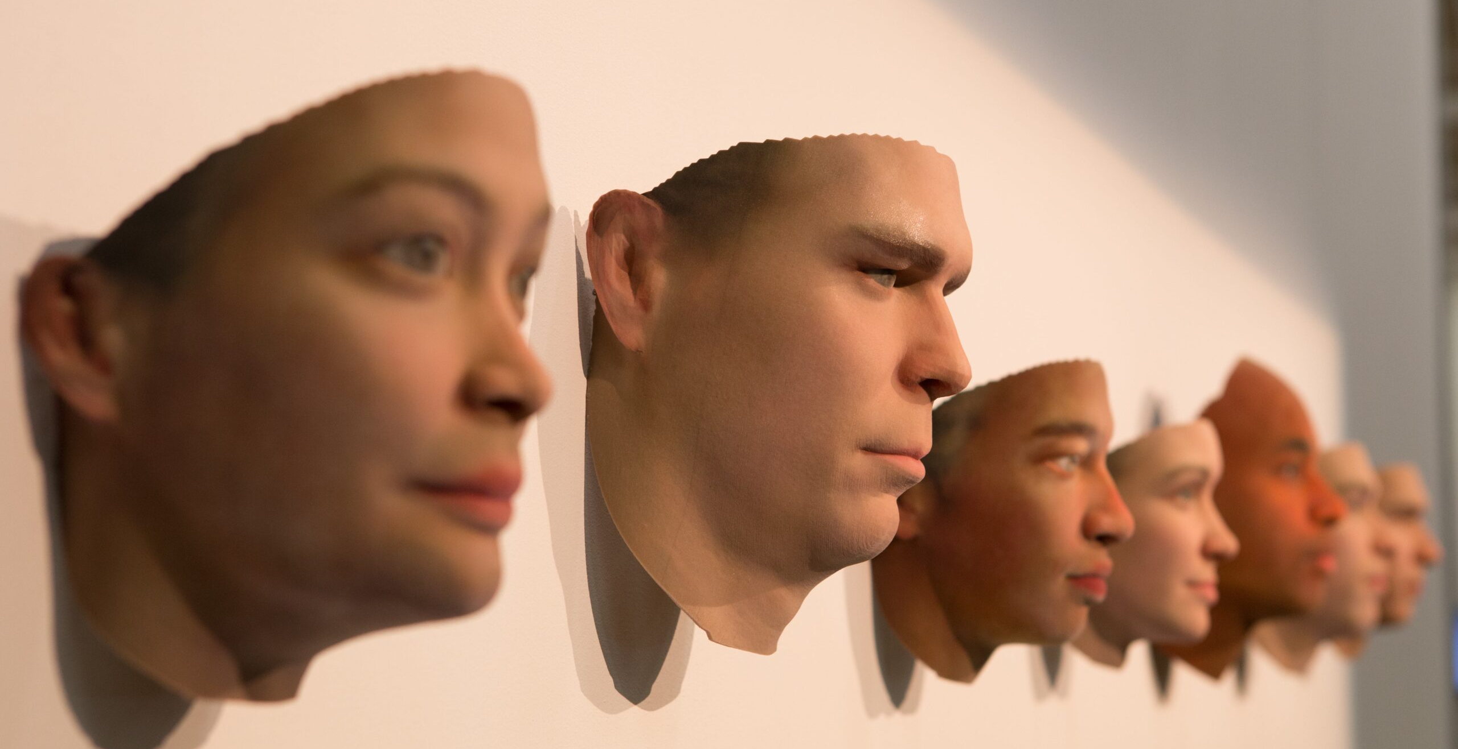
Emerging Adulthood
Emerging adulthood is a relatively newly defined period of lifespan development.
  18 years to mid 20s.
  Identity exploration is focused on work and love.
Why are people taking longer to grow up?
  Product of Western culture and current times.
  People are living longer allowing them extra time to start a career and family.
  Higher levels of education are required for careers.
  Higher cultural value placed on taking time to explore options.
Photo by flickr.com user Carolien Coenen
Image and text from Psychology 2e OpenStax Revised Version Copyright © 2020 by Openstax is licensed under a Creative Commons Attribution 4.0 International License, except where otherwise noted. Edited by Maria Pagano

Slide 37
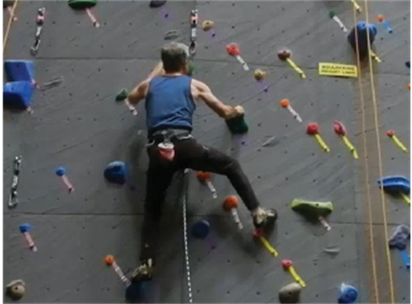
Adulthood: Physical Development
Early Adulthood (20s-40s): Physical abilities are at their peak.
Middle Adulthood (40s-60s):
  Physical decline is gradual.
  Skin loses elasticity (wrinkles form).
  Visual acuity decreases.
  Women experience menopause.
  Men and women both tend to gain weight.
  Hair begins to thin and turn gray.
Late Adulthood (60s +):
  Skin continues to lose elasticity.
  Reaction time slows further.
  Muscle strength diminishes.
  Smell, taste, hearing, vision decline.
Figure 9.18 Physical declines of middle and late adulthood can be minimized with proper exercise, nutrition, and an active lifestyle.
Link to Learning Video: Aging doesn’t mean a person can’t explore new pursuits, learn new skills, and continue to grow. Watch this inspiring story about Neil Unger who is a newbie to the world of skateboarding at 60 years old to learn more (2.41).
Image and text from Psychology 2e OpenStax Revised Version Copyright © 2020 by Openstax is licensed under a Creative Commons Attribution 4.0 International License, except where otherwise noted. Edited by Maria Pagano

Slide 38
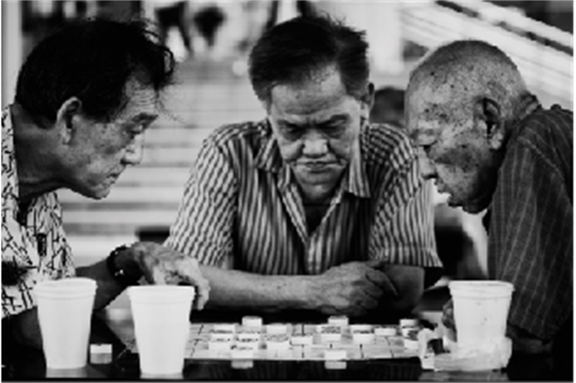
Adulthood: Cognitive Development
Cognitive abilities remain steady throughout early and middle adulthood.
  Crystalized intelligence (information, skills, and strategies gathered through experience) remains steady or improves.
  Fluid intelligence (information processing abilities, reasoning, and memory) begins to decline.
Link to Learning Video: There is good news for the middle age brain. View this brief video about the middle age brain to find out what it is (2.21).
Figure 9.19 Cognitive activities such as playing mahjong, chess, or other games, can keep you mentally fit and delay cognitive decline. The same is true for solo pastimes like reading and completing crossword puzzles.
Image and text from Psychology 2e OpenStax Revised Version Copyright © 2020 by Openstax is licensed under a Creative Commons Attribution 4.0 International License, except where otherwise noted. Edited by Maria Pagano

Slide 39

Adulthood: Psychosocial Development
Theorists believe that as we age, we need to continue to have meaning in our lives. Many adults define themselves by their job, or relationships with family.
Employment and Well-Being
  Job satisfaction is closely tied to work that:
  Involves contact with other people.
  Is interesting.
  Provides opportunities for advancement.
  Allows some independence.
Relationships and Well-Being
  Positive influences on well-being include:
  Having a stable marriage.
  Having children (initially stressful but rewarding later).
  Socioemotional selectivity theory – as we get older, our social support and friendships dwindle in number, but remain as close, if not closer than in our earlier years.
Figure 9.20 Social support is important as we age.
Link to Learning Video: View this video about aging in America to learn more (7.22).
Text from Psychology 2e OpenStax Revised Version Copyright © 2020 by Openstax is licensed under a Creative Commons Attribution 4.0 International License, except where otherwise noted. Edited by Maria Pagano

Slide 40

Death and Dying
The process of accepting one’s own death (Elizabeth Kubler-Ross (1969))
  5 stages of grief:
    Denial
    Anger
    Bargaining
    Depression
    Acceptance
Video: The 5 Stages of Grief looks at and explains the complex emotional response to loss (3:48).
5 Stages of Grief from flickr by Cocomariposa. Licensed under CC BY 2.0 DEED.
Image and text from Psychology 2e OpenStax Revised Version Copyright © 2020 by Openstax is licensed under a Creative Commons Attribution 4.0 International License, except where otherwise noted. Edited by Maria Pagano

Slide 41
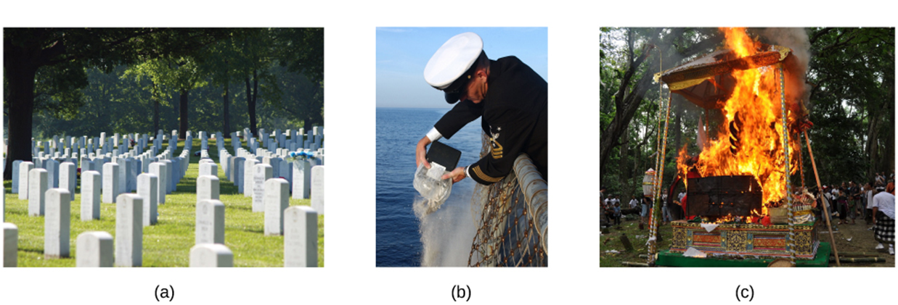
Death and Dying
Figure 9.21 Different cultures, societies, and religions have varying practices surrounding death.
For example, people’s bodies may be (a) buried in a cemetery, (b) cremated and buried at sea as in this U.S. Navy ceremony, or (c) cremated such as in this Hindu ceremony in Bali.
Image and text from Psychology 2e OpenStax Revised Version Copyright © 2020 by Openstax is licensed under a Creative Commons Attribution 4.0 International License, except where otherwise noted. Edited by Maria Pagano

