Slide 1
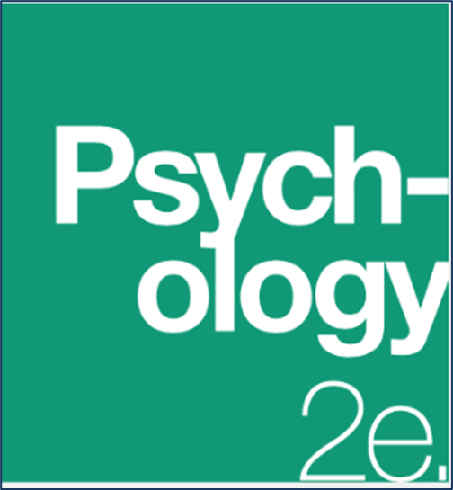
Chapter 7
Thinking and Intelligence
OpenStax Psychology 2E
OpenStax ancillary resource is © Rice University under a CC-BY-4.0 DEED license and may be used with proper attributes. Unless otherwise noted all material and text contained in these ancillary materials is from Spielman, R. M., Jenkins, W. J., & Lovett, M. D. (2020). Psychology 2E. OpenStax and is licensed under CC BY 4.0 DEED.

Slide 2
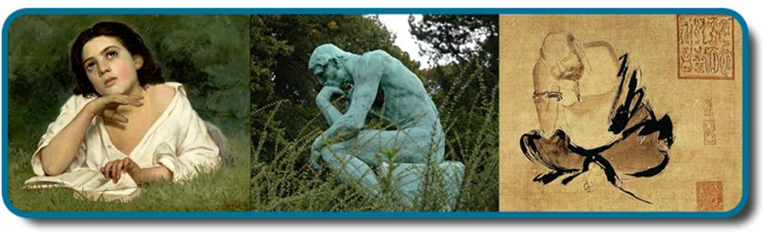
Cognitive Psychology
Cognition, most simply, is thinking. It encompasses the processes associated with:
  Perception
  Knowledge
  Problem-solving
  Judgement
  Language
  Memory
Figure 7.1Thinking is an important part of our human experience, and one that has captivated people for centuries. Today, it is one area of psychological study. The 19th-century Girl with a Book by José Ferraz de Almeida Júnior, the 20th-century sculpture The Thinker by August Rodin, and Shi Ke’s 10th-century painting Huike Thinking all reflect the fascination with the process of human thought. (credit “middle”: modification of work by Jason Rogers; credit “right”: modification of work by Tang Zu-Ming)
All text from Psychology 2e OpenStax Revised Version Copyright © 2020 by Openstax is licensed under a Creative Commons Attribution 4.0 International License, except where otherwise noted. Edited by Maria Pagano

Slide 3
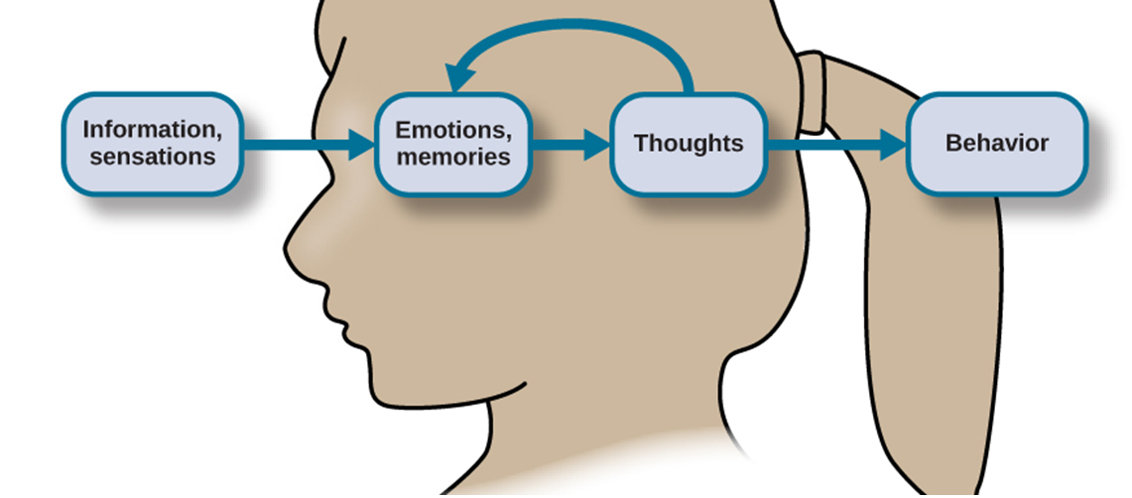
Cognition
Figure 7.2 Sensations and information are received by our brains, filtered through emotions and memories, and processed to become thoughts.
Video: What is Cognitive Psychology? explains the field of cognitive psychology and discusses some of the strengths and weaknesses of cognitive theory (3:49).
All text from Psychology 2e OpenStax Revised Version Copyright © 2020 by Openstax is licensed under a Creative Commons Attribution 4.0 International License, except where otherwise noted. Edited by Maria Pagano

Slide 4
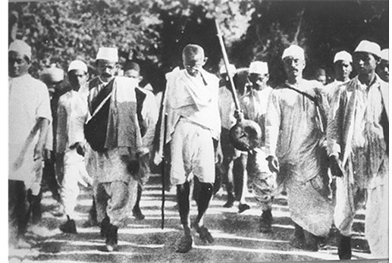
Concepts and Prototypes
The brain organizes information via:
  Concepts – categories of linguistic information, images, ideas, or memories.
    Used to see relationships among different elements of experience.
    Can be complex and abstract (e.g. the idea of justice) or concrete (types of birds).
  Prototype – the best example or representation of a concept.
    E.g. Mahatma Gandhi could be a prototype for the category of civil disobedience.
    E.g. An apple is a prototype for a fruit
In 1930, Mohandas Gandhi led a group in peaceful protest against a British tax on salt in India.
All text from Psychology 2e OpenStax Revised Version Copyright © 2020 by Openstax is licensed under a Creative Commons Attribution 4.0 International License, except where otherwise noted. Edited by Maria Pagano

Slide 5

Natural and Artificial Concepts
Natural concepts:
  Created “naturally” through either direct or indirect experience.
    E.g. our concept of snow.
Artificial concepts:
  Defined by a specific set of characteristics.
    E.g. Properties of geometric shapes (squares, triangles etc).
Figure 7.3 (a) Our concept of snow is an example of a natural concept—one that we understand through direct observation and experience. (b) In contrast, artificial concepts are ones that we know by a specific set of characteristics that they always exhibit, such as what defines different basic shapes.
All text from Psychology 2e OpenStax Revised Version Copyright © 2020 by Openstax is licensed under a Creative Commons Attribution 4.0 International License, except where otherwise noted. Edited by Maria Pagano

Slide 6
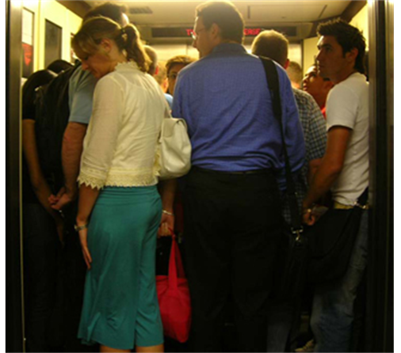
Schemata
Schema – a mental construct consisting of a collection of related concepts.
  When a schema is activated, we automatically make assumptions about the person/object/situation.
Role schema – makes assumptions about how individuals in certain roles will behave.
  What assumptions come to mind about a librarian?
Event schema (cognitive script) – a set of routine or automatic behaviors.
  Can vary widely among different cultures and countries.
  Dictate behavior.
  Make habits difficult to break.
  E.g. when riding in an elevator, we automatically stand facing the door.
Figure 7.4 What event schema do you perform when riding in an elevator?
Video: What is Schema Theory in Psychology? explains what a schema is and the different types of schemas that we create including those which can lead to biases (6:36).
All text from Psychology 2e OpenStax Revised Version Copyright © 2020 by Openstax is licensed under a Creative Commons Attribution 4.0 International License, except where otherwise noted. Edited by Maria Pagano

Slide 7
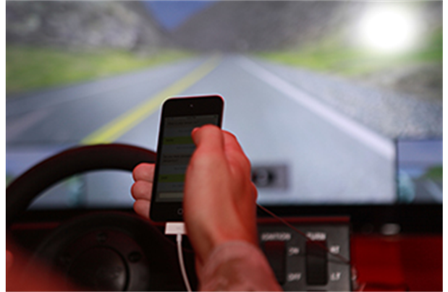
Event Schema
Event schemas are difficult to change because they are automatic.
  When we receive a text, our event schema is to pick up our phone and reply. The problem is that this automatic reaction will arise even in situations when it is not safe to reply. For example, texting while driving is dangerous, but it is a difficult event schema for some people to resist.
  Research suggests that just the event schema of regularly checking our phone makes it increasingly difficult to resist picking it up while driving.
Figure 7.5 Texting while driving is dangerous, but it is a difficult event schema for some people to resist.
Image and text from Psychology 2e OpenStax Revised Version Copyright © 2020 by Openstax is licensed under a Creative Commons Attribution 4.0 International License, except where otherwise noted. Edited by Maria Pagano

Slide 8
Language
Language – a communication system that involves using words and systematic rules to organize those words to transmit information from one individual to another.
Components of Language
  Lexicon – the words of a given language.
  Grammar – the set of rules that are used to convey meaning through the use of the lexicon.
  Phoneme – a basic sound unit (ah, eh,).
  Morphemes – the smallest units of language that convey some type of meaning.
Language is constructed through semantics and syntax.
  Semantics – the meaning we derive from morphemes and words.
  Syntax – the way words are organized into sentences.
Image and text from Psychology 2e OpenStax Revised Version Copyright © 2020 by Openstax is licensed under a Creative Commons Attribution 4.0 International License, except where otherwise noted. Edited by Maria Pagano

Slide 9
Language Development
Noam Chomsky – proposed that the mechanisms underlying language acquisition are biologically determined.
  Language develops in the absence of formal instruction.
  Language acquisition follows similar patterns in children from different cultures/backgrounds.
Critical period – proficiency at acquiring language is maximal early in life.
  Being deprived of language during the critical period impedes the ability to fully acquire and use language.
The Case of Genie
  The effects of language deprivation during the critical period can be seen in the case study of Genie.
    Was found at age 13 after being raised in neglectful and abusive conditions.
    Grew up with virtually no social interaction and was unable to speak when found.
    With help, Genie was able to acquire vocabulary but was not able to learn the grammatical aspects of language.
Video: Noam Chomsky on Language Acquisition briefly explains Chomsky’s theory of language development (1:47).
Video: History Uncovered provides a brief video of Genie’s ability to speak (0:31).
Image and text from Psychology 2e OpenStax Revised Version Copyright © 2020 by Openstax is licensed under a Creative Commons Attribution 4.0 International License, except where otherwise noted. Edited by Maria Pagano

Slide 10
Language Development
Stages of Language and Communication Development
Stage | Age | Developmental Language and Communication
1 | 0–3 months | Reflexive communication; unlearned vocalizations, involuntary movements or facial expressions in response to pleasure or discomfort
2 | 3–8 months | Reflexive communication; interest in others
3 | 8–13 months | Intentional communication; sociability
4 | 12–18 months | First words
5 | 18–24 months | Simple sentences of two words
6 | 2–3 years | Sentences of three or more words
7 | 3–5 years | Complex sentences; has conversations
Video: 1 Week Old Responding to Mother's Voice (0:21).
Video: 7 to 9 Month Communication Milestones to Look For shows 8 different communication milestones in children ages 7 to 9 months of age (1:27).
Video: 4-Month-Old Vocal Play (0:45).
Video: 13 to 18 Month Communication Milestones shows 7 different communication milestones in children ages 13 to 18 months of age (2:31).
Link to Learning Video: Watch this video about how babies lose the ability to discriminate among all possible human phonemes as they age to learn more (3:22).
Image and text from Psychology 2e OpenStax Revised Version Copyright © 2020 by Openstax is licensed under a Creative Commons Attribution 4.0 International License, except where otherwise noted. Edited by Maria Pagano

Slide 11
Problem Solving Strategies
Trial and error – continue trying different solutions until problem is solved.
Algorithm – step-by-step problem-solving formula.
Heuristic – general problem-solving framework.
  Short-cuts.
  A “rule of thumb”.
  Working-backwards – begin solving the problem by focusing on the end result.
  Breaking large tasks into a series of smaller steps.
When do people use heuristics?
  When one is faced with too much information.
  When the time to make a decision is limited.
  When the decision to be made is unimportant.
  When there is access to very little information to use in making the decision.
  When an appropriate heuristic happens to come to mind in the same moment.
Image and text from Psychology 2e OpenStax Revised Version Copyright © 2020 by Openstax is licensed under a Creative Commons Attribution 4.0 International License, except where otherwise noted. Edited by Maria Pagano

Slide 12
Problem Solving Strategies
Method | Description | Example
Trial and error | Continue trying different solutions until problem is solved | Restarting phone, turning off WiFi, turning off Bluetooth to determine why your phone is malfunctioning
Algorithm | Step-by-step problem-solving formula | Instruction manual for installing new software on your computer
Heuristic | General problem-solving framework | Working backwards; breaking a task into steps
Video: Solve a Problem Using Trial and Error demonstrates someone working through a math problem using trial and error (3:27).
Video: Problem Solving: Algorithms vs. Heuristics (Intro Psych Tutorial #91) explains the difference between an algorithm and a heuristic and provides an example demonstrating why we tend to use heuristics when solving problems (4:49).
Image and text from Psychology 2e OpenStax Revised Version Copyright © 2020 by Openstax is licensed under a Creative Commons Attribution 4.0 International License, except where otherwise noted. Edited by Maria Pagano

Slide 13
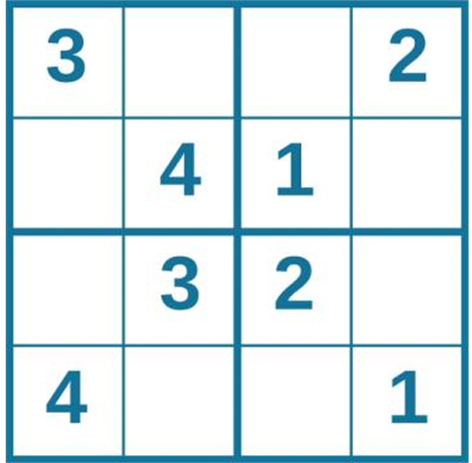
Puzzle 1: Sudoku
Figure 7.7 Problem solving abilities can improve with practice. Many people practice everyday with puzzles such as sudoku.
Image and Text from Psychology 2e OpenStax Revised Version Copyright © 2020 by Openstax is licensed under a Creative Commons Attribution 4.0 International License, except where otherwise noted. Edited by Maria Pagano

Slide 14
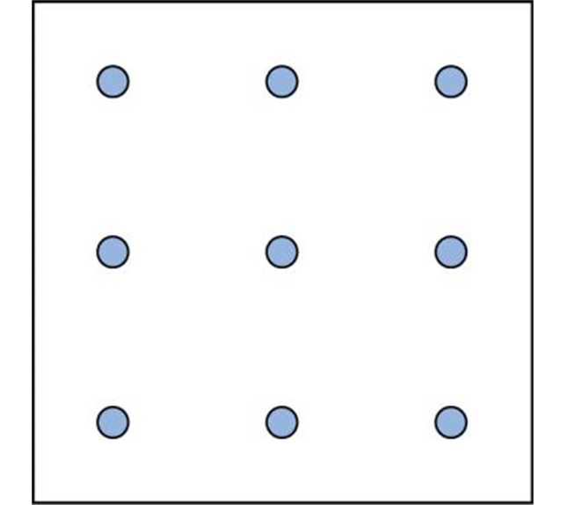
Puzzle 2: Spatial Reasoning
Figure 7.8 Connect all nine dots with four connecting straight lines without lifting your pencil from the paper.
Text and image from Psychology 2e OpenStax Revised Version Copyright © 2020 by Openstax is licensed under a Creative Commons Attribution 4.0 International License, except where otherwise noted. Edited by Maria Pagano

Slide 15
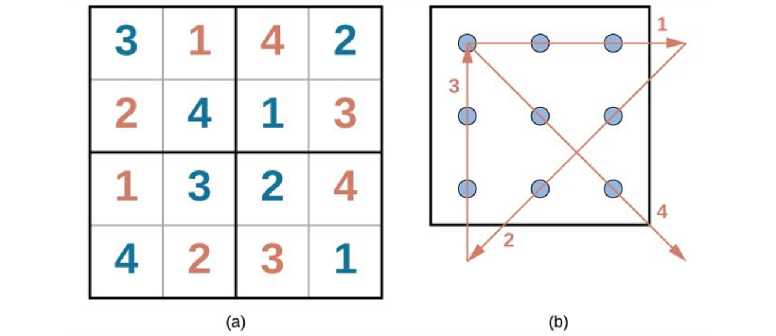
Answers to Puzzle 1 and Puzzle 2
Text from Psychology 2e OpenStax Revised Version Copyright © 2020 by Openstax is licensed under a Creative Commons Attribution 4.0 International License, except where otherwise noted. Edited by Maria Pagano
Image from Wikimedia Commons authored by Blausen.com staff (2014). Medical Gallery of Blausen Medical 2014. Licensed under CC BY 3.0 DEED.

Slide 16
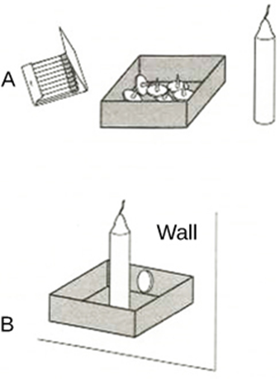
Pitfalls to Problem Solving
“Insanity is doing the same thing over and over again and expecting a different result” – Albert Einstein.
Mental sets - Persistence in approaching a problem in a way that has worked in the past. (A set way of looking at a problem).
Becomes a problem when that way is no longer working.
  Functional fixedness – inability to perceive an object being used for something other than what it was designed for.
    Imagine you have a candle, thumbtacks and a box of matches. You need to mount the candle on the wall and light it. What do you do?
    Very few people think to use the box as a holder for the candle which can be tacked to the wall because they are fixated on its normal function.
Figure 7.10 In Duncker's classic study, participants were provided the three objects in the top panel and asked to solve the problem. The solution is shown in the bottom portion.
Link to Learning Video: Check out this Apollo 13 scene about NASA engineers overcoming functional fixedness to learn more (1:06).
Text and image from Psychology 2e OpenStax Revised Version Copyright © 2020 by Openstax is licensed under a Creative Commons Attribution 4.0 International License, except where otherwise noted. Edited by Maria Pagano

Slide 17
Pitfalls to Problem-Solving: Cognitive Biases
Knowledge and reasoning are used to make decisions. However, sometimes our ability to reason can be swayed by biases.
  Anchoring bias – tendency to focus on one piece of information when making a decision or solving a problem.
    Serendipity 3, a restaurant in NYC placed a $69.00 hot dog at the top of its menu – not to sell it, but rather to sell $25.00 cheeseburgers. A $25.00 cheeseburger seems much more reasonable after seeing the $69.00 hot dog on the menu.
  Confirmation bias – tendency to focus on information that confirms your existing beliefs.
    If a baseball player hits many home runs, coaches and others may overlook the fact that the same player also has a high number of strike-outs.
  Hindsight bias – leads you to believe that the event you just experienced was predictable, even though it wasn’t.
    After breaking up with someone, the person then claims to have known that the relationship was doomed from the start.
  Representative bias – tendency to unintentionally stereotype someone or something.
    Individuals who wear glasses are more likely to be smarter than those who do not.
  Availability heuristic – tendency to make a decision based on an example, information, or recent experience that is readily available to you, even though it may not be the best example to inform your decision.
    After watching several television shows on shark attacks, you begin to think that shark attacks are more commonplace than they actually are.
Link to Learning Video: Watch this teacher-made music video about cognitive biases to learn more (2:45).
Text and image from Psychology 2e OpenStax Revised Version Copyright © 2020 by Openstax is licensed under a Creative Commons Attribution 4.0 International License, except where otherwise noted. Edited by Maria Pagano

Slide 18
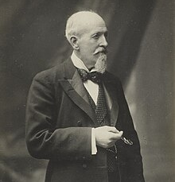
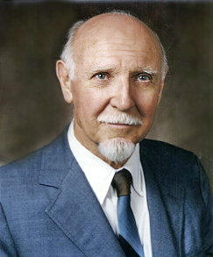
Classifying Intelligence: Spearman and Cattell
What is intelligence?
  The way researchers have defined intelligence has been modified many times since the birth of psychology.
Charles Spearman
  Believed intelligence consisted of one general factor, called g.
  Focused on commonalities amongst various intellectual abilities.
Raymond Cattell
  Divided intelligence into two components.
    Crystalized intelligence – acquired knowledge and the ability to retrieve it.
      Knowing facts.
  Fluid intelligence – the ability to see complex relationships and solve problems.
    Knowing how to do something.
Charles R. Spearman
1863-1945
Image from Wikimedia Commons from Bibliothèque Nationale de France. Permission granted for use by Bibliothèque Nationale de France
Raymond Cattell
1905-1998
Text from Psychology 2e OpenStax Revised Version Copyright © 2020 by Openstax is licensed under a Creative Commons Attribution 4.0 International License, except where otherwise noted. Edited by Maria Pagano
Image from Wikimedia Commons Permission granted for use to the Wikimedia Foundation.

Slide 19
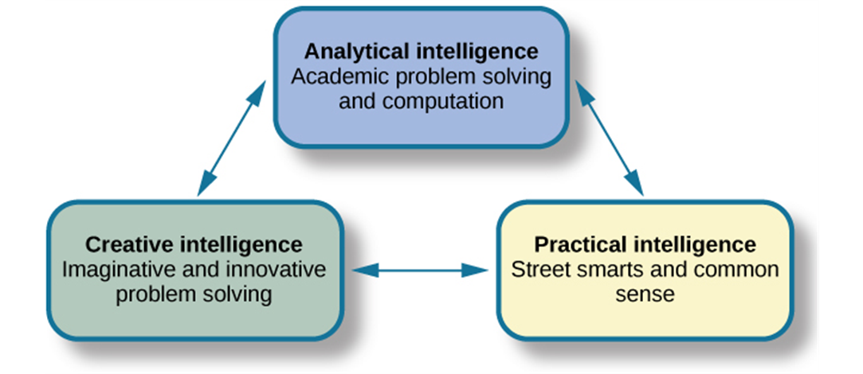
Classifying Intelligence: Triarchic Theory of Intelligence
Figure 7.12 Robert Sternberg’s theory identifies three types of intelligence: practical, creative, and analytical.
Text from Psychology 2e OpenStax Revised Version Copyright © 2020 by Openstax is licensed under a Creative Commons Attribution 4.0 International License, except where otherwise noted. Edited by Maria Pagano

Slide 20
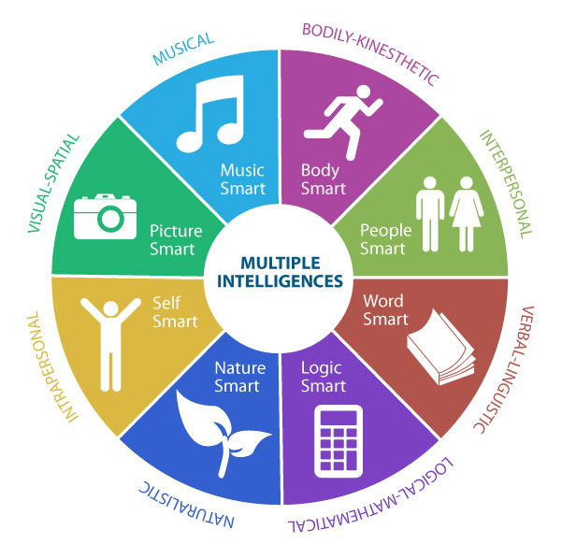
Classifying Intelligence: Multiple Intelligences Theory
Howard Gardner proposed that each person possesses at least 8 intelligences.
Inter and intrapersonal intelligences are often combined and called emotional intelligence.
  Emotional intelligence – the ability to understand the emotions of yourself and others, show empathy, understand social relationships and cues, and regulate your own emotions and respond in culturally appropriate ways.
Image from Wikimedia Commons by Sajaganesandip. Licensed under CC BY SA 4.0 DEED.
Text from Psychology 2e OpenStax Revised Version Copyright © 2020 by Openstax is licensed under a Creative Commons Attribution 4.0 International License, except where otherwise noted. Edited by Maria Pagano

Slide 21
Classifying Intelligence: Multiple Intelligences Theory
Multiple Intelligences
Intelligence Type | Characteristics | Representative Career
Linguistic intelligence | Perceives different functions of language, different sounds and meanings of words, may easily learn multiple languages | Journalist, novelist, poet, teacher
Logical-mathematical intelligence | Capable of seeing numerical patterns, strong ability to use reason and logic | Scientist, mathematician
Musical intelligence | Understands and appreciates rhythm, pitch, and tone; may play multiple instruments or perform as a vocalist | Composer, performer
Bodily kinesthetic intelligence | High ability to control the movements of the body and use the body to perform various physical tasks | Dancer, athlete, athletic coach, yoga instructor
Spatial intelligence | Ability to perceive the relationship between objects and how they move in space | Choreographer, sculptor, architect, aviator, sailor
Interpersonal intelligence | Ability to understand and be sensitive to the various emotional states of others | Counselor, social worker, salesperson
Intrapersonal intelligence | Ability to access personal feelings and motivations, and use them to direct behavior and reach personal goals | Key component of personal success over time
Naturalist intelligence | High capacity to appreciate the natural world and interact with the species within it | Biologist, ecologist, environmentalist
Table 7.4
Link to Learning Video: Watch this video that compares different theories of intelligence to learn more (7:11).
Text from Psychology 2e OpenStax Revised Version Copyright © 2020 by Openstax is licensed under a Creative Commons Attribution 4.0 International License, except where otherwise noted. Edited by Maria Pagano

Slide 22
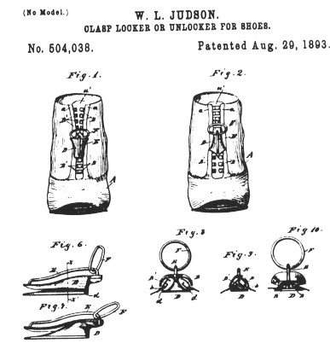
Creativity
Creativity – the ability to generate, create, or discover new ideas, solutions, and possibilities.
  Creative people usually:
  Have intense knowledge about something.
  Work on it for years.
  Look at novel solutions.
  Seek out the advice and help of other experts.
  Take risks.
Creativity is often thought of as one’s ability to engage in divergent thinking.
  Divergent thinking – thinking “outside the box”.
    Used when more than one possibility exists on a situation.
  Convergent thinking – ability to provide a correct or well-established answer or solution to a problem.
The original patent drawings for the "clasp locker" - what we today call a zipper. This ubiquitous device was the product of the creative mind of American inventor Whitcomb Judson, who also invented a machine to make zippers quickly and cheaply.
Above image and text from Noba Textbook Series: Psychology by Dean Keith Simonton. Licensed under CC BY NC SA 4.0 DEED.
Text from Psychology 2e OpenStax Revised Version Copyright © 2020 by Openstax is licensed under a Creative Commons Attribution 4.0 International License, except where otherwise noted. Edited by Maria Pagano

Slide 23
Measures of Intelligence
A person’s Intelligence quotient (IQ) is a score earned on a test designed to measure intelligence.
How do psychologists ensure that tests function as valid measures of intelligence?
Standardization – the manner of administration, scoring, and interpretation of results is consistent.
Norming – giving a test to a large population so data can be collected comparing groups, such as age groups.
  The resulting data provide norms/referential scores used to interpret future scores.
  Standardization and norming ensure that new scores are reliable.
Text from Psychology 2e OpenStax Revised Version Copyright © 2020 by Openstax is licensed under a Creative Commons Attribution 4.0 International License, except where otherwise noted. Edited by Maria Pagano

Slide 24
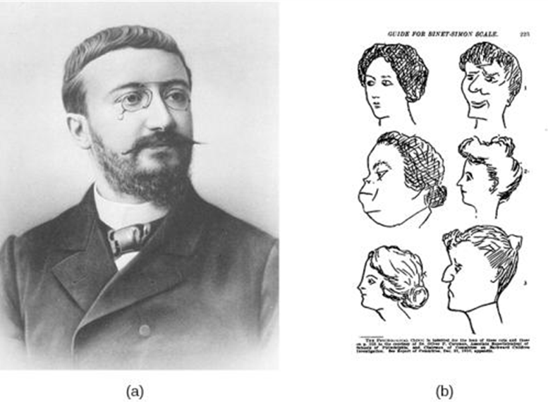
Measures of Intelligence: Alfred Binet
The Stanford-Binet Intelligence Scale
  Early 1900’s – Alfred Binet developed an intelligence test (Binet-Simon Intelligence Test) to use on children to determine which ones might have difficulty in school.
  Louis Terman (a Stanford psychologist) modified Binet’s work by standardizing the administration of the test and testing thousands of children to establish a norm. The resulting Stanford-Binet Intelligence Scale has been updated and is still widely used today.
Figure 7.13 (a) French psychologist Alfred Binet helped to develop intelligence testing. (b) The page is from a 1908 version of the Binet-Simon Intelligence Scale. Children being tested were asked which face, of each pair, was prettier.
Video: Alyssa and Her Mother Prepare for the Stanford Binet Test shows a child working through a serial reasoning task on the Stanford Binet (2:48).
Text and image from Psychology 2e OpenStax Revised Version Copyright © 2020 by Openstax is licensed under a Creative Commons Attribution 4.0 International License, except where otherwise noted. Edited by Maria Pagano

Slide 25
Measures of Intelligence: Wechsler and The Flynn Effect
David Wechsler’s definition of intelligence - ”the global capacity of a person to act purposefully, to think rationally, and to deal effectively with his environment.”
In 1939, Wechsler developed a new IQ test by combining several subtests from other intelligence tests.
  Wechsler Adult Intelligence Scale (WAIS)
    Tapped into a variety of verbal and nonverbal skills.
    One of the most extensively used intelligence tests.
  Wechsler Intelligence Scale for Children (WISC-V) is one of many versions used today that tests 1) verbal comprehension, 2) visual spatial, 3) fluid reasoning, 4) working memory and 5) processing Speed.
Flynn Effect
  After years of use within schools and communities, periodic recalibration of WAIS lead to an observation known as the Flynn effect.
  The observation that each generation has a significantly higher IQ than the last.
Text from Psychology 2e OpenStax Revised Version Copyright © 2020 by Openstax is licensed under a Creative Commons Attribution 4.0 International License, except where otherwise noted. Edited by Maria Pagano

Slide 26
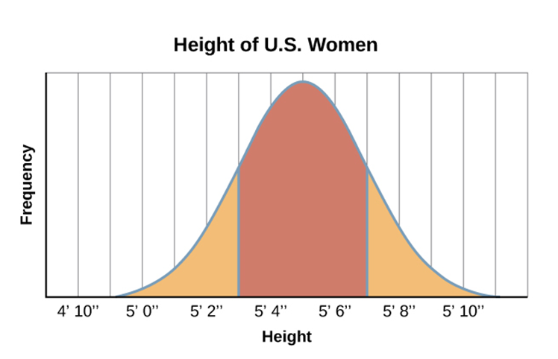
The Bell Curve
Results of intelligence tests follow a bell curve distribution.
In psychological testing, this graph demonstrates a representative sample/normal distribution of a trait in the human population.
  Representative sample – a subset of the population that accurately represents the general population.
    Usually requires a large sample size.
Figure 7.14 Are you of below-average, average, or above-average height?
Text from Psychology 2e OpenStax Revised Version Copyright © 2020 by Openstax is licensed under a Creative Commons Attribution 4.0 International License, except where otherwise noted. Edited by Maria Pagano

Slide 27
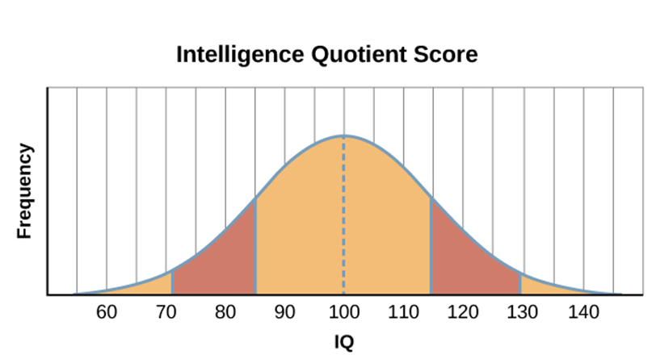
IQ and the Bell Curve
The average IQ score is 100.
Standard deviations – describe how data are dispersed in a population.
  One standard deviation in IQ testing is 15 points.
  A score of 85 is one standard deviation below the mean (average).
  Any score between one standard deviation above and below the mean is considered and average.
  82% of the population have an IQ score between 85 and 115.
Figure 7.15 The majority of people have an IQ score between 85 and 115.
Video: Normal Distribution - Intro To Psychology describes the properties of a bell curve and the distribution for intelligence (1:31).
Text from Psychology 2e OpenStax Revised Version Copyright © 2020 by Openstax is licensed under a Creative Commons Attribution 4.0 International License, except where otherwise noted. Edited by Maria Pagano

Slide 28
Characteristics of Cognitive Disorders
A score of 70 or below indicates significant cognitive delays.
  Only 2.2% of the population has an IQ score below 70 (American Psychological Association [APA], 2013).
  When these are combined with major deficits in adaptive functioning, a person is diagnosed with having an intellectual disability (American Association on Intellectual and Developmental Disabilities, 2013).
Characteristics of Cognitive Disorders
Intellectual Disability Subtype | Percentage of Population with Intellectual Disabilities | Description
Mild | 85% | 3rd- to 6th-grade skill level in reading, writing, and math; may be employed and live independently
Moderate | 10% | Basic reading and writing skills; functional self-care skills; requires some oversight
Severe | 5% | Functional self-care skills; requires oversight of daily environment and activities
Profound | <1% | May be able to communicate verbally or nonverbally; requires intensive oversight
Table 7.5
Text from Psychology 2e OpenStax Revised Version Copyright © 2020 by Openstax is licensed under a Creative Commons Attribution 4.0 International License, except where otherwise noted. Edited by Maria Pagano

Slide 29
The Source of Intelligence
Nature or Nurture?
  Nature perspective – intelligence is inherited from a person’s parents.
    The heritability of intelligence is often researched using twin studies.
    Identical twins raised together, and identical twins raised apart exhibit a higher correlation between IQ scores than siblings or fraternal twins raised together.
  Nurture perspective – intelligence is shaped by a child’s developmental environment.
    If parents present children with intellectual stimuli it will be reflected in the child’s intelligence level.
  Most psychologists now believe levels of intelligence are a combination of both.
Range of Reaction
  Theory that each person responds to the environment in a unique way based on his or her genetic makeup.
    Genetic makeup is a fixed quantity.
    Whether you reach your full intellectual potential is dependent upon environmental factors.
Text and image from Psychology 2e OpenStax Revised Version Copyright © 2020 by Openstax is licensed under a Creative Commons Attribution 4.0 International License, except where otherwise noted. Edited by Maria Pagano

Slide 30
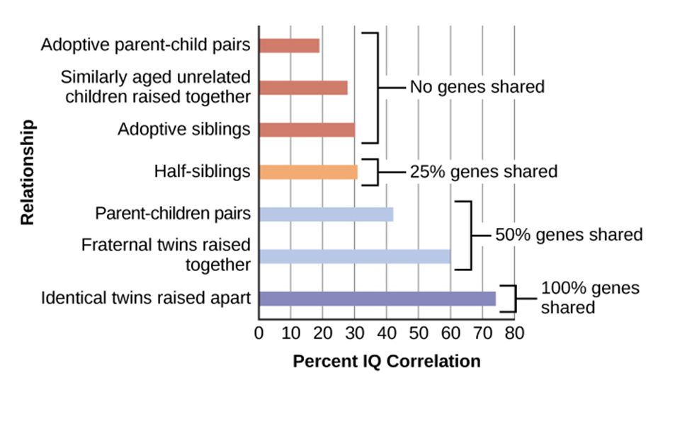
Genetics and IQ
Figure 7.16 The correlations of IQs of unrelated versus related persons reared apart or together suggest a genetic component to intelligence.
Text and image from Psychology 2e OpenStax Revised Version Copyright © 2020 by Openstax is licensed under a Creative Commons Attribution 4.0 International License, except where otherwise noted.

Slide 31
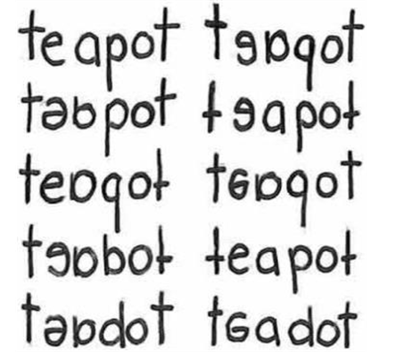
Learning Disabilities
Learning disabilities are cognitive disorders that affect different areas of cognition, particularly language or reading.
  Specific neurological impairments, not an intellectual/developmental problem.
  Often affect children with average to above-average intelligence.
  Exhibit comorbidity with other disorders.
Dysgraphia - A learning disability resulting in a struggle to write legibly.
  Have difficulty putting their thoughts down on paper.
Dyslexia - An inability to correctly process letters.
  Most common learning disability in children.
  May mix up letters within words and sentences (letter reversals).
Dyscalculia – Difficulty in learning or comprehending arithmetic.
  Difficulty applying math facts for addition or subtraction.
  Trouble with everyday calculations like making change.
Figure 7.17 These written words show variations of the word “teapot” as written by individuals with dyslexia.
Video: Understanding Common Types of Learning Disabilities takes you through some of the more common types of learning disabilities (6:10).
Image and text from Psychology 2e OpenStax Revised Version Copyright © 2020 by Openstax is licensed under a Creative Commons Attribution 4.0 International License, except where otherwise noted.

