Slide 1

Chapter 5
Sensation and Perception
OpenStax Psychology 2E
OpenStax ancillary resource is © Rice University under a CC-BY-4.0 DEED license and may be used with proper attributes. Unless otherwise noted all material and text contained in these ancillary materials is from Spielman, R. M., Jenkins, W. J., & Lovett, M. D. (2020). Psychology 2E. OpenStax and is licensed under CC BY 4.0 DEED.

Slide 2
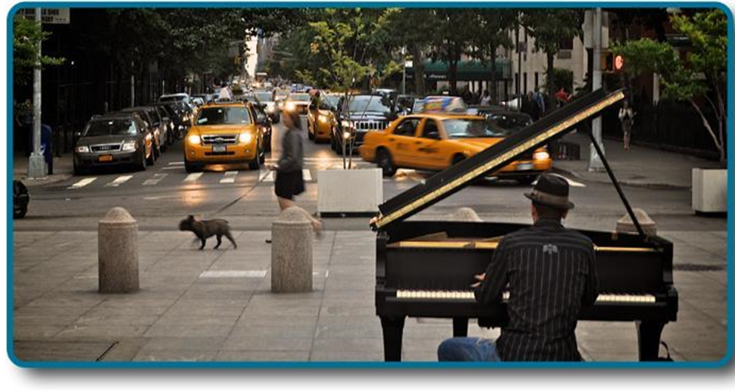
Sensory Systems
Our sensory systems are responsible for providing information about our surroundings which allow us to successfully navigate and interact with our environments.
Figure 5.1 If you were standing in the midst of this street scene, you would be absorbing and processing numerous pieces of sensory input.
Image and text from Psychology 2e OpenStax Revised Version Copyright © 2020 by Openstax is licensed under a Creative Commons Attribution 4.0 International License, except where otherwise noted. Edited by Maria Pagano

Slide 3
Sensation
Sensory receptors - specialized neurons that respond to specific types of stimuli.
Sensation – occurs when sensory receptors detect sensory stimuli.
When sensory receptors detect a specific stimuli, they convert that energy into an action potential which is sent to the central nervous system. This is called transduction.
Sensory systems:
  Vision
  Hearing (audition)
  Smell (olfaction)
  Taste (gustation)
  Touch (somatosensation)
  Balance (Vestibular sense)
  Body position (proprioception)
  Movement (kinesthesia)
  Pain (nociception)
  Temperature (thermoception)
Video: Sensation: Stimuli, Receptors, & Transduction discusses examples sensation, sensory receptors, and transduction (6:46).
Image and text from Psychology 2e OpenStax Revised Version Copyright © 2020 by Openstax is licensed under a Creative Commons Attribution 4.0 International License, except where otherwise noted. Edited by Maria Pagano

Slide 4
Sensation: Continued
For a stimulus to cause an action potential, it first must be strong enough to be detected.
  Absolute threshold – minimum amount of stimulus energy that must be present for the stimulus to be detected 50% of the time.
    On a clear night, the most sensitive sensory cells in the eye can detect a candle flame 30 miles away.
We are also able to receive messages presented below the threshold of conscious awareness which are known as subliminal messages.
  The stimulus causes an action potential, but we are not consciously aware of it.
Just noticeable difference (JND) –the minimum difference in stimuli required to detect a change or a difference between stimuli.
  Can change depending on the stimulus intensity.
    A cell phone lighting up in a dark movie theatre is more likely to be noticed than if it lights up in a brightly lit shopping mall. The brightness of the cell phone does not change, but the ability to detect the change in illumination does.
The JND would be the minimum increase in brightness required for the change to be detected.
Video: Absolute Threshold, Difference Threshold and Weber's Law provides examples of absolute thresholds, and difference thresholds for sound and discusses Weber’s Law (3:36).
Image and text from Psychology 2e OpenStax Revised Version Copyright © 2020 by Openstax is licensed under a Creative Commons Attribution 4.0 International License, except where otherwise noted. Edited by Maria Pagano

Slide 5
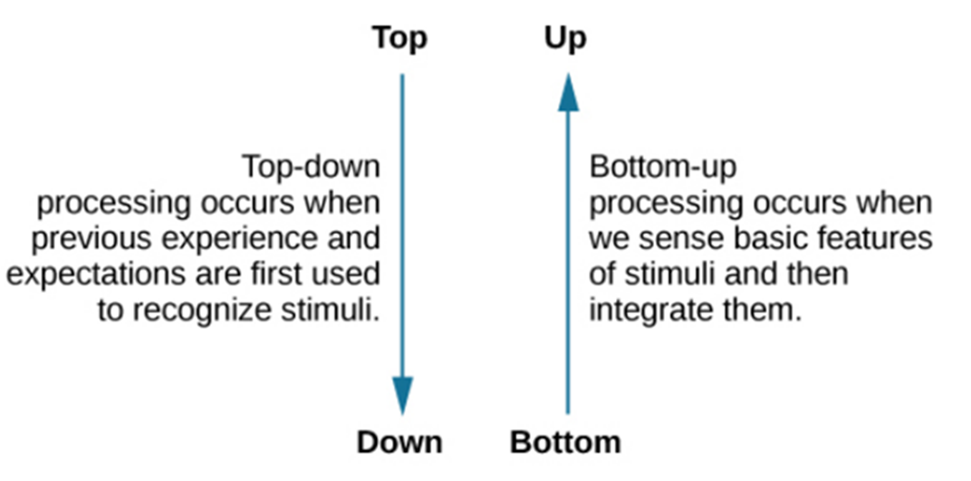
Perception
While our sensory receptors collect information about our environment, perception is the way that sensory information is interpreted, organized, and consciously experienced. Perception involves two forms of processing:
  Bottom-up processing – system in which perceptions are built from sensory input.
  Top-down processing – interpretation of sensations is influenced by available knowledge, experiences, and thoughts.
Figure 5.2Top-down and bottom-up are ways we process our perceptions.
Link to Learning Video: See for yourself how inattentional blindness works by checking out this selective attention test from Simons and Chabris (1999) (1:21).
Video: Sensation & Perception: Top Down vs. Bottom-Up Processing provides examples for bottom-up and top-down processing (2:30).
Image and text from Psychology 2e OpenStax Revised Version Copyright © 2020 by Openstax is licensed under a Creative Commons Attribution 4.0 International License, except where otherwise noted. Edited by Maria Pagano

Slide 6
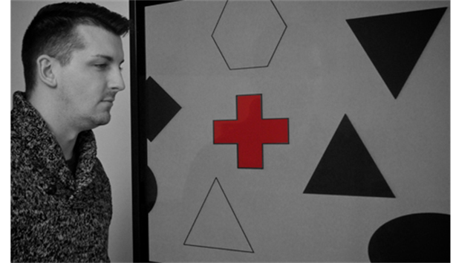
Factors Affecting Perception
Sensory adaption – not perceiving stimuli that remain relatively constant over prolonged periods of time.
  For example, when you first enter a quiet room, you may hear the clock ticking. Over time you become unaware of the ticking. The ticking is still affecting sensory receptors, but you are no longer perceiving the sound.
Attention – The ability to actively process specific information in the environment while ignoring other information.
  Inattentional blindness - Failure to notice something that is completely visible because of a lack of attention.
    Nearly one third of participants in a study did not notice that a red cross passed on the screen because their attention was focused on the black or white figures.
Figure 5.3 Nearly one-third of participants in a study did not notice that a red cross passed on the screen because their attention was focused on the black or white figures. (credit: Cory Zanker)
All text from Psychology 2e OpenStax Revised Version Copyright © 2020 by Openstax is licensed under a Creative Commons Attribution 4.0 International License, except where otherwise noted. Edited by Maria Pagano

Slide 7
Factors Affecting Perception: Continued
Motivation
  Sometimes we think we hear something such as a phone ringing when it is not because we are motivated to perceive it (such as waiting for an important phone call).
  Signal detection theory – change in stimulus detection as a function of current mental state.
Beliefs, values, prejudices and expectations
  People who hold positive attitudes towards low-fat foods are more likely to rate foods with low-fat labels as tasting better than people with less positive attitudes about low-fat products.
Life/Cultural experiences
  One study found that people from Western cultures (where there is a perceptual context of buildings with straight lines) were more likely to experience certain types of visual illusions, like the Muller-Lyer illusion, than individuals from non-western cultures (where they are more likely to live in round huts).
Video: Signal Detection Theory: Psych/Soc MCAT Prep explains how signal detection theory works (4:07).
Image and text from Psychology 2e OpenStax Revised Version Copyright © 2020 by Openstax is licensed under a Creative Commons Attribution 4.0 International License, except where otherwise noted. Edited by Maria Pagano

Slide 8
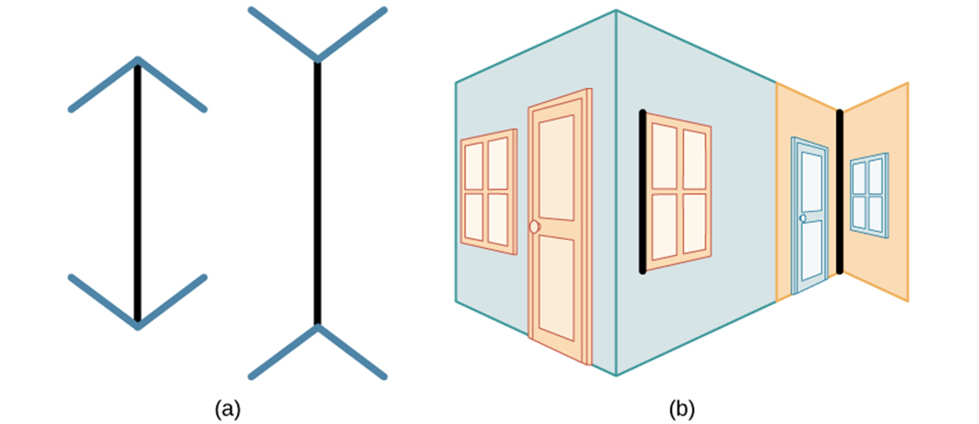
The Muller-Lyer Illusion
Figure 5.4 In the Müller-Lyer illusion, lines appear to be different lengths although they are identical. (a) Arrows at the ends of lines may make the line on the right appear longer, although the lines are the same length. (b) When applied to a three-dimensional image, the line on the right again may appear longer although both black lines are the same length.
Image and text from Psychology 2e OpenStax Revised Version Copyright © 2020 by Openstax is licensed under a Creative Commons Attribution 4.0 International License, except where otherwise noted. Edited by Maria Pagano

Slide 9
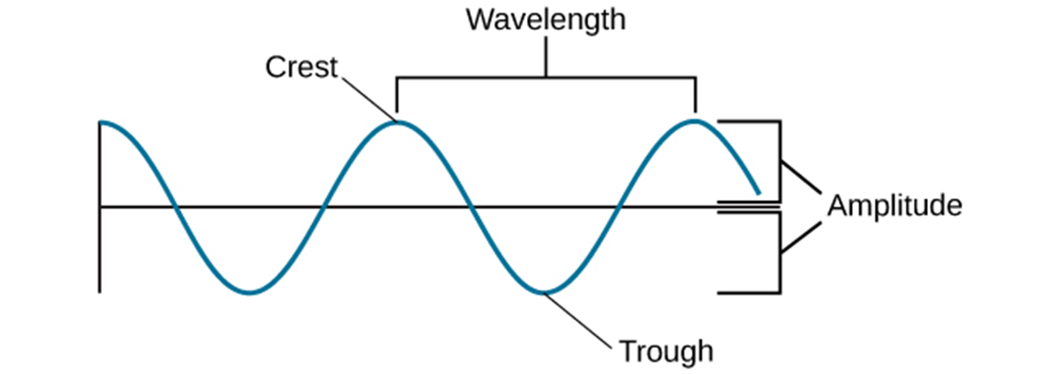
Amplitude and Wavelength
Visual and auditory stimuli both occur in the form of waves.
  Two physical properties of waves are amplitude and wavelength.
The wavelength is measured from peak to peak while the amplitude or height of a wave is the measurement between the origin and crest (or trough).
Figure 5.5 The amplitude or height of a wave is measured from the peak to the trough. The wavelength is measured from peak to peak.
Video: Wavelength and Amplitude shows how to measure the wavelength and amplitude of a wave (3:42).
Image and text from Psychology 2e OpenStax Revised Version Copyright © 2020 by Openstax is licensed under a Creative Commons Attribution 4.0 International License, except where otherwise noted. Edited by Maria Pagano

Slide 10
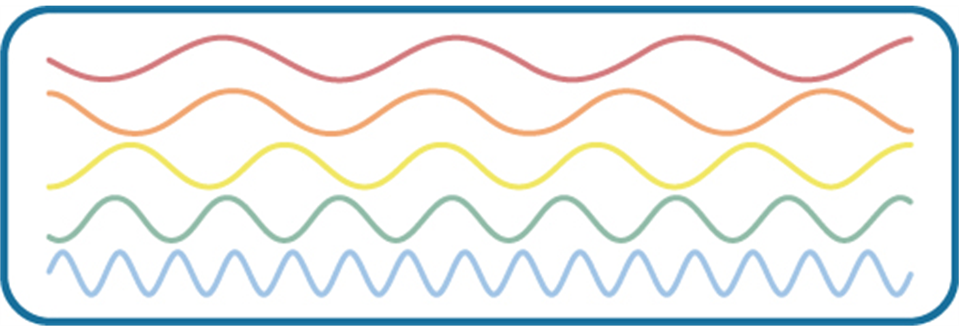
Frequency of a Wave
Wavelength is directly related to frequency.
  Frequency – number of waves that pass a given point in a given time period.
  Expressed in hertz (Hz) or cycles per second.
Longer wavelengths have lower frequencies and shorter wavelengths have higher frequencies.
Figure 5.6 illustrates waves of differing wavelengths/frequencies. At the top of the figure, the red wave has a long wavelength/short frequency. Moving from top to bottom, the wavelengths decrease and frequencies increase.
Video: How to Measure a Wave: Frequency and Period Explained shows how to measure the frequency and period of a wave (2:25).
Image and text from Psychology 2e OpenStax Revised Version Copyright © 2020 by Openstax is licensed under a Creative Commons Attribution 4.0 International License, except where otherwise noted. Edited by Maria Pagano

Slide 11
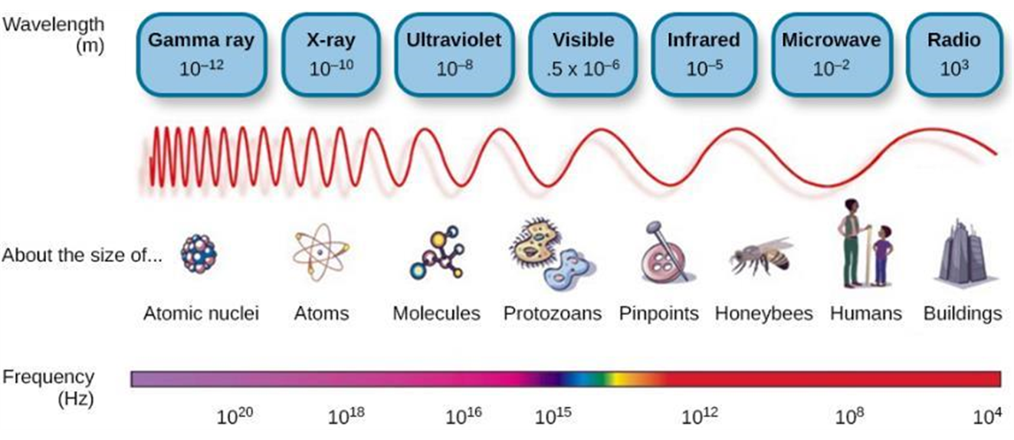
Light Waves
The visible spectrum is the portion of the electromagnetic spectrum that we can see.
  Different species can see different portions of the spectrum.
  Humans can see wavelengths ranging from about 380 – 740nm (remember: a nanometer is one billionth of a meter).
Figure 5.6 Light that is visible to humans makes up only a small portion of the electromagnetic spectrum.
Image and text from Psychology 2e OpenStax Revised Version Copyright © 2020 by Openstax is licensed under a Creative Commons Attribution 4.0 International License, except where otherwise noted. Edited by Maria Pagano

Slide 12
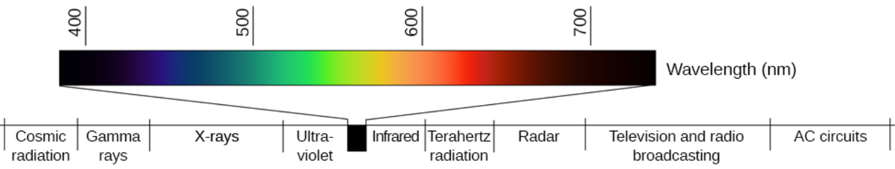
Light Waves: Continued: The Visible Spectrum
In humans, light wavelength is associated with perception of color.
  Within the visible spectrum, our experience of red is associated with longer wavelengths, greens are intermediate, and blues and violets are shorter in wavelength.
  An easy way to remember the human color spectrum is by using the mnemonic ROYGBIV: red, orange, yellow, green, blue, indigo, violet.
The amplitude of light waves is associated with our experience of brightness or intensity of color, with larger amplitudes appearing brighter, and larger amplitudes appear brighter.
Figure 5.8 Different wavelengths of light are associated with our perception of different colors. (credit: modification of work by Johannes Ahlmann)
Video: Color in Our World: The Electromagnetic Spectrum: Arbor Scientific discusses the electromagnetic spectrum, the visible spectrum and how we perceive colors (2:19).
Image and text from Psychology 2e OpenStax Revised Version Copyright © 2020 by Openstax is licensed under a Creative Commons Attribution 4.0 International License, except where otherwise noted. Edited by Maria Pagano

Slide 13
Soundwaves
Frequency
  Frequency of soundwaves = pitch
    High frequency = high-pitched sound
    Low frequency = low-pitched sound
  The audible range of sound frequencies in humans is between 20 – 2000Hz
Amplitude and Decibels
  Amplitude of soundwaves = loudness
    Higher amplitude = louder sounds
    Lower amplitude = quieter sounds
  Loudness is measured in decibels (dB).
    Typical conversation = 60 dB
    Rock concert = 120 dB
    Potential for hearing damage = 80 – 130 dB
    The threshold for pain = 130 dB
Demonstration Link: Waves: Amplitude, Frequency, and Wavelength provides three instruments that allow you to change the amplitude, frequency, and wavelength of light and sound. Click on the which of the properties you would like to demonstrate and click “LAUNCH.” (To change the wavelength for color, once you open the demonstration you will need to click “NEXT” twice.)
Image and Text from Psychology 2e OpenStax Revised Version Copyright © 2020 by Openstax is licensed under a Creative Commons Attribution 4.0 International License, except where otherwise noted. Edited by Maria Pagano

Slide 14
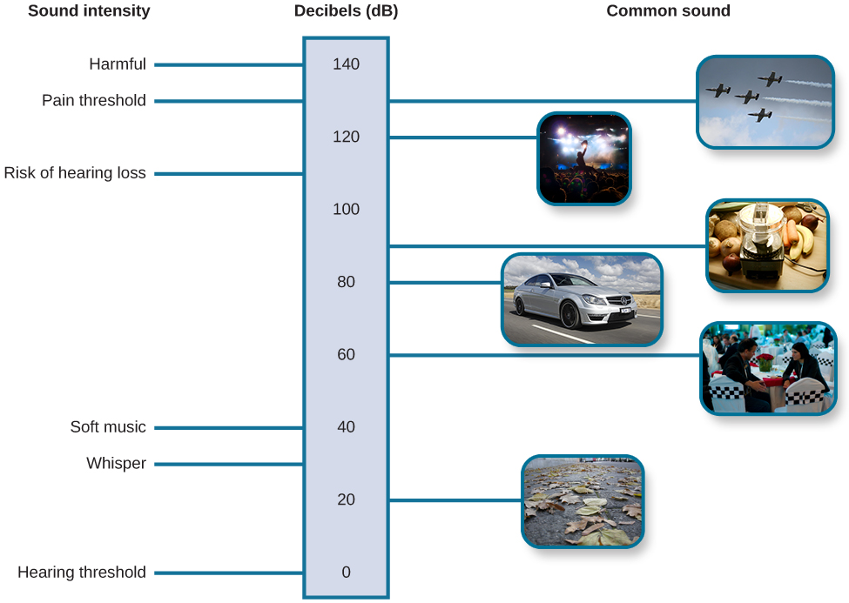
Soundwaves: Continued
Link to Learning Video: Watch this brief video about our perception of frequency and amplitude to learn more. (4:18).
Figure 5.9 This figure illustrates the loudness of common sounds.
Text and image from Psychology 2e OpenStax Revised Version Copyright © 2020 by Openstax is licensed under a Creative Commons Attribution 4.0 International License, except where otherwise noted. Edited by Maria Pagano

Slide 15
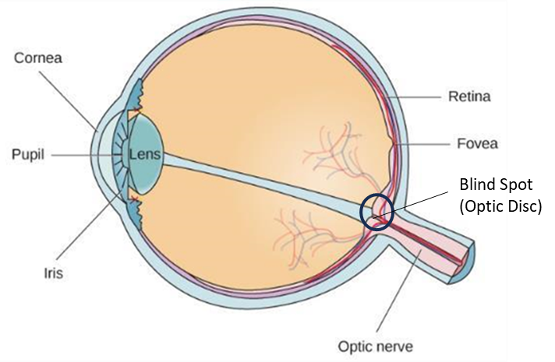
Vision: Anatomy of the Visual System
Light waves are transmitted across the cornea and enter through the pupil.
  The pupil’s size is controlled by muscles that are connected to the iris (the colored part of the eye).
Light then crosses the lens and is focused on the fovea, which is part of the retina.
  The fovea contains photoreceptors.
    Photoreceptors are connected to retinal ganglion cells. Axons from these cells exit through the back of the eye where they form the optic nerve.
The optic nerve then carries the visual information to the brain.
The blind spot (optic disc) – a point of no receptors, where information exits the eye, where we cannot respond to visual information.
Figure 5.11 The anatomy of the eye is illustrated in this diagram.
Video: This one-minute video, How Eyes Work (Animation) explains how the eyes work to create vision (1:00).
Text from Psychology 2e OpenStax Revised Version Copyright © 2020 by Openstax is licensed under a Creative Commons Attribution 4.0 International License, except where otherwise noted. Edited by Maria Pagano

Slide 16
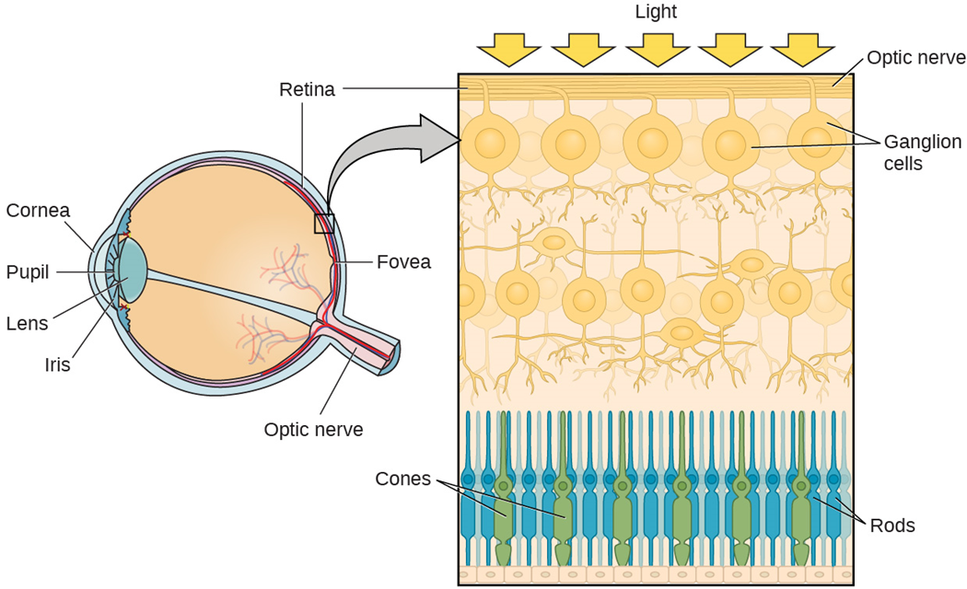
Anatomy of the Visual System: Photoreceptors
Cones
  Photopic (daytime) vision.
    Work best in bright light conditions.
  High-acuity color information.
  Located in the fovea.
Rods
  Scotopic (nighttime) vision.
    Work best in low light conditions.
  High-sensitivity.
  Allows for low-acuity vision in dim light.
  Involved in the perception of movement in our peripheral vision.
  Located in the periphery of the retina.
Figure 5.12 The two types of photoreceptors are shown in the image above. Rods are colored green, and cones are blue.
Video: The video 2-Minute Neuroscience: The Retina explains the anatomy and physiology of the retina and discusses the five major types of neuron found in the retina. (1:55).
Text and image from Psychology 2e OpenStax Revised Version Copyright © 2020 by Openstax is licensed under a Creative Commons Attribution 4.0 International License, except where otherwise noted. Edited by Maria Pagano

Slide 17
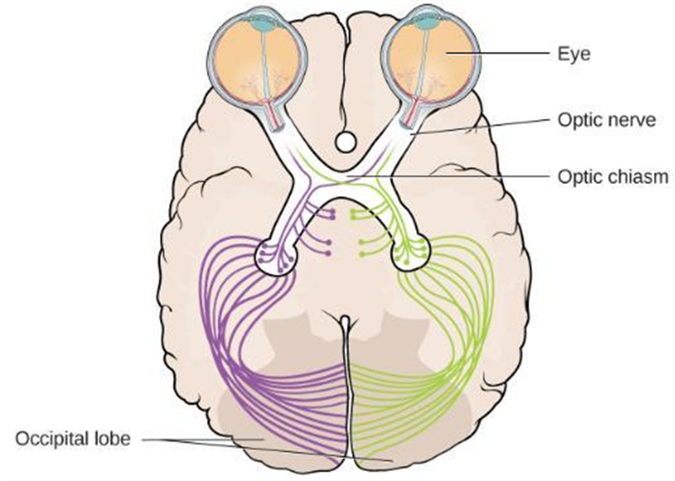
Optic Chiasm
The optic nerve of each eye merges at the optic chiasm, an X-shaped structure just below the cerebral cortex.
  Information from the right visual field is sent to the left hemisphere and information from the left visual field is sent to the right hemisphere.
  This information is then sent to the occipital lobe where the information is processed by the visual cortex which is part of the occipital lobe
Figure 5.13 illustrates the optic chiasm at the front of the brain and the pathways to the occipital lobe at the back of the brain, where visual sensations are processed into meaningful perceptions.
Video: The video 2-Minute Neuroscience: The Optic Nerve explains the optic nerve, the optic chiasm, the optic tract, and the visual cortex. The video also discusses optic nerve damage (1:53).
Text and image from Psychology 2e OpenStax Revised Version Copyright © 2020 by Openstax is licensed under a Creative Commons Attribution 4.0 International License, except where otherwise noted. Edited by Maria Pagano

Slide 18
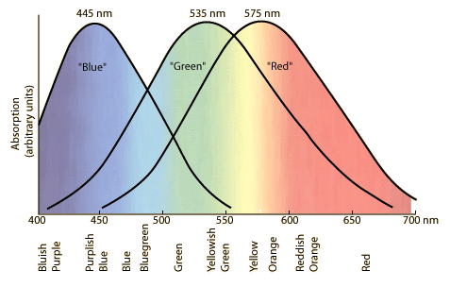
Color Vision: Trichromatic Theory of Color Vision
According to the Trichromatic Theory of Color vision
  All colors can be produced by combining red, green, and blue.
    Blues are produced by short wavelengths, greens are produced by medium wavelengths, and reds are produced by long wavelengths. Note how yellows are produced by an overlap of the long and medium wavelengths.
    Applies to the retina where color vision is controlled by three types of cones.
The figure above illustrates the different sensitivities for the three cone types (long, medium, and short) and the color equivalents found in a normal-sighted individual.
(Credit: Image from YouTube video Color Vision: Trichromatic and Opponent Process Theories (Intro Psych Tutorial #46) by Michael Corayer for Psych Exam Review.)
Text from Psychology 2e OpenStax Revised Version Copyright © 2020 by Openstax is licensed under a Creative Commons Attribution 4.0 International License, except where otherwise noted. Edited by Maria Pagano

Slide 19

Color Vision: Opponent Process Theory
Opponent-Process Theory states that:
  Color is coded in opponent pairs.
    Black – white
    Yellow – blue
    Green – Red
  Some cells are excited by one of the opponent colors and are inhibited by the other.
  Applies to cells after the retina.
  Research has found that both trichromatic theory and opponent processing theory are true but for different parts of the visual system.
Text below and image above from Wikipedia: Opponent Process and is licensed under CC BY 4.0 DEED International,
Ewald Herring (1834-1918) first defined the unique hues as red, green, blue, and yellow, and based them on the concept that these colors could not be simultaneously perceived. For example, a color cannot appear both red and green.
Text from Psychology 2e OpenStax Revised Version Copyright © 2020 by Openstax is licensed under a Creative Commons Attribution 4.0 International License, except where otherwise noted. Edited by Maria Pagano

Slide 20

Color Vision: Opponent Process Theory in Action
When staring at a colored stimulus, the color-parings of the opponent-process theory leads to a negative afterimage.
  Afterimage - continuation of a visual sensation after removal of the stimulus.
Figure 5.15 Stare at the white dot for 30–60 seconds and then move your eyes to a blank piece of white paper. What do you see? This is known as a negative afterimage, and it provides empirical support for the opponent-process theory of color vision.
Text from Psychology 2e OpenStax Revised Version Copyright © 2020 by Openstax is licensed under a Creative Commons Attribution 4.0 International License, except where otherwise noted. Edited by Maria Pagano

Slide 21
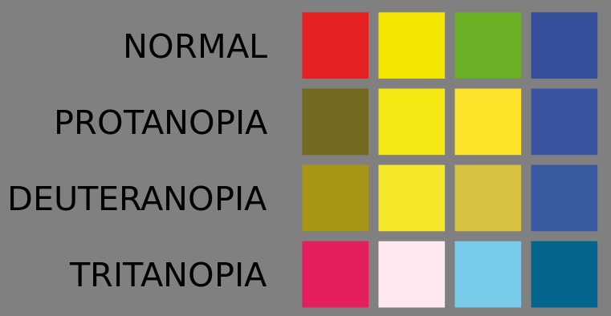
Color Blindness
Color blindness or color vision deficiency (CVD) is the decreased ability to see color or differences in color.
Color blindness is usually an inherited condition in the functionality of one or more of the three classes of cone cells in the retina.
  Protanopia – color blindness to red.
  Deuteranopia (red-green colorblindness) – makes certain shades of green look more red (most common)
  Tritanopia – makes someone unable to distinguish between blue and green , purple and red, and yellow and pink
Image from Wikimedia Commons Colour Perception in Different Types of Colour Blindness by D. R Keene. Licensed under CC BY SA 4.0 DEED.
Text from Psychology 2e OpenStax Revised Version Copyright © 2020 by Openstax is licensed under a Creative Commons Attribution 4.0 International License, except where otherwise noted. Edited by Maria Pagano

Slide 22
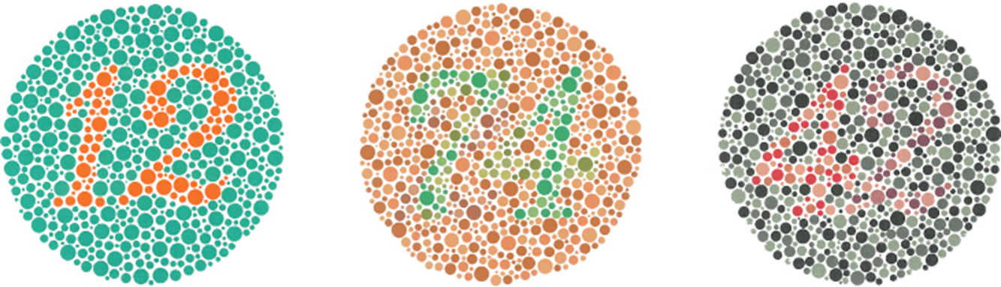
Color Blindness: Ishihara Color Plate Test for Color Blindness
Figure 5.16 The Ishihara test evaluates color perception by assessing whether individuals can discern numbers that appear in a circle of dots of varying colors and sizes.
Link to Learning Video: Watch this video to learn more about how humans perceive color (9:31).
Text from Psychology 2e OpenStax Revised Version Copyright © 2020 by Openstax is licensed under a Creative Commons Attribution 4.0 International License, except where otherwise noted. Edited by Maria Pagano

Slide 23

Depth Perception
Depth Perception – our ability to perceive spatial relationships in 3-D.
Depth cues of a visual scene are used to establish our sense of depth.
Depth Cues Include:
  Binocular cues - cue that relies on the use of both eyes.
      Binocular disparity - slightly different view of the world that each eye receives.
  Monocular cues – cue that relies on only one eye.
    Linear perspective – when two parallel lines seem to converge.
    Interposition – the partial overlap of objects.
Figure 5.17 We perceive depth in a two-dimensional figure like the one above via the use of monocular cues like linear perspective, like the parallel lines converging as the road narrows in the distance.
Video: The video How Do We Work With Depth Perception in Vision Therapy? explains how important depth perception is to our vision and how vision therapy can help to improve someone’s depth perception (2:16).
Text and image from Psychology 2e OpenStax Revised Version Copyright © 2020 by Openstax is licensed under a Creative Commons Attribution 4.0 International License, except where otherwise noted. Edited by Maria Pagano

Slide 24
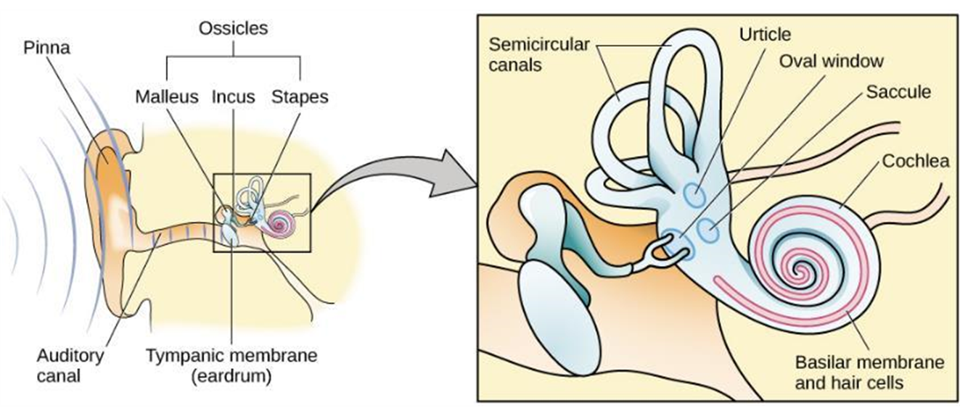
Anatomy of the Auditory System
Figure 5.18 The ear is divided into outer (pinna and tympanic membrane), middle (the three ossicles: malleus, incus, and stapes), and inner (cochlea and basilar membrane) divisions.
Video: Auditory System discusses the anatomy of the auditory system and both conduction hearing loss and sensorineural hearing loss (2:36).
Image and text and from Psychology 2e OpenStax Revised Version Copyright © 2020 by Openstax is licensed under a Creative Commons Attribution 4.0 International License, except where otherwise noted. Edited by Maria Pagano

Slide 25
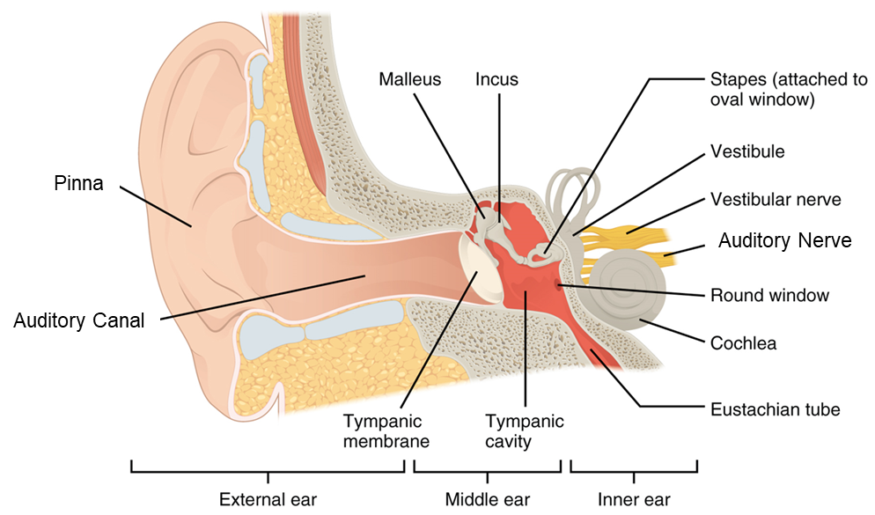
Auditory Transduction
Sound waves travel along the auditory canal and strike the tympanic membrane, causing it to vibrate.
The vibration causes the 3 ossicles (the malleus, incus, and stapes) to move. This presses the stapes into the oval window of the cochlea.
The fluid inside the cochlea begins to move, stimulating the hair cells (sensory receptors for sound) which become activated.
The hair cells generate neural impulses that travel along the auditory nerve to the brain.
Auditory information is sent to the inferior colliculus, then the medial geniculate nucleus of the thalamus and finally to the auditory cortex in the temporal lobe for processing.
Text from Psychology 2e OpenStax Revised Version Copyright © 2020 by Openstax is licensed under a Creative Commons Attribution 4.0 International License, except where otherwise noted. Edited by Maria Pagano

Slide 26
Pitch Perception
How does the auditory system differentiate among various pitches?
Temporal Theory (Also known as Frequency Theory or Timing Theory
  Frequency is coded by the activity level of a sensory neuron.
  Problem – the frequency of action potentials cannot account for the entire range that we are able to hear. There is a point at which a cell cannot fire any faster.
Place Theory
  Different portions of the basilar membrane are sensitive to sounds of different frequencies.
  The base responds to high frequencies and the tip responds to low frequencies.
Both theories explain different aspects of pitch perception.
  The rate of action potentials applies up to about 4000Hz but higher frequencies can only be encoded using place cues.
Text from Psychology 2e OpenStax Revised Version Copyright © 2020 by Openstax is licensed under a Creative Commons Attribution 4.0 International License, except where otherwise noted. Edited by Maria Pagano

Slide 27
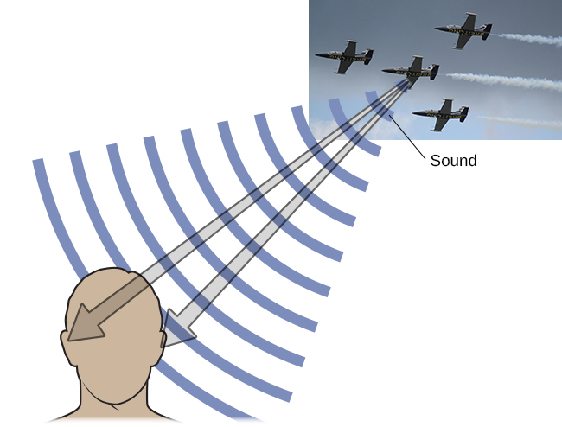
Sound Localization
Localizing sound involves the use of two cues:
  Monaural cues:
    One ear
      Each ear interacts with incoming sound waves differently.
  Binaural cues:
    Two ears
      Provide information on the location of sound along a horizontal axis.
      Relies on differences in patterns of vibration.
        Interaural level difference – sound coming from one side of the body is more intense at the closest ear because of the attenuation of the sound wave as it passes through the head.
        Interaural timing difference – small difference in the time at which a given sound wave arrives at each ear.
Figure 5.19 Localizing sound involves the use of both monaural and binaural cues.
Text and image from Psychology 2e OpenStax Revised Version Copyright © 2020 by Openstax is licensed under a Creative Commons Attribution 4.0 International License, except where otherwise noted. Edited by Maria Pagano

Slide 28
Hearing Loss
Deafness – the partial or complete inability to hear.
  Congenital deafness – deafness from birth.
Conductive hearing loss:
  Associated with a failure in the vibration of the eardrum and/or movement of the ossicles.
  Can often be dealt with using hearing aids which amplify incoming sound waves to make vibration of the eardrum and movement of the ossicles more likely to occur.
    Can be caused by:
      Age
      Genetic predisposition
Sensorineural hearing loss – failure to transmit neural signals from the cochlea to the brain.
  Can be caused by Meniere’s disease which results in degeneration of inner ear structures.
Environmental effects – exposure to extreme noise, certain illnesses and infections, such as mumps, some autoimmune disorders
Text and image from Psychology 2e OpenStax Revised Version Copyright © 2020 by Openstax is licensed under a Creative Commons Attribution 4.0 International License, except where otherwise noted.

Slide 29
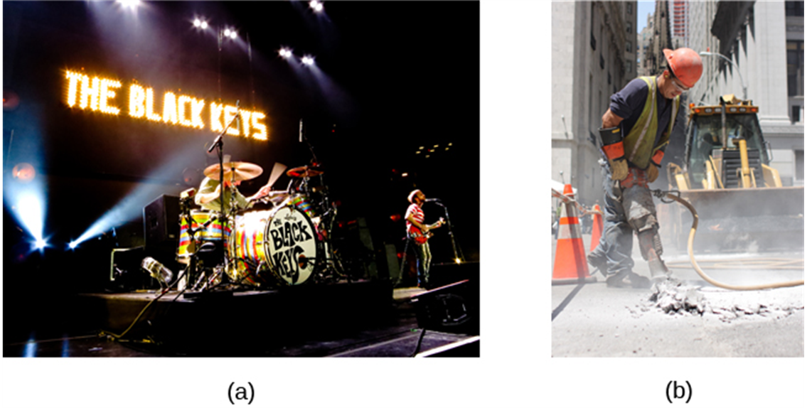
Hearing Loss: Sensorineural Hearing Loss
Figure 5.20 Environmental factors that can lead to sensorineural hearing loss include regular exposure to loud music or construction equipment. (a) Rock musicians and (b) construction workers are at risk for this type of hearing loss.
Link to Learning Video: Watch this video about cochlear implant surgeries to learn more (2:58).
Image and text from Psychology 2e OpenStax Revised Version Copyright © 2020 by Openstax is licensed under a Creative Commons Attribution 4.0 International License, except where otherwise noted.

Slide 30
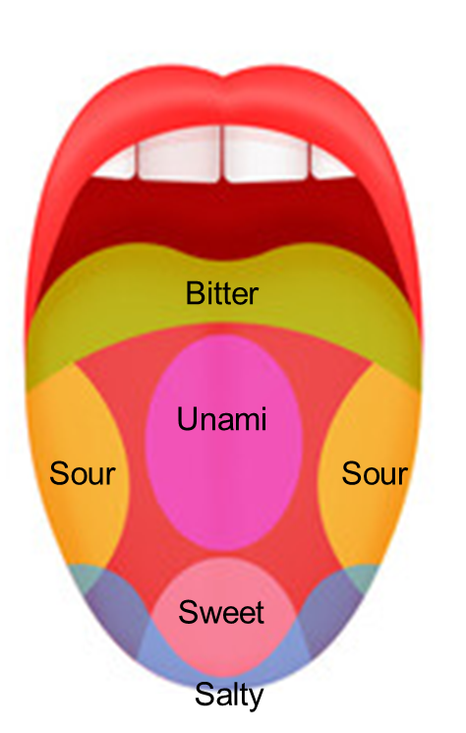
Taste (Gustation)
Research demonstrates that we have about 6 groupings of taste:
  Sweet
  Salty
  Sour
  Bitter
  Umami – has been described as savory and meaty tasting. For example, foods that contain high levels of the amino acid glutamate (used to biosynthesize proteins in the body), like mushrooms, parmesan cheese, and miso.
  Some research suggests we possess a taste for the fatty content of food.
Taste buds: groupings of taste receptor cells with hair-like extensions that protrude into the central pore of the taste bud.
  Taste buds have a life cycle of 10 days to 2 weeks.
Transduction:
  Taste molecules bind to receptors and cause chemical changes within the sensory cell.
  These changes result in neural impulses being sent to the brain.
Video: The video 2-Minute Neuroscience: Taste discusses the sense of taste and follows the path of taste information from the tongue to the gustatory cortex (1:57).
Text from Psychology 2e OpenStax Revised Version Copyright © 2020 by Openstax is licensed under a Creative Commons Attribution 4.0 International License, except where otherwise noted. Image by Maria Pagano

Slide 31
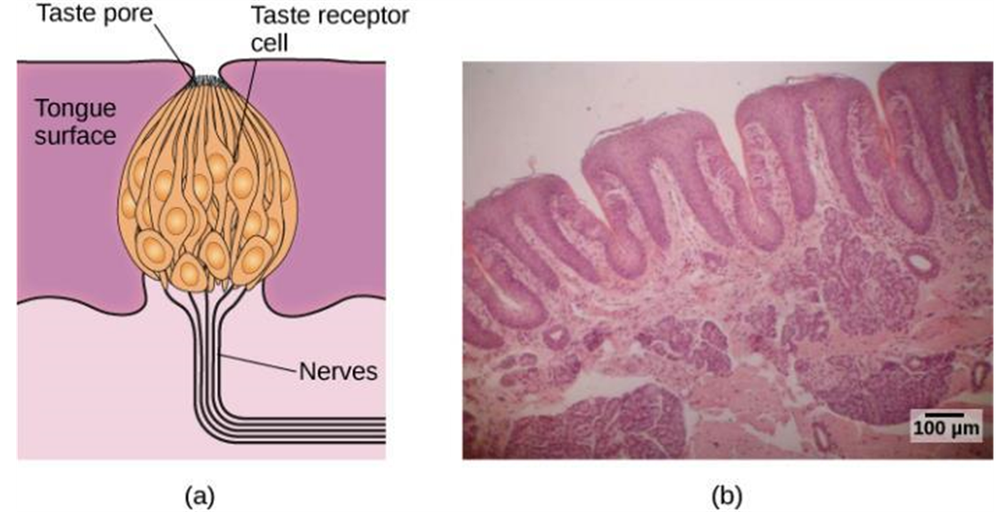
Taste (Gustation):Continued
Figure 5.21: (a) Taste buds are composed of several individual taste receptors cells that transmit information to nerves. (b)This micrograph image shows a close-up view of the tongue’s surface.
Video: Using Bitter Taste to Understand Disease - Breakthrough Science showcases how research using taste may help us better understand disease risk (2:04).
Image and text from Psychology 2e OpenStax Revised Version Copyright © 2020 by Openstax is licensed under a Creative Commons Attribution 4.0 International License, except where otherwise noted. Edited by Maria Pagano

Slide 32
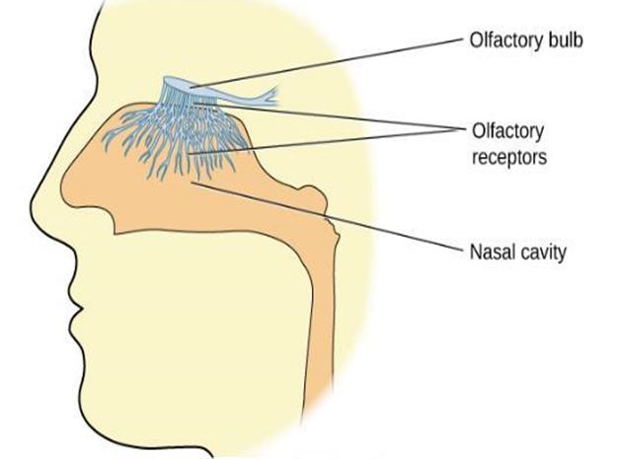
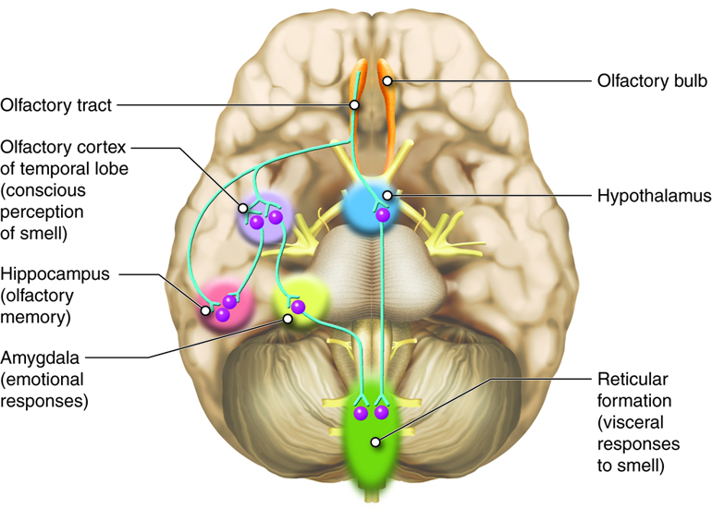
Smell (Olfaction)
Olfactory receptor cells Contain small hair-like extensions which serve as the site for odor molecules to interact with chemical receptors located on these extensions (Located in a mucous membrane at the top of the nose).
Transduction occurs when:
  Odor molecules bind to receptors.
  Chemical changes cause signals to be sent to the olfactory bulb (where the olfactory nerves begin).
  Information is sent to the limbic system and primary olfactory cortex.
Pheromones – chemical messages sent by another individual.
  Many species respond to pheromones sent by another individual.
  Usually communicate information about the reproductive status of a potential mate.
Figure 5.22 Olfactory receptors are the hair-like parts that extend from the olfactory bulb into the mucous membrane of the nasal cavity.
Video: The video 2-Minute Neuroscience: Olfaction summarizes the process of olfaction beginning with the olfactory receptors found in the olfactory epithelium until information reaches the olfactory cortex in the brain (1:59).
Image from Lumen Learning by Cenveo is licensed under CC BY 3.0 US DEED
Image (olfactory bulb, olfactory recptors, and nasal cavity) and Text from Psychology 2e OpenStax Revised Version Copyright © 2020 by Openstax is licensed under a Creative Commons Attribution 4.0 International License, except where otherwise noted. Edited by Maria Pagano

Slide 33
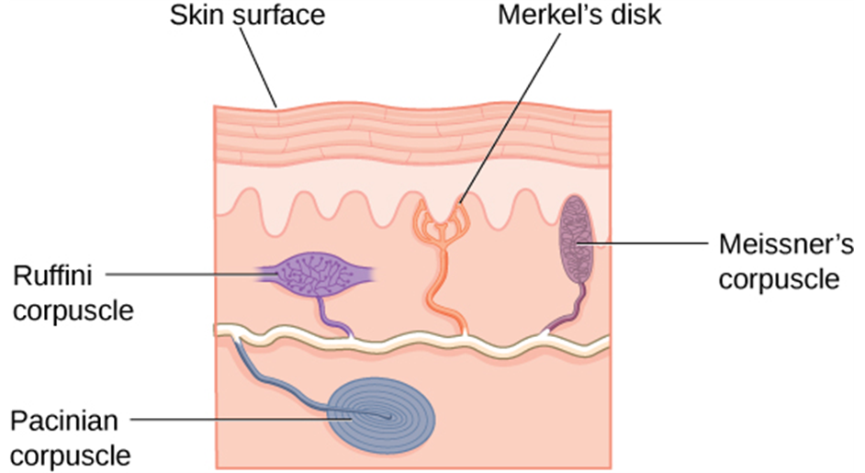
Touch
There are many types of sensory receptors located in the skin, each attuned to specific touch-related stimuli.
  Meissner’s corpuscles – respond to pressure and lower-frequency vibrations.
  Pacinian corpuscles – detect transient pressure and higher-frequency vibrations.
  Merkel’s disks – respond to light pressure.
  Ruffini corpuscles - detect stretch.
Figure 5.23 There are many types of sensory receptors located in the skin, each attuned to specific touch-related stimuli.
Video: The video 2-Minute Neuroscience: Touch Receptors summarizes the four main types of touch receptors found on hairless skin (1:59).
Image and text from Psychology 2e OpenStax Revised Version Copyright © 2020 by Openstax is licensed under a Creative Commons Attribution 4.0 International License, except where otherwise noted. Edited by Maria Pagano

Slide 34
Thermoception and Nociception
As well as receptors located in the skin, there are several free nerve endings that serve sensory functions. These nerve endings respond to a variety of different types of touch-related stimuli and serve as sensory receptors for both:
  Thermoception – temperature perception.
  Nociception – sensory signal indicating potential harm and maybe pain.
    Note that while nociception is the neural encoding of potentially harmful stimuli such as intense pressure, pain refers to the subjective experience that results from nociception.
Sensory information collected from both the free nerve endings and the receptors travel up the spinal cord and are transmitted to regions of the medulla, thalamus and ultimately to the somatosensory cortex.
Video: What is Thermoception? (temperature) summarizes the concept of thermoception (1:50).
Video: Pain versus Nociception in 2 Minutes compares how the human body processes pain and nociception differently (1:55).
Image and text from Psychology 2e OpenStax Revised Version Copyright © 2020 by Openstax is licensed under a Creative Commons Attribution 4.0 International License, except where otherwise noted. Edited by Maria Pagano

Slide 35
Pain Perception
Pain perception is important because it motivates us to remove ourselves from the cause of injury.
  Inflammatory pain – signals some type of tissue damage.
  Neuropathic pain – caused by damage to neurons of either the peripheral or central nervous system.
Congenital insensitivity to pain - a rare genetic disorder in which the individual is born without the ability to feel pain.
  Can detect differences in temperature and pressure but cannot experience pain.
  Individuals are at greater risk of injury and have shorter life expectancies.
Link to Learning Video: Watch this video about congenital insensitivity to pain to learn more (12:21).
Image and text from Psychology 2e OpenStax Revised Version Copyright © 2020 by Openstax is licensed under a Creative Commons Attribution 4.0 International License, except where otherwise noted. Edited by Maria Pagano

Slide 36
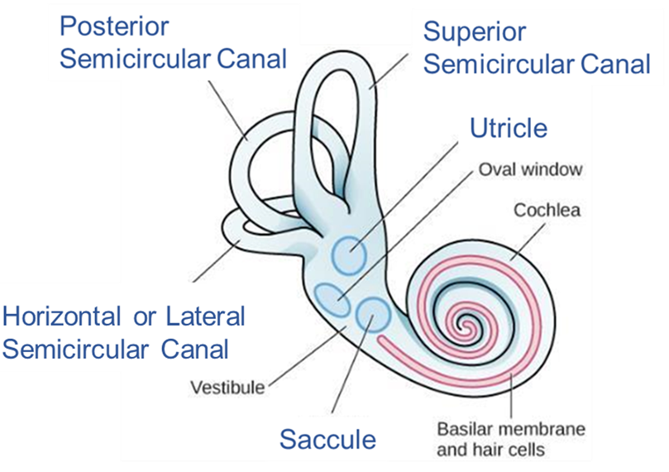
The Vestibular Sense
Vestibular sense – contributes to our ability to maintain balance and body posture.
  The major sensory organs of the vestibular system are located next to the cochlea in the inner ear.
  These organs are fluid-filled and contain hair cells which respond to movement of the head and gravitational forces.
Figure 5.24 The five major vestibular structures (highlighted in blue) are located in the inner ear and include: the utricle, the saccule, and the horizontal/lateral, superior, and posterior semicircular canals.
Video: The video 2-Minute Neuroscience: The Vestibular System explains the primary structures of the vestibular system and how these structures provide the brain with information about things like motion, head position, and spatial orientation (1:55).
Image and text from Psychology 2e OpenStax Revised Version Copyright © 2020 by Openstax is licensed under a Creative Commons Attribution 4.0 International License, except where otherwise noted. Edited by Maria Pagano

Slide 37
Proprioception and Kinesthesia
The vestibular system also collects information important for controlling movement and reflexes that move parts of our bodies to compensate for changes in body position.
Both proprioception and kinesthesia interact with information provided by the vestibular system.
  Proprioception - perception of body position.
  Kinesthesia – perception of the body’s movement through space.
    This information travels to the brain via the spinal column.
    Information from the brain is then sent to the sensory organs of the proprioceptive and kinesthetic systems.
Video: Proprioception and Kinesthesia shows a therapy student testing a patient’s proprioception and kinesthesia (2:18).
Image and text from Psychology 2e OpenStax Revised Version Copyright © 2020 by Openstax is licensed under a Creative Commons Attribution 4.0 International License, except where otherwise noted. Edited by Maria Pagano

Slide 38
Gestalt Principes of Perception
Gestalt psychology – field of psychology based on the idea that the whole is different from the sum of its parts.
  The brain creates a perception that is more than simply the sum of available sensory inputs.
  The brain does this in predictable ways which gestalt psychologists translated into principles by which we organize sensory information.
Gestalt Principles include (each is discussed in the slides which follow):
  Figure– ground relationship
  Proximity
  Similarity
  Continuity
  Closure
Image and text from Psychology 2e OpenStax Revised Version Copyright © 2020 by Openstax is licensed under a Creative Commons Attribution 4.0 International License, except where otherwise noted. Edited by Maria Pagano

Slide 39

Gestalt Principles: Figure Ground Relationship
The idea that we tend to segment our visual world into figure and ground.
  Figure – the focus of the visual field.
  Ground – the background.
Our perception can vary depending on what we view as figure and what we view as ground.
Figure 5.23 The concept of figure-ground relationship explains why this image can be perceived either as a vase or as a pair of faces.
Image and text from Psychology 2e OpenStax Revised Version Copyright © 2020 by Openstax is licensed under a Creative Commons Attribution 4.0 International License, except where otherwise noted. Edited by Maria Pagano

Slide 40
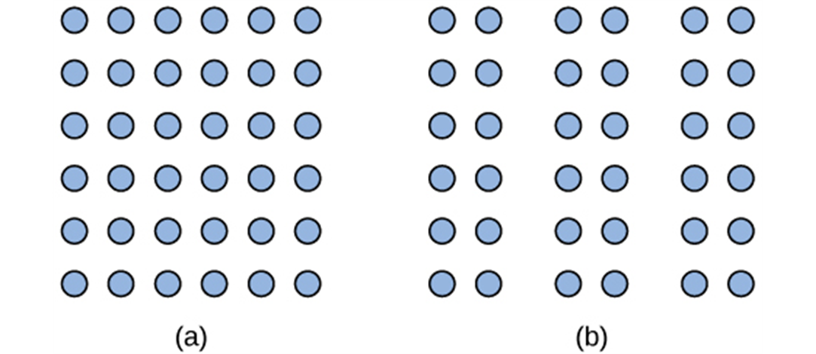
Gestalt Principles: Proximity
Things that are close to one another tend to be grouped together.
Figure 5.26 The Gestalt principle of proximity suggests that you see (a) one block of dots on the left side and (b) three columns on the right side.
Text from Psychology 2e OpenStax Revised Version Copyright © 2020 by Openstax is licensed under a Creative Commons Attribution 4.0 International License, except where otherwise noted. Edited by Maria Pagano

Slide 41
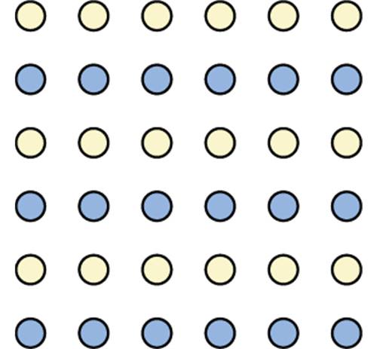
Gestalt Principles: Similarity
Things that are alike tend to be grouped together.
Figure 5.27 When looking at this array of dots, we likely perceive alternating rows of colors. We are grouping these dots according to the principle of similarity.
Image and text from Psychology 2e OpenStax Revised Version Copyright © 2020 by Openstax is licensed under a Creative Commons Attribution 4.0 International License, except where otherwise noted. Edited by Maria Pagano

Slide 42
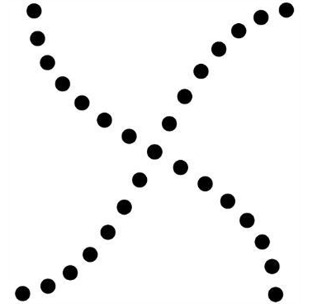
Gestalt Principles: Continuity
We are more likely to perceive continuous, smooth flowing lines rather than jagged, broken lines.
Figure 5.28 Good continuation would suggest that we are more likely to perceive this as two overlapping lines, rather than four lines meeting in the center.
Image and text from Psychology 2e OpenStax Revised Version Copyright © 2020 by Openstax is licensed under a Creative Commons Attribution 4.0 International License, except where otherwise noted. Edited by Maria Pagano

Slide 43

Gestalt Principles: Closure
We organize our perceptions into complete objects rather than a series of parts.
5.29 Closure suggests that we will perceive a complete circle and rectangle rather than a series of segments.
Link to Learning Video: Watch this video showing real world examples of Gestalt principles to learn more (11:14).
Image and text from Psychology 2e OpenStax Revised Version Copyright © 2020 by Openstax is licensed under a Creative Commons Attribution 4.0 International License, except where otherwise noted. Edited by Maria Pagano

