Slide 1

Chapter 3
Biopsychology
OpenStax Psychology 2E
OpenStax ancillary resource is © Rice University under a CC-BY-4.0 DEED license and may be used with proper attributes. Unless otherwise noted all material and text contained in these ancillary materials is from Spielman, R. M., Jenkins, W. J., & Lovett, M. D. (2020). Psychology 2E. OpenStax and is licensed under CC BY 4.0 DEED.

Slide 2
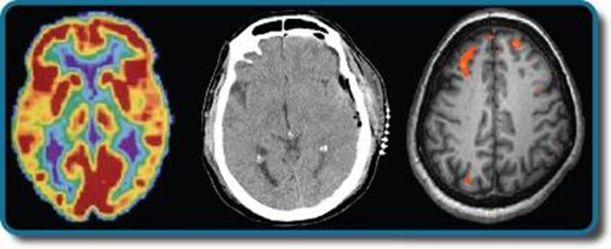
What is Biopsychology?
Biopsychology explores the biological mechanisms that underlie behavior. Among many things, it studies:
  Genetics - focusing on how inherited genes can affect not just the physiological, but psychological traits of a person.
  The structure and function of the nervous system.
  How the nervous system interacts with the endocrine system.
Figure 3.1 Different brain imaging techniques provide scientists with insight into different aspects of how the human brain functions. Left to right, PET scan (positron emission tomography), CT scan (computed tomography), and fMRI (functional magnetic resonance imaging) are three types of scans.
All text from Psychology 2e OpenStax Revised Version Copyright © 2020 by Openstax is licensed under a Creative Commons Attribution 4.0 International License, except where otherwise noted. Edited by Maria Pagano

Slide 3
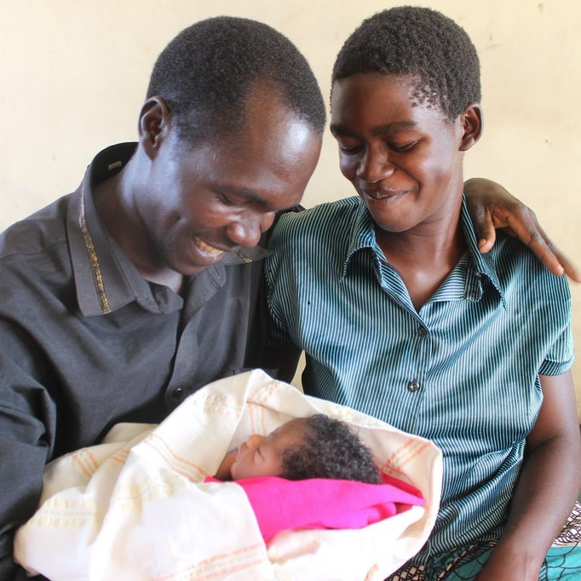
Why Do Psychologists Study Human Genetics?
Studying human genetics can help researchers understand the biological basis underlying the different behaviors, thoughts and reactions of humans.
  Why do two people infected by the same disease have different outcomes?
  Are there genetic components to psychological disorders, such as depression?
  How are genetic diseases passed through family lines?
Image from Flickr. No author credit. Licensed under CC BY NC ND 2.0 DEED
All text from Psychology 2e OpenStax Revised Version Copyright © 2020 by Openstax is licensed under a Creative Commons Attribution 4.0 International License, except where otherwise noted. Edited by Maria Pagano

Slide 4
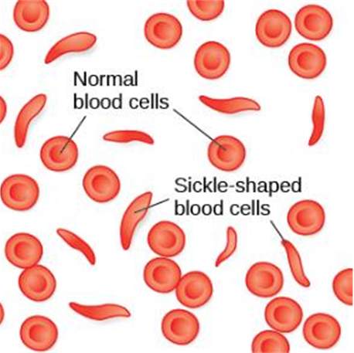
Theory of Evolution
Why have certain genetic diseases, like sickle cell anemia, that cause people to die not become less common?
Example: Sickle cell anemia
  A genetic condition in which red blood cells take on a crescent-like shape affecting how they function.
  Causes many people to die at an early age but it is still common among people of African descent.
  Carriers of only one copy of the sickle cell gene are thought to be immune from malaria, a deadly disease which is common in Africa.
  In this example, carrying the gene makes a person better suited for their environment.
Figure 3.2 Normal blood cells travel freely through the blood vessels, while sickle-shaped cells form blockages preventing blood flow.
Link to Learning Video: Visit this website about how a mutation in DNA leads to sickle cell anemia to learn more (0:58).
All text from Psychology 2e OpenStax Revised Version Copyright © 2020 by Openstax is licensed under a Creative Commons Attribution 4.0 International License, except where otherwise noted. Edited by Maria Pagano

Slide 5
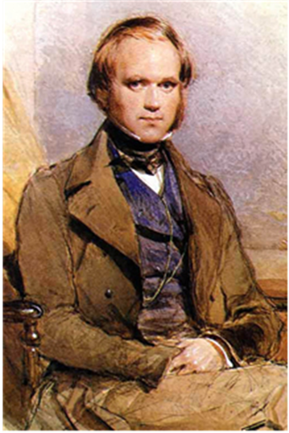
Theory of Evolution: Charles Darwin
Charles Darwin explored the concept of inheritance of traits throughout generations in his theory of evolution through natural selection.
  Natural Selection: Organisms that are better suited for their environment will survive and reproduce, while those that are poorly suited for their environment will die off.
Characteristics and behaviors that impact survival and reproduction include:
  Those that help protect against predators.
  Those that increase access to food.
  Those that help to offspring alive.
Figure 3.3 (a) In 1859, Charles Darwin proposed his theory of evolution by natural selection in his book, On the Origin of Species.
Link to Learning Video: Watch this interview with renowned evolutionary psychologist David Buss to learn more about how a psychologist approaches evolution and how this approach fits within the social sciences (8:37).
Video: Theory of Evolution: How did Darwin Come Up With It?: Discusses in detail how Darwin’s research supported his Theory of Evolution (5.23).
All text from Psychology 2e OpenStax Revised Version Copyright © 2020 by Openstax is licensed under a Creative Commons Attribution 4.0 International License, except where otherwise noted. Edited by Maria Pagano

Slide 6
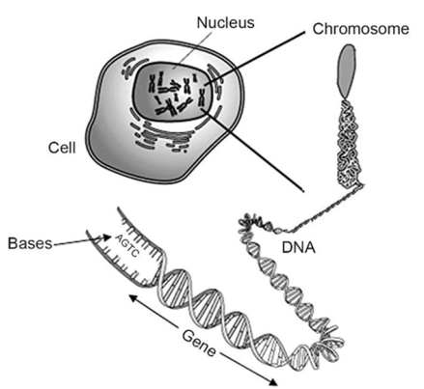
Genetic Variation
Genetic Variation: The genetic difference between individuals.
  Contributes to a species’ adaptation to its environment.
  Begins when an egg (containing 23 chromosomes) is fertilized by a sperm (containing 23 chromosomes).
What is a..
  Chromosome: long strand of genetic information known as DNA.
  Deoxyribonucleic acid (DNA): helix-shaped molecule made of nucleotide base pairs.
    In each chromosome, sequences of DNA make up genes.
  Gene: sequence of DNA that controls or partially controls physical characteristics known as traits (eye color, hair color etc).
    A gene may have multiple possible variations or alleles (a specific version of a gene).
    A specific gene may code for hair color and the different alleles of that gene affect what the hair color will be.
Figure 3.4 (a) DNA is made up of two chemical chains joined together like rungs on a ladder. At each rung along the DNA chain there is a part of DNA called a base. Four different bases make up DNA, and they are called A, C, T and G, for short. The specific order, or sequence, of all the As, Cs, Ts, and Gs in DNA determines the exact information carried in each gene, like the way that a specific pattern of letters makes up the words in a sentence.
Video: The video Chromosomes, DNA, Genes, and Alleles provides an explanation of chromosomes, DNA, genes, and alleles (1:59).
All text from Psychology 2e OpenStax Revised Version Copyright © 2020 by Openstax is licensed under a Creative Commons Attribution 4.0 International License, except where otherwise noted. Edited by Maria Pagano

Slide 7

Genetic Variation: Continued
Figure 3.4(b) Genes are very complex. In the same gene, there can be different variations of the gene called alleles. For example, earlobe attachment is a physical trait controlled by a single gene with two alleles. This gene provides instructions to the body to produce either earlobes that are attached to the sides of the head or earlobes that hang freely and are not attached to the sides of the head. In this example, one “version”, or allele, codes for attached earlobes while the other allele codes for detached earlobes. The combination of alleles a person has for their earlobe gene, determines which type of earlobes they have.
All text from Psychology 2e OpenStax Revised Version Copyright © 2020 by Openstax is licensed under a Creative Commons Attribution 4.0 International License, except where otherwise noted. Edited by Maria Pagano

Slide 8
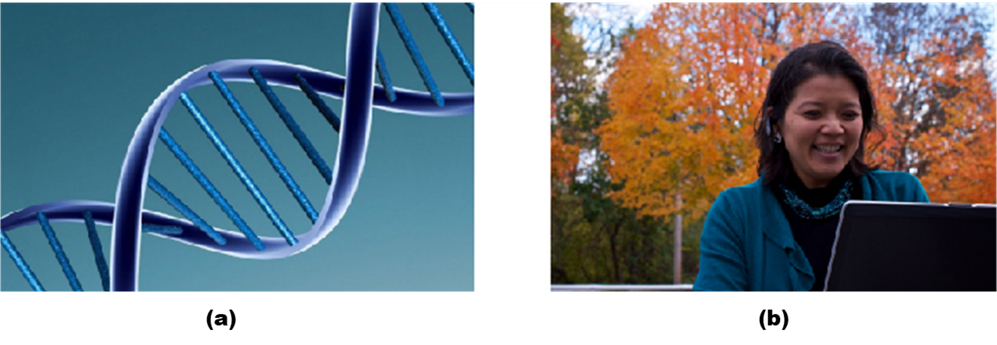
Genotype versus Phenotype
Figure 3.5 Genotype (a) refers to the genetic makeup of an individual based on the genetic material (DNA) inherited from one’s parents. Phenotype (b) describes an individual’s observable characteristics, such as hair color, skin color, height, and build. (credit a: modification of work by Caroline Davis; credit b: modification of work by Cory Zanker)
Video: The video Genotype vs Phenotype: Understanding Alleles discusses the difference between one’s genotype and one's phenotype (1:42).
Image and text from Psychology 2e OpenStax Revised Version Copyright © 2020 by Openstax is licensed under a Creative Commons Attribution 4.0 International License, except where otherwise noted. Edited by Maria Pagano

Slide 9
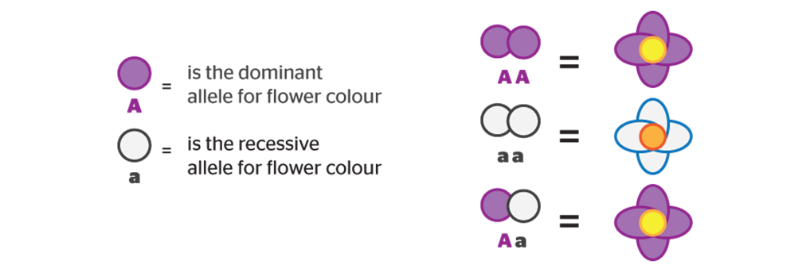
Dominant versus Recessive Alleles
While some traits are controlled by one gene, most inheritable traits are controlled by more than just one gene and in such cases, they are known as polygenic traits.
Alleles can be dominant or recessive. In the example below, A is the dominant allele for flower color (purple) and a is the recessive allele for flower color (white).
  Possession of a dominant allele will always result in expression of that phenotype. This could be inherited from one parent (Aa) or both parents (AA).
  The phenotype of a recessive allele will only be physically expressed if the person is homozygous for that allele, meaning they inherited a recessive allele from BOTH parents (aa).
Heterozygous - consisting of two different alleles (Aa).
Homozygous - consisting of two identical alleles (AA/aa).
Video: Dominant Alleles vs Recessive Alleles: Understanding Inheritance: Discusses the difference between dominant and recessive alleles (2:07).
Image and text from Psychology 2e OpenStax Revised Version Copyright © 2020 by Openstax is licensed under a Creative Commons Attribution 4.0 International License, except where otherwise noted. Edited by Maria Pagano

Slide 10
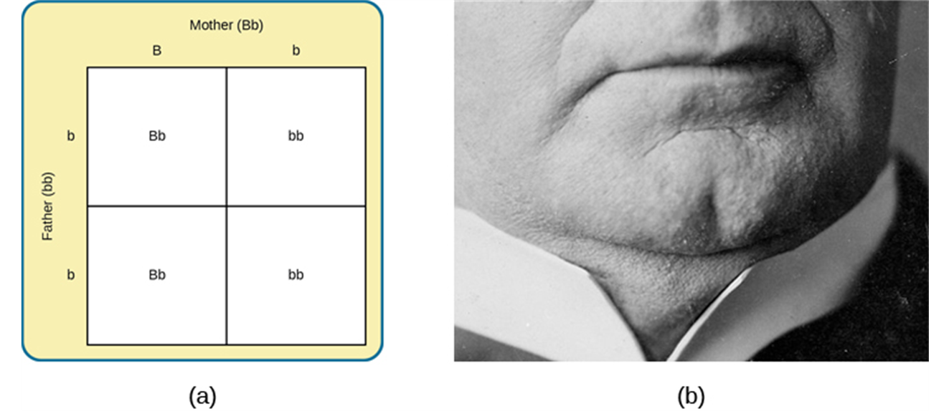
Punnett Squares and Inheritance of Dominant Traits
Figure 3.6 A Punnett square (a) is a tool used to predict how genes will interact in the production of offspring. The capital B represents the dominant allele, and the lowercase b represents the recessive allele. In the example of the cleft chin, where B is cleft chin (dominant allele), wherever a pair contains the dominant allele, B, you can expect a cleft chin phenotype. You can expect a smooth chin phenotype only when there are two copies of the recessive allele, bb. (The image below (b) shows a picture of a cleft chin.)
  In the example below, Mom has a cleft chin (Bb) (but also carries the allele for a smooth chin), however dad has a smooth (bb). Any child born from this union will have 50 percent chance of having a cleft chin, while the remaining 50% will have the chance of a smooth chin.
Video: The video Genotype, Phenotype and Punnet Squares Made EASY! Reviews genotype and phenotype and walks you through how to create a Punnett Square (discussed on next slide). the difference between one’s genotype and one's phenotype. If you don’t need to review genotype and phenotype you can start the video at timestamp 0:48 (6:05).
Image and text from Psychology 2e OpenStax Revised Version Copyright © 2020 by Openstax is licensed under a Creative Commons Attribution 4.0 International License, except where otherwise noted. Edited by Maria Pagano

Slide 11
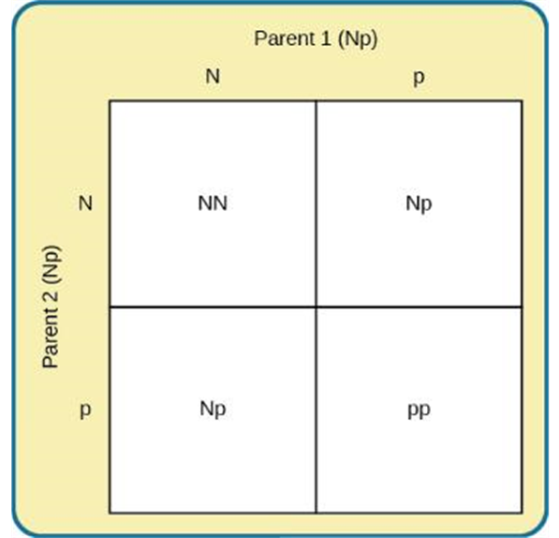
Punnett Squares and Inheritance of Recessive Traits
Harmful genes like PKU* are a result of mutations.
  Mutations - sudden, permanent change in a gene.
    Many mutations are harmful, but some can also be beneficial. For example, lactose tolerance is a mutation found on chromosome 2.
*PKU or Phenylketonuria is a recessive trait disorder. Individuals with PKU cannot breakdown the amino acid phenylalanine, that then builds up in their and blood and brain, which can lead to brain damage.
Figure 3.7 In the Punnett square above, N represents the dominant allele, and p represents the recessive allele that is associated with PKU*, which can lead to brain damage, intellectual disabilities and seizures. If two individuals who are both heterozygous (Np) for the allele associated with PKU, will have a 25% chance of having a child with PKU.
Image and text from Psychology 2e OpenStax Revised Version Copyright © 2020 by Openstax is licensed under a Creative Commons Attribution 4.0 International License, except where otherwise noted. Edited by Maria Pagano

Slide 12
Gene-Environment Interactions
Nature and nurture work together like complex pieces of a human puzzle, and this interaction of our environment and genes makes us the individuals that we are. Researchers have different ways to look at and describe the interaction between one’s genes and environment, which include the following:
  Range of reaction - asserts our genes set the boundaries within which we can operate, and our environment interacts with the genes to determine where in that range we will fall.
    For example, if an individual’s genetic makeup predisposes her to high levels of intellectual potential and she is reared in a rich, stimulating environment, then she will be more likely to achieve her full potential than if she were raised under conditions of significant deprivation.
  Genetic environmental correlation - view of gene-environment interaction that asserts our genes affect our environment, and our environment influences the expression of our genes.
    For example, the child of an NBA player would probably be exposed to basketball from an early age. Such exposure might allow the child to realize his or her full genetic, athletic potential. Thus, the parents’ genes, which the child shares, influence the child’s environment, and that environment, in turn, is well suited to support the child’s genetic potential.
Text from Psychology 2e OpenStax Revised Version Copyright © 2020 by Openstax is licensed under a Creative Commons Attribution 4.0 International License, except where otherwise noted. Edited by Maria Pagano

Slide 13
Gene-Environment Interactions: Continued
  Epigenetics - study of gene-environment interactions such as how the same genotype leads to different phenotypes.
    For example, people whose mothers were pregnant with them during the Dutch hunger winter famine that lasted from 1944 to 1945 were more likely to develop certain diseases such as heart disease, schizophrenia, and type 2 diabetes when compared with their siblings who were not exposed to famine before their birth. (From the Centers for Disease Control and Prevention: What is Epigenetics? No author information provided. Page last reviewed on August 15, 2022. Licensed under Public Domain.)
Link to Learning Video: Watch this video about the epigenetics of twin studies to learn more (4:41).
Video: While the Kahn Academy video Gene Environment Interaction does not specifically address the descriptions of gene/environment presented above, the video does present a general overview discussion of gene/environment interactions and discusses how both genes and environment interact when treating PKU (4:29).
Text from Psychology 2e OpenStax Revised Version Copyright © 2020 by Openstax is licensed under a Creative Commons Attribution 4.0 International License, except where otherwise noted. Edited by Maria Pagano

Slide 14
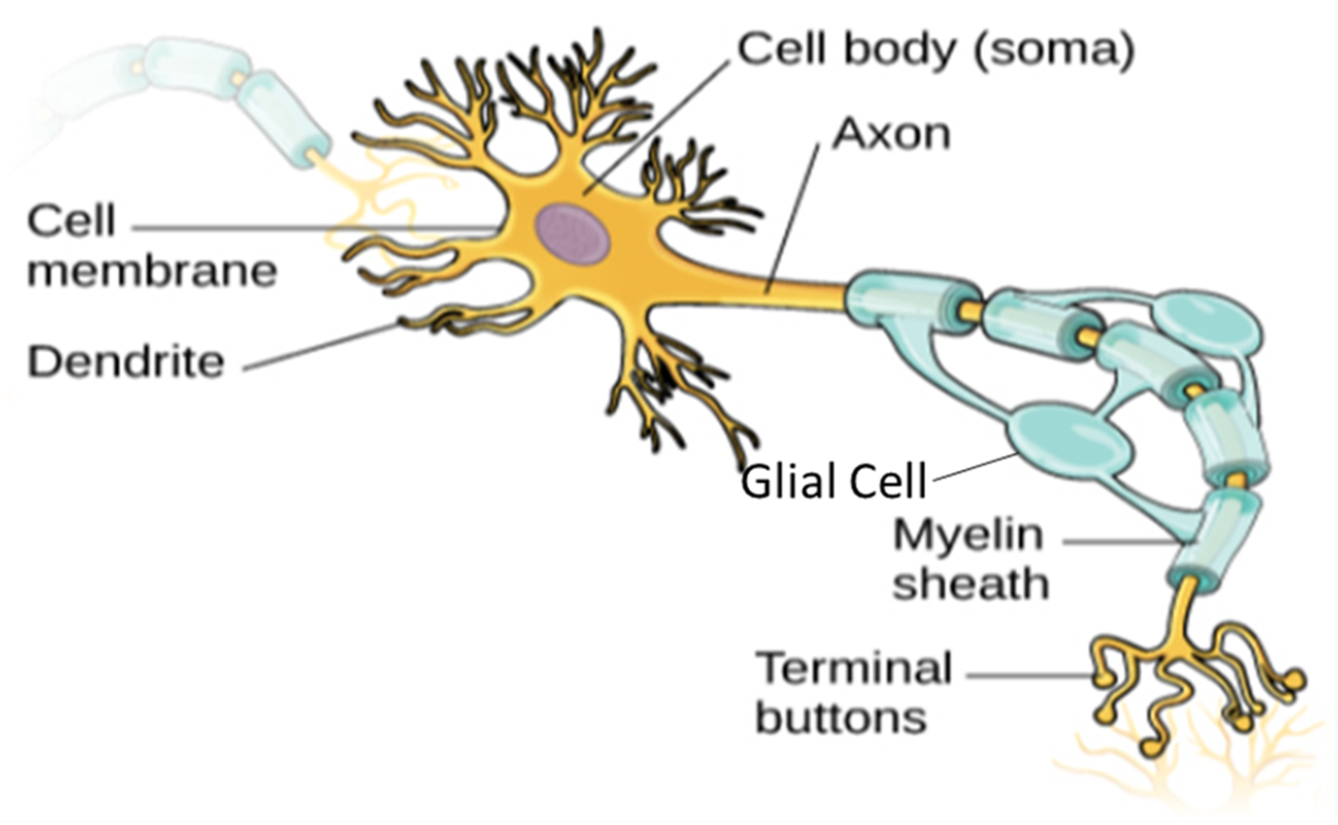
Neuron Structure
The function of a neuron is aided by specific aspects of its structure.
Its semi-permeable membrane allows smaller molecules or molecules without an electrical charge to pass through it, while stopping larger or highly charged molecules.
Incoming electrical signals from other neurons are received by the dendrites which then send the signal down the axon.
Axons are covered in a myelin sheath made of a fatty substance that insulates axons and allows the signal to travel down the axon quicker.
At the end of the axons are terminal buttons which contain synaptic vessels (storage sites for chemical messengers called neurotransmitters).
Figure 3.9 The illustration above shows a prototypical neuron, which is being myelinated.
Video: The video 2-Minute Neuroscience: The Neuron provides a brief introduction to different parts of the neuron and the function of each part (1:47).
Text and images from Psychology 2e OpenStax Revised Version Copyright © 2020 by Openstax is licensed under a Creative Commons Attribution 4.0 International License, except where otherwise noted. Edited by Maria Pagano

Slide 15
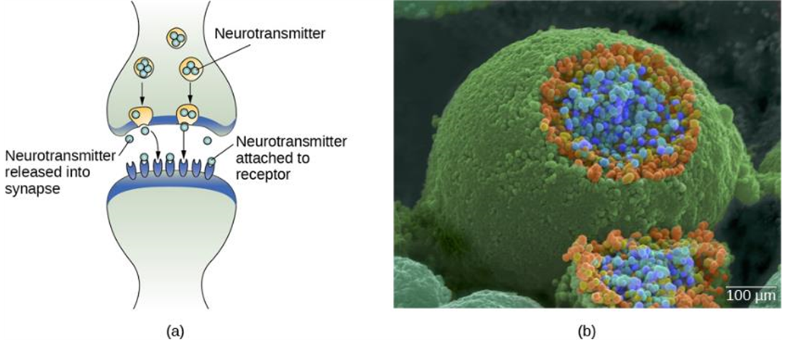
The Gap Between Neurons: The Synapse
Figure 3.10(a) The synaptic cleft is the space between the terminal button of one neuron and the dendrite of another neuron. (b) In this pseudo-colored image from a scanning electron microscope, a terminal button (green) has been opened to reveal the synaptic vesicles (orange and blue) inside. Each vesicle contains about 10,000 neurotransmitter molecules.
Link to Learning Video: Watch this video which describes the synapse, the synaptic cleft, the release of neurotransmitters, and synaptic transmission (1:51).
Image and Text from Psychology 2e OpenStax Revised Version Copyright © 2020 by Openstax is licensed under a Creative Commons Attribution 4.0 International License, except where otherwise noted. Edited by Maria Pagano

Slide 16
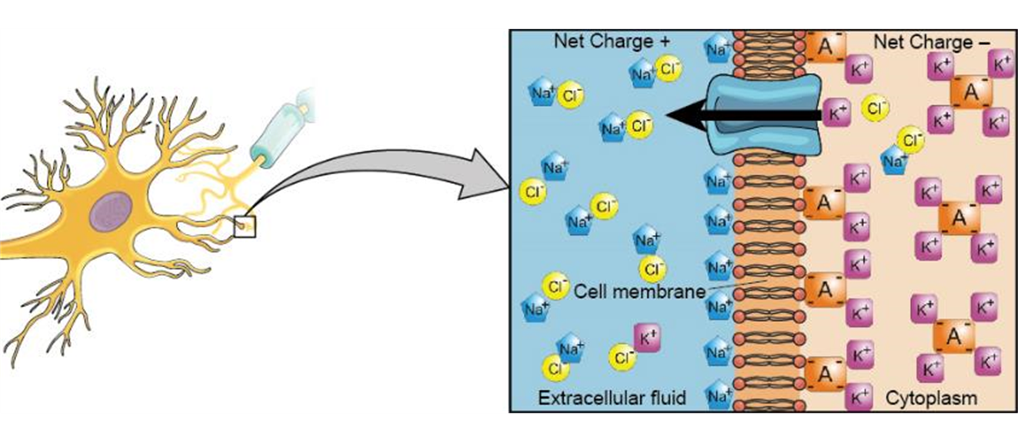
The Resting Potential of a Neuron
Figure 3.11 At resting potential, Na⁺ (blue pentagons) is more highly concentrated outside the cell in the extracellular fluid (shown in blue), whereas K⁺ (purple squares) is more highly concentrated near the membrane in the cytoplasm or intracellular fluid. Other molecules, such as chloride ions (yellow circles) and negatively charged proteins (brown squares), help contribute to a positive net charge in the extracellular fluid and a negative net charge in the intracellular fluid.
Link to Learning Video: Watch this video which explains the resting potential of a neuron and how this membrane potential is maintained (2:01).
Text and image from Psychology 2e OpenStax Revised Version Copyright © 2020 by Openstax is licensed under a Creative Commons Attribution 4.0 International License, except where otherwise noted. Edited by Maria Pagano

Slide 17
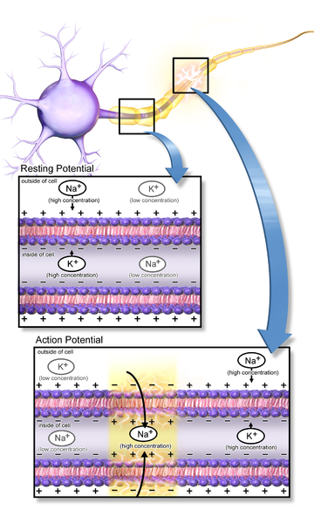
The Action Potential of a Neuron
Neurotransmitters from nearby neurons attach to receptors on dendrites causing the membrane potential to change.
  Depolarization – membrane potential becomes less negative making the neuron more likely to fire (excitation).
  Hyperpolarization – membrane potential becomes more negative making the neuron less likely to fire (inhibition).
If the level of charge reaches the threshold of excitation an action potential will occur. Ion channels open causing Na+ to rush into the cell and the inside to momentarily become more positive.
  Threshold of excitation – level of charge in the membrane that causes the neuron to become active.
  Action Potential – an electrical signal.
  Action potentials act on an All-or-None Principle - the incoming signal is either sufficient to reach the threshold of excitation or it is not.
Link to Learning Video: Watch this video which explains how an action potential occurs to learn more (2:01).
All text from Psychology 2e OpenStax Revised Version Copyright © 2020 by Openstax is licensed under a Creative Commons Attribution 4.0 International License, except where otherwise noted. Edited by Maria Pagano

Slide 18
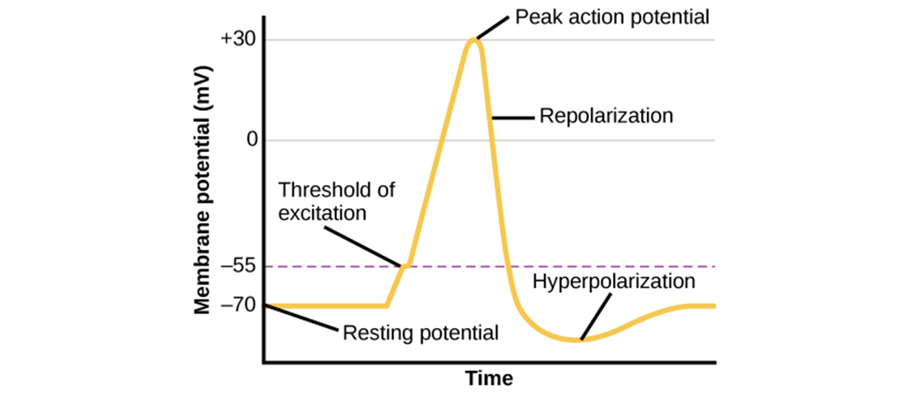
The Action Potential of a Neuron: Continued
Figure 3.12 During the action potential, the electrical charge across the membrane changes dramatically.
Text and image from Psychology 2e OpenStax Revised Version Copyright © 2020 by Openstax is licensed under a Creative Commons Attribution 4.0 International License, except where otherwise noted. Edited by Maria Pagano

Slide 19
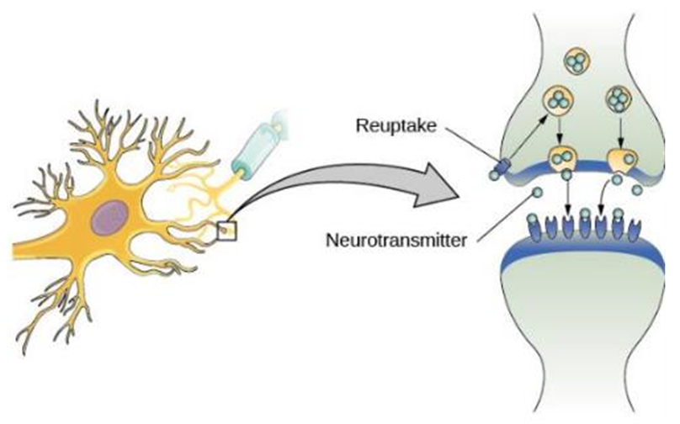
Reuptake
Once an action potential has occurred, excess neurotransmitters in the synapse either drift away, are broken down or are reabsorbed back into the axon terminal from which it was released via the process a process called reuptake.
  Reuptake involves moving a neurotransmitter from the synapse back into the axon terminal from which it was released.
Figure 3.13 Reuptake involves moving a neurotransmitter from the synapse back into the axon terminal from which it was released.
Link to Learning Video: Watch this video about neuronal communication to learn more about how electrical and chemical signals are used by neurons to communicate with one another (1:09).
Text and image from Psychology 2e OpenStax Revised Version Copyright © 2020 by Openstax is licensed under a Creative Commons Attribution 4.0 International License, except where otherwise noted. Edited by Maria Pagano

Slide 20
Neurotransmitters and Drugs
Different neurons release different types of neurotransmitters that have many different functions.
  Neurotransmitter – chemical messenger of the nervous system.
Major Neurotransmitters and How Each Affects Behavior
Neurotransmitter | Involved in | Potential Effect on Behavior
Acetylcholine | Muscle action, memory | Increased arousal, enhanced cognition
Beta-endorphin | Pain, pleasure | Decreased anxiety, decreased tension
Dopamine | Mood, sleep, learning | Increased pleasure, suppressed appetite
Gamma-aminobutyric acid (GABA) | Brain function, sleep | Decreased anxiety, decreased tension
Glutamate | Memory, learning | Increased learning, enhanced memory
Norepinephrine | Heart, intestines, alertness | Increased arousal, suppressed appetite
Serotonin | Mood, sleep | Modulated mood, suppressed appetite
Table 3.1
Text from Psychology 2e OpenStax Revised Version Copyright © 2020 by Openstax is licensed under a Creative Commons Attribution 4.0 International License, except where otherwise noted. Edited by Maria Pagano

Slide 21

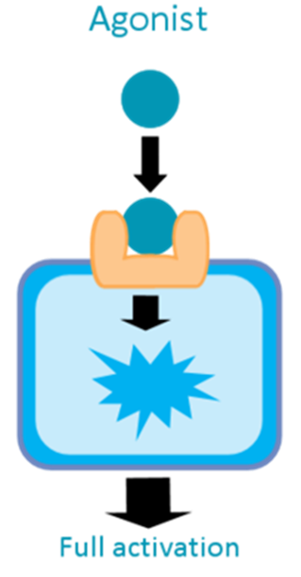
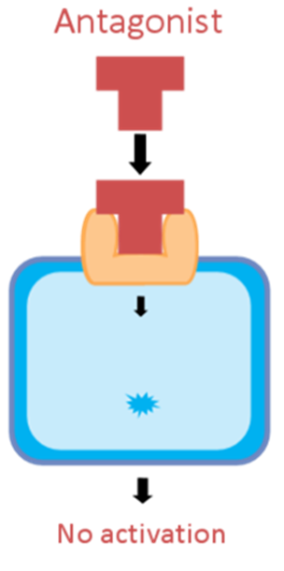
Neurotransmitters, The Biological Perspective and Drugs
Biological perspective - view that psychological disorders like depression and schizophrenia are associated with imbalances in one or more neurotransmitter systems.
Psychotropic medication - drugs that treat psychiatric symptoms by restoring neurotransmitter balance.
  Agonist - drug that mimics or strengthens the effects of a neurotransmitter.
  Antagonist - drug that blocks or impedes the normal activity of a given neurotransmitter.
Agonist or antagonist drugs are prescribed to correct neurotransmitter imbalances.
  Parkinson’s disease is associated with low levels of dopamine. Dopamine agonists are often prescribed as one form of treatment.
  Schizophrenia on the other hand is associated with too much dopamine. Many antipsychotic drugs are therefore dopamine antagonists.
Image from PsychonautWiki Antagonist Licensed under CC BY SA 4.0 DEED, except where otherwise noted. Edited by Maria Pagano
Text from Psychology 2e OpenStax Revised Version Copyright © 2020 by Openstax is licensed under a Creative Commons Attribution 4.0 International License, except where otherwise noted. Edited by Maria Pagano

Slide 22
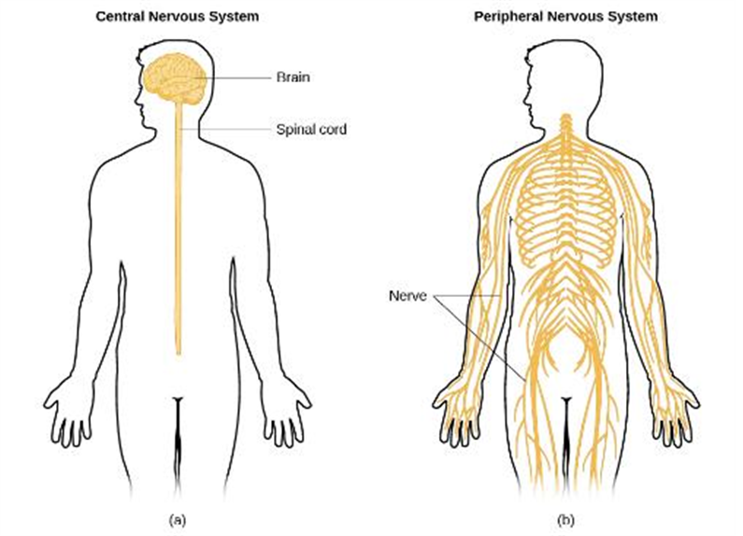
Parts of the Nervous System
Figure 3.14 The nervous system is divided into two major parts: (a) the Central Nervous System and (b) the Peripheral Nervous System.
Text and image from Psychology 2e OpenStax Revised Version Copyright © 2020 by Openstax is licensed under a Creative Commons Attribution 4.0 International License, except where otherwise noted. Edited by Maria Pagano

Slide 23
The Peripheral Nervous System
The Peripheral Nervous System Consists of the Somatic Nervous System and the Autonomic Nervous System
Somatic Nervous System - relays sensory and motor information to and from the CNS.
Autonomic Nervous System - controls our internal organs and glands and can be divided into the Sympathetic and Parasympathetic nervous systems.
The Autonomic Nervous System is Further Broken into the Sympathetic and Parasympathetic Nervous Systems.
Parasympathetic nervous system - associated with routine, day-to-day operations of the body under relaxed conditions.
  Rest and restore response – relaxes the body after fight or flight (aka rest and digest).
Sympathetic nervous system - involved in stress-related activities and functions; prepares us for fight or flight.
  Fight or flight response - activation of the sympathetic division of the autonomic nervous system, allowing access to energy reserves and heightened sensory capacity so that we might fight off a given threat or run away to safety.
The Sympathetic and Parasympathetic nervous systems complement each other to maintain homeostasis, a state of equilibrium in the body.
Text from Psychology 2e OpenStax Revised Version Copyright © 2020 by Openstax is licensed under a Creative Commons Attribution 4.0 International License, except where otherwise noted. Edited by Maria Pagano

Slide 24
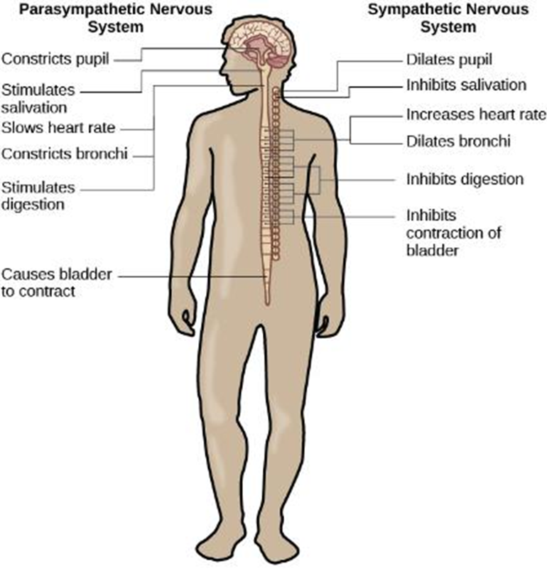
The Autonomic Nervous System
Figure 3.15 The sympathetic and parasympathetic divisions of the autonomic nervous system have the opposite effects on various systems.
Video: The video Autonomic Nervous System: Sympathetic vs Parasympathetic shows the functions of the parasympathetic and sympathetic nervous system and how each reacts under certain condition. (4:22)
Link to Learning Video: Watch this video about the Fight Flight Freeze response to learn more (3:05).
Image and text and from Psychology 2e OpenStax Revised Version Copyright © 2020 by Openstax is licensed under a Creative Commons Attribution 4.0 International License, except where otherwise noted. Edited by Maria Pagano

Slide 25
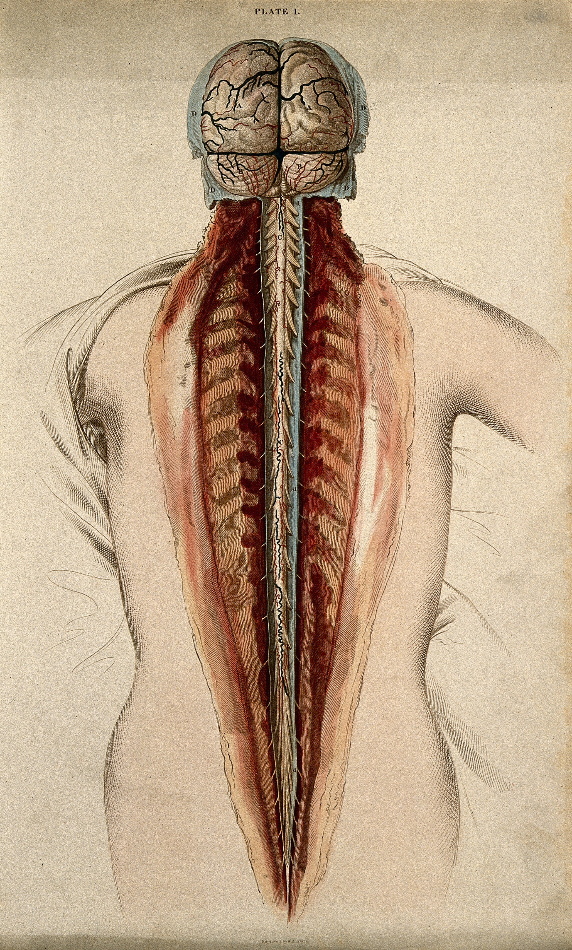
The Brain and the Spinal Cord: The Spinal Cord
The spinal cord delivers messages to and from the brain.
  The top merges with the brain stem and the bottom ends just below the ribs
  Has its own system of reflexes.
  Functionally organized into 30 segments, each connected to a specific part of the body through the PNS.
  Sensory nerves bring messages in and up to the brain; motor nerves send messages out to the muscles and organs.
  In moments of survival, automatic reflexes allow motor commands to be initiated without sending signals from sensory nerves to the brain first, allowing for very quick reactions.
Image from Welcome Collection: Brain and Spinal Cord Dissection. Colored engraving by W. H. Lizars. Licensed under CC BY 4.0 DEED International,
Text from Psychology 2e OpenStax Revised Version Copyright © 2020 by Openstax is licensed under a Creative Commons Attribution 4.0 International License, except where otherwise noted. Edited by Maria Pagano

Slide 26
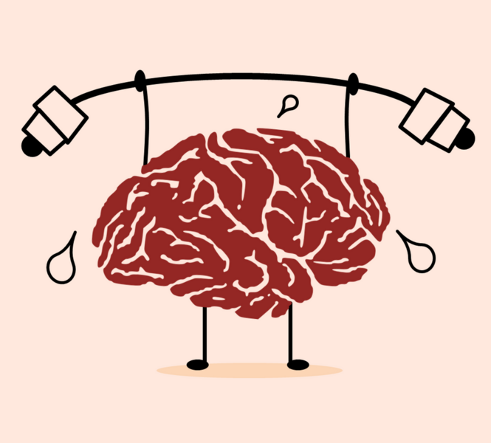
The Brain and the Spinal Cord: The Brain
Comprised of billions of interconnected neurons and glia.
Bilateral (two-sided).
Can be separated into distinct lobes but all areas interact with one another.
Image from Wikimedia Commons: Brain Exercising Licensed under CC0 1.0 DEED,
Text from Psychology 2e OpenStax Revised Version Copyright © 2020 by Openstax is licensed under a Creative Commons Attribution 4.0 International License, except where otherwise noted. Edited by Maria Pagano

Slide 27
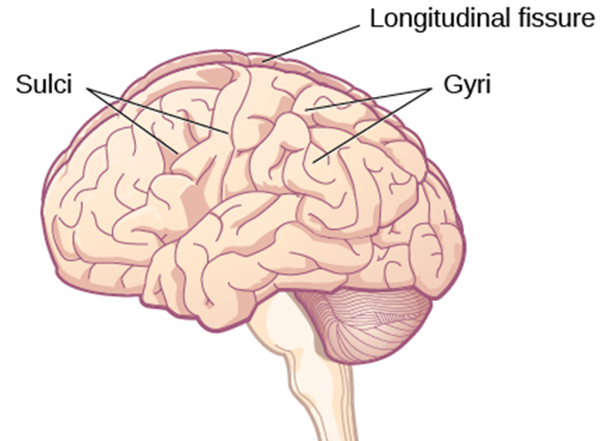
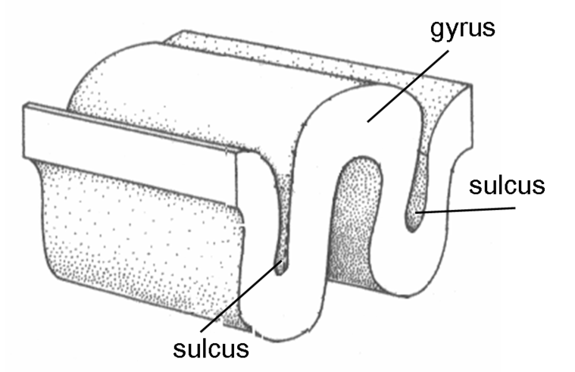
The Two Hemispheres
Figure 3.16 The surface of the brain (the cerebral cortex) is covered with gyri and sulci. A deep sulcus is called a fissure, such as the longitudinal fissure that divides the brain into left and right hemispheres.
Lateralization - concept that each hemisphere of the brain is associated with specialized functions.
  The left hemisphere controls the right side of the body.
  The right hemisphere controls the left side of the body.
Cross-section slice of human brain detailing gyrus and sulcus. (Image from Wikimedia Commons by Albert Kok at Dutch Wikipedia. Released into the Public Domain by author Albert Kok.)
Text and image from Psychology 2e OpenStax Revised Version Copyright © 2020 by Openstax is licensed under a Creative Commons Attribution 4.0 International License, except where otherwise noted. Edited by Maria Pagano

Slide 28
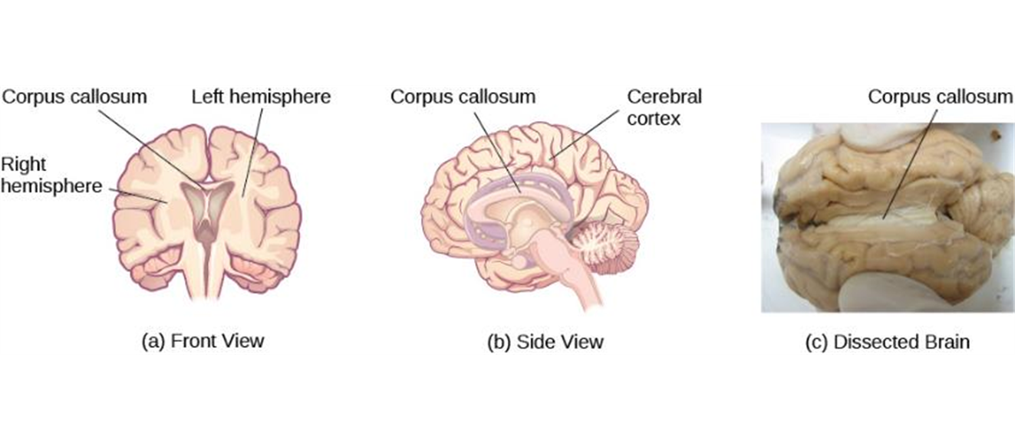
The Corpus Callosum
Figure 3.17(a, b) The corpus callosum connects the left and right hemispheres of the brain. (c) A scientist spreads this dissected sheep brain apart to show the corpus callosum between the hemispheres.
Video: The video 2-Minute Neuroscience: Limbic System looks at the corpus callosum and its function (2:00).
Text and image from Psychology 2e OpenStax Revised Version Copyright © 2020 by Openstax is licensed under a Creative Commons Attribution 4.0 International License, except where otherwise noted.

Slide 29
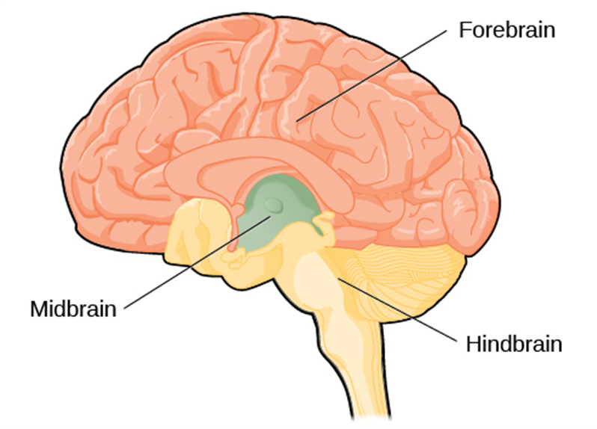
Forebrain, Midbrain, and Hindbrain
Figure 3.18 The brain and its parts can be divided into three main categories: the forebrain, midbrain, and hindbrain.
Image and text from Psychology 2e OpenStax Revised Version Copyright © 2020 by Openstax is licensed under a Creative Commons Attribution 4.0 International License, except where otherwise noted.

Slide 30
Forebrain Structures
The forebrain is the largest part of the brain. It contains:
  The cerebral cortex – the outer layer of neural tissue of the cerebrum which is responsible for higher level processes.
  Thalamus - sensory relay
  Hypothalamus – homeostasis (See video under pituitary gland)
  Pituitary gland – master gland of the endocrine system
  Limbic system – emotion and memory circuit
Video: The video 2-Minute Neuroscience: Cerebral Cortex discusses the cerebral cortex and the functional subdivisions of the cerebral cortex (2:00).
Video: The video 2-Minute Neuroscience: The Thalamus discusses the function of the thalamus as a relay station for information that is traveling to the cortex and the ventral posterolateral nucleus (VPL), the ventral posteromedial nucleus (VPM), pulvinar nucleus, medial geniculate nucleus, lateral geniculate nucleus, and reticular nucleus (2:00).
Video: The video 2-Minute Neuroscience: Hypothalamus and Pituitary Gland discusses the two major roles of the hypothalamus: homeostasis and hormones and discusses the anterior and posterior lobes of the pituitary gland (2:00).
Video: The first half of the video 2-Minute Neuroscience: Limbic System discusses the limbic system’s role in emotions and the second half describes some of the structures often included in the limbic system (2:00).
Text from Psychology 2e OpenStax Revised Version Copyright © 2020 by Openstax is licensed under a Creative Commons Attribution 4.0 International License, except where otherwise noted.

Slide 31
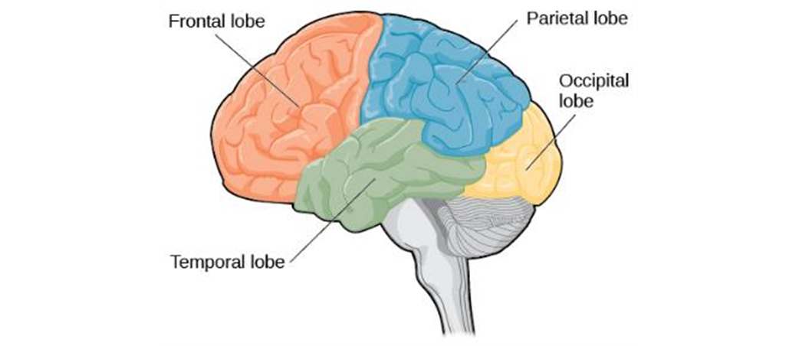
Cerebral Cortex: Lobes of the Brain
Cerebral cortex - surface of the brain that is associated with out highest mental capabilities such as consciousness, thought, emotion, reasoning, language and memory.
  It can be broken up into four lobes, each with a different function.
Figure 3.19 The lobes of the brain are shown
Video: The video 2-Minute Neuroscience: Lobes and Landmarks of the Brain Surface (Lateral View) discusses the frontal, parietal, temporal, and occipital lobes of the brain as well as some major landmarks that can be seen from a lateral view of the brain (2:00).
Image and text from Psychology 2e OpenStax Revised Version Copyright © 2020 by Openstax is licensed under a Creative Commons Attribution 4.0 International License, except where otherwise noted. Edited by Maria Pagano

Slide 32
The Frontal Lobe
The frontal lobe is involved in executive functioning (planning, organization, judgement, attention, reasoning), motor control, emotion, and language. It contains:
  The Motor cortex - strip of cortex involved in planning and coordinating movement.
  The Prefrontal cortex - responsible for higher-level cognitive functioning.
  Broca’s area - region in the left hemisphere that is essential for language production.
    Damage to Broca’s area leads to difficulties producing language.
.
Video: The video 2-Minute Neuroscience: The Motor Cortex discusses the location and the functions of the primary motor cortex and the nonprimary motor cortex (2:00).
Video: The video 2-Minute Neuroscience: The Prefrontal Cortex discusses the role of the prefrontal cortex in executive function (2:00).
Video: The video 2-Minute Neuroscience: Broca's Area discusses Broca’s area and some hypotheses regarding its function (2:00).
Text from Psychology 2e OpenStax Revised Version Copyright © 2020 by Openstax is licensed under a Creative Commons Attribution 4.0 International License, except where otherwise noted. Edited by Maria Pagano

Slide 33
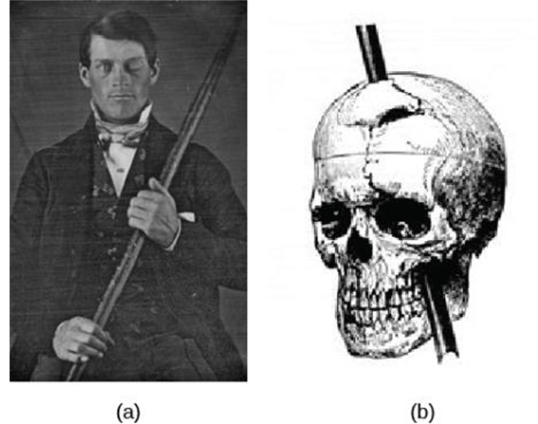
Damage to the Frontal Lobe: Phineas Gage
While working as a railroad foreman, an accident caused an iron rod to penetrate through Gage’s skull and frontal lobe. After the accident, people noticed changes in his personality.
  Before the accident - Well-mannered and soft-spoken.
  After the accident - Started behaving in odd and inappropriate ways.
These changes were consistent with loss of impulse control (a function of the frontal lobe).
Figure 3.21 Phineas Gage (a) holds the iron rod that penetrated his skull in an 1848 railroad construction accident. (b) Gage’s prefrontal cortex was severely damaged in the left hemisphere. The rod entered Gage’s face on the left side, passed behind his eye, and exited through the top of his skull, before landing about 80 feet away.
Image and text from Psychology 2e OpenStax Revised Version Copyright © 2020 by Openstax is licensed under a Creative Commons Attribution 4.0 International License, except where otherwise noted. Edited by Maria Pagano

Slide 34
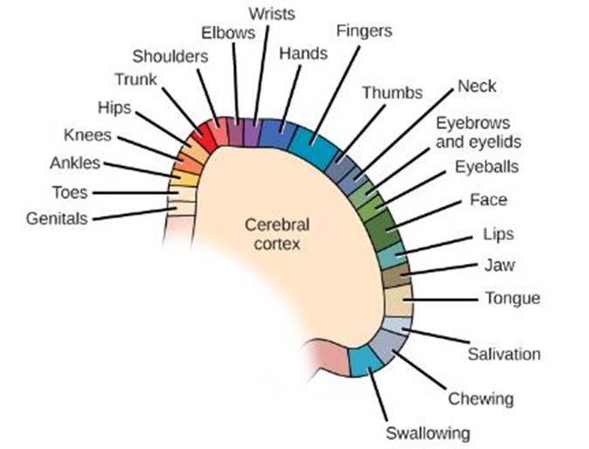
The Parietal Lobe
The parietal lobe is involved in processing various sensory and perceptual information.
The parietal lobe contains the primary somatosensory cortex, which is organized topographically (as shown in the image on the right) and is essential for processing sensory information such as touch, temperature and pain from across the body.
Link to Learning Audio Segment: One fascinating example of neuroplasticity involves reorganization of the somatosensory cortex following limb amputation. Check out this NPR segment about amputees’ experiences of “phantom limbs” following amputation to learn more (3:05).
Video: The video 2-Minute Neuroscience: Primary Somatosensory Cortex discusses the functions of the four areas of the primary somatosensory cortex (2:00).
Image and text from Psychology 2e OpenStax Revised Version Copyright © 2020 by Openstax is licensed under a Creative Commons Attribution 4.0 International License, except where otherwise noted. Edited by Maria Pagano

Slide 35
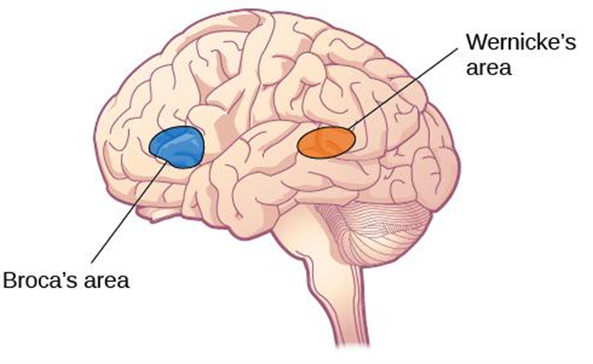
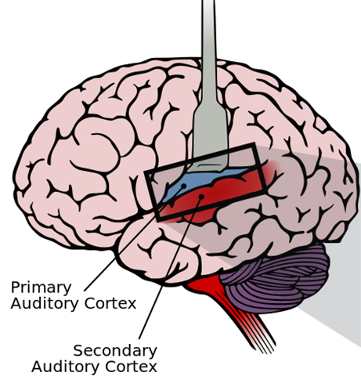
The Temporal Lobe
The temporal lobe (located on the side of the head, near the temples) is associated with hearing, memory, emotion and some aspects of language. It contains:
  The auditory cortex - strip of cortex in the temporal lobe that is responsible for processing auditory information.
  Wernicke’s area - important for speech comprehension.
    Damage to Wernicke’s area results in difficulty understanding language.
Figure 3.23 Damage to either Broca’s area or Wernicke’s area can result in language deficits. The types of deficits are very different, however, depending on which area is affected. Note that Broca’s area is found in the left frontal lobe and not in the temporal lobe, and damage to Broca’s area results in difficulties in speech production.
The primary auditory cortex contains a topographical map of the cochlea, while the secondary auditory cortex is important for sound localization and analysis of complex sounds
Image and text from Psychology 2e OpenStax Revised Version Copyright © 2020 by Openstax is licensed under a Creative Commons Attribution 4.0 International License, except where otherwise noted. Edited by Maria Pagano

Slide 36
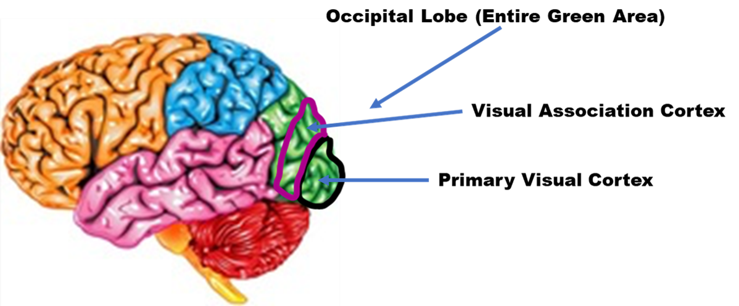
Occipital Lobe
The occipital lobe is associated with visual processing. It contains:
  The primary visual cortex, receives, integrates, and processes basic information such as the size, shape, and orientation of an object relayed from the retina.
  The visual association cortex is involved in more complex aspects of perception like using disparity information sent from the eyes to perceive depth.
Image and text from Psychology 2e OpenStax Revised Version Copyright © 2020 by Openstax is licensed under a Creative Commons Attribution 4.0 International License, except where otherwise noted. Edited by Maria Pagano

Slide 37
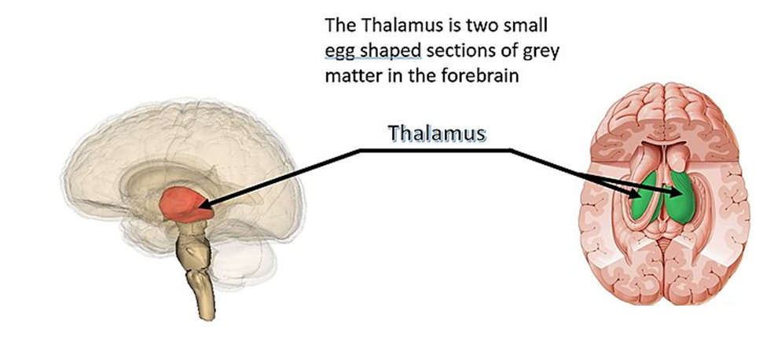
The Thalamus
The thalamus serves as the relay center of the brain where most senses (excluding smell) are routed before being directed to other areas of the brain for processing. The thalamus also plays a role in sleep, wakefulness, consciousness, learning and memory.
Image from Wikimedia Commons, Thalamus Chart by Damonlemay. Licensed under CC BY SA 4.0 DEED International. Edited by Maria Pagano.
Video: The video 2-Minute Neuroscience: The Thalamus discusses the function of the thalamus and covers some of the major nuclei of the thalamus (2:03).
Text from Psychology 2e OpenStax Revised Version Copyright © 2020 by Openstax is licensed under a Creative Commons Attribution 4.0 International License, except where otherwise noted. Edited by Maria Pagano

Slide 38
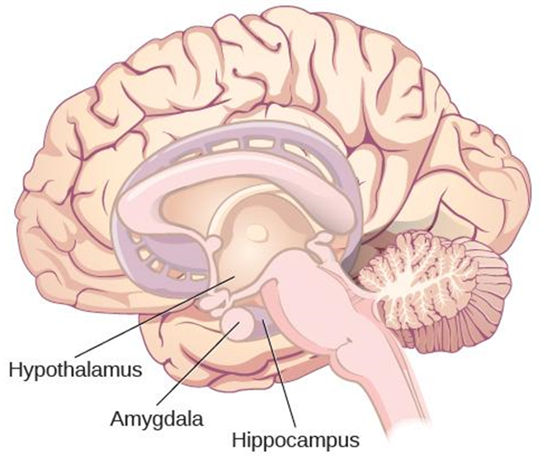
The Limbic System
The Limbic System is involved in mediating emotional response and memory and is made up of a number of different structures. Some of the most important ones being:
  The Amygdala – involved in our experience of emotion and tying emotional meaning to our memories. Involved in processing fear.
  The Hippocampus – structure associated with learning and memory (in particular spatial memory).
  The Hypothalamus – regulates homeostatic processes including body temperature, appetite, and blood pressure.
Figure 3.25 The limbic system is involved in mediating emotional response and memory.
Link to Learning Video: Clive Wearing, an accomplished musician, lost the ability to form new memories when his hippocampus was damaged through illness. Check out the first few minutes of this documentary video about this man and his condition to learn more (47:07).
Video: The video 2-Minute Neuroscience: The Limbic System discusses the function of the limbic system including the hypothalamus, amygdala, and hippocampus. The video also briefly looks at other areas of the limbic system (1:51).
Image and text from Psychology 2e OpenStax Revised Version Copyright © 2020 by Openstax is licensed under a Creative Commons Attribution 4.0 International License, except where otherwise noted. Edited by Maria Pagano

Slide 39
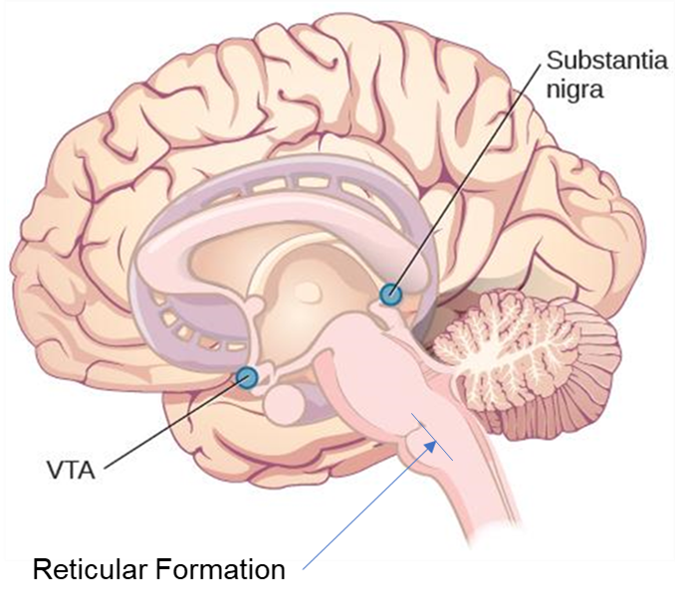
The Midbrain
The midbrain is the smallest portion of the brainstem and plays an important role sensory and motor control pathways.
  Reticular formation - important in regulating the sleep/wake cycle, arousal, alertness, and motor activity.
  Substantia Nigra - where dopamine is produced; involved in control of movement.
  Ventral tegmental area (VTA) - where dopamine is produced; associated with mood, reward, and addiction.
Degeneration of the Substantia Nigra and VTA is involved in Parkinson’s disease.
Figure 3.26 The reticular formation is a nerve network found in the brain stem. While most of the reticular formation is located in the hindbrain portion of the brain stem (as shown above), a small part of the reticular formation extends into the midbrain and up to the forebrain.
Image and text from Psychology 2e OpenStax Revised Version Copyright © 2020 by Openstax is licensed under a Creative Commons Attribution 4.0 International License, except where otherwise noted. Edited by Maria Pagano

Slide 40
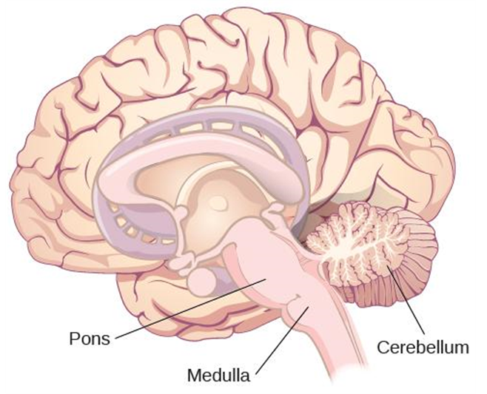
The Hindbrain
The hindbrain coordinates functions that are basic to survival like sleep, breathing, and motor activity.
  Medulla - controls automated processes like breathing, blood pressure, and heart rate.
  Pons - connects the brain and the spinal cord; involved in regulating brain activity during sleep.
  Cerebellum - controls our balance, coordination, movement, and motor skills, and it is thought to be important in processing some types of memory.
These 3 structures (the medulla, pons, and cerebellum) collectively are known as the brain stem.
Figure 3.28 The pons, medulla, and cerebellum make up the hindbrain.
Video: The video The Nervous System #04: The Hindbrain, Its Structures and Functions discusses the functions of the pons, medulla, and cerebellum which are in the hindbrain (3:30).
Image and text from Psychology 2e OpenStax Revised Version Copyright © 2020 by Openstax is licensed under a Creative Commons Attribution 4.0 International License, except where otherwise noted. Edited by Maria Pagano

Slide 41
Brain Imaging Techniques
Techniques Involving Radiation
CT Scan (Computerized Tomography)
PET Scan (Positron Emission Tomography)
Techniques Involving Magnetic Fields
MRI (Magnetic Resonance Imaging)
FMRI (Functional Magnetic Resonance Imaging)
Techniques Involving Electrical Activity
EEG (Electroencephalography)
Text from Psychology 2e OpenStax Revised Version Copyright © 2020 by Openstax is licensed under a Creative Commons Attribution 4.0 International License, except where otherwise noted. Edited by Maria Pagano

Slide 42
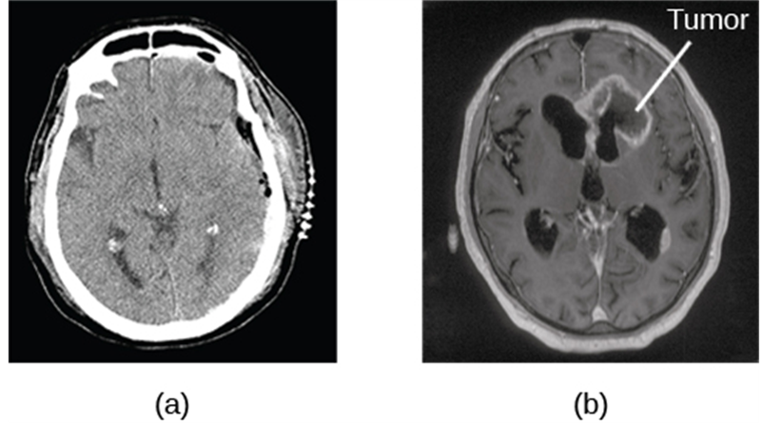
Computerized Tomography (CT) Scan
A CT or CAT scan involves x-rays and creates an image through a combined series of x-rays passing through varied densities within the brain or body.
  A CT scan be used to show brain tumors.
Figure 3.29 The image on the left (a) shows a healthy brain, whereas the image on the right (b) indicates a brain tumor in the left frontal lobe.
Video: The video How Does a CT Scan Work? provides information on how CT scans collect information (1.26).
Image and text from Psychology 2e OpenStax Revised Version Copyright © 2020 by Openstax is licensed under a Creative Commons Attribution 4.0 International License, except where otherwise noted. Edited by Maria Pagano

Slide 43
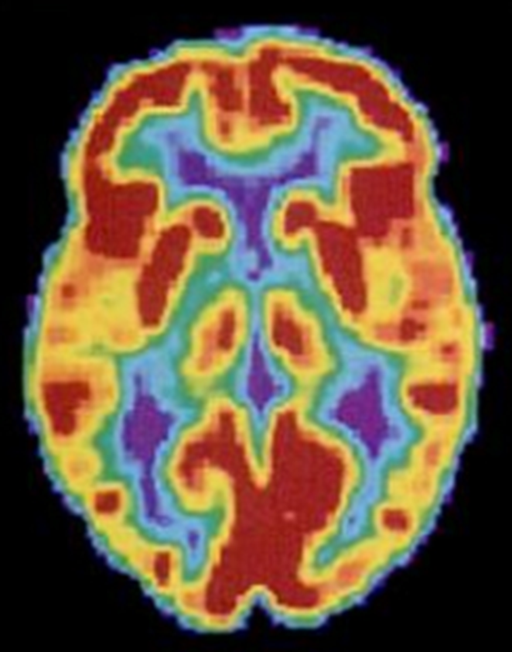
Positron Emission Tomography (PET)
Figure 3.30 A PET scan is helpful for showing activity in different parts of the brain.
Video: The video Pet Scan: How It Works shows how a PET scan is conducted on the brain (1:29).
Image and text from Psychology 2e OpenStax Revised Version Copyright © 2020 by Openstax is licensed under a Creative Commons Attribution 4.0 International License, except where otherwise noted. Edited by Maria Pagano

Slide 44
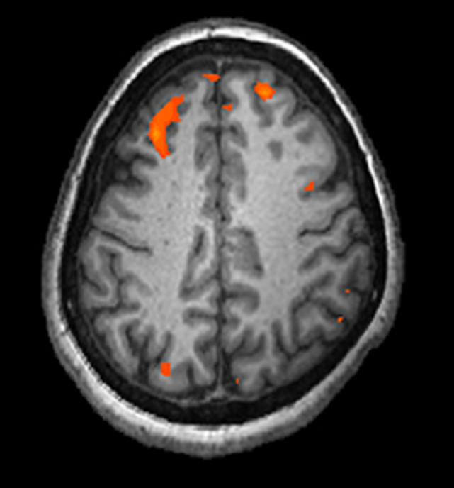
Magnetic Resonance Imaging (MRI) and Functional Magnetic Resonance Imaging (fMRI)
Magnetic resonance imaging (MRI) - magnetic fields used to produce a picture of the tissue being imaged. Typically used for determining evidence of brain injury, stroke, or spinal cord damage.
Functional magnetic resonance imaging (fMRI) - MRI that show changes in metabolic activity over time by tracking changes in blood flow. In the case of your brain, brain cells use more oxygen when they are working, which will result in increased blood flow to the areas of the brain that are working hardest.
Video: The video How Does an MRI Work? MRI Basics Explained presents an animated explanation of the basics of MRI (3:48).
Video: The video 2-Minute Neuroscience: Functional Magnetic Resonance Imaging (fMRI) discusses how fMRI works, what is represented in a typical fMRI image, and some methodological problems associated with the use of MRI (1:59).
Figure 3.31 An fMRI shows activity in the brain over time. This image represents a single frame from an fMRI.
Link to Learning Reading: Visit this virtual lab about MRI and fMRI to learn more.
Image and text from Psychology 2e OpenStax Revised Version Copyright © 2020 by Openstax is licensed under a Creative Commons Attribution 4.0 International License, except where otherwise noted. Edited by Maria Pagano

Slide 45
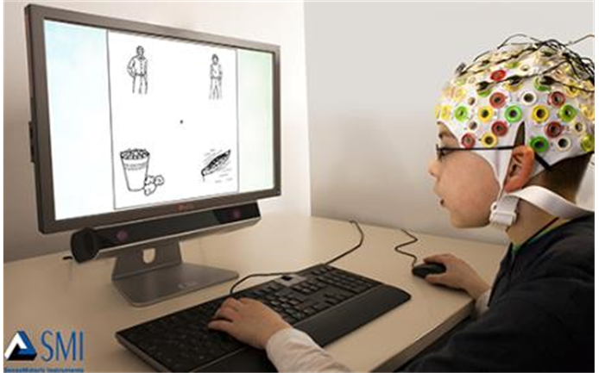
Electroencephalography (EEG)
Electroencephalography measures the electrical activity of the brain using small electrodes which are attached to the scalp or a skullcap.
Figure 3.32 Using caps with electrodes, modern EEG research can study the precise timing of overall brain activities.
Video: The video 2-Minute Neuroscience: Electroencephalography discusses the how EEG’s are measured, used, and some strengths and limitations (1:59).
Image and text from Psychology 2e OpenStax Revised Version Copyright © 2020 by Openstax is licensed under a Creative Commons Attribution 4.0 International License, except where otherwise noted. Edited by Maria Pagano

Slide 46
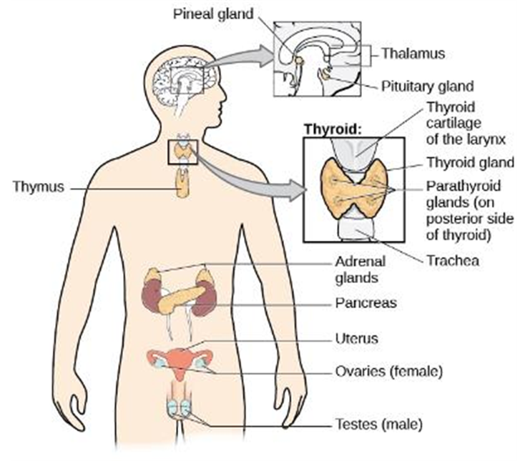
The endocrine system is a series of glands that produce hormones to regulate normal body functions.
  Pituitary gland – serves as the master gland, controlling the secretions of all other glands.
  Thyroid – secretes Thyroxine which regulates growth, metabolism and appetite
  Adrenal gland - secretes hormones involved in the stress response.
  Gonads - secretes sex hormones, which are important for successful reproduction, and regulate sexual motivation and behavior.
  Pancreas - secretes hormones that regulate blood sugar.
The hypothalamus links the nervous system and endocrine system by controlling the pituitary gland.
The Endocrine System
Video: The video 2-Minute Neuroscience: The Hypothalamus and the Pituitary Gland discusses the major roles of the hypothalamus and pituitary gland (2:00).
Video: The video How does the Thyroid Manage Your Metabolism?, shows how the thyroid works (3.36).
Video: The video Endocrine: The Adrenal Glands, provides a brief overview of the adrenal gland (1.24).
Video: While not the best in terms of presentation, the video Gonads - Structure and Function, does provide a very good description of the structure and function of the gonads in males and females (2.22).
Figure 3.33 The major glands of the endocrine system are shown.
Video: The video Anatomy and Physiology of the Pancreas, Animation, discusses the endocrine function of the pancreas (hormone production) at timestamp (3:02).
Image and text from Psychology 2e OpenStax Revised Version Copyright © 2020 by Openstax is licensed under a Creative Commons Attribution 4.0 International License, except where otherwise noted. Edited by Maria Pagano

Slide 47
The Endocrine System
Major Endocrine Glands and Associated Hormone Functions
Endocrine Gland | Associated Hormones | Function
Hypothalamus | Releasing and inhibiting hormones, such as oxytocin | Regulate hormone release from pituitary gland
Pituitary | Growth hormone, releasing and inhibiting hormones (such as thyroid stimulating hormone) | Regulate growth, regulate hormone release
Thyroid | Regulate growth, regulate hormone release | Regulate metabolism and appetite
Pineal | Melatonin | Regulate some biological rhythms such as sleep cycles
Adrenal | Epinephrine, norepinephrine | Stress response, increase metabolic activities
Pancreas | Insulin, glucagon | Regulate blood sugar levels
Ovaries | Estrogen, progesterone | Mediate sexual motivation and behavior, reproduction
Testes | Androgens, such as testosterone | Mediate sexual motivation and behavior, reproduction
Table 3.2
Table from Psychology 2e OpenStax Revised Version Copyright © 2020 by Openstax is licensed under a Creative Commons Attribution 4.0 International License, except where otherwise noted. Edited by Maria Pagano

