Slide 1

Chapter 1 Introduction to Psychology
OpenStax Psychology 2E
OpenStax ancillary resource is © Rice University under a CC-BY-4.0 DEED license and may be used with proper attributes. Unless otherwise noted all material and text contained in these ancillary materials is from Spielman, R. M., Jenkins, W. J., & Lovett, M. D. (2020). Psychology 2E. OpenStax and is licensed under CC BY 4.0 DEED.

Slide 2
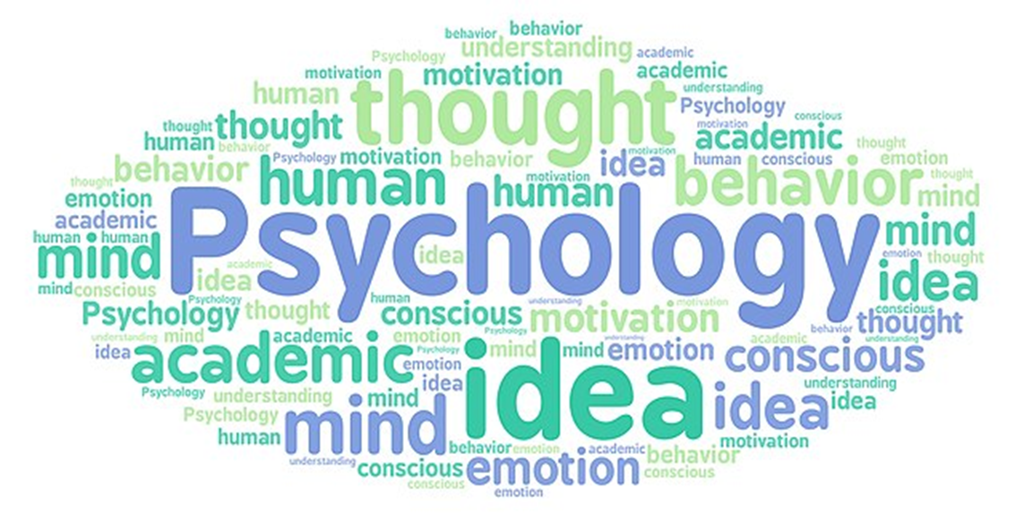
What is Psychology?
Psychology is the scientific study of mind and behavior.
OpenStax ancillary resource is © Rice University under a CC-BY-4.0 DEED license and may be used with proper attributes. Unless otherwise noted all material and text contained in these ancillary materials is from Spielman, R. M., Jenkins, W. J., & Lovett, M. D. (2020). Psychology 2E. OpenStax and is licensed under CC BY 4.0 DEED. Edited by Maria Pagano

Slide 3
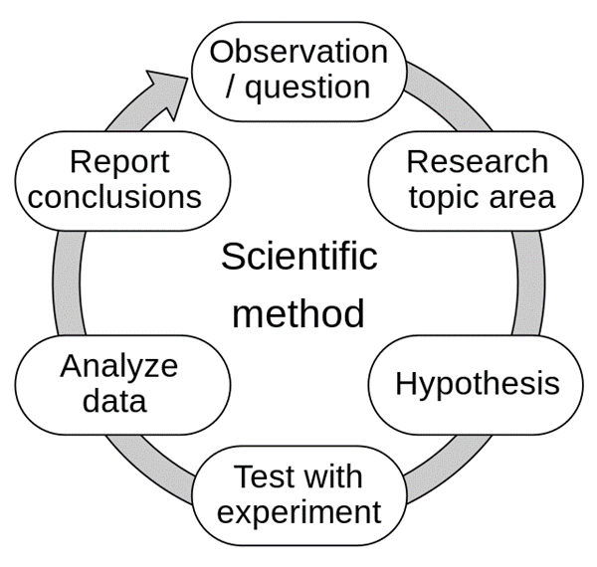
What is Psychology?
Psychologists use the scientific method to acquire knowledge. To apply the scientific method psychologists will:
  Form a hypothesis that will fit into the context of a theory and will then make observations or conduct experiments to test the validity of the hypothesis.
  Use the test results from these observations or experiments are then published and/or presented at research conferences so that others can replicate or build on the results.
The scientific method is a form of empiricism.
One reason scientific understanding of the mind is so limited is because thoughts cannot be directly measured like matter and energy.
Image from Wikimedia Commons by Efbrazil is licensed under CC BY 4.0 International.
OpenStax ancillary resource is © Rice University under a CC-BY-4.0 DEED license and may be used with proper attributes. Unless otherwise noted all material and text contained in these ancillary materials is from Spielman, R. M., Jenkins, W. J., & Lovett, M. D. (2020). Psychology 2E. OpenStax and is licensed under CC BY 4.0 DEED. Edited by Maria Pagano

Slide 4
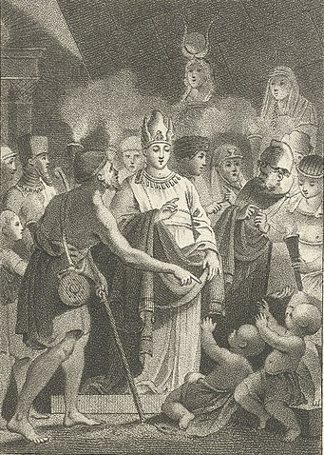
Why Study Psychology?
Psychology is one of the most popular majors in the United States, and accounts for approximately 6 percent of all bachelor’s degrees granted in the U.S.
An education in psychology can be valuable for many reasons as it can:
    train one in the use of the scientific method
    help to develop critical thinking skills
    show how to evaluate information for reliability and usefulness
    teach how to ask appropriate questions and make observations
    develop communication skills
    assist in understanding complex factors that shape behavior
Image from Wikimedia Commons, from Rijks Museum collection. Licensed under Public Domain .
Link to Learning Video: Watch a brief video about some questions to consider before deciding to major in psychology to learn more (5:42).
Records of psychological experiments can date back as far to the Pharaoh Psammetichus I who ruled Egypt from 664-610 BC. The title of this etching, circa 1800 is, “The Linguistic Experiment of Pharaoh Psammetichus.”
OpenStax ancillary resource is © Rice University under a CC-BY-4.0 DEED license and may be used with proper attributes. Unless otherwise noted all material and text contained in these ancillary materials is from Spielman, R. M., Jenkins, W. J., & Lovett, M. D. (2020). Psychology 2E. OpenStax and is licensed under CC BY 4.0 DEED. Edited by Maria Pagano

Slide 5
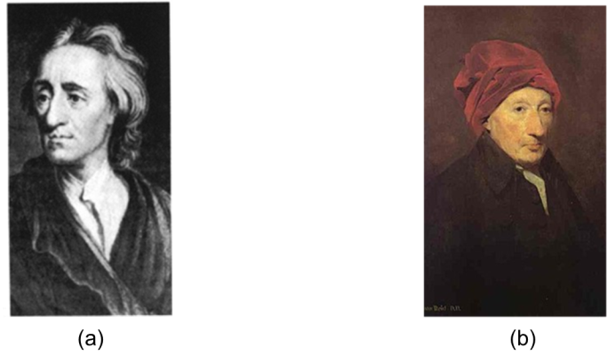
History of Psychology: The Influence of Philosophy
John Locke and Thomas Reid
Both Locke and Reid
  Promoted empiricism
  Emphasized the role of the human observer and the primacy of the senses in defining how the mind comes to acquire knowledge.
Figure 1.2 (a) John Locke (1632-1704): One of Locke’s many contributions to psychology is the idea that the human mind is born “empty,” or a tabula rasa and is subsequently shaped by one’s sensations and experiences. Locke's ideas laid the groundwork for the learning theories of Skinner and Bandura. (b) Thomas Reid (1710-1796): Reid proposed that perception is knowledge of the external world through direct experience and therefore experience was the source of all knowledge.
OpenStax ancillary resource is © Rice University under a CC-BY-4.0 DEED license and may be used with proper attributes. Unless otherwise noted all material and text contained in these ancillary materials is from Spielman, R. M., Jenkins, W. J., & Lovett, M. D. (2020). Psychology 2E. OpenStax and is licensed under CC BY 4.0 DEED. Edited by Maria Pagano

Slide 6
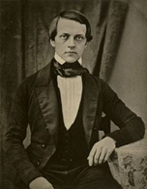
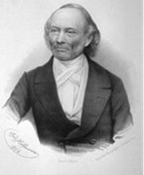
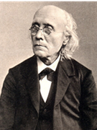
History of Psychology: The Influence of Physiology and Psychophysics
Hermann von Helmholtz, Ernst Weber, and Gustav Fechner
Figure 1.3 Helmholtz was a world recognized physiologist whose work led him to believe that our senses are not a mirror of the external world and can deceive us. An important implication of Helmholtz’s work is that there is both a psychological reality and physical reality, and the two are not the same.
Figure 1.4a Weber was an influential and important figure in the areas of physiology and psychology during his lifetime and beyond. His studies on sensation and touch, along with his emphasis on good experimental techniques led to new directions and areas of study for future psychologists, physiologists, and anatomists.
Figure 1.4b Fechner was a pioneer in experimental psychology and is credited as the founder of the field of psychophysics, a branch of psychology that deals with the relationships between physical stimuli and its interaction with the sensory system.
OpenStax ancillary resource is © Rice University under a CC-BY-4.0 DEED license and may be used with proper attributes. Unless otherwise noted all material and text contained in these ancillary materials is from Spielman, R. M., Jenkins, W. J., & Lovett, M. D. (2020). Psychology 2E. OpenStax and is licensed under CC BY 4.0 DEED. Edited by Maria Pagano

Slide 7
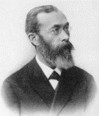
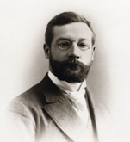
History of Psychology: Structuralism
Wilhelm Wundt and Edward Titchener
Figure 1.5a Wundt opened the first laboratory for psychological research in Leipzig, Germany in 1875, and is considered one of the founders of psychology.
  He provided classes, textbooks, and a laboratory for training students.
  His research focused on understanding the structure and characteristics of the mind through introspection.
    Introspection - Process by which someone examines their own conscious experience to break it into its component parts
Figure 1.6 Wundt’s student Titchener brought brought to America his version of experimental psychology, known as structuralism.
  Structuralism focused on the breaking down of mental process into its most basic components.
  Titchener’s first doctoral student was Margaret Floy Washburn who would go on to become the first woman in America to earn a Ph.D. in psychology.
OpenStax ancillary resource is © Rice University under a CC-BY-4.0 DEED license and may be used with proper attributes. Unless otherwise noted all material and text contained in these ancillary materials is from Spielman, R. M., Jenkins, W. J., & Lovett, M. D. (2020). Psychology 2E. OpenStax and is licensed under CC BY 4.0 DEED. Edited by Maria Pagano

Slide 8
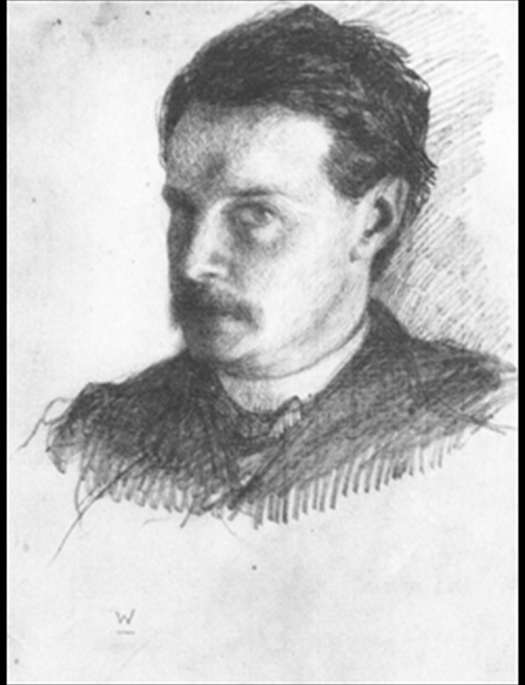
History of Psychology: Functionalism
William James
William James was the first American psychologist; He drew his ideas from the functionality of cognitive processes and established the school of thought known as functionalism.
  Functionalism – emphasized how mental activities contributed to basic environmental survival.
  Unlike structuralists like Wundt and Titchener, functionalists are more interested in the operation of the whole mind rather than its individual parts.
Video: Structuralism and Functionalism by Skepsy: Explores the differences between Structuralism and Functionalism (8:02)
Figure 1.7 William James, shown here in a self-portrait, was the first American psychologist.
OpenStax ancillary resource is © Rice University under a CC-BY-4.0 DEED license and may be used with proper attributes. Unless otherwise noted all material and text contained in these ancillary materials is from Spielman, R. M., Jenkins, W. J., & Lovett, M. D. (2020). Psychology 2E. OpenStax and is licensed under CC BY 4.0 DEED. Edited by Maria Pagano

Slide 9
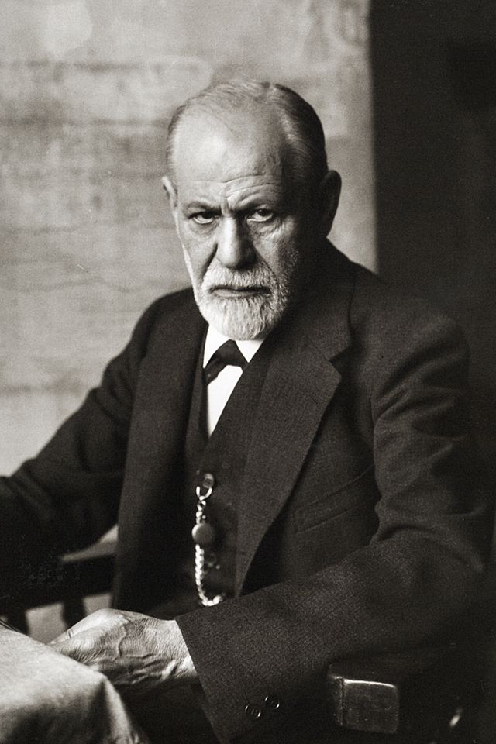
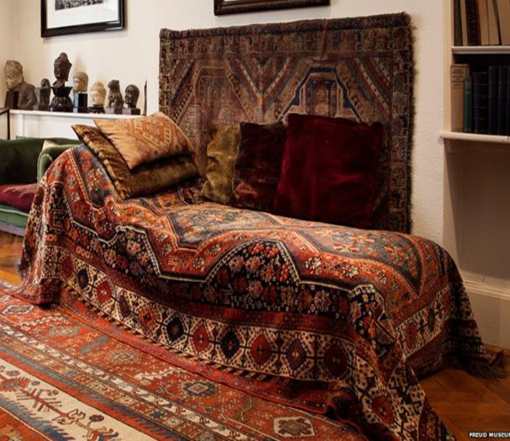
History of Psychology: Psychoanalytic Theory: Sigmund Freud
Sigmund Freud was Austrian neurologist who turned to the study of the unconscious mind, a repository of feelings and urges of which we have no awareness.
  Founded Psychoanalytic theory which focuses on the role of a person’s unconscious and early childhood experiences.
    Psychoanalytic theory dominated clinical psychology for several decades
  Theorized that many of his patients’ problems arose from the unconscious mind.
    Believed one way the unconscious mind could be accessed was through dream analysis.
  While Freud is considered a highly influential figure in the history of psychology, today his ideas are considered both influential as well as controversial
Freud’s couch. Photograph Is part of a collection from the Freud Museum in London and may be used for educational purposes.
Figure 1.8(a) Sigmund Freud was a highly influential figure in the history of psychology.
OpenStax ancillary resource is © Rice University under a CC-BY-4.0 DEED license and may be used with proper attributes. Unless otherwise noted all material and text contained in these ancillary materials is from Spielman, R. M., Jenkins, W. J., & Lovett, M. D. (2020). Psychology 2E. OpenStax and is licensed under CC BY 4.0 DEED. Edited by Maria Pagano

Slide 10
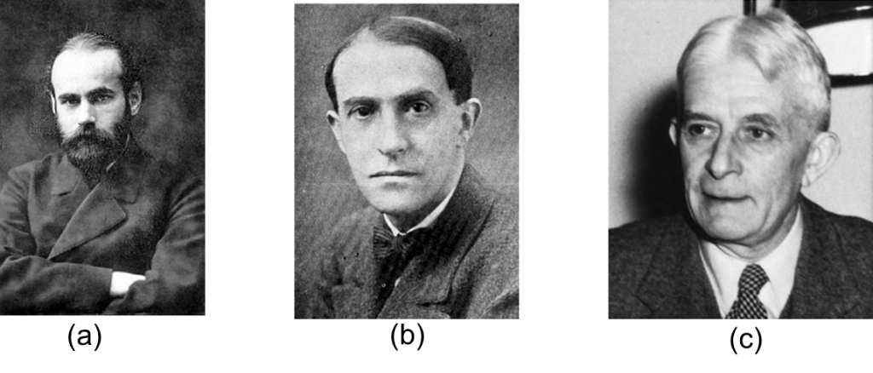
History of Psychology: Gestalt Psychology
Max Wertheimer, Kurt Koffka, and Wolfgang Kohler
Wertheimer, Koffka, and Kohler were German psychologists who immigrated to the U.S. to escape Nazi Germany and introduced the idea of Gestalt psychology.
  The word Gestalt translates to “whole”
    Gestalt psychology is based on the idea that while a sensory experience can be broken down into individual parts, how those parts relate to each other to create a whole is often what the individual responds to in terms of perception.
    Gestalt psychology continues to influence research on sensation and perception even today.
Figure 1.9 (a) Max Wertheimer was also interested in perception and is credited with being the first to demonstrate what he called the phi phenomenon. (b) Kurt Koffka became interested in Gestalt psychology after taking part in Wertheimer's phi phenomenon studies. (c) Wolfgang Kohler was critical of both introspection and behaviorism. He, too met Wertheimer by taking part in phi phenomenon studies.
OpenStax ancillary resource is © Rice University under a CC-BY-4.0 DEED license and may be used with proper attributes. Unless otherwise noted all material and text contained in these ancillary materials is from Spielman, R. M., Jenkins, W. J., & Lovett, M. D. (2020). Psychology 2E. OpenStax and is licensed under CC BY 4.0 DEED. Edited by Maria Pagano

Slide 11
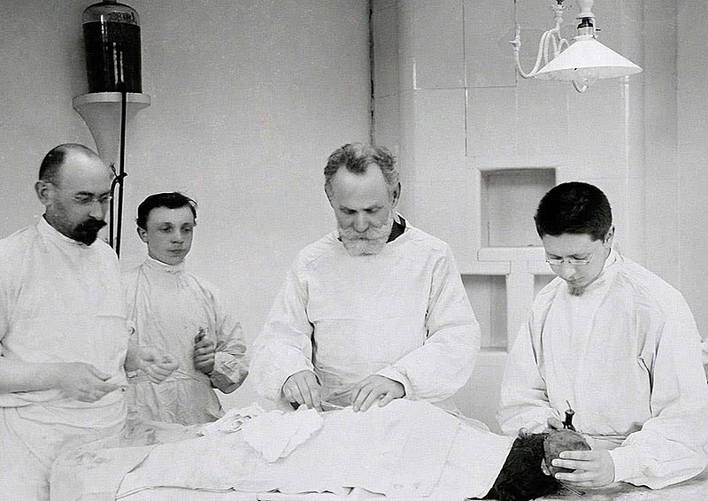
History of Psychology: Behaviorism
Ivan Pavlov
Pavlov was a Russian physiologist who studied a form of learning called the conditioned reflex. He called this type of learning classical conditioning.
  Prior to conditioning, an animal or human will naturally produce a reflex response to a stimulus. For examples, the sight of food will make a human or animal salivate if they are hungry.
  However, if another stimulus (the sound of a bell) is introduced immediately prior to the sight of the food, then the individual or animal will associate the sight of the bell with the food and will consequently salivate when they hear the bell.
(Image of Pavlov working in his lab with his associates from Wikimedia Commons by Vibha C Kashyap Licensed under CC BY SA 4.0 DEED)
OpenStax ancillary resource is © Rice University under a CC-BY-4.0 DEED license and may be used with proper attributes. Unless otherwise noted all material and text contained in these ancillary materials is from Spielman, R. M., Jenkins, W. J., & Lovett, M. D. (2020). Psychology 2E. OpenStax and is licensed under CC BY 4.0 DEED. Edited by Maria Pagano

Slide 12
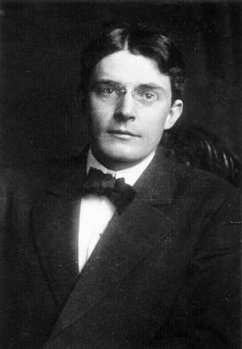
History of Psychology: Behaviorism
John B. Watson
Watson is known as the father of behaviorism within psychology and applied Pavlov’s principles to human learning.
  Watson believed that objective analysis of the mind was impossible and that the focus of psychology should be on observable behavior and ways to bring that behavior under control.
  Behaviorism dominated experimental psychology for several decades and is still used in behavioral and cognitive-behavioral therapies.
Figure 1.11 John B. Watson is known as the father of behaviorism within psychology.
OpenStax ancillary resource is © Rice University under a CC-BY-4.0 DEED license and may be used with proper attributes. Unless otherwise noted all material and text contained in these ancillary materials is from Spielman, R. M., Jenkins, W. J., & Lovett, M. D. (2020). Psychology 2E. OpenStax and is licensed under CC BY 4.0 DEED. Edited by Maria Pagano

Slide 13
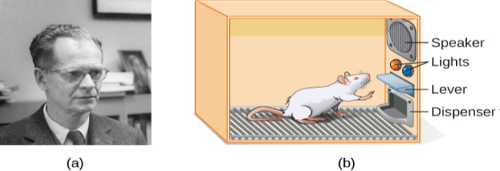
History of Psychology: Behaviorism: B.F Skinner
Like Watson, Skinner was also a behaviorist.
  His research focused on how behavior was affected by the consequences which followed the behavior.
    He called this type of learning operant conditioning
      Operant conditioning is a type of learning that occurs via the rewards or punishments that follow a behavior.
  Studied the principles of modifying behavior through reinforcement and punishment which he saw as major factors in driving behavior.
  Figure 1.12(a) B. F. Skinner is famous for his research on operant conditioning. (b) Modified versions of the operant conditioning chamber, or Skinner box, are still widely used in research settings today. When the animal pushes the button or lever, the box can deliver a reinforcement of the behavior (such as food) or a punishment (such as a noise) or a token conditioner (such as a light) that is correlated with either the reinforcement or punishment.
OpenStax ancillary resource is © Rice University under a CC-BY-4.0 DEED license and may be used with proper attributes. Unless otherwise noted all material and text contained in these ancillary materials is from Spielman, R. M., Jenkins, W. J., & Lovett, M. D. (2020). Psychology 2E. OpenStax and is licensed under CC BY 4.0 DEED. Edited by Maria Pagano

Slide 14
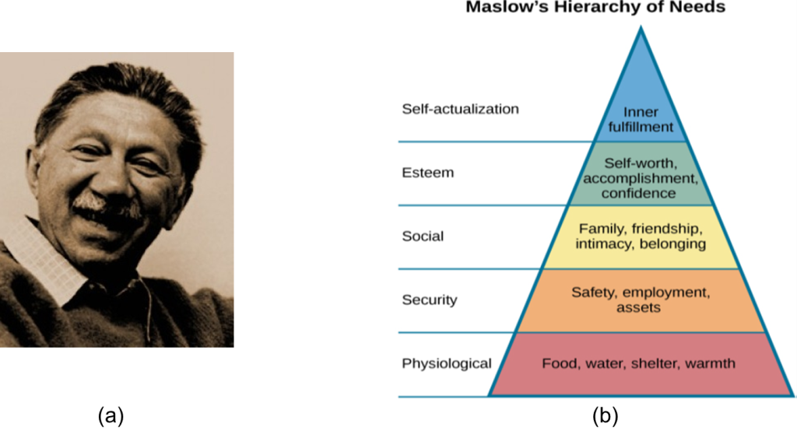
History of Psychology: Humanism
Abraham Maslow
Maslow asserted that so long as basic needs necessary for survival were met (e.g., food, water, shelter), higher-level needs (e.g., social needs) would begin to motivate behavior.
  Like most humanist psychologists, Maslow rejected, on principle, the research approach based on reductionist experimentation in the tradition of the physical and biological sciences, because it missed the “whole” human being.
Figure 1.13(a) Maslow's studies of self-actualization began under the supervision of one of his mentors, Gestalt psychologist Max Wertheimer. (b) Maslow's hierarch of needs, represented as a pyramid with the more basic needs at the bottom.
OpenStax ancillary resource is © Rice University under a CC-BY-4.0 DEED license and may be used with proper attributes. Unless otherwise noted all material and text contained in these ancillary materials is from Spielman, R. M., Jenkins, W. J., & Lovett, M. D. (2020). Psychology 2E. OpenStax and is licensed under CC BY 4.0 DEED. Edited by Maria Pagano

Slide 15
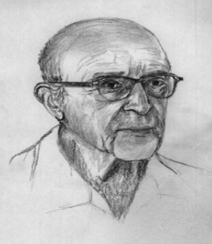
History of Psychology: Humanism: Carl Rogers
Like Maslow, Rogers emphasized the potential for good that exists within all people.
Rogers developed the therapeutic technique known as client-centered therapy.
  Unlike the psychoanalytic approach, client-centered therapy involves the patient taking a lead role in the session.
Rogers believed that a therapist needed to display three features to maximize the effectiveness of this approach: unconditional positive regard, genuineness, and empathy.
    Unconditional positive regard refers to the fact that the therapist accepts their client for who they are, no matter what he or she might say.
Figure 1.14 Carl Rogers, shown in this portrait, developed a client-centered therapy method that has been influential in clinical settings.
Link to Learning Video: View a brief video of Carl Rogers describing his therapeutic approach to learn more (1:48).
OpenStax ancillary resource is © Rice University under a CC-BY-4.0 DEED license and may be used with proper attributes. Unless otherwise noted all material and text contained in these ancillary materials is from Spielman, R. M., Jenkins, W. J., & Lovett, M. D. (2020). Psychology 2E. OpenStax and is licensed under CC BY 4.0 DEED. Edited by Maria Pagano

Slide 16
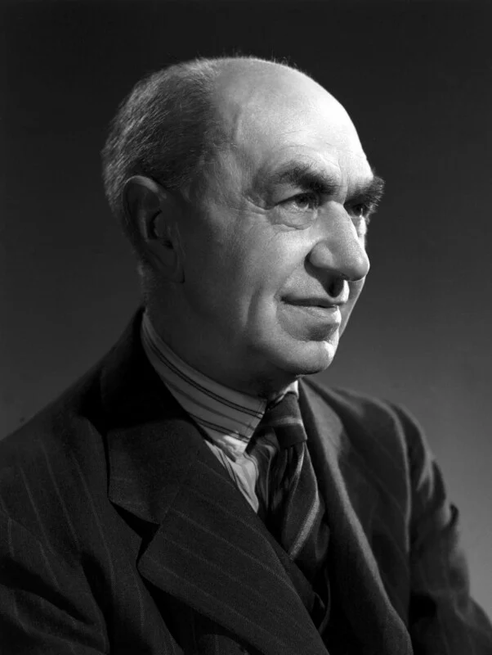
History of Psychology: The Cognitive Revolution: Frederic C. Bartlett
Bartlett was appointed the first professor of experimental psychology at the University of Cambridge in 1931.
  Proposed that memories of past events and experiences are mental reconstructions that are influenced by cultural norms and beliefs and individual behaviors. As a result of this influence, recollections of these events and experiences are shaped by the process of reconstructing the memory.
  Demonstrated that only a small portion of an event is perceived in the moment in which it occurs, and during the reconstruction of this memory, any gaps in observation or perception are filled in with the assistance of prior experiences.
Figure 1.15(a) Frederic C. Bartlett was the Chair of Experimental Psychology at Cambridge when he published the book he is most famously recognized for: Remembering (1932), which look at how cultural attitudes and personal habits affected recollection of memory.
OpenStax ancillary resource is © Rice University under a CC-BY-4.0 DEED license and may be used with proper attributes. Unless otherwise noted all material and text contained in these ancillary materials is from Spielman, R. M., Jenkins, W. J., & Lovett, M. D. (2020). Psychology 2E. OpenStax and is licensed under CC BY 4.0 DEED. Edited by Maria Pagano

Slide 17
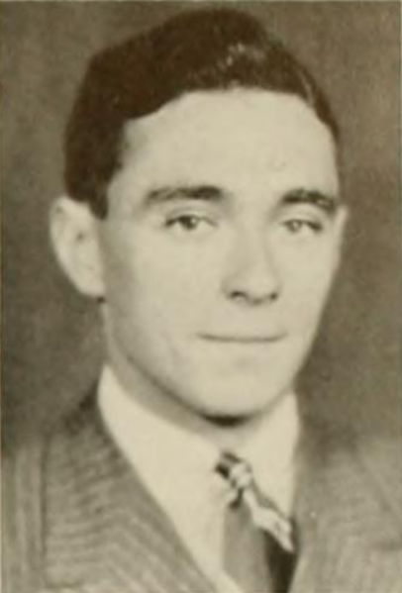
History of Psychology: The Cognitive Revolution
Jerome Bruner
Bruner is credited as one of the pioneers in cognitive psychology.
  His early research looked at how one’s environment and culture shaped the way we perceive the world around us.
  Bruner posited that organisms struggle to perceive elements that deviate from their expectations.
    For example, Bruner found that when he rearranged the colors and suits of a deck of playing cards (e.g., red spades and black hearts) participants showed slower reaction times and less accurate answers, particularly when such cards followed a "normal" playing card. However, once subjects became aware of the differences, they demonstrated improved accuracy.
Figure 1.15b Jerome S. Bruner developed theories on several aspects of cognition, including perception and learning.
OpenStax ancillary resource is © Rice University under a CC-BY-4.0 DEED license and may be used with proper attributes. Unless otherwise noted all material and text contained in these ancillary materials is from Spielman, R. M., Jenkins, W. J., & Lovett, M. D. (2020). Psychology 2E. OpenStax and is licensed under CC BY 4.0 DEED. Edited by Maria Pagano

Slide 18
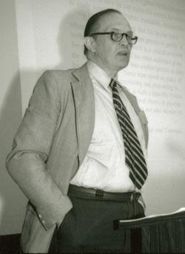
History of Psychology: The Cognitive Revolution
George Miller
Like Bartlett and Bruner, Miller is also considered one of the founders of cognitive psychology.
  His most famous publication, :The Magical Number Seven, Plus or Minus Two” showed that, on average, human short-term-memory was limited to an average capacity of 7 items, plus or minus two.
  Miller also coined the term “chunk,” or “chunking,” to describe how individuals could enhance the capacity limit posed by short-term-memory by grouping elements.
Figure 1.15c George A. Miller contributed not only to cognitive psychology but also contributed to the founding of the field of psycholinguistics.
OpenStax ancillary resource is © Rice University under a CC-BY-4.0 DEED license and may be used with proper attributes. Unless otherwise noted all material and text contained in these ancillary materials is from Spielman, R. M., Jenkins, W. J., & Lovett, M. D. (2020). Psychology 2E. OpenStax and is licensed under CC BY 4.0 DEED. Edited by Maria Pagano

Slide 19
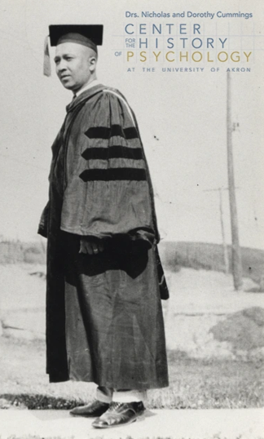
History of Psychology: Multicultural and Cross-Cultural Psychology
Francis C. Sumner
In addition to being known as the first African-American to receive a Ph.D. in psychology, Sumner was also widely known as a leader in education reform.
  From 1928 until his death in 1954, Sumner served as the chair of the psychology department at Howard University.
  Sumner’s research in psychology focused on how to understand and eliminate racial bias in the administration of justice and he was one of the first to contribute to the fields of psychology, religion, and the administration of justice collectively.
Figure 1.16 Francis C. Sumner earned his psychology degree under G. Stanley Hall at Clark University on June 14, 1920.
OpenStax ancillary resource is © Rice University under a CC-BY-4.0 DEED license and may be used with proper attributes. Unless otherwise noted all material and text contained in these ancillary materials is from Spielman, R. M., Jenkins, W. J., & Lovett, M. D. (2020). Psychology 2E. OpenStax and is licensed under CC BY 4.0 DEED. Edited by Maria Pagano

Slide 20
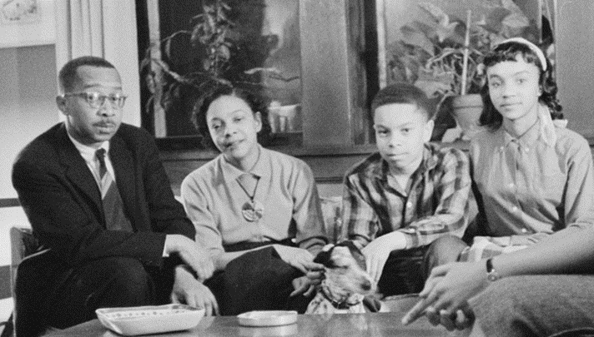
History of Psychology: Multicultural and Cross-Cultural Psychology
Kenneth Clark and Mamie Phipps Clark
Approximately fourteen years before testifying before the Supreme Court, Kenneth and Mamie Clark conducted studies with African-American children which led the Clarkes to conclude that, prejudice, discrimination, and segregation created a feeling of inferiority among African-American children and damaged their self-esteem.
  Both Kenneth and Mamie Clark testified before the Supreme Court as expert witnesses in Briggs v. Elliott (1952), one of the five cases consolidated into Brown v. Board of Education (1954).
  Their testimony played a crucial role in the U.S. Supreme Court's decision, declaring that legally mandated racial segregation in public education was unconstitutional.
Figure 1.17 Kenneth Clark, Mamie Clark and their children.
Link to Learning Podcast: Listen to a podcast about the influence of an African American's psychology research on the historic Brown v. Board of Education civil rights case to learn more (8:00)
OpenStax ancillary resource is © Rice University under a CC-BY-4.0 DEED license and may be used with proper attributes. Unless otherwise noted all material and text contained in these ancillary materials is from Spielman, R. M., Jenkins, W. J., & Lovett, M. D. (2020). Psychology 2E. OpenStax and is licensed under CC BY 4.0 DEED. Edited by Maria Pagano

Slide 21
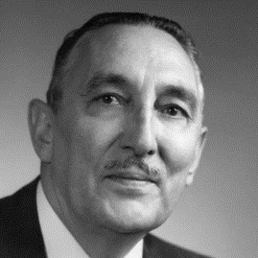
History of Psychology: Multicultural and Cross-Cultural Psychology
George Sanchez
In 1940, Sánchez released his most renowned publication, "Forgotten People: A Study of New Mexicans." This publication chronicled the disparities encountered by schoolchildren in the state and highlighted the many different challenges faced by Spanish-speaking children living in New Mexico such as literacy rates, insufficient educational funding, and notably low enrollment in schools catering to Spanish-speaking children.
  In 1946 and 1947 Sánchez conducted surveys for the U.S. Department of the Interior regarding the state of Navajo education. The results of this survey concluded that only about a quarter of Navajo children attended school. Moreover, in order to attend school these children often encountered rough road conditions and insufficient educational materials and establishments.
Figure 1.17 George Sanchez was involved in many different legal cases either as an advisor or expert witness. One such landmark case Delgado v. Gracy ended the policy of school segregation of Mexican Americans.
OpenStax ancillary resource is © Rice University under a CC-BY-4.0 DEED license and may be used with proper attributes. Unless otherwise noted all material and text contained in these ancillary materials is from Spielman, R. M., Jenkins, W. J., & Lovett, M. D. (2020). Psychology 2E. OpenStax and is licensed under CC BY 4.0 DEED. Edited by Maria Pagano

Slide 22
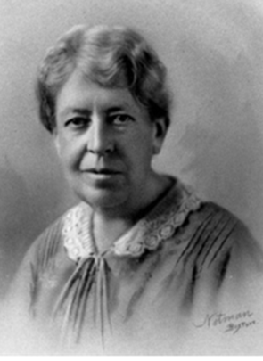
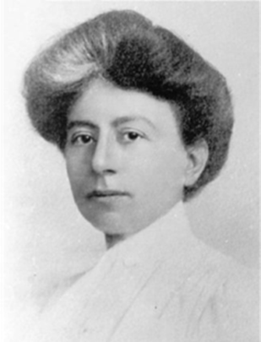
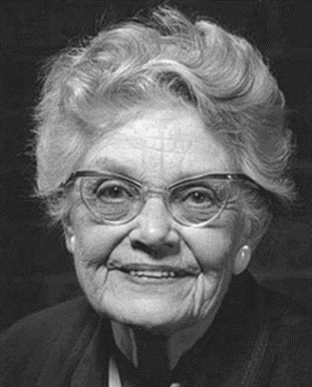
History of Psychology: Women in Psychology
Mary Whiton Calkins, Margaret Floy Washburn and Mary Cover Jones
Figure 1.18 (a) Even though she had completed the requirements for a doctoral degree in psychology, Calkins was a refused a Ph.D. by Harvard because she was a woman
  During her lifetime Calkins taught psychology and philosophy at Wellesley College and conducted research at Harvard.
Figure 1.18b Washburn was the first woman to receive a Ph.D. in psychology and was the second woman after Mary Whiton Calkins to serve as the President of the American Psychological Association.
  In 1903 Washburn returned to Vassar to head the newly founded department of psychology.
Figure 1.18c Jones was a pioneer of behavior therapy (therapies which used behavioral techniques to treat clients).
  In 1924, she desensitized a child’s (Peter) fear of rabbits by gradually exposing the child to rabbits while providing positive associations.
OpenStax ancillary resource is © Rice University under a CC-BY-4.0 DEED license and may be used with proper attributes. Unless otherwise noted all material and text contained in these ancillary materials is from Spielman, R. M., Jenkins, W. J., & Lovett, M. D. (2020). Psychology 2E. OpenStax and is licensed under CC BY 4.0 DEED. Edited by Maria Pagano

Slide 23
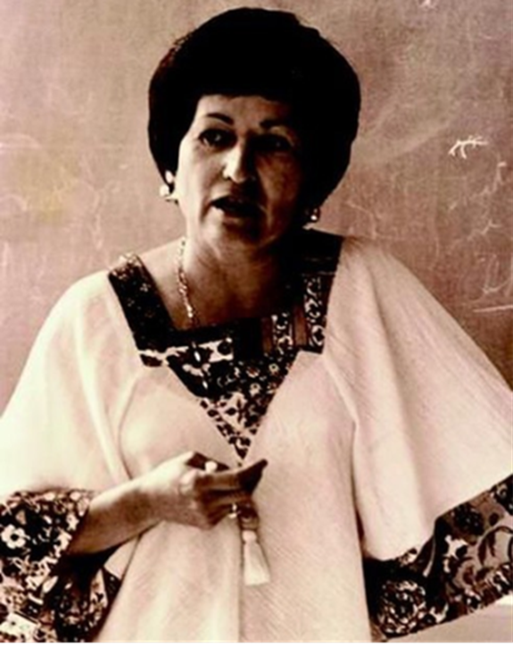
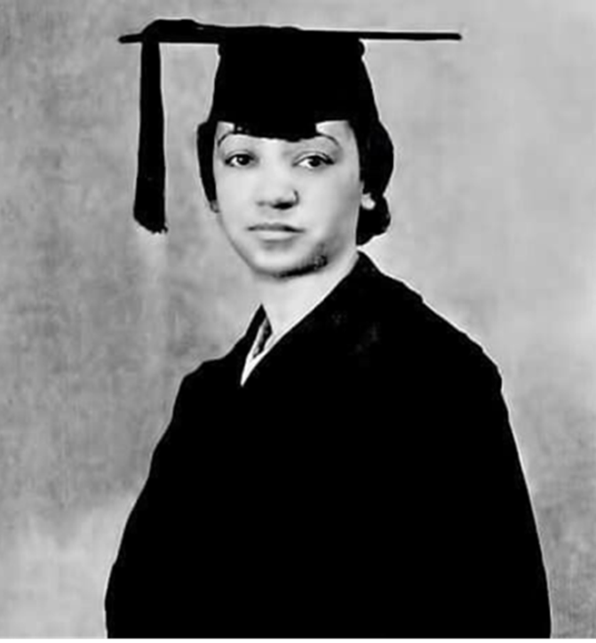
History of Psychology: Minority Women in Psychology
Martha Bernal and Inez Beverly Prosser
Figure 1.19a Even though Bernal was turned down for many faculty positions because she was a woman, she went on to make many contributions to the field of psychology.
  One such accomplishment was incorporating specific organizations into the American Psychological Association (APA) which focused on ethnic issues. As a result, the APA formed the Board of Ethnic Minorities
Figure 1.19b While Prosser’s life was cut short when she died in a car accident at the age of 39. Although her life was cut short, Prosser helped many African-American students obtain funding for college and graduate study.
  Her dissertation examined self-esteem and personality development in African-American children who attended segregated schools and those who attended integrated schools.
OpenStax ancillary resource is © Rice University under a CC-BY-4.0 DEED license and may be used with proper attributes. Unless otherwise noted all material and text contained in these ancillary materials is from Spielman, R. M., Jenkins, W. J., & Lovett, M. D. (2020). Psychology 2E. OpenStax and is licensed under CC BY 4.0 DEED. Edited by Maria Pagano

Slide 24
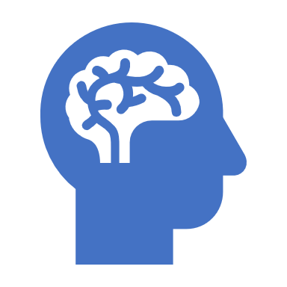
Contemporary Psychology: Branches of Psychology
Biopsychology and Evolutionary Psychology
Sensation and Perception
Cognitive Psychology
Developmental Psychology
Personality Psychology
Social Psychology
Health Psychology
Industrial-Organizational Psychology
Sports and Exercise Psychology
Clinical Psychology
Forensic Psychology
Link to Learning Reading: Please visit this website about the divisions within the APA to learn more. View these student resources also provided by the APA.
OpenStax ancillary resource is © Rice University under a CC-BY-4.0 DEED license and may be used with proper attributes. Unless otherwise noted all material and text contained in these ancillary materials is from Spielman, R. M., Jenkins, W. J., & Lovett, M. D. (2020). Psychology 2E. OpenStax and is licensed under CC BY 4.0 DEED. Edited by Maria Pagano

Slide 25
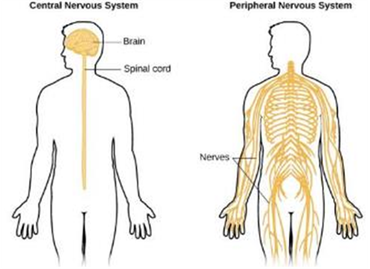
Contemporary Psychology: Biopsychology
Biological psychologists study how the structure and function of the nervous system generate behavior.
Research can include:
  Biopsychology and Evolutionary Psychology
  Sensation and Perception
  Cognitive Psychology
  Developmental Psychology
  Personality Psychology
  Social Psychology
  Health Psychology
  Industrial-Organizational Psychology
  Sports and Exercise Psychology
  Clinical Psychology
  Forensic Psychology
Figure 1.20 Biological psychologists study how the structure and function of the nervous system generate behavior.
Text and image from Psychology 2e OpenStax Revised Version Copyright © 2020 by Openstax is licensed under a Creative Commons Attribution 4.0 International License, except where otherwise noted. Edited by Maria Pagano

Slide 26

Contemporary Psychology: Evolutionary Psychology
Evolutionary psychologists presume all human behaviors reflect the influence of physical and psychological predispositions that helped human ancestors survive and reproduce. (From Evolutionary Psychology by Kenrick, D. T. (2019, March 19) in Encyclopedia Britannica. Material is copyrighted but may be used for educational purposes and presentations.)
  In general, evolutionary psychologists expect all human cultures to express a behavior if it is caused genetically, since the genetic differences among human groups are small.
  Demonstrating that a trait, especially in humans, is naturally selected is extraordinarily difficult.
  Behavioral traits need not be adaptive under current conditions, only under the conditions of the past when they evolved, about which we can only hypothesize.
  Evolutionary psychologists have had success in finding experimental correspondence between observations and expectations. For example, Buss (1989) found that women valued earning potential factors greater than men, and men valued potential reproductive factors (youth and attractiveness) greater than women in their prospective mates
Image from Wikimedia Commons by User.private. Licensed under a CC BY SA 3.0 DEED,
Text and from Psychology 2e OpenStax Revised Version Copyright © 2020 by Openstax is licensed under a Creative Commons Attribution 4.0 International License, except where otherwise noted. Edited by Maria Pagano

Slide 27
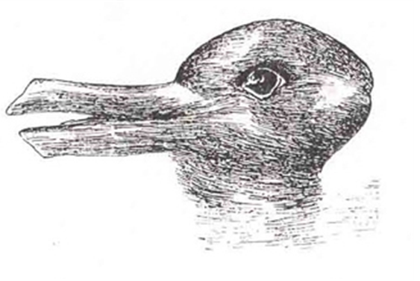
Contemporary Psychology: Perception
This area of study focuses on both physiological aspects of sensory systems and the psychological experience of sensory information.
  Sensation – Sensory information (sights, sounds, touch, smell).
  Perception – Experience of the world which is influenced by where we focus our attention, our previous experiences, and our cultural backgrounds.
Figure 1.21 When you look at this image, you may see a duck or a rabbit. The sensory information remains the same, but your perception can vary dramatically.
Text and image from Psychology 2e OpenStax Revised Version Copyright © 2020 by Openstax is licensed under a Creative Commons Attribution 4.0 International License, except where otherwise noted.

Slide 28
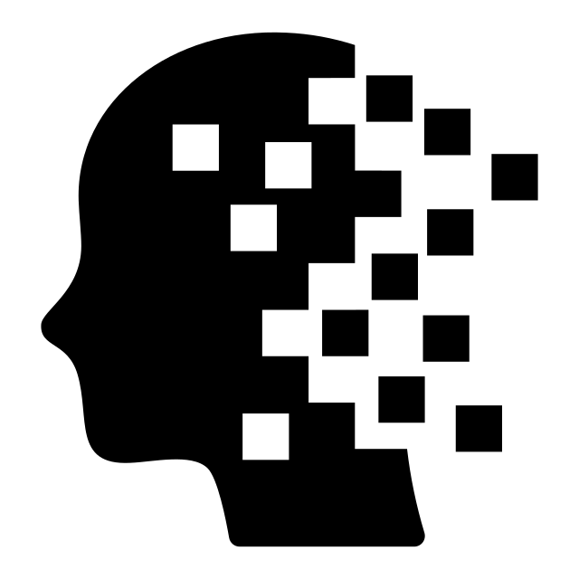
Contemporary Psychology: Cognitive Psychology
Cognitive psychology is the area of psychology that focuses on studying cognitions, or thoughts, and their relationship to our experiences and our actions.
  Cognitive psychologists have research interests that span a spectrum of topics, ranging from attention to problem solving to language to memory.
Image from Wikimedia Commons by Victoruler and sourced by "thenounproject.". Licensed under a CC BY SA 4.0 DEED International,
OpenStax ancillary resource is © Rice University under a CC-BY-4.0 DEED license and may be used with proper attributes. Unless otherwise noted all material and text contained in these ancillary materials is from Spielman, R. M., Jenkins, W. J., & Lovett, M. D. (2020). Psychology 2E. OpenStax and is licensed under CC BY 4.0 DEED. Edited by Maria Pagano

Slide 29
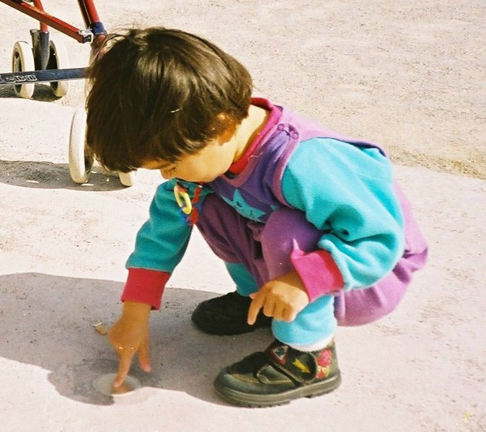
Contemporary Psychology: Developmental Psychology
Developmental psychology studies the physical and mental attributes of aging and maturation.
This can include various skills that are acquired throughout growth.
  Moral Reasoning
  Cognitive Skills
  Social Skills
Image from Wikimedia Commons by Kucharek. Released by author as Public Domain,
OpenStax ancillary resource is © Rice University under a CC-BY-4.0 DEED license and may be used with proper attributes. Unless otherwise noted all material and text contained in these ancillary materials is from Spielman, R. M., Jenkins, W. J., & Lovett, M. D. (2020). Psychology 2E. OpenStax and is licensed under CC BY 4.0 DEED. Edited by Maria Pagano

Slide 30
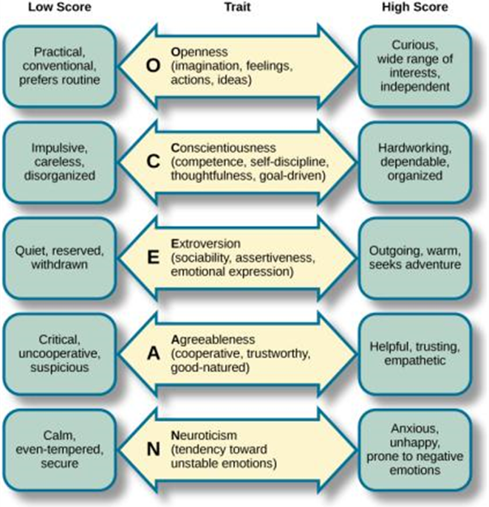
Contemporary Psychology: Personality Psychology
Focuses on behaviors and thought patterns that are unique to everyone.
Studies in this field include conscious and unconscious thinking and identifying personality traits.
Figure 1.23 Each of the dimensions of the Five Factor model is shown in this figure. The provided description would describe someone who scored highly on that given dimension. Someone with a lower score on a given dimension could be described in opposite terms.
Image and text from Psychology 2e OpenStax Revised Version Copyright © 2020 by Openstax is licensed under a Creative Commons Attribution 4.0 International License, except where otherwise noted. Edited by Maria Pagano

Slide 31
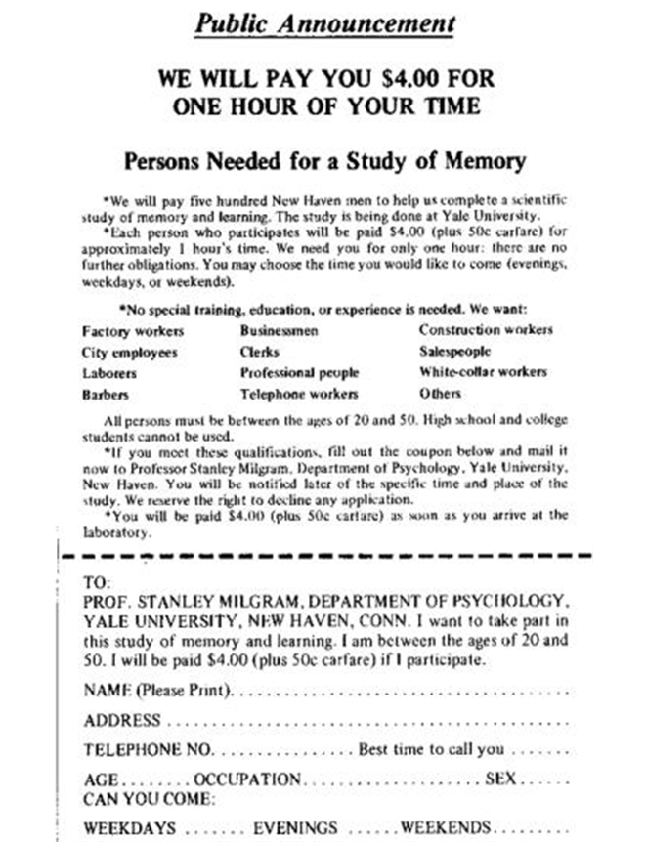
Contemporary Psychology: Social Psychology
Social psychology studies how individuals interact and relate with others and how such interactions can affect behavior
  Prejudice
  Attraction
  Interpersonal conflicts
  Obedience
Figure 1.24 Stanley Milgram’s research demonstrated just how far people will go in obeying orders from an authority figure. This advertisement was used to recruit subjects for his research.
Image and text from Psychology 2e OpenStax Revised Version Copyright © 2020 by Openstax is licensed under a Creative Commons Attribution 4.0 International License, except where otherwise noted. Edited by Maria Pagano

Slide 32
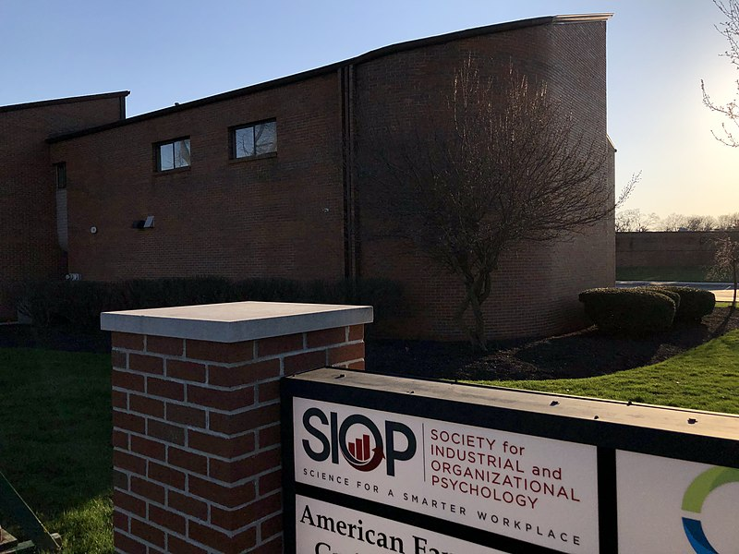
Contemporary Psychology: Industrial Organizational Psychology
Branch of psychology that applies psychological theories, principles and research to industrial and organizational settings.
Involves issues related to:
  personnel management
  organizational structure and workplace environment.
Image from Wikimedia Commons by Mbrickn (own work). Licensed as CC BY 4.0 International ,
Text from Psychology 2e OpenStax Revised Version Copyright © 2020 by Openstax is licensed under a Creative Commons Attribution 4.0 International License, except where otherwise noted. Edited by Maria Pagano

Slide 33
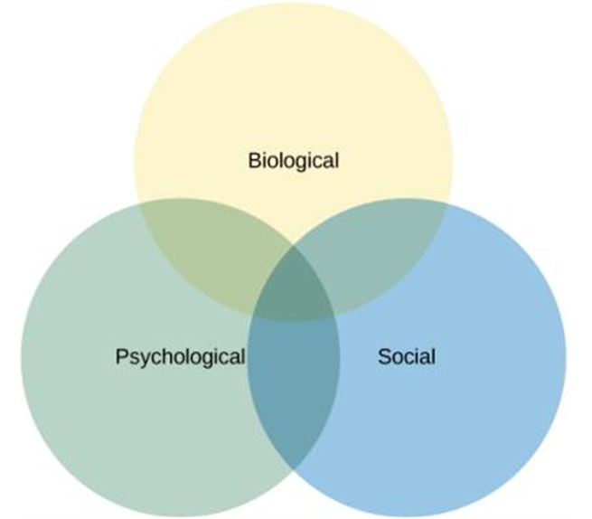
Contemporary Psychology: Health Psychology
Branch of psychology that focuses on how individual health is directly related or affected by biological, psychological, and sociocultural influences.
The biopsychosocial model suggests that health/illness is determined by an interaction of these three factors as shown in the image on the left.
Figure 1.25 The biopsychosocial model suggests that health/illness is determined by an interaction of these three factors.
Image and text from Psychology 2e OpenStax Revised Version Copyright © 2020 by Openstax is licensed under a Creative Commons Attribution 4.0 International License, except where otherwise noted. Edited by Maria Pagano

Slide 34

Contemporary Psychology: Sports and Exercise Psychology
Focuses on psychological aspects regarding sports and physical performance.
Study includes
  Motivation
  Performance related anxiety
  General mental well being
Image from Wikimedia Commons by Pedros.lol. Licensed as CC BY 4.0 International , Edited by Maria Pagano
Text from Psychology 2e OpenStax Revised Version Copyright © 2020 by Openstax is licensed under a Creative Commons Attribution 4.0 International License, except where otherwise noted. Edited by Maria Pagano

Slide 35
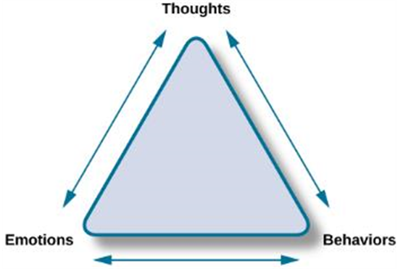
Contemporary Psychology: Clinical Psychology
Focuses on diagnosis and treatment of psychological disorders and problematic patterns of behavior.
  Study involves clinical therapy and counseling.
Figure 1.26 Cognitive-behavioral therapists take cognitive processes (thoughts), emotions and behaviors into account when providing psychotherapy. This is one of several strategies that may be used by practicing clinical psychologists.
Image and text from Psychology 2e OpenStax Revised Version Copyright © 2020 by Openstax is licensed under a Creative Commons Attribution 4.0 International License, except where otherwise noted. Edited by Maria Pagano

Slide 36
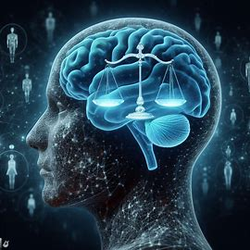
Contemporary Psychology: Forensic Psychology
Branch of psychology dealing with justice system.
This field of psychology requires a strong understanding of the legal system.
Tasks of Forensic Psychologists include
  assessment of individuals' mental competency to stand in trial
  sentencing and treatment suggestions
  advisement regarding eyewitness testimonies
Text from Psychology 2e OpenStax Revised Version Copyright © 2020 by Openstax is licensed under a Creative Commons Attribution 4.0 International License, except where otherwise noted. Edited by Maria Pagano

Slide 37
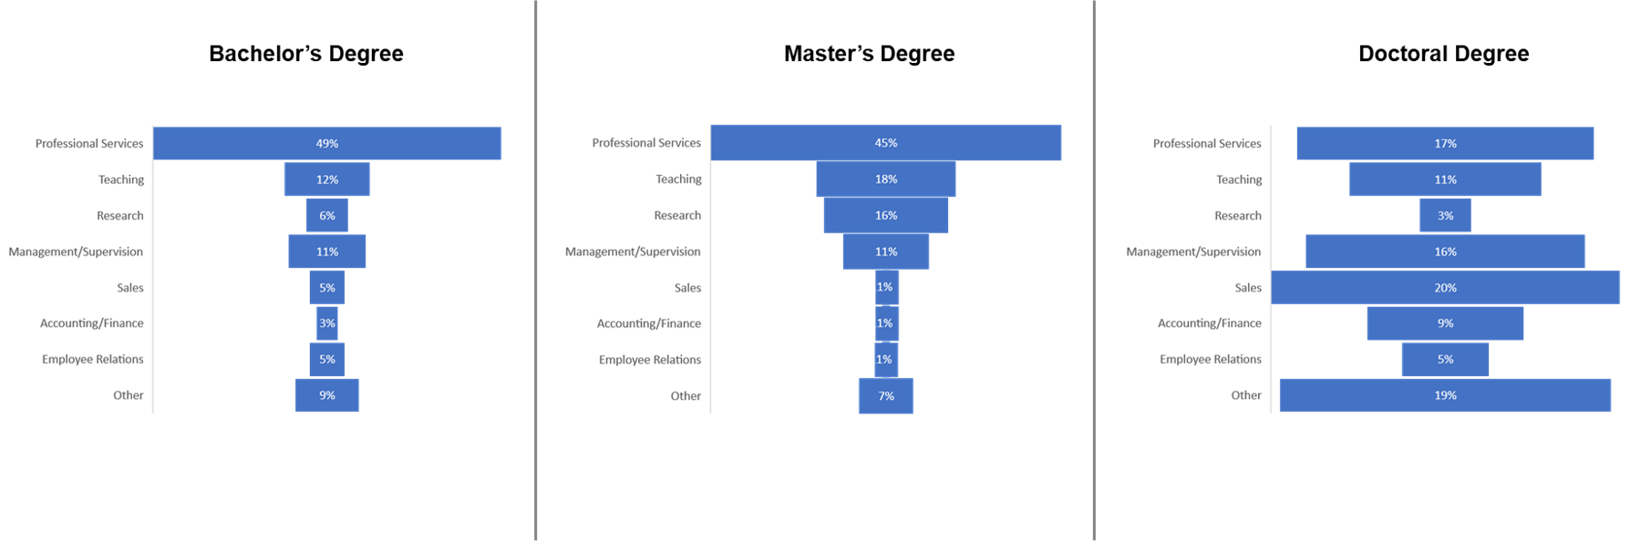
Careers in Psychology

Slide 38
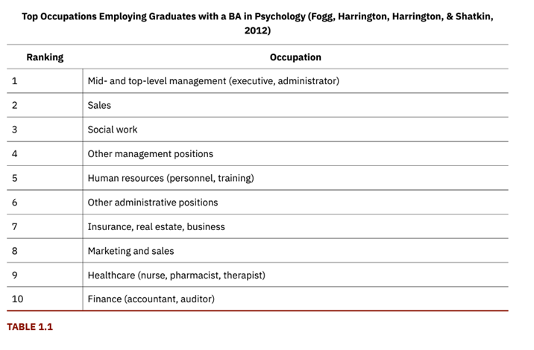
Careers in Psychology: Career Options Outside of Academic Settings
Link to Learning Video: Use this interactive tool which explores different careers in psychology based on degree levels to learn more.
OpenStax ancillary resource is © Rice University under a CC-BY-4.0 DEED license and may be used with proper attributes. Unless otherwise noted all material and text contained in these ancillary materials is from Spielman, R. M., Jenkins, W. J., & Lovett, M. D. (2020). Psychology 2E. OpenStax and is licensed under CC BY 4.0 DEED. Edited by Maria Pagano

