Slide 1

Chapter 16
Therapy and Treatment
OpenStax Psychology 2E
OpenStax ancillary resource is © Rice University under a CC-BY-4.0 DEED license and may be used with proper attributes. Unless otherwise noted all material and text contained in these ancillary materials is from Spielman, R. M., Jenkins, W. J., & Lovett, M. D. (2020). Psychology 2E. OpenStax and is licensed under CC BY 4.0 DEED.

Slide 2

Therapy & Treatment
Many forms of therapy have been developed to treat a wide array of problems. These marines who served in Iraq and Afghanistan, together with community mental health volunteers, are part of the Ocean Therapy program at Camp Pendleton, a program in which learning to surf is combined with group discussions. The program helps vets recover, especially vets who suffer from post-traumatic stress disorder (PTSD).
Text and image retrieved from OpenStax Psychology 2E is licensed under CC BY 4.0 International.

Slide 3
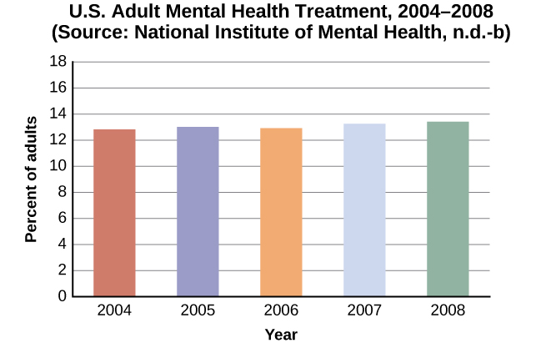
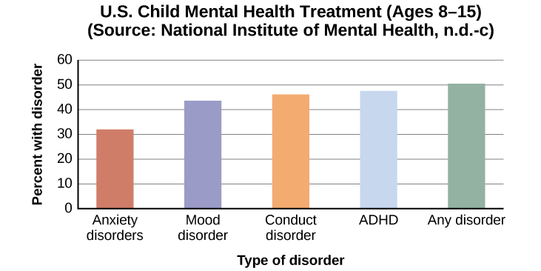
Mental Health treatment
Approximately 19% of U.S. adults, and 13% of adolescents (ages 8-15) experience mental illness in a given year.
The percentage of adults who received mental health treatment in 2004–2008 is shown below. Adults seeking treatment increased slightly from 2004 to 2008.
About one-third to one-half of U.S. adolescents with mental disorders receive treatment, with behavior-related disorders more likely to be treated.
Text retrieved from OpenStax Psychology 2E is licensed under CC BY 4.0 International. Edited by Marie Parnes

Slide 4
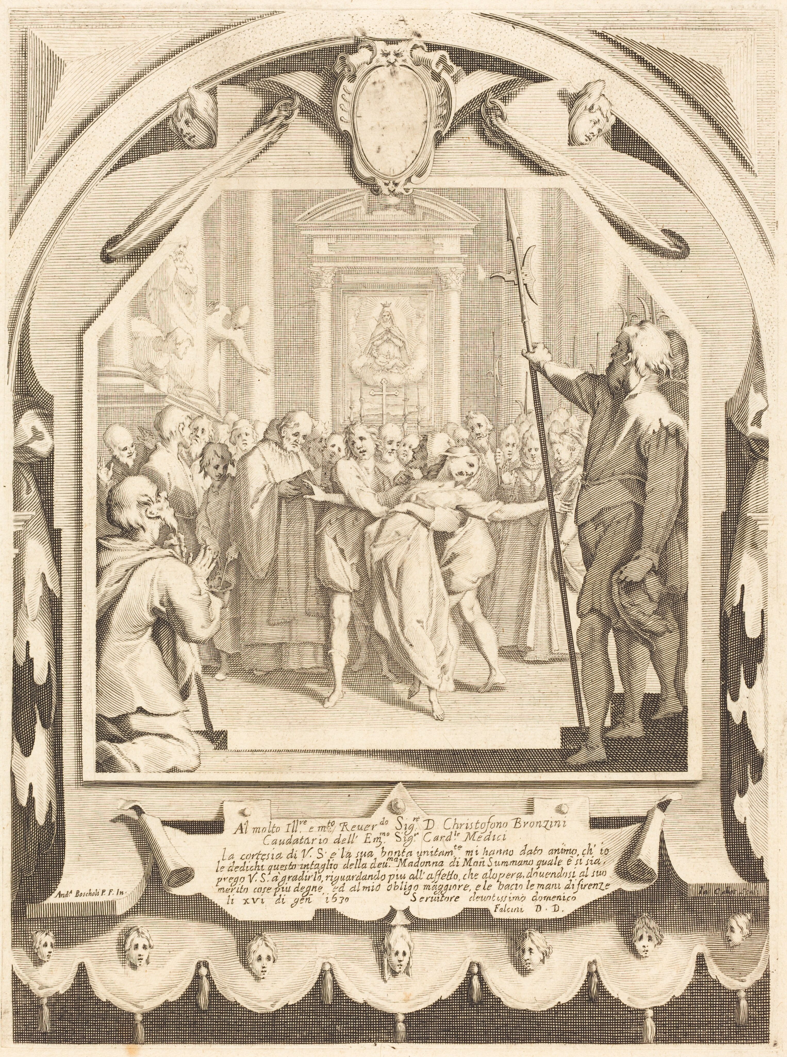
Treatment in the Past
Throughout most of history, mental illness was believed to be caused by supernatural forces such as witchcraft or demonic possession. People with mental illnesses at this time were often subjected to cruelty and poor treatment.
Treatments aimed at supernatural forces:
Exorcism – involving incantations and prayers said over the individual’s body by a priest/religious figure.
Trephining – a hole was made in the skull to release spirits from the body. This often lead to death.
Execution or imprisonment - many mentally ill people were burnt at the stake after being accused of witchcraft.
How Medieval Europe Treated Its Mentally Ill
Reviews the various methods used to treat mental illness during medieval times and up to the 18th century. Video retrieved from YouTube.
The Possessed, probably c. 1620
Jacques Callot (artist) French, 1592 - 1635
Andrea Boscoli (artist after) Italian, 1564 - 1608
Is licensed under https://creativecommons.org/publicdomain/zero/1.0/
Retrieved from the National Gallery of Art.
Text retrieved from OpenStax Psychology 2E is licensed under CC BY 4.0 International. Edited by Marie Parnes

Slide 5

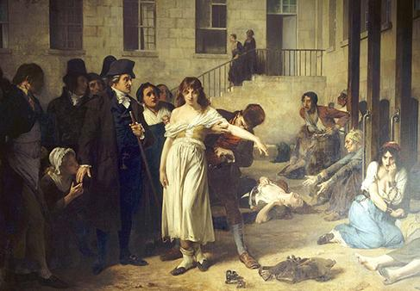
18TH Century
By the 18th century, people exhibiting unusual behavior began to be institutionalized
Asylums – the first institutions created for the specific purpose of housing people with psychological disorders.
Focus was ostracizing them from society rather than treatment.
Individuals often kept in windowless dungeons, chained to beds, little to no contact with caregivers.
This painting by Francisco Goya, called The Madhouse, depicts a mental asylum and its inhabitants in the early 1800s. It portrays those with psychological disorders as victims.
Philippe Pinel (Late 1700s)
French physician.
Argued for more humane treatment of the mentally ill.
Suggested that they be unchained and talked to.
Implemented in Paris, 1975.
Patients benefited and many were able to be released from hospital.
This painting by Tony Robert-Fleury depicts Dr. Philippe Pinel ordering the removal of chains from patients at the Salpêtrière asylum in Paris.
Text and images retrieved from OpenStax Psychology 2E is licensed under CC BY 4.0 International. Edited by Marie Parnes

Slide 6
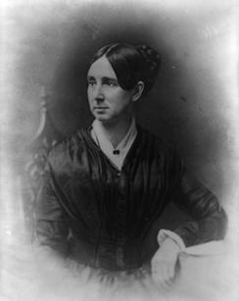
19TH Century
Dorothea Dix
A social reformer who became an advocate for the indigent insane.
Investigated the state of care for the mentally ill and poor.
Discovered an underfunded and unregulated system that perpetuated abuse of the mentally ill.
Instrumental in creating the first American mental asylum - by relentlessly lobbying state legislatures and Congress to set up and fund such institutions.
Dorothea Dix
American Asylums
Usually filthy.
Offered little treatment.
Individuals were often institutionalized for decades.
Treatment:
Submersion into cold baths for long periods of time.
Electroshock treatment (now called electroconvulsive therapy) – involves a brief application of electric stimulus to produce a generalized seizures.
Conditions such us these were common until well into the 20th century.
The Trans-Allegheny Lunatic Asylum
This video covers the 130 year history of this asylum. Photos of the actual asylum are presented with captions. There is no narration.
Video retrieved from YouTube.
Text and image retrieved from OpenStax Psychology 2E is licensed under CC BY 4.0 International. Edited by Marie Parnes

Slide 7

20TH Century
1954 - Antipsychotic medications were introduced.
Proved successful in treating symptoms of psychosis.
Psychosis was a common diagnosis, evidenced by symptoms such as hallucinations and delusions, indicating a loss of contact with reality.
1975 - Mental Retardation Facilities & Community Mental Health Centers Construction Act
Provided federal support and funding for community mental health centers.
Started the process of deinstitutionalization.
Deinstitutionalization – the closing of large asylums, by providing for people to stay in their communities and be treated locally.
Patients were released but the new system was not set up effectively.
Centers were underfunded, staff untrained to handle severe mental illnesses.
Lead to an increase in homelessness.
The former St Elizabeth's Hospital in Washington D.C.
Image retrieved from Wikipedia is licensed under Creative Commons Attribution-ShareAlike License 4.0
Text retrieved from OpenStax Psychology 2E is licensed under CC BY 4.0 International. Edited by Marie Parnes

Slide 8
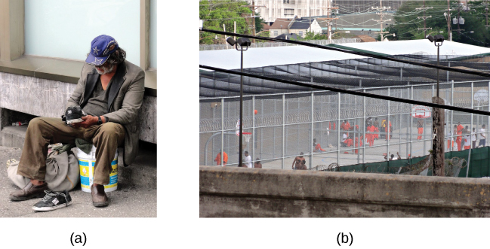
Mental Health Treatment Today
Asylums have since been replaced with psychiatric hospitals and local community hospitals focused on short-term care.
Emphasis on short-term stays (average stay is less than two weeks).
Due to high costs of psychiatric hospitalization - Insurance coverage often limits length of time individuals can be hospitalized.
Individuals are usually only hospitalized if they are an imminent threat to themselves or others.
Most people are not hospitalized but can still seek psychological treatment.
Involuntary treatment – therapy that is not the individual’s choice.
E.g. weekly counseling sessions might be a condition of parole.
Voluntary treatment – the person chooses to attend therapy to obtain relief from symptoms.
Sources of psychological treatment – community mental health centers, private or community practitioners, school counselors, school psychologists or school social workers, group therapy.
Treatment providers include psychologists, psychiatrists, clinical social workers, marriage and family therapists.
We Shut Down State Mental Hospitals. Some Want to Bring Them Back.
Many people dealing with mental illness have been forced onto the streets or into jails. There is a call to bring back long-term care facilities. Video retrieved from YouTube.
Mental illness among the homeless population is still common today.
(a) Of the homeless individuals in U.S. shelters, about one-quarter have a severe mental illness (HUD, 2011). (b) Correctional institutions also report a high number of individuals living with mental illness. credit a: modification of work by C.G.P. Grey; credit b: modification of work by Bart Everson)
Text and images retrieved from OpenStax Psychology 2E is licensed under CC BY 4.0 International. Edited by Marie Parnes

Slide 9
Types of Treatment
Type | Description | Example
Psychodynamic psychotherapy | Talk therapy based on belief that the unconscious and childhood conflicts impact behavior | Patient talks about his past
Play therapy | Psychoanalytical therapy wherein interaction with toys is used instead of talk; used in child therapy | Patient (child) acts out family scenes with dolls
Behavior therapy | Principles of learning applied to change undesirable behaviors | Patient learns to overcome fear of elevators through several stages of relaxation techniques
Cognitive therapy | Awareness of cognitive process helps patients eliminate thought patterns that lead to distress | Patient learns not to overgeneralize failure based on single failure
Cognitive-behavioral therapy | Work to change cognitive distortions and self-defeating behaviors | Patient learns to identify self-defeating behaviors to overcome an eating disorder
Humanistic therapy | Increase self-awareness and acceptance through focus on conscious thoughts | Patient learns to articulate thoughts that keep her from achieving her goals
Text retrieved from OpenStax Psychology 2E is licensed under CC BY 4.0 International. Edited by Marie Parnes

Slide 10
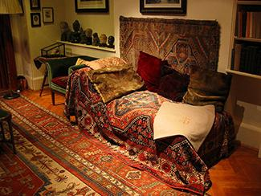
Psychoanalysis
First form of psychotherapy, developed by Sigmund Freud in the early 20th century.
Aimed to help uncover repressed feelings.
Techniques:
Free association – patient relaxes and then says whatever comes to mind at the moment.
Freud theorized that the ego would try to block unacceptable urges or painful conflicts during free association causing the patient to demonstrate resistance.
Dream analysis – therapist interprets the underlying meaning of dreams.
Transference – patient transfers all the positive or negative emotions associated with their other relationships to the psychoanalyst.
Psychoanalysis Today:
Psychoanalysis is less popular today but Freud’s perspective has been expanded upon by incorporating modern theories and methodology.
Psychodynamic psychotherapy - Talk therapy based on belief that the unconscious and childhood conflicts impact behavior.
This is the famous couch in Freud’s consulting room. Patients were instructed to lie comfortably on the couch and to face away from Freud in order to feel less inhibited and to help them focus. Today, a psychotherapy patient is not likely to lie on a couch; instead he is more likely to sit facing the therapist
(Prochaska & Norcross, 2010).
(credit: Robert Huffstutter)
View a brief video overview of Freud and his theory of personality to learn more.
Text and image retrieved from OpenStax Psychology 2E is licensed under CC BY 4.0 International. Edited by Marie Parnes

Slide 11

Play Therapy
Play Therapy - Psychoanalytical therapy wherein interaction with toys is used instead of talk; used in child therapy to help them prevent/resolve psychosocial difficulties & achieve optimal growth. In some cases, play therapy may be used with teenagers and adults.
Techniques:
Toys, such as dolls, stuffed animals, and sandbox figurines are used to help children play out their hopes, fantasies and traumas.
Sandplay or sandtray therapy - children can set up a three dimensional world using various figures and objects that correspond to their inner state (Kalff, 1991).
Therapist observes how child interacts with toys in order to understand the roots of the child’s disturbed behavior. Can be used to make a diagnosis.
Nondirective play therapy – children are encouraged to work through problems by playing freely while therapist observes.
Directive play therapy – therapist provides structure/guidance by suggesting topics, asking questions, and playing with the child.
This type of play therapy is known as sandplay or sandtray therapy. Children can set up a three-dimensional world using various figures and objects that correspond to their inner state (Kalff, 1991). (credit: Kristina Walter)
Sandtray Therapy example
This video shows snippets of an actual sand play therapy session with a teenager. Video retrieved from YouTube.
Text and image retrieved from OpenStax Psychology 2E is licensed under CC BY 4.0 International. Edited by Marie Parnes

Slide 12

Behavior Therapy
Principles of learning are applied to change undesirable behaviors. Based on the belief that dysfunctional behaviors can be changed by teaching clients more constructive behaviors.
Classical Conditioning - Conditioning principles are applied to recondition clients and change their behavior.
Counterconditioning - Client learns a new response to a stimulus that has previously elicited an undesirable behavior. Includes aversive conditioning and exposure therapy.
Aversive conditioning – uses an unpleasant stimulus to stop an undesirable behavior.
Used to eliminate addictive behaviors.
Client is repeatedly exposed to something unpleasant, such as a mild electric shock or bad taste while they engage in a specific behavior → client learns to associate the unpleasant stimulus and unwanted behavior.
Antabuse (substance that causes negative side effects such as vomiting when combined with alcohol) has been used effectively to treat alcoholism.
Exposure therapy – seeks to change the response to a conditioned stimulus.
Used to treat fears or anxiety.
Client is repeatedly exposed to the object/situation that causes their problem, with the idea that they will eventually get used to it.
Taking Antabuse for alcohol abuse results in severe throbbing headaches, increased heart rate, palpitations, nausea, and vomiting.
Image and text retrieved from Simply Psychology is licensed under Attribution-NonCommercial-NoDerivatives 4.0 International
Text is retrieved from OpenStax Psychology 2E , unless otherwise noted, is licensed under CC BY 4.0 International. Edited by Marie Parnes

Slide 13
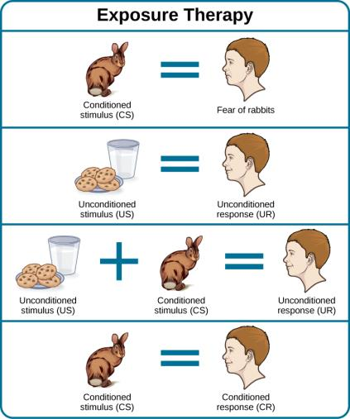
Exposure Therapy
Mary Cover Jones - Developed the first type of exposure therapy.
Exposure Therapy - An unconditioned stimulus is presented over and over just after the presentation of the conditioned stimulus.
Jones’ Study (1924): Aimed to replace Peter’s fear of rabbits with a conditioned response of relaxation.
Repeatedly exposed Peter to a rabbit, while he was eating a snack (in a relaxed state).
Rabbit started in a cage on the other side of the room and over several days was gradually moved closer to Peter while he ate his snack.
After 2 months, Peter was able to pet the rabbit while eating his snack.
Text and image retrieved from OpenStax Psychology 2E is licensed under CC BY 4.0 International. Edited by Marie Parnes

Slide 14
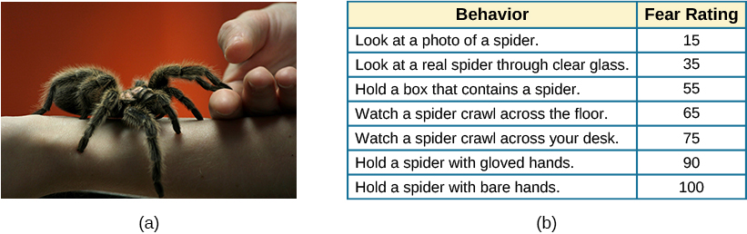
Exposure Therapy
Joseph Wolpe (1958) - Refined Jones’s techniques and developed the version of exposure therapy used today.
Systematic desensitization – type of exposure therapy wherein a calm and pleasant state is gradually associated with increasing levels of anxiety-inducing stimuli.
Fear and relaxation are incompatible – if client can relax around fear-inducing stimuli, the unwanted fear response will eventually be eliminated.
Client is taught progressive relaxation – how to relax each muscle group to achieve a relaxed and comfortable state of mind.
Progressive relaxation is used while client imagines anxiety-inducing situations.
Overtime, progressive relaxation helps the client become desensitized to the anxiety inducing stimuli.
Virtual reality exposure therapy – uses a stimulation to help conquer fears when it’s too impractical, expensive or embarrassing to recreate anxiety-inducing situations.
This person suffers from arachnophobia (fear of spiders). Through exposure therapy he is learning how to face his fear in a controlled, therapeutic setting.
(credit: “GollyGforce – Living My Worst Nightmare”/Flickr)
Virtual Iraq video that shows soldiers being treated via simulation (Virtual Reality Exposure Therapy). This method of virtual reality exposure therapy has been effective in treating PTSD for combat veterans. (Rizzo et al., 2010)
Text and image retrieved from OpenStax Psychology 2E is licensed under CC BY 4.0 International. Edited by Marie Parnes

Slide 15

Behavior Therapy
Operant Conditioning - Based on the principle that behaviors become extinguished when not reinforced.
Applied behavior analysis: Operant conditioning technique designed to reinforce positive behaviors and punish unwanted behaviors.
Effective in helping children with autism.
Child-specific reinforcers (e.g., stickers, praise, candy) are used to reward and motivate autistic children when they demonstrate desired behaviors.
Punishment (e.g., timeout) might be used to discourage undesirable behaviors.
Token economy:
Used in controlled settings such as psychiatric hospitals.
Individuals are reinforced for desired behaviors with tokens (e.g., a poker chip), that can be exchanged for items or privileges.
Often used in psychiatric hospitals or prisons to increase cooperation.
ABA Autism Training - Chapter 1 - The Discrete Trial
This video demonstrates how ABA therapists implement their training (learning) trials when working with children on the autism spectrum. Examples from actual ABA sessions are included. Video retrieved from YouTube.
Token economies can also be used in the classroom. A behavior chart is posted in a place that is visible to all. The chart has each student’s name on it. Appropriate behaviors occurring through out the day are noted with a sticker for each student. At the end of the day, children can exchange their stickers for desired items.
Image from Simply Psychology is licensed under Attribution-NonCommercial-NoDerivatives 4.0 International
Text retrieved from OpenStax Psychology 2E, unless otherwise notd, is licensed under CC BY 4.0 International. Edited by Marie Parnes

Slide 16
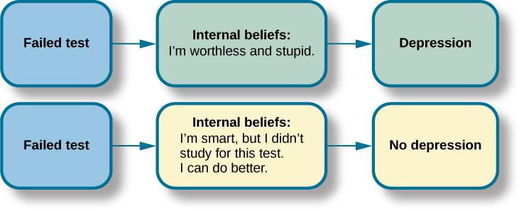
Cognitive Therapy
Developed by Aaron Beck in the 1960’s.
Cognitive Therapy - Based on the idea that how you think determines how you feel and act; cognitive therapy focuses on how thoughts lead to feelings of distress.
Emotional reactions are the result of your thoughts about the situation rather than the situation itself.
Encourages clients to find more logical ways of interpreting situations and positive ways of thinking.
Cognitive therapists help clients become aware of their cognitive distortions (thinking errors).
  Examples:
  Overgeneralizing – taking a small situation and making it huge.
  Polarized (“black & white”) thinking – Seeing things in absolutes, ”I am either perfect, or a failure”. (Common in depression).
  Jumping to conclusions – assuming that people are thinking negatively about you or reacting negatively to you, without evidence.
Clients are helped to change dysfunctional thinking patterns by challenging irrational beliefs, focusing on their illogical basis, and correcting them with more logical and rational thoughts/beliefs.
View a brief video in which Judith Beck talks about cognitive therapy and conducts a session with a client.
If you consistently interpret events and emotions around the themes of loss and defeat, then you are likely to be depressed.
Text and image retrieved from OpenStax Psychology 2E is licensed under CC BY 4.0 International. Edited by Marie Parnes

Slide 17
Cognitive Behavioral Therapy
Unlike other forms of psychotherapy, cognitive behavioral therapy focuses more on present issues rather than on a patient’s past.
Cognitive-behavioral therapy (CBT) – works to change cognitive distortions and self-defeating behaviors. (Aims to change both how people think and how they act).
Helps clients examine how their thoughts affect their behavior.
Combination of cognitive therapy (making individuals aware of irrational, negative thoughts and replacing them with positive ways of thinking) and behavior therapies (teaches people to practice and engage in more positive, healthy approaches to situations).
Uses the ABC model to reveal cognitive distortions (e.g., overgeneralizing, black and white thinking, jumping to conclusions).
  A - Action – is the activating event.
  B - Belief – is your belief about the event.
  C- Consequences- the consequences of the belief.
  Rational-Emotive Behavior Therapy (REBT) - one of the first forms of cognitive-behavioral therapy, founded by Albert Ellis.
ABCDE Model. Change Negative Thoughts and Beliefs. CBT and REBT.
This video discusses the REBT model by Albert Ellis in more detail and how D & E are used to change a client’s irrational thoughts. Video retrieved from YouTube.
Text retrieved from OpenStax Psychology 2E is licensed under CC BY 4.0 International. Edited by Marie Parnes

Slide 18
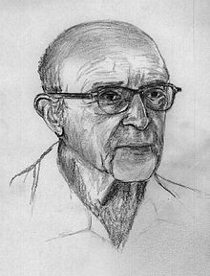
Humanistic Therapy
Humanistic Therapy - focuses on helping people achieve their potential. Goal is to increases self-awareness and acceptance through focus on conscious thoughts.
Rogerian/Client-centered Therapy
Developed by Carl Rogers.
Emphasized the importance of the person taking control of his own life to overcome life’s challenges.
Non-directive therapy – therapist does not give advice or provide interpretations but helps client identify conflicts and understand feelings.
Techniques:
Active listening – therapist acknowledges, restates, and clarifies what the client expresses.
Unconditional positive regard – therapist does not judge clients and simply accepts them for who they are.
Genuineness, empathy, and acceptance towards clients – Rogers felt that therapists should demonstrate these because it helps the client become more accepting of themselves, which results in personal growth.
Carl Rogers was one of the founders of humanistic psychology
Retrieved from Wikipedia is licensed under Creative Commons Attribution-ShareAlike License 4.0
Text retrieved from OpenStax Psychology 2E, unless otherwise noted, is licensed under CC BY 4.0 International. Edited by Marie Parnes

Slide 19
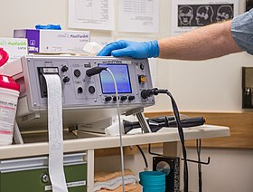
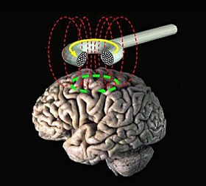
Biomedical Therapies
Psychotropic medications – medications used to treat psychological disorders. Used to treat the symptoms of psychological disorders but do not cure the disorder.
Antipsychotics – treat positive psychotic symptoms such as hallucinations, delusions, and paranoia by blocking dopamine.
Atypical antipsychotics – treat the negative symptoms of schizophrenia such as withdrawal and apathy, by targeting both dopamine and serotonin receptors.
Antipsychotics and atypical antipsychotics both treat schizophrenia and other types of severe thought disorders.
Anti-depressants – alter levels of serotonin and norepinephrine.
Depression and anxiety.
Anti-anxiety agents – depress central nervous system activation.
Anxiety, OCD, PTSD, panic disorder and social phobia.
Mood stabilizers – treat episodes of mania as well as depression (Bipolar disorder).
Stimulants – improve ability to focus on a task and maintain attention (ADHD).
Electroconvulsive therapy – induces seizures to help alleviate severe depression.
Transcranial magnetic stimulation – magnetic fields stimulate nerve cells to improve depression symptom.
Electroconvulsive therapy (ECT) or electroshock therapy (EST) is a psychiatric treatment where a generalized seizure (without muscular convulsions) is electrically induced to manage refractory mental disorders
Retrieved from Wikipedia is licensed under Creative Commons Attribution-ShareAlike License 4.0
Retrieved from Wikipedia is licensed under Creative Commons Attribution-ShareAlike License 4.0
How deep transcranial magnetic stimulation changed one woman's life
This video explores an alternative treatment that uses magnetic pulses to stimulate neurons in the brain. Retrieved from YouTube.
Text retrieved from OpenStax Psychology 2E, unless otherwise noted, is licensed under CC BY 4.0 International. Edited by Marie Parnes

Slide 20
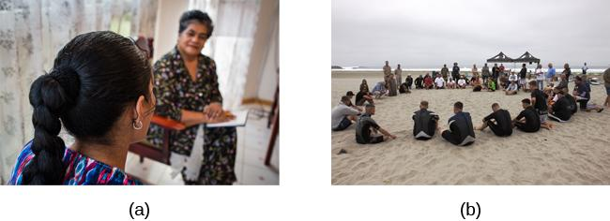
Treatment Modalities
Intake - once an individual seeks treatment, therapists will arrange an intake, an initial meeting to assess the client’s clinical needs.
Therapist gathers specific information to address client’s immediate needs.
Presenting problem, the client’s support system, insurance status.
Therapist informs client about confidentiality, fees, and what to expect in treatment. Confidentiality – the therapist cannot disclose confidential communications to any third party unless mandated or permitted to do so by law.
Treatment goals are discussed and a treatment plan is formed.
Therapy may occur (a) one-on-one between a therapist and client, or (b) in a group setting.
(credit a: modification of work by Connor Ashleigh, AusAID/Department of Foreign Affairs and Trade)
Text and images retrieved from OpenStax Psychology 2E, is licensed under CC BY 4.0 International. Edited by Marie Parnes

Slide 21

Treatment Modalities
Individual Therapy - In an individual therapy session, a client works one-on-one with a trained therapist.
Usually lasts 45 minutes – 1 hour and meetings occur in a confidential environment.
Clients might explore feelings, work through life challenges, identify aspects of themselves and their lives that they wish to change, and set goals to work towards these changes.
Group Therapy - In group therapy, several clients meet with a trained therapist to discuss a common issue such as divorce, grief, an eating disorder, substance abuse, or anger management.
Can help decrease shame and isolation.
Clients may have concerns about confidentiality or feel uncomfortable sharing problems with strangers.
Psycho-educational groups – groups with a strong educational component. E.g., group for children whose parents have cancer which teaches them about cancer.
Family Therapy - aims to enhance growth of each family member as well as that of the family as a whole.
Systems approach – family is viewed as an organized system, and each individual is a contributing member who creates and maintains processes within the system that shape behavior. Each member influences and is influenced by the others.
One member usually has a problem that effects everyone (e.g., alcohol dependence) and the therapist helps them to cope with the issue.
Structural family therapy – examines and discusses the boundaries and structure of the family. Therapist helps them resolve issues and learn to communicate effectively.
Strategic family therapy – aims to address specific problems within the family that can be dealt with in a short amount of time.
Couples Therapy - therapist helps people work on difficulties in their relationship - aims to help them resolve problems and implement strategies that will lead to a healthier and happier relationship.
E.g. how to listen, how to argue, and how to express feelings.
Primarily uses cognitive-behavioral therapy.
Text and image retrieved from OpenStax Psychology 2E is licensed under CC BY 4.0 International. Edited by Marie Parnes
(credit: Cory Zanker)

Slide 22
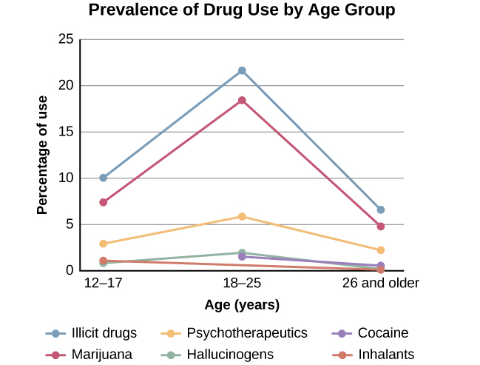
Addiction
Initially, individuals voluntarily choose to use a substance.
Chronic substance use can permanently alter the neural structure in the prefrontal cortex (associated with decision-making and judgement).
Person becomes driven to use drugs and/or alcohol making it difficult to stop.
Relapse – individual returns to abusing a substance after a period of improvement.
About 40%-60% of individuals relapse.
Comorbid Disorders - Individuals addicted to drugs and/or alcohol frequently have an additional psychological disorder.
Substance abusers are twice as likely to have a mood or anxiety disorder.
People with psychiatric disorders may self-medicate and abuse substances.
Categorized as mentally ill and chemically addicted (MICA).
Problems are often chronic and treatment has limited success.
The National Survey on Drug Use and Health shows trends in prevalence of various drugs for ages 12–17, 18–25, and 26 or older.
Text and image retrieved from OpenStax Psychology 2E is licensed under CC BY 4.0 International. Edited by Marie Parnes

Slide 23
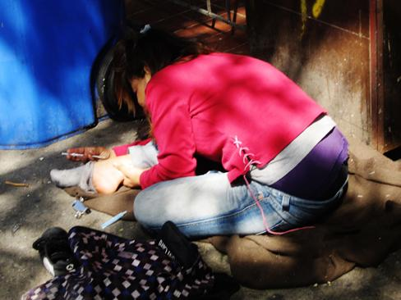
Substance-Related Treatment
Goal is to help an addicted person stop compulsive drug-seeking behaviors.
Requires long-term treatment.
More cost-effective than incarceration or not treating those with addiction - Substance use and abuse costs the United States over $600 billion a year (NIDA, 2012).
Behavior therapy - can help motivate the addict to participate in the treatment program and teach strategies for dealing with cravings and how to prevent relapse.
Medication uses:
To detox the addict safely after an overdose.
To prevent seizures and agitation that often occur in detox.
To prevent reuse of the drug.
To manage withdrawal symptoms.
Watch this video about treating substance-related disorders using the biological, behavioral, and psychodynamic approaches to learn more.
(credit: "jellymc - urbansnaps"/Flickr)
Text and image retrieved from OpenStax Psychology 2E is licensed under CC BY 4.0 International. Edited by Marie Parnes

Slide 24
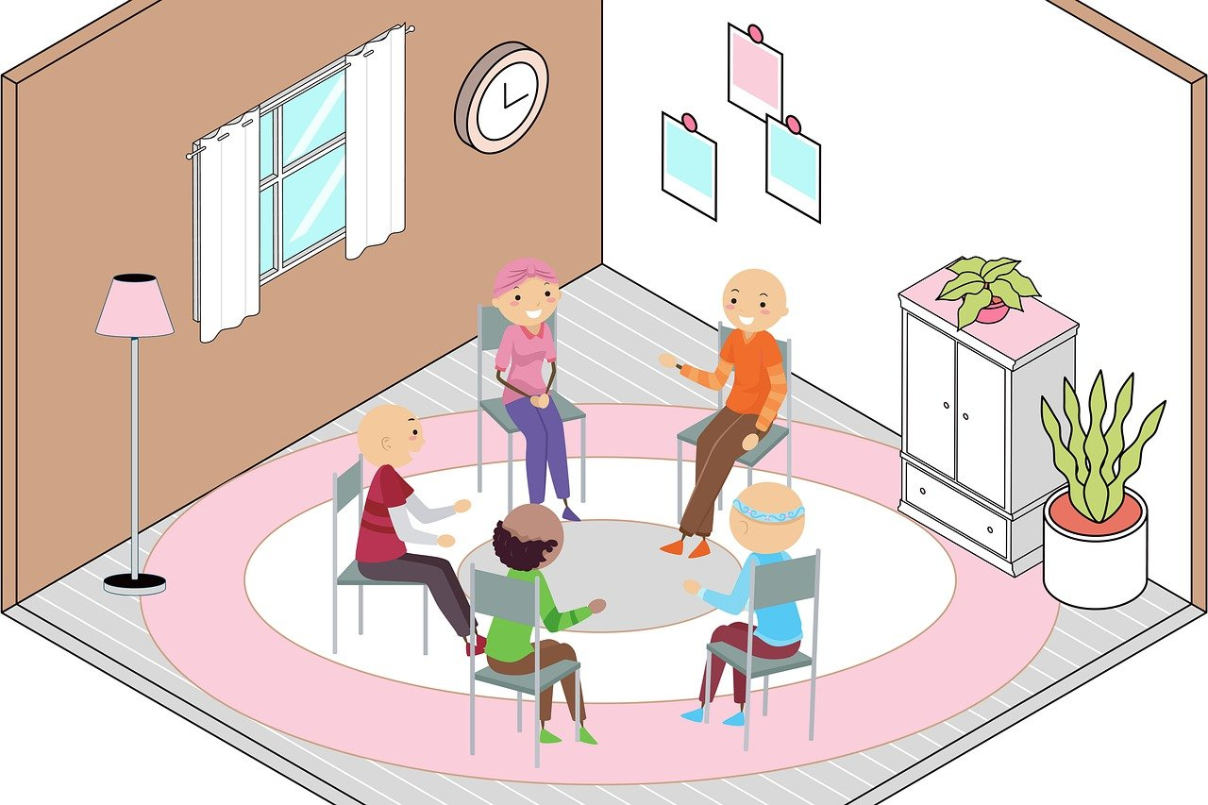
What Makes Substance-Abuse Treatment Effective?
Duration of treatment - At least 3 months is usually needed to achieve a positive outcome.
Holistic treatment – addresses multiple needs, not just the drug addiction, due to psychological, physiological, behavioral, and social aspect of abuse.
Addresses stress management, communication, relationship issues, parenting, vocational concerns, and legal concerns.
Group therapy – addicts are more likely to maintain sobriety in a group format due to
the rewarding and therapeutic benefits of the group such as support, affiliation,
identification, and even confrontation.
Parental involvement – correlated with greater reduction in use by teen substance abusers.
Group therapy offers many therapeutic benefits in the treatment of substance abuse.
Image retrieved from Pixabay and is licensed under and is licensed under CC0 1.0 Universal
Text retrieved from OpenStax Psychology 2E, is licensed under CC BY 4.0 International. Edited by Marie Parnes

Slide 25

The Sociocultural Approach
This perspective looks at you, your behaviors, and symptoms in the context of your culture and background. How do your cultural and religious beliefs affect your attitude toward mental health treatment?
Cultural competence – mental health professionals must understand and address issues of race, culture, and ethnicity and use strategies to effectively address needs of various populations.
Multicultural counseling and therapy:
Integrates the impact of cultural and social norms.
Aims to work with clients and define goals consistent with their life experiences and cultural values.
Strives to recognize client identities to include individual, group, and universal dimensions.
Advocates the use of universal and culture-specific strategies and roles in the healing process.
Balances the importance of individualism and collectivism in the assessment, diagnosis, and treatment of clients.
Image retrieved from Pixabay and is licensed under and is licensed under CC0 1.0 Universal
Watch this short video about cultural competence and sociocultural treatments to learn more.
Text retrieved from OpenStax Psychology 2E, is licensed under CC BY 4.0 International. Edited by Marie Parnes

Slide 26

Treatment Barriers
Access and availability of mental health services:
Lack of insurance.
Transportation.
Time
Even when access is comparable among racial and ethnic groups, minorities utilize mental health services less than white, middle-class Americans.
Ethical disparities:
Lack of bilingual treatment.
Stigma.
Fear of not being understood.
Family privacy.
Lack of education on mental illness.
Perceptions and attitudes:
Self-sufficiency and not seeing the need for help.
Not seeing therapy as effective.
Concerns about confidentiality.
Fear of psychiatric hospitalization or treatment itself.
Technology makes mental health treatment more accessible.
Image retrieved from Pixabay and is licensed under and is licensed under CC0 1.0 Universal
Telehealth effectively expands mental health treatment
This video discuss telehealth and its use in removing some barriers to treatment in underserved populations.
Text retrieved from OpenStax Psychology 2E, is licensed under CC BY 4.0 International. Edited by Marie Parnes

