Slide 1

ENG 1101
English Composition 1
Objectives
Review how to join OpenLab
Discuss Westengard’s work
Put “Read Like a Writer” to action!

Slide 2

The English language is nobody's special property. It is the property of the imagination: it is the property of the language itself.
Derek Walcott
What does Walcott mean by saying English isn’t anyone’s “special property”?
Do you agree or disagree with his definition? Be sure to explain why!

Slide 3
If today’s your first day…
Take an index card.
Write your full name on one side.
If you have a preferred name or nickname, write that beneath your legal name.
Write your preferred pronouns (he/him, she/her, they/them, etc.)
When you’re finished, bring the card to the front and place it next to the “in” card.
Every day, when you arrive for class, take your card from the “out” pile and put it under the “in” card. Don’t make a new card. Find your old card. This is how I take attendance!

Slide 4

Register/Join OpenLab
Go to https://openlab.citytech.cuny.edu/ on your smartphones or laptops.
If you’ve joined OpenLab, log in.
If you haven’t, sign up now!
Notes:
ECRI
20 min
Say: Everyone, please get out your smartphones! Ask: Has anyone NOT logged in on OpenLab before? Will the students who have logged in please coach the students who have not?

Slide 5
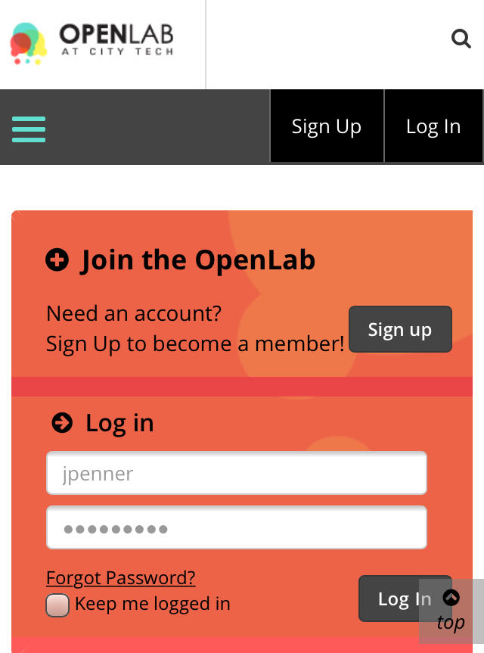
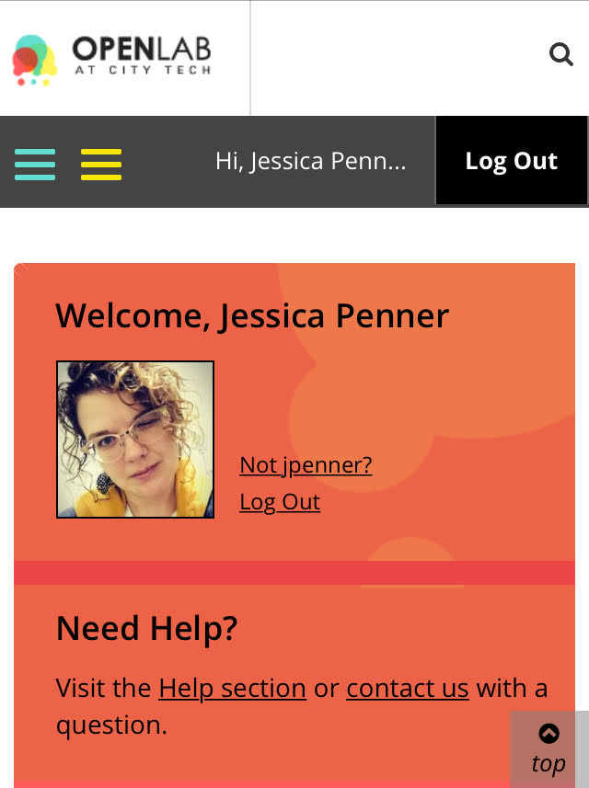
You must use your City Tech-approved email!

Slide 6

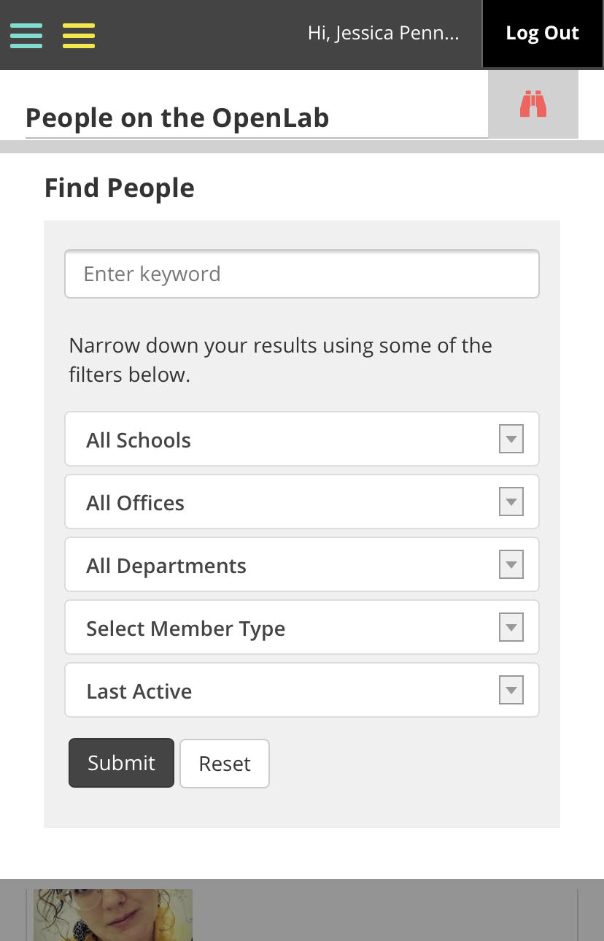
Jessica Penner
The easiest way to find our class is by finding me!

Slide 7

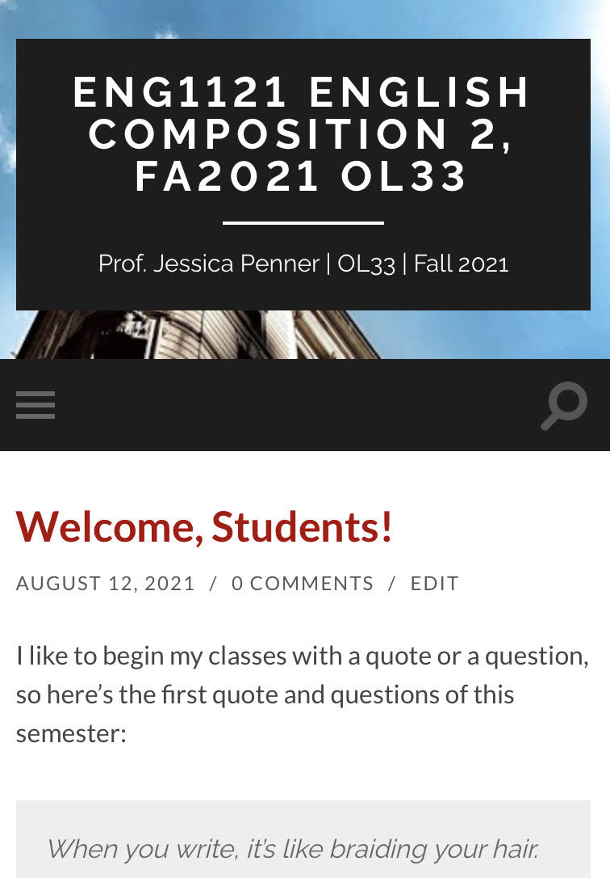
Course Info
We won’t review this as much as we did on Monday, but here’s the basics…

Slide 8

How to read like a writer
Mike Bunn
By Prof. Laura Westengard

Slide 9
Before you Start Reading
Do you know the author’s purpose for this piece of writing?
Do you know who the intended audience is for this piece of writing?
In what genre is it written?
Is this a published or a student-produced piece of writing?
Is this the kind of writing you will be assigned to write yourself?

Slide 10
As You Are Reading
What is the author’s purpose for this piece of writing?
Who is the intended audience?
How effective is the language the author uses? Is it too formal? Too informal? Perfectly appropriate?
What kinds of evidence does the author use to support his/her claims? Does he/she use statistics? Quotes from famous people? Personal anecdotes or personal stories? Does he/she cite books or articles?
How appropriate or effective is this evidence? Would a different type of evidence, or some combination of evidence, be more effective?
Are there places in the writing that you find confusing? What about the writing in those places makes it unclear or confusing?
How does the author move from one idea to another in the writing? Are the transitions between the ideas effective? How else might he/she have transitioned between ideas instead?

Slide 11
What Should You Be Writing as You are Reading?
What is the technique the author is using here?
Is this technique effective?
What would be the advantages and disadvantages if I tried this same technique in my writing?

Slide 12
Let’s practice “RWL”!
I will distribute copies of three different kinds of writing to small groups.
You will be given a period of time to read and annotate the writing you’re given. You’ll also have a worksheet.
  Annotate this copy as you read.
    What does “annotate” mean? Highlight words or phrases you find interesting. Write thoughts or questions in the margins that come up as you read. If you don’t know the definition of a word, circle or underline it (don’t stop reading).
  Before and while you read, answer the questions in the worksheet.
When I announce that time’s up, pass your copy to a neighbor in your group. Take a neighbor’s copy. Repeat the steps above.
  There will hopefully be previous annotations but try to find new words or phrases and different thoughts and questions.
We’ll repeat the steps one more time. By the end, all the writing examples should be full of notes and your worksheets should have a lot of information!

Slide 13
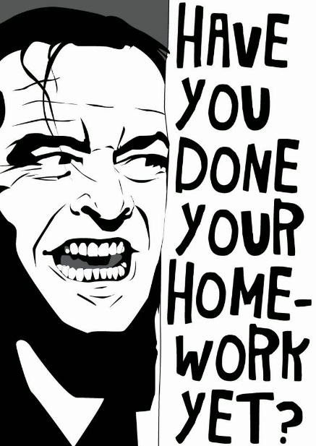
Homework
Please read the following before class on Monday:
Read “The Memory of My Grandmother” (City Tech student essay) by Anita Jiang. The essay is in a larger journal--you only need to read Jiang's essay!
Read “Chapter 7” from the Narrative of the Life of Frederick Douglass by Frederick Douglass.
For both texts, use the suggestions presented in "How to Read Like a Writer.“
If you missed class on Monday, you need to talk to me before you leave!

