Slide 1

ENG 1101
English Composition 1
Objectives
Discuss syllabus & schedule
Join OpenLab
Write!

Slide 2
Take a card…
Take an index card.
Write your full name on one side.
If you have a preferred name or nickname, write that beneath your legal name.
Write your preferred pronouns (he/him, she/her, they/them, etc.)
When you’re finished, bring the card to the front and place it next to the “in” card.
Every day, when you arrive for class, take your card from the “out” pile and put it under the “in” card. Don’t make a new card. Find your old card. This is how I take attendance!

Slide 3

Welcome!
When you write, it’s like braiding your hair. Taking a handful of coarse unruly strands and attempting to bring them unity. Your fingers have still not perfected the task. Some of the braids are long, others are short. Some are thick, others are thin. Some are heavy. Others are light.
– Edwidge Danticat
Why does this writer equate writing with braiding?
There isn’t one “correct” answer—there are as many answers as there are people in this class!

Slide 4
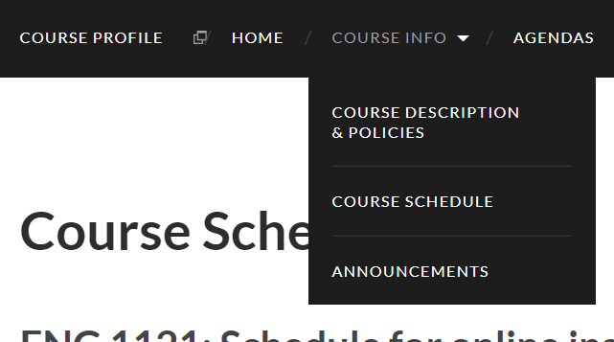
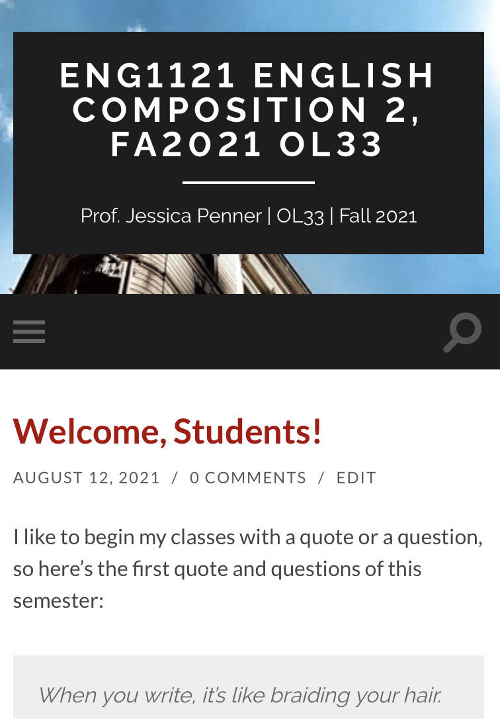
Course Info
Let’s go to the syllabus on our own devices.
  If you’re on a laptop, it’ll look like the image on the top.
  If you’re on a cell, it’ll look like the image on the bottom. (Click on the three gray strips on the left.)
First, find Course Info and then look at Course Descriptions & Policies.
Next, go to Course Schedule.
Now, go to Announcements.
Finally, go to Agendas.

Slide 5

Register/Join OpenLab
Go to https://openlab.citytech.cuny.edu/ on your smartphones or laptops.
If you’ve joined OpenLab, log in.
If you haven’t, sign up now!
Notes:
ECRI
20 min
Say: Everyone, please get out your smartphones! Ask: Has anyone NOT logged in on OpenLab before? Will the students who have logged in please coach the students who have not?

Slide 6
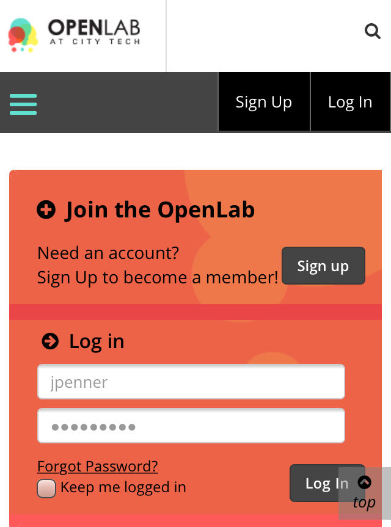
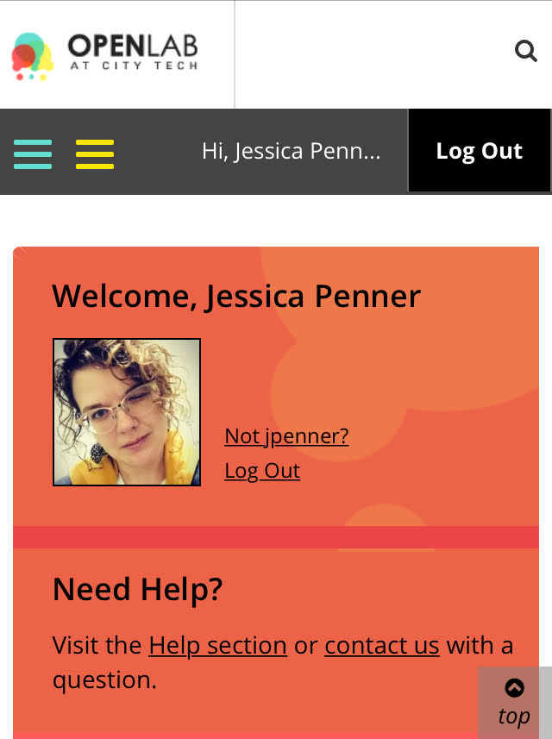
You must use your City Tech-approved email!

Slide 7
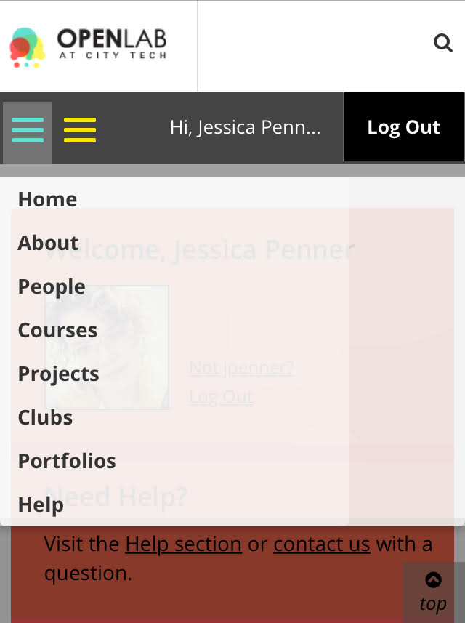
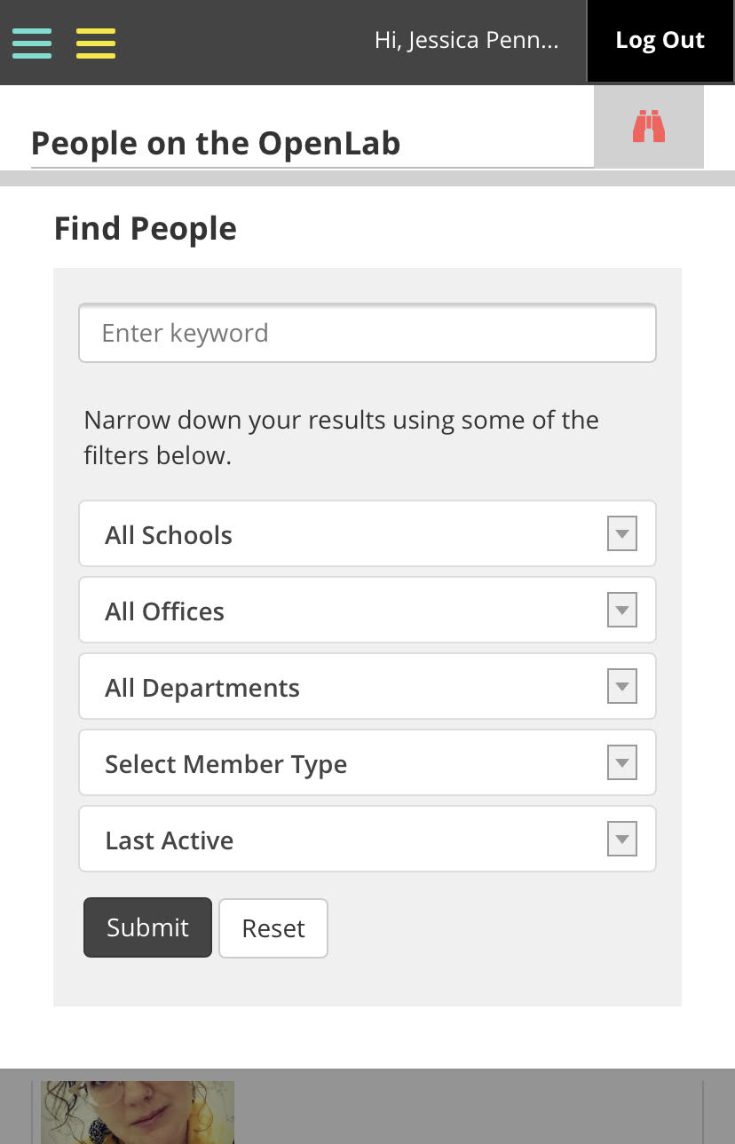
Jessica Penner
The easiest way to find our class is by finding me!

Slide 8
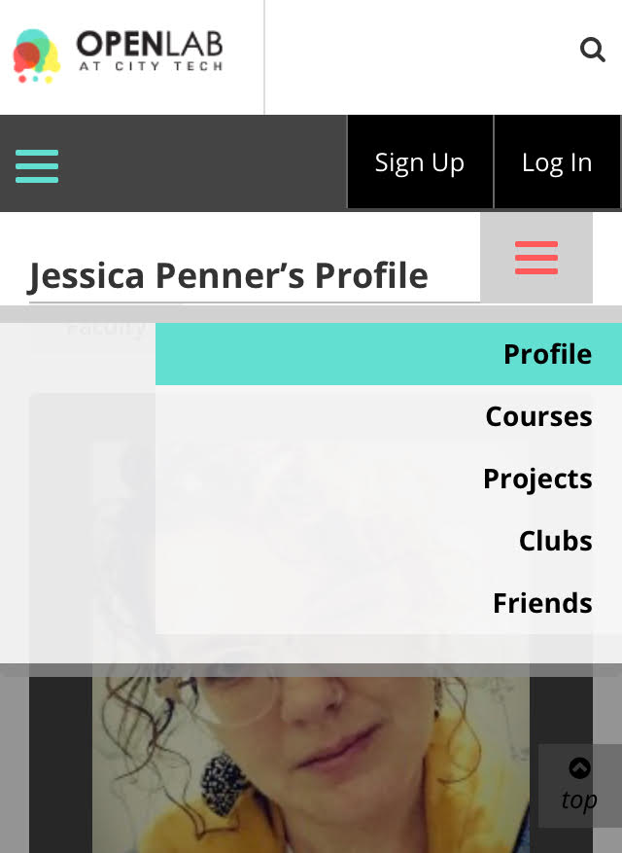
Go to Courses and find your class section (that thing that starts with a D) and join that class!

Slide 9

Speaking of writing…
Write two paragraphs that introduce yourself to me in the “Blue Book” I will provide:
On the cover, write your full, legal name, your preferred name (if you have one), and your pronouns (he/she/they). Write the date at the top of the first page and title the paragraphs “Introducing Me!”
Paragraph 1: Tell me about yourself, academic and otherwise.
  What your major is and why you chose your major. What career are you aiming for when you’re done with college?
  Share what you enjoy doing in your non-academic time (hobbies, jobs, pets, favorite television shows, etc.) Add anything else you want me to know about you.
Paragraph 2: Write about yourself as a reader and writer.
  What kinds of reading are you drawn to? (For example, do you read graphic novels, news articles, biographies, etc.?) What types do you avoid and dislike? Why?
  What writing assignments do you enjoy–if any? Why do you like them, and if you don’t like any writing assignments, explain why?

Slide 10

Homework
FYI: The reading assignments will always be homework.
  Hint: This means you need to do it before our class meeting. ☺
You can find the links to Thursday’s reading assignments on the Agenda page for this week. The font for the links is red.
By Wednesday review the PowerPoint. Again, the link is on the Agenda in the red font.
Return the Blue Book in before you leave the class!
  This is a low-stakes writing assignment, and worth 30% of your overall grade.
  If you take the Blue Book with you, you will not receive credit!

