Slide 1

ENG 1101
English Composition 2
Objectives
Begin writing an intro to your U2 Reflective Annotated Bibliography
Start researching your question online

Slide 2
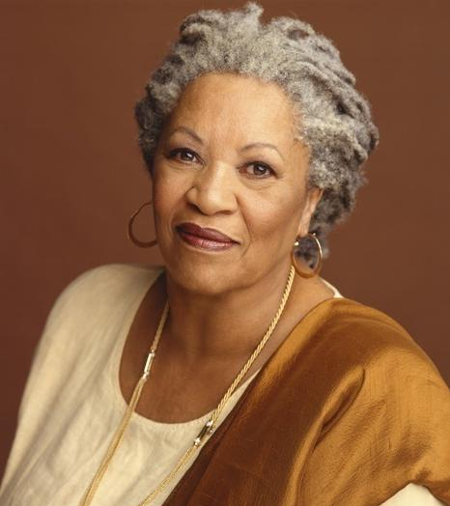
“When you get these jobs you have been so brilliantly trained for, just remember that your real job is that if you are free, you need to free somebody else. If you have some power, then your job is to empower somebody else.”
— Toni Morrison
Do you agree with this? Explain your answer.
What does this quote have to do with social justice?

Slide 3

Write
Spend 15 minutes writing a substantial paragraph answering the following questions (BTW, this will help you write your introduction to your U2 assignment):
  How did you get interested in your research question?
  Why are you interested?
  What answers and information do you expect to find in response to your research question?
Notes:
TPS

Slide 4

Research online!
Now that you have a research question, we’re going to do some research.
You need three specific sources: a peer-reviewed source, a multimodal source, and another source of your choosing—as long as it’s from a credible source.
I’m willing to bet you’ll probably use online sources for most, if not all, of your sources. But remember, they need to be from credible sources!
Of course, what make a source—especially an online source—credible?
Watch this video and take notes!
https://www.youtube.com/watch?v=MatV2mvSTrA&ab_channel=CityTechLibraryCUNY

Slide 5
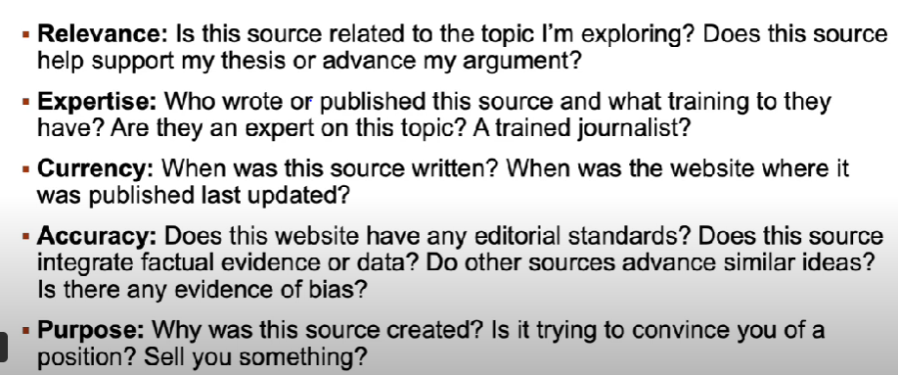
Recap: What questions help determine if a source is credible?

Slide 6

Research online!
For the rest of class, research your question via the internet.
If you’re unsure of how credible it is, remember those questions and ask them. If you’re still unsure, ask me!
DO NOT just social media scroll or nap during this time! DO NOT just find one source and then assume you’re done!
This is class time that should be utilized!

Slide 7
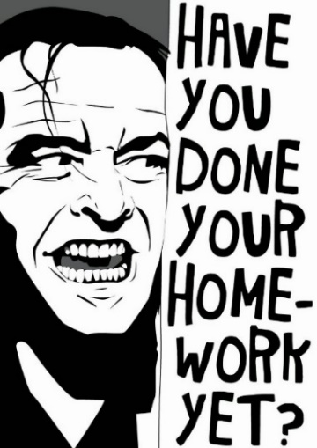
Homework
Continue doing research for U2! Be ready with at least ONE source to share with the class on Tuesday.
By 11:59pm on 10/19 (tonight), submit your U1 Writing Assignment to OpenLab. Directions on where and how to post your essay can be found in the Course Profile.
  Create a post titled Full Name, U1 Writing Assignment and save it under U1 Work.
  If I don’t see the title Full Name, U1 Writing Assignment, I won’t evaluate it and you’ll earn a 0 for this assignment!
  DO NOT simply copy and paste your essay into the body of the post! Please follow the directions on the Course Profile and save it as a PDF!
  This is a hard deadline!
U1 Reflection: Write a short reflective paragraph (150-200 words) about the process of writing your education narrative. In your paragraph, discuss whether reading “Shitty First Drafts” affected your writing process. If so, how? If not, discuss how you approached the assignment.
  This is one of the low-stakes writing assignments (worth 30% of your overall grade). Title it Full Name, U1 Reflection and post it under the category U1 Work by 11:59PM next Tuesday.

