Slide 1

ENG 1101
English Composition 1
Objectives
Discuss grading criteria for U3
Work on U3 project

Slide 2

Gratitude
“As we express our gratitude, we must never forget that the highest appreciation is not to utter words but to live by them.”
—John F. Kennedy
How can a person “live by” words of gratitude?

Slide 3
Part I: Your original piece…
uses one of the genres from the list provided or one we agreed on.
follows the conventions and formatting of your chosen genre that you explored and listed in your reflection (Part II).
Incorporates information from the research done for your reflective annotated bibliography and gives appropriate credit in order to avoid plagiarism.
  Make sure you refer to each source at least once in your U3 assignment.

Slide 4
Part II: Your one-page reflection…
is thoughtfully written and follows the assignment guidelines.
clearly and convincingly explains why the genre you plan to compose in makes sense for the audience you have chosen to address.
clearly lists and explains the traits that are unique to the genre.

Slide 5
Discuss
In small groups and then the class, you’ll briefly share your genre and its conventions and ask each other for feedback on the following questions:
  How will you show the information from your research? For example, if you’re doing a podcast, you will…
  How will you give credit to your sources to avoid plagiarism? For example, if you’re doing a brochure, you will…
  What excites you about creating your genre?
  What worries you about this project as a whole?

Slide 6
Write!
For the rest of class, work on your U3 project!
If you need to refer to your mentor text (remember the U3 Genre assignment?), spend time (quietly) viewing/reading it.
If you need help with either Parts I or II, come talk to me about it! (That’s what they pay me the big bucks for! LOL)

Slide 7
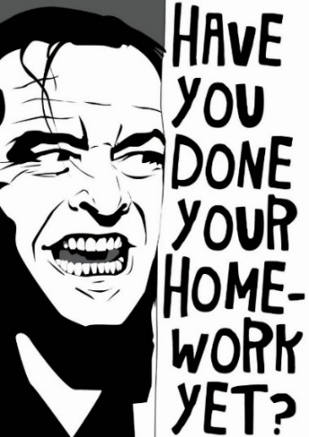
Homework
Begin creating your U3 project. This project requires some maturity as a student on your part. Why? Because each student’s project is different, the time required for Parts I and II will vary. You’ll need to schedule in the time needed. Also, the temptation to put off this assignment until right before the first draft due date will be strong–do not give in to this temptation!
However, I will give you two new due dates to keep y’all motivated and on track:
  Plan on sharing your progress on Part I on Monday and Part II on Wednesday.
    What do I mean by “progress”? Being ready to show or discuss in detail what you’re working on for Part I on Monday and having a few paragraphs to show for Part II on Wednesday.

