Slide 1

ENG 1101
English Composition 2
Objectives
Review how to cite sources using MLA
Work on citations, summaries, reflections, and quotes

Slide 2
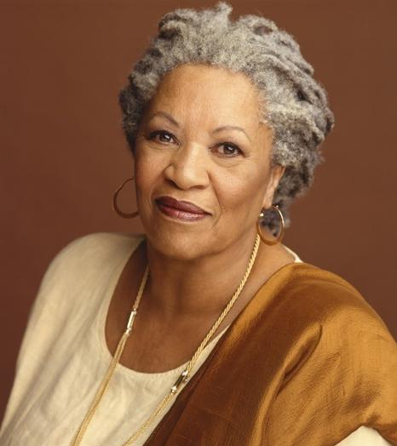
“When you get these jobs you have been so brilliantly trained for, just remember that your real job is that if you are free, you need to free somebody else. If you have some power, then your job is to empower somebody else.”
— Toni Morrison
Do you agree with this? Explain your answer.
What does this quote have to do with social justice?

Slide 3

MLA Review
If your source comes from the databases at City Tech Library, usually the “citation” button will do most of the work for you.
If your source isn’t from the databases, you’ll have to go to the Purdue OWL site.

Slide 4
First Source Citation
For the rest of class, work on citing, summarizing, reflecting, and quoting your first source.
As a reminder of what these all look like…

Slide 5

Sample Entry

Slide 6

Sample Entry

Slide 7

Sample Entry

Slide 8
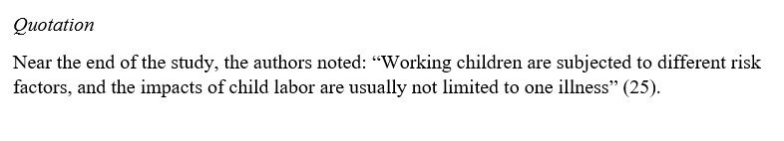
Sample Entry

Slide 9
First Source Citation
When you’re finished with the source, create a post titled Full Name, First Source Citation, and save it under the category U2 Work.
If you finish one, start working on the next one!

Slide 10

Homework
Continue working on the sources, as well as the introduction and conclusion.
We’ll work on the remaining two in class on Wednesday. Be sure to bring your laptop or tablet.
Want help? Come to an office hour on Tuesday and we can look over your sources together!

