Slide 1

ENG 1101
English Composition 2
Objectives
Listen to The Declaration of Independence
Discuss Baldwin & Long Soldier’s work
Discuss how to upload U1 writing assignment

Slide 2
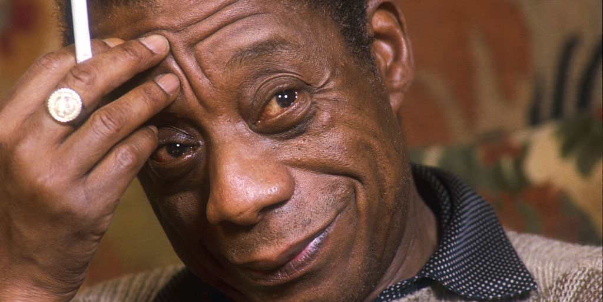
I would try to make [the student] know that just as American history is longer, larger, more various, more beautiful and more terrible than anything anyone has ever said about it, so is the world larger, more daring, more beautiful and more terrible, but principally larger – and that it belongs to him. I would teach him that he doesn’t have to be bound by the expediencies of any given administration, any given policy, any given morality; that he has the right and the necessity to examine everything. – James Baldwin
What do you think you have the “necessity” to examine, or the obligation to learn more about? Why?
What do you wish had been taught to you in school that wasn’t? Why do you want to know about these topics?

Slide 3
The Declaration of Independence
Read the Declaration of Independence (text) while we listen to the Declaration of Independence (audio).
  [NPR's] Editor's note on July 8, 2022: This story quotes the U.S. Declaration of Independence — a document that contains offensive language about Native Americans, including a racial slur.
Next, think about The Declaration of Independence in modern terms.
In small groups, discuss if at least one of the arguments in this founding document are relevant to you and relate to issues that affect you, your family, and/or your community in the 21st century. If you feel the document is completely irrelevant to your life, explain your reasoning in specific terms.
  Remember to discuss this respectfully! You don't have to agree with each other, but use polite language!

Slide 4
Baldwin
Now, if what I have tried to sketch has any validity, it becomes thoroughly clear, at least to me, that any Negro who is born in this country and undergoes the American educational system runs the risk of becoming schizophrenic. On the one hand he is born in the shadow of the stars and stripes and he is assured it represents a nation which has never lost a war. He pledges allegiance to that flag which guarantees “liberty and justice for all.” He is part of a country in which anyone can become president, and so forth. But on the other hand he is also assured by his country and his countrymen that he has never contributed anything to civilization – that his past is nothing more than a record of humiliations gladly endured.
What is Baldwin saying here?

Slide 5
Long Soldier
The Dakota 38 refers to thirty-eight Dakota men who were executed by hanging, under orders from President Abraham Lincoln.
To date, this is the largest “legal” mass execution in US history.
The hanging took place on December 26, 1862—the day after Christmas.
This was the same week that President Lincoln signed the Emancipation Proclamation.
In the preceding sentence, I italicize “same week” for emphasis.
There was a movie titled Lincoln about the presidency of Abraham Lincoln.
The signing of the Emancipation Proclamation was included in the film Lincoln; the hanging of the Dakota 38 was not.
What is Long Soldier saying here?

Slide 6

Discuss
Now, think about the history that Layli Long Soldier covers in her poem “38.” Considering her history and the quote from Baldwin's piece, discuss the following questions:
Are there any incidents in US history that you think are not as visible as they should be, and that you think are important for people to learn about?
Are there contemporary incidents that you think should be included in historical accounts of our era so people in the future can learn from them?
Take notes, because your answers will help with what we'll be discussing on Wednesday!

Slide 7
How to Upload U1 Education Narrative
Go to Course Profiles > Files > ENG1101 Handouts
There are two documents:
ENG1101 Education Narrative Template
  This is how I want everyone’s essay to look like!
ENG1101 How to Upload U1 Writing Assignment
  This is how you’ll submit this assignment. I will not grade an essay that is not turned in this way!

Slide 8

Homework, Part 1
Although Americans today recognize that the Founders had racist/misogynist bias about who "all men" were when they wrote the phrase: "We hold these truths to be self-evident, that all men are created equal," we also recognize that what the Founders did (writing and signing the Declaration) could've led to their deaths because what they did amounted to treason against the King. They were willing to risk this because they believed in what they were saying.
With the idea of fighting for your beliefs and values in mind, consider issues that affect you. What are some social justice issues (local or global) that you feel strongly about and might inspire you to act?
  Make a list of at least three issues (think about laws, policies, movements, etc.). You might also think about our discussion on Baldwin and the things you feel the necessity or obligation to learn about; or, think about Long Soldier and incidents or chapters in US history that you think are not visible and should be.
  Please avoid typical topics that are sensitive (abortion, for example). Search for issues or problems--local, national, global--that matters to you and that you have questions about, not entrenched beliefs. Brainstorm a list.

Slide 9
Homework, Part 2
Submit your U1 Writing Assignment to OpenLab. Directions on where and how to post your essay can be found in the Course Profile.
  Create a post titled Full Name, U1 Writing Assignment and save it under U1 Work.
  If I don’t see the title Full Name, U1 Writing Assignment, I won’t evaluate it and you’ll earn a 0 for this assignment!
  DO NOT simply copy and paste your essay into the body of the post! Please follow the directions on the Course Profile and save it as a PDF!
  Submit this assignment by 11:59PM on Wednesday, 10/19. This is a hard deadline!

