Slide 1

ENG 1101
English Composition 1
Objectives
Discuss Westengard’s PowerPoint
Analyze & discuss Lorde’s work

Slide 2

“I was squinting because I was in that silent agony that characterized all of my childhood summers, from the time school let out in June to the end of July, brought about by my dilated and vulnerable eyes exposed to the summer brightness.
“I viewed Julys through an agonizing corolla of dazzling whiteness and I always hated the Fourth of July, even before I came to realize the travesty such a celebration was for black people in this country.”
- Audre Lorde
What is Lorde saying to us in this passage?

Slide 3
Education Narrative
Basic Features
By Prof. Laura Westengard
Adapted from St. Martin’s Guide to Writing, edited by Rise B. Axelrod; Charles R. Cooper; Ellen Carillo; Wallace Cleaves

Slide 4
A Well-Told Story
The story should be enjoyable. It should be a pleasure to read.
  What parts of our assigned readings have been enjoyable?
The story should use dialogue to portray people, help readers understand their point of view, and heighten the drama.
  Where did the readings include direct quotes?
The story should include a dramatic arc.

Slide 5
Dramatic Arc
Climax
Rising Action
Falling Action
Exposition/Inciting Incident
Resolution/Reflection

Slide 6
Vivid Description of People and Places
Naming: What is it?
  Call attention to observable details and notable features
Detailing: What are its parts or features?
  Make the features more specific
Comparing: What is it like?
  Similes and Metaphors
Remember to use ALL five senses!

Slide 7
Significance
Your story should have a clear message about how certain experiences have shaped your understanding of the world and/or your educational journey
  What are the messages conveyed in our assigned readings?
You can convey this by:
  Describing feelings and thoughts from the time the event took place
  Reflecting on the past from the present perspective
  Choosing details and words that create a dominant impression

Slide 8
Discuss
With your group, find the “feature” of the narrative that you have been assigned to examine (dramatic arc, dialogue, vivid description, significance).
Identify moments in the Lorde text where you see the feature you have been assigned.
Copy out quotes or mark the text where you see the feature at work and explain why it is that feature and/or how the feature is working in that moment.
Be ready to share your findings with the class!

Slide 9
Write!
Spend the remainder of class working on your Education Narrative—see how you can use some of the features discussed/found in Lorde’s text in your own work.

Slide 10
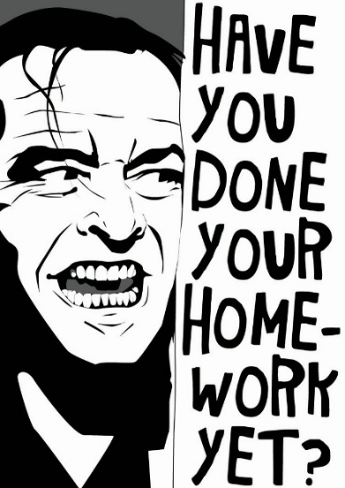
Homework
There’s no class on Monday, 9/26!
Read “Shitty First Drafts” by Anne Lamott for Wednesday.
Work on your own “shitty first draft”! Look at the material you’ve generated through brainstorming and freewriting in this class.
I’ll post more details about next week by Friday in our weekly Agenda.

