Slide 1

ENG 1101
English Composition 1
Objectives
Reread & Analyze Plato
Freewrite for Education Narrative

Slide 2
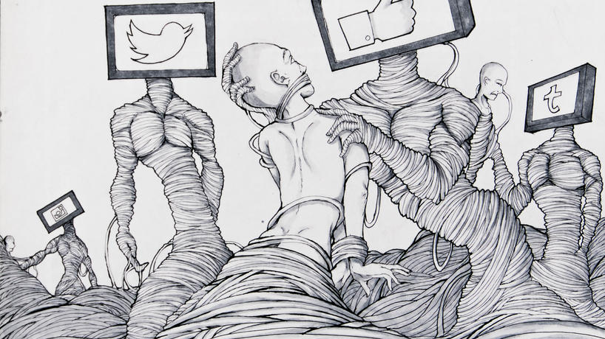
“[I]t isn't the law's concern to make any one class in the city outstandingly happy but to contrive to spread happiness throughout the city by bringing the citizens into harmony with each other through persuasion or compulsion and by making them share with each other the benefits that each class can confer on the community. The law produces such people in the city, not in order to allow them to turn in whatever direction they want, but to make use of them to bind the city together.”
- from “The Allegory of the Cave”
What is Plato saying?
Do you agree or disagree with this idea? Why or why not?
Notes:
Modern Allegory of the Cave, by Janji009
https://www.deviantart.com/janji009/art/Modern-Allegory-of-the-Cave-488546404

Slide 3
Reread “Allegory of the Cave”
Read Plato’s “Allegory of the Cave” again.
Look for moments where Plato emphasizes physical and concrete details the prisoners experience; for example, pay attention to anything they see, hear, and physically feel (along with what causes it).
Find three of these details and think about what they might symbolize.
For each detail, write a few sentences explaining the point/s Plato makes through his imagery.

Slide 4
Discuss
In your assigned group, share the moments you wrote about earlier.
Next, talk about the following questions:
  Why are we spending so much time talking about metaphors and symbolism when the writing assignment is about education narratives?
  How can we use symbolism in our own writing about our experiences?

Slide 5
Freewrite
Get out your device and respond to the following prompts (I’ll give you a specific amount of time to write about each):
Write about all of the times you can think of that changed how you approached the learning process or shifted how you felt about education
Write about your chosen major or career goals and all the valuable moments that shaped your interest in your chosen field
Write about all of the moments when you “woke up” in some way and changed a central belief, value, or idea that your felt certain about for a long time
Remember when we did the double-entry journal exercise last week? Go back to that exercise and write more about the experiences you mentioned in your double-entry journal for Jiang, Douglass, and/or Malcolm X. Include as many details as possible.

Slide 6

Homework
Read “The Fourth of July” by Audre Lorde.
Review “Narrative Basic Features” PowerPoint by Laura Westengard.
Use the freewriting exercise to assist you in crafting your Education Narrative—use whatever writing you’ve already done in this class for this Major Writing Assignment.

