Slide 1

ENG 1101
English Composition 1
Objectives
Practice double-entry journaling
Practice genre awareness
Discuss Unit 1 Major Writing Assignment

Slide 2
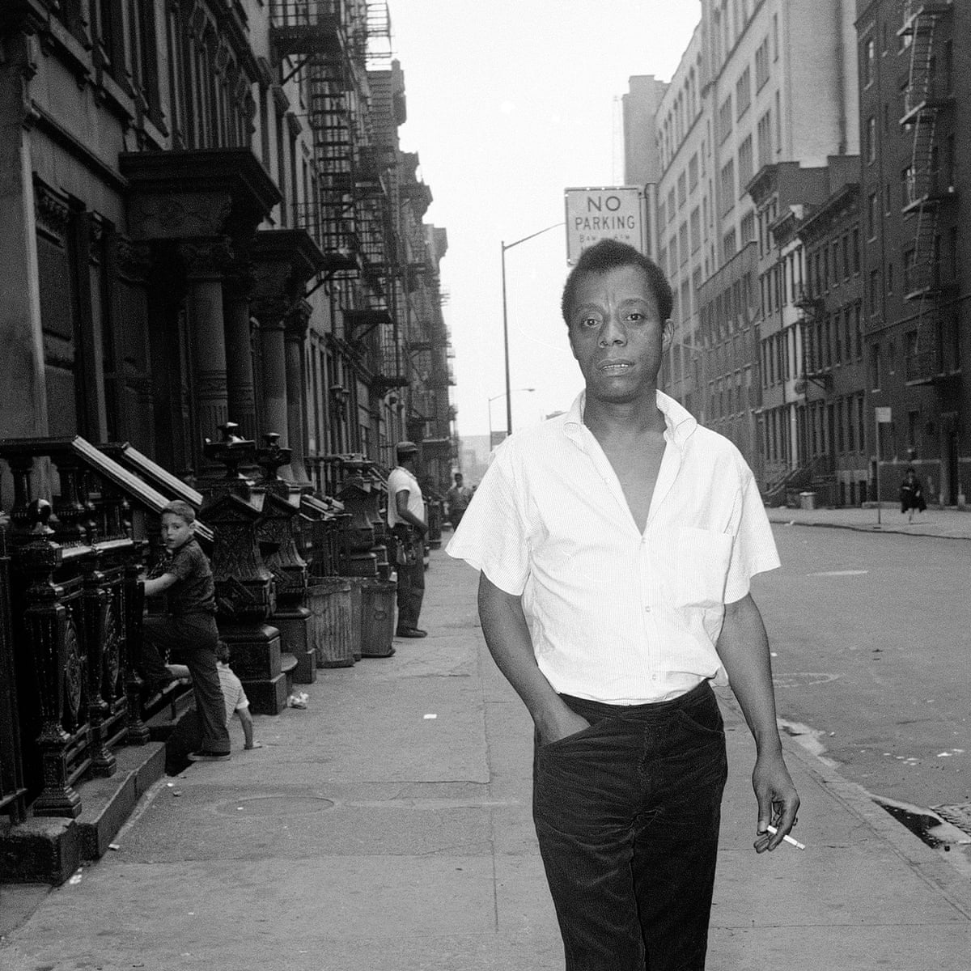
“The paradox of education is precisely this - that as one begins to become conscious one begins to examine the society in which [they are] being educated.”
- James Baldwin
What is the definition of “paradox”?
What does Baldwin mean by the phrase “one begins to examine the society”?
Have you had an experience where you’ve found yourself examining your society?

Slide 3
Double-entry Journal
Direct Quote Pick one quote from each of the readings we did for homework. Choose a quote that reminds you of an experience that you have had. It doesn’t have to be exactly the same–just be sure to pick quotes that you relate to in some way. | Thoughts/Reflections Reflect on why you chose this quote. How/why does it remind you of your own experience?
Jiang Quote
Malcolm X Quote
Douglass Quote
Create a “double-entry journal” like the one talked about in one of our texts for today in your notebooks: in the left-hand column, write the quotes.
In the right-hand column, explain why it reminds you of your own learning experience (whether that experience was in an actual school setting or elsewhere).

Slide 4
Discussion
Join your assigned group; be sure to agree on a leader and a speaker first!
Share at least one of your quotes and the reason you chose this quote. If time, share the others!
When time’s up, be ready to share with the larger class one of the quotes y’all discussed and the reason why it was chosen.

Slide 5
Genre Awareness
Malcolm X: Learning to Read
Speaker | Who is the narrator?
Occasion | What is the context for this piece?
Audience | Who is this piece for?
Purpose | What is the reason for writing this text?
Subject | What is the focus here?
Tone | How would you describe the narrator’s language?
Draw three charts in your notebooks (one for each reading we’ve covered so far).
On the left side, write speaker, occasion, audience, etc. On the right, answer the corresponding questions you see at the right:

Slide 6
Discussion
In your group, share your answers quickly, before tackling these questions:
  What is the definition of genre?
  Why is it important to know about speaker, occasion, audience, etc. when you’re thinking about genre?

Slide 7
Unit 1 Major Writing Assignment
Let’s review the Unit 1 Major Writing Assignment. (Go to Major Writing Assignment > Unit 1.)
Now, think about the pieces by Douglass, Malcolm X, and Jiang. Although these pieces are very different, they are all education narratives. What do you think puts them into this category? In other words, what do they have in common?
Share your thoughts on this in a Post (this is a low-stakes assignment–worth 30% of your overall grade).
  Be sure to title the post correctly: Full Name, Education Narratives
  Save it under Unit 1 Work.
  Hit “Publish” by the next class!

Slide 8
In-class & Homework
Brainstorm topics for Unit 1. [If we have time,] I’m going to set a timer. Spend 5-10 minutes brainstorming a quick list of stories, ideas, questions, and moments that are important to your experience.
Select one of the texts we’ve read so far (Jiang, Douglass, Malcolm X) as a model for your own narrative. The story in the model text does not need to be like yours, but there is something about the way the story is told that you would like to emulate. Identify which text you have chosen as your model and what it is about the way the author composes their narrative (their techniques, strategies, and style) that appeals to you.
  You won’t have to submit anything–yet–but be prepared to share and discuss these items SOON.

Slide 9
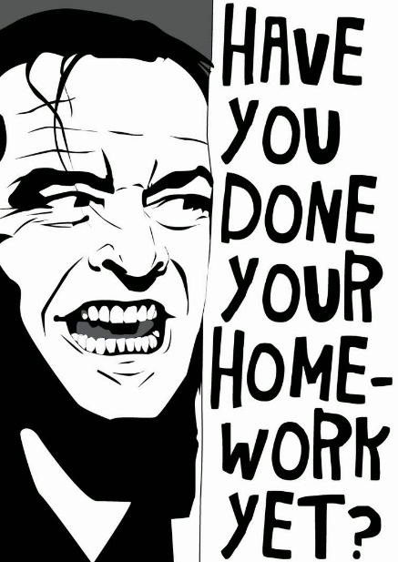
Homework
Keep on working/brainstorming on ideas for Unit 1.
You don’t have to read this before class but be prepared to read in class the “Allegory of the Cave” (Book VII) from The Republic, by Plato. (If you want to review it, the section we’re reading starts on page 6!)
If you haven’t joined our class on OpenLab, please do this soon! This is how all assignments for this class will be posted.
  Seriously—there are still a few folks who haven’t joined! If you’re having issues with email or OpenLab, come talk to me.

