Slide 1

ENG 1101
English Composition 1
Objectives
Discuss our own “Shitty First Drafts”
Write!
Practice a quick peer review

Slide 2
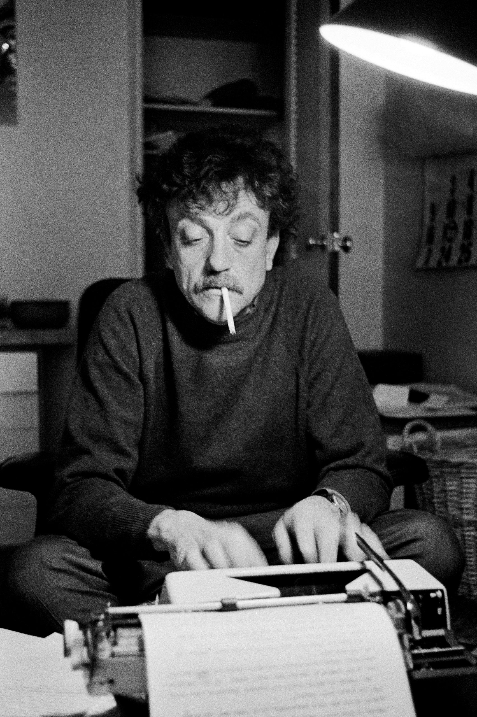
“We have to continually be jumping off cliffs and developing our wings on the way down.”
— Kurt Vonnegut
What is Vonnegut saying, exactly?
Think about other skills you’ve learned by doing.

Slide 3

Discuss
Join your assigned small group and discuss your “Shitty First Draft” worksheet.
When time's up, please go to the Full Name, My Writing Process you created last week and hit "reply."
Then copy and paste the document in the response section (this is how I'll know you've completed this assignment).

Slide 4
Write!
Work on revising Unit 1: Education Narrative on your own for a specified amount of time.
We're going to do a quick peer review, so please spend the time wisely!

Slide 5
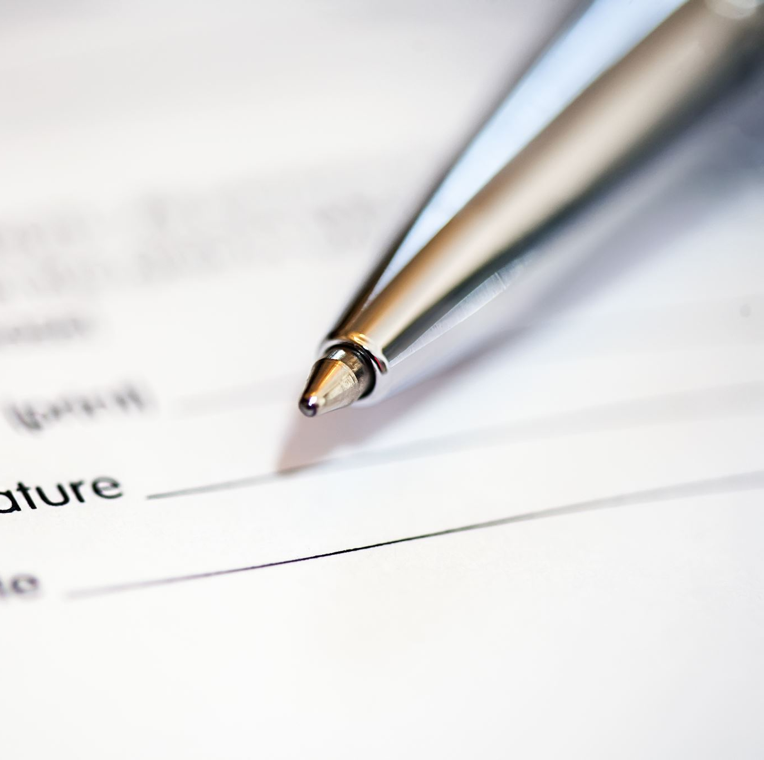
Quick Peer Review!
Email whatever you've written to the assigned peer.
When you receive your partner's draft, quickly read and respond to the following questions on the Google Doc I’ll email to you.

Slide 6
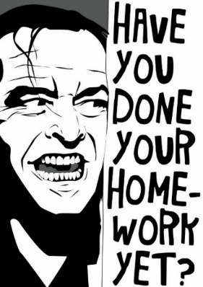
Homework
There are no classes scheduled for Wednesday or Monday, but there’s work to be done between now and the next time we meet!
Review your partner's comments on the Google Doc. Review the websites listed on the Agenda as you work on a second draft.
Bring a complete draft (at least 1,000 words) to class on Wednesday, 10/12--preferably printed, but at least a digital copy you can quickly email to your partner! Remember, just bringing a draft to be peer reviewed earns 50 points!

