Slide 1

Proposal
Research can be so hard at times for students. The internet will give you tons of sites that is not essential to the actually topic of your choice.
Some students could waste hours looking for the right site for a project.
What if you could fast forward time and skip all the sites that have nothing to do with your topic
What if the internet could direct you exactly to the site of your best understanding.

Slide 2
EASY SEARCH

Slide 3
what is Easy search
easy search is a tool that allows people to search on any topic related to their area of studies or career without any difficulty. Easy search will be able to help a wide variety of people such as students of all ages ,professors, and even people with careers that have nothing to do with academics.

Slide 4
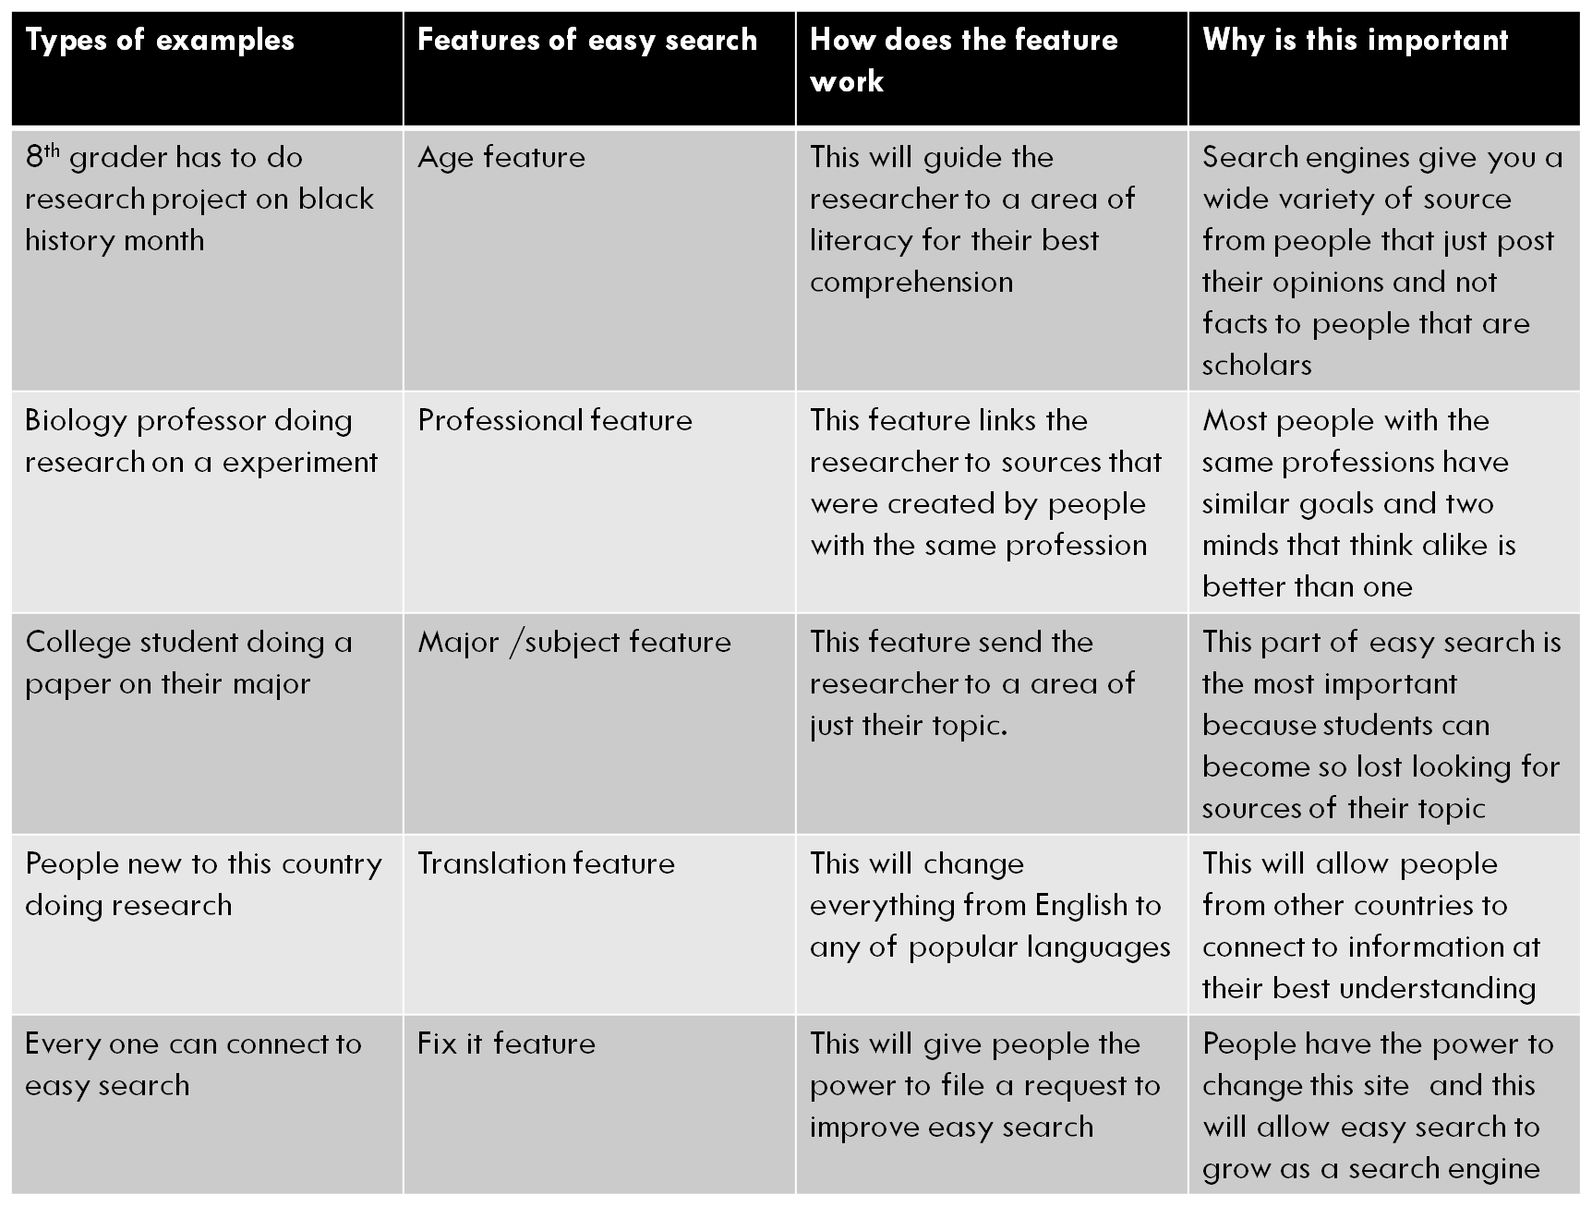
How will easy search connect to you

Slide 5

How does easy search work

Slide 6
Easy search
The survey
The survey
The survey
Age
Occupation
Education level
Major/ area of interest
English, math , history, and sciences
Psychology, nursing, computer science, and others
Search topic
Choose a language for results

Slide 7
Easy search results process
Best results
Good result
Topic
In this section you will have the most results
You could have up to 20 of the best sites for you on here
In this section your going have sites that are also good but do not relate to your survey questions
For example the literacy maybe harder to comprehend or it may not connect to your exact major
The most sites you may have in this section is 10-15
This section is for people that finish there research but are interested in the same topic but for different reasons
This section may have only 5- 10 sites

Slide 8
Easy search media
Images
Videos
Reflection of you
Just like google you can get tons of photos
You can save and download them
Just like YouTube you can watch tons of video for free
You can rate video and share with friends
This is another feature of easy search. This will allow you to post pictures ,videos, poems , essays ,and a lot more
So that other people will e able to use it for research

Slide 9
Easy search fix it
This is the last part of the search engine. Before anyone exits the app they will be ask if they have any concerns or request.
Questions like
Did you like using this app and why
Do we need any improvements

