Slide 1

ENG 1101
English Composition 1
Objectives
Self-Review Reflective Annotated Bibliography
Work on Reflective Annotated Bibliography

Slide 2
Self-Review
Complete a self-review of your Reflective Annotated Bibliographies (see Course Profile > Files > ENG1101 Handouts > ENG1101 Self-Review Reflective Annotated Bibliography).
After you’ve completed and emailed this document and your draft to eng1121.citytech1@gmail.com, review your notes and start working on the final draft.
  This is how you’ll earn those 50 points. Make sure you email BOTH documents.
Do whatever needs to be done in order to submit the assignment on time and as perfect as possible!
Throughout this session, I’ll be calling each student up individually to check in with their progress. Be ready to share any issues/questions during this time!

Slide 3
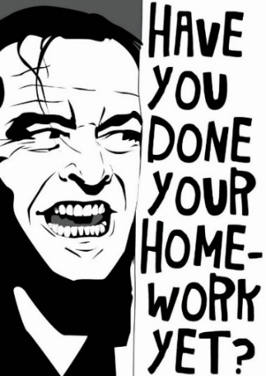
Homework
Continue working on the U2 Reflective Annotated Bibliography, which is due before midnight on Wednesday, 11/9.
Want further assistance? Sign up for a session at the Writing Center (you have to register if you haven’t done this before) or come by my office hour on Tuesday!

