Slide 1

ENG 1101
English Composition 2
Objectives
Review how to cite sources using MLA
Work on citations, summaries, reflections, and quotes

Slide 2

“When we identify where our privilege intersects with somebody else's oppression, we'll find our opportunities to make real change.”
— Ijeoma Oluo
Can you think of where your privilege intersects with another’s oppression?
What can we do when we understand this?

Slide 3

Questions about MLA Review?
If your source comes from the databases at City Tech Library, usually the “citation” button will do most of the work for you.
If your source isn’t from the databases, you’ll have to go to the Purdue OWL site.

Slide 4
Second (and Third) Source Citation
For the rest of class, work on citing, summarizing, reflecting, and quoting your first source.
As a reminder of what these all look like…

Slide 5
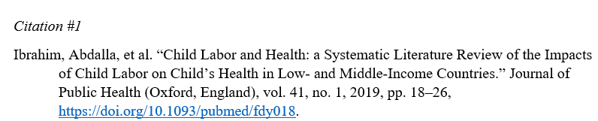
Sample Entry

Slide 6
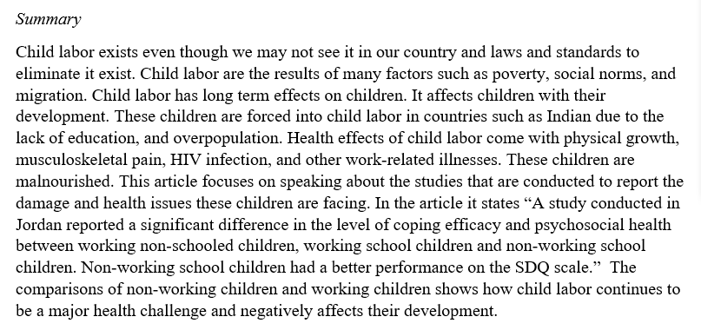
Sample Entry

Slide 7
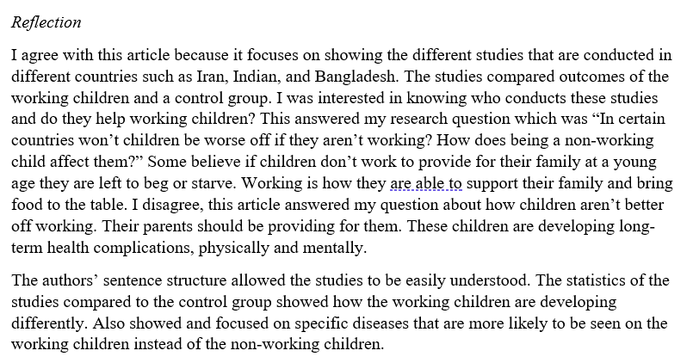
Sample Entry

Slide 8
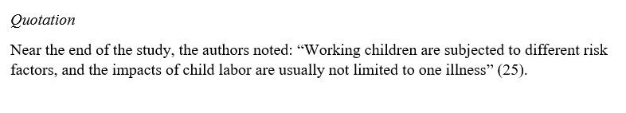
Sample Entry

Slide 9
Source Citation
When you’re finished with the source, create a post titled Full Name, Second Source Citation, and save it under the category U2 Work.
If you finish, start working on the next one—it’s due on Monday!

Slide 10
Write an Introduction
Introduce your question.
Explain how or why you got interested in your question.
Explain what you expect to find in your research.
300 words (or more).

Slide 11
Write a Conclusion
Summarize what you found in your research.
Discuss what you learned while doing this research and why it is important to the overall topic.
Explain who you think needs to know about your research and why. (The answer cannot be “everyone needs to know.” That is too big of an audience.) Narrow it down to who needs to hear about it first or the most!
400 words (or more)

Slide 12
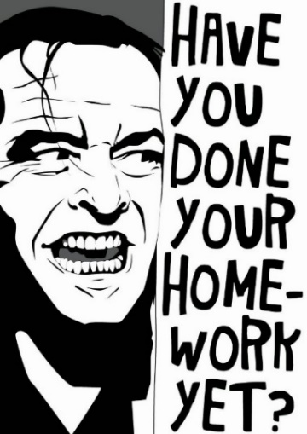
Homework
Gather all sections of this project (Introduction, Sources, Conclusion) into one document by class time on Monday. Even if it’s not complete, bring a copy (preferably printed) to be peer reviewed.
  I’ll be posting a Reflective Annotative Bibliography Template under Course Profiles on Friday.
Be prompt on Monday, so we can start peer reviewing right away!

