Slide 1
City Tech 101
Prof. Jessica Penner
jpenner@citytech.cuny.edu
City Tech 101 by Karen Goodlad and Sarah Paruolo is licensed under a Creative Commons Attribution-NonCommercial-ShareAlike 4.0 International License.

Slide 2
#YellowJacketLife:
The Buzz on
Getting Involved
Session 8
Prof. Jessica Penner
jpenner@citytech.cuny.edu
City Tech 101 by Karen Goodlad and Sarah Paruolo is licensed under a Creative Commons Attribution-NonCommercial-ShareAlike 4.0 International License.

Slide 3
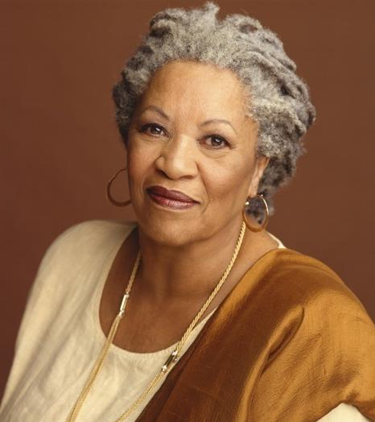
“When you get these jobs you have been so brilliantly trained for, just remember that your real job is that if you are free, you need to free somebody else. If you have some power, then your job is to empower somebody else.”
— Toni Morrison
Do you agree with this? Explain your answer.

Slide 4

Today’s Topics
Why Participate?
Co-curriculars @City Tech
Extracurriculars @City Tech
A visit from SLD

Slide 5
Why Participate?

Slide 6

Personal Benefits

Slide 7
Make friends
Build community
Discover interests
Explore areas of study

Slide 8
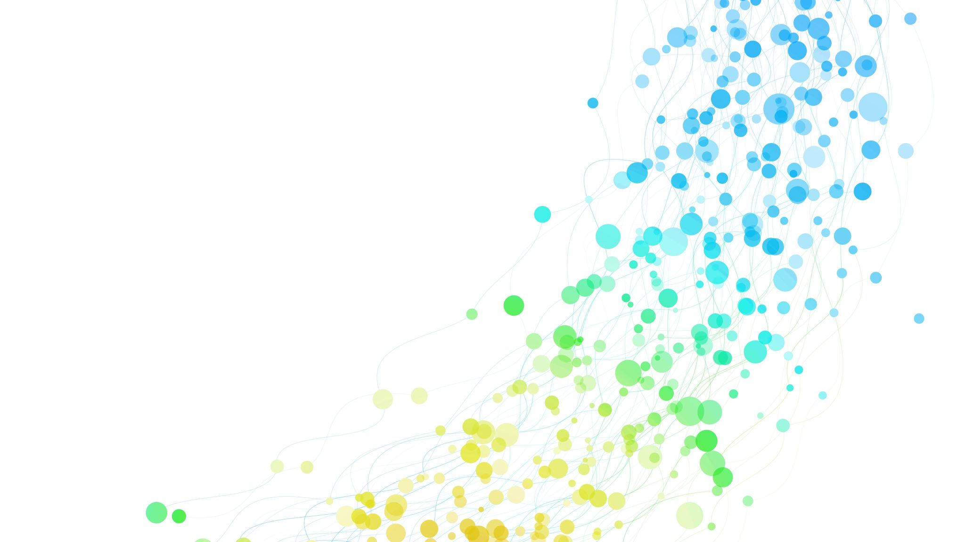
Academic Benefits

Slide 9
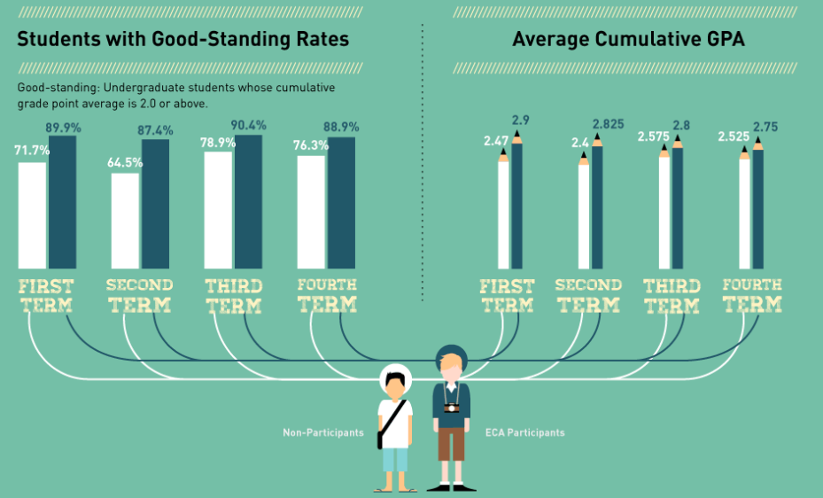

Slide 10

Career Benefits

Slide 11
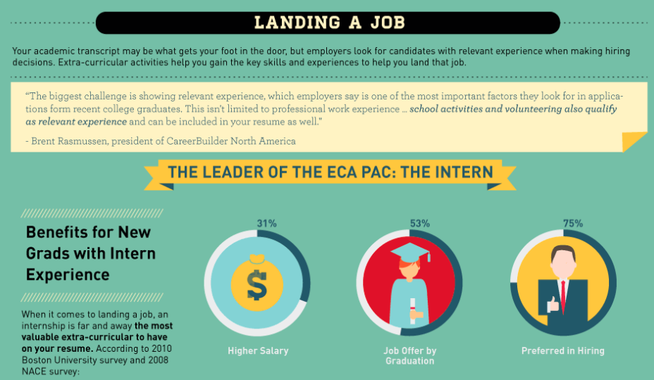

Slide 12
Sources
Boston University
California State University, Sacramento
Careerbuilder.com
The College Board
Collegiate Assessment
Elearninginfographics.com
Graduate Management Admissions Council
Harris Interactive
National Association of Colleges and Employers
National Center for Education Statistics
Stanford University

Slide 13
Hard Skills vs. Soft Skills:
What’s the Difference?
Hard Skills:
Specific knowledge and abilities needed in order to perform a certain job
For example: An architect needs to be able to draft blueprints, have a knowledge of the strengths and uses of various building materials, etc.
Soft Skills:
Knowledge and abilities that don’t directly relate to a certain job, but that make an employee valuable
For example: communication skills, interpersonal skills, managerial skills, etc.

Slide 14

Building Skills Through Participation
Decision-Making Skills
Interpersonal Skills
Managerial Skills
General Workplace Knowledge

Slide 15

Co-curriculars
@City Tech

Slide 16
Co-curricular
Extracurricular
Programs, clubs, + activities NOT directly related to what you are studying in college, but still relevant to your growth as a student or a person
Programs, clubs, + activities directly related to what you are studying in college

Slide 17
Co-curricular Examples
Honors Scholars Program Internships/Externships
Emerging Scholars Program Clubs related to a major or department
Undergraduate Research Events related to a major or department
Academic Competitions Study Abroad Programs
Place-based Learning
More information: http://citytech.cuny.edu/research/
http://www.citytech.cuny.edu/pdc/
https://www.citytech.cuny.edu/student-life/

Slide 18
Extracurriculars
@City Tech

Slide 19
Co-curricular
Extracurricular
Programs, clubs, + activities NOT directly related to what you are studying in college, but still relevant to your growth as a student or a person
Programs, clubs, + activities directly related to what you are studying in college

Slide 20
Extracurricular Examples
Affinity Clubs (ex. Bengali Students Club, Chinese Christian Fellowship)
Social Clubs (ex. E-sports Club, Step Team)
Student Government
Peer Mentoring (ex. FYP Peer Mentors, Perkins Peer Advisement)
Social Events (ex. Welcome Back Bash, De-Stress Week)
Community Events (ex. PLAN Week, Literary Arts Festival)
Volunteering (ex. Spoons Across America)
More information: https://www.citytech.cuny.edu/student-life/ https://www.citytech.cuny.edu/sga/

Slide 21

If you can’t find what you are looking for...
Start your own club!

Slide 22

Create & Present Your Club
In your small group, decide whether you’ll create a co-curricular (related to your field of study) or extracurricular club (a hobby or personal interest).
When you’ve decided the above, work on the following:
  Name of club
  Club leadership (president, vice president, and secretary)
  What is the purpose of the club?
    For example, if it’s a co-curricular club, you might be interested in discussing different facets or challenges of your major. If it’s extracurricular, you might want to get together to actively do the hobby.
  How would you get other students interested in joining?

Slide 23

Student Life and Development (SLD) website
  Yellow Jacket Journey
OpenLab
Instagram
Facebook
Flyers on campus
Club + Activities Fair
Email Announcements
Weekly PM Newsletter

Slide 24
Student Life and Development
General Building Room G-516
Phone: 718-260-5391
studentlife@citytech.cuny.edu
https://www.citytech.cuny.edu/student-life/

Slide 25
Recap
Why Participate?
Co-curriculars @City Tech
Extracurriculars @City Tech
A visit from SLD

Slide 26
Before Session 9…
Complete Reflection on OpenLab by replying to Reflection #8 Post.
Reflection #8
Think about a time when you joined a new group activity (maybe a team, religious retreat, club, or workplace).
How did you feel when you first joined?
Do you recall a moment when you felt like you were part of the group?
What benefits did you get from participation in the group?

Slide 27
#YellowJacketLife:
The Buzz on Your Future
Session 8
Prof. Jessica Penner
City Tech 101 by Karen Goodlad and Sarah Paruolo is licensed under a Creative Commons Attribution-NonCommercial-ShareAlike 4.0 International License.

