Slide 1
City Tech 101
Fall 2023
Prof Jessica Penner
jpenner@citytech.cuny.edu
City Tech 101 by Karen Goodlad and Sarah Paruolo is licensed under a Creative Commons Attribution-NonCommercial-ShareAlike 4.0 International License.

Slide 2

Discussion
Answer the following questions in your notebooks. We’ll discuss them in small groups in a few minutes.
  Why did you choose your major?
  Are you still confident that this major is right for you?
  Why?

Slide 3
#aMAJORdecision
Session 6
Prof. Jessica Penner
City Tech 101 by Karen Goodlad and Sarah Paruolo is licensed under a Creative Commons Attribution-NonCommercial-ShareAlike 4.0 International License.

Slide 4

Today’s Topics
Vocabulary Preview
Student Success Center
University Structure
Academic Advisement vs. Registration
Academic Advising Preparation
DegreeWorks Degree Audit
My Academic Career Planner
Academic Advisors
Vocabulary Review

Slide 5

Vocabulary Preview

Slide 6
Here are some words you may hear today in class.
What are the words you don’t know or are unsure about?
If you want to learn these words, what are some study strategies you can use to help you in this class and later on your own?
Academic Calendar
Admissions Criteria
Advisement
Advisor
Associate Degree
Baccalaureate Degree
Corequisites
Credits
Credit Hours
Full Time
General Education/Gen Ed/Common Core
Lab
Major
Part Time
Pathways
Prerequisites
Registration
School
Sequential
To-Do List (CUNYFirst)
Writing Intensive
Notes:
Professors:
Some suggestions for skills to practice with students:
Chunking (breaking the list down into smaller groups/categories)
looking for related words/terms to compare
Callback to note-taking in session 5

Slide 7

University Structure

Slide 8
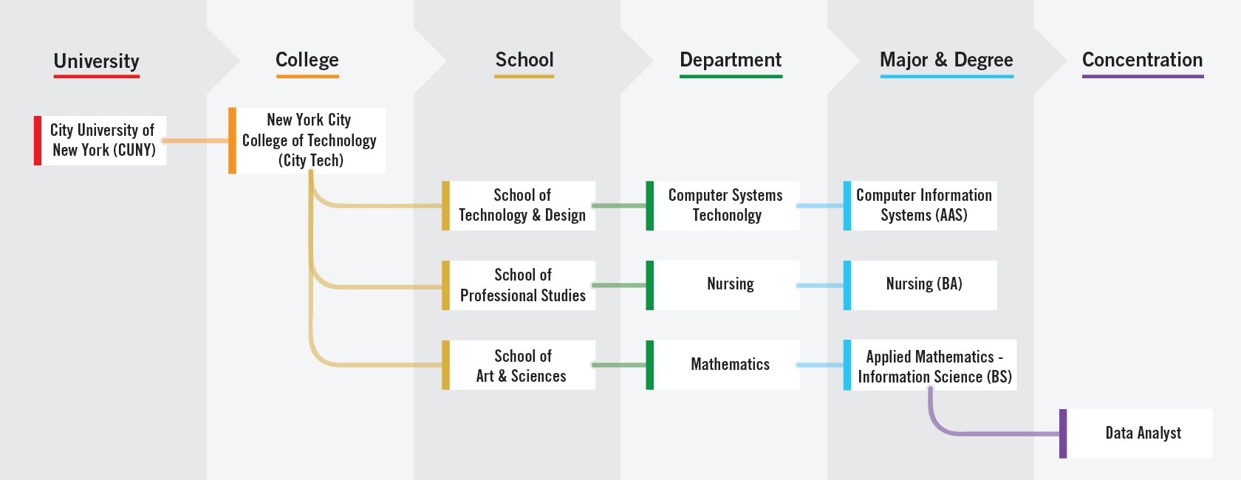
Notes:
4 minutes
Explain the foundation of the organizaiton and where each student fits into the organization. Ask there they fit into the organizaion.
It is exciting to announce that the college now offers New for fall 2021, Minors!
I asked this question using polls so that we can use the information in discussion during the session
1.How confident are you that you chose the right major? (Single Choice)*
I am Not Confident
I am Somewhat Confident
Neutral
I am Confident
I am Very Confident

Slide 9

Academic advisement and registration.
Is there really a difference?
Notes:
This slide brings in important vocabulary. Initially it is the difference between advisement and registration. Next it will be examples of questions that are related to both registration (the act of enrollment, something students do on their own, PM will guide them through the process), academic advisement is the act of discussing ones path to graduation, which includes advice on which classes to register for, but is more. Students work with an Academic Advisor who is a full time faculty member in their department. Academic Advisors should be able to
Discuss prerequisites
Which clubs are available and how to join
Guide a student who is struggling or who is excelling
Offer career advice
Discuss programs available to students.
Advisors will NOT talk about financial aid issues
Some students have additional advisors if they are in SEEK or ASAP programs.

Slide 10
Academic advisement prepares you for registration
Your advisor can answer questions like these:
Which classes should I register for?
How do I enroll in classes?
Which activities will support my academic and career goals?
How can I maximize the value of tuition?
Besides class, what else does City Tech offer me?
How can I connect my education with my future?
Notes:
Peer Mentors helped develop this list of questions.
To engage students, ask if they think these questions are more academic advisement or registration

Slide 11

Registration is the physical act of signing up for classes
We’re going to review this together.
Be sure to take notes AND ask questions as we discuss this—it’s a process!

Slide 12

Find Information About
Your Department and Major
Sample Course of Study on your Department Site
Degree Requirements and Course Descriptions are found in the College Catalog
  choose the one from the semester your started!
Talk to an Academic (Faculty) Advisor
Explore the Academic Advising Webpage
Notes:
Sample Course of Study on your Department Site
Each department offers a sample course of study. This is exactly what it says, a sample. Students should use the sample as a guide but should consider their own specific plan towards graduation
For instance, some students will be enrolled in MAT1272CO but their sample states the first course as MAT1375. An example: https://www.citytech.cuny.edu/computer-engineering/computer-engineering-btech.aspx
Course Descriptions are found with in the department the course if offered

Slide 13
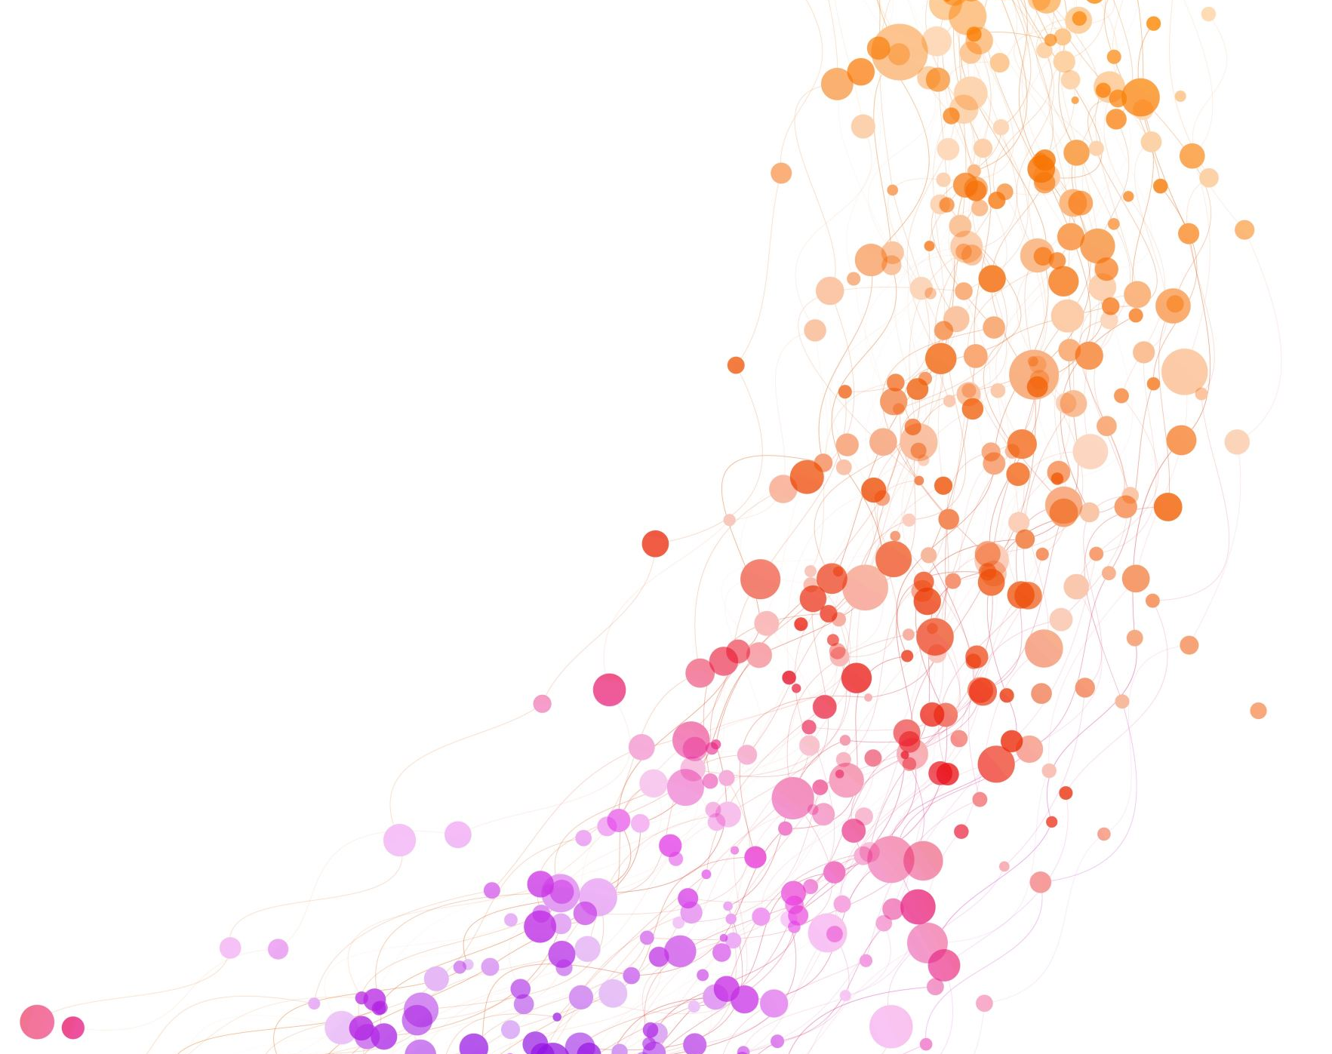
Academic Advising Preparation

Slide 14


Slide 15
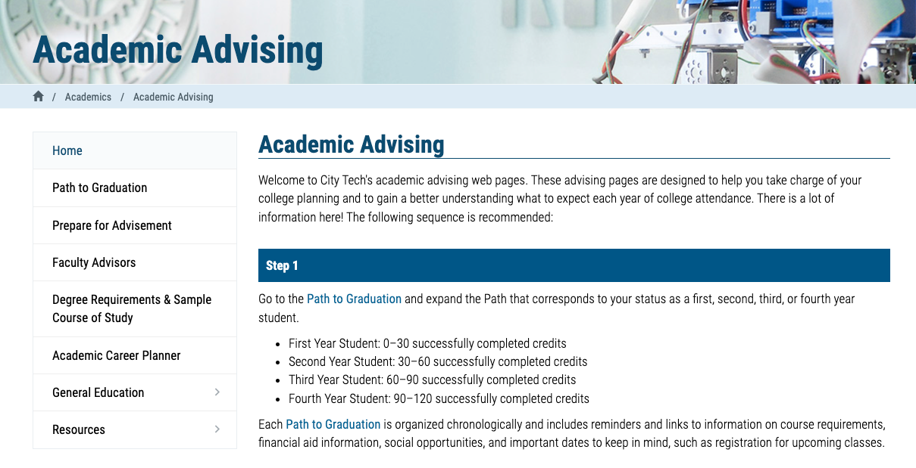
http://www.citytech.cuny.edu/advisement/

Slide 16
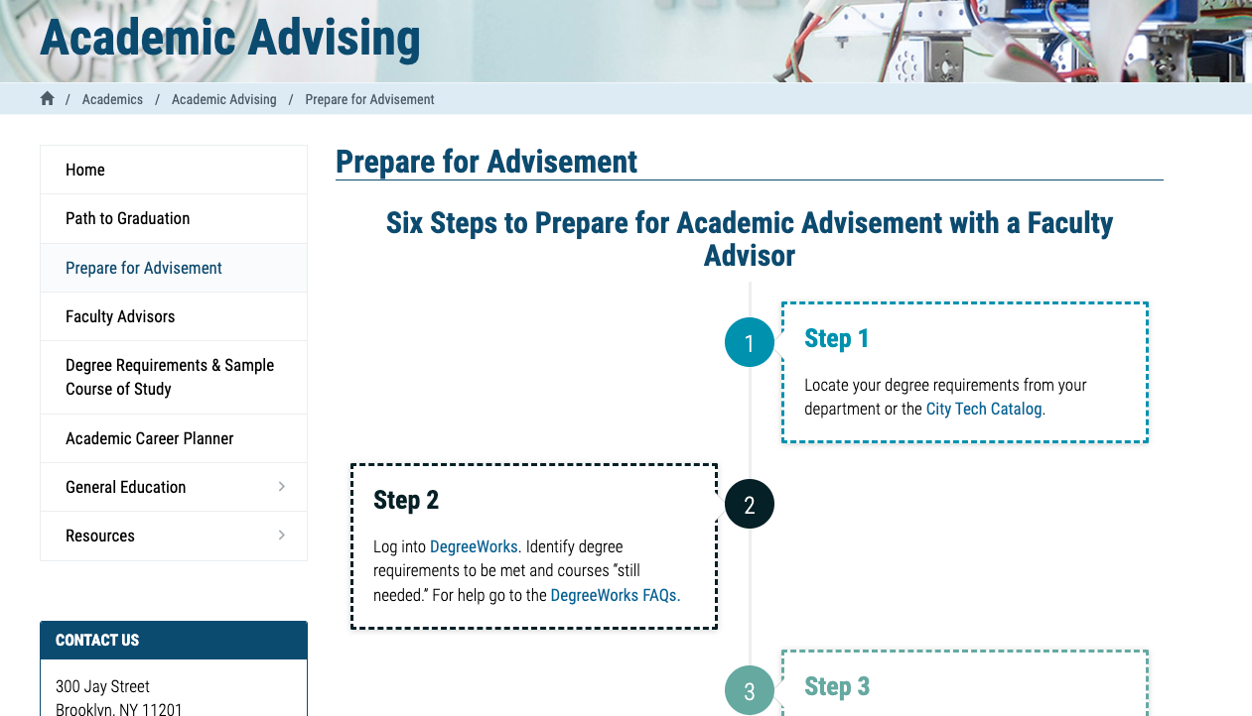
http://www.citytech.cuny.edu/advisement/six-steps.aspx

Slide 17
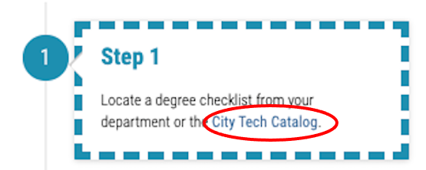

Slide 18
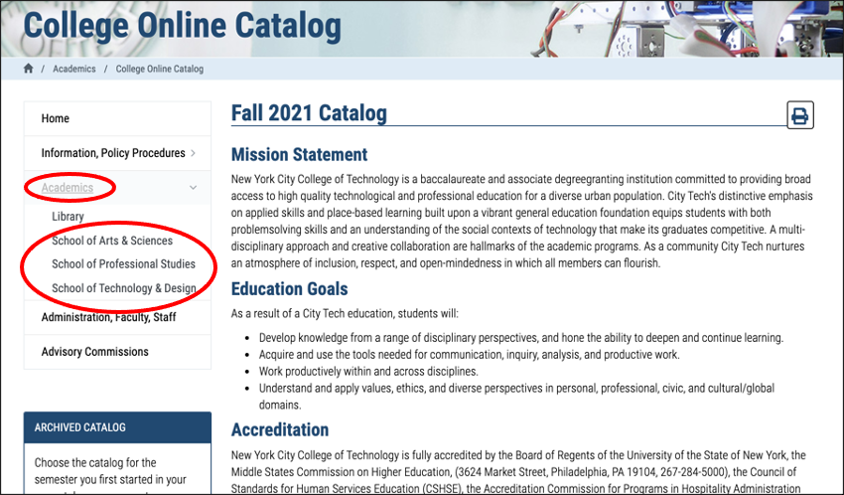

Slide 19
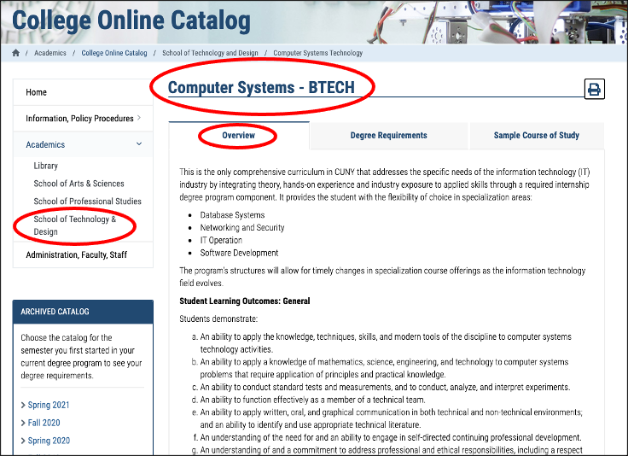

Slide 20
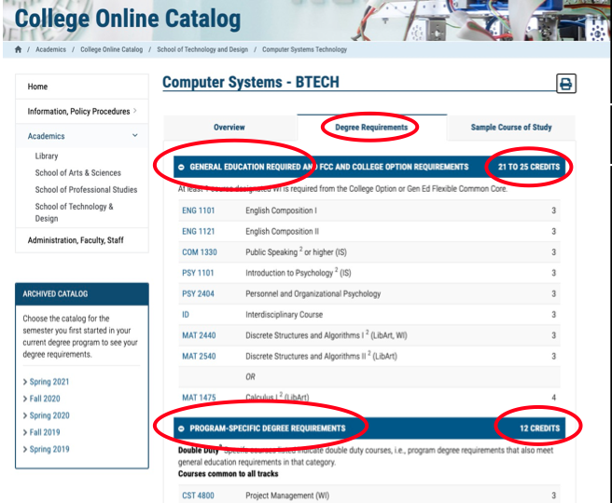

Slide 21
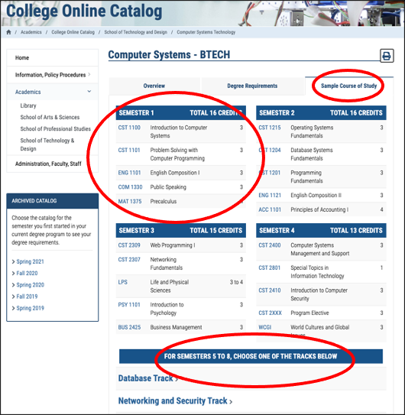

Slide 22
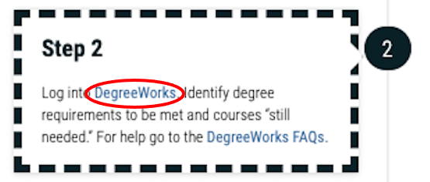

Slide 23
Questions?
Extra Info from Peer Mentors?
This is a lot of information!

Slide 24

DegreeWorks
Degree Audit

Slide 25
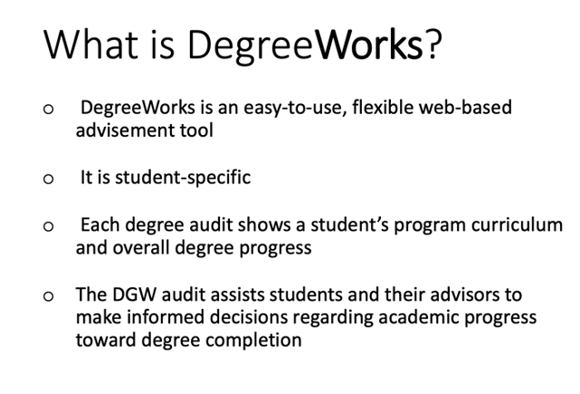
https://www.citytech.cuny.edu/registrar/docs/Student_Guides/How_to_Read_your_DegreeWorks_Presentation.pdf

Slide 26
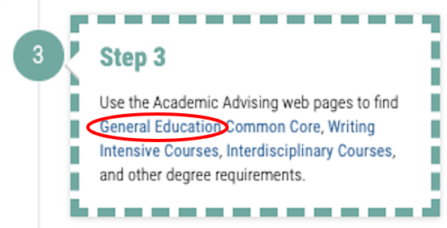

Slide 27
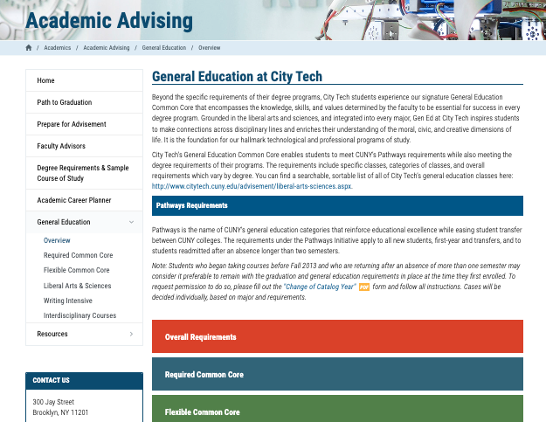
General Education
Individual and Society
World Cultures and Global Issues
Creative Expression
Scientific World
US Experience in its Diversity
Life and Physical Sciences
Writing Intensive
Interdisciplinary
College Requirements
http://www.citytech.cuny.edu/advisement/gen-ed.aspx

Slide 28

Questions?
Extra Info from Peer Mentors?
This is a lot of information!

Slide 29
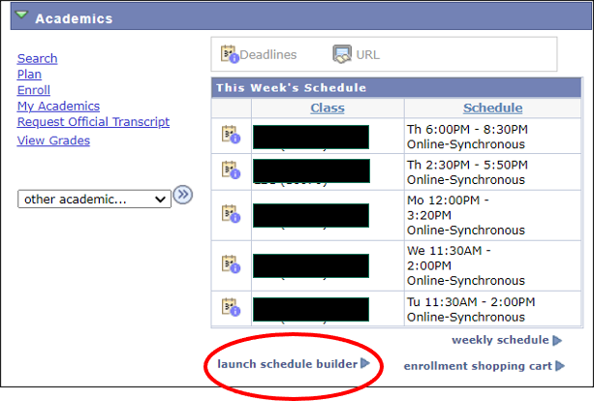
Schedule
Builder
https://www.citytech.cuny.edu/registrar/docs/Student_Guides/How_to_Use_Schedule_Builder_Presentation.pdf

Slide 30
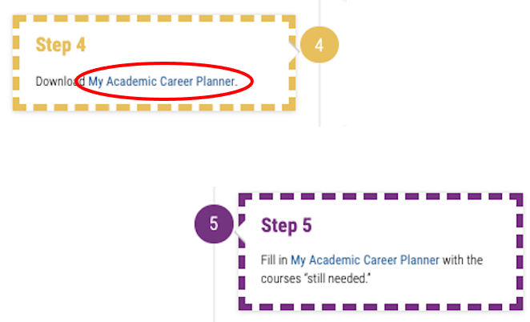

Slide 31
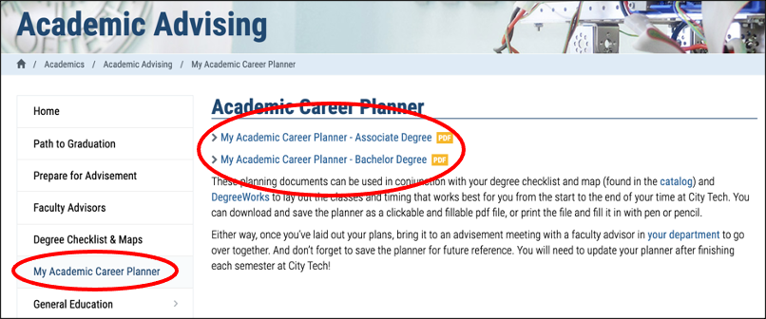
http://www.citytech.cuny.edu/advisement/planner.aspx

Slide 32

Questions?
Extra Info from Peer Mentors?
This is a lot of information!

Slide 33

My Academic Career Planner

Slide 34
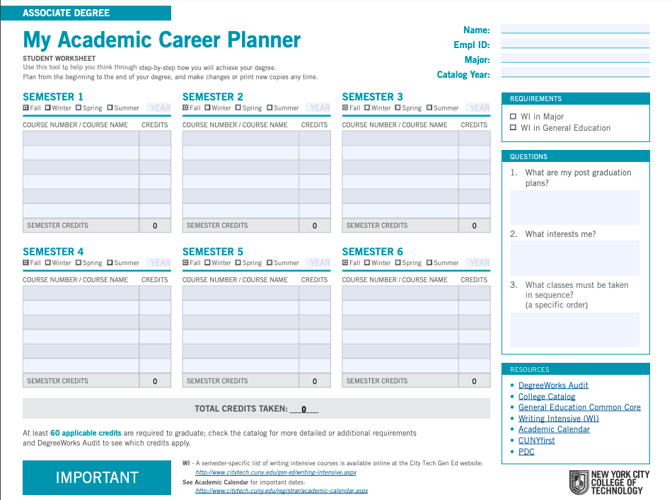
My Academic Career Planner
Download the PDF
(do not complete it on the web, you will lose all your work)
What else will you need?

Slide 35
My Academic Career Planner Review
First fill out your current course enrollment.
Complete the next three semesters of the My Academic Career Planner using the sample course of study as a guide.
Consider which Gen Ed courses you will consider to fulfill the required categories.

Slide 36
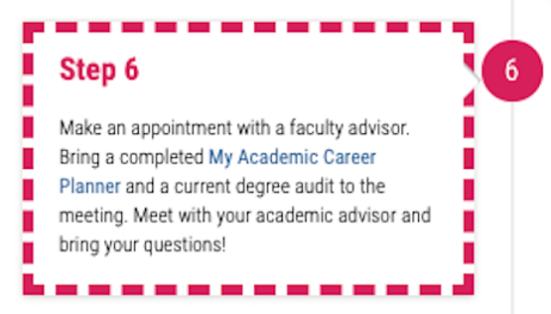

Slide 37
Questions?
Extra Info from Peer Mentors?
This is a lot of information!

Slide 38

Academic Advisors

Slide 39

Who is your Academic Advisor?
https://www.citytech.cuny.edu/advisement/virtual-advisors.aspx
Notes:
4 minutes
Share this link with students: https://www.citytech.cuny.edu/advisement/virtual-advisors.aspx
They will need to know the department/degree
It leads to the Academic Advising page and all departments will have something posted. Note, there is no consistency in the listing of the department’s information.

Slide 40
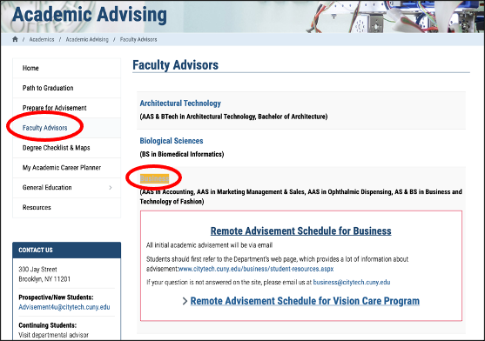

Slide 41
You found your Academic Advisor
Name
Emplid
Email
Phone number
Reason for advising appointment
What do you do now?
Notes:
I asked the PMs to talk about this slide
Remind students to use the city tech email address.

Slide 42

Questions?
Extra Info from Peer Mentors?
This is a lot of information!

Slide 43
Vocabulary Review

Slide 44
Let’s look again at our vocabulary list.
What words did you hear in class?
Which words do you still need to learn? What strategies will you use to learn them?
Academic Alert
Academic Calendar
Admissions Criteria
Advisement
Advisor
Associate Degree
Baccalaureate Degree
Contributory Credits
Corequisites
Credits
Credit Hours
Full Time Student
General Education/Gen Ed/Common Core
Major
Matriculated Student
Non-Contributory Course(s)
Part-Time
Prerequisites
Registration
School
Shopping Cart
Units
Writing Intensive
12-Credit Policy

Slide 45
Recap
Vocabulary Preview
Student Success Center
University Structure
Academic Advisement vs. Registration
Academic Advising Preparation
DegreeWorks Degree Audit
My Academic Career Planner
Academic Advisors
Vocabulary Review

Slide 46
Before Session 7…
Complete Reflection on OpenLab by replying to Reflection #6 Post.
Reflection #6
Now that you are a few weeks into the semester, what questions do you still have about becoming a college student? Ask four questions you would like to have answers to by the end of CT101.

Slide 47
#aMAJORdecision
Session 6
Prof. Jessica Penner
City Tech 101 by Karen Goodlad and Sarah Paruolo is licensed under a Creative Commons Attribution-NonCommercial-ShareAlike 4.0 International License.

