Slide 1
City Tech 101
Professor Jessica Penner
jpenner@citytech.cuny.edu
City Tech 101 by Karen Goodlad and Sarah Paruolo is licensed under a Creative Commons Attribution-NonCommercial-ShareAlike 4.0 International License.

Slide 2

Think & Discuss
What do you think is a Growth Mindset?
What do you think is a Fixed Mindset?
Take two strips of paper and decide whether it is part of a Fixed Mindset or a Growth Mindset. Be prepared to explain why you think it is one or the other.
Discuss your statements and your answers with a neighbor.
Explain to the larger group why you think your statements are part of a Fixed or Growth Mindset.
We’ll be talking more about this later today!
Notes:
Use 1st page of this document:
https://docs.google.com/document/d/1MS2s2Xmydx-mnBnQdp3q1jucdeaUFfqAq-37CYb-QIo/edit

Slide 3
#RiseAndGrind
Session 3
Professor Jessica Penner
City Tech 101 by Karen Goodlad and Sarah Paruolo is licensed under a Creative Commons Attribution-NonCommercial-ShareAlike 4.0 International License.

Slide 4
Today’s Topics
Learning Plan Questions
Creating Workspaces
Your New Schedule
Time Management
Study Techniques
Mindset Module
What is your study plan?

Slide 5
Increased Personal Responsibility
Taking Control of Your Own Learning
=
Notes:
Q: What does it mean to take control of your own learning?
Q: Why is this important?
Q: How does this present as being different from how you learned in high school?

Slide 6

Learning Plan Questions
Google Doc of Learning Questions
Notes:
Introduce the idea that people learn in different ways, know how you learn makes a huge difference in how easy you find school/studying.
Give them 10 minutes to take the quiz.

Slide 7

Learning Spaces:
Where do I learn?
Notes:
Q: Where do you do your homework and study? Why? Do you think that is the best place to do it? Why/Why not?

Slide 8

Working Remotely – Pros and Cons
In your home
In your own space
In your personal classroom
In a suitable place in your neighborhood (library, coffee shop, park, or a different CUNY campus)
Notes:
Pros and cons
Online/Remote Learning-- difficulties and advantages
Armed with the knowledge of past 2.5 years
Even if in person, will all your work be done at school? Do you need a space at home to work?

Slide 9

Create Your Own Workspace at Home
Limit distractions and noise
Set up computer/tablet on a desk or table, not your lap
Sit in a chair, rather than a couch or bed
Have a notebook and pens/pencils nearby
Make sure there is plenty of light
Hang a calendar or weekly schedule
Post To Do list
Post pictures, images, and/or motivational quotes
Add a plant for increased oxygen
Notes:
Importance of making space
Creating the right atmosphere and routine
Train your brain to know that this is a space for work

Slide 10

On City Tech Campus – Pros and Cons
In the classroom
In the lab
In the library
In the computer lab
In other spaces
Have you found a place on campus to study that works for you?
A place to hang out?
Notes:
Pros and cons:
Quiet v. Noise
Distractions
Comfort-- but not too much
Specific spaces
What kind of access will you have this/next semester?

Slide 11

Find Your Own Workspace on Campus
Which spaces have the optimal amount of quiet or noise for you?
Alone or with friends/classmates?
Find a place where you can work in a comfortable position
Carry your supplies with you
Where are the places you can get help on campus when you need it?
Notes:
Importance of making space
Creating the right atmosphere and routine
Train your brain to know that this is a space for work

Slide 12

What other places are workspaces?

Slide 13

What other places are workspaces?
Coffee shop or restaurant
Park or other outdoor area
Public Library
Library at a different CUNY campus

Slide 14

Think back to the answers you gave on your “Learning Profile” Questions.
What spaces will help you study most productively?

Slide 15

When do I learn?

Slide 16
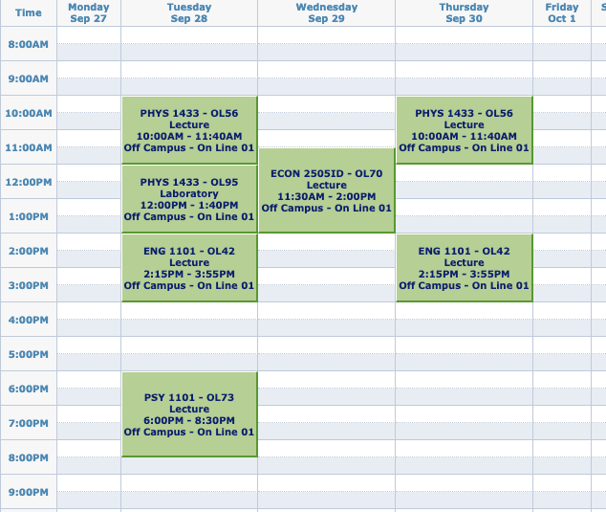
A Typical FY College Schedule
What does this schedule look like compared to your HS schedule?
What assumptions might you make based on those differences?
IMAGE

Slide 17

Do you really have all that free time now??
One of the hardest parts of college is BALANCING everything—your courses, your assignments, and the rest of your life.

Slide 18

Question:
How many hours will you spend in class and doing work for class in one semester?
Notes:
Have them guess

Slide 19

Answer:
Over 600 hours!
That’s a lot of hours!
Let’s break it down week by week.

Slide 20
The Breakdown
15 credits = roughly 15 hours in class each week
for each hour in class, budget 2 hours for homework and studying
15 credits = roughly 30 hours of work outside of class each week
so when taking 15 credits, you should expect to spend about 45 hours each week just on school
15 credits each semester
many classes are 3 credits
often, 15 credits means
5 courses (but not always)
1 credit = approximately 1 hour in class each week

Slide 21
How many hours a week do you spend doing…
Go to CUNYfirst on your phone and look at your schedule.
On the worksheet, fill out your classes.
If you have a job or other commitments, fill out those.
Finally, fill out at least two hours for each credit hour you’ll spend studying for each class (if a particular class is going to be a tough one for you, I suggest you fill out three hours for each credit hour).
Remember, for one class of three credits, you need at least 6 hours of study time each week!
Notes:
https://drive.google.com/file/d/1ycTpwn2xv4P5ikVizU4UQvJapQUU9rOC/view?usp=drive_link
https://drive.google.com/file/d/15apYnKPpSNu-cw6uV9LSDIwbD8aTf-xn/view

Slide 22

Think back again to the answers you gave on your “Learning Profile” Questions.
What times of the day are the best time for you to study? What can you do to make sure you’re available during those times?

Slide 23

Mindset Module:
Remember at the beginning of class I asked for a definition of Fixed Mindset & Growth Mindset?

Slide 24
What kinds of habits and practices do Fixed Mindset students have?

Slide 25
Fixed Mindset Behaviors:
Resistance
pushing back; working without enthusiasm or engagement
Procrastination
Unnecessarily delaying a task or act, even when the delay brings negative consequences
Plagiarism/Cheating
Using the words and ideas of others instead of your own; using unethical methods to complete work “successfully”
Notes:
10:40-10:45
Activate the poll

Slide 26

Academic Integrity

Slide 27
Discussion
Academic Integrity
Question #1: Why do students decide to cheat and plagiarize?
Question #2: How does having a fixed mindset lead to violating academic integrity?
Question #3: What are some examples of actions that might violate City Tech’s Academic Integrity Policy?
Notes:
ADJUST FOR IN-PERSON/ONLINE CLASSES

Slide 28
City Tech’s Commitment to Academic Integrity
Students and all others who work with information, ideas, texts, images, music, inventions, and other intellectual property owe their audience and sources accuracy and honesty in using, crediting, and citing sources. As a community of intellectual and professional workers, the College recognizes its responsibility for providing instruction in information literacy and academic integrity, offering models of good practice, and responding vigilantly and appropriately to infractions of academic integrity. Accordingly, academic dishonesty is prohibited in The City University of New York (CUNY) and at New York City College of Technology (City Tech) and is punishable by penalties, including failing grades, suspension, and expulsion.
— NYCCT statement on Academic Integrity

Slide 29
Forms of Academic Dishonesty
a. Cheating is the unauthorized use or attempted use of material, information, notes, study aids, devices or communications during an academic exercise.
b. Plagiarism is the act of presenting another person’s ideas, research or writings as your own.
c. Internet plagiarism includes submitting downloaded term papers or parts of term papers, paraphrasing or copying information from the internet without citing the source (including AI sources like ChatGPT), and “cutting and pasting” from various sources without proper attribution.
d. Obtaining unfair advantage is any activity that intentionally or unintentionally gives a student an unfair advantage in his/her academic work over another student.
e. Falsification of records and official documents includes, but is not limited to, forging signatures of authorization and falsifying information on an official academic record.
Notes:
Falsification includes vaccination records...

Slide 30

Full Academic Integrity Policy
https://www.citytech.cuny.edu/academics/docs/academic_integrity_policy.pdf

Slide 31

Is this cheating?
Let’s do the quiz at this link: https://guides.centralpenn.edu/academicintegrity/test-violateAI

Slide 32

What can you do instead?
You have been working hard and completing lots of homework for different classes. You have a paper due for your Psychology class tomorrow morning, and the teacher has a strict no late-work policy.
You start to work on the paper and realize that it is a far more complicated assignment than you thought; there’s no way you can get it done. You think that your choices are to use AI to write a paper or to take a zero. What should you do?

Slide 33

Habits of Growth Mindset
College Students

Slide 34
What kinds of habits and practices do Growth Mindset students have?

Slide 35
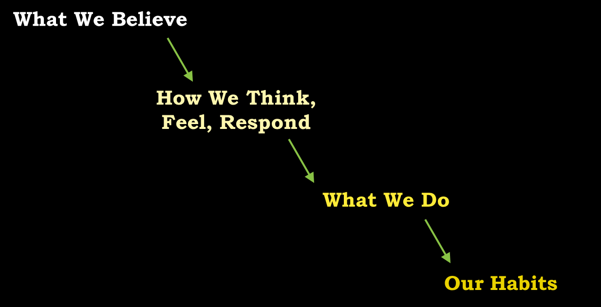

Slide 36

Growth Mindset Behaviors
How do we…
focus on building skills?
work with patience and engagement?
ask for what we need?
care for ourselves?
Notes:
10:40-10:45
Activate the poll

Slide 37
Based on all you have learned today, take time to write down three growth mindset practices or study habits you will incorporate into your routine.
We will check back later this semester to see which ones you tried and how they worked!

Slide 38
Recap
Learning Plan Questions
Creating Workspaces
Your New Schedule
Time Management
Study Techniques
Mindset Module
What is your study plan?

Slide 39
Before Session 4…
Complete Reflection on OpenLab by replying to Reflection #3 Post.
Reflection #3
You have learned what a growth mindset is, and you have also been asked to think about what study habits and techniques will work best for you. What do you think the connection is between having a growth mindset and developing an effective study routine?
Of the things you have learned on this subject, which have you found the most interesting or the most helpful so far?

Slide 40
#RiseAndGrind
Session 3
Professor Jessica Penner
City Tech 101 by Karen Goodlad and Sarah Paruolo is licensed under a Creative Commons Attribution-NonCommercial-ShareAlike 4.0 International License.

