Slide 1

ENG 1101
English Composition 1
Objectives
Annotate & discuss Lamott’s work
Write!

Slide 2
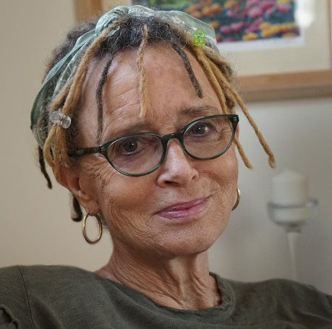
“Almost all good writing begins with terrible first efforts. You need to start somewhere. Start by getting something -- anything -- down on paper. A friend of mine says that the first draft is the down draft -- you just get it down. The second draft is the up draft -- you fix it up. You try to say what you have to say more accurately. And the third draft is the dental draft, where you check every tooth, to see if it's loose or cramped or decayed, or even, God help us, healthy.”
- Anne Lamott
Lamott tells us that writing requires repetition. Discuss another activity/skill you’ve had to work at repetitively in your life.

Slide 3

Before you start re-reading
Do you know Lamott’s purpose for writing “Shitty First Drafts”?
Do you know who the intended audience is?
In what genre is it written?
Is this a published or a student-produced piece of writing?

Slide 4

Next…
So, we’ve done the “before” bit as a class for both Lamott’s work.
Now, we’re going to revisit Mike Bunn’s “How to Read Like a Writer” questions.
Go to Course Profile > Files > ENG1101 Handouts > How to Read Like a Writer for Lamott. Download it on your device!
Answer as many as you can within the given time frame.

Slide 5
Discuss
Join your assigned small group and discuss the questions.
  Be sure to choose a leader and speaker!
After the time is up, we’ll regroup and briefly discuss our answers.

Slide 6
Think/
Discuss
Think about how you approach writing assignments and write a few sentences describing this approach.
For example, do you write several drafts? wait until the last minute? proofread carefully?
Give honest details! Then, add what you would like to change or improve about your writing process.
Share your thoughts with your small group.

Slide 7
Write!
Spend the remainder of class working on your Education Narrative—see how you can use some of the features discussed in the texts we’ve covered (Jiang, Douglass, Malcolm X, Lorde, Lamott) in your own work.

Slide 8
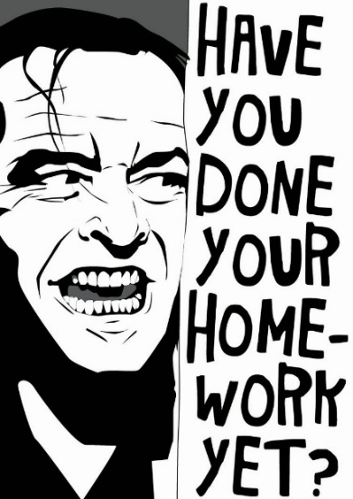
Homework
Although tomorrow (Thursday) is on a Monday schedule, this class will not be meeting—but before you run away, look at the Agenda for two things:
A writing assignment you must complete by 11:59 PM on 9/29. This will be a low-stakes writing assignment, which is worth 30% of your overall grade.
A worksheet you must complete by our next class on Monday, 10/3.
Just because this class isn’t meeting tomorrow doesn’t mean your other Monday/Wednesday classes aren’t meeting! Be sure to follow your other professors’ guidance!

