Slide 1

ENG 1101
English Composition 1
Objectives
Review how to join OpenLab
Discuss Bunn & Westengard’s work
Review how to comment & how to post on OpenLab
Create your first OpenLab post

Slide 2
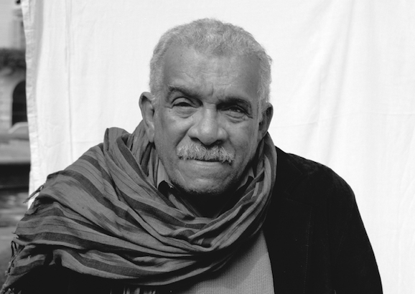
The English language is nobody's special property. It is the property of the imagination: it is the property of the language itself.
Derek Walcott
What does Walcott mean by saying English isn’t anyone’s “special property”?
Do you agree or disagree with his definition? Be sure to explain why!

Slide 3
If today’s your first day…
Take an index card.
Write your full name on one side.
If you have a preferred name or nickname, write that beneath your legal name.
Write your preferred pronouns (he/him, she/her, they/them, etc.)
When you’re finished, bring the card to the front and place it next to the “in” card.
Every day, when you arrive for class, take your card from the “out” pile and put it under the “in” card. Don’t make a new card. Find your old card. This is how I take attendance!

Slide 4

Register/Join OpenLab
Go to https://openlab.citytech.cuny.edu/ on your smartphones or laptops.
If you’ve joined OpenLab, log in.
If you haven’t, sign up now!
Notes:
ECRI
20 min
Say: Everyone, please get out your smartphones! Ask: Has anyone NOT logged in on OpenLab before? Will the students who have logged in please coach the students who have not?

Slide 5
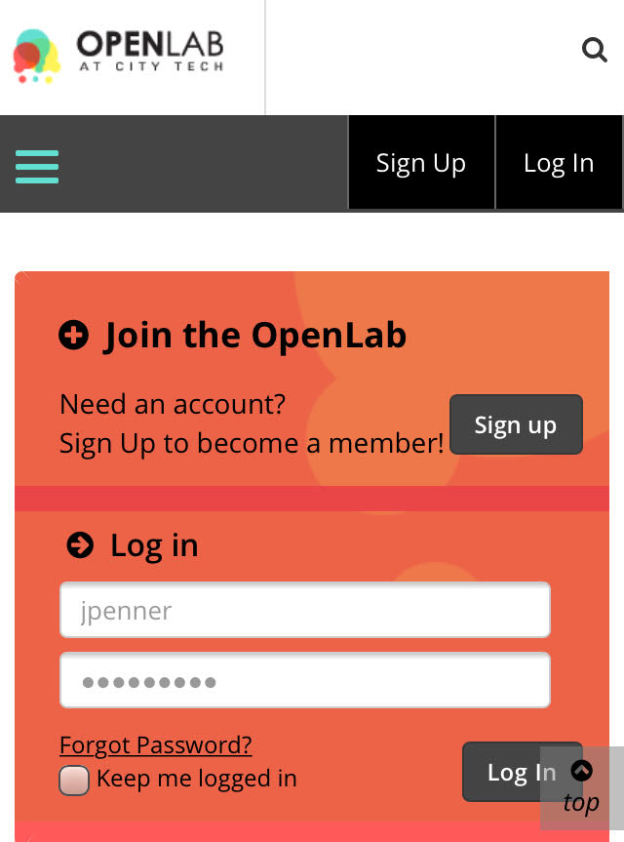
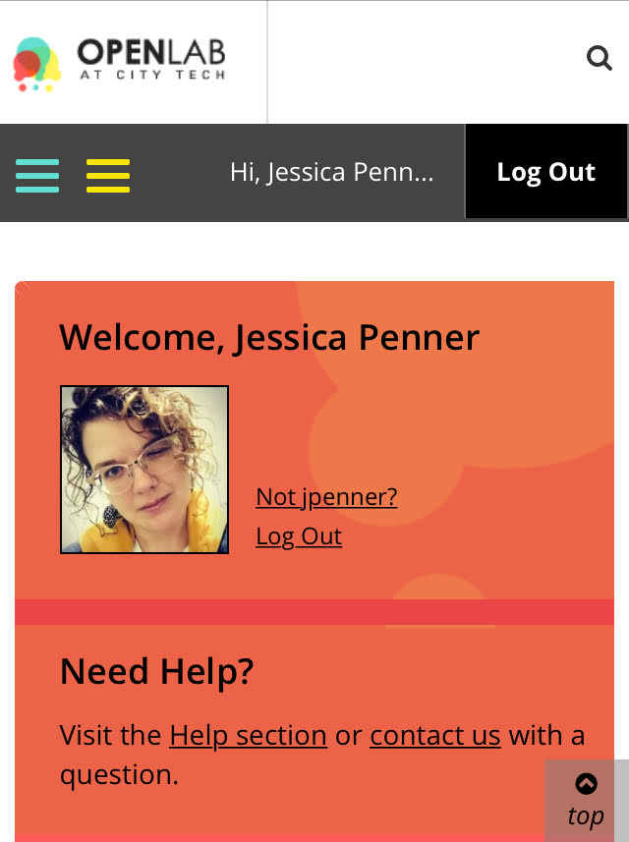
You must use your City Tech-approved email!

Slide 6
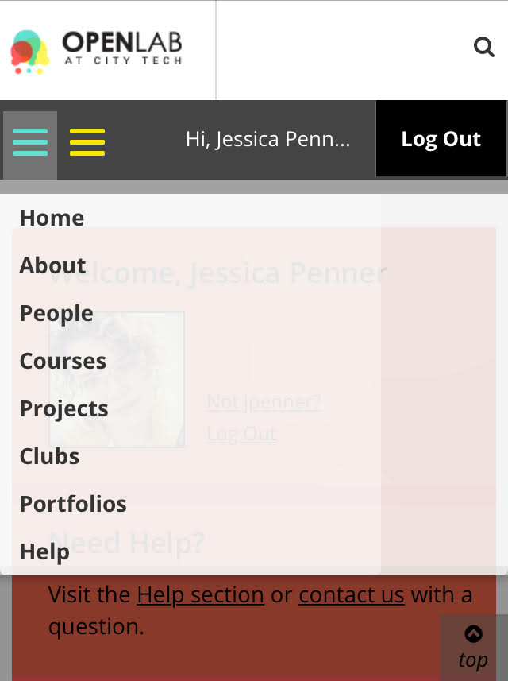
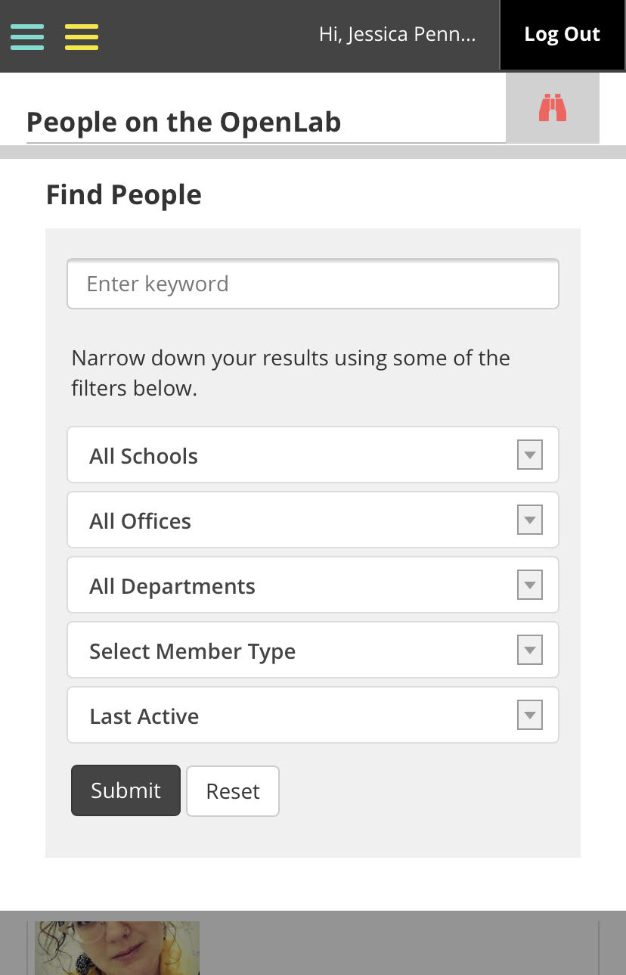
Jessica Penner
The easiest way to find our class is by finding me!

Slide 7
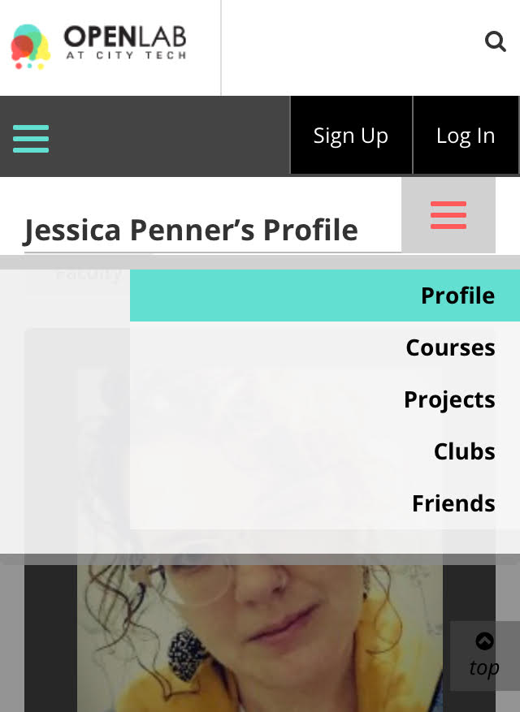


If you’re in the D438 2PM class, your class has this avatar:
If you’re in the D308 4PM class, your class has this avatar:

Slide 8
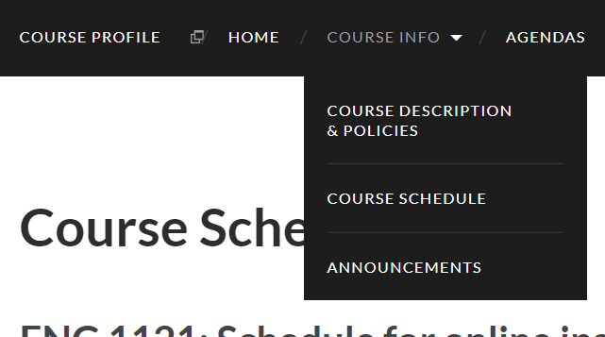
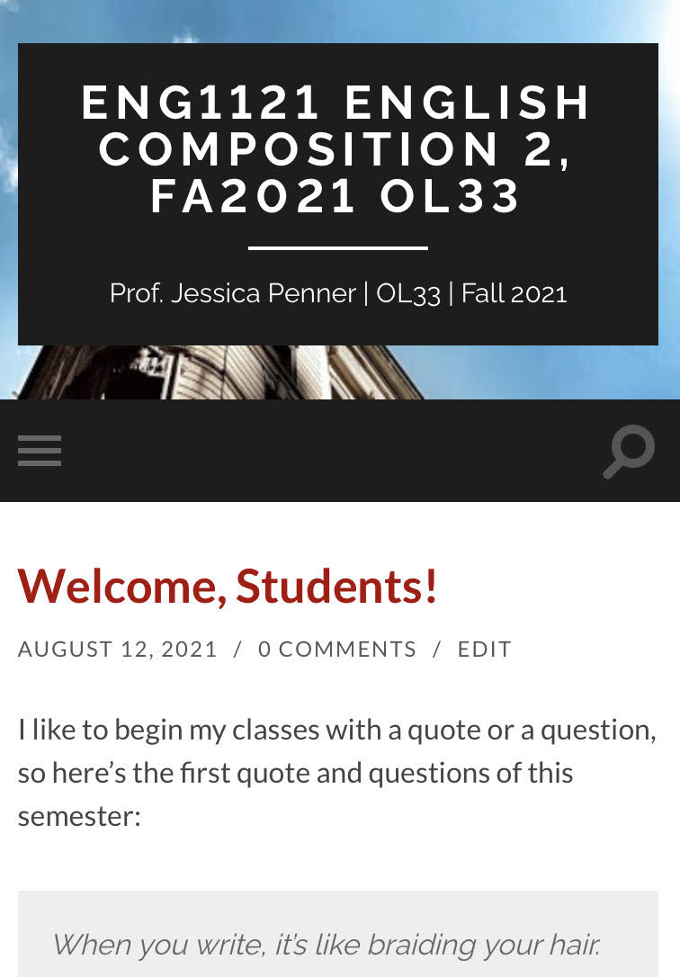
Course Info
We won’t review this as much as we did on Monday, but here’s the basics…
https://openlab.citytech.cuny.edu/pennereng1101fa2022d438/2022/08/10/welcome/
https://openlab.citytech.cuny.edu/pennereng1101fa2022d308/2022/08/10/welcome/

Slide 9
If today’s your first day (or you haven’t completed this yet)…
Look at the Agenda for this week. You’ll see this in hypertext: Discussion: Introductions.
Click on this link. Scroll down. Read the writing prompt:
  Write a paragraph discussing your academic interests, why you chose your major, what you enjoy reading, listening to, watching, and doing in your spare time, or anything else you want to share (include your pronouns if you wish).
  Write a short paragraph about yourself as a reader and writer. What kinds of readings and writings are you drawn to? What type do you avoid and dislike? Why do you think you lean towards certain types of texts and away from others?
Click on “leave a reply” and respond to the prompts! You should have around 100 words total for both paragraphs.
Those who have already commented, take this time to read some of the comments already posted and respond to at least three comments. For example, if someone writes about a favorite music artist that you also enjoy, let them know!

Slide 10
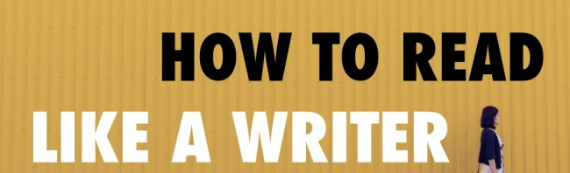
Review/Discuss/Write
Pull up “How to Read Like a Writer” on your device. I’ll give you 10 minutes to review this piece.
When time’s up, we’re going to discuss the essay in small groups for about 10 minutes.
Next, we’ll review the three actions that Prof. Westengard highlights in the PowerPoint.
Finally, we’ll do some writing about this essay and practice posting on OpenLab (if you haven’t registered and joined this class, do so ASAP).

Slide 11

Small Group Discussion
How do you usually read for classes? Quick read? Slow read? No read? ☺
What are the steps for reading suggested by the author of this essay? As a group, try to define as many as you can.
What is at least one “takeaway” you’ve learned from the essay and will try this semester?

Slide 12

How to read like a writer
Mike Bunn
By Prof. Laura Westengard

Slide 13
Before you Start Reading
Do you know the author’s purpose for this piece of writing?
Do you know who the intended audience is for this piece of writing?
In what genre is it written?
Is this a published or a student-produced piece of writing?
Is this the kind of writing you will be assigned to write yourself?

Slide 14
As You Are Reading
What is the author’s purpose for this piece of writing?
Who is the intended audience?
How effective is the language the author uses? Is it too formal? Too informal? Perfectly appropriate?
What kinds of evidence does the author use to support his/her claims? Does he/she use statistics? Quotes from famous people? Personal anecdotes or personal stories? Does he/she cite books or articles?
How appropriate or effective is this evidence? Would a different type of evidence, or some combination of evidence, be more effective?
Are there places in the writing that you find confusing? What about the writing in those places makes it unclear or confusing?
How does the author move from one idea to another in the writing? Are the transitions between the ideas effective? How else might he/she have transitioned between ideas instead?

Slide 15
What Should You Be Writing as You are Reading?
What is the technique the author is using here?
Is this technique effective?
What would be the advantages and disadvantages if I tried this same technique in my writing?

Slide 16
Posting on OpenLab
I’m going to show you how to post (hopefully you’ve joined our class website by now).
  Be sure to title the post correctly: Full Name, Discussion of “How to Read Like a Writer”
  Save it under Discussions.
  Hit “Publish”!
Now that you can post, respond to the following prompt and put your response in the body of the post.
  Write a short paragraph responding to the Bunn essay: identify one specific moment you found useful and you want to try out as a reader. Quote or paraphrase this moment, and explain why this idea appeals to you.
Before we begin, what does “quote” mean?
What does “paraphrase” mean?

Slide 17
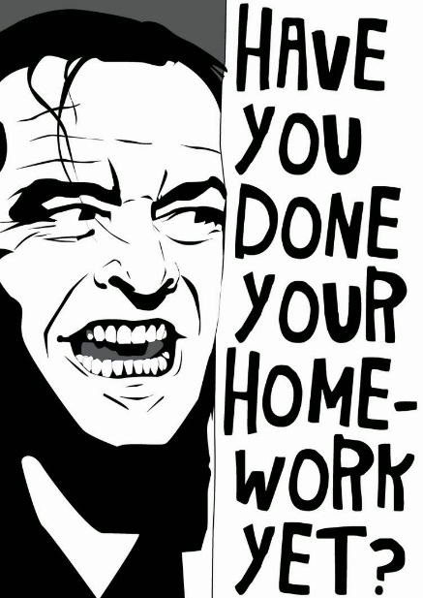
Homework
Please read the following before class on Monday:
Read “The Memory of My Grandmother” (City Tech student essay) by Anita Jiang. The essay is in a larger journal--you only need to read Jiang's essay!
Read “Chapter 7” from the Narrative of the Life of Frederick Douglass by Frederick Douglass.
For both texts, use the suggestions presented in "How to Read Like a Writer."

